Slide 1
Adolescent Development
Allison Eliscu, MD, FAAP
Rev. Aug 2012

Slide 2
Adolescent Development
Physical growth and development
Psychosocial development
Sexual development

Slide 3
Physical Growth and Development during Adolescence

Slide 4
Sexual Maturity Rating
(Tanner Stage)
Rating scale describing secondary sex characteristics
Does not always correlate with chronological age
Based on:
  Pubic hair development for males and females
  Breast development for females
  Testicular and penile development for males
Uses of sexual maturity rating
  Objective measure to follow progression of development
  Easily describe stage of development to other providers
Does not always correlate with chronological age

Slide 5
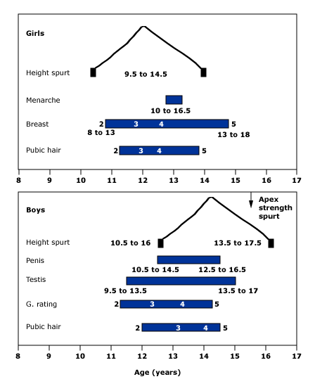
Sequence of Puberty in Females
Breast buds appear (thelarche)
Pubic hair appears (pubarche)
Growth spurt
Body hair
Breasts mature
Menarche
Adult height
Age (years)

Slide 6
Tanner Stages of Breast Development
Tanner 1 Prepubertal, no breast tissue
Tanner 2 Breast bud with small mound and some increased areolar diameter
Tanner 3 Larger bud, more elevation, darkened areola, no separation of areola or papilla
Tanner 4 Secondary mound (areola and papilla elevate above breast level)
Tanner 5 Mature breast, projection of nipple only

Slide 7
Tanner Stages of Pubic Hair Development in Females
Tanner 1 Fine peach fuzz
Tanner 2 Sparse, longer straight hair along labia
Tanner 3 Darker, coarser, curlier hair
Tanner 4 Adult type hair with decreased distribution (not yet on thighs)
Tanner 5 Coarse and curly hair with extension to medial thighs

Slide 8
Peak Growth Velocity in Females
Peak velocity is 3-4 inches per year
Average age 11-11 ½ years old
2 years earlier for females than males
Midway between thelarche and menarche
After menarche, only gain an additional 2 inches on average

Slide 9
Menarche
Usually during Tanner 3-4
Average age 12 yrs 4 mos (9-17 yrs)
Occurs 2.6 years on average after thelarche
Always occurs after peak height velocity
Varies by race, genetic factors, nutrition
Notes:
9

Slide 10
Sequence of Puberty in Males
Growth of testicles
Thinning and reddening of skin of scrotum
Appearance of pubic hair
Growth of penis, scrotum
Axillary hair
First ejaculations
Growth spurt
Facial hair
Adult height
Age (years)

Slide 11
Tanner Stages in Males
Tanner 2 Sparse hair at base, slight testicular growth and texture change
Tanner 3 Darker and curlier hair, testicles larger, penis longer
Tanner 4 More pubic hair, testicles bigger and more textured, longer and broader penis
Tanner 5 Pubic hair to thighs; testes and penis adult length and width
Notes:
11

Slide 12
Peak Growth Velocity in Males
Occurs in late puberty (Tanner 4-5)
Growth accelerates slower in males and lasts longer
Growth begins to accelerate about 9 months after the first signs of testicular enlargement
Peak velocity is 3.5-5 inches per year
On average, males grow 10-11 inches during puberty

Slide 13
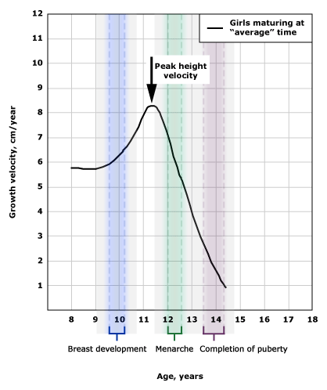
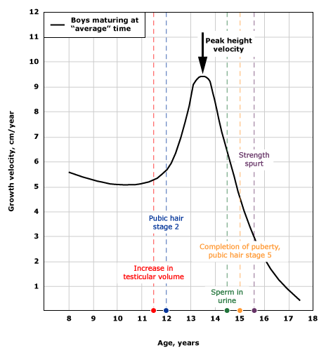
Typical Ages of Pubertal Events
Females
Males

Slide 14
 | Females | Males
Mean Age of Onset of Puberty | 8.9 (African American) 9.9 (Caucasian) | 11.6 years
Mean Age of Onset of Peak Growth Velocity | 11 – 11 ½ years | 13 - 13 ½ years
Mean Peak Growth Velocity | 8.3 cm/year | 9.5 cm/yr
Mean Onset of Menarche | 12.3 years (Range 9-17 years old)
Length of Puberty | 1.5 – 8 years | 3 – 5 years

Slide 15
Common Concerns About Puberty
Development of secondary sexual characteristics
  Early onset
  Late onset
Size of breasts or penis
  Are they too big? Is it too small?
Normal variants (very common)
  Breast asymmetry, Gynecomastia
Physiologic changes
  Acne, dandruff, body odor, body hair
Concerns vary based on
peer group and gender
Am I Normal?
Notes:
15
Concerns that adolescents have about going through puberty. Early onset can be difficult, especially for females (early bloomer) – these are the young girls (ex: 5th graders) who are taller than everyone else in the class and have started breast development and acne before anyone else. Late onset can be difficult, especially for males (late bloomer) – these are the older boys who are the last to develop and have a growth spurt (ex: the shortest 9th or 10th grade boys in the class)

Slide 16
Continued Concerns About Puberty
Height concerns
  “Early bloomer” females (tallest in class)
  “Late bloomer” males (shortest in high school class)
Weight concerns
  Usually more of concern for females
  Increased adipose tissue deposition during puberty in females (compared to muscle in males)

Slide 17
Psychosocial Development during Adolescence

Slide 18
Psychosocial Goals of Adolescence
Good health habits
Conflict resolution skills
Coping skills
Career goals
Peer relationships
Decision making skills
Ability to understand risks and consequences
Communication skills
Independence
Autonomy from parents
Sense of morality
Sense of responsibility
Abstract thinking
Financial independence
These goals should be attained or almost attained by young adulthood
Notes:
By the end of adolescence, these goals should hopefully be acquired.

Slide 19
Obstacles to Healthy Development
Mental health disorder onset
Body image concerns
Learning disabilities
Family problems
Homelessness
Lack of insurance
Poverty
Substance use
Risk taking behaviors
Peer pressure
Exposure to violence
Poor nutrition
Unsafe neighborhoods
Health care disparities
These issues may hinder healthy development

Slide 20
Motor Vehicle Accidents
Sexually Transmitted Infections
Substance-Related Injuries
Adolescence can be a dangerous time
Future Goals and Aspirations
BUT Protective Factors May Help Prevent Danger
Pregnancy
Suicide
Drug Use
Strong Support Network
Good Relationship with Parents
Notes:
**This slide shows best in a slideshow setting**

Slide 21
Early Adolescence (10-13 years old)
Rapid physical changes
Preoccupied with self
Uncertain of appearance
Comparing self to other adolescents
Beginning to struggle for independence from parents
Search for love and acceptance outside of parents
Concrete thinking
Am I Normal?
Notes:
Early adolescents frequently ask themselves “Am I Normal” and compare themselves to each other, especially as their body is starting to change

Slide 22
Middle Adolescence (14-17 years old)
Increased importance of peer groups
Major parent-teen conflicts
Increasing struggle for independence
Conformity to peer groups
More accepting of new body
Strong focus on looking attractive
Feelings of omnipotence and immortality
Increased Risk Taking Behaviors

Slide 23
Late Adolescence (17-21 years old)
Puberty mostly complete
More comfortable with adult body
More comfortable with own decisions and identity
Rely less on peer group for identity (has own self identity)
Improved relationship with family members

Slide 24
Late Adolescence (17-21 years old)
Achieved abstract thinking
Ability to develop vocational goals
Start to be financially independent
Able to make independent decisions
Able to set own limits
Understand risks and consequences

Slide 25
Sexual Development in Adolescence

Slide 26
Sexual Goals of Adolescence
Develop sexual identity
  Gender role
  Gender identity
    Ex: masculine, feminine, both, neither
  Sexual orientation
    Ex: Heterosexual, homosexual, bisexual, asexual
Develop capacity for intimacy

Slide 27
Sexual Development in Adolescence
Early Adolescence
  Many questions about sexual self
  Predominantly develop same sex relationships
  Occasional group contact with opposite sex groups
Middle Adolescence
  More partner activities (dating, sexual experimentation)
  Feelings of invincibility and “it can’t happen to me”
  Risk taking behaviors
Late Adolescence
  Comfortable with adult body
  Able to make own decisions
  More intimate and long term relationships

Slide 28
A healthy 10 year old female presents for a routine physical exam. Which of the following is a TRUE statement which you could include in your discussion with the patient and her mother about what to expect during puberty?
Puberty in females begins with the development of pubic hair
After menarche, there is minimal growth remaining until adult height is attained
The growth spurt occurs very late in females and usually marks the end of puberty
The average age of menarche is 14 years old
Breast asymmetry during development is very uncommon

Slide 29
A healthy 10 year old female presents for a routine physical exam. Which of the following is a TRUE statement which you could include in your discussion with the patient and her mother about what to expect during puberty?
Puberty in females begins with the development of pubic hair
After menarche, there is minimal growth remaining until adult height is attained
The growth spurt occurs very late in females and usually marks the end of puberty
The average age of menarche is 14 years old
Breast asymmetry during development is very uncommon

Slide 30
Answer: B. Menarche occurs very late in puberty and there is usually only about 2 inches of growth remaining after menarche until adult height is attained. Thelarche, development of breast buds, usually marks the onset of puberty in females; pubarche (the development of pubic hair) usually follows. During breast development, breast asymmetry in size or shape is extremely common. The peak height velocity (growth spurt) tends to occur early in puberty for females, usually halfway between thelarche and menarche. The average age of menarche is about 12 years old.

Slide 31
Which of the following statements about pubertal development in males is FALSE?
Gynecomastia is rare and requires a work-up to rule-out malignancy
Testicular enlargement usually marks the onset of puberty
Males tend to start puberty later than females
Males usually grow 10-11 inches during puberty
Deposition of muscle tissue is common towards the end of puberty

Slide 32
Which of the following statements about pubertal development in males is FALSE?
Gynecomastia is rare and requires a work-up to rule-out malignancy
Testicular enlargement usually marks the onset of puberty
Males tend to start puberty later than females
Males usually grow 10-11 inches during puberty
Deposition of muscle tissue is common towards the end of puberty

Slide 33
Answer: A. Gynecomastia is incredibly common in males, especially during sexual maturity rating 2-3. Affected males should be screened for drug or medication use as well as for the presence of associated symptoms (headaches, galactorrhea, thyroid symptoms, tunnel vision) and a testicular exam should be done to rule-out masses. If all of this is negative, no further work-up should be done at this time. Gynecomastia usually resolves as puberty progresses. Puberty in males tends to begin with testicular enlargement and males tend to enter puberty later than females. The other statements are true.

Slide 34
Which of the following statements about friendships during adolescence is TRUE?
Older adolescents prefer friendships with younger adolescents
Relationships during early adolescents tend to be with individuals of the opposite gender
Adolescents dress differently from their friends in order to stand out and gain attention
Adolescents usually seek parental approval of their friends
Peer groups have a powerful influence on an adolescent’s risk taking behaviors

Slide 35
Which of the following statements about friendships during adolescence is TRUE?
Older adolescents prefer friendships with younger adolescents
Relationships during early adolescents tend to be with individuals of the opposite gender
Adolescents dress differently from their friends in order to stand out and gain attention
Adolescents usually seek parental approval of their friends
Peer groups have a powerful influence on an adolescent’s risk taking behaviors

Slide 36
Answer: E. One goal of adolescence is to become independent from their parents. This is partially accomplished through the formation of strong peer relationships. Adolescents tend to conform so that they can fit in and frequently experience peer pressure. Peer groups have an extremely powerful influence on an adolescent’s risk taking behaviors. Adolescents in all stages of development do not seek parental approval of their peer groups. Adolescents usually prefer friendships with peers in similar age groups. In early adolescence, friendships tend to be with individuals of the same gender compared to middle and late adolescence where friendships are more likely to involve individuals from the opposite gender.

Slide 37
An anti-smoking campaign targeting 12-13 year olds should focus on which of the following concepts?
Smoking decreases your life expectancy by 5 years
Smoking turns your teeth and nails yellow and makes your hair and breath smell bad
Smoking increases your risk of developing lung cancer
If your parents find out that you have been smoking you will be punished
Smoking can impact your endurance in sports and make it harder to be a star athlete
Both B and E
Both A and D

Slide 38
An anti-smoking campaign targeting 12-13 year olds should focus on which of the following concepts?
Smoking decreases your life expectancy by 5 years
Smoking turns your teeth and nails yellow and makes your hair and breath smell bad
Smoking increases your risk of developing lung cancer
If your parents find out that you have been smoking you will be punished
Smoking can impact your endurance in sports and make it harder to be a star athlete
Both B and E
Both A and D

Slide 39
Answer: F. 12-13 year olds are in early adolescence, a phase which is dominated by wanting to feel normal, wanting to fit in, and constantly feeling uncertain about their appearance and comparing themselves to their peers. They are not able to process long term consequences of their actions (like decreasing their life expectancy or developing lung cancer). Since they are focused on their appearance and fitting in, anti-smoking campaigns should focus on the changes in their appearance (yellow teeth and nails and bad breath). Additionally, if they are athletes, campaigns can focus on the impact that it will have on their sport. Adolescents are not as worried about what their parents will think about their behaviors as they are struggling to become independent and are more focused on gaining acceptance from their peers than from their parents.

Slide 40
Recommended Reading
Garofalo R, Forcier M. Adolescent Sexuality. UpToDate Online. Updated September 28, 2009.
Peterson AC, Leffert N, Graham BL. Adolescent Development and the Emergence of Sexuality. Suicide & Life – Threat Behav. 1995;25 Suppl: 4-17.

