Slide 1
Breast Masses in Adolescent Females
Allison Eliscu, MD, FAAP
Rev. Aug 2012

Slide 2
Breast Masses - History
Duration of mass
Presence of nipple discharge
History of prior breast disease
History of prior malignancy or radiation therapy
Menstrual history
Obstetric history
Current medications
Family history of malignancy

Slide 3
Breast Masses– Physical Examination
Location of mass
Consistency (cystic vs. solid)
Size
Mobility of mass relative to overlying skin
Tenderness with palpation
Overlying skin changes
Attempt to express nipple discharge
Check for axillary and supraclavicular lymphadenopathy

Slide 4
DIFFERENTIAL DIAGNOSIS
Common Causes
Fibroadenoma – 67% of adolescent masses
Fibrocystic change – 15% of adolescent masses
Mastitis or abscess – 3% of adolescent masses
Rare Causes
Phylloides tumor
Mammary duct ectasia
Fat necrosis due to trauma
  Direct blow or seat belt injury
Primary carcinoma of breast
Metastatic cancer
Extremely rare in adolescents

Slide 5
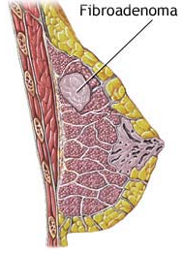
Fibroadenoma
Most common breast mass in adolescent females
Benign mass
More common in late adolescents
Rapid initial growth – size may double in 6-12 months
Asymptomatic but may have premenstrual discomfort
Physical Exam Findings
  Well circumscribed
  Rubbery
  Mobile
  Average size 2-3 cm
  Most commonly in upper outer quadrant
  Nontender
  No lymphadenopathy

Slide 6
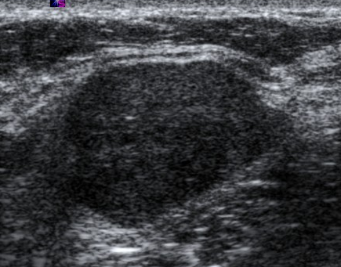
Management of Fibroadenoma
Diagnosis based on physical exam findings
May confirm with ultrasound
Initial management is observation
  May decrease in size or self-resolve with time
  NSAIDS for pain
Excisional biopsy recommended if:
  Size >5 cm
  Growth after initial period of stability
  Lesion persists to adulthood
Incredibly low risk of malignancy
Fibroadenoma on ultrasound – Note the smooth, well circumscribed lesion

Slide 7
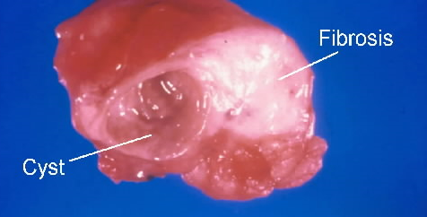
FIBROCYSTIC CHANGE
Present in more than 50% of women’s breasts
Results from estrogen and progesterone imbalance
May have premenstrual enlargement and tenderness
Physical Exam Findings
  Cord-like thickening and lumps
  Exam changes with menstrual cycle
May confirm with ultrasound
Management
  NSAIDs for pain
  Oral contraceptives improve symptoms in 70-90% of cases
  Decrease caffeine intake

Slide 8
PHYLLODES TUMOR
Stromal tumor
May be benign, intermediate, or malignant
More common in adult women
Usually asymptomatic
Physical Exam Findings
  Large, rapidly growing mass
  Shiny overlying skin due to rapid stretching
  Bloody discharge may be present if nipple involved
Confirm with ultrasound
Requires resection

Slide 9
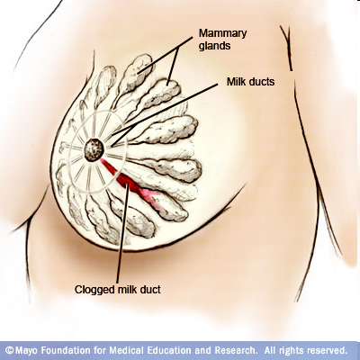
MAMMARY DUCT ECTASIA
Blockage of subareolar ducts
Presents with sticky, multicolored nipple discharge
May lead to infection
Confirm with ultrasound
Usually self-limited
Resection for persistent lesions

Slide 10

BREAST CANCER IN ADOLESCENTS
Extremely uncommon during adolescence
Suspicious Clinical Findings
  Hard, irregular shaped mass
  Mass fixed to chest wall
  Skin or nipple retraction
  Nipple discharge
  Axillary or supraclavicular lymphadenopathy
Risk Factors
  Family history of breast cancer
  Prior radiation therapy to chest
NO ASSOCIATION between oral contraceptive use and risk of breast cancer

Slide 11
BREAST MASSES - SUMMARY
Majority of masses in adolescents are benign
Many masses are self-limited
Ultrasound is preferred imaging modality
Mammogram NOT recommended in adolescents
  Difficult to interpret due to increased breast density
Management for most masses is observation only
Consider further management for:
  Large lesions
  Growing lesions
  Symptomatic lesions
  Suspicious lesions

Slide 12
On routine examination of a healthy 17 year old female, you note a small, rubbery, mobile mass in the upper, outer quadrant of the left breast. It is nontender and there is no surrounding lymphadenopathy. The right breast is normal. The most likely diagnosis is
Gynecomastia
Fibrocystic change
Phyllodes tumor
Fibroadenoma
Primary breast cancer
Metastatic cancer to breast

Slide 13
On routine examination of a healthy 17 year old female, you note a small, rubbery, mobile mass in the upper, outer quadrant of the left breast. It is nontender and there is no surrounding lymphadenopathy. The right breast is normal. The most likely diagnosis is
Gynecomastia
Fibrocystic change
Phyllodes tumor
Fibroadenoma
Primary breast cancer
Metastatic cancer to breast

Slide 14
Answer: D. Fibroadenomas are the most common breast masses in adolescent females. They tend to present as asymptomatic, single, rubbery, mobile masses with an average size of 2-3 cm. Diagnosis of a fibroadenoma is usually based on clinical features of the exam. Gynecomastia refers to benign proliferation of breast tissue in a male. Fibrocystic change is also a common entity in adolescent females. Patients with fibrocystic change tend to be asymptomatic but may complain of mild premenstrual discomfort. On examination fibrocystic change is described as cord-like thickening or lumps which change with the menstrual cycle. Phyllodes tumors is less common in adolescent females and tends to be a rapid growing mass which may involve the nipple causing bloody nipple discharge. Breast cancer, both primary and metastatic, is rare in otherwise healthy adolescent females.

Slide 15
An 18 year old otherwise healthy female presents to the office after noticing a lump in her right breast. She started having some discomfort in the area of the lump 2 days ago which made it come to her attention. She denies nipple discharge or medication use and just started her menses this morning. On examination, you find diffuse thickened cord-like areas with a few lumps in both breasts which are mildly tender to palpation. There are no skin changes and no lymphadenopathy. Which of the following is true?
She most likely has a fibroadenoma and should receive a mammogram
She most likely has a fibroadenoma and should receive an ultrasound
She most likely has fibrocystic change and should receive a mammogram
She most likely has fibrocystic change and should have a repeat examination in a different part of her menstrual cycle
She most likely has breast cancer and should receive an ultrasound

Slide 16
An 18 year old otherwise healthy female presents to the office after noticing a lump in her right breast. She started having some discomfort in the area of the lump 2 days ago which made it come to her attention. She denies nipple discharge or medication use and just started her menses this morning. On examination, you find diffuse thickened cord-like areas with a few lumps in both breasts which are mildly tender to palpation. There are no skin changes and no lymphadenopathy. Which of the following is true?
She most likely has a fibroadenoma and should receive a mammogram
She most likely has a fibroadenoma and should receive an ultrasound
She most likely has fibrocystic change and should receive a mammogram
She most likely has fibrocystic change and should have a repeat examination in a different part of her menstrual cycle
She most likely has breast cancer and should receive an ultrasound

Slide 17
Answer: D. Patients with fibrocystic change are frequently asymptomatic or may have mild premenstrual discomfort. On examination, lesions of fibrocystic change are described as thickened cord-like areas and lumps which may be mildly tender on palpation. Skin changes (ie, stretching or dimpling of the skin) and swollen lymph nodes, which are more common in cancerous lesions, are not typically seen with fibrocystic change. Lesions of fibrocystic change tend to fluctuate with the menstrual cycle so patients with suspected lesions should be examined again during a different part of their menstrual cycle. A fibroadenoma usually presents as a single, rubbery, mobile, asymptomatic mass. Adolescent patients with a breast masses requiring further delineation should receive an ultrasound. Mammograms are more difficult to read in adolescents due to the increased density of the breast tissue and should be avoided in adolescent patients.

Slide 18
Recommended Reading
Breast concerns in the adolescent. ACOG Committee Opinion No. 350. American College of Obstetricians and Gynecologists. Obstet Gynecol 2006;108:1329–36.
De Silva NK, Brandt ML. Disorders of the Breast in Children and Adolescents. Part 2: Breast masses. J Pediatr Adolesc Gynecol. 2006 Dec;19(6):415-8.
Banikarim C, De Silva NK. Overview of Breast Masses in Children and Adolescents. UpToDate Online. Updated February 9, 2009.

