Slide 1
Breast Disorders in Adolescents
Breast Examination
Nipple Discharge
Mastitis
Nipple Piercing
Gynecomastia
Allison Eliscu, MD, FAAP
Rev. Aug 2012

Slide 2
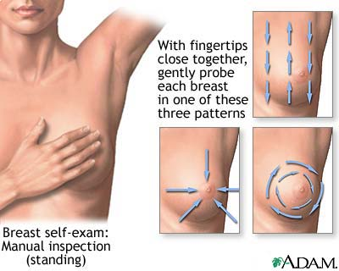
How To Do A Breast Exam In An Adolescent Female
Suggested patterns to follow during breast examination to insure entire breast examined
Inspect skin for abnormalities
Supine position with ipsilateral arm above head
Use flat finger pads over entire breast surface
  Follow pattern to cover ENTIRE breast
Compress areola to express discharge
Palpation for lymphadenopathy
  Axillary, supraclavicular, infraclavicular

Slide 3
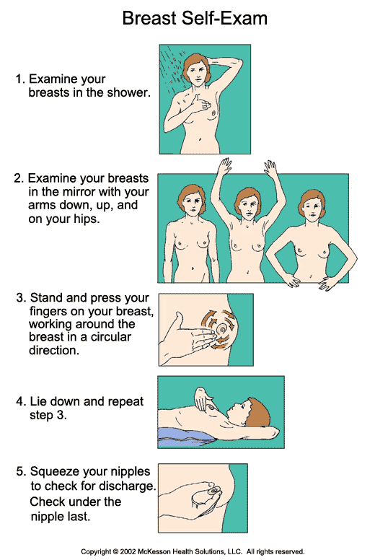

Breast Self-Examination
Controversial
  Impact on cancer diagnosis, death, and tumor stage at diagnosis not proven
We recommend monthly exams after 18 years old
  Become more familiar with their body
  Get used to self-exam early
Should be performed monthly after period ends
Inspect breasts in mirror for abnormality
  Arms by side, arms overhead, hands on hips
Ipsilateral arm above head, palpate entire breast
  May be easier in shower with soapy hand

Slide 4
Nipple Discharge - History
Discharge Characteristics
  Unilateral or bilateral
  Spontaneous expression or requires stimulation
  Color and consistency of discharge
    Milky, bloody, serosanguinous
  Painful?
Miscellaneous
  Last menstrual period
  Medication use
  Drug use
Review of Systems
  Headache, tunnel vision
  Temperature intolerance, energy level, constipation
  Fever

Slide 5
Nipple Discharge – Differential Diagnosis
Milky discharge (galactorrhea)
  Excessive stimulation
  Pregnant or postpartum
  Recent abortion
  Prolactinoma
  Hypothyroidism - Most Common Cause of Galactorrhea
  Medication use (antipsychotics, oral contraceptives, opiates)
  Drug use (codeine, marijuana, morphine)
Purulent discharge
  Infection
Serosanguinous discharge
  Fibrocystic change
  Intraductal papilloma
  Nipple erosion or eczema
  Mammary duct ectasia
  Cancer (very rare in adolescence)
  Paget’s Disease (very rare in adolescence)
Notes:
Paget’s Disease is extremely rare in adolescents, it’s a breast cancer presenting with persistent scaling or ulcerative lesion of the nipple, usually unilateral, associated with yellowish or bloody nipple discharge. It’s diagnosed by punch biopsy and

Slide 6
Nipple Discharge
Work Up & Management
Work Up
  Urine HCG
  TSH, free T4
  Prolactin
  LH, FSH
  Attempt to express discharge for culture
Management
  Discontinue offending drugs
  Avoid excessive nipple stimulation
  Begin antibiotics if suspicious for infection
  Obtain ultrasound if mass palpable

Slide 7
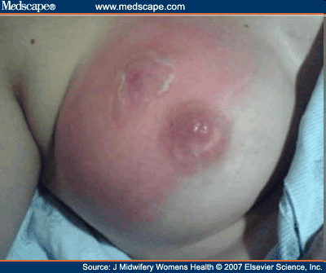
Mastitis
Risk Factors
  Excessive stimulation
  Shaving
  Nipple piercing
  Trauma
Organisms
  Most Common - S. aureus & Group A Streptococcus
  E. Coli, Pseudomonas, enterococcus, anaerobics possible but less likely

Slide 8
Mastitis
Physical Examination and Management
Clinical Findings
  Swelling, erythema, warmth
  Induration
  Nipple discharge
  Fluctuance may be present (indicates abscess)
Management
  Warm Compresses
  Antibiotic coverage (oral if well appearing)
    PO – Dicloxacillin, keflex, clindamycin, bactrim
    IV – Nafcillin, cefazolin, vancomycin, clindamycin
  Should have clinical improvement in 24-48 hours
  If abscess suspected will need incision and drainage

Slide 9
Nipple Piercing
Proper Care
  Wash with antibacterial soap twice daily
  Rotate jewelry
  Apply antibacterial ointment for 1 week
  Usually heals in 3-6 months
Complications
  Superinfection
    Local cellulitis or abscess (usually Staph or Strep)
  Contraction of infection (Hepatitis B or C, HIV)
  Pain
  Bleeding
  Allergic reaction to metal
  Keloid formation
  May interfere with breastfeeding

Slide 10
Gynecomastia
Defined as breast tissue in males
Differentiate from adipose tissue in obese males (pseudogynecomastia)
Due to transient imbalance between estrogen and androgen
Very common in adolescent males
Average onset Tanner 3-4 (age 13 years old)
More commonly bilateral (may be unilateral)
Frequently asymmetric
Usually self-resolves within 6-12 months

Slide 11
Gynecomastia (Continued)
Differential Diagnosis
  Physiologic – most common etiology in pubertal males
  Medications (Spironolactone, H2 blockers, TCAs, reglan, phenytoin, ace inhibitors)
  Drugs (Marijuana, alcohol, methamphetamines)
  Hyperthyroidism
  Tumors (testicular, adrenal)
Management
  Screen for medication or drug use
  Reassurance
  Repeat examination in 6 months
  Work-up required if persisting >2 years

Slide 12
A 16 year old female presents to the office complaining of right sided breast pain which has been getting worse over the past day. On exam, you note erythema and edema with some yellowish nipple discharge. The affected area is extremely tender to palpation. The most likely diagnosis is
Fibrocystic change
Eczema
Mastitis
Mammary duct ectasia
Prolactinoma

Slide 13
A 16 year old female presents to the office complaining of right sided breast pain which has been getting worse over the past day. On exam, you note erythema and edema with some yellowish nipple discharge. The affected area is extremely tender to palpation. The most likely diagnosis is
Fibrocystic change
Eczema
Mastitis
Mammary duct ectasia
Prolactinoma

Slide 14
Answer: C. Mastitis tends to present with acute onset of pain with swelling, erythema, warmth, and induration on exam. Nipple discharge may also be present. Fibrocystic change tends to present with mild premenstrual tenderness with cords and lumps on exam but no erythema, edema, or discharge. Eczema is usually a subacute presentation with skin irritation, erythema, and prurtitis with or without mild nipple discharge. Mammary duct ectasia is a blockage of the subareolar duct which presents with sticky, multicolored nipple discharge which is nontender with minimal skin changes. Prolactinomas tend to present with bilateral milky nipple discharge without skin involvement.

Slide 15
A 13 year old male presents to the office complaining of breast enlargement over the past month. He denies nipple discharge or tenderness. He is not taking any medications and has never experimented with any drugs. On examination, you note 2cm breast bud under the right nipple and 1 cm on the left. He is Tanner Stage 2 for genitalia and has an otherwise normal exam. What is the most appropriate first step in management?
Obtain a CT scan of the head
Serum HCG
Testicular ultrasound
Urine toxicology screen for marijuana
Reassurance that this is a normal occurrence

Slide 16
A 13 year old male presents to the office complaining of breast enlargement over the past month. He denies nipple discharge or tenderness. He is not taking any medications and has never experimented with any drugs. On examination, you note 2cm breast bud under the right nipple and 1 cm on the left. He is Tanner Stage 2 for genitalia and has an otherwise normal exam. What is the most appropriate first step in management?
Obtain a CT scan of the head
Serum HCG
Testicular ultrasound
Urine toxicology screen for marijuana
Reassurance that this is a normal occurrence

Slide 17
Answer: E. Gynecomastia is an extremely common occurrence in young males, which usually begins during Tanner stage 2-3 and self resolves within 6-12 months. It is frequently asymmetric and usually nontender. Patients should be asked about the use of medications (such as antipsychotics, TCAs, spironolactone) or drugs (marijuana, alcohol, methamphetamine) which may cause gynecomastia. Since this patient is within the expected age range for the presentation of physiologic gynecomastia and has an otherwise normal exam, initial management should be reassurance with repeat examination in 6 months at which time the breast development should have stabilized or regressed. Work-up for malignancy is not recommended unless the patient develops other symptoms (galactorrhea, testicular mass, headaches, etc), the breast buds persist for longer than 2 years, or the onset of gynecomastia is in a prepubertal or postpubertal male.

Slide 18
Initial work-up for an adolescent female presenting with bilateral milky nipple discharge should include all of the following EXCEPT:
TSH
Prolactin
Breast ultrasound
Pregnancy test

Slide 19
Initial work-up for an adolescent female presenting with bilateral milky nipple discharge should include all of the following EXCEPT:
TSH
Prolactin
Breast ultrasound
Pregnancy test

Slide 20
Answer: C. Common etiologies for galactorrhea in adolescent females include hypothyroidism, prolactinomas, and pregnancy. Additionally, patients should be asked about excessive breast stimulation, medication use, and recreational drug use. Ultrasound of the breast is not part of the initial work-up unless a mass is palpated.

Slide 21
Recommended Reading
Breast concerns in the adolescent. ACOG Committee Opinion No. 350. American College of Obstetricians and Gynecologists. Obstet Gynecol 2006;108:1329–36.
De Silva NK, Brandt ML. Disorders of the Breast in Children and Adolescents. Part 1: Disorders of growth and infections of the breast. J Pediatr Adolesc Gynecol. 2006 Oct;19(5):345-9.
Mayers LB, Moriarty BW, Judelson DA, Rundell KW. Complications of Body Art. Consultant. 2002;42:1744-52.
Nordt CA, DiVasta AD. Gynecomastia in Adolescents. Curr Opin Pediatr. 2008 Aug;20(4):375-82.

