Slide 1
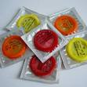
Contraception in Adolescents
Allison Eliscu, MD, FAAP
Rev. Aug 2012

Slide 2


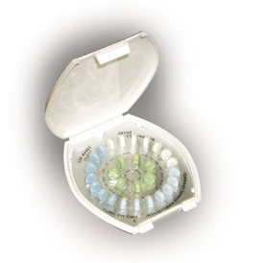
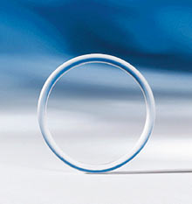
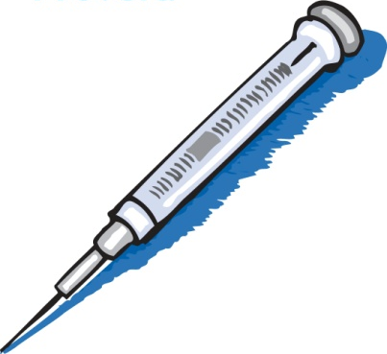
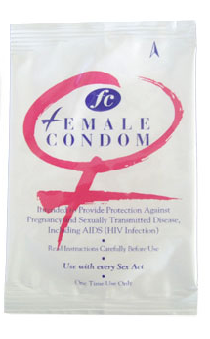
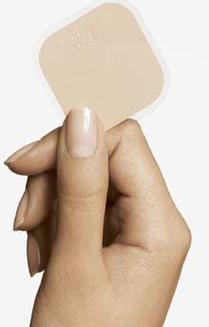
Contraception in Adolescents
Male Condom
Oral Contraceptive
IUD
NuvaRing
Depo Provera
Female Condom
Birth Control Patch

Slide 3
The Importance of Contraception in Adolescence
Average age of sexual debut is 16
47% of U.S. high school students are sexually active
62% used condoms at last sexual event
16% used OCPs at last sexual event
35% of teens do not use contraception at first intercourse
Average time between initial intercourse and medical visit for contraception is 12 months!

Slide 4
Considerations Before Initiating Contraception with Adolescents
Pelvic Exam
  Not required if asymptomatic for STIs (may be recommended)
Pap Smear
  Not indicated unless 21 years old
  Changed from prior guidelines in 2009 (see notes below for explanation)
Emphasize condom use
  Hormonal contraceptives do not prevent STIs
Discuss emergency contraception
  Consider advance prescriptions
Notes:
Prior guidelines had recommended pap smear if sexually active >3 years (regardless of age) or 21 years old. It’s no longer recommended to do paps <21 years old b/c many adolescents have HPV or ASCUS on paps which self-resolve. Aggressive treatments had been done for these pts (leeps, colposcopy with bx, etc) causing more side effects (in addition to pt angst and being expensive) for lesions that for the most part are self-resolving with time. Pap smear is supposed to be a cancer screen, not a test for HPV and there was NOT an inc in cancerous or precancerous changes in paps under 21 years old.

Slide 5
When To Start Contraception
QuickStart Method (Preferred)
  Patient starts method the day she gets the medication
  Must do pregnancy test if she is not on menses
  May increase compliance
  Requires back-up method for 1st month as ovulation may have already occurred
Notes:
Traditionally, reproductive health care providers have delayed initiating patients on hormonal contraception until the next menses occurs (most likely to confirm that the patient is not pregnant).
However, while waiting to start a new birth control method, many young women become pregnant unintentionally.
The “quick start” method allows most young women with a negative urine pregnancy test to begin using the birth control pill, patch or vaginal ring immediately after an office visit, at any point in the menstrual cycle.
This strategy eliminates the delay between receiving a prescription and starting the new method and may improve adherence.
In the quick start trial, women who took their first birth control pill during an office visit had significantly higher adherence three months later than women randomized to the delayed start.
Source: Lesnewski R, Prine L. Initiating Hormonal Contraception. American Family Physician 2006;74:105-11. Downloaded July 10, 2006 at: http://www.aafp.org/afp/20060701/105.html

Slide 6
When To Start Contraception
QuickStart Method (Preferred)
First day of menses
  Easy for patients to remember
  May have decreased compliance if patients forget to start
  May have irregular bleeding for first month

Slide 7
When To Start Contraception
QuickStart Method (Preferred)
First day of menses
Sunday after menses starts
  Frequent confusion about which day to actually start
  Decreased irregular bleeding in initial month

Slide 8
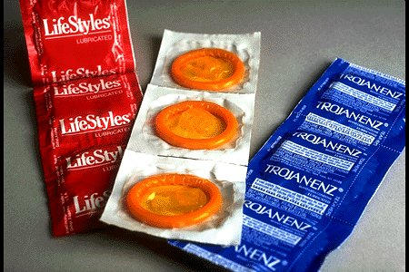
Optimal Adolescent Contraceptive Plan
Hormonal Method Barrier Method
AND

Slide 9
Hormonal Contraception Options
Estrogen and progesterone containing products
  Combined oral contraceptive
  Patch (OrthoEvra)
  NuvaRing
Progesterone-only products
  Oral progestin (mini-pill)
  Depo Provera
  Mirena (Levonorgesterol IUD)
  Implanon (Long acting implant)

Slide 10
Combined Estrogen and Progesterone Containing Products

Slide 11
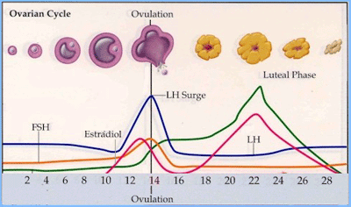
Combined Estrogen and Progestin Mechanism of Action
Blocks LH and FSH
Inhibits ovulation
Thickens cervical mucus to prevent sperm penetration
Inhibits capacitation of sperm
Notes:
Source: Hatcher R, Nelson A. Combined Hormonal Contraceptive Methods. In: Hatcher R, Trussell J, Stewart F, Nelson A, Cates W, Guest F, Kowal D. Contraceptive Technology. 18th Edition. New York, NY: Ardent Media Inc; 2005: 226; 462

Slide 12
Estrogen and Progesterone Noncontraceptive Benefits
Menstrual-related effects
  Regularity of cycles
  Decreased dysmenorrhea
  Decreased blood loss
  May decrease PMS symptoms
Decreased anemia
Improved acne and hirsutism
Reduced risk of
  Ectopic pregnancies
  Endometrial and ovarian cancer risk
  Benign breast conditions (i.e.: fibrocystic change)
  PID

Slide 13
Estrogen and Progesterone
Adverse Effects
Nausea*
Vomiting*
Breast tenderness*
Elevated blood pressure
Headaches
Abdominal bloating
Mood changes (irritability, depression, anxiety)
*These effects usually resolve within 3 months
Not Associated with Significant Weight Gain

Slide 14
Rare Estrogen-Related Health Risks
Screen for ACHES at follow-up visits:
  Abdominal pain
  Chest pain
  Headaches
  Eye or visual changes
  Severe leg pain or swelling
Blood clot in liver or pelvis
Benign liver tumor
Gall bladder disease
Pulmonary embolus
Angina/heart attack
Stroke
Migraine headache
High blood pressure
Stroke
Migraine headache
Retinal vessel embolus
Deep vein thrombosis
Notes:
Source: Hatcher R, Nelson A. Combined Hormonal Contraceptive Methods. In: Hatcher R, Trussell J, Stewart F, Nelson A, Cates W, Guest F, Kowal D. Contraceptive Technology. 18th Edition. New York, NY: Ardent Media Inc; 2005: 226; 462

Slide 15
Efficacy of Combined Contraception
Perfect use: 0.3% failure (pregnancy) rate in 1 year
Typical adult use: 8% failure rate
Typical adolescent use: 5-25% failure rate
  Due to poor adherence
*Compared to failure rate of 85% with no contraception (85% of sexually active women become pregnant in 1 year when no contraception is used)

Slide 16
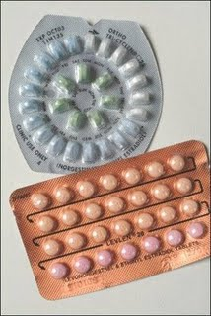
Combined Oral Contraceptives
Contains estrogen and progesterone
Requires taking pill daily
Efficacy decreases with missed pills
Typically taken for 21 days
Menses during 7 day of placebo pills

Slide 17
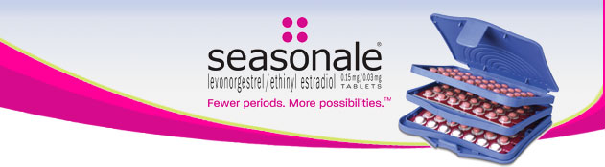
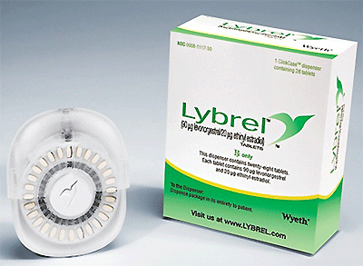
Continuous Oral Contraceptives
Monophasic pill taken consecutively for longer than 28 days
Benefits
Amenorrhea
Decreased PMS Symptoms
Decreased dysmenorrhea
Beneficial in endometriosis
Contraceptive benefit equal to 28-day pill
Risks
Break through bleeding
Long term effects of continuous estrogen unknown
Seasonale 84 active pills + 7 placebo pills (4 menses/year)
Lybrel 28 active pills only (no menses/year)

Slide 18
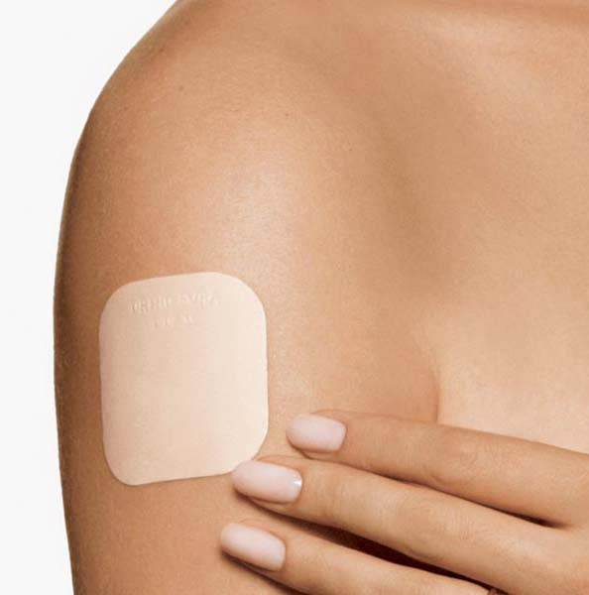
Contraceptive Patch (OrthoEvra)
Patch releases estrogen and progestin through skin
New patch applied weekly for 3 weeks
Menses in patch-free week (week 4)
Change location with each patch
Back-up method required if patch in place >9 days

Slide 19
Contraceptive Patch
Advantages
  Efficacy comparable to oral contraceptives
  Weekly use improves compliance
Disadvantages
  Application site reactions (irritation or hyperpigmentation)
  Possibly less effective in patients over 198 pounds
  Higher detachment rate in teens
  May be visible to others
  FDA concerns about the increased rate of thromboembolism

Slide 20
Blood Clot Risk… Keep it in Perspective
Risk in General Population:
  0.8 per 10,000 women per year
Risk in Women Using Oral Contraception:
  3–4 per 10,000 women per year
Risk in Women Using Contraceptive Patch
  4-5 per 10,000 women per year
Pregnancy and Postpartum Period:
  6–12 per 10,000 women per year
60% higher estrogen exposure with patch use compared to oral contraceptive
Notes:
**This slide best seen in slideshow format**
Sources:
Kujovich JL. Hormones and pregnancy: thromboembolic risks for women. Br J Haematol. 2004 Aug; 126(4):443-54.
Vandenbroucke JP, Rosing J, Bloemenkamp KW, Middeldorp S, Helmerhorst FM, Bouma BN, Rosendaal FR. Oral contraceptives and the risk of venous thrombosis. N Engl J Med. 2001 May 17;344(20):1527-35.
Greer IA. Thrombosis in pregnancy: maternal and fetal issues. Lancet 1999;353:1258–1265.

Slide 21
Contraceptive Patch
Safe and effective product in low risk patients
Appropriate risk/benefit profile (per FDA)
Better alternative than getting pregnancy

Slide 22
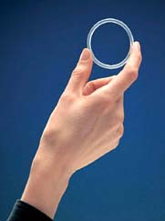
NuvaRing
Soft, flexible ring placed in vagina
Does not need to cover cervix or be in specific position
Remains in place for 3 weeks
Menses during 7 day withdrawal (no ring in place)
Significantly lower serum estrogen levels

Slide 23
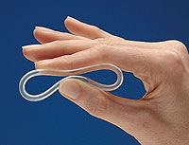
NuvaRing
Advantages
  Lower rates of breakthrough spotting
  Lower rates of systemic side effects
  3 week use increases compliance
  High rates of patient satisfaction
Disadvantages
  Requires insertion by adolescent
  May cause vaginal irritation or discharge
  Occasional expulsion
  May have foreign body sensation or coital problem
    Very few partners object to Ring use based on coital problems

Slide 24
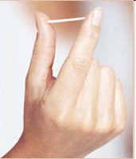
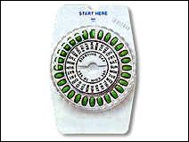
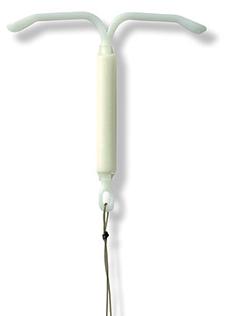
Progesterone-Only Products

Slide 25
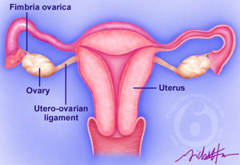
Progesterone Methods
Mechanism of Action
Decreased GnRH pulse frequency
Ovulation inhibited
Endometrial hypoplasia
Cervical mucus thickened

Slide 26
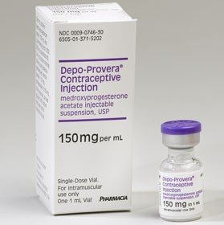
Depot Medroxyprogesterone Acetate
(Depo Provera)
150mg IM injection every 12 weeks
Usually initiated within first 5 days of menses
May QuickStart if pregnancy test is negative
  Repeat urine HCG in 2-3 weeks if quickstart
Likely prevents ovulation for 14 weeks (2 week grace period)
Failure (pregnancy) rate 0.3%
*GREAT METHOD FOR ADOLESCENTS*

Slide 27
Depo Provera
Advantages
  3 month schedule improves adherence
  Contraceptive option when estrogen is contraindicated
  Decreases risk of endometrial cancer and PID
  May increase seizure threshold
  Safe for breastfeeding and postpartum women
  Extremely effective
Disadvantages
  Weight gain
  Irregular bleeding Amenorrhea
  Depression and mood changes
  Decreased bone mineral density
    Likely reversible after discontinuation

Slide 28
Progesterone Only Pill (“Mini Pill”)
Same pill daily without placebo pills
Alternative when estrogen contraindicated
Must take consistently at same time of day
  Break through ovulation possible if delayed > 2-3 hours (may get pregnant if pill delayed >3 hours)
*NOT A GOOD METHOD FOR ADOLESCENTS*
Notes:
This is not a great method for adolescents to prevent pregnancy b/c of the need for strict adherence to daily, on-time use. Adolescents are frequently less compliant with regular meds than adults. Cell phone alarms may help improve compliance.

Slide 29
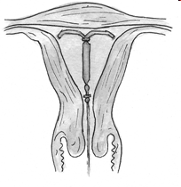
Levonorgesterol-Releasing
Intrauterine Device (Mirena)
Releases 20mcg/day of progesterone into endometrium
FDA approved for up to 5 years
Inserted during menses or after spontaneous or induced abortion since cervix is open
Failure (pregnancy) rate 0.2% in 1 year
*EXCELLENT METHOD FOR ADOLESCENTS!*

Slide 30
Mirena IUD
Advantages
  Decreased menstrual bleeding
  Decreased dysmenorrhea
  Frequently develop amenorrhea
  Systemic adverse effects are rare
  Contraceptive option when estrogen contraindicated
  Alternative for breastfeeding women
Disadvantages
  Spotting common (especially in first 6 months)
  Cramping pain with placement

Slide 31
Mirena IUD – Dispelling Myths
IUDs are NOT contraindicated in adolescents
IUDs do NOT increase the risk of PID
IUDs do NOT increase the risk of ectopic pregnancies
IUDs do NOT affect fertility after removal
Reliable method
Excellent, long-term protection
Low risk of systemic side effects
  Slight increase risk of PID for 3 weeks after insertion
  After 3 weeks, risk of PID is equal to that of an adolescent without IUD
  Do not place IUD if patient has cervicitis or PID currently or within past 3 months
If pregnancy occurs with IUD in place, likely to be ectopic
BUT, overall risk of getting pregnant with IUD is incredibly low
Notes:
**This slide is best viewed in slideshow format**

Slide 32
Implanon
Single rod containing progesterone
Inserted under skin of inner upper arm
Effective within 24 hours of insertion
Small incision for removal
Local anesthesia may be used for insertion and removal
Approved for 3 year use

Slide 33
Implanon
Advantages
  Effective within 24 hours of insertion
  Fertility returns rapidly after removal
  Decreased menstrual bleeding (amenorrhea possible)
  Decreased dysmenorrhea
Disadvantages
  Requires provider insertion and removal
  Break-through bleeding possible
  Adverse effects possible
    Headache, acne, mood changes, weight gain

Slide 34
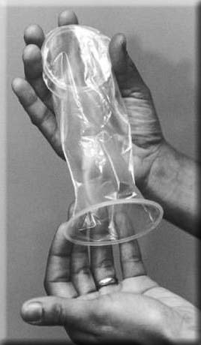
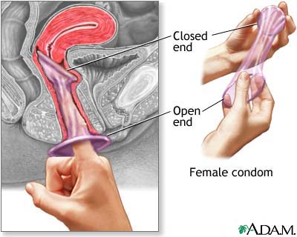
NONHORMONAL METHODS CONTRACEPTION
Female Condom
  Polyurethane sheath with 2 rings
  May be inserted hours before intercourse
  Can be used by latex allergic individuals
  May be noisy and uncomfortable
  Failure (pregnancy) rate:
    Typical use: 21-26%, Perfect use: 5%
Male Condom
  Provides protection against STDs and pregnancy
  Occasionally slips (2%) or breaks (2%)
  May interfere with spontaneity
  Most inexpensive and cost effective method of protection
  Failure (pregnancy) rate:
    Typical use: 12%, Perfect use: 3%
Notes:
**This slide is best viewed in slideshow format**

Slide 35
CONTRACEPTIVE METHODS NOT RECOMMENDED FOR ADOLESCENTS
Withdrawal
  Low efficacy rate
  STI risk
  Relies entirely on male partner, female has no control
Sterilization
  Irreversible
Calendar/Natural Planning Method
  Low efficacy rate
  STI risk
  Irregular cycles in adolescents make timing of ovulation more difficult and less predictable

Slide 36
CONTRACEPTIVE METHODS NOT RECOMMENDED FOR ADOLESCENTS
Must meet all 3 conditions to be effective
Copper T IUD (ParaGard)
  Increased menstrual bleeding and cramping may not be tolerated
Lactation
  Not reliable unless:
    Less than 6 months postpartum
    Amenorrheic
    Breastfeeding exclusively

Slide 37

EMERGENCY CONTRACEPTION
Levonorgesterol 0.75 mg tabs x 2 together
Progesterone only (contains NO estrogen)
Can use up to 120 hours (5 days) after unprotected sex (more effective the sooner it’s used)
Recommend empiric use after sexual assault
Available over-the-counter for individuals ≥17 years old
Consider giving advance prescription to adolescents
  Especially to patients relying on condoms alone

Slide 38

EMERGENCY CONTRACEPTION
Possible method of action
  Inhibits or delays ovulation
Does not interrupt current pregnancy
Not teratogenic
Effectiveness
  <24 hrs – 95% pregnancy reduction
  Within 72 hours – 89% pregnancy reduction
  More effective the sooner it’s taken

Slide 39
A 17 year old female present to the office asking to start on birth control. She is currently monogamous with a male partner, using condoms most of the time, and has had 3 male partners in the past. She has never had a gyn exam and is currently asymptomatic. She has regular monthly menses and her last period started 1 week ago. She is interested in starting pills with her next menses. Which of the following must be done before starting on the pill?
Obtain consent from a parent
Perform a gyn exam with pap smear
Perform an HIV test
None of the above

Slide 40
A 17 year old female present to the office asking to start on birth control. She is currently monogamous with a male partner, using condoms most of the time, and has had 3 male partners in the past. She has never had a gyn exam and is currently asymptomatic. She has regular monthly menses and her last period started 1 week ago. She is interested in starting pills with her next menses. Which of the following must be done before starting on the pill?
Obtain consent from a parent
Perform a gyn exam with pap smear
Perform an HIV test
None of the above

Slide 41
Answer: E. None of the listed entities must be performed prior to starting birth control. A sexually active 17 year old female should be encouraged to receive STI testing, either by endocervical swab or urine testing. All sexually active females under the age of 25 should receive annual STI screening, however this is not required before beginning contraception. In the past, providers used to require a gynecological exam prior to dispensing birth control but this became an obstacle for teens who wanted to acquire contraception. Although an initial gyn exam may be recommended (for STI screening, to get the patient used to the exam, to screen for skin lesions, etc.), it is no longer a requirement prior to beginning contraception. The newest ACOG guidelines* recommend delaying the initial pap smear until 21 years of age, regardless of when sexual intercourse was first initiated. So this patient should not receive a pap smear at this time. The patient in the vignette has regular menses and is planning on beginning the pill with her next menses so a pregnancy test is not required. If she had irregular menses or wanted to “quickstart” the pill (meaning begin the pill in the middle of her cycle rather than waiting for her next menses), then she would require a pregnancy test first. An HIV test may be offered to the patient but is also not required. Additionally, adolescents are able to obtain contraception without parental consent.

Slide 42
Which of the following statements about the use of contraception among adolescents is TRUE?
Adolescents typically consult a physician for contraceptive advice before becoming sexually active
The progestin-only pill (mini pill) is a good contraceptive alternative for adolescents since pregnancy is prevented even if pills are occasionally forgotten
Depo provera is a potential option for an adolescent female who is breastfeeding
Adolescents who are abstinent do not require anticipatory counseling about contraception since it may encourage them to become sexually active
None of the above are true

Slide 43
Which of the following statements about the use of contraception among adolescents is TRUE?
Adolescents typically consult a physician for contraceptive advice before becoming sexually active
The progestin-only pill (mini pill) is a good contraceptive alternative for adolescents since pregnancy is prevented even if pills are occasionally forgotten
Depo provera is a potential option for an adolescent female who is breastfeeding
Adolescents who are abstinent do not require anticipatory counseling about contraception since it may encourage them to become sexually active
None of the above are true

Slide 44
Answer: C. Lactating women may use progesterone-only methods of contraception such as the mini-pill or depo provera. Estrogen should not be used in the immediate postpartum period due to an intrinisic increased risk of clotting during that time. Additionally, estrogen can decrease a woman’s milk supply making it harder to breastfeed. Adolescents generally do not consult a physician regarding contraception before initiating intercourse. In fact, they tend to wait 6-12 months between initiating intercourse and seeking contraception which is why anticipatory counseling should be discussed before females become sexually active. Discussing contraception beforehand does not make a person more likely to engage in intercourse but may increase the chance of using protection at the initial episode. The progesterone-only pill is not a good contraceptive choice for adolescents since break-through ovulation can occur if it is delayed by more than 2 hours.

Slide 45
A 16 year old female is interested in starting depo provera. Which of the following statements about depo is NOT true?
A. Weight gain is a common side effect of depo
B. Depo use may increase a person's chance of developing a blood clot
C. Bone mineral density may decrease with depo use
D. Women frequently stop using depo because of irregular spotting
E. It may take 6-12 months for a female to regain normal menstrual cycles after stopping depo

Slide 46
A 16 year old female is interested in starting depo provera. Which of the following statements about depo is NOT true?
A. Weight gain is a common side effect of depo
B. Depo use may increase a person's chance of developing a blood clot
C. Bone mineral density may decrease with depo use
D. Women frequently stop using depo because of irregular spotting
E. It may take 6-12 months for a female to regain normal menstrual cycles after stopping depo

Slide 47
Answer: B. Females using estrogen-containing methods of contraception have a slightly increased risk of developing blood clots. These methods include the combined pill, patch, and nuvaring. Depo provera contains progesterone only so there is no increased risk of developing a clot. Side effects of depo include weight gain, irregular spotting, amenorrhea, hair loss, and mood changes. Additionally, bone mineral density is frequently decreased with depo use but this is likely reversible within 2 years of stopping depo. Resumption of normal menses and fertility may take 6-12 months after stopping depo.

Slide 48
You are counseling a sexually active 15 year old female about contraception. Which of the following is a true statement which you may include in your conversation?
A. Noncontraceptive benefits of oral contraceptives include improved acne and dysmenorrhea
B. IUD is not a good method for adolescents due to an increased risk of pelvic inflammatory disease (PID) in young women
C. Nuvaring is not popular among adolescents since you must be fitted for a nuvaring and have it placed monthly by a provider
D. The contraceptive patch is associated with a lower risk of developing a blood clot compared to depo provera
E. Both A & B are true

Slide 49
You are counseling a sexually active 15 year old female about contraception. Which of the following is a true statement which you may include in your conversation?
A. Noncontraceptive benefits of oral contraceptives include improved acne and dysmenorrhea
B. IUD is not a good method for adolescents due to an increased risk of pelvic inflammatory disease (PID) in young women
C. Nuvaring is not popular among adolescents since you must be fitted for a nuvaring and have it placed monthly by a provider
D. The contraceptive patch is associated with a lower risk of developing a blood clot compared to depo provera
E. Both A & B are true

Slide 50
Answer: A. All estrogen-containing contraceptives (combined pill, patch, and nuvaring) have noncontraceptive benefits including decreased dysmenorrhea, more predictable menses, decreased blood loss with menses, and improved acne and hirsutism. The IUD is an excellent method for adolescents since it may be in place for a long period of time and does not require them to remember to take something daily or weekly. The Mirena and ParaGard are not associated with an increased risk of PID outside of the initial period 3 weeks immediately after insertion. Nuvaring is also a good method for adolescents since it remains in place for 3 weeks at a time. Unlike a diaphragm, nuvarings do not have to be fitted by a provider, there is only 1 size of nuvaring available. Unlike an IUD, nuvarings are inserted and removed by the patient. Finally, the contraceptive patch is associated with a higher risk of developing a blood clot compared to the other estrogen-containing contraceptives (combined pill and nuvaring) as well as the progesterone-only methods (such as depo). This is because of the elevated serum level of estrogen in a female on the patch.

Slide 51
Which of the following contraceptive options are NOT routinely recommended for adolescents?
A. Nuvaring
B. IUD
C. Diaphragm
D. Contraceptive patch
E. Female condom
F. All of the above are routinely recommended for adolescents

Slide 52
Which of the following contraceptive options are NOT routinely recommended for adolescents?
A. Nuvaring
B. IUD
C. Diaphragm
D. Contraceptive patch
E. Female condom
F. All of the above are routinely recommended for adolescents

Slide 53
Answer: C. The diaphragm is not recommended for use by adolescents since its use requires a high level of motivation and skill in order to insure accurate placement each use and proper care and cleaning after use. It also does not afford any protection against STIs and needs to be refitted after an abortion or significant weight change (>10-20 pounds). All other methods are recommended in adolescents but nonbarrier methods should be used in conjunction with a barrier (male or female condom) to protect against STIs.

Slide 54
Which of the following is an absolute contraindication to the use of oral contraceptives?
Current pelvic inflammatory disease
Hyperthyroidism
Severe uncontrolled hypertension
Adolescent female on augmentin for a sinus infection
Healthy adolescent female who smokes 2-4 cigarettes per day

Slide 55
Which of the following is an absolute contraindication to the use of oral contraceptives?
Current pelvic inflammatory disease
Hyperthyroidism
Severe uncontrolled hypertension
Adolescent female on augmentin for a sinus infection
Healthy adolescent female who smokes 2-4 cigarettes per day

Slide 56
Answer: C. Oral contraceptive pills (OCPs) are absolutely contraindicated in females with severe hypertension (>160/110) as well as females with a history of DVT or PE, females with a hypercoagulable disorder, pregnant women or lactating <6 wks postpartum, women with prior breast cancer, liver disease, or migraine with focal neurological deficits. Females with PID (current or past) or hyperthyroidism are not restricted from using oral contraceptives. The only antibiotic which may potentially interact with OCPs to decrease contraceptive efficacy is rifampin. All others do not interact with OCP use. For a female on rifampin, OCPs may be continued but a back-up method (ie, condoms) should be used. Females should be counseled that tobacco use while using OCPs can increase their risk of developing cardiovascular disease. In females under the age 35 and those smoking less than 15 cigarettes per day, this increase risk is minimal so OCP use is not contraindicated.

Slide 57
RECOMMENDED READING
Gupta N, Corrado S, Goldstein M. Hormonal Contraception for the Adolescent. Peds in Review. 2008;29:386-396.
Zieman M. Overview of Contraception. UpToDate Online. Updated June 1, 2009.
Rimsza M. Counseling the Adolescent About Contraception. Peds in Review. 2003;24:162-169.

