Slide 1
Performing a Gynecological Examination on Adolescent Females
Allison Eliscu, MD, FAAP
Rev. June 2012

Slide 2
Obtaining a Gyn History
Menstrual history
Menarche
Length of cycle (time between 1st day of bleeding from one cycle to next)
Duration of bleeding
Last menstrual period
Presence of symptoms?
Vaginal discharge?
Dysuria?
Vaginal itch?
Odor?
Prior gynecological exams

Slide 3
Obtaining a Sexual History
History of sexual activity
Number of lifetime partners (male, female, both)
Coitarche (age of sexual debut)
Most recent sexual encounter
Risk of pregnancy
Determine if they need emergency contraception (for unprotected sex within last 5 days)
History of contraception use
Frequency of condom use
History of STIs
History of pregnancy

Slide 4
Before Starting the Exam
Ask patient about expectations of exam
Explain exam step-by-step
Show her equipment and explain how it works
Set up equipment and tests before starting
Have chaperone present
Explain that exam is easier if muscles are relaxed

Slide 5
Gyn Testing Recommendations
Pap Smear
Initial pap when 21 years old – regardless of age of sexual debut (unless immunecompromised)
Repeat testing every 2 years
Gonorrhea and Chlamydia Testing
Annual testing in sexually active adolescents
More frequent if they are high risk, have vaginal symptoms or HIV+
Notes:
Pap Smear is not recommended before 21 years old b/c sexually active adolescents have a very high rate of HPV and cervical changes consistent with HPV (ASCUS and LGSIL) which frequently self-resolve. The rate of cervical cancer in adolescents under 21 years old is 1-2/million. In the past, invasive procedures had been done on adolescents with an abnormal pap smear (colposcopy with biopsy, leep procedures, cone bx, etc) which were expensive, caused a lot of pt anxiety and medical consequences for a lesion that almost always self-resolves.

Slide 6
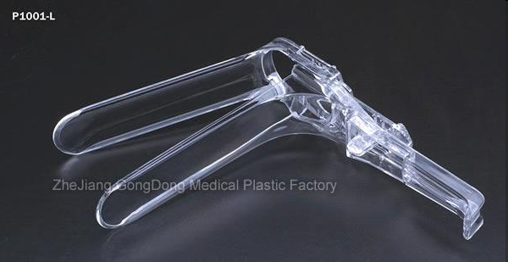
Equipment
Speculum (smallest size possible)
Lubricant (Does NOT interfere with results)
Light source
Liquid thin prep container (for Pap smear)
Spatula & cytobrush or broom to collect pap smear
Gonorrhea/Chlamydia DNA probe container

Slide 7
Patient Positioning
Gown patient with drape across lap
Raise head of table slightly
Extend stirrups (should be slightly outwards)
Slide body down until buttocks hangs off table by 1-2 inches
Ask if patient is comfortable in stirrups before proceeding
Keep drape across unexamined areas
Do not let drape block eye contact with patient

Slide 8
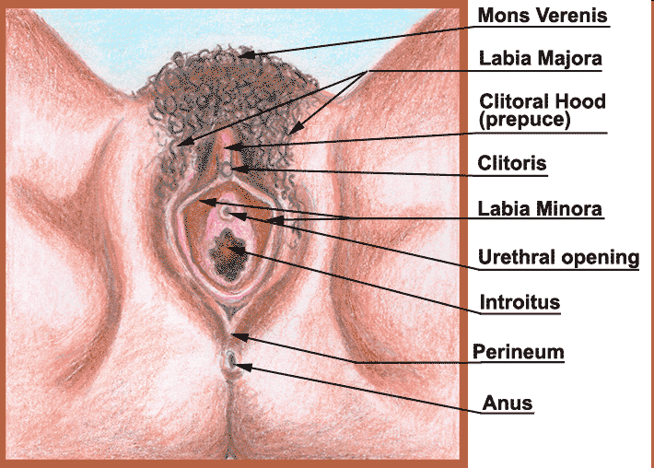
External Genital Examination
Begin by touching the thigh with back of hand
Check pubic hair region for lesions
Check labia majora for lesions
Spread labia majora to check labia minora and introitus for lesions or abnormalities
Inspect perianal area for abnormalities

Slide 9
Speculum Examination
Separate labia minora with fingers of nondominant hand
Start with speculum in vertical position
Hold bills closed
Insert gradually with bills pointing posteriorly (downward position towards back)
Once fully inserted, turn speculum horizontally
Open bills slowly to allow cervix to pop into view
Do NOT open bills until inserted completely
If unable to find cervix, remove speculum and check position with finger, then retry inserting speculum

Slide 10
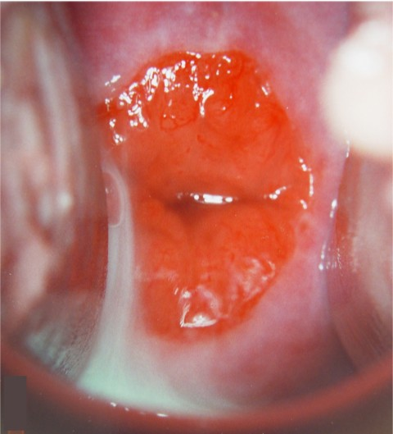
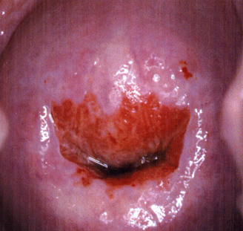
Normal Adolescent Cervix
Ectropion – transformation zone between immature (columnar) and mature (squamous) epithelium
Ectropion is dark red and usually asymmetric
Does not bleed when touched with Qtip (nonfriable)
No treatment necessary
Normal Ectropion

Slide 11
Obtaining Endocervical Specimens
Begin with either pap smear or STI testing
Usually begin with test you are more concerned about
Wipe cervix clean with cotton swab
STI Testing
Insert test-specific swab into cervical os
Rotate swab for 10-30 seconds
Insert swab immediately into collection tube, break swab at scoring, cap test tube

Slide 12
Obtaining Endocervical Specimens
Pap smear testing
Insert spatula with long arm into cervix
Rotate the spatula once
Put spatula immediately into thinprep canister
Rinse spatula vigorously 10 times in liquid
Insert brush into cervix
Rotate brush ¼ to ½ turn only
Put brush in liquid and rotate vigorously
May use spatula to scrape extra cells off of brush
May use broom instead of spatula/brush combination for pap smear
Insert broom into cervix and rotate 5 times
Vigorously rotate broom in liquid 10 times

Slide 13
Bimanual Examination
Apply lubrication to 2nd and 3rd fingers of dominant hand
Slowly introduce 1 or 2 fingers into vagina
Assess Cervix
Note size, shape, and consistency
Move cervix side-to-side checking for cervical motion tenderness (cmt)
Assess Uterus
Place nondominant hand on lower midabdomen
Slide vaginal fingers anterior to cervix, push fingers anteriorly
Push downwards with abdominal hand
Try to palpate uterus between 2 hands
Assess size, consistency, shape, tenderness, and masses

Slide 14
Bimanual Examination
Assess Ovaries
Move vaginal fingers into right lateral fornix
Place abdominal hand on right lower quadrant
Sweep abdominal hand downwards and medially
Try to palpate adnexal contents between fingers
Assess for shape, masses, tenderness
May or may not be palpable based on body habitus
Move to left side and repeat
Rectovaginal Exam
Optimal palpation of posterior cul-de-sac and retroverted uterus

Slide 15
Recommended Reading
Potter J, Carrion-Gomez Y. Pelvic Exam. Retrieved from Reference Library: Virtual Patient 09 – A woman at Midlife; The Carl J. Shapiro Institute for Education and Research at Harvard Medical School and Beth Israel Deaconess Medical Center website at: http://research.bidmc.harvard.edu/VPTutorials/midlife/default.htm
Carusi DA, Goldstein DP. The Gynecologic History and Physical Examination. UpToDate Online. Updated August 11, 2009.
Cervical cytology screening. ACOG Practice Bulletin No. 109. American College of Obstetricians and Gynecologists. Obstet Gynecol 2009; 114:1409.

