Slide 1
How to Succeed in Graduate School: The Hidden Curriculum Orientation 2019

Slide 2
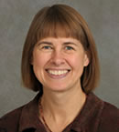
Good news…you will have lots of support along the way!
GPD
Advisory Committee
Advisor
GPC

Slide 3
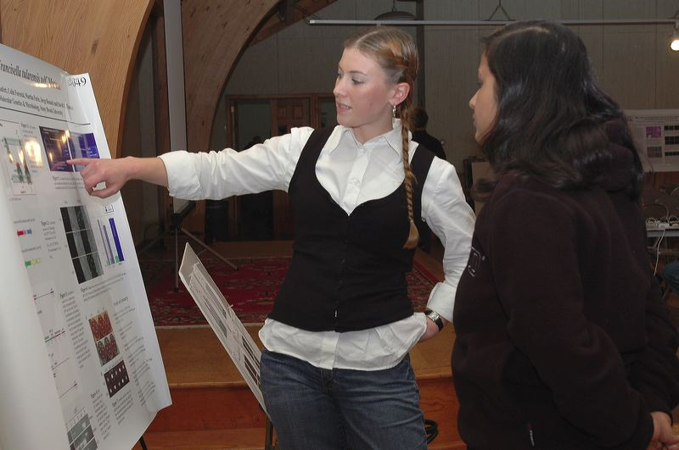
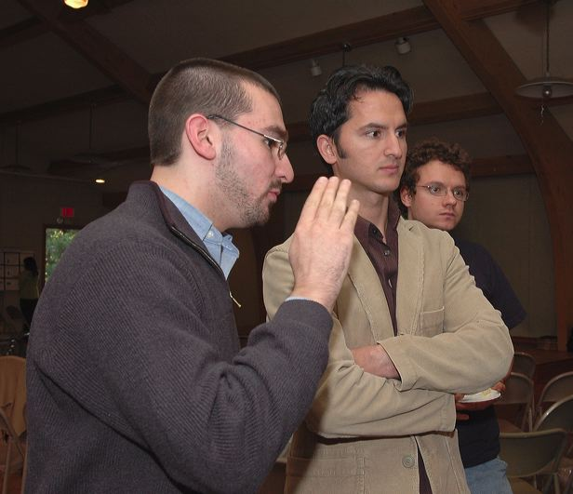
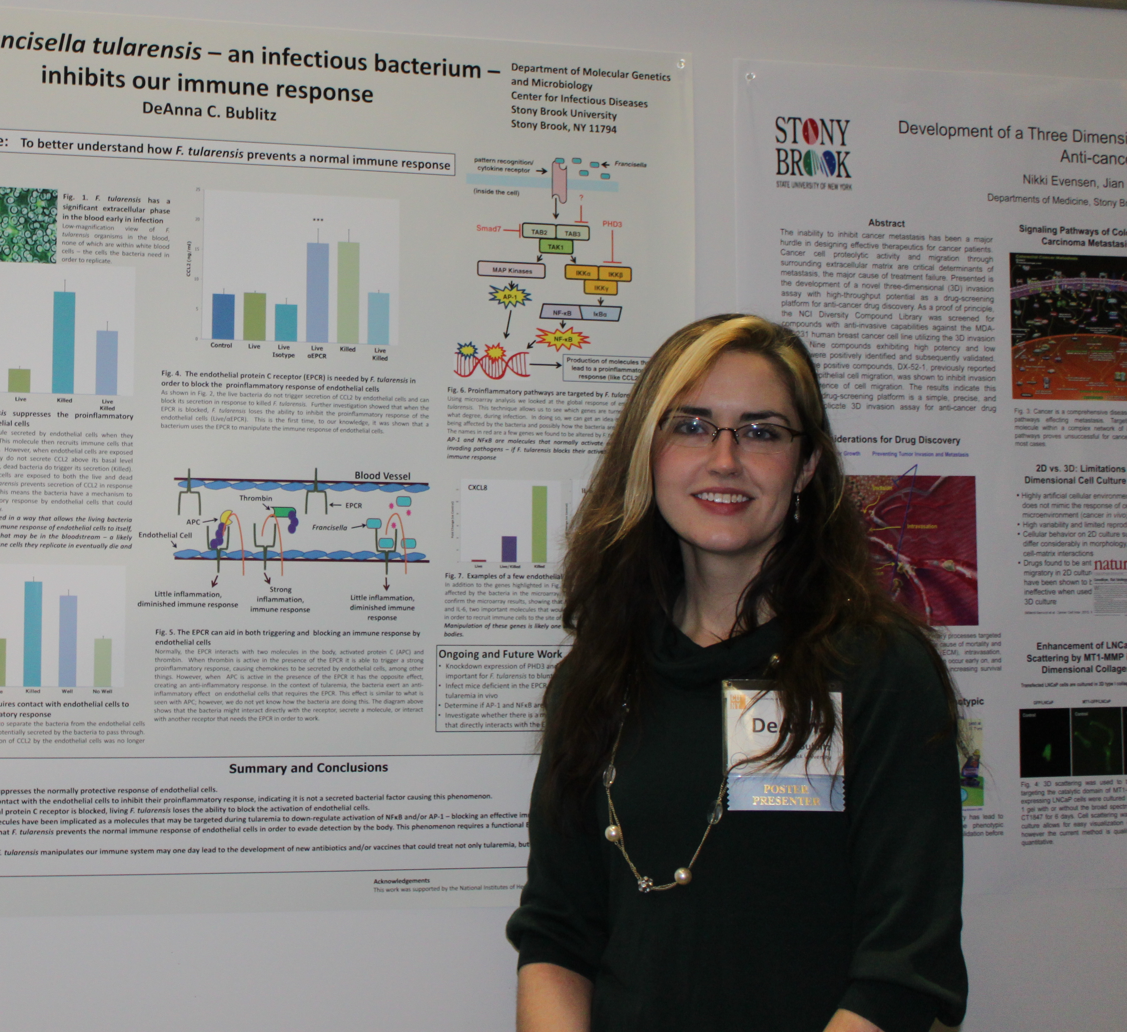
However, your background and goals are unique…you need to take charge of your training!

Slide 4
Formal Coursework is only Part of your Training
Molecular Genetics
Graduate Genetics
Graduate Biochemistry
Cell Biology
Readings in Genetics/MBM
Graduate Immunology

Slide 5
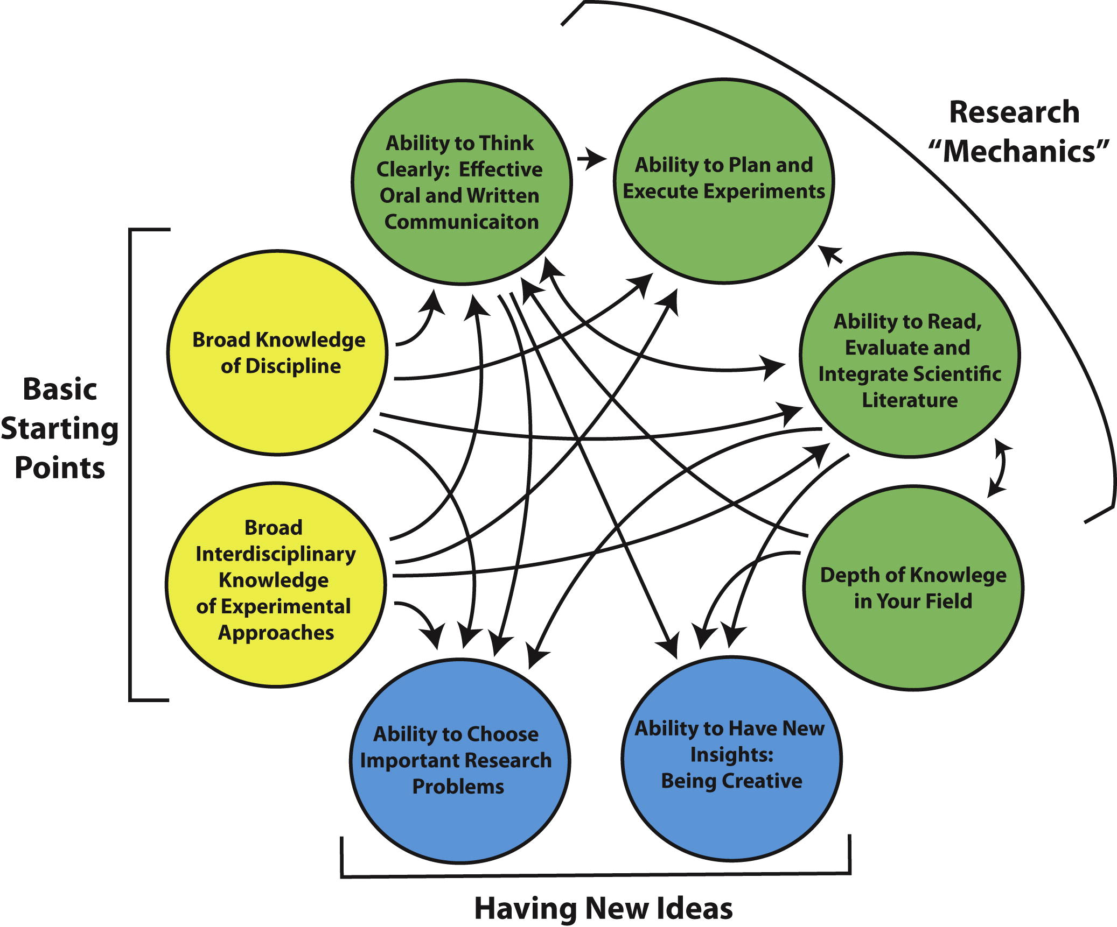
Scientific Skills and the “Hidden Curriculum”
Parker, R. 2012. Skill development in graduate education. Mol. Cell 46: 377-381.

Slide 6
Basic Starting Points
Broad knowledge of discipline
Broad interdisciplinary knowledge of experimental approaches
Courses (e.g., Molecular Genetics, Microbial Pathogensis)
Seminars, symposia, scientific meetings
Journal clubs
Reading the literature
Parker, R. 2012. Skill development in graduate education. Mol. Cell 46: 377-381.

Slide 7
Seminars, Symposia, Meetings
Graduate seminars (Tuesdays 1:30 - 2:30pm)
Departmental seminar series
Mondays at noon for MGM
Other seminar series
e.g., BNL, Laufer Center, Cancer Center
Symposia & Colloquia
Cancer Center, Laufer Center, ICB&DD, department- and program-sponsored
Scientific meetings
e.g., CSHL, discipline-specific
Parker, R. 2012. Skill development in graduate education. Mol. Cell 46: 377-381.
Notes:
Mention sources of funds for travel awards

Slide 8
Research “Mechanics”
Effective oral and written communication (courses, journal clubs, graduate seminar, Center for Communicating Science, workshops and special seminars, group meetings, qualifying exam, poster & oral presentations; dissertation proposal defense, dissertation, manuscript preparation)
Depth of knowledge in field (literature, scientific meetings, seminars)
Read, evaluate and integrate literature (journal clubs, qualifying exam, reading the literature)
Plan and execute experiments (methods courses, journal clubs, mentor, advisory committee, group meetings)
Parker, R. 2012. Skill development in graduate education. Mol. Cell 46: 377-381.

Slide 9
Having New Ideas
Choose important research problems
Reflect on the careers of other scientists
Be aware of directions in science, societal needs
Qualifying exam, dissertation proposal defense
Have new insights – be creative!
Be aware of technological developments
“Chance favors the prepared mind” L. Pasteur
Recommended readings:
McKnight, S.L. 2009. Unconventional wisdom. Cell 138: 817-819
Scheffer, M. 2014. The forgotten half of scientific thinking. PNAS 111: 6119
Parker, R. 2012. Skill development in graduate education. Mol. Cell 46: 377-381.

Slide 10
Career Development: Don’t Leave it to the End!!
Individual Development Plans
Workshops (Postdoctoral Affairs, department-sponsored)
Special seminars
TLT Center
Network (including program alumni)
Reflect on career goal and update CV often
Notes:
GRD 500 session on Mentoring

Slide 11
Listservs Plus
Office for the Integration of Research, Education and Professional Development (IREP) listserv http://stonybrook.us10.list-manage.com/subscribe?u=783a0762b53304103756b32e9&id=e46e07406e
Campus Announcements
Departmental Seminars
Notes:
GRD 500 session on Mentoring

