Slide 1
Lower Extremity Injuries in Adolescent Athletes
Allison Eliscu, MD, FAAP
Rev. Aug 2012

Slide 2
Lower Extremity Injuries
Patellofemoral Pain Syndrome
Osgood Schlatter Disease
Ankle sprains
Sever’s Disease

Slide 3
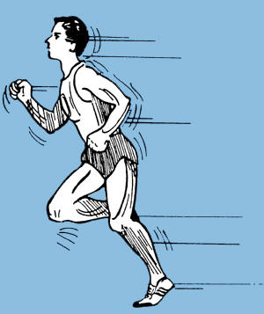
Patellofemoral Pain Syndrome (PFPS) Runner's Knee

Slide 4
What is Patellofemoral Pain Sx?
Anterior knee pain involving the patella and retinaculum
Must exclude joint and peripatellar damage
Most common cause of knee pain
Multifactorial etiology:
Overuse, patellar malalignment, trauma
Anatomic risk Factors:
Tight lower extremity muscles
Patellar hypermobility
Pes cavus (high arch)

Slide 5
History Consistent With PFPS
Achy pain behind, underneath, or around patella
Gradual onset
Pain or stiffness with sitting for long periods of time
Pain with squatting, stairs, or running
May hear popping or feel knee catching
Associated with increase in activity level
Frequency, duration, or intensity

Slide 6
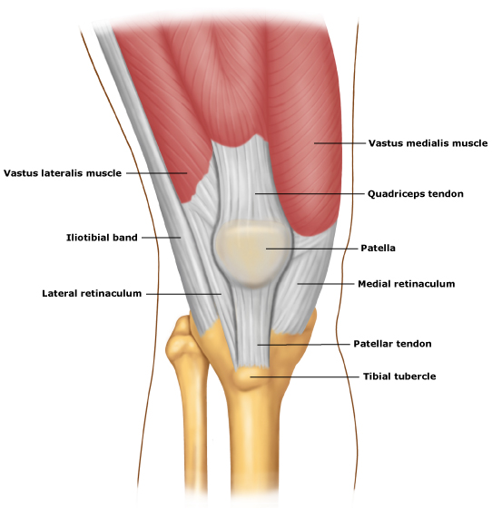
Physical Exam of PFPS
No Effusion
Normal range of motion
Normal internal ligament exam
Decreased flexibility of IT Band or quadriceps
Special patellar tests:
Patellar glide
Patellofemoral compression test
Patellar facet tenderness
Notes:
Diagnosis is based on constellation of history and physical findings. There is no pathognomonic sign for PFPS. Must rule-out alternative diagnoses.

Slide 7
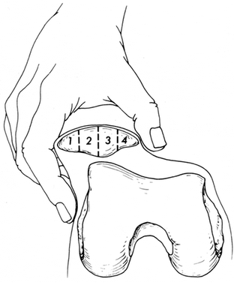
Patellar Glide Test
Patient supine with knee extended
Displace the patella medially
Movement < ¼ of patella’s width = tight retinaculum
Movement > ¾ of width = hypermobility of patella
Both are risk factors for PFPS
Lateral
Medial
Medial Displacement

Slide 8
Patellar Examination
Patellofemoral Compression Test
Patient supine, knee extended
Compress patella posteriorly into femoral trochlear groove
Pain consistent with PFPS
Patellar Facet Tenderness
Displace the patella laterally
Palpate the lateral facet (undersurface)
Repeat medially
Pain consistent with PFPS

Slide 9
Management of PFPS
Initial treatment: relative rest, ice, NSAIDS for pain
Reduce workout until have no pain
Consider nonimpact workout (swimming, biking)
Physical therapy
Goal: Decrease patellar strain
Improve flexibility and strength of surrounding muscles
Focus on quadriceps, hamstrings, gastrocnemius, soleus
Taping and braces may improve symptoms
Consider surgery if no improvement in 6-12 months

Slide 10
Recommended Reading
Dixit S, DiFiori JP, Burton M, Mines B. Management of Patellofemoral Pain Syndrome. Am Fam Physician. 2007 Jan;75(2):194-202.
Patel DR, Nelson TL. Sports Injuries in Adolescents. Med Clin North Am 2000 Jul;84(4):983-1007.
O’Connor FG, Mulvaney SW. Patellofemoral Pain Syndrome. UpToDate Online. Updated April 30, 2009.

Slide 11
Osgood-Schlatter Disease

Slide 12
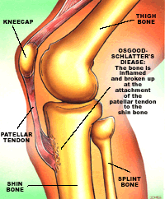
What is Osgood-Schlatter Disease?
Traction apophysitis affecting insertion of patellar tendon on tibial tuberosity
Overuse injury
~20% adolescent athletes affected
Males > Females
Presents in Tanner 2-3
Separation of patellar tendon from tibial tuberosity due to chronic avulsions of apophysis

Slide 13
Clinical Presentation
Subacute pain of anterior knee
Gradually worsening
Pain exacerbated by jumping, squating, and kneeling
Relieved with rest
Bilateral symptoms in 20-30% of patients

Slide 14
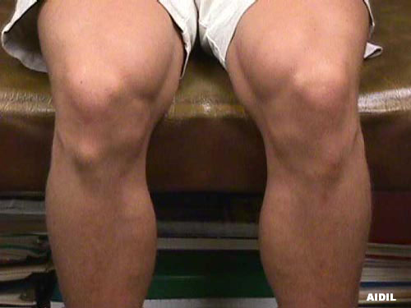
Physical Examination Findings
Local tenderness and swelling over tibial tuberosity
Pain reproduced by extending knee against resistance
Pain with squatting in full flexion
Ossicle in tendon may be present
Prominence over
tibial tuberosity

Slide 15
Management of Osgood-Schlatter
X-ray required if atypical complaints present
Night pain, acute onset, pain unrelated to activity
Continue to participate in sports as tolerated
Even if some pain is present
Avoidance of activity NOT recommended
Ice may improve symptoms
Physical therapy
Improve flexibility and strength of hamstrings and quads
Usually resolves with ossification of growth plate
Rarely requires surgery to remove ossicle (only done after closure of growth plate)
Notes:
Avoiding activity completely can lead to deconditioning and may lead to more injuries upon resuming activity.

Slide 16
Recommended Reading
Patel DR, Nelson TL. Sports Injuries in Adolescents. Med Clin North Am 2000 Jul;84(4):983-1007.
Kienstra AJ, Macias CG. Osgood-Schlatter Disease. UpToDate Online. Updated September 8, 2008.
Notes:
16

Slide 17
Ankle Sprains

Slide 18
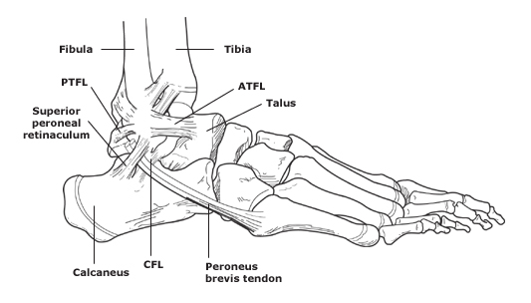
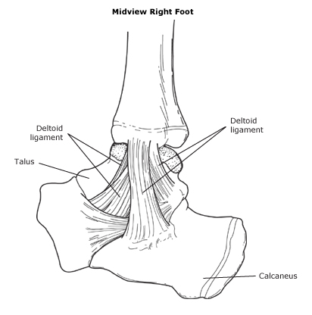
Types of Ankle Sprains
Posterotalofibular Ligament (PTFL)
Lateral Ankle View
Lateral sprain – inversion injury
Most common (85% of sprains)
Involves ATFL most commonly
May affect stronger CFL or PTFL
Medial sprain – eversion injury
Rare injury
Involves strongest ligaments (deltoid)
Anteriotalofibular Ligament (ATFL)
Calcaneofibular Ligament (CFL)
Medial Ankle View

Slide 19
Ankle Sprains
Lateral Ankle View
Posterotalofibular Ligament (PTFL), Anteriotalofibular Ligament (ATFL),
Calcaneofibular Ligament (CFL)

Slide 20
Ankle Sprains
Medial Ankle View

Slide 21
High Ankle (Syndesmotic) Sprain
Due to dorsiflexion + eversion of ankle with internal rotation of tibia
Involves ATFL + PTFL + tibiofibular ligaments + interosseous membrane
Critical to ankle stability
Frequently leads to recurrent sprains
Confirm with MRI and refer to orthopedics

Slide 22
Grading Ankle Sprains
Grade I – Mild stretch of ligament
Mild swelling and tenderness
Able to walk with minimal pain
Grade II – Incomplete tear of ligament
Moderate pain, swelling, and bruising
Pain with walking
Mild decreased range of motion
Grade III – Complete tear of ligament
Severe pain, swelling, and bruising
Unable to walk
Significantly decreased range of motion

Slide 23
Questions to Ask a Patient Presenting with an Ankle Injury
Mechanism of injury
History of prior injuries
Ability to walk immediately after injury

Slide 24
On Physical Examination
Examine for swelling and ecchymosis
Palpate fibula, tibia, foot, and Achilles tendon for pain
Palpate tip of malleoli, base of 5th metatarsal, and navicular bone for pain
Check for pain with passive inversion and eversion
Special ankle tests:
Squeeze test
External rotation test
Anterior drawer test
Talar tilt test

Slide 25
Ankle Examination
Squeeze Test
Compress fibula and tibia at mid-calf level
Pain in ATFL area suggests high ankle sprain
External Rotation Test
Stabilize tibia and fibula with one hand
Rotate foot externally
Pain in ATFL area suggests high ankle sprain

Slide 26
Ankle Examination (Continued)
Anterior Drawer Test*
Stabilize tibia and fibula with one hand
Opposite hand on heel, apply anterior force
Compare to uninjured side
Excessive displacement is a sign of ligamentous injury
Talar Tilt Test*
Stabilize tibia and fibula with one hand
Invert the foot gently
Compare to uninjured side
Excessive laxity is a sign of ligamentous injury
*Limited use in acute phase – motion limited by pain/swelling

Slide 27
Ottawa Rules for Obtaining X-Ray
Method of clinically excluding fractures
Goals:
Avoid unnecessary x-rays in those unlikely to have a fracture
Avoid missing fractures
High sensitivity (>96%), variable specificity (10-79%)
Disregard rules if patient is intoxicated or has impaired sensation
**May be less reliable in prepubescent patient with open growth plates**
Notes:
Ankle X-ray series should include AP, lateral, and mortise views. There is a less than 2% chance that a patient with no sign of fracture by the rules will have a fracture on X-ray. Of note, the ottawa rules were validated on adult studies. They may be less reliable in prepubescent patinets with open growth plates or those who are less communicative.

Slide 28
Ottawa Rules
Obtain ankle X-ray if: pain in either malleolus AND
Tenderness at tip of malleolus or distal 6 cm of tibia or fibula
Can’t weight bear immediately after injury AND for 4 steps on examination
Obtain foot X-ray if: pain in midfoot AND
Tenderness at base of 5th metatarsal or navicular bone
Can’t weight bear immediately after injury AND for 4 steps on examination
OR
OR

Slide 29
Management of Ankle Sprains
RICE (Rest, ice, compression, elevation) x 2-3 days
Crutches until gait is normal
Begin exercises early (as soon as edema decreases)
Plantar and dorsiflexion exercises and foot circles
Early weight bearing with brace to prevent reinjury
Usually heal completely in 4-6 weeks
Prolonged symptoms (>6-8 wks) require MRI

Slide 30
Recommended Reading
Maughan, KL. Ankle Sprain. UpToDate Online. Updated June 4, 2009.
Giunta YP, Rocker JA. Sprains. Pediatr Rev. 2008 May;29(5):176-8.
Clark KD, Tanner S. Evaluation of the Ottawa Ankle Rules in Children. Pediatr Emerg Care. 2003 Apr;19(2):73-8.
Myers A, Canty K, Nelson T. Are the Ottawa Ankle Rules Helpful in Ruling Out the Need for X-Ray Examination in Children? Arch Dis Child. 2005 Dec;90(12):1309-11.

Slide 31
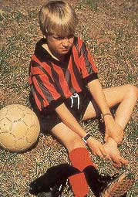
Sever's Disease (Calcaneal Apophysitis)

Slide 32
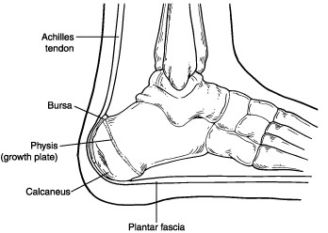
Sever’s Disease
Overuse injury of posterior calcaneous
Common cause of heel pain in young adolescents
Typically in 8-12 years old males (M:F=3:1)
Common in gymnasts, basketball players, soccer players
Risk factors:
Repetitive jumping and landing from height
Decreased flexibility of Achilles tendon and gastrocnemius
Affected Area

Slide 33
Sever’s Disease
History
Presents as gradual heel pain
Worse with running (especially decelaration)
Does not affect gait or regular activities
Bilateral in 61% of cases
Physical Exam
Pain reproduced by palpation of posterior calcaneous
Decreased flexibility of gastrocnemius and soleus

Slide 34
Management of Sever’s Disease
Ice and NSAIDS acutely for pain control
Relative rest
Heel pad inside shoes
Stretching exercises for gastrocnemius/soleus
Strengthen dorsiflexing muscles
Usually resolves in 6-8 weeks

Slide 35
Which of the following signs or symptoms is NOT consistent with patellofemoral pain syndrome?
Effusion surrounding the patella
Pain with squatting
Decreased flexibility of quadriceps
Popping noise with walking
Pain onset following recent increase in exercise level

Slide 36
Which of the following signs or symptoms is NOT consistent with patellofemoral pain syndrome?
Effusion surrounding the patella
Pain with squatting
Decreased flexibility of quadriceps
Popping noise with walking
Pain onset following recent increase in exercise level

Slide 37
Answer: A. Effusion surrounding the patella indicates internal injury (ligamentous or meniscal) and is not consistent with patellofemoral pain syndrome.

Slide 38
A 16 year old runner presents to your office complaining of an achy pain in her right knee. It started a few days ago after she had increased her mileage and added hills to her running routine. Her physical exam is remarkable for tight quadriceps and pain when the patella is pushed posteriorly. You diagnose her with patellofemoral pain syndrome. How should you manage this patient?
Recommend that she stop exercising until she is pain-free
Apply heat to the area for 20 minutes twice daily
Begin physical therapy once the pain has improved to increase flexibility and strength
Recommend that she use crutches until the pain has resolved
Both A and C

Slide 39
A 16 year old runner presents to your office complaining of an achy pain in her right knee. It started a few days ago after she had increased her mileage and added hills to her running routine. Her physical exam is remarkable for tight quadriceps and pain when the patella is pushed posteriorly. You diagnose her with patellofemoral pain syndrome. How should you manage this patient?
Recommend that she stop exercising until she is pain-free
Apply heat to the area for 20 minutes twice daily
Begin physical therapy once the pain has improved to increase flexibility and strength
Recommend that she use crutches until the pain has resolved
Both A and C

Slide 40
Answer: C. Patients with patellofemoral pain syndrome should be instructed to decrease their exercising to a level that isn’t painful and consider changing to a nonimpact workout (i.e., swimming or biking) rather than stopping exercising completely. NSAIDs and ice may be beneficial in the acute setting but heat should not be used. The mainstay of treatment is a physical therapy regimen which should focus on improving the flexibility and strength of the lower extremity, hip abductor, and core muscles.

Slide 41
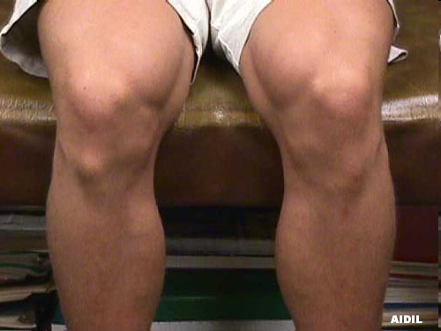
A 12 year old male basketball player presents to your office complaining of right knee pain which has gradually been getting worse. It gets worse with jumping and running and improves with rest. Findings on physical exam are shown in the picture. What is this patient’s diagnosis?
Patellofemoral pain syndrome
Patellar dislocation
Osgood-Schlatter Disease
Stress fracture of proximal tibia

Slide 42
A 12 year old male basketball player presents to your office complaining of right knee pain which has gradually been getting worse. It gets worse with jumping and running and improves with rest. Findings on physical exam are shown in the picture. What is this patient’s diagnosis?
Patellofemoral pain syndrome
Patellar dislocation
Osgood-Schlatter Disease
Stress fracture of proximal tibia

Slide 43
Answer: C. This patient has a prominence over his tibial tuberosity which is consistent with Osgood-Schlatter disease, traction apophysitis where the patellar tendon inserts on the tibial tuberosity. Patients with patellofemoral pain syndrome tend to have no abnormality on inspection. Those with a patellar dislocation usually have an effusion and a gross deformity and present with acute pain. Patients with a stress fracture may have an effusion.

Slide 44
An 11 year old male presents to your office complaining of left knee pain. The pain has been getting worse over the past few months since he has been playing soccer and gets better with rest. You suspect that he may have Osgood-Schlatter Disease. The most appropriate next step is to:
Obtain an x-ray of the knee with contralateral side for comparison
Discontinue all sports until the pain resolves
Refer him to an orthopedist
Continue to participate in sports even if it is slightly painful

Slide 45
An 11 year old male presents to your office complaining of left knee pain. The pain has been getting worse over the past few months since he has been playing soccer and gets better with rest. You suspect that he may have Osgood-Schlatter Disease. The most appropriate next step is to:
Obtain an x-ray of the knee with contralateral side for comparison
Discontinue all sports until the pain resolves
Refer him to an orthopedist
Continue to participate in sports even if it is slightly painful

Slide 46
Answer: D. Osgood-Schlatter is a clinical diagnosis that is based on history and physical exam. X-rays are not needed unless the patient has an atypical complaint (acute pain, pain waking them up, pain unrelated to activity). This is one of the rare times that participating in sports despite pain (as long as the pain is tolerable) is encouraged in order to avoid deconditioning. Referral to orthopedics is rarely necessary in Osgood-Schlatter unless the pain persists despite physical therapy and after closure of growth plates.

Slide 47
Which of the following patients does NOT require an x-ray?
12 year old male with some pain in the left malleolus, no tenderness on exam, and able to walk with a limp.
An intoxicated 18 year old male with pain in his right ankle, difficult to assess for tenderness on exam, and able to walk without limping.
11 year old female with pain in the left lateral malleolus and tenderness over the distal fibula but able to walk with a limp.
19 year old female complaining of pain in the right midfoot area with no tenderness on exam but unable to walk.

Slide 48
Which of the following patients does NOT require an x-ray?
12 year old male with some pain in the left malleolus, no tenderness on exam, and able to walk with a limp.
An intoxicated 18 year old male with pain in his right ankle, difficult to assess for tenderness on exam, and able to walk without limping.
11 year old female with pain in the left lateral malleolus and tenderness over the distal fibula but able to walk with a limp.
19 year old female complaining of pain in the right midfoot area with no tenderness on exam but unable to walk.

Slide 49
Answer: A. The Ottawa rules recommend that a patient with pain in either malleolus or midfoot should get an x-ray if they also have either tenderness in the tip of the malleolus or distal tibia or fibula on exam OR inability to bear weight immediately after injury and for at least 4 steps on exam (limping is permitted). The rules may be less reliable in skeletally immature patients as they are at risk for Salter-Harris fractures. The patient in answer A does not qualify for an x-ray. If pain persists for more than a few weeks, he may need an x-ray in the future but will probably not benefit from one now. The intoxicated patient should receive an x-ray since the rules may not be valid in intoxicated patients.

Slide 50
A 12 year old male soccer player is complaining of heel pain for the past 1 ½ months. Pain is worse after playing soccer and his mother has noticed him limping a little bit after games. He has no nighttime symptoms and no pain or limping with regular activities. What is the most likely diagnosis?
High ankle sprain
Bone tumor
Sever’s Disease
Osgood Schlatter Disease

Slide 51
A 12 year old male soccer player is complaining of heel pain for the past 1 ½ months. Pain is worse after playing soccer and his mother has noticed him limping a little bit after games. He has no nighttime symptoms and no pain or limping with regular activities. What is the most likely diagnosis?
High ankle sprain
Bone tumor
Sever’s Disease
Osgood Schlatter Disease

Slide 52
Answer: C. Subacute pain localized to the heel which worsens with running in a young athlete is consistent with Sever’s Disease (calcaneal apophysitis). High ankle sprains tend to produce acute pain in the distal tibia/fibula region or the posterior ankle which worsens with weight bearing. Bone tumor may cause pain in the heel but may cause nighttime wakening with pain, fever, and night sweats. Osgood Schlatter Disease is a traction apophysitis which produces pain at the site of the patellar tendon insertion on the tibial tuberosity.

Slide 53
Which of the following statements is true regarding ankle sprains?
Medial ankle sprains are the most common type.
A thorough ankle examination on a patient with ankle pain should include palpation of tip of malleolus, base of 5th metatarsal, and navicular bone.
Patients recovering from an ankle sprain should wait at least 6 months after the injury to start physical therapy.
A patient with an ankle sprain will have decreased displacement on anterior drawer test on the affected side compared to the unaffected side.

Slide 54
Which of the following statements is true regarding ankle sprains?
Medial ankle sprains are the most common type.
A thorough ankle examination on a patient with ankle pain should include palpation of tip of malleolus, base of 5th metatarsal, and navicular bone.
Patients recovering from an ankle sprain should wait at least 6 months after the injury to start physical therapy.
A patient with an ankle sprain will have decreased displacement on anterior drawer test on the affected side compared to the unaffected side.

Slide 55
Answer: B. A thorough ankle examination should be performed on all patients with ankle pain. This should include palpation of the malleoli, base of the 5th metatarsal, and navicular bone as well as the tibia, fibula, and ankle ligaments. Lateral ankle sprains are the most common type of sprain; the anterior talofibular ligament is the weakest ligament. Medial sprains are significantly less common since the deltoid ligaments are the strongest ankle ligaments. On exam, patients with an ankle sprain usually have increased laxity and displacement on the affected side on anterior drawer test compared to the unaffected side. Patients recovering from an ankle sprain should begin PT as soon as the edema begins to subside.

Slide 56
Recommended Reading
Patel DR, Nelson TL. Sports Injuries in Adolescents. Med Clin North Am 2000 Jul;84(4):983-1007.
Chorley J, Powers CR. Clinical Features and Management of Heel Pain in the Young Athlete. UpToDate Online. Updated September 14, 2006.

