Slide 1
Neonatal Circumcision
Indications
The Procedure
Recommendations
Complications
Rachel Boykan, MD 2012

Slide 2
AAP Policy Statement (2012)
Preventive health benefits of elective circumcision of male newborns outweigh the risks of the procedure
Although health benefits are not great enough to recommend routine circumcision for all male newborns, the benefits are sufficient to justify access to this procedure to warrant third-party payment for circumcision of male newborns.
Clinicians should routinely inform parents of the health benefits and risks of male newborn circumcision in an unbiased and accurate manner.

Slide 3
AAP Policy Statement (2012)
Parents ultimately should make the decision whether to or not to circumcise their child.
Analgesia is safe and effective in reducing the procedural pain associated with circumcision and should be provided.
If circumcision is performed in the newborn period, it should only be done on infants who are stable and healthy.

Slide 4
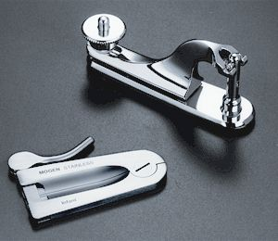
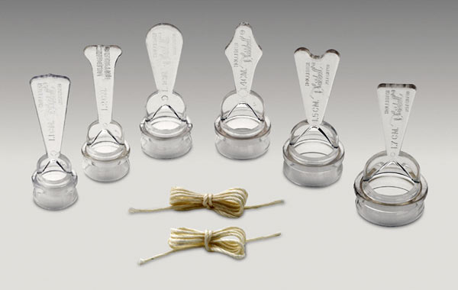
Circumcision: Methods
Three common methods of circumcision
Gomco clamp
Mogen clamp
Plastibel

Slide 5
Analgesia
There is considerable evidence that newborns who are circumcised without analgesia experience pain and physiologic stress.
Types of Analgelsia
EMLA
Sucrose
Dorsal Penile Nerve Block
Ring Block
Efficacy: Evidence that DPNB is superior to lidocaine-prilocaine in relieving pain during and after circumcision in newborns
Complications of DPNB
Bruising is the most frequent complication
Hematomas were rarely seen and caused no long-term injury

Slide 6
Benefits
Circumcision protects against urinary tract infection in the first year of life
Anywhere from a 3 to 10-fold reduction in the risk
Decreased risk of HIV and other STI later on in life for those who are circumcised
Decreased risk of penile cancer

Slide 7
Contraindications- Anatomic
Hypospadias (opening on ventral side; may look partially circumcised)
Chordee (ventral curvature of shaft)
Penile Torsion (< 60 degrees is considered normal variant)
Webbed Penis (very little skin surface between the tip of the foreskin and the scrotum)
Buried Penis
Urethral Hypoplasia
Epispadias
Ambiguous Genitalia (including bilateral cryptorchidism or micropenis)
For photos, and further reference:
http://newborns.stanford.edu/Circumcision.html

Slide 8
Contraindications - Medical
Any current illness or medical condition that requires monitoring
Age less than 12 - 24 hours
Known bleeding diathasis (e.g. hemophilia or thrombocytopenia)
Disorders of the skin or connective tissue that would impair normal healing
significantly premature infants
Infants with blood dyscrasias
Family history of bleeding disorders
AAP 2012 Circumcision Policy Statement
http://newborns.stanford.edu/Circumcision.html

Slide 9
Circumcision – Basic Steps
Basic steps of the procedure will vary, depending upon the technique used
General steps include:
Obtain informed consent
Ensure that Vitamin K was given
Provide analgesia
Clean area in sterile fashion and drape
The foreskin is separated from the glans, removing adhesions
If using the Gomco or Plastibel, a slit is made on the dorsal side of the foreskin, the appropriately-sized bell is placed over the glans, and the foreskin is removed, using the bell as a guide.
If the Mogen is used, the clamp is placed distal to the glans (taking care not to trap the glans in the clamp) and foreskin is removed along the line of the clamp.
With the exception of the Plastibel (which remains in place until it falls off), the apparatus is removed and any remaining adhesions are lysed gently, ensuring that the rim of the glans is fully visible.
Vitamin A&D ointment and gauze are placed over the glans

Slide 10
Complications
Acute complications are rare, occurring in approximately 1 in 500 newborn male circumcisions
Most complications that do occur are minor, and most commonly involved bleeding, infection or an imperfect amount of tissue removed
Second most common complication is infection; in these case they are usually minor with only some local redness or purulence
Late complications do occur, most commonly adhesions, skin
bridges, and meatal stenosis
AAP Policy Statement, 2012

Slide 11
Circumcision: Questions
You are discussing circumcision with a new mother, who is considering having her baby circumcised. A true statement regarding circumcision is:
The benefits of circumcision include improved hygiene and a decreased risk of urinary tract infection until two years of age
The most common risk of circumcision is infection
The benefits of circumcision include a decreased risk of urinary tract infection up to one year of age
AAP guidelines recommend circumcision as the benefits outweigh the risks.

Slide 12
Circumcision: Questions
Contraindications to circumcision include:
Chordee
Buried Penis
Hydrocele
A & B

Slide 13
Circumcision: Questions
You are preparing to circumcise a newborn baby. You have obtained consent and have performed your “time out,” identifying the patient and procedure per protocol. In identifying the patient you realize the baby is only 10 hours old and has not yet voided. The most appropriate next step is:
Notify the mother that you must wait for the baby to void and to be 12 hours old
Notify the mother that she should give formula to encourage the baby to void
Circumcise the baby, as he appears well and is prepped for the procedure
None of the above

Slide 14
References
http://pediatrics.aappublications.org/content/130/3/e756.full.pdf+html?sid=da52aec0-fef5-4229-a48c-5d9be9e24103
http://newborns.stanford.edu/Circumcision.html

