Slide 1
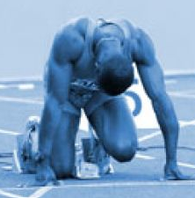
The Preparticipation Sports Physical in Adolescents
Allison Eliscu, MD, FAAP
Rev. Aug 2012

Slide 2
Goals of Preparticipation Physical
Identify abnormalities which could lead to sudden death
Detect musculoskeletal injuries which could be reinjured
Promote health and safety in athletes
Entry point for healthy adolescents into routine care
Sports physical is most common reason for healthy adolescents to see a physician
Notes:
In a study of over 2700 high school athletes, only 1.9% were disqualified from participating in sports and an additional 12% required follow-up for a prior injury, nutritional counseling, physical therapy, or undiagnosed HTN. So the goal of the preparticipation physical for the majority of young athletes is to discuss healthy training and to use the opportunity to engage them in care, establish a rapport with the patient, and screen for risky behaviors (ie, HEADDS exam).
Smith J. and Laskowski JS. The Preparticipation Physical Examination: Mayo Clinic experience with 2,739 examinations. Mayo Clin Proc. 1998;73:491-429.

Slide 3
Sudden Death in Adolescent Athletes
Very rare (5-15 athletes/1 million participants)
More common in males (9:1) and African Americans
Usually cardiac-related
Only 2% have normal cardiac structure on autopsy
Usually (>80%) asymptomatic until death
Notes:
Need to screen 200,000 children and adolescents to detect 1,000 athletes who are at risk for sudden death and 1 would actually die.
Lyznicki JM, Nielsen NH, Schneider JF. Cardiovascular Screening of Student Athletes. Am Fam Physician. 2000;62(4):765-74.

Slide 4
Cardiac Causes of Sudden Death in Athletes
Hypertrophic cardiomyopathy (HCM)
Present in 1/500 individuals
Most common cause of sudden death (>33% of cases)
Usually asymptomatic with abnormal EKG
Coronary artery anomaly
History of exertional chest pain or syncope
Myocarditis
Valvular Disease
Arrhythmia (Prolonged QT syndrome, WPW)
Notes:
Only 11% of athletes with a cardiomyopathy survived a cardiac arrest on the field despite witnessed collapse, timely initiation of CPR, and prompt defibrillation. So having a defibrillator at the field does not override the recommendations for an athlete with a cardiomyopathy to be disqualified from play.
Drezner JA, Rogers KJ. Sudden Cardiac Arrest in Intercollegiate Athletes: Detailed analysis and outcomes of resuscitation in nine cases. Heart Rhythm. 2006 Jul;3(7):755-9.

Slide 5
Screening by Hx for Cardiac Disease
History of chest pain or discomfort on exertion
Unexplained syncope or near syncope (esp. on exerti0n)
Excessive dyspnea or fatigue with exercise
Prior heart murmur
Increased blood pressure
Premature death (<50 yo) in 1 relative due to heart condition
Premature (<50 yo) disability in close relative due to cardiac condition
Family hx of HCM, DCM, long QT Sx, Marfan’s Sx, arrythmia, etc.
Notes:
75% of significant findings on the preparticipant physical are uncovered by taking a thorough history. Histories for middle school and high school athletes should be confirmed by a parent.

Slide 6
Screening by PE for Cardiac Disease
Heart murmur (listen in supine, standing, and Valsalva)
HCM murmur exacerbated w/ standing or Valsalva
Femoral pulses (r/o coarctation of aorta)
Physical stigmata of Marfan’s Sx
Long arm span, arachnodactyly, pectus, scoliosis
Blood pressure (while sitting, in both arms)

Slide 7
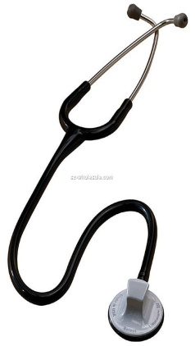
Patients with 1 or more positive finding on the prior 12 items should be referred to a pediatric cardiologist for evaluation with EKG and Echocardiogram

Slide 8
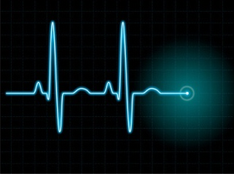
To EKG or Not To EKG…
Routine EKG for all athletes is a controversial issue
Required for all athletes in Italy
>90% of patients with HCM have abnormal EKG
But…EKG has low specificity
Frequent EKG changes in normal athlete may be difficult to distinguish from abnormal
Many false positives -> excessive referrals to specialists
False negatives -> coronary anomalies and arrhythmias may be intermittent
Not cost effective
** Not Currently Recommended in the United States **

Slide 9
Other Screening Issues
Wheezing with exertion (c/w exercise-induced asthma)
Recent mono infection
Spleen size peaks within ~3-4 wks of symptom onset
No contact sports for at least 1 month after infection
Menstrual history – screen for female athlete triad
Steroid use
4% of high school students have used steroids at least once*
* Centers for Disease Control and Prevention. Youth Risk Behavior Surveillance – United States, 2011.

Slide 10
Other Screening Issues
Single kidney – Contraindication for contact sports
Single testicle – Requires protective cup
Recent concussion
Should be asymptomatic for 1-2 weeks before returning to play
Gradual return to play
Progress from light exercise to more intense drills to practice to games
Must remain asymptomatic at each phase
Consider referral to neurologist and neuropsychological testing for those with multiple concussions
Recent sports injuries or pain with exercise

Slide 11
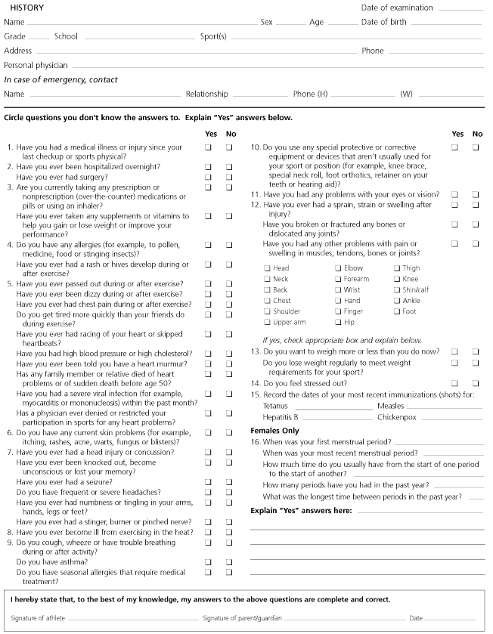
Notes:
The patient or parent should complete their section first and it should be reviewed by the physician before signing off on the physical

Slide 12
Which of the following statements about sudden cardiac death in adolescent athletes is FALSE?
The most common cause of sudden death among adolescent athletes is hypertrophic cardiomyopathy
The majority of sudden cardiac death events occurs in athletes with no prior history of symptoms and no significant family history
The murmur of hypertrophic cardiomyopathy is exacerbated with standing
An athlete with hypertrophic cardiomyopathy may participate in contact sports if an automated external defibrillator (AED) is present at all competitions
The vast majority of adolescents with hypertrophic cardiomyopathy have an abnormal EKG

Slide 13
Which of the following statements about sudden cardiac death in adolescent athletes is FALSE?
The most common cause of sudden death among adolescent athletes is hypertrophic cardiomyopathy
The majority of sudden cardiac death events occurs in athletes with no prior history of symptoms and no significant family history
The murmur of hypertrophic cardiomyopathy is exacerbated with standing
An athlete with hypertrophic cardiomyopathy may participate in contact sports if an automated external defibrillator (AED) is present at all competitions
The vast majority of adolescents with hypertrophic cardiomyopathy have an abnormal EKG

Slide 14
Answer: D. Studies suggest that athletes with structural heart disease may not respond to defibrillation as well as other patients with sudden cardiac arrest. One study analyzed 9 cases of sudden cardiac arrest among intercollegiate athletes and found that despite having a witnessed collapse, rapid initiation of CPR, and prompt defibrillation, only 1 athlete (11%) survived the arrest. So having a defibrillator at the field does not override the recommendations for an athlete with a cardiomyopathy to be disqualified from play. (Drezner JA, Rogers KJ. Sudden Cardiac Arrest in Intercollegiate Athletes: Detailed analysis and outcomes of resuscitation in nine cases. Heart Rhythm. 2006 Jul;3(7):755-9.)
At least 1/3 of sudden cardiac death among young athletes is due to hypertrophic cardiomyopathy (HCM) and almost all of the patients have no prior history of symptoms or remarkable family history. The murmur in HCM decreases with squatting because of an increased left ventricular volume which increases the size of the outflow tract; and increases with standing due to a decrease in left ventricular outflow tract size. Finally, >90% of adolescents with HCM have an abnormal EKG. However, normal athletes may have EKG changes which may be difficult to differentiate from abnormal and EKGs have a low specificity with frequent false positives (leading to patient/parental anxiety and unnecessary specialist referrals) and false negatives (long QT syndrome, coronary anomalies, and transient arrhythmias may be normal). (Beckerman, et al. Clin J Sport Med. 2004; 14(3):127-33.)

Slide 15
All of the following should be included in a preparticipation sports physical for an otherwise healthy young athlete EXCEPT:
Screen for history of chest pain or dizziness with exertion
Listen for heart murmur in supine position and either standing position or with valsalva maneuver
EKG
Screen for family history of sudden death
All of the above should be part of a routine preparticipation sports physical

Slide 16
All of the following should be included in a preparticipation sports physical for an otherwise healthy young athlete EXCEPT:
Screen for history of chest pain or dizziness with exertion
Listen for heart murmur in supine position and either standing position or with valsalva maneuver
EKG
Screen for family history of sudden death
All of the above should be part of a routine preparticipation sports physical

Slide 17
Answer: C. The goals of a preparticipation physical for an otherwise healthy young athlete include identifying abnormalities which could lead to sudden death, detecting musculoskeletal injuries which may be reinjured, and promote health and safety in athletes. The history should include a past history of exertional chest pain, unexplained syncope or near syncope, excessive dyspnea or fatigue with exercise, history of prior heart murmur, and history of elevated blood pressure. Family history should include premature death or disability in a family member less than 50 years of age due to heart disease or family history of hypertrophic cardiomyopathy, dilated cardiomyopathy, long QT syndrome, or Marfan’s Disease. Physical exam should include listening for a murmur in different positions, palpating femoral pulses to rule-out aortic coarctation, look for symptoms of Marfan’s disease, and check the blood pressure in a seated position. In the U.S., an EKG is not part of the routine preparticipation physical and should only be included if indicated by the screening questions and exam described above.

Slide 18
All of the following conditions would disqualify a young athlete from participating in contact sports EXCEPT:
Recent concussion with persistent headache
Diagnosed with infectious mononucleosis1 week ago in a patient who is feeling well
Had scoliosis repair 2 months ago
Tobacco smoker with intermittent productive cough
None of the athletes would be disqualified
All of the athletes would be disqualified

Slide 19
All of the following conditions would disqualify a young athlete from participating in contact sports EXCEPT:
Recent concussion with persistent headache
Diagnosed with infectious mononucleosis1 week ago in a patient who is feeling well
Had scoliosis repair 2 months ago
Tobacco smoker with intermittent productive cough
None of the athletes would be disqualified
All of the athletes would be disqualified

Slide 20
Answer: D. Patients recovering from a recent concussion must be symptom free before returning to play. The recommended time before returning to play depends on the severity of symptoms and whether there was a loss of consciousness at the time of injury. When the patient is symptom free at rest, they can then begin low-impact, noncontact exercise and must remain asymptomatic before returning to full participation. Athletes with a recent diagnosis of infectious mononucleosis should be advised to delay participating in contact sports for at about 3-4 weeks after symptom onset to prevent possible splenic rupture. >50% of patients with mononucleosis develop an enlarged spleen, most commonly 2-21 days from onset of symptoms. It remains controversial whether to perform an abdominal ultrasound on recovering patients prior to resuming full sports participation. Patients recovering from a recent scoliosis repair should wait 9-12 months after surgery before returning to sports to allow complete spinal fusion without trauma. After 9-12 months, patients are permitted to participate in all sports with the possible exception of collision sports (such as football). Although young athletes who smoke tobacco may develop a productive cough or shortness of breath, they do not need to be disqualified from participating in contact sports. Counseling for these patients should include the benefits of quitting smoking (including improvement in stamina) and smoking cessation tips.

Slide 21
Recommended Reading
Maron BJ. Sudden Death in Young Athletes. NEJM. 2003;349:1064-75.
Metzel JD. Preparticipation Examination of the Adolescent Athlete: Part 1. Peds in Review. 2001;22:199-203.
Metzel JD. Preparticipation Examination of the Adolescent Athlete: Part 2. Peds in Review. 2001;22:227-239.
Giese EA, O’Connor FG, Brennan FH, Depenbrock PJ, Oriscello RG. The Athletic Preparticipation Evaluation: cardiovascular assessment. Am Fam Physician. 2007;75(7):1008-14.
Beckerman J, Wang P, Hlatky M. Cardiovascular Screening of Athletes. Clin J Sport Med. 2004;14(3):127-33.
Myers A, Sickles T. Preparticipation Sports Examination. Prim Care. 1998;25(1):225-36.

