Slide 1
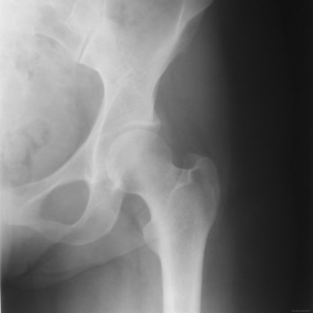
Slipped Capital Femoral Epiphysis (SCFE)
Allison Eliscu, MD, FAAP
Rev. Aug 2012

Slide 2
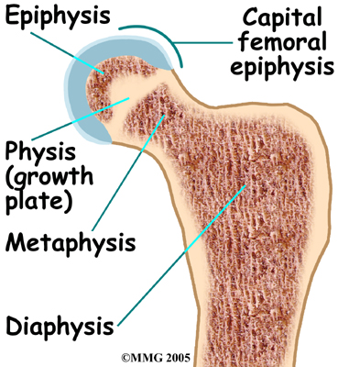
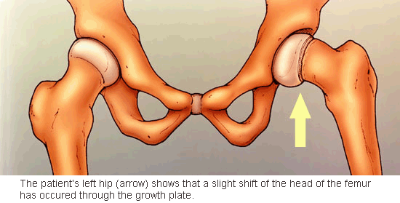
What is SCFE?
Salter Harris I fracture through proximal femoral epiphysis
Displacement of femur distal to physis anterolaterally and superiorly
SCFE is a misnomer because epiphysis actually remains in place in acetabulum
Metaphysis and diaphysis actually slip upwards and fwds
Epiphysis remains in place in acetabulum
Physeal fracture with slippage of femoral neck
Normal Bone Anatomy

Slide 3
Details About SCFE
Occurs during period of rapid growth
Usually before Tanner 4
Mean age: 12 yo in females, 13-15 yo in males
Males slightly more common than females
Risk factors which weaken physeal plate:
Obesity (>60% of affected patients are obese)
Trauma
Genetic predisposition (ex: Down Syndrome)
Endocrinopathy (ex: hypothyroidism, GH deficiency)
Renal failure
Radiation therapy
Causes of Atypical SCFE

Slide 4
Atypical SCFE
Suspect in patients with atypical presentation
< 10 years old
> 16 years old
Weight < 50%
Consider endocrine work-up for all patients with atypical presentation (at least TSH, free T4)
Almost 100% of patients with atypical SCFE have bilateral slips
If patient presents with unilateral slip, prophylactic pinning of contralateral side recommended

Slide 5
Presentation of SCFE
Dull aching pain in hip, groin, thigh, or knee
15% of patients c/o isolated thigh or knee pain
<50% of patients c/o isolated hip pain
Most commonly subacute onset(>3 weeks of symptoms)
Usually no history of trauma
Pain worse with activity
Pain relieved by rest
Altered gait or limping
20-40% cases are bilateral

Slide 6
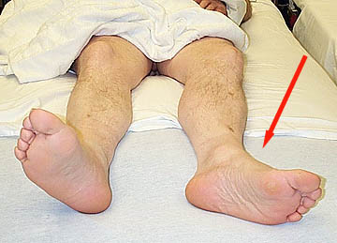
SCFE on Physical Examination
Affected leg held in external rotation
Leg may be shorter than unaffected side
Tenderness at anterior hip
Normal knee exam (even if presenting sign is knee pain)
Decreased range of motion at hip
Abduction, internal rotation, and flexion
With passive hip flexion patient will
abduct and externally rotate thigh
Abnormal gait to minimize
weight bearing
Leg externally rotated at rest

Slide 7
SCFE on X-ray
AP and lateral of hip for all patients with suspected SCFE
Bilateral images for comparison
Looks like ice cream falling off cone
Kleins Line – line along superior margin of femoral neck towards hip joint on A/P view
Line outside of epiphysis consistent with SCFE
Blurring junction between metaphysis and plate
May be widening or irregularity of physis

Slide 8
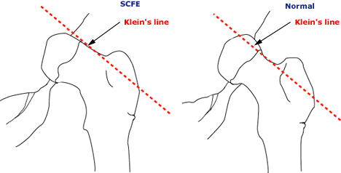
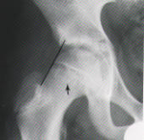
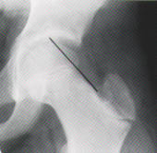
Kleins Line in SCFE
SCFE
Normal

Slide 9
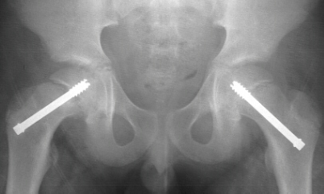
Management of SCFE
Goals of management:
Stabilize the joint to prevent further slippage
Avoid complications
Urgent referral to orthopedist
Nonweight bearing until surgical repair
Consider admission for acute slip or bilateral SCFE
Surgical treatment with screw placement required

Slide 10
Complications of SCFE
30-60% patients with unilateral SCFE will develop bilateral slippage (usually within next 18 mos)
Bilateral repair for unilateral slip is controversial
Osteonecrosis of femoral head
Premature osteoarthritis

Slide 11
A 12 year old male presents to the office complaining of dull right knee and thigh pain for the past 2 weeks. The pain gets worse when he tries to chase after his younger brother and improves after resting for awhile. He denies recent trauma and does not participate in sports. On exam, you notice that his BMI is >97% for age and that he is holding his right leg in external rotation when resting in the supine position. His knee and thigh exam are normal. He is walking with a limp, favoring the left side. What is the most likely diagnosis?
Osgood-Schlatter Disease
Patellofemoral pain syndrome
Femoral anteversion
Slipped capital femoral epiphysis

Slide 12
A 12 year old male presents to the office complaining of dull right knee and thigh pain for the past 2 weeks. The pain gets worse when he tries to chase after his younger brother and improves after resting for awhile. He denies recent trauma and does not participate in sports. On exam, you notice that his BMI is >97% for age and that he is holding his right leg in external rotation when resting in the supine position. His knee and thigh exam are normal. He is walking with a limp, favoring the left side. What is the most likely diagnosis?
Osgood-Schlatter Disease
Patellofemoral pain syndrome
Femoral anteversion
Slipped capital femoral epiphysis

Slide 13
Answer: D. Slipped capital femoral epiphysis (SCFE) tends to present in young, obese males before Tanner 4 . SCFE usually presents as a subacute, dull, aching pain in the hip, knee, or thigh which gets worse with activity and improves with rest. At least 15% of affected males do not have hip pain at all. Affected patients tend to walk with a limp and hold their leg in external rotation when lying supine. Patients with Osgood Schlatter Disease complain of pain at the tibial tuberosity and have a prominence over that area on exam. Patients with patellofemoral pain syndrome usually complain of an achy pain behind or around the patella with stiffness during periods of prolonged rest, occasional “popping” sensation, and pain with squatting or going up steps. This entity tends to occur in athletes who have recently increased their exercise level. Femoral anteversion is a twist in the femur between the hip and the knee. Patients with this condition tend to sit in the “W” position.

Slide 14
A 17 year old female presents to the office complaining of dull hip pain for the past 3 weeks. The pain worsens with activity and improves with rest. On exam, she holds her leg externally rotated and has decreased range of motion in abduction and internal rotation at the affected hip. The rest of her physical examination is normal with a BMI at 25% for age. A hip x-ray confirms your suspicion of slipped capital femoral epiphysis. Based on the patient’s presentation, which of the following laboratory tests should you consider doing?
TSH and free T4
CBC
Testosterone level
Chlamydia test
All of the above

Slide 15
A 17 year old female presents to the office complaining of dull hip pain for the past 3 weeks. The pain worsens with activity and improves with rest. On exam, she holds her leg externally rotated and has decreased range of motion in abduction and internal rotation at the affected hip. The rest of her physical examination is normal with a BMI at 25% for age. A hip x-ray confirms your suspicion of slipped capital femoral epiphysis. Based on the patient’s presentation, which of the following laboratory tests should you consider doing?
TSH and free T4
CBC
Testosterone level
Chlamydia test
All of the above

Slide 16
Answer: A. This patient is presenting with atypical slipped capital femoral epiphysis (SCFE). This is classified as atypical because she is over 16 years old and is not overweight. Patients with atypical presentations should be screened for hypothyroidism and renal failure. Other etiologies of atypical SCFE include genetic abnormality such as Down Syndrome and prior radiation therapy to the hip area.

Slide 17
Recommended Reading
Kienstra AJ, Macias CG. Slipped Capital Femoral Epiphysis. UpToDate Online. Updated May 26, 2009.
Scherl SA. Common Lower Extremity Problems in Children. Pediatr Rev. 2004 Feb;25(2):52-62.

