Slide 1
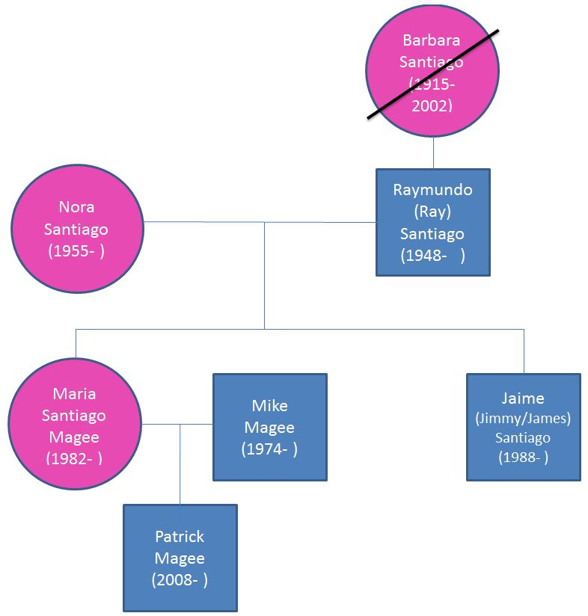
Meet the Santiago – Magee Family Stephen Post, PhD; Lisa Strano-Paul, MD; Lory Bright-Long, MD; Janet Fischel, PhD; Vrajesh Patel, MD

Slide 2
Family Member Name (age in yrs) | Medical Conditions | Psychosocial Issues/ HOT TOPICS | Comments
Raymundo (Ray) Santiago (66) [Barbara, his mother, deceased age 87 after protracted AD) | Alzheimer disease | End of life care; ethical decision making; law and medicine; medical genetics; nutrition; medical genetics | Genetics of disease, caregiving, progression through stages
Nora Santiago (59) | Depression Obesity Hypertension Diabetes | Stress and depression in relation to certain relocations; complementary and alternative medicine; | Disease based and the alternative/complementary medicine angle
Maria Santiago Magee (32) | Gestational diabetes mellitus Overweight (BMI 29) Pre-diabetic | Disease prevention; women’s health; Nutrition; Community resources | Attends Overeaters Anonymous (OA), a 12-step program; son Patrick (6) has an autism spectrum disorder
Mike Magee (40) | COPD PTSD Tobacco Addiction | Occupational health; health care financing; health surveillance strategies; health policy | A first responder fireman at 9/11, Mike is anxious about his susceptibility to cancer
Patrick Magee (6), son of Maria and Mike Magee | Autism spectrum disorder, Level 2 severity | Behavioral sciences; epidemiology; chronic care; communication skills; diagnosis of disorder; care and healthcare of the disabled; role of social service agencies; healthcare financing | Patrick receives ABA support at home and enjoys stays at the St. Charles Maryhaven Community for Children with Autism
Jaime (Jimmy/James) Santiago (26), son of Raymundo and Nora Santiago | Substance abuse/alcoholism PTSD Abnormalities of mood | Drug and alcohol abuse; community health; Professionalism; VA resources | James is a recovering alcoholic with PTSD who is treated at Northport VA and attends AA meetings daily

Slide 3
Placement in Current Curriculum | content | Issues
Time 1 (infants and children) | Patrick (Autism) Introduce the Santiago Family here once again, regarding Patrick as a 6-year-old with ASD. | J. Fischel gave a 20-minute lecture on ASD this past year and will speak with Dr. Granek about next year. There was a panel of parents.
Medicine in Contemporary Society | Raymundo (Alzheimer’s Disease) – Session on AD including autonomy and consent/human subjects, as part of a set of ethical issues following the chronology of AD from diagnosis to death (SGP) Three 4-week selectives: (1) Clinical ethics of dementia & autism/ SGP & J Fichel (2) 9/11 responders/B Luft | Dr Post conducts lecture/discussion of human subjects research ethics and can integrate issues re consenting/conducting research re Raymundo, along with a broader overview of ethical issues as they arise over the course of the illness.

Slide 4
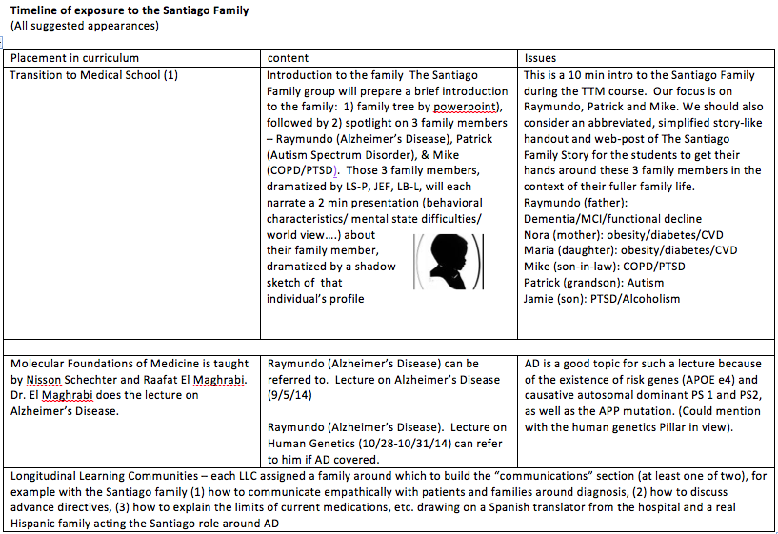

Slide 5
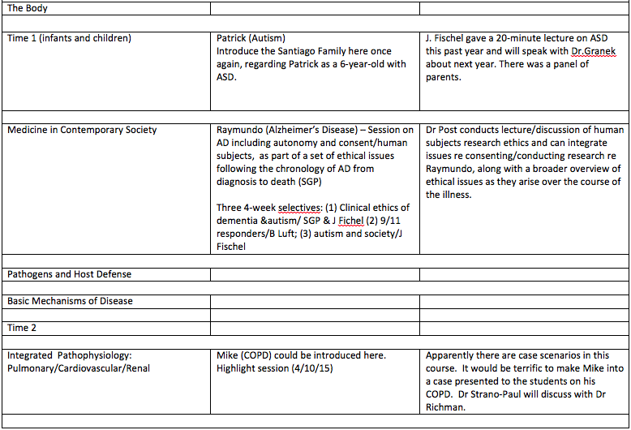

Slide 6
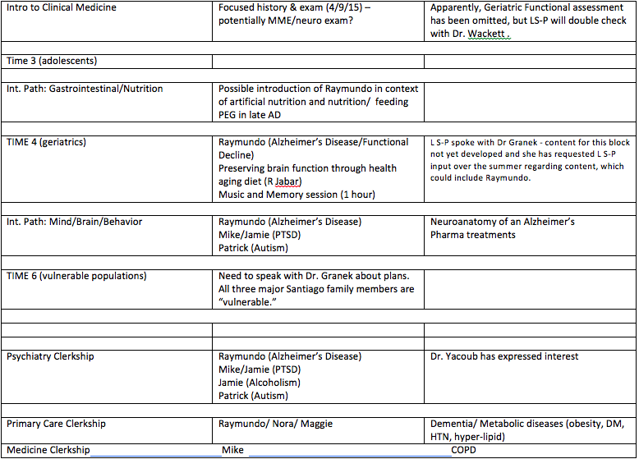

Slide 7
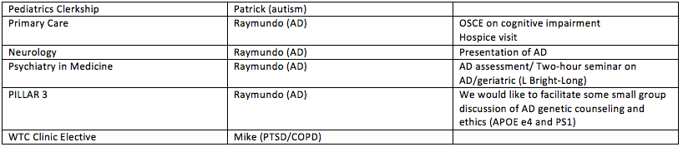

Slide 8
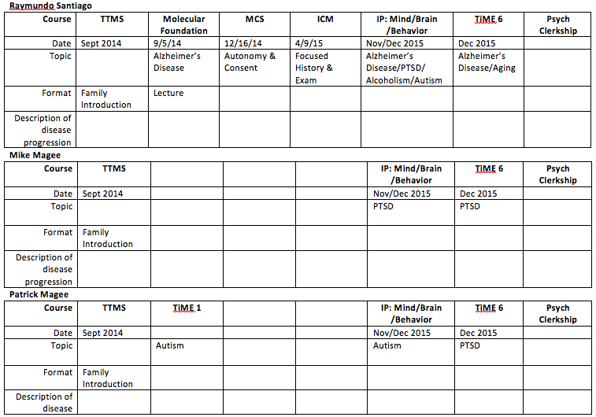

Slide 9
Development Over Time
For example, we can follow Raymundo from genetic risk and diagnosis through end of life. Topics might include: ethnic diversity and interpretations of dementia/self-identity, diagnostic testing including family history and genetics (risk and causative), breaking the news to patient and family, participation in research, restrictions on driving, pharmacology, music & memory, advance planning, behavioral issues in the moderate stage, decisions around life sustaining treatments including insulin, application of palliative care, use of feeding PEGs, hospice and end of life
Possible Yr. 4 Selective on the bio-psycho-social-ethical aspects of the Santiago Family

