Slide 1
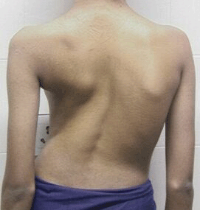
Scoliosis in the Adolescent
Allison Eliscu, MD, FAAP
Rev. Aug 2012

Slide 2
What is Adolescent Idiopathic Scoliosis?
Lateral curvature in spine >10° with rotational curvature
Categorized by:
Degree of curvature by Cobb angle
Location of curve: thoracic, lumbar, thoracolumbar
Direction of curve: right or left based on its convexity
Affects 2-4% of adolescents
<10% of affected patients will need management
Occurrence in males = females
Much more likely to progress in females
Notes:
Incidental finding of small curvature (Cobb angle <10°) on CXR is NOT scoliosis and does not require further X-rays.

Slide 3
Screening for Scoliosis
Annual screening is controversial
Does early detection change the progression? (Possibly)
Does untreated scoliosis cause morbidity? (Unlikely)
AAP recommends screening:
Females at 10 and 12 years old
Males at 13-14 years old
Annual school screening mandatory in some states
Not all patients detected by screening require X-ray
Notes:
Bright Futures recommends screening annually in all patients over 8 years old. The American Academy of Family Physicians does not recommend screening routinely. It isn’t clear if the benefits of routinely screening for scoliosis outweigh the risks. The main benefit is the idea that early detection of scoliosis should lead to bracing which may circumvent surgery. The reasons not to screen include: (1) Low prevalence of scoliosis actually requiring intervention, (2) Potential harm of false positive screen (missing school, getting X-rays), (3) Untreated scoliosis rarely causes significant morbidity or mortality, (4) The sensitivity and specificity of the Adams bending test is variable based on the screener, and (5) the benefit of early detection of scoliosis may not be significant.

Slide 4
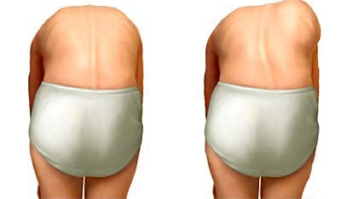
Signs of Scoliosis
Asymmetry of shoulders, hips, back creases or scapulae
Prominence on Adams Forward Bending Test
Standing with feet and knees together
Bend forward with palms facing each other
Examine from behind, sides, and front
Look for asymmetry, rib hump, or spine curve
Rib Hump
Adams Forward Bending Test
Normal Spine
Scoliosis Deformity

Slide 5
If Scoliosis is Detected, Also Screen For…
History
Physical Exam
Back pain or stiffness
Unusual in idiopathic scoliosis
History of diagnosis & progression
Muscle weakness
Bowel/bladder problems
Difficulty breathing
Growth trajectory
Age of menarche
Family history of scoliosis
Height
Skin lesions
Sacral dimple or tuft
Café-au-lait macules
Neurological deficits
Deep tendon reflexes
Sensory and motor exam
Gait
Tanner stage
Leg length
Notes:
It is unusual for idiopathic scoliosis to be painful. If pain is present, rule-out nonidiopathic (neuromuscular, oncologic, infectious) etiologies. Screen for neurological symptoms which are also uncommon in idiopathic scoliosis. If present, will likely need an MRI. Growth trajectory and menarche history are important to determine the possibility of progression of curvature. There is some genetic link for scoliosis with ~30% of scoliotic patients have a remarkable family history. This may be a marker for progression. Additionally, patients with 2 affected parents are 10x more likely to develop scoliosis. On exam, make sure there are no signs of neurological deficit or markers of NF.

Slide 6
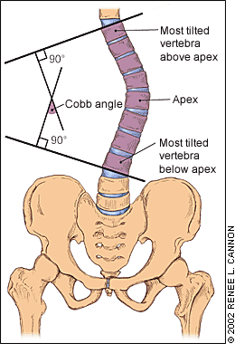
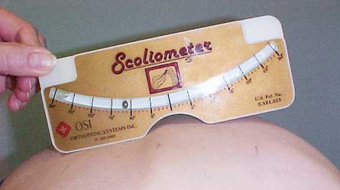
Measure the Degree of Curvature
Scoliometer
X-Ray
Similar to carpenter’s level
Run along patient’s spine
Ball deviates if rotation present
X-ray if ≥ 5-7° curvature
Gold standard to diagnose scoliosis
Standing PA and Lateral images
Measure Cobb Angle

Slide 7
Natural History of Scoliosis
Typically worsens 1° every month until skeletal maturity
Progression of scoliosis defined as ≥5° on Cobb Angle
Increased risk of progression:
Gender – Females more likely to progress than males
Severity of curve – Severe curves more likely to progress
Maturity – Immature and premenarchal patients more likely to progress

Slide 8
Initial Management of Scoliosis
Get X-Ray
Large asymmetry on exam
Observe with frequent exams and X-ray in 6-8 months
Scoliometer <5-7°
Cobb angle ≤20°
Refer to Orthopedist
Scoliometer >7° and can’t obtain Cobb angle
Cobb angle >20-30° (especially in skeletally immature)
Scoliometer >5-7°
Asymmetry in skeletally immature patient
Asymmetry in patient with family history of scoliosis
Progression of Cobb angle by ≥5°

Slide 9
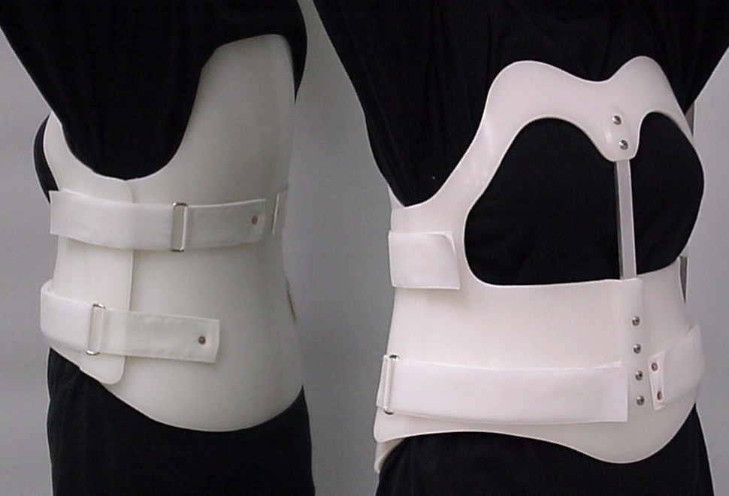
Treatment Options - Braces
Only indicated in skeletally immature patients
Goal to prevent progression of curvature
Does NOT improve curvature
Use if Cobb angle 25-40°
Improved results with increased use (~23 hours/day)
X-ray every 6-8 months without brace to check progression
Continue use 2 years after menarche
Thoraco-lumbar-sacral-orthosis Brace (TLSO)

Slide 10
Treatment Options - Surgery
Recommended for patients with:
Cobb angle >40-45° in skeletally immature
Cobb angle>50° in any patient
Goals:
Prevent progression of curvature (Primary Goal)
Correction of curve
Improve quality of life
Anterior or posterior approach
Post-op expectations:
5-7 day hospital stay
Return to school in 3-4 weeks
Return to contact sports in 6-9 months

Slide 11
On a routine physical examination, you discover that an 11 year old premenarchal female patient has an abnormal prominence on her upper back during the forward bending test. Which of the following statements are you most likely to include in your discussion with the patient and her parents about thoraco-lumbar-sacral-orthosis (TLSO) braces:
A. She may need to wear a TLSO brace in order to correct the curvature of her spine
B. She may benefit from wearing a TLSO brace since she is skeletally immature
C. A TLSO brace is recommended at this point to prevent restrictive lung disease which is extremely common in these patients
D. She will only need to wear a brace if her Cobb angle on X-ray is <10°

Slide 12
On a routine physical examination, you discover that an 11 year old premenarchal female patient has an abnormal prominence on her upper back during the forward bending test. Which of the following statements are you most likely to include in your discussion with the patient and her parents about thoraco-lumbar-sacral-orthosis (TLSO) braces:
A. She may need to wear a TLSO brace in order to correct the curvature of her spine
B. She may benefit from wearing a TLSO brace since she is skeletally immature
C. A TLSO brace is recommended at this point to prevent restrictive lung disease which is extremely common in these patients
D. She will only need to wear a brace if her Cobb angle on X-ray is <10°

Slide 13
Answer: B. Braces are only helpful in skeletally immature patients and are used to prevent progression of curvature rather than to correct the curvature. Cobb angle of <10° is not consistent with scoliosis and so does not require a brace. Restrictive lung disease is rare in otherwise healthy adolescents with idiopathic scoliosis

Slide 14
A 12 year old female is referred to you by the school nurse after she detected an abnormality during the routine school-wide scoliosis screen. The most appropriate initial step is to:
Obtain an X-ray to determine the Cobb angle
Repeat the forward bending test
Refer her to an orthopedist
Fit her for a thoraco-lumbar-sacral-orthosis (TLSO) brace

Slide 15
A 12 year old female is referred to you by the school nurse after she detected an abnormality during the routine school-wide scoliosis screen. The most appropriate initial step is to:
Obtain an X-ray to determine the Cobb angle
Repeat the forward bending test
Refer her to an orthopedist
Fit her for a thoraco-lumbar-sacral-orthosis (TLSO) brace

Slide 16
Answer: B. You should repeat the forward bending test yourself to insure that scoliosis is present before trying to manage her scoliosis. If she has a large curve on exam or >5-7° curve by scoliometer then she should have an x-ray to determine the Cobb angle. If there is a Cobb angle of >20°, she should be referred to an orthopedist.

Slide 17
Recommended Reading
Kim HJ, Blanco JS, Widmann RF. Update on the Management of Idiopathic Scoliosis. Curr Opin Pediatr. 2009;21(1):55-64.
Stewart DG and Skaggs DL. Consultation with the Specialist: Adolescent Idiopathic Scoliosis. Pediatr Rev. 2006;27(8):299-306.
Richards BS, Vitale MG. Screening for Idiopathic Scoliosis in Adolescents. An Information Statement. J Bone Joint Surg Am 2008;90:195-198.
Scherl SA. Clinical Features; Evaluation; and Diagnosis of Adolescent Idiopathic Scholiosis. UpToDate Online. Updated May 21, 2009.
Scherl SA. Treatment and Prognosis of Adolescent Idiopathic Scoliosis. UpToDate Online. Updated June 9, 2009.
Scoliosis Research Society website. http://www.srs.org/

