Slide 1
Scrotal Masses in Adolescent Males
Bumps and Lumps
Allison Eliscu, MD, FAAP
Rev. Aug 2012

Slide 2
Hydroceles

Slide 3
Hydrocele
Collection of fluid between the layers of tunica vaginalis
Most common cause of painless scrotal swelling
Extremely common in adolescent males
Usually noncommunicating hydrocele (processus vaginalis closed)
Frequently idiopathic
May be secondary to orchitis, epididymitis, testicular torsion, or tumor
Hydrocele

Slide 4
Clinical Presentation of Hydrocele
Usually incidental finding on examination
Usually asymptomatic unless associated with trauma, torsion, or infection
Patients may complain of dragging sensation

Slide 5
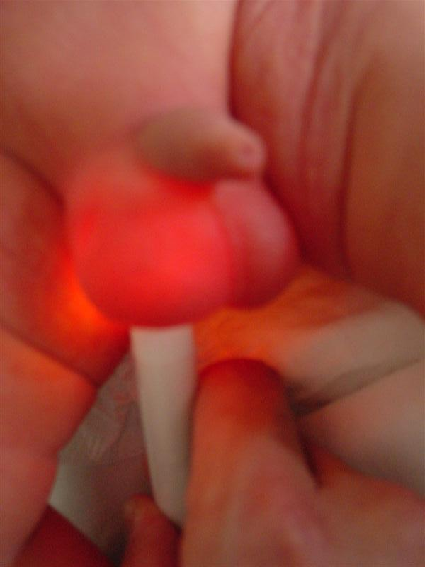
Hydrocele on Examination
Soft, painless, fluctuant mass
Anterior to testicle typically
Communicating hydrocele
Smaller with lying down
Larger with valsalva maneuver
Noncommunicating unchanged with maneuvers
Transilluminates
Transillumination – transmission of light through the scrotum and clear fluid of a hydrocele

Slide 6
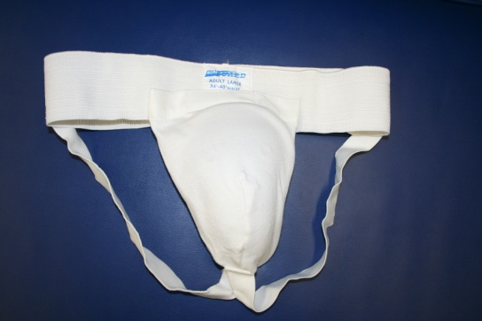
Management of Hydroceles
No ultrasound required if able to palpate entire testicle
Must be able to exclude infection, torsion, or malignancy otherwise need ultrasound
Secondary hydroceles resolve with treatment of underlying issue
Majority of idiopathic hydroceles self-resolve
Athletic Supporter for pain with exercise
Notes:
Reactive hydroceles may form secondary to orchitis, epididymitis, or torsion or malignancy. If the entire testicle can be palpated and feels normal, ultrasound is not required, this is typically the case. If the hydrocele prevents palpating the testicle or if the hydrocele is tense and painful then ultrasound is required to rule-out reactive hydrocele or concomitant torsion or malignancy or infection.

Slide 7
Spermatoceles

Slide 8
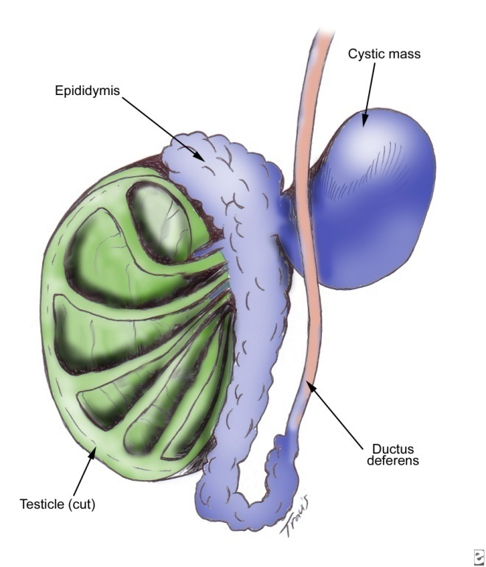
Spermatocele
Painless retention cyst of epididymis
Usually contains dead spermatzoa
Incidence <1%
Located superior and posterior to testicle
Small, painless, mobile
Transilluminates
Spermatocele

Slide 9
Management of Spermatocele
Diagnosis may be made by physical exam
May need ultrasound to confirm diagnosis
No treatment necessary

Slide 10
Varicoceles

Slide 11
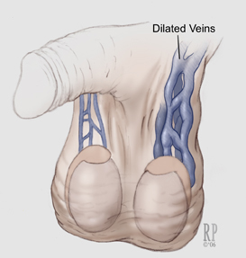
Varicocele
Tortuous veins of pampiniform plexus
Present in 15-20% of adolescent males
85-90% on left side
Likely due to venous drainage patterns of spermatic veins

Slide 12
Clinical Presentation of Varicocele
Typically asymptomatic incidental finding on physical exam
Patients may complain of dull ache or fullness
Feels like bag of worms above testicle
Larger with valsalva maneuver
Smaller in supine position
May develop testicular atrophy on affected size

Slide 13
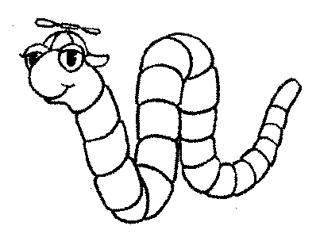
What’s the Harm in a Bag of Worms?
80% of adult males w/ varicocele have normal fertility
BUT 40% of infertile men have varicocele
Impaired venous circulation may decrease quality of sperm
Notes:
Remember that the pampiniform plexus drains blood from the testicle. When dilated and tortuous, there is impaired circulation which could have a negative impact on sperm quality either by increased pressure on the testicle, increased temperature, or presence of toxins unable to be quickly cleared

Slide 14
Managing Varicocele
Determine testicular volume
Physical exam or ultrasound (most accurate)
Decreased volume indicates decreased spermatogenesis
More accurate indicators of fertility:
**These are not recommended routinely yet, still undergoing research to determine if should be routine**
Basal LH and FSH levels - elevated levels indicative of problem
Semen analysis

Slide 15
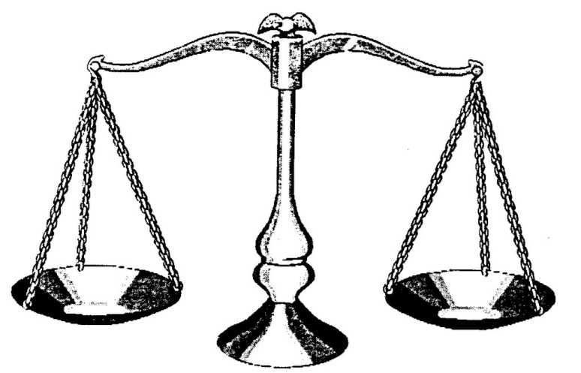
Referral to Urology If…
Large varicocele with small testicle
>2-3 mL difference in testicle volume by U/S
Bilateral or symptomatic varicoceles
Scrotal Pain
Testicular size 2 S.D. below normal
Abnormal semen analysis
Elevated basal LH and FSH levels
Unnecessary
Surgery
Infertility
Notes:
Surgery is >90% successful with ~10% recurrence rate. Conception rate is increased by 40-60% after the procedure. If an older adolescent patient presents with a hydrocele with borderline concern for surgery or the patient is concerned, refer him for a semen analysis. If he has decreased sperm count, surgery is recommended.

Slide 16
Testicular Tumors

Slide 17
Testicular Tumor Epidemiology
Most common solid cancer in 15-34 yo males
Risk factors:
Cryptorchidism (undescended testicle)*
Family history of testicular cancer
HIV infection
Prior germ cell tumor (intra or extragonadal)
Prior tumor in contralateral testicle
History of mumps orchitis
Trauma
* Most significant risk factor
Notes:
Testicular tumors are the most common cancer found in 15-34 yo males and affects about 1/10,000 teens overall with about 6,000-8,000 new cases diagnosed yearly. There is an increased risk of developing testicular cancer in white males, family history of cancer, gonadal dysgenesis, and cryptorchidism with cryptorchidism being the most significant risk factor. There is a 2.5-11 times higher risk of developing testicular cancer in those with a h/o cryptorchidism, furthermore 1-5% of males with a h/o cryptorchidism develop cancer. Undescended testicles need to be corrected as soon as possible and these patients need to perform frequent self exams. It is controversial whether correcting this changes the rate of malignancy but it does increase the rate of fertility and makes examination possible. But keep this in perspective, 90% of patients dx’ed with cancer did not have a history of undescended testicle so you must have a high clinical susupicion and check each patient regardless of their history.

Slide 18
A Little Note on Cryptorchidism
Most significant risk factor for developing testicular cancer
Patients with history of cryptorchidism
2.5-11 times higher risk of cancer
BUT only 1-5% pts w/ prior undescended testis actually develop cancer (not 100%)
Incidence may be decreased by early orchiopexy
BUT 90% of germ cell tumors occur in patients with NO history of cryptorchidism

Slide 19
Testicular Tumors – Hx and PE
History:
Painless mass found on exam
Dull achy feeling or heaviness (30-40%)
Acute testicular pain (10%) – due to hemorrhage or infarction)
Physical Exam:
Firm, nontender mass
Does not transilluminate
Reactive hydrocele may be present

Slide 20
Diagnosis/Management
Testicular ultrasound is very accurate test
If U/S unequivical, testicular MRI may help determine if mass is benign or malignant
Chest X-ray
CT scan of abdomen and pelvis
Immediate referral to urologist or oncologist
Look for metastases

Slide 21
Self-Testicular Exam To Do…or Not To Do?
Why is it controversial?
Specificity, sensitivity, and PPV unknown
Does not appear to change mortality –due to low incidence of disease and high survival rates
We recommend teaching males >15 yo how to do exam and encouraging monthly exams
*Stress importance in patients with risk factors
How to do self-exam?
Best done after warm shower to relax scrotal tissue
Roll testicle between thumb and index/middle fingers
Feel for lumps, hardness, or thickness
Compare to last exam and opposite side

Slide 22
95% of testicular tumors
* 40% of germ cells * Embryonal, teratoma,
* Peak 25-45 yo yolk sac, choriocarcinoma
* 25% w/ mets at dx * Peak 15-30 yo
* 0% AFP+, 9% HCG+ * 60-70% w/ mets at dx
* Slightly higher survival * 65% AFP+, 56% HCG+

Slide 23
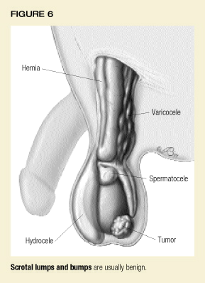
Scrotal Lumps and Bumps In Summary
Keep normal anatomy in mind as you go through a genital exam

Slide 24
A 16 year old male presents for a routine physical examination. On exam, you note a small scrotal swelling on the right side. He denies pain, discharge, or urinary symptoms. He didn’t even know the mass was there before you noted it. The mass is anterior to the testicle and is nontender to palpation. It has an orange glow when you shine a light through it. The testicles themselves feel completely normal. Which of the following is the most likely diagnosis?
Varicocele
Hydrocele
Testicular tumor
Spermatocele
Unable to make a guess without a testicular ultrasound

Slide 25
A 16 year old male presents for a routine physical examination. On exam, you note a small scrotal swelling on the right side. He denies pain, discharge, or urinary symptoms. He didn’t even know the mass was there before you noted it. The mass is anterior to the testicle and is nontender to palpation. It has an orange glow when you shine a light through it. The testicles themselves feel completely normal. Which of the following is the most likely diagnosis?
Varicocele
Hydrocele
Testicular tumor
Spermatocele
Unable to make a guess without a testicular ultrasound

Slide 26
Answer: B. This patient has a small, asymptomatic mass anterior to the testicle with a completely normal adjacent testicle which is consistent with a hydrocele. This mass transilluminates (light passes through it) which is also consistent with a hydrocele. A varicocele is superior to the testicle and does not transilluminate. Testicular tumors are not able to be separated from the testicle and do not transilluminate. Spermatoceles are usually superioposterior to the testicle and may transilluminate since they are fluid filled.

Slide 27
An 18 year old male presents for a routine physical examination. He has no complaints. On exam, you find a nontender swelling superior to the left testicle which does not transilluminate and seems to resemble a bag of worms. The testicle itself is normal without tenderness or masses and seems to be symmetric to the unaffected side. You suspect a varicocele. Which of the following is the most appropriate next step in management?
Reassurance that this is normal and recheck in a few months
Recommend sperm analysis to check fertility
Immediate referral to urologist for ligation of varicocele
Empirically treat him for gonorrhea and chlamydia

Slide 28
An 18 year old male presents for a routine physical examination. He has no complaints. On exam, you find a nontender swelling superior to the left testicle which does not transilluminate and seems to resemble a bag of worms. The testicle itself is normal without tenderness or masses and seems to be symmetric to the unaffected side. You suspect a varicocele. Which of the following is the most appropriate next step in management?
Reassurance that this is normal and recheck in a few months
Recommend sperm analysis to check fertility
Immediate referral to urologist for ligation of varicocele
Empirically treat him for gonorrhea and chlamydia

Slide 29
Answer: A. Varicoceles are common masses in adolescents which are frequently asymptomatic and incidentally found on exam. There is less of a concern about fertility if the testicle on the affected side appears to be the same size as the testicle on the unaffected side. If this is difficult to determine on exam, a testicular ultrasound should be performed to rule-out hypotrophy which would indicate decreased spermatogenesis. Patients with extremely large, symptomatic, or bilateral varicoceles should be referred to a urologist for evaluation and management. They may recommend a sperm analysis or LH/FSH levels to check fertility levels. Gonorrhea and chlamydia do not cause varicoceles.

Slide 30
A 20 year old male presents to your office complaining of a bump in the genital area. He recently started doing monthly self-testicular exams and he found a new bump last week. He reports that it is nontender and he has no discharge or urinary complaints. He has not other complaints and an unremarkable past medical history. On exam, you note a small, indurated, nontender mass on the left testicle which cannot be separated from the testicle and does not transilluminate. There is no swelling and the contralateral side is normal. Which of the following is the most appropriate next step in management?
Reassurance that this is normal and recheck it in a few months
Immediate referral to urologist
Testicular ultrasound
Empirically treat him for gonorrhea and chlamydia

Slide 31
A 20 year old male presents to your office complaining of a bump in the genital area. He recently started doing monthly self-testicular exams and he found a new bump last week. He reports that it is nontender and he has no discharge or urinary complaints. He has not other complaints and an unremarkable past medical history. On exam, you note a small, indurated, nontender mass on the left testicle which cannot be separated from the testicle and does not transilluminate. There is no swelling and the contralateral side is normal. Which of the following is the most appropriate next step in management?
Reassurance that this is normal and recheck it in a few months
Immediate referral to urologist
Testicular ultrasound
Empirically treat him for gonorrhea and chlamydia

Slide 32
Answer: C. A nontender, indurated testicular mass which can not be separated from the testicle and does not transilluminate is a testicular tumor until proven otherwise. This patient should have an immediate ultrasound to get more information about the mass followed by an immediate referral to a urologist or oncologist for further management. This should not wait a few months. If you suspect epididymitits (painful mass superoposterior to the testicle with dysuria and possibly urethral discharge), then the patient should be empirically treated for gonorrhea and chlamydia. However this patient’s examination is not consistent with epididymitis.

Slide 33
Recommended Reading
Brenner JS, Ojo A. Causes of Painless Scrotal Swelling in Children and Adolescents. UpToDate Online. Updated February 2, 2009.
Adelman WP, Joffe A. Controversies in Male Adolescent Health: Varicocele, circumcision, and testicular self-examination. Curr Opin Pediatr. 2004 Aug;16(4):363-7.
Diamond DA. Adolescent Varicocele. Curr Opin Urol. 2007;17:263-7.
Rubenstein RA, Dogra VS, Seftel AD, Resnick MI. Benign Intrascrotal Lesions. J Urol. 2004 May;171(5):1765-72.

