Slide 1
The Normal Menstrual Cycle
Allison Eliscu, MD, FAAP
Rev. July 2012

Slide 2
The Normal Menstrual Cycle
Goal of normal menstrual cycle: release single mature oocyte to become fertilized
Average adult cycle is 28 days
Day 1 is first day of menses
Cycle divided into 2 phases
Follicular phase (Days 1-14)
Begins with menses, ends with LH surge
Luteal phase (Days 14-28)
Begins with LH surge, ends with onset of menses

Slide 3
Follicular Phase
Ovarian Changes
Group of follicles recruited
Follicles release estradiol
Estradiol has negative feedback on LH and FSH
Estradiol promotes follicular growth
Dominant follicle chosen, others become atretic
Estradiol peaks on day 13 causing LH surge
Change from negative to positive feedback on LH
Endometrial Changes
Proliferation of glands

Slide 4
Luteal Phase
Ovarian Changes
Dominant oocyte released within 36 hours of LH surge
Remains of dominant oocyte become corpus luteum
Corpus luteum secretes progesterone
Oocyte viable for up to 24 hours after ovulation
Without fertilization, estradiol and progesterone decrease
Endometrial Changes
Progesterone causes organization of glands
Prepares for implantation
Without fertilization loss of endometrial blood supply
Causes sloughing of endometrial lining (menses)

Slide 5
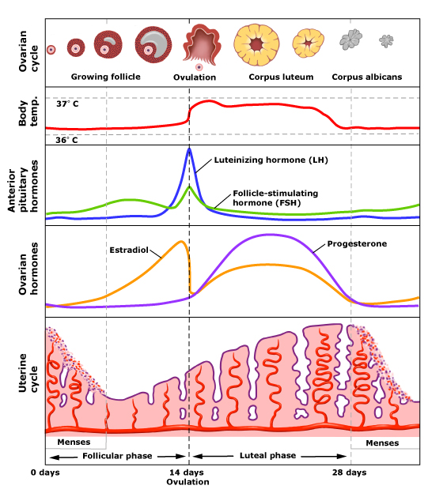
LH Surge
Estradiol peak causing
LH surge

