Slide 1
Yelamos Family and Colon Cancer
IRIS A. GRANEK, MD, MS
Department of Prev. Med.
JOAN KIELY, M.S.
CESAME
JENNIE WILLIAMS, Ph.D.
Department of Prev. Med.
Division of Cancer Prevention
PAULA I. DENOYA, MD
Department of Medicine
Division of Colon and Rectal Surgery
CATHERINE MESSINA, Ph.D
Department of Prev. Med.
JUAN CARLOS BUCOBO, MD
Department of Medicine
Division of Gastroenterology

Slide 2
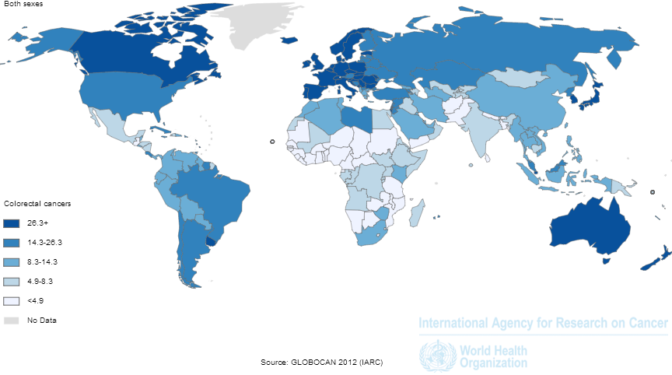
IARC Globcan estimate of colorectal cancer rates 2012 (http://globocan.iarc.fr/Pages/Map.aspx#)

Slide 3
Meet the Yelamos
Parents: Immigrated to the US from Guatemala
Primary medical issue: Colon Cancer
Premise:
Based on ethnic health disparity
Native country: low rates of colon cancer
Unbeknownst to them, they have a genetic mutation that put them at high risk of developing colon cancer
The shift to an American lifestyle has exacerbated this mutation

Slide 4
Yelamos Family
X
Moises
(d 74)
Alejandro
(73)
Bernicia
(70)
Carolina
(44)
Destina
(41)
Estevan
(39)
Federico
(37)
Gitana
(35)
Xavier
(30)
Benjamin
(41)
Michael
(40)
Anarosa (18)
Estevan Jr (20)
Bernardo (24)
Carmen (22)
Diego
(20)
Federico (2yrs)
Grayson (6mo)

Slide 5
Proposed Yelamos Family Visits
Transition to Medical School (TTMS)
Introduction video (already created and implemented).
Molecular Foundations (Human Genetics Lectures)
Genetic risk associated with Lynch syndrome: Dr. Raafat El-Maghrabi .
Basic Mechanisms of Disease
Lectures on Genes & Cancer; Tumor invasion and metastasis; cancer chemotherapy.
TiME 2
Video of Estevan receiving news that he has colon cancer (already created and implemented in TiME wk 2)
A small/large group discussion
OSCE: related to Lynch
TiME session?)
“Nutrition Over Lunch” regarding the relationship between nutrition and colon cancer: Dr. Raja Jaber
Introduction to Clinical Medicine (ICM)
Case studies, abdominal exam session
Integrated Pathophysiology: Gastrointestinal/Nutrition
Estevan’ condition: Dr. Satish Nagula
microbiome and macrobiotic diet: Dr. Satish Nagula
Integrated Pathophysiology: Endocrine/Reproduction
Carolina had endometrial cancer: Drs. Richard Bronson & Harold Carlson
Integrated Pathophysiology: Mind/Brain/Behavior
Estevan Jr. will have anorexia: Dr. Mary Kritzer.
Surgery Clerkship
Estevan will have a surgical resection. Potentially can be integrated into clerkship.
OB/GYN Clerkship
Carolina (endometrial cancer).

Slide 6
Medical Conditions
Psychosocial Issues/HOT TOPICS:
Colon cancer
GERD
Obesity
Hypertension
Endometrial Dysplasia
Colon Polyps
Anemia
Cultural Competency*
Health Care Disparities*
Health Care Systems
Physician-Patient Communication*
Complementary and Alternative Medicine
Diagnosis
Clinical Pathology
Gender/Cultural Bias*
Nutrition/Diet*
Drug and Alcohol Use
Interpretation of Clinical Data/Laboratory Reports
Management of Disease
Evidence Based Medicine*
Medical Treatments
Screening
Cancer Prevention
Endoscopy
Genetic Testing
Curricular Content in the Family

Slide 7
THANK YOU

Slide 8
Demographic information
Yelamos Family
Name | Age | Gender | Ethnicity | Race
Alejandro | 73 | Male | Hispanic | Caucasian
Bernicia | 70 | Female | Hispanic | Caucasian
Moises | 74 (d) | Male | Hispanic | Caucasian
Carolina (Castaneda) | 44 | Female | Hispanic | Caucasian
Destina (Lakota) | 41 | Female | Hispanic | Caucasian
Estevan | 39 | Male | Hispanic | Caucasian
Federico | 37 | Male | Hispanic | Caucasian
Gitana (Hernandez) | 35 | Female | Hispanic | Caucasian
Anarosa (Castaneda) | 18 | Female | Hispanic | Caucasian
Benjamin Lakota | 41 | male | Non-Hispanic | Native American
Bernardo (Lakota) | 24 | Male | Hispanic | Native American/Caucasian
Carmen (Lakota) | 22 | Female | Hispanic | Native American/Caucasian
Diego (Lakota) | 20 | Male | Hispanic | Native American/Caucasian
Estevan Jr. | 20 | Male | Hispanic | Caucasian
Michael Thompson | 40 | Male | Non-Hispanic | Caucasian
Federico (Yelamos-Thompson) | 2 | Male | Hispanic | Caucasian
Grayson (Yelamos-Thompson) | 4 | Male | Non-Hispanic | Caucasian
Xavier Hernandez | 30 | Male | Hispanic | Caucasian

Slide 9
Timeline of exposure to the Yelamos Family
(All suggested appearances)
Placement in curriculum | Content | Issues
TTMS TiME 2 | Introduction to the family (video) Video | Alejandro (father): Apparently healthy. He seeks the aid of physician only when in crisis (broken limb etc.). Depression (perhaps) Bernicia (mother): Gestational Diabetes, Hypertension, osteoarthritis and obese Carolina (daughter): Has a prior medical history significant for endometrial dysplasia treated by dilation/curettage 2 years ago and followed by endometrial ultrasound every 6 months. Destina (daughter): Medical history is deemed un-remarkable. Had stomach issues but credit macrobiotic diet with cure. Estevan (son): Not seen by MD for years. Ultimate diagnosis colon cancer Frederico (son): medical history is deemed un-remarkable Gitana (daughter): Was a troubled teen (smoked, used drugs and drank heavily); however, after a few rounds of rehab, is now clean and sober. Now compulsive dieter and exerciser. Estevan Jr: excessive dieting (anorexia?) Family dynamic: concern for Estevan and Estevan Jr.

Slide 10
Timeline of exposure to the Yelamos Family (Continue)
Placement in curriculum | Content | Issues
Molecular Foundations of Medicine | Estevan (colon cancer): tyrosine kinases/apoptosis and cancer lecture (10/24/14) All family members: human genetics (10/28-10/31/14) | Genetic risk/Lynch
The Body | Estevan (colon cancer): colon/abdomen (9/11-9/15/14)
Time 1 (infants and children)
Pathogens and Host Defense | Microbiome, diet and colon cancer | Destina and macrobiotic diet
Basic Mechanisms of Disease | Estevan (colon cancer): Genes and Cancer lecture (1/29-1/30/15) Estevan (colon cancer): Tumor invasion and metastasis lecture (1/30/15) Estevan (colon cancer): Cancer chemotherapy (2/10/15)

Slide 11
Timeline of exposure to the Yelamos Family (Continue)
Placement in curriculum | Content | Issues
Time 2 | Lynch diagnosis/genetic risk video/discussion
Int. Path: Pulmonary/Cardiovascular/Renal
Intro to Clinical Medicine | Abdominal Exam (12/18/14)
Medicine in Contemporary Society | Truth telling, confidentiality and candor (1/6/15) | Culture competence

Slide 12
Timeline of exposure to the Yelamos Family (Continue)
Placement in curriculum | Content | Issues
Time 3 (adolescents) | Estevan Jr, Grayson, Federico. Anarosa, Bernardo, Carmen and Diego | Genetic testing
Int. Path: Gastrointestinal/Nutrition | Estevan/Estevan Jr. | Destina and macrobiotic diet
TIME 4 (geriatrics)
Int. Path: Endocrine/Reproduction

Slide 13
Timeline of exposure to the Yelamos Family (Continue)
Placement in curriculum | Content | Issues
TIME 5 (Women’s Health) | endometrial cancer Gestational diabetes | Carolina : endometrial cancer Bernicia
Int. Path: Mind/Brain/Behavior | Anorexia, compulsive behavior and addiction/ depression | Estevan Jr.(anorexia) /Gitano (excessive diet and exercise)/ Alejandro
TIME 6
Translational Pillar: Genetics | Lynch/RASSF1 – genetic risk
Medicine clerkship
Surgery clerkship

