Slide 1
NEW EMPLOYEE ORIENTATION
Dawn Scarzella Chief of Police
Assistant Vice President for Healthcare Safety

Slide 2
University Police at a Glance
Sworn law enforcement agency
Consisting of uniformed members (42 police officers, 9 supervisors, 5 detectives, and 9 command staff, 65 total uniformed members)
Graduates of the Suffolk or Nassau County Police Academy
Achieved New York State DCJS Reaccreditation in December of 2020
110 required standards

Slide 3
University Police at a Glance
Patrol Operations
Community Relations
Special Events
Specialized Programs
Office of Emergency Management
Access Control
Investigations Division

Slide 4
University Police Public Safety of East Campus
Director of Public Safety for East Campus Operations
University Police are assigned to East Campus
Associate Director of Pubic Safety
Security Services Assistants (SSA’s)
24 hour coverage throughout the University Hospital
Main Entrance
Emergency Department
Comprehensive Psychiatric Emergency Program (CPEP)

Slide 5
Campus Emergency Communications
Provides text, voice, and e-mail to the campus community
Emergency Management Website (SB Advisory & SB Alert)
Campus wide LCD panels
Voice capable Fire Alarms
Campus Siren
Facebook and Twitter
Campus Radio, Campus Cable TV and External Media

Slide 6
SB Guardian
Personal Safety System:
“Blue light phone in your pocket”
Faster and more effective emergency response
Improved safety communications on campus
FREE service offered by the University
Voluntary but highly recommended
Available as a free app (Rave Guardian) for cell phones

Slide 7
The Jeanne Clery Campus Security Policy and Crime Statistics Disclosure Act
Federal statute (20 USC 1092(f)) requires all colleges and universities that participate in Federal Title IV student financial aid programs to disclose campus crime statistics and security information
Compliance with the Clery Act falls under the mandate of the US Department of Education

Slide 8
The Clery Act Requirements:
Institutions must collect, classify and count crime reports and submit statistics to the US Department of Education
Devise an emergency response, notification, and testing policy
Issue timely warnings about Clery Act crimes which pose a serious or ongoing threat to students and employees
Publish an Annual Security Report and Fire Safety Report

Slide 9
The Clery Act Requirements:
Inform the campus community where to obtain information about registered sex offenders
Create, maintain and make available a crime log and fire log
Enact policies and procedures to handle reports of missing students
Stony Brook University’s Annual Security Report can be found on our website using the following link: https://www.stonybrook.edu/commcms/police/news/Annual-Security- Report.php

Slide 10
Bias Crime Prevention
The Stony Brook University Police Department protects all members of the campus community by preventing and prosecuting bias or hate crimes that occur within the campus’ jurisdiction.
Hate crimes, also called bias crimes or bias-related crimes, are criminal acts motivated by the perpetrator’s bias or attitude against an individual victim or group based on perceived or actual personal characteristics, such as any incidents of Larceny-Theft, Simple Assault, Intimidation, or Destruction, Damage, or Vandalism of Property that were motivated by bias based on race, religion, sexual orientation, gender, gender identity, ethnicity, nation origin or disability.
The Office of Equity and Access, University Ombudsman Office, and the Office of Student Conduct and Community Standards also assist in addressing bias-related acts that do not rise to the level of a crime.

Slide 11
Crimes of Opportunity
The most common crime on our campus is the theft of unattended property. In order to prevent these crimes we recommend that you:
Lock your doors when leaving your office.
Do not leave cell phones, wallets, purses or other valuable items unattended or in plain sight.
Utilize tracking software for your cell phones, laptops, iPads
and similar items.
Be aware of your surroundings

Slide 12
Pedestrian Safety
If you need to use your phone, stop walking
Wait for drivers to stop and make eye contact before crossing the street. Never assume a driver sees you
Wear bright/light colored clothing and reflective material
Carry a flashlight when walking at night
Cross in a well-lit area at night
Stand clear of buses, parked cars, or other obstacles before crossing so the driver can see you

Slide 13
Pedestrian Safety
Cross streets at marked crosswalks or intersections
Obey pedestrian signals
Look both ways before crossing the street
Be careful at intersections where drivers may fail to yield the right-
of-way to pedestrians
Always walk on the sidewalk; if there is no sidewalk, walk facing traffic
Remove headphones when crossing the street

Slide 14
How to Contact UPD During An Emergency:
Dial 333/ 911 from any campus phone
Dial (631) 632-3333 from non campus phones or cell phones
Community Relations Team (631) 632-3056
University Police Department 175 Dutchess Hall
631-632-6350 for non emergencies

Slide 15
Workplace Violence
Dawn Smallwood Chief of Police
Assistant Vice President for Campus Safety

Slide 16
New York State Workplace Violence Act
NYS Department of Labor
On June 7, 2006 New York State passed legislation, Article 27-b of the Labor Law, requires public employers to develop and implement programs to prevent and minimize workplace violence and to provide annual training to employees.

Slide 17
Stony Brook Policy P519
It is Stony Brook University's policy to promote a safe environment for all
members of the community.
Workplace violence may occur within a wide spectrum of interactions between students, faculty, staff, patients, and visitors of the University.
It is the responsibility of all employees to create and maintain a campus
environment free from any acts of workplace violence.
Reports of incidents of workplace violence will be taken seriously and dealt with appropriately.
Individuals who engage in workplace violence may be subject to arrest and/or disciplinary action.

Slide 18
Workplace Violence Is:
Physical assaults or acts of aggressive behavior including but not limited to:
an attempt or threat, whether verbal or physical, to inflict physical injury;
any intentional display of force that gives reason for someone to fear or expect bodily harm;
intentional and wrongful physical contact with a person without his or her consent that entails some injury;
stalking with the intent of causing fear or harm to the physical safety and health of the individual.

Slide 19
Workplace Violence Falls into Four Broad Categories:
Strangers– the individual has no legitimate relationship to the university or its employees.
Customer/Clients – the individual has a legitimate relationship with the university. This category includes students, patients, parents, customers and any other group for which the university provides services.
Worker-on-Worker- the individual is an employee or former employee who attacks or threatens another employee or former employee in the workplace.
Personal Relationship – the individual usually does not have a relationship with the university, but has a personal relationship.

Slide 20
Workplace Violence Includes:
Threats of Violence from Co-Workers, Subordinates, Colleagues,
Supervisors
Domestic Violence/Dating Violence
Stalking and/or Intimidation
Rapes/Sexual Assaults
Threating or Obscene Phone Calls
Bullying/Cyber Bullying
Assaults
Stabbings
Suicides
Shootings
Harassment of any nature

Slide 21
Root Causes of Workplace Violence:
Verbal or Written Counseling/Notice of Discipline
Poor Performance Review
Conflict with Co-Workers, Subordinates, Colleagues, Supervisors
Alcohol/Substance Abuse
Mental Illness
Marital/Relationship Problems
Perceived Unfairness
Layoff
Termination
Financial Difficulties
Personal Problems

Slide 22
Domestic Violence Dating Violence Sexual Assault Stalking
Dawn Smallwood Chief of Police
Assistant Vice President for Campus Safety

Slide 23
Stony Brook Policy 520: Domestic Violence and the Workplace Policy
Domestic violence permeates the lives and compromises the safety of thousands of New York State employees each day, with tragic, destructive, and often fatal results.
Domestic violence occurs within a wide spectrum of relationships, including married and formerly married couples, couples with children in common, couples who live together or have lived together, gay, lesbian, bisexual and transgender couples, and couples who are dating or who have dated in the past.
The University, to the fullest extent possible will take all appropriate actions to promote safety in the workplace and respond effectively to the needs of victims of domestic violence.

Slide 24
Definitions for Domestic Violence:
Domestic Violence: A pattern of coercive tactics, which can include physical, psychological, sexual, economic and emotional abuse, perpetrated by one person against an adult intimate partner, with the goal of establishing and maintaining power and control over the victim.
Intimate Partner: Includes persons legally married to one another; persons formerly married to one another; persons who have a child in common, regardless of whether such persons are married or have lived together at any time, couples who are in an intimate relationship, including but not limited to, couples who live together or have lived together, or persons who are dating or who have dated in the past, including same sex couples.

Slide 25
Definitions for Domestic Violence:
Abuser: A person who perpetrates a pattern of coercive tactics which can include physical, psychological, sexual, economic, and emotional abuse against an adult intimate partner, with the goal of establishing and maintaining power and control over the victim.
Victim: The person against whom an abuser directs coercive and/or violent acts.

Slide 26
Dating Violence:
The term “dating violence” means violence committed by a person-
Who is or has been in a social relationship of a romantic or intimate nature with the victim; and
Where the existence of such a relationship shall be determined based on a consideration of the following factors:
The length of the relationship
The type of relationship
The frequency of interaction between the persons involved in the relationship

Slide 27
Sexual Assault:
No person shall engage in sexual contact with another person without consent. This includes but is not limited to nonconsensual sexual contact of another.
In addition no person shall engage in nonconsensual physical assault during a consensual sexual contact, such as punching, choking, burning or otherwise intentionally causing serious physical harm without consent of a partner.

Slide 28
Affirmative Consent
Affirmative consent is a knowing, voluntary and mutual decision among all participates to engage in sexual activity.
Consent can be given by words or actions, as long as those words or actions create clear permission regarding willingness to engage in the sexual activity.
Silence or lack of resistance, in and of itself, does not demonstrate
consent.
The definition of consent does not vary based upon a participant’s
sex, sexual orientation, gender identity, or gender expression.
NYS Education Law, art. 129B, §6441

Slide 29
Consent
to one sexual act is not consent to every sexual act
may be withdrawn at any time
cannot be given if the person is mentally incapacitated or lacks the ability to knowingly engage in sexual activity -- an individual whose judgement is impaired by drugs or alcohol is incapacitated
cannot be given if it is the result of any coercion, intimidation, force, or threat of harm
cannot be given if the individual is under the age of 17
is required regardless of whether the person initiating is under the influence of drugs and/or alcohol
once withdrawn, or when consent can no longer be given, all
sexual activity must stop

Slide 30
Stalking:
The term “stalking” means engaging in a course of conduct directed at a specific person that would cause a reasonable person to-
Fear for his or her safety or safety of others; or
Suffer substantial emotional distress

Slide 31
Community Relations Team:
The members of the University Police are committed to community policing and are actively involved in campus activities. The goal of the Community Relations Team is to educate the campus community on personal safety, risk awareness, crime prevention (including date and acquaintance rape prevention), drug and alcohol risk awareness, and many other community safety issues. The unit's members accomplish their mission through formal talks, informal talks, and new student and employee orientation programs and have an exceptional working relationship with groups and organizations on campus.
Officers on the Community Relations Team are certified instructors in many courses including:
Active Shooter Instructors
American Heart Association CPR/AED/First Aid Instructors
Distracted Driving Instructors
Green Dot Instructors
Rape Aggression Defense (R.A.D.) Instructors
Safe Space Providers
Click here to view a list of the programs offered by the Community Relations Team.

Slide 32
Police Emergency
Call 911 from any on campus phone.
Call (631) 632-3333 from a cell phone.
Survive an Active Shooter Event
Run • Hide • Fight
Always know your exits!

Slide 33
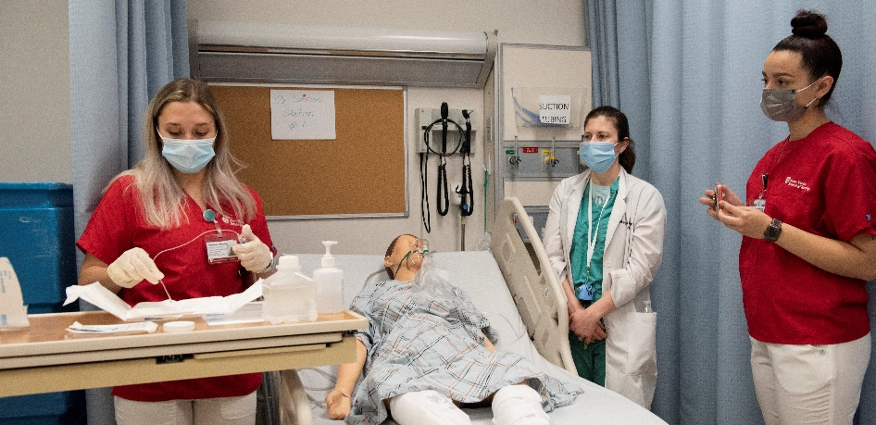
Knowledge Check
Select NEXT to begin.

Slide 34
Properties
On passing, 'Finish' button: Goes to next slide
On failing, 'Finish' button: Goes to next slide
Allow user to leave quiz: At any time
User may view slides after quiz: After passing quiz
Show quiz in menu as: Single Item
Edit in Quizmaker
Edit Properties

Slide 35
For Further Information:
University Police
In an Emergency Dial 333 from campus phones 631-632-3333 from non-campus phones or cell phones For questions/information call
631-632-6350
Employee Assistance Program Rm. 192 Administration Building (West Campus)
Level 5 University Medical Center 631-632-6085
Labor Relations
291 Administration Bldg
631-632-6140 or 040,
Level 3 Health Science Center 631-444-3780
Human Resource Services 390 Administration Building
631-632-6161
University Medical Center Human Resources
3 Technology Drive, Suite 100 Technology Park
East Setauket, NY 11733 631-444-4700
Long Island State Veterans Home Human Resources
100 Patriots Road
631-444-8617

Slide 36
Related Documents:
Disruptive Behavior Policy http://www.stonybrook.edu/policy/policies.shtml?ID=521
Domestic Violence & the Workplace Policy http://www.stonybrook.edu/policy/policies.shtml?ID=520
Sexual Harassment http://www.stonybrook.edu/policy/policies.shtml?ID=106

Slide 37
Thank you for completing this course.
You may close this window to return to the LMS.

