Slide 1

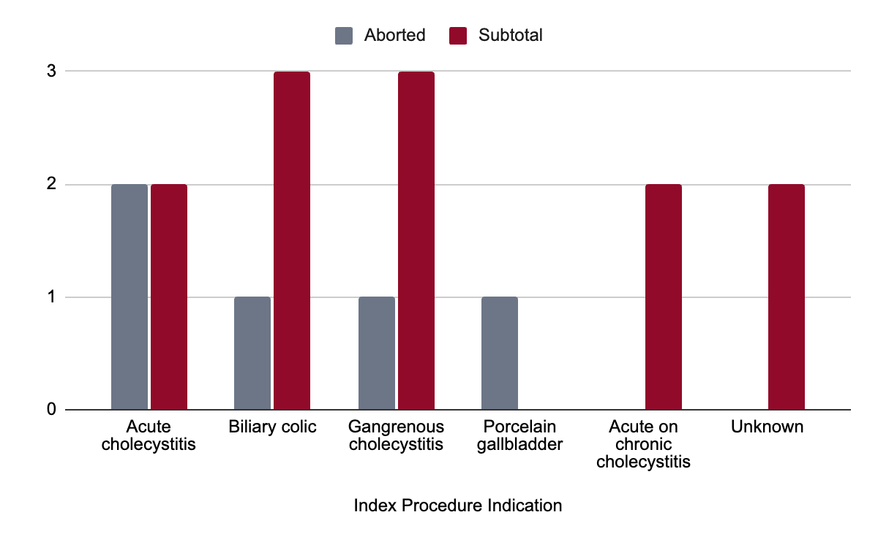
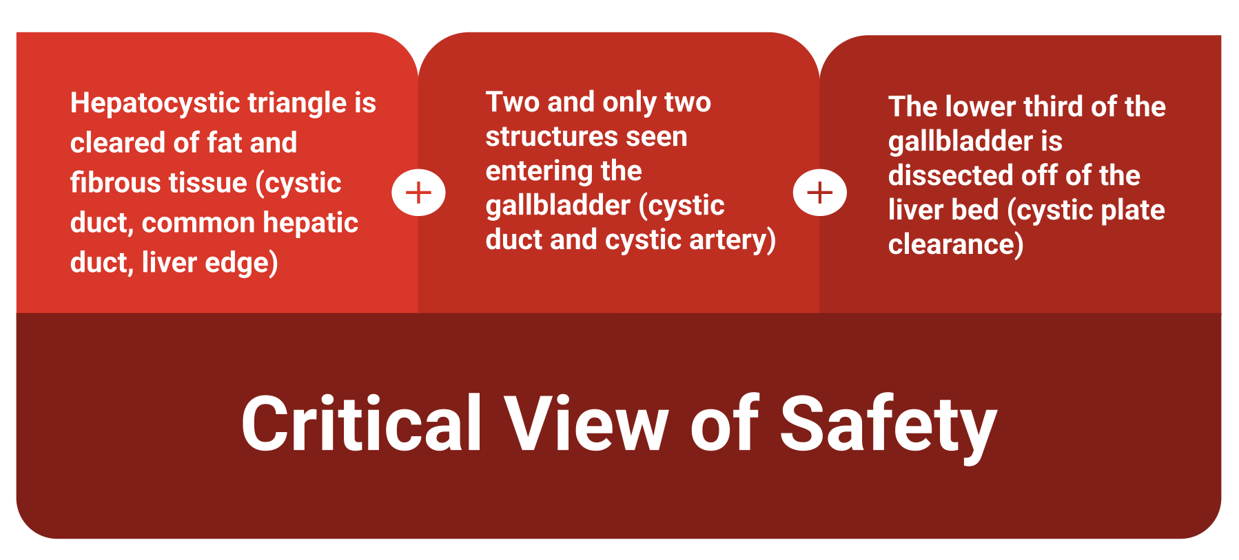
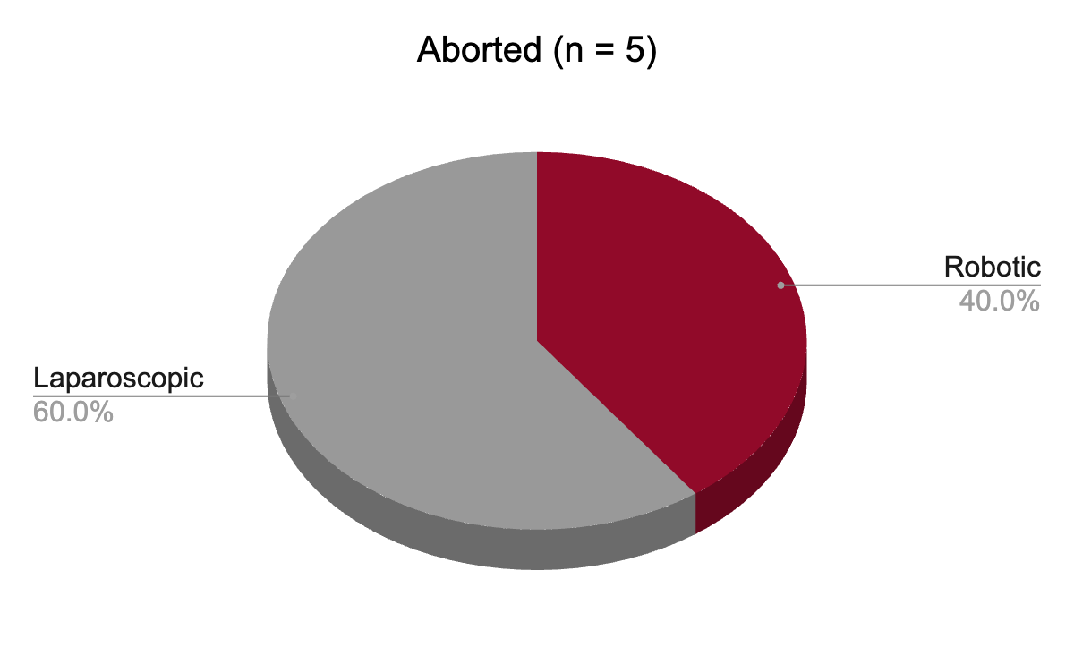
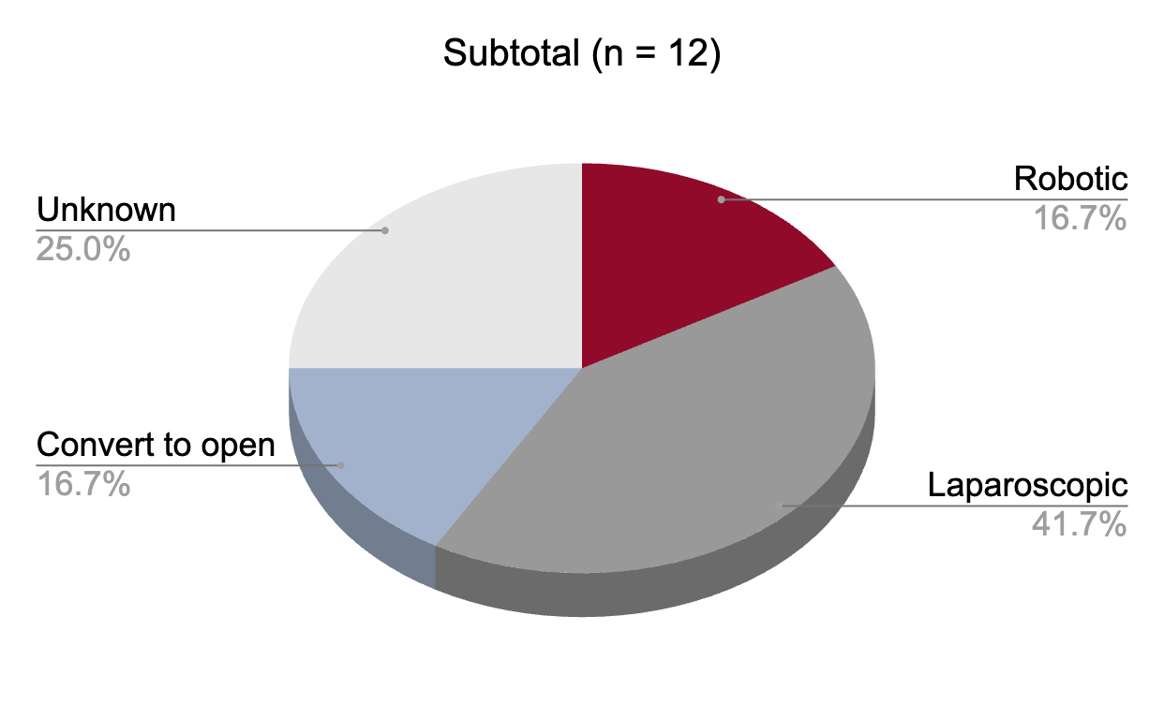
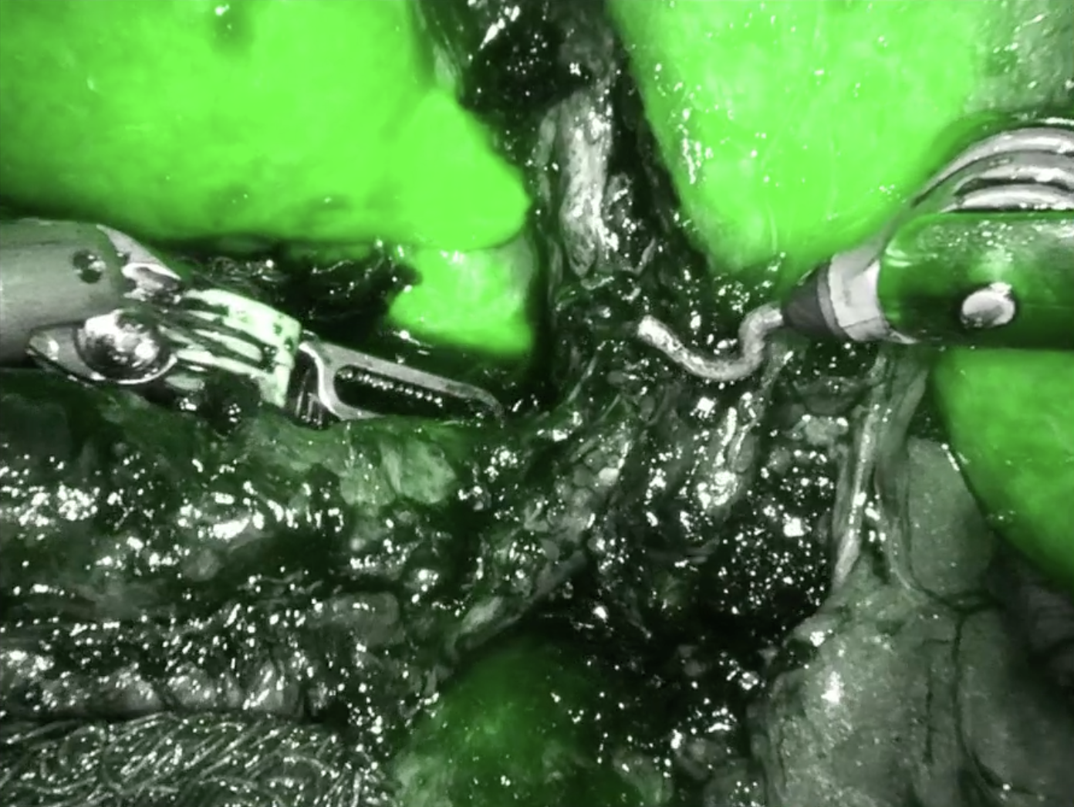
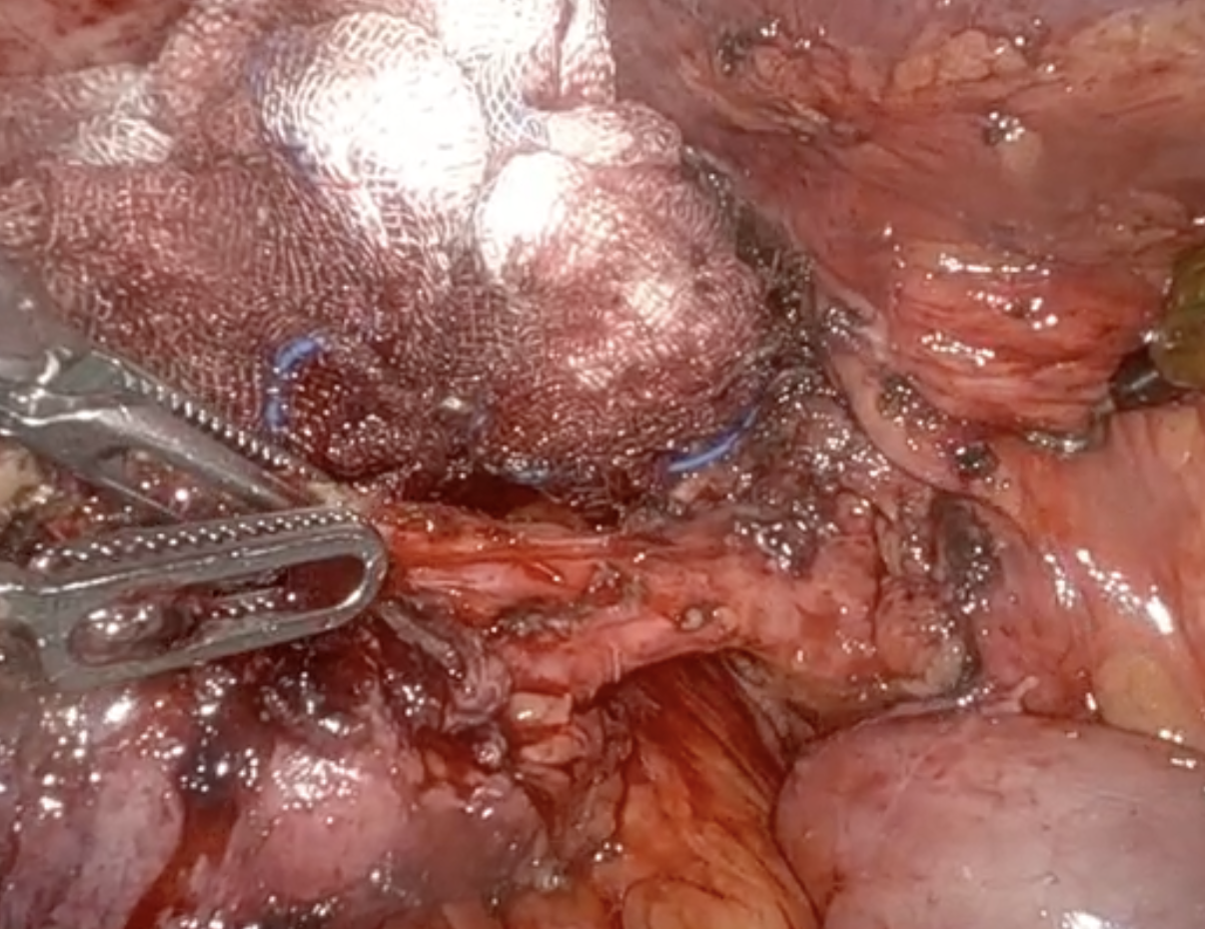
Preserving safety in difficult cholecystectomy: outcomes of robotic completion surgery at a tertiary center
Claire H Parker, Arianna Ferretti, Mallory Dunphy, Lokesh Patil, MPH, Sherif Abdel-Misih, MD, Aaron Sasson, MD, Georgios V Georgakis, MD, PhD
Introduction
Results
Cholecystectomy remains one of the most common surgical procedures performed. Over 700,000 cholecystectomies are performed each year in the United States, and over 90% of elective cholecystectomies are performed laparoscopically.
Figure 1. Critical view of safety for cholecystectomy
Common bile duct (CBD) injury, which is reliably prevented by observing the critical view of safety, is one of the most feared complications of cholecystectomy.
Hazardous inflammation can make the critical view of safety unattainable.
Some providers elect to do a subtotal cholecystectomy. One concern with the subtotal approach is persistence or development of symptomatic gallstones in the remnant, requiring completion cholecystectomy.
Others abort the procedure and plan for definitive operative management later, typically after 4 to 8 weeks.
Table 1. Patient Characteristics
Figure 2. Index Procedure Indication
Table 3. Robotic Completion Cholecystectomy Outcomes
 | Aborted ( n= 5) | Subtotal (n = 12)
Count (female) | 5 (3) | 12 (9)
Median age, years, (IQR) | 69 (63 – 71) | 45.5 (37 – 72.5)
Median BMI (IQR) | 30.4 (30.2 – 33.7) | 30.5 (29.2 – 34.8)
Comorbidities
Hypertension | 3 | 3
Hyperlipidemia | 4 | 3
Psychiatric disorders | 3 | 5
 | Aborted ( n= 5) | Subtotal (n = 12)
Successful completion (%) | 3 (60%) | 12 (100%)
Median operative time, minutes (IQR) | 158 (129 – 161) | 121 (100 – 149)
Median EBL, mL (IQR) | 50 (50 – 100) | 10 (10 – 50)
Cholelithiasis (%) | 3 (60%) | 8 (67%)
CBD exploration (%) | 0 (0%) | 1 (8.3%)
Drain placement (%) | 5 (100%) | 1 (8.3%)
Median postoperative LOS, days (IQR) | 4 (2 – 5) | 1 (1 – 2)
Median total LOS, days (IQR) | 4 (2 – 5) | 6 (3 – 7)
Complications (%) | 1 (20%) | 0 (0%)
30-day readmission (%) | 1 (20%) | 0 (0%)
BMI: body mass index; IQR: interquartile ratio
Table 2. Interval events and patient presentation
Figure 3. Index Procedure Approach
 | Aborted ( n= 5) | Subtotal (n = 12)
Median interval, days (IQR) | 42 (42 – 56) | 1,278 (365 – 3376)
Imaging & procedures
ERCP (%) | 1 (20%) | 6 (50%)
MRCP (%) | 2 (40%) | 6 (50%)
CT (%) | 2 (40%) | 10 (83%)
Ultrasound (%) | 0 (0%) | 7 (58%)
HIDA (%) | 0 (0%) | 2 (17%)
Symptoms
Acute (%) | 1 (20%) | 9 (75%)
Chronic (%) | 3 (60%) | 4 (33%)
Labs, median (IQR)
WBC count (K/uL) | 5.1 (3.2 – 8.0) | 6.6 (5.6 – 7.7)
Bilirubin, total (mg/dL) | 1.05 (0.88 – 1.2) | 0.55 (0.38 – 0.95)
ALP (IU/L) | 141 (126 – 155) | 144 (105 – 210)
ALT (IU/L) | 66 (41 – 90) | 66 (55 – 82)
AST (IU/L) | 97 (61 – 132) | 41 (25 – 54)
IQR: interquartile ratio; EBL: estimated blood loss; CBD: common bile duct; LOS: length of stay
Conclusion
Subtotal cholecystectomy is an important bail‑out strategy
Remnant gallbladder disease is a recognized long‑term risk
Robotic completion cholecystectomy enables safe reoperation
Referral to hepatobiliary centers may optimize outcomes
Objective
To detail our institutional experience with robotic completion cholecystectomy at a tertiary hepatobiliary center in patients with prior attempted cholecystectomy or gallbladder remnants after subtotal cholecystectomy, focusing on clinical presentation, operative strategy, and perioperative morbidity.
Limitations and next steps
Limitations: Single‑center, retrospective design with a small, heterogeneous cohort limits generalizability and precludes direct comparison with alternative management strategies
Next Steps: Future multi‑center studies are needed to compare outcomes across management strategies and evaluate long‑term symptom resolution following robotic completion cholecystectomy.
Methods
Design: Retrospective case series
Intervention: robotic completion cholecystectomy
Outcomes: (1) successful completion cholecystectomy; (2) perioperative morbidity
Setting: Tertiary hepatobiliary center
Study Period: July 2019 – November 2025
Population: patients undergoing reoperation for cholecystectomy
IQR: interquartile ratio; ERCP: endoscopic retrograde cholangiopancreatography; MRCP: magnetic resonance cholangiopancreatography; CT: computed tomography; HIDA: hepatobiliary iminodiacetic acid; WBC: white blood cell; ALP: alkaline phosphatase; ALT: alanine aminotransferase; AST: aspartate aminotransferase
References
Figure 4. Intraoperative images of robotic completion cholecystectomy with (L) and without (R) indocyanine green cholangiography
Concors SJ, Kirkland ML, Schuricht AL, et al. Resection of gallbladder remnants after subtotal cholecystectomy: presentation and management. HPB (Oxford). 2018;20(11):1062-1066. doi:10.1016/j.hpb.2018.05.005
Vollmer CM, Callery MP. (2007 Sep 1) Biliary injury following laparoscopic cholecystectomy: why still a problem? Gastroenterology 133: 1039–1041.
Strasberg SM, Brunt LM. (2010 Jul 1) Rationale and use of the critical view of safety in laparoscopic cholecystectomy. J Am Coll Surg 211:132–138.
Strasberg SM, Pucci MJ, Brunt LM, Deziel DJ. (2016 Jan 1) Subtotal Cholecystectomy–“Fenestrating” vs “reconstituting” subtypes and the prevention of bile duct injury: definition of the optimal procedure in difficult operative conditions. J Am Coll Surg 222:89–96.
Elshaer M, Gravante G, Thomas K, Sorge R, Al-Hamali S, Ebdewi H. (2015 Feb) Subtotal cholecystectomy for “difficult gallbladders”: systematic review and meta-analysis. JAMA Surg 150:159–168.
SinghA,Kapoor A, SinghRK,Prakash A,BehariA,Kumar Aet al. (2018 Feb) Management of residual gall bladder: a 15-year experience from a north Indian tertiary care centre. Ann Hepatobiliary Pancreat Surg 22:36–41.
Phillips MR, Joseph M, Dellon ES, Grimm I, Farrell TM, Rupp CC. (2014 Jul 1) Surgical and endoscopic management of remnant cystic duct lithiasis after cholecystectomy—a case series. J Gastrointest Surg18:1278–1283.
Pernice LM, Andreoli F. (2009 Nov) Laparoscopic treatment of stone recurrence in a gallbladder remnant: report of an additional case and literature review. J Gastrointest Surg Off J Soc Surg Aliment Tract 13: 2084–2091.
Palanivelu C, Rangarajan M, Jategaonkar PA, Madankumar MV, Anand NV. (2009 Jan) Laparoscopic management of remnant cystic duct calculi: a retrospective study. Ann R Coll Surg Engl 91:25–29.
Accreditation Council for Graduate Medical Education Surgery Case Logs [Internet]. ACGME. (2017). Available from: http://www.acgme.org/ Portals/0/PDFs/440_National_Report_Program_Version_2016-2017.pdf.
Strasberg SM, Linehan DC, Hawkins WG. (2009 Aug) The accordion severity grading system of surgical complications.Ann Surg 250:177–186.
van Dijk AH, Donkervoort SC, Lameris W, de Vries E, Eijsbouts QAJ, Vrouenraets BC et al. (2017 Sep) Short- and long-term outcomes after a reconstituting and fenestrating subtotal cholecystectomy. J Am Coll Surg 225:371–379.
Disclosures
GVG and SAM report consulting relationships with ThermaSolutions. All other authors report no conflicts of interest.

