Slide 1
Antibiotic Stewardship
2025
May 2025
Notes:
Created February 27, 2024

Slide 2
What is Antibiotic Stewardship?
Antibiotic Stewardship: the effort to measure and improve how antibiotics are prescribed by clinicians and used by patients
Antibiotic Stewardship is the responsibility of all healthcare practitioners!
Notes:
Management and care of appropriate antimicrobial use, selection, and treatment, while limiting use when no infection is present

Slide 3
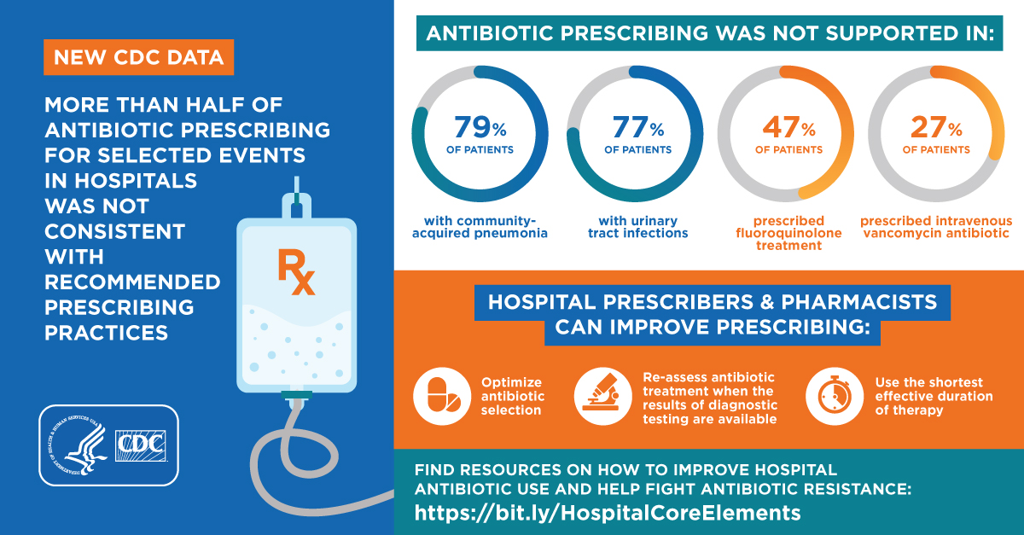
Benefits of Antibiotic Stewardship
Improved quality of patient care
Reduced adverse events including C. difficile infection
Decrease spread of antibiotic resistance
Optimized resource utilization
Antibiotic Stewardship programs in acute care hospitals are now mandated by Joint Commission and CMS for accreditation!

Slide 4
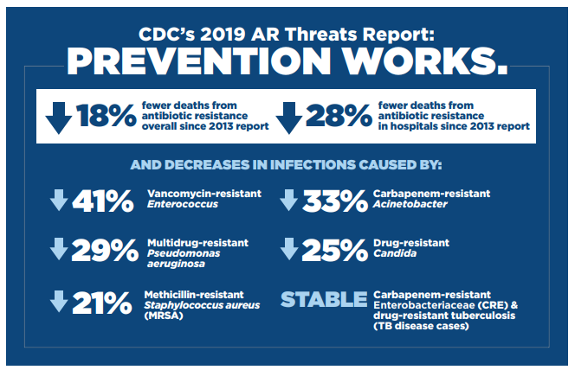

Antibiotic Stewardship Works!
2019 Antibiotic Resistance Threats Report. Centers for Disease Control and Prevention.
https://www.cdc.gov/drugresistance/biggest-threats.html. Published November 23, 2021.
Accessed September 19, 2022.
Notes:
According to the CDC, there have been 18% fewer deaths from antibiotic resistance since their 2013 report
Additionally, there have been 28% fewer deaths from antibiotic resistance in hospitals alone since 2013
However, much of this progress has been lost due to the effects of the COVID-19 pandemic

Slide 5


Appropriate Antibiotic Prescribing
Use shortest effective antibiotic duration
Reassess antibiotic therapy
Use guidelines for antibiotic use
Surveillance of antibiotic use and resistance

Slide 6
Examples of Better Antibiotic Prescribing
Reassess the need for antibiotics daily
De-escalate broad spectrum antibiotics when not needed
Changing from piperacillin/tazobactam to sulfamethoxazole/trimethoprim for a sensitive E. coli UTI
Performing antibiotic timeouts
Follow evidence-based recommendations for duration of therapy
Prescribe only 5-7 days of antibiotics for community-acquired bacterial pneumonia
Avoid antibiotics when there is no infection
For example, bacteriuria does not require treatment in most asymptomatic persons

Slide 7
Examples of the Nursing Role in Antibiotic Stewardship
Early and appropriate cultures
Antibiotic dosing, culture reporting, and de-escalation
Obtain cultures before starting antibiotics
Adverse events
Monitor and report to the physician and pharmacist any adverse events including diarrhea.
Patient education, medication reconciliation
Educate the patient and family, and perform discharge teaching
Review clinical and laboratory renal function results, drug levels, and preliminary/final microbiology results.

Slide 8
Examples of the Pharmacist Role in Antibiotic Stewardship
Accurate antibiotic allergy and medication history
Promote optimal medication dosing
Clarify allergy histories, perform medication histories and review medication reconciliation
IV-to-PO antibiotic transitions
Guide prescribers on appropriate stepdown conversions
Patient and prescriber education
Educate patients and prescribers about antibiotics
Perform pharmacokinetic monitoring and drug/dose/frequency adjustments

Slide 9
Institutional Resources to Improve Antibiotic Use
Antibiograms
Institutional Guidelines
Antimicrobial Stewardship Website
Antimicrobial Stewardship Team

Slide 10
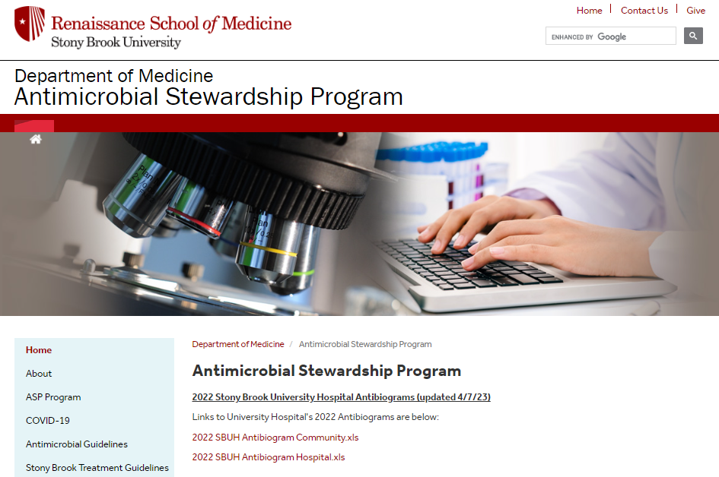
Knowing Local Susceptibility Data
Antibiograms
    Profile of antimicrobial susceptibilities of organisms isolated from patients within Stony Brook University Hospital
    Data is collated annually
    Provides percentage of resistant organisms isolated in the hospital laboratory
    While helpful when deciding on the best antibiotic, choices still need to be tailored to your patient and the infection being treated
Current antibiograms can be found on the Antimicrobial stewardship website

Slide 11
Utilize Institution Guidelines
 Available on the Antimicrobial Stewardship Program Website 
Treatment specific guidelines
Examples: Clostridioides difficile, Community Acquired Bacterial Pneumonia, COVID-19, Neutropenic Fever, Urinary Tract Infection
Drug dosage guides
Vancomycin, Aminoglycosides
Dosing in Obese Patients
Antimicrobial Prescribing Policies and Protocols
Restricted Antibiotics
IV to PO Conversion/Sequential Therapy

Slide 12
Restricted Antibiotics
Antibiotics that are restricted to services including SBUH Infectious Diseases (Adult and Pediatrics) or Antimicrobial Stewardship
May be dispensed for up to 24 hours without ID/ASP approval (except for Fosfomycin)
Artesunate
Cefiderocol (Feftroja)
Ceftaroline (Teflaro)
CefTAZidime/avibactam (Avycaz)
Ceftolozane/tazobactam (Zerbaxa)
Fidaxomicin (Dificid)*
Fosfomycin (Monorul)
Maribavir (Livtencity)
Minocycline (Minocin)
Nirmatrelvir/ritonavir (Paxlovid)
Omadacycline (Nuzyra)
Peramivir (Rapivab)**
Remdesivir (Veklury)
Sulbactam-durlobactam (Xacduro)
SBM Policy MM0086
*May also be approved by Gastroenterology
** May also be approved by Pulmonology/Critical Care

Slide 13
IV to PO Conversions/
Sequential Therapy
Pharmacists will notify you about changing certain IV antibiotics to oral equivalents
  Example: azithromycin 500mg IV to azithromycin 500mg tablet
  Medications and criteria are campus specific
The pharmacist will perform the change for you
SBM Policy MM0092

Slide 14
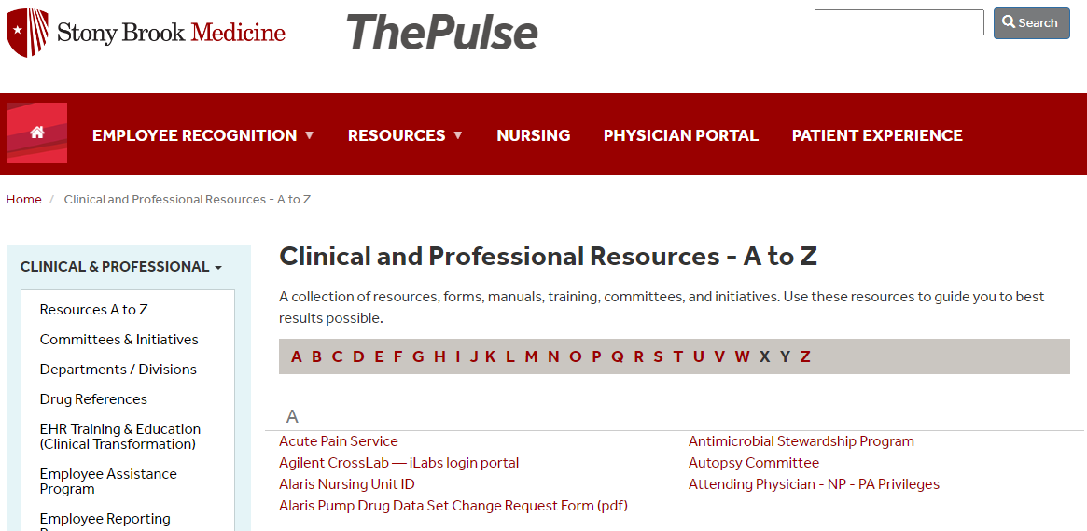

Stony Brook Medicine Antimicrobial Stewardship Website
https://renaissance.stonybrookmedicine.edu/medicine/asp
Use the QR code to access
Link to the webpage can be found on The Pulse under “Resources”
https://renaissance.stonybrookmedicine.edu/medicine/asp

Slide 15


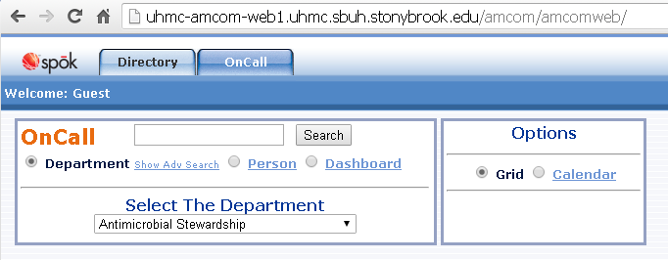


Antimicrobial Stewardship Team at SBUH
How we can help:
Answer questions on appropriate antibiotics
Perform therapeutic dose monitoring (vancomycin, aminoglycosides)
Identify De-escalation opportunities
Develop institutional guideline
Physician Leads
Pharmacist Leads
Roderick Go, DO
Adult ASP
Katherine De Jesus, PharmD
Adult ASP
Find us on Spok
Dalia Eid, MD
Pediatric ASP
Matthew Unruh, PharmD
Adult ASP

Slide 16


Slide 17

Summary
Antibiotic stewardship improves patient outcomes, decreases adverse events related to antibiotic including C.difficile infections, and decreases the spread of antibiotic resistance
Antibiotic Stewardship is the responsibility of all healthcare practitioners!
There are many resources available to help you practice good antibiotic stewardship
  Antimicrobial Stewardship webpage
  Antibiograms
  Institutional Disease and Dosing Guidelines
  Institutional Protocols and Policies
  The Antimicrobial Stewardship team

Slide 18
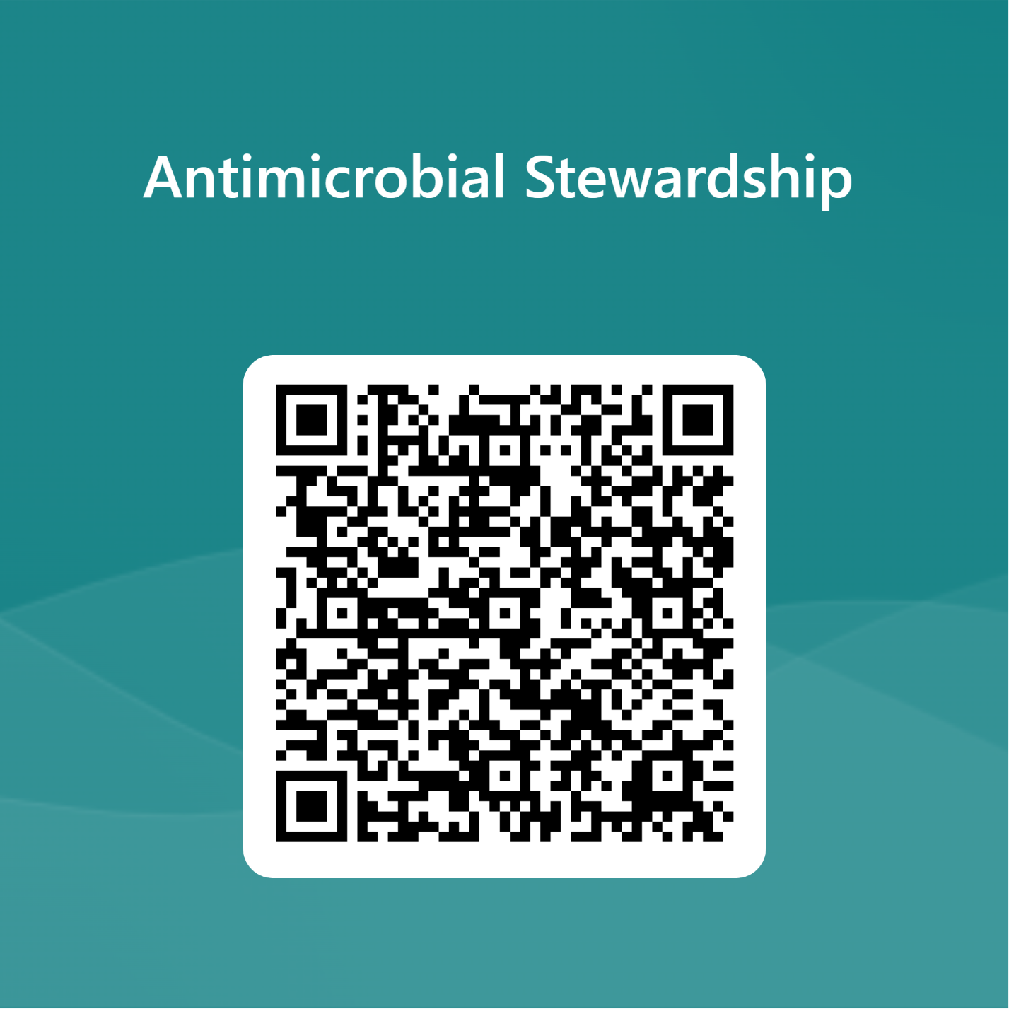
Please complete required competency exam
https://forms.office.com/Pages/ResponsePage.aspx?id=MRv66pSxXUKzZlbCFbd2DKX4S52_abdHmHhhZ9cOUftUMkRLSTg3N1lMMk1INkMzT1JYNTJBVkVFMi4u

