Slide 1
Antibiotic Stewardship
2024
Notes:
Created February 27, 2024

Slide 2
What is Antibiotic Stewardship?
Antibiotic Stewardship: Management and care of appropriate antimicrobial use, selection, and treatment, while limiting use when no infection is present
Antibiotic Stewardship is the responsibility of all healthcare practitioners!

Slide 3
Benefits of Antibiotic Stewardship
Improved quality of patient care
Reduced adverse events including C. difficile infection
Decrease spread of antibiotic resistance
Optimized resource utilization
Antibiotic Stewardship programs in acute care hospitals are now mandated by Joint Commission and CMS for accreditation!

Slide 4
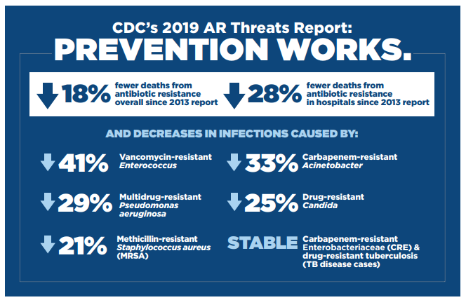
Antibiotic Stewardship Works!
2019 Antibiotic Resistance Threats Report. Centers for Disease Control and Prevention.
https://www.cdc.gov/drugresistance/biggest-threats.html. Published November 23, 2021.
Accessed September 19, 2022.
Notes:
According to the CDC, there have been 18% fewer deaths from antibiotic resistance since their 2013 report
Additionally, there have been 28% fewer deaths from antibiotic resistance in hospitals alone since 2013
However, much of this progress has been lost due to the effects of the COVID-19 pandemic

Slide 5
Appropriate Antibiotic Prescribing
Use shortest effective antibiotic duration
Reassess antibiotic therapy
Use guidelines for antibiotic use
Surveillance of antibiotic use and resistance

Slide 6
Examples of Better Antibiotic Prescribing
Reassess the need for antibiotics daily
De-escalate broad spectrum antibiotics when not needed
Changing from piperacillin/tazobactam to sulfamethoxazole/trimethoprim for a sensitive E. coli UTI
Performing antibiotic timeouts
Follow evidence-based recommendations for duration of therapy
Prescribe only 5-7 days of antibiotics for community-acquired bacterial pneumonia
Avoid antibiotics when there is no infection
For example, bacteriuria does not require treatment in most asymptomatic persons

Slide 7
Examples of the Nursing Role in Antibiotic Stewardship
Early and appropriate cultures
Antibiotic dosing, culture reporting, and de-escalation
Obtain cultures before starting antibiotics
Adverse events
Monitor and report to the physician and pharmacist any adverse events including diarrhea.
Patient education, medication reconciliation
Educate the patient and family, and perform discharge teaching
Review clinical and laboratory renal function results, drug levels, and preliminary/final microbiology results.

Slide 8
Examples of the Pharmacist Role in Antibiotic Stewardship
Accurate antibiotic allergy and medication history
Promote optimal medication dosing
Clarify allergy histories, perform medication histories and review medication reconciliation
IV-to-PO antibiotic transitions
Guide prescribers on appropriate stepdown conversions
Patient and prescriber education
Educate patients and prescribers about antibiotics
Perform pharmacokinetic monitoring and drug/dose/frequency adjustments

Slide 9
Institutional Resources to Improve Antibiotic Use
Antibiograms
Institutional Guidelines
Antimicrobial Stewardship Website
Antimicrobial Stewardship Team

Slide 10
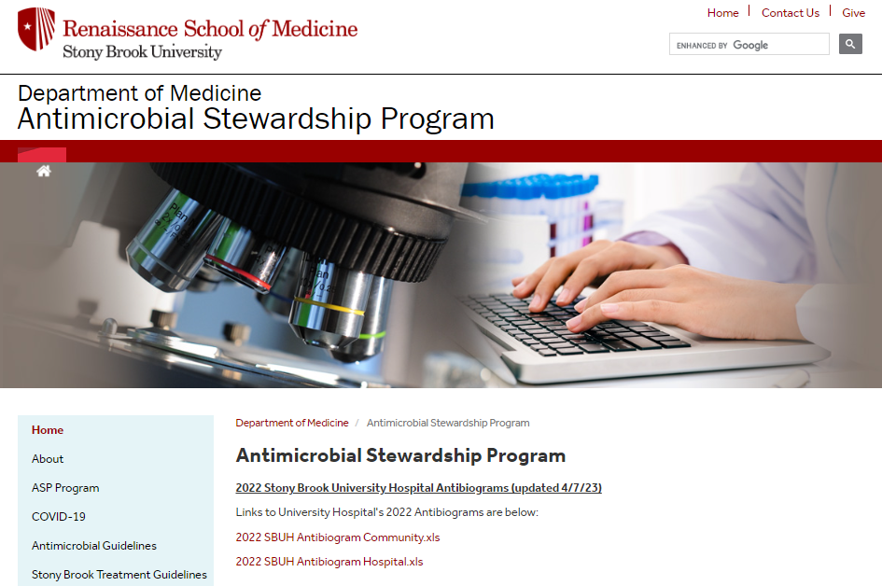
Knowing Local Susceptibility Data
Antibiograms
Profile of antimicrobial susceptibilities of organisms isolated from patients within Stony Brook University Hospital
Data is collated annually
Provides percentage of resistant organisms isolated in the hospital laboratory
While helpful when deciding on the best antibiotic, choices still need to be tailored to your patient and the infection being treated
Current antibiograms can be found on the Antimicrobial stewardship website

Slide 11
Utilize Institution Guidelines
 Available on the Antimicrobial Stewardship Program Website 
Treatment specific guidelines
Examples: COVID-19, Clostridioides difficile, Community Acquired Bacterial Pneumonia, Neutropenic Fever
Drug dosage guides
Vancomycin, Aminoglycosides
Antimicrobial Prescribing Policies and Protocols
Restricted Antibiotics

Slide 12
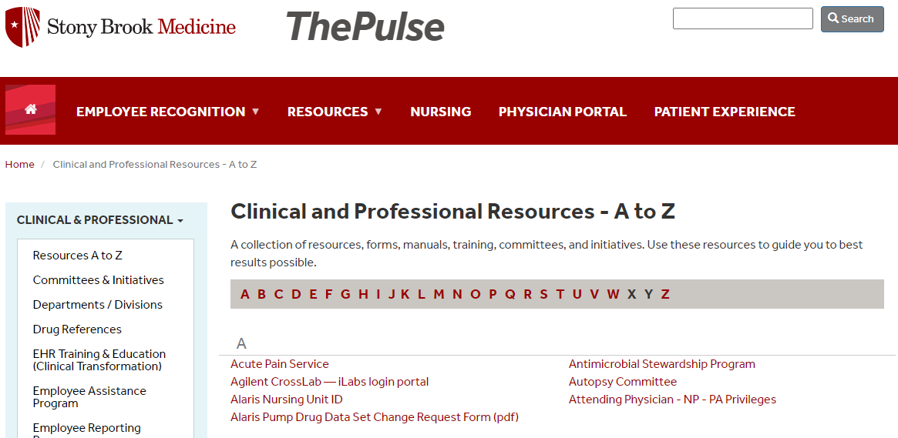
Stony Brook Medicine Antimicrobial Stewardship Website
https://renaissance.stonybrookmedicine.edu/medicine/asp
Use the QR code to access
Link to the webpage can be found on The Pulse under “Resources”
https://renaissance.stonybrookmedicine.edu/medicine/asp

Slide 13
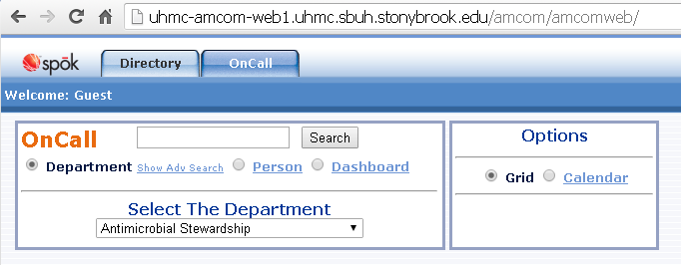
Antimicrobial Stewardship Team at SBUH
How we can help:
Answer questions on appropriate antibiotics
Perform therapeutic dose monitoring (vancomycin, aminoglycosides)
Identify De-escalation opportunities
Develop institutional guideline
Physician Leads
Pharmacist Leads
Roderick Go, DO
Adult ASP
Katherine De Jesus, PharmD
Adult ASP
Find us on Spok
Dalia Eid, MD
Pediatric ASP
Matthew Unruh, PharmD
Adult ASP

Slide 14
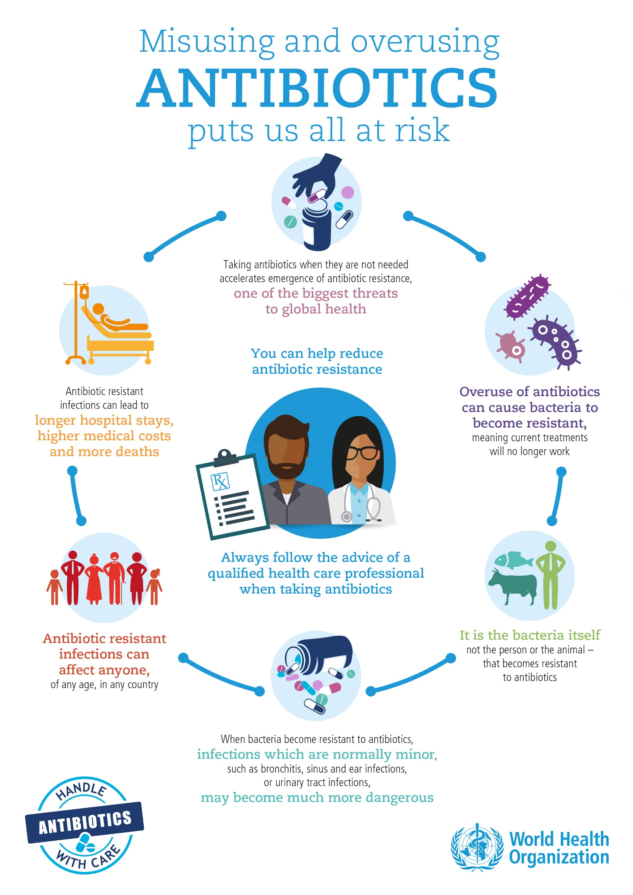

Slide 15
Summary
Antibiotic stewardship improves patient outcomes, decreases adverse events related to antibiotic including C.difficile infections, and decreases the spread of antibiotic resistance
Antibiotic Stewardship is the responsibility of all healthcare practitioners!
There are many resources available to help you practice good antibiotic stewardship
Antimicrobial Stewardship webpage
Antibiograms
Institutional Disease and Dosing Guidelines
Institutional Protocols and Policies
The Antimicrobial Stewardship team

Slide 16
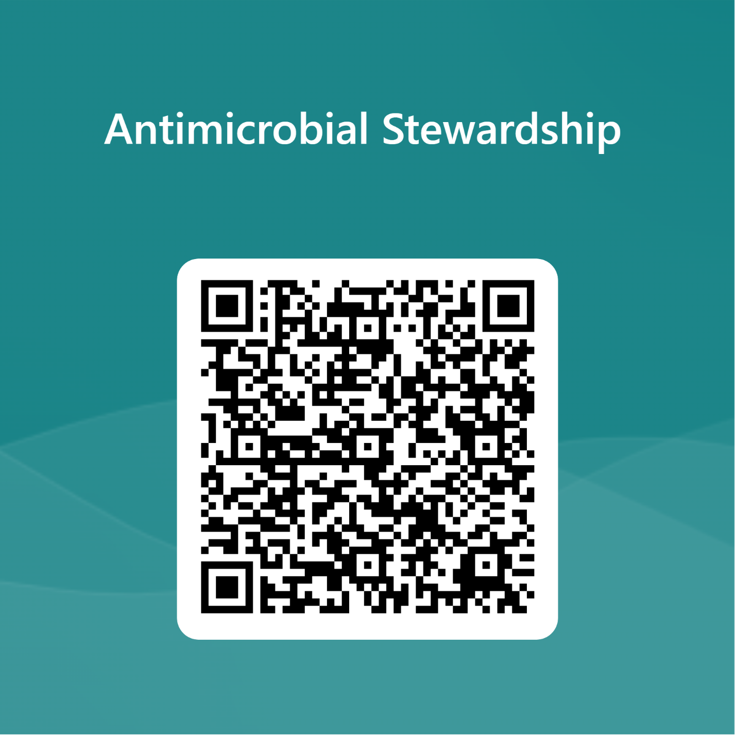
Please complete required competency exam
https://forms.office.com/Pages/ResponsePage.aspx?id=MRv66pSxXUKzZlbCFbd2DKX4S52_abdHmHhhZ9cOUftUMkRLSTg3N1lMMk1INkMzT1JYNTJBVkVFMi4u

