Slide 1
Antimicrobial Stewardship
&
Antibiotic Resistance
Roderick Go, DO - Adult Antimicrobial Stewardship
Dalia Eid, MD - Pediatric Antimicrobial Stewardship
Katherine De Jesus, PharmD - Adult Antimicrobial Stewardship
11/17/2022

Slide 2
What is Antimicrobial Stewardship?
Stewardship: Management or care of something
Antimicrobial Stewardship: Management and care of appropriate antimicrobial use, selection, and treatment, while limiting use when no infection is present
Antimicrobial Stewardship is the responsibility of all healthcare providers!

Slide 3
Responsibilities of Antimicrobial Stewardship
Promote appropriate and optimal use of antimicrobials
Minimize adverse events and emergence of resistance
Improve patient outcomes
Decrease spread of multi-drug resistant infections
Establish policies for antimicrobial usage

Slide 4
Benefits of Antimicrobial Stewardship
Improved quality of patient care
Reduced adverse events including C. difficile infection
Improved antibiotic susceptibilities
Optimized resource utilization
Antimicrobial Stewardship programs in acute care hospitals are now mandated by Joint Commission and CMS for accreditation!

Slide 5
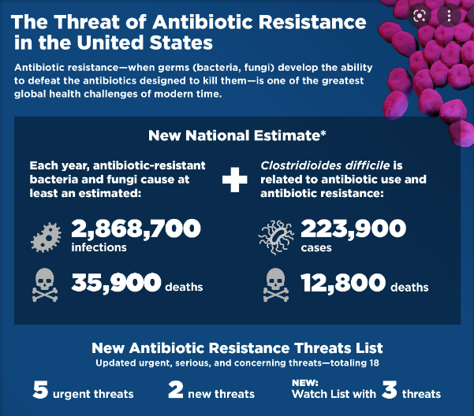
2019 Antibiotic Resistance Threats Report. Centers for Disease Control and Prevention. https://www.cdc.gov/drugresistance/biggest-threats.html. Published November 23, 2021. Accessed September 19, 2022.
Notes:
Antibiotic resistance has been a rising global health challenge in the United States
According to the CDC’s 2019 Antimicrobial Resistance Threats Report, more than 2.8 million antibiotic-resistant infections occur in the United States yearly
Of these infections that occur, more than 35,000 people in the US die yearly due to antibiotic-resistant infections
Worldwide, overall, antimicrobial resistance claims at least 1.27 million lives

Slide 6
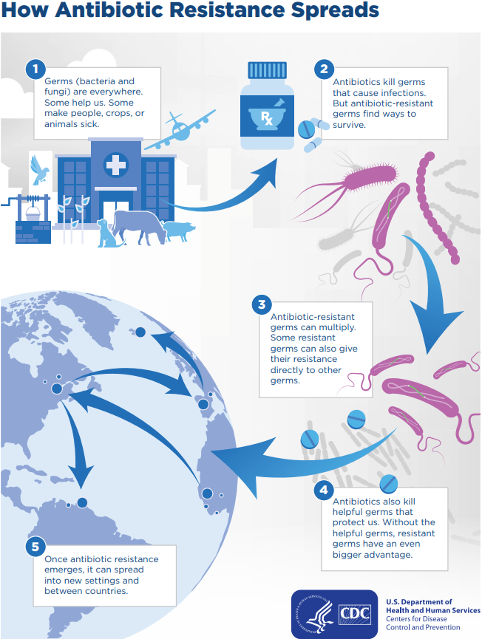
Antimicrobial Resistance
Occurs when germs develop the ability to defeat the drugs designed to kill them, and they continue to grow
Affects people at any stage of life, including healthcare, veterinary, and agriculture industries
Antimicrobial resistance can result in the inability to treat infections and control public health threats
The pace of development of new antimicrobials is not keeping up with antimicrobial resistance
Any antibiotic use can lead to antibiotic resistance

Slide 7
Combating Antibiotic Resistance
Handwashing
Stay up to date with vaccinations
Stay informed about current outbreaks
Complete full courses of antibiotics
Notify providers about recent travel
Appropriate antibiotic prescribing
Follow infection prevention recommendations
Alert receiving facilities of antibiotic resistance
Patients
Providers
Notes:
Recently traveled or received care in another country: Antibiotic resistance can spread in hospitals, farms, the community, and the environment

Slide 8

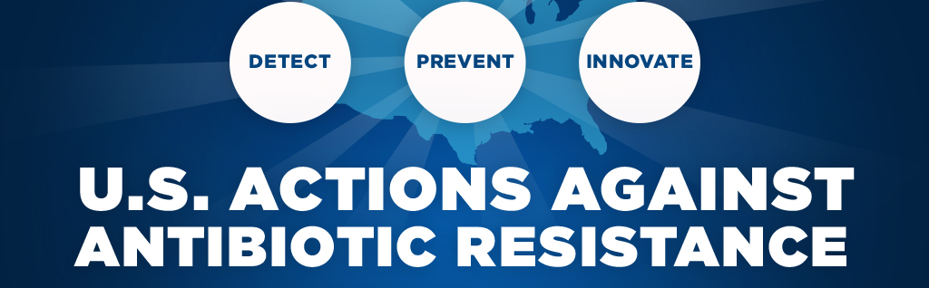
Appropriate Antibiotic Prescribing
Use shortest effective antibiotic duration
Reassess antibiotic therapy
Use guidelines for antibiotic use
Surveillance of antibiotic use and resistance

Slide 9
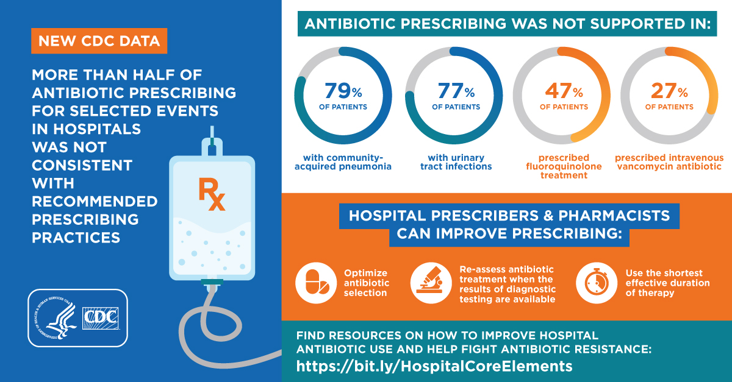
Core Elements of Antibiotic Stewardship. Centers for Disease Control and Prevention. https://www.cdc.gov/antibiotic-use/core-elements/index.html. Published April 7, 2021. Accessed September 19, 2022.

Slide 10
Adverse Effects of Poor Antimicrobial Use
Use of second and third line agents
Extended hospital stays
Additional outpatient visits
C. difficile infection
Increased deaths due to bacterial infection
Notes:
Use of second and third line agents: Expensive, more adverse effects, prolonged care and recovery, and eventual exhaustion of treatment options

Slide 11
Examples of Better Antibiotic Prescribing
Reassessing the need for antibiotics daily
De-escalating broad spectrum antibiotics when not needed
Changing from piperacillin/tazobactam to sulfamethoxazole/trimethoprim for a sensitive E. coli UTI
Performing antibiotic timeouts
Following evidence-based recommendations for duration of therapy
5-7 days of antibiotics for community-acquired bacterial pneumonia
Avoiding antibiotics when there is no infection
Bacteriuria does not require treatment in most asymptomatic persons

Slide 12
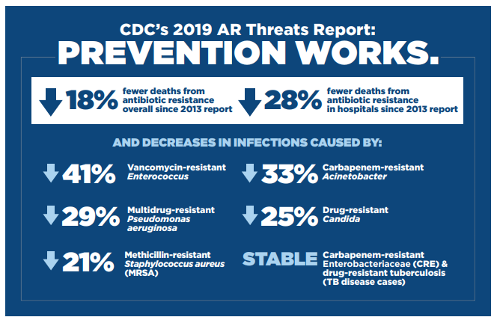

CDC’s 2019 Antimicrobial Resistance Threats Report
2019 Antibiotic Resistance Threats Report. Centers for Disease Control and Prevention. https://www.cdc.gov/drugresistance/biggest-threats.html. Published November 23, 2021. Accessed September 19, 2022.
Notes:
According to the CDC, there have been 18% fewer deaths from antibiotic resistance since their 2013 report
Additionally, there have been 28% fewer deaths from antibiotic resistance in hospitals alone since 2013
However, much of this progress has been lost due to the effects of the COVID-19 pandemic

Slide 13
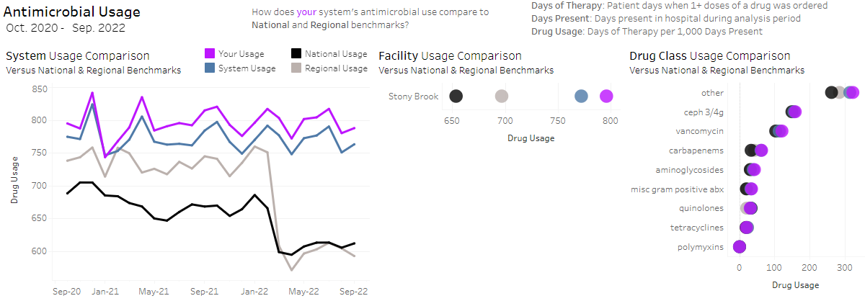
How Are We Doing at
Stony Brook Medicine?
Antibiotic use at Stony Brook is overall higher compared to other institutions

Slide 14
Antimicrobial Stewardship Team
Stony Brook University Hospital
Adult Antimicrobial Stewardship
Roderick Go, DO
Katherine De Jesus, PharmD
Pediatric Antimicrobial Stewardship
Dalia Eid, MD
Southampton Hospital
Christine Holuka, PharmD
Eric Sin, MD
Eastern Long Island Hospital
Raymond Krupski, PharmD
Visit our website for more information:
https://renaissance.stonybrookmedicine.edu/medicine/asp
Notes:
https://renaissance.stonybrookmedicine.edu/medicine/asp

Slide 15
How can your Stewardship Team help you?
Restricted antimicrobials
Check this link for restricted antimicrobial agents https://renaissance.stonybrookmedicine.edu/medicine/asp
Guidance with antimicrobial choices
Initial empiric choices
De-escalation options
Assistance with antimicrobial dosing
Examples: Vancomycin, Aminoglycosides

Slide 16

Summary
Antimicrobial resistance is a public health threat
Antibiotics are important for combating life-threatening bacterial infections but can have side effects
Antibiotic overuse promotes development of drug-resistant germs
Antimicrobial Stewardship can assist with appropriate antibiotic use
Antimicrobial Stewardship is the responsibility of all healthcare providers!

Slide 17
