Slide 1
C. difficile Reflex testing based on ordering location Prepared by the Preventing C. diff Infection Workgroup
Updated 5/24

Slide 2
Categorizing CDI – Testing and Detection
Beginning January 2, 2020, Stony Brook will be utilizing a two-step testing algorithm including a PCR (polymerase chain reaction) and EIA (enzyme immunoassay) for all Inpatient and ED locations.
The PCR test is highly sensitive and specific test for toxigenic genes. It cannot distinguish between active infection and asymptomatic carriage
The EIA test has a low sensitivity, but high specificity for the toxin production. It helps to determine an active infection or asymptomatic carriage
The EIA test will result after a +PCR result in PowerChart
Utilizing both PCR and EIA testing helps clinicians determine an appropriate treatment plan based on active infections or asymptomatic carriage.

Slide 3
Categorizing CDI – Testing and Detection
Two-step testing protocol
▪ 1. C. difficile toxin PCR (note: this is not available in the GI/diarrhea PCR panel)
▪ 2. Positive PCR results are reflexed to a C. difficile toxin EIA
• CDI testing is limited to attending physicians if the patient has any of the following:
o < 3 bowel movements documented in the EMR
o Recent laxative use in the past 48 hours
o Prior CDI testing within the past 7 days
• Stool specimens that are not liquid will be rejected by the laboratory
• If patient has an ileus, rectal swab should be used for stool sample collection
o For this specimen type please consult with the Molecular Diagnostics Laboratory at x4-3747

Slide 4
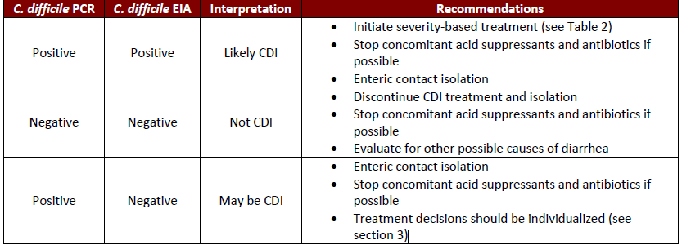
When to Reflex?
PCR + EIA Reflex Testing
How to Interpret your CD Test Results Table 1.

Slide 5
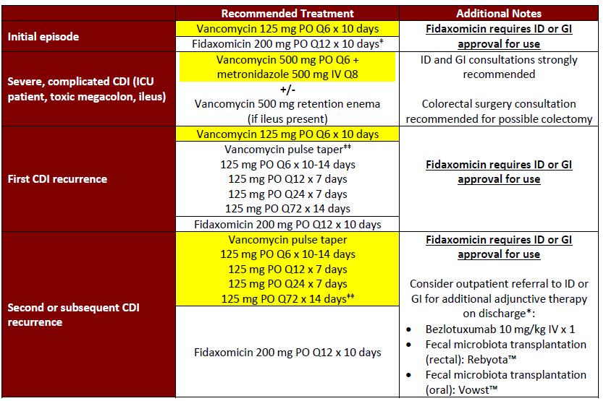
When to Reflex?
PCR + EIA Reflex Testing
Treatment Recommendations (preferred regimens highlighted in yellow) Table 2.
*Bezlotoxumab, Rebyota, and Vowst are not on the hospital formulary and are not available for inpatient use.
‡Note that fidaxomicin use for the initial episode of CDI has been associated with a 16% relative risk reduction in recurrent CDI. However, this needs to be balanced with the high cost expense of fidaxomicin therapy compared to oral vancomycin, which may ultimately impact on patient adherence.
‡‡The duration of vancomycin pulse taper regimens may vary depending on clinical factors. Consultation with ID or GI is recommended.

