Slide 1
Venous Thromboembolism (VTE)
Revised 6/2026
Reviewed for LMS 6/2026 kp

Slide 2
MAJOR PEARLS
Refusal of mechanical or pharmacological VTE prophylaxis should be discussed with the patient. Alternatives explored.
VTE prophylaxis needs to be ordered within the first 24 hours (for heart failure patients, the clock starts at registration time, not admission time).
VTE Advisor needs to be completed within 12 hours to avoid order lock out.
Pharmacologic prophylactic anticoagulation very rarely needs to be held pre-op (brain and spine always contraindicated).
Most patients with major abdominal surgery should be discharged on apixaban 2.5mg for VTE prophylaxis.

Slide 3
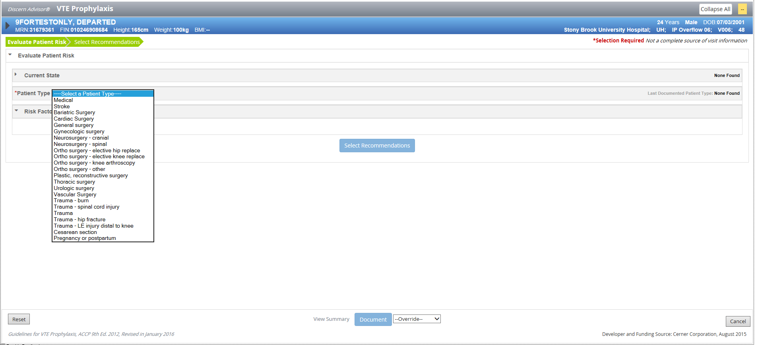
COMPLETE WHEN PLACING ADMISSION ORDERS
SELECT PATIENT TYPE
ENSURE APPROPRIATE COMPLETION OF THE VTE ADVISOR.
RISK ASSESSMENT COMPLETED THROUGH VTE ADVISOR. NURSES NEED A VTE RISK LEVEL.

Slide 4
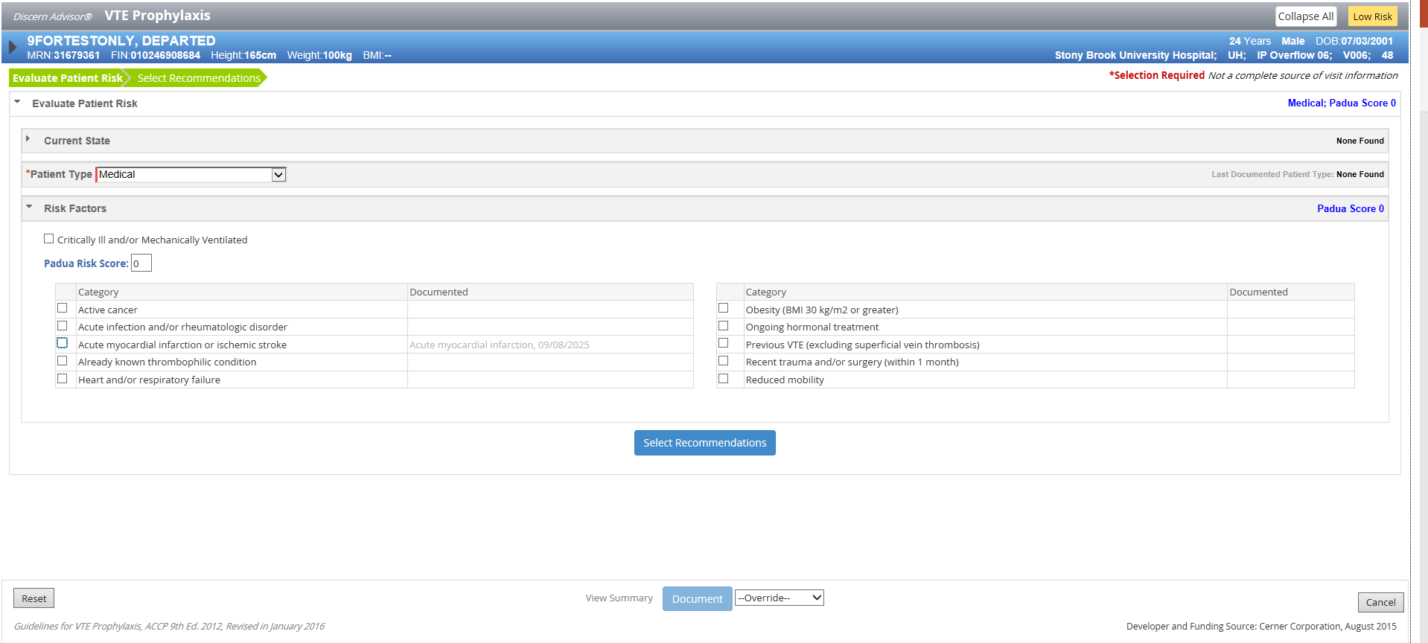
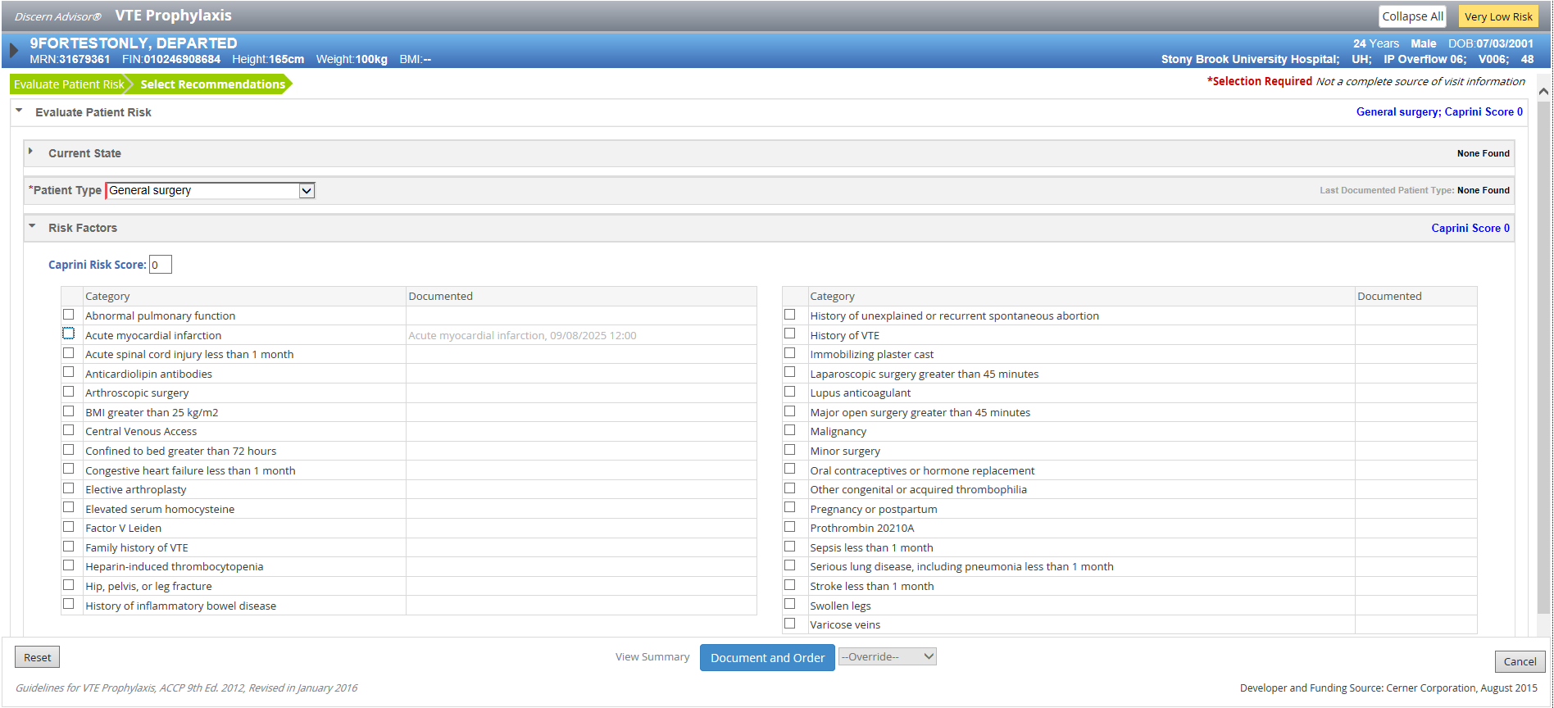
MEDICAL- PADUA SCORE
SURGICAL- CAPRINI SCORE

Slide 5
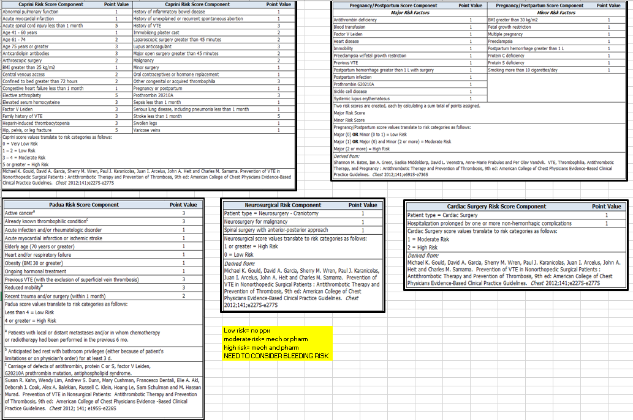
RISK ASSESSMENTS IN CERNER

Slide 6
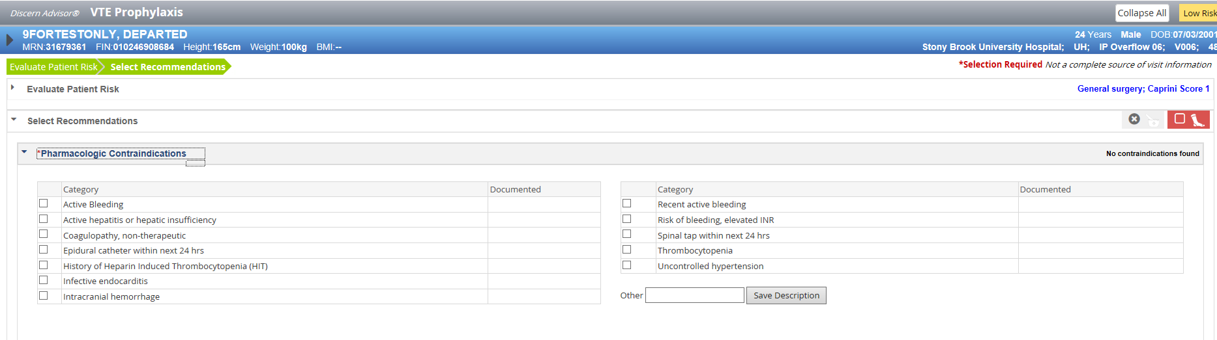
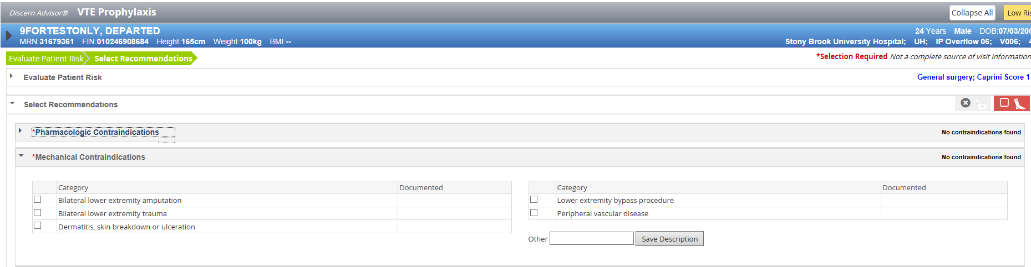
AUTOPOPULATES CONTRAINDICATIONS

Slide 7
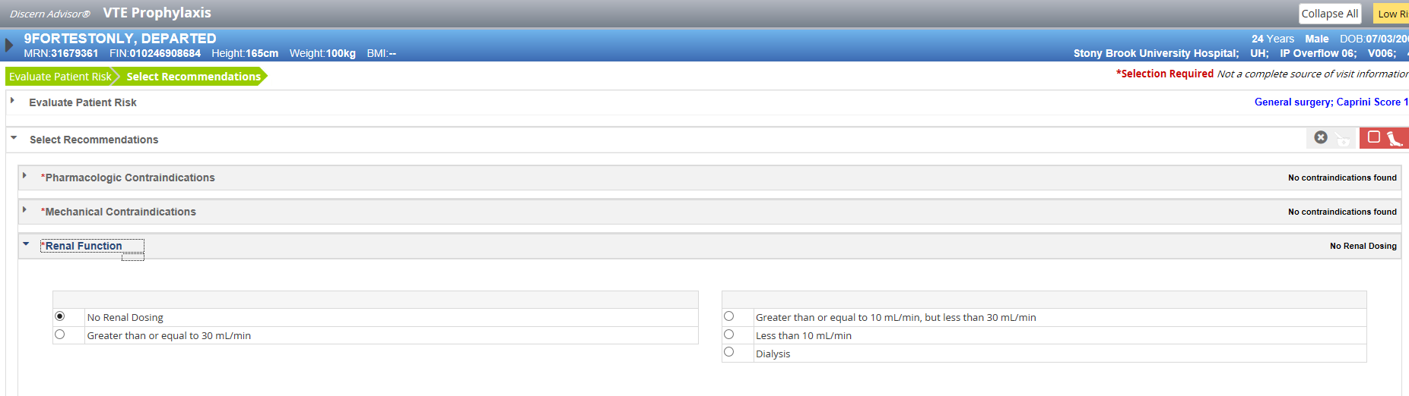
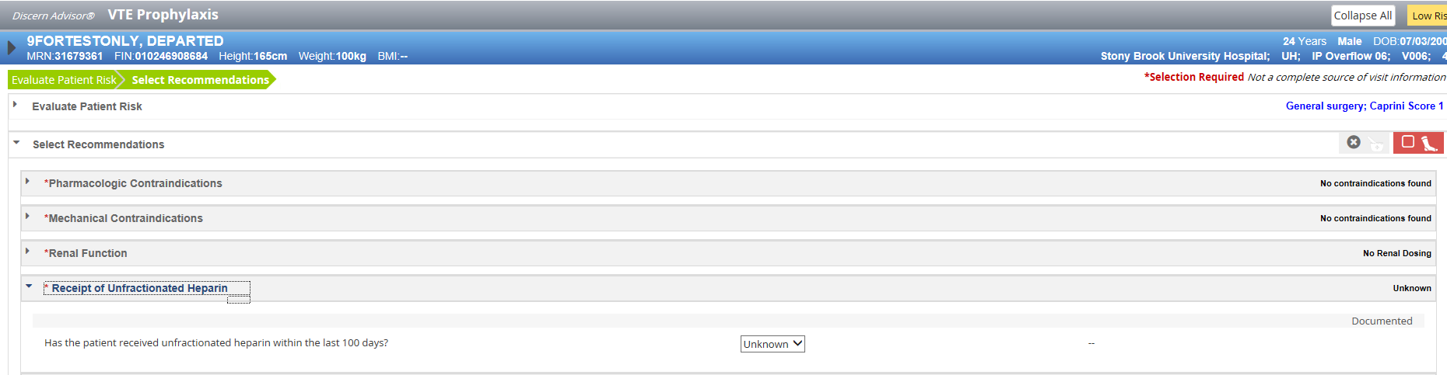
RENAL DOSING AND H/O HEPARIN AUTOPOPULATE

Slide 8
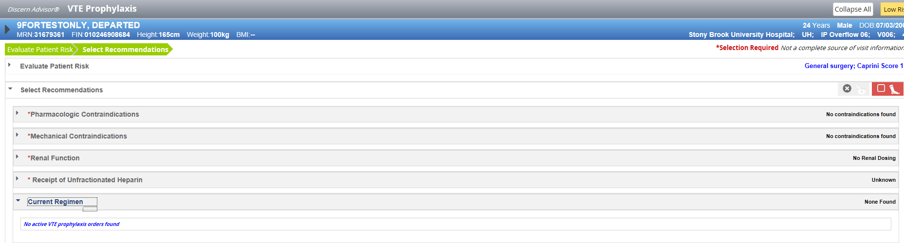
CURRENT REGIMEN- AUTOPOPULATES

Slide 9
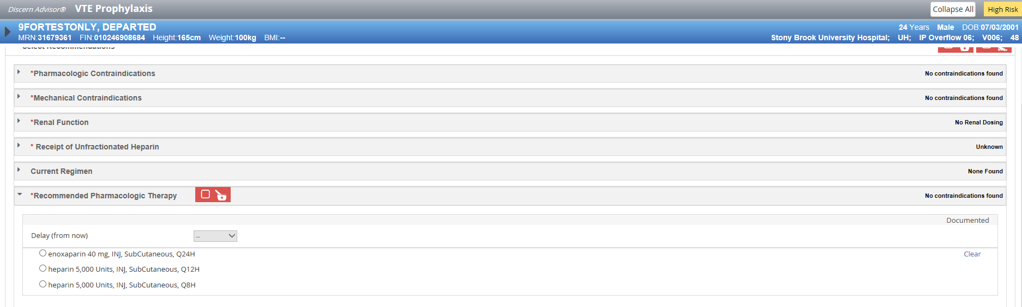
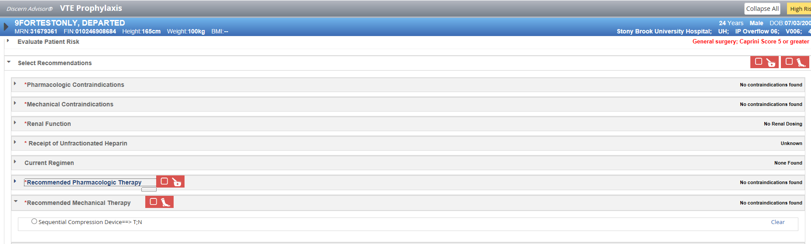
IF NOTHING IS ORDERED, CAN ORDER PHARMACOLOGICAL OR MECHANICAL PPX HERE

Slide 10
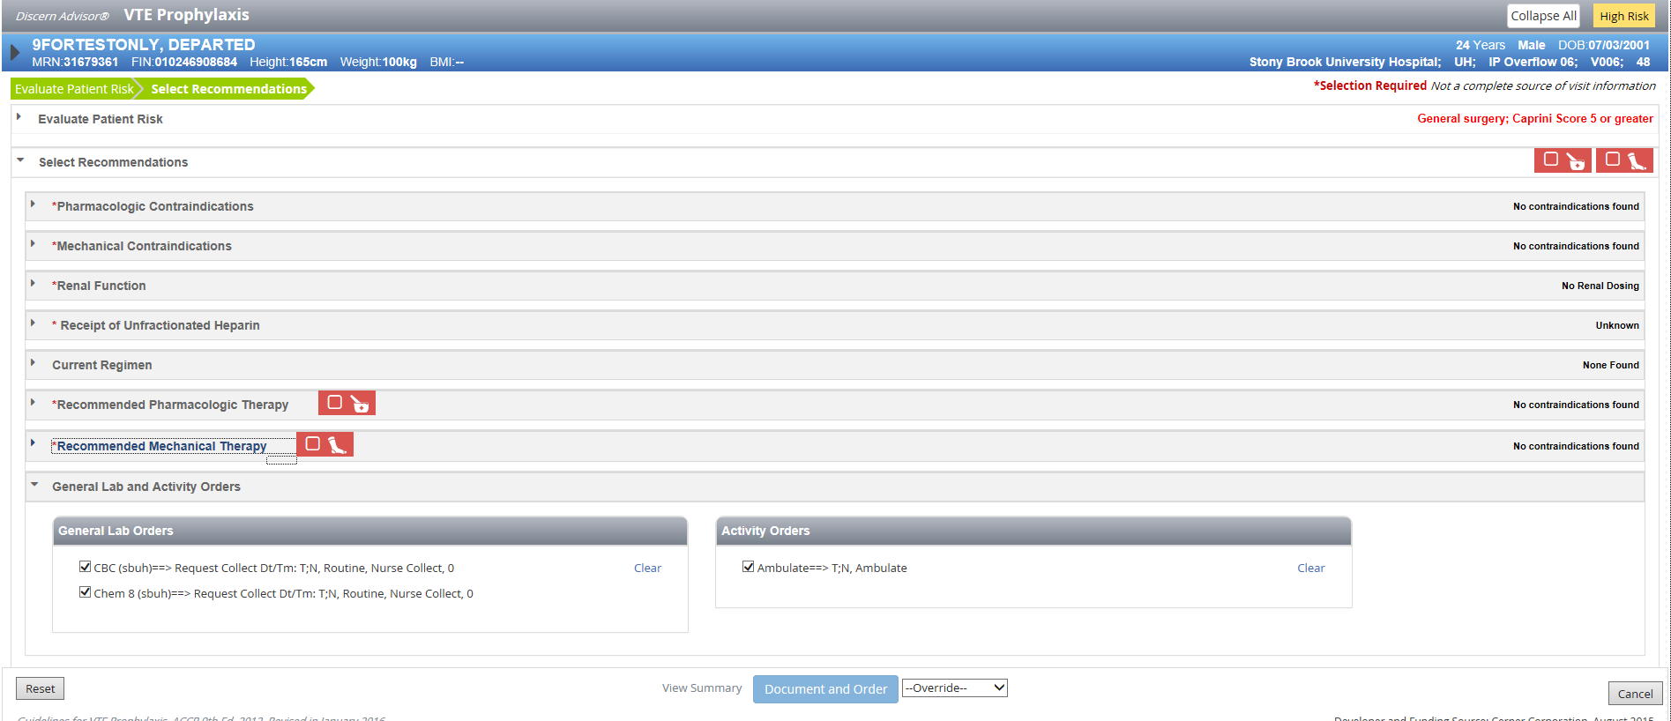
CAN ORDER LABS HERE
AFTER, SELECT DOCUMENT AND ORDER BUTTON

Slide 11
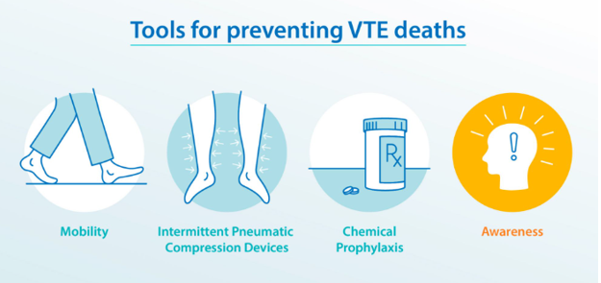
PREVENTION OF VTE

Slide 12
LOW RISK | MODERATE RISK | HIGH RISK
-Minor surgery in mobile patients -Medical patients that are FULLY mobile | -Most general, open GYN or URO surgery patients -Medical patients on bedrest | -Hip/ knee replacement -Hip fracture surgery -Major trauma -Spinal cord injury -Any surgery lasting >4 hours
-Early AGGRESSIVE ambulation | -LMWH 40mg QDay -LDUF BID/ TID; 5000u-7500u (obese) Q8H, Q12H -Fondaparinux 2.5 MG QD -Acute medically ill: rivaroxaban 10mg QD -Bleeding risk: Sequential compression device | -LMWH 40mg QDay -LDUF BID/TID; 5000u- 7500u (obese) Q8H, Q12H -Fondaparinux 2.5 MG QD -Hip/knee replacement: rivaroxaban/ apixaban AND -Sequential compression device
<10% risk of DVT without prophylaxis | 10-40% risk without prophylaxis | 40-80% risk without prophylaxis
Notes:
Rivaroxaban-Acutely ill medical patients:
Oral: 10 mg once daily for a total duration of 31 to 39 days (including hospitalization and postdischarge) (^{R}
Total hip arthroplasty or total knee arthroplasty:
Oral: 10 mg once daily initiated ≥6 to 10 hours after surgery or when hemostasis established.
Duration: Optimal duration of prophylaxis is unknown but it is usually given for a minimum of 10 to 14 days and can be extended for up to 35 days (^{Ref}); some experts suggest a duration in the lower end of the range (10 to 14 days) for total knee arthroplasty (TKA) or higher end of range (30 days) for total hip arthroplasty (THA)
FONDAPARINUX-Note: Prophylactic use contraindicated in patients <50 kg. Fondaparinux may be used in patients with a history of HIT

Slide 13
Pulmonary Embolism Response Team (PERT)
Consensus treatment plan specifically tailored to the needs of a particular patient.
Expert advice from a collaborative team (ED, Pulmonary, Interventional Radiology, Hematology, Vascular Surgery, Cardiothoracic surgery).
Data collection and reporting to improve patient outcomes.
PERT went live 08/06/2024. Data being entered into a national registry.

Slide 14
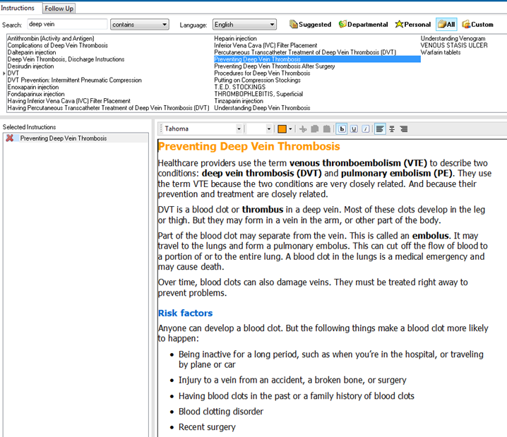
Discharge Education
Written VTE and anticoagulation education should be provided on discharge
VTE events often occur after discharge for up to 30 days

Slide 15

RESOURCE ON THE PULSE

Slide 16
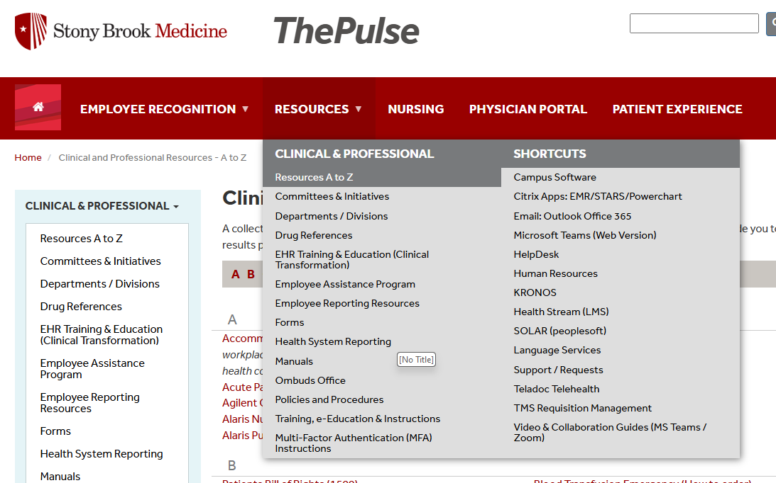
RESOURCE ON THE PULSE
Select “V”

Slide 17
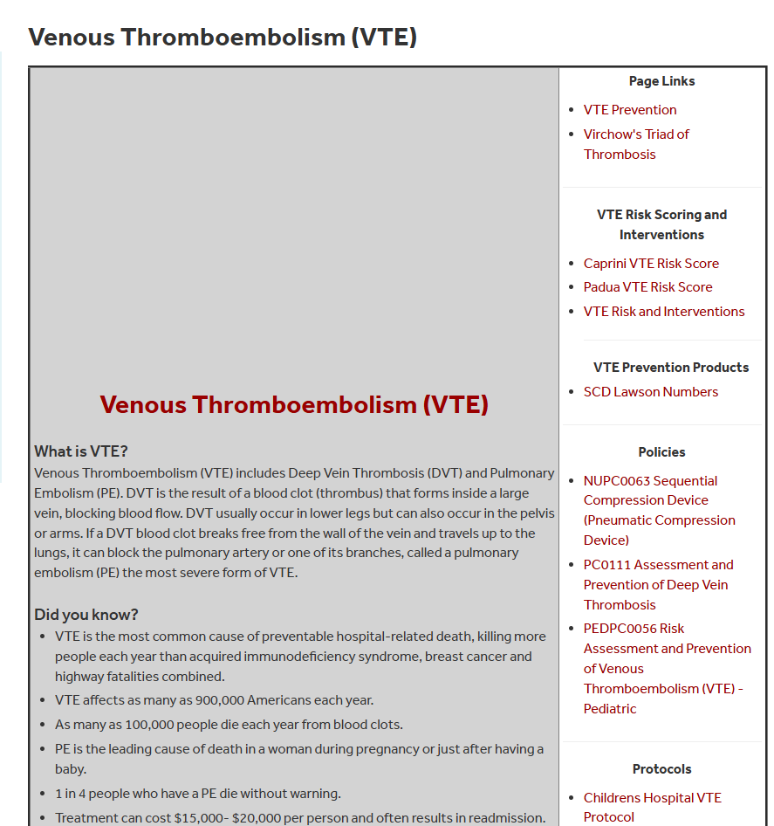
RESOURCE ON THE PULSE

Slide 18
VTE Team:
Dr. Angela Kokkosis
Kristan Probeck, NP (631-459-6991)
Lauren Koller, NP

