Slide 1
EQUAL OPPORTUNITY IN THE WORKPLACE:
Policies, Practices & Guidelines
Reviewed 5/2026

Slide 2

Stony Brook’s Commitment
University Policy Manual Equal Opportunity and Discriminatory Misconduct Policy Sexual Misconduct & Reporting Policy
Stony Brook University and Stony Brook Medicine are committed to equal employment and educational opportunity, and to creating workplace, educational and recreational environments that are safe and accessible, free from all forms of discrimination and that ensure that everyone in the Stony Brook University community is treated with respect, dignity, fairness, and equity. The Stony Brook University community includes, but is not limited to employees, students, visitors, guests, contractors, patients, volunteers and vendors associated with the institution.
.

Slide 3

The Office of Equity and Access’s (OEA) mission is to uphold and reaffirm Stony Brook University and Stony Brook Medicine’s commitment to environments free of all forms of discrimination.
OEA
The primary responsibilities of OEA are to:
Implement policies that safeguard equal opportunity in employment and education.
Establish Stony Brook-wide goals and internal systems to monitor recruitment activities, which includes but is not limited to hiring, training, promotion, transfer and termination,
Promote an awareness of and appreciation for equal opportunity, non-discrimination and sexual misconduct prevention through sponsoring programs, providing educational and training activities, and engaging in collaborative initiatives.
Provide employees with disabilities reasonable accommodation as requested, necessary and appropriate.
Impartial investigation and resolution of complaints of unlawful discrimination, including discriminatory harassment and sexual misconduct.
Mission

Slide 4
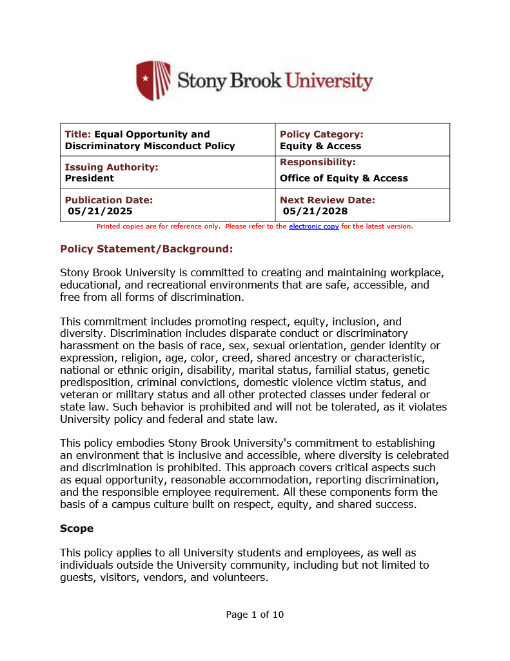
Stony Brook Policy
Equal Opportunity & Discriminatory Misconduct Policy
HIGHLIGHTS
Discrimination includes disparate conduct or discriminatory harassment on the basis of race, sex, sexual orientation, gender identity or expression, religion, age, color, creed, shared ancestry or characteristic, national or ethnic origin, disability, marital status, familial status, genetic predisposition, criminal convictions, domestic violence victim status, and veteran or military status and all other protected classes under federal or state law. Such behavior is prohibited and will not be tolerated, as it violates University policy and federal and state law.in the administration of Stony Brook policies, program of activities.
Responsible Employees, including supervisors and faculty members, are required to report incidents of discrimination.

Slide 5
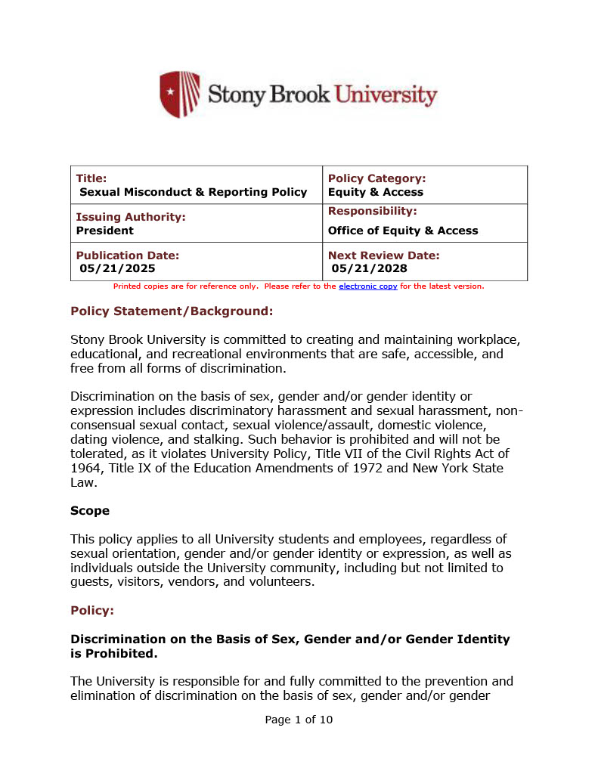
Stony Brook Policy
Sexual Misconduct and Reporting Policy
HIGHLIGHTS
Discrimination on the basis of sex, gender and/or gender identity is prohibited and includes but is not limited to: discriminatory harassment and sexual harassment, non-consensual sexual contact, sexual violence or assault, domestic violence, dating violence and stalking.
Sexual harassment is unwelcome sexual advances, requests for sexual favors and verbal, physical or communicative conduct of an abusive or sexual nature which interferes with individual work or academic performance or creates an intimidating, hostile or offensive work or academic environment.
Responsible Employees, including supervisors and faculty, are required to report any incident of sexual.

Slide 6
Stony Brook Policy
Sexual Misconduct and Reporting Policy
HIGHLIGHTS
Retaliation against an employee, student or any witness who participates in any University investigation is prohibited. Retaliation is also prohibited against any individual who files a discrimination complaint under participates in a complaint investigation in any way.
Retaliation is a form of discrimination under Stony Brook Policy as well as applicable Federal and State laws.
Fear of retaliation is the #1 reason targets of discrimination do not report. Stony Brook University takes all reports of retaliation seriously.

Slide 7
Discrimination Is… is disparate treatment as a result an individual’s membership in a protected class, such as:
Criminal Convictions
Genetic Predisposition
Domestic Violence Victim Status
Veteran or Military Status
Sex
National or Ethnic Origin
Age
Familial Status
Gender Identity or Expression
Marital Status
Creed
Disability
Race
Sexual Orientation
Color
Religion
Gender
Stony Brook Policy and Federal and State laws protect all members of the Stony Brook community from discrimination, including discriminatory harassment and sexual misconduct.

Slide 8
Discrimination Includes…
Discrimination in unequal, unfair or disparate treatment based on a protected class.
Discriminatory harassment or Sexual harassment, including sexual violence
Failure to provide reasonable accommodation
Failure to provide accessible facilities and digital platforms or content
Failure to promptly and effectively respond to a complaint
Quotas or “Diversity” Hiring
Retaliation
Individuals who are affected by or are aware of suspected cases of harassment or discrimination are urged to bring such situations to the University’s attention by contacting OEA. OEA has professional staff trained to conduct impartial investigations and provides assistance ending any on-going harassment.

Slide 9
What is Title IX & Sexual Misconduct?
Title IX is a comprehensive Federal Law that prohibits discrimination on the basis of sex, including sexual violence in any education program receiving federal funding, including Stony Brook University.
When Stony Brook University knows of an act of Title IX discrimination the University must take prompt and equitable steps to resolve the allegations and respond; including providing supportive measures designed to preserve access to the educational program.
Title IX protects all members of the Stony Brook community from sex and/or gender discrimination in nearly every facet of Stony Brook’s programs and activities, including Stony Brook Medicine, Stony Brook School of Medicine, Stony Brook School of Nursing or the Long Island State Veteran’s Home.
Title IX discrimination can impact anyone, regardless of sex, gender identity or expression or sexual orientation.
Under NYS and Federal laws discrimination on the basis of pregnancy or lgbtq* status is discrimination on the basis of sex.

Slide 10
Title IX Prohibits
Sex and/or Gender Based Discrimination
Sexual Harassment
Sexual Assault,
Domestic Violence,
Dating Violence, Stalking &
All Other Forms of Sexual Misconduct or Violence
Sexual assault, domestic violence, dating violence, stalking and all other forms of sexual misconduct are extreme forms of sexual harassment. Sexual harassment is a form of sex and/or gender based discrimination prohibited by Title IX.

Slide 11
Sexual Harassment includes…
HOSTILE WORK ENVIRONMENT
Conduct has the purpose or effect of unreasonably interfering with an individual's work or academic performance or creating an intimidating, hostile, or offensive working, living, or academic environment.
Types of behavior include:
Inappropriate gift giving, (flowers, jewelry, clothing, etc.)
Inappropriate touching, kissing, giving massages
Talking about personal sexual experiences in the presence of another individual, two employees having a conversation about their sexual exploits that happened over the weekend-- co-workers overhear the conversation and it is unwelcome.
Sending sexually suggestive jokes, comments or visuals via email at work
Displaying sexually suggestive art pieces, screen savers, posters, photos, etc.
QUID PRO QUO
Submission to conduct is made either explicitly or implicitly a term or condition of an individual's employment or academic advancement
submission to or rejection of such conduct by an individual is used as the basis for employment or academic decisions affecting such individual;
Targets of sexual harassment can be of any sex, gender or gender identity.

Slide 12
Supervisor Responsibilities
Responsible Employees (including supervisors and faculty) must report any known incidents of discrimination, including sexual misconduct, to OEA immediately.
Department chairs, directors, administrators, managers and supervisors are responsible for promoting an atmosphere that prohibits such unacceptable behavior.
Evaluate the workplace to for ongoing harassment. Report any concerns to OEA.
When possible, ensure that ongoing harassment stops.
Emphasize the policy against retaliation with all employees.
Reach out to OEA and/or Labor Relations for assistance.

Slide 13

Personal Experience
Recall an incident that occurred in your life/career in which you felt different people around you?
What Happened?
How did you feel?
How did this incident influence the choices you made in the future?

Slide 14

Do I Stereotype?
ASK YOURSELF:
DO I characterize whole groups of people together without regard for the individual?
DO I describe or depict individuals in stereotypical terms?
DO I consider individuals as “exceptions to the rule” if they do not fit my stereotype?
DO I deny individuality to a person because his/her behavior doesn’t fit my stereotype?
DO I expect an individual to be a spokesperson for everyone in a group?

Slide 15
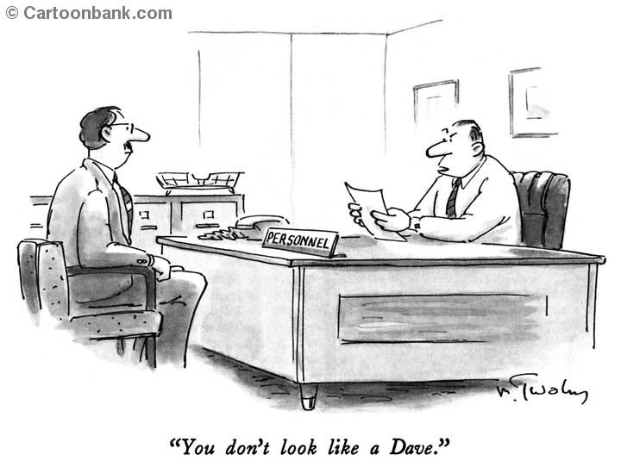
How can bias and stereotypes affect our decisions? What affects first impressions?
How do stereotypes play themselves out in the workplace? Think about the meaning of this cartoon – have you ever been In a situation where you met someone who didn’t look like you expected? What was that based on?
Acknowledge stereotypes exist. Social stereotypes about certain demographics or groups of people form outside of our own conscious awareness.

Slide 16
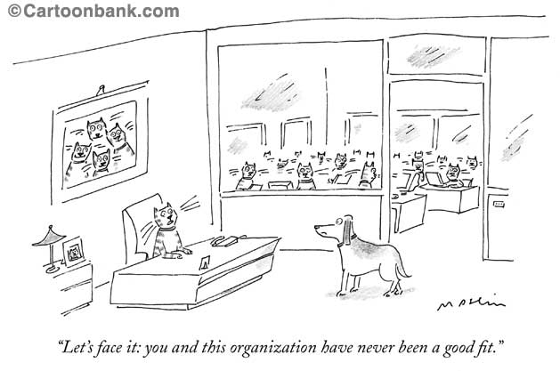
What is Inclusion?
What type of organization is a cat-only organization? How are meetings conducted? What language do they speak? What is the ideal work day like? What would be good reward for good work? What personalities and style of work are valued?
What requests might the dog make? The dog speaks the cat language – but maybe with an accent. Would the cat’s complain about the dog’s communication skills? Would they think the dog doesn’t understand them? The dog wants to start the meetings with a good run and a game of fetch as a team builder – the cats are frustrated by his energy.
All this can be related to the workplace. Are the structures part of the issue? How do you as a supervisor create a structure to help all of your employees succeed.
Inclusion provides the opportunity for all employees to develop their skills to their full potential because an inclusive organization is able to achieve common goals while valuing differences.

Slide 17
Unconscious Bias
Biologically we are hard-wired to prefer people who look like us, sound like us and share our interests.
“Social categorization‟ is the process whereby we routinely and rapidly sort people into groups.
This preference bypasses our normal, rational and logical thinking.
We use these processes very effectively (we call it intuition) but the categories we use to sort people are not logical, modern or perhaps even legal.
Unconscious bias is a hidden bias that affect day-to-day interactions, decisions, and access to opportunities. It is also known as Implicit Bias.

Slide 18

Lenses as Filters
We view the world through many lenses.
What worldview lenses (belief systems) am I seeing?
How have these lenses served me? How have they been helpful? Unhelpful?
What lenses can I discard and replace with better lenses?
Experience
+ Perceived Reality
The “Truth”

Slide 19
Unconscious Bias, Unconscious Effects Within the Work Environment
Workplace conflicts, leading to:
Discrimination allegations/grievances
Low morale, productivity, and tense working relationships
Issues with retention, terminations, resignations
Bullying and workplace violence
Low job productivity and employee satisfaction

Slide 20

What can you do?
Diversity and inclusion is a hard topic…It starts with awareness and grows with knowledge and exposure.
Enhancement of and interest in learning about new perspectives.
Polished cross-cultural encounters.
Professional decorum in the workplace.
Tone can be everything.

Slide 21

What can you do?
Recognize that you have biases.
Identify what those biases are.
Dissect your biases.
Decide which of your biases you will address first.
Look for common interest groups.

Slide 22

What can you do?
Seek first to understand before being understood
Observe and actively listen without judging-remember listening does not equate to agreeing
Be willing to allow people to express how they feel. Allow ownership of that feeling
When addressing issues – do not make blanket statements – speak about what occurred, how you interpreted it and what you would have liked to have seen instead.
Be willing to commit to future actions and learning.

Slide 23
Additional Guidelines
Remember that when you are at work, your focus should be on work. When in doubt stay professional!
The policies explained here also may apply at off-campus events and communications, including work related events, social events and social media.
Remember that the intent of your behavior may be harmless, but the impact of certain behavior (like jokes or stereotypical comments) may be harassment. Inappropriate, demeaning or derogatory comments may make someone feel uncomfortable working with you and may result in allegations of creating a hostile environment.
If the harassment is on-going, open and/or obvious then Stony Brook has notice and may be legally required to address it even if it was not formally reported. We encourage all employees to report any on-going discrimination to OEA.

Slide 24
Cultural Competence, Unconscious Bias & Improving Patient Care
How can you avoid making judgments about patient’s beliefs and practices ?
Examine aspects of communication:
Directness
Gestures and facial expression
Distance
Touch
Topics appropriate for discussion
Pace
Language
Understand your own responses to these behaviors and the emotions that they can trigger.
From Managing Diversity in Health Care, Gardenswartz & Rowe, 1998
Notes:
These hints come from “managing diversity in health care” Lee Gardenswartz and Anita Rowe - What might they add?
Not a checklist – remember everyone’s experience is different – but this can serve as a guide.
How can you avoid making judgments? When these things are different than your culture/style/preferences/how do you react? Some examples include:
Directness –If you ask ‘do you understand’ and the person nods or says yes, that may not be the case. They may not really understand. Instead of yes/no may need to rephrase question
Gestures and facial expression – demonstration of emotion – anger, joy, upset, kind of acceptable gestures varies by culture
Distance – how much space are you comfortable with – creating comfortable space
Touch – rules about who can be touched and where. Touching can be seen as a sign of disrespect
Topics appropriate for discussion – what information is discussed in private or with the family, vs. what is discussed with others.
Pace – are those with a more relaxed pace viewed as lazy, unreliable, unintelligent
Language – How open are you to working with people who speak with accents? How do you feel when people speak with family members or coworkers in their native language while you are working with them? If you are irritated in these situations, consider what it feels like for them. Do you know a second language? How easy is it for you to use, and how confident are you about your effectiveness when using it?
Page 113 – photocopy for notes

Slide 25
Best Practices
It’s all about respect! Respect is one of the hospital’s values and is essential in providing excellent care.
Communicate ongoing commitment to the values of diversity and non-discrimination.
Use inclusive language to remove perceived barriers.
Avoid disparate treatment – apply policies fairly and consistently.
Avoid stereotyping and question your own assumptions.
Consult with Human Resources for assistance if you need an accommodation. Be open to discussion.
When in doubt – Call! Consult with OEA, HR, and other departments that are designed to provide assistance.

Slide 26
Where is OEA located?
OEA Website = stonybrook.edu/oea/
University Policy Manual – stonybrook.edu/policy/
Sexual Misconduct & Title IX - stonybrook.edu/oea-sm-ix/
Accessibility & Accommodations - stonybrook.edu/oea-accessibility/
File a Complaint -stonybrook.edu/reportit
Where can I find out more?
West Campus Office, Administration Building , Room 201
631 632-6280 Phone 631 632-9428 Fax
East Campus Office, University Hospital, Level 4, room 121
Hospital lobby next the Admitting Dept. - by appointment
Notes:
P105 Equal Opportunity
P106 Sexual Harassment
P208 Relationships between university staff and students

Slide 27

Questions?
If you have any questions regarding the information presented, do not hesitate to contact the Office of Equity and Access at oea@stonybrook.edu or 631-632-6280.
Thank you for your participation.

