Slide 1

ED Note Writing 101
Carl Kaplan, MD
Pediatric Emergency Medicine
Stony Brook Children’s
August 2, 2017

Slide 2
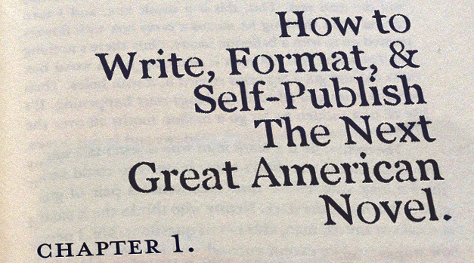
What to avoid!!!

Slide 3
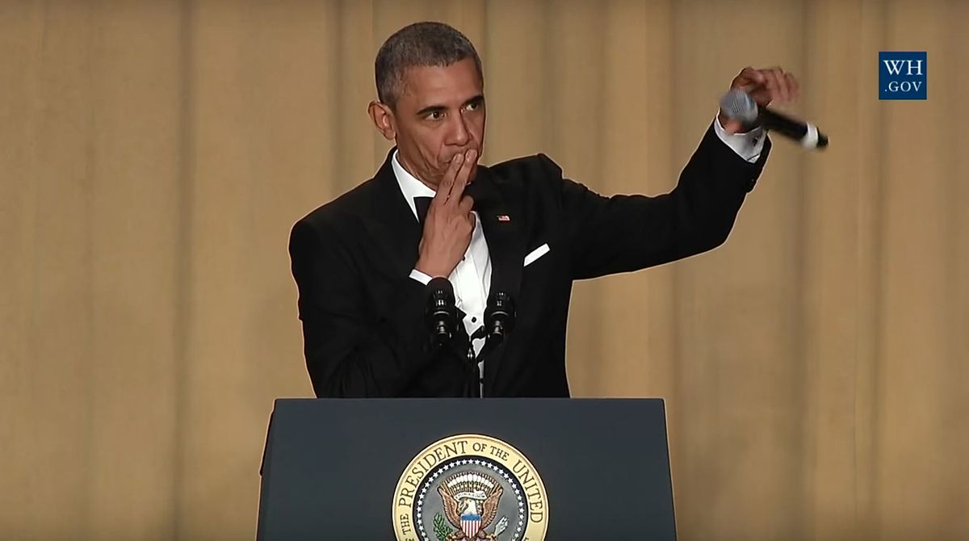
What we want to accomplish!
Streamline note writing
More clinical time, less screen time
Finish notes during shift

Slide 4
Why do we need to write notes in the ED…
Communication
Billing
Legal purposes

Slide 5
How long should the actual note take to complete?
3-5 minutes

Slide 6
Should notes in the ED be comparable to those in clinic or wards?
Deep Thought #1 … when was the last time you cut and paste an HPI from the ED note and used it for admission note???

Slide 7
What is 11 x 2 ???
22
The maximum amount of patients you will probably ever see in a shift

Slide 8
How long should notes take???
Rough estimates…
  22pts x (3-5 min) = 66 – 110 min
  9.2% – 15.3% of a 12 hour shift
What percentage of shift is screen time now?
What other tasks are delayed because of notes now???
Would this all be easier if there were fixed expectations.

Slide 9
What does CMS expect??
Key Elements of E/M coding
  History
  Physical Exam
  Medical decision making
Minor elements
  Counseling, coordination of care, nature of presenting problem, and time.
Procedures

Slide 10
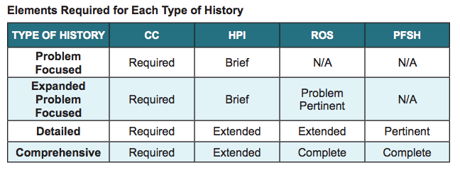
Focused vs. Comprehensive

Slide 11
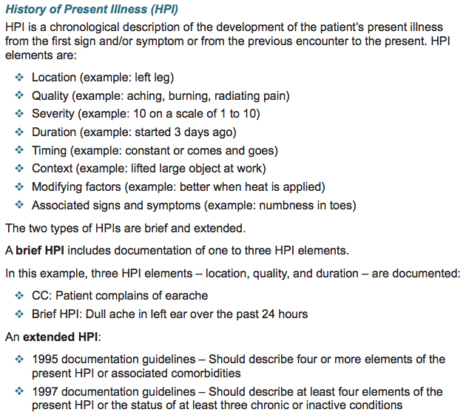
How Brief is “Brief”

Slide 12
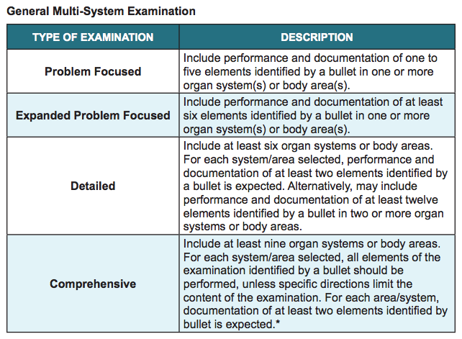
Focused vs. Comprehensive

Slide 13

Saving time
Best match note to chief complaint (s)
Import VS, PMHx if available
Place orders and review labs/imaging via note
Use procedure formats
Use re-evaluation formats
Pretend you are a surgeon reading your note
  Don’t rpt the same info 3 different times
  The title is “ED physician note” not “War & Peace”

Slide 14
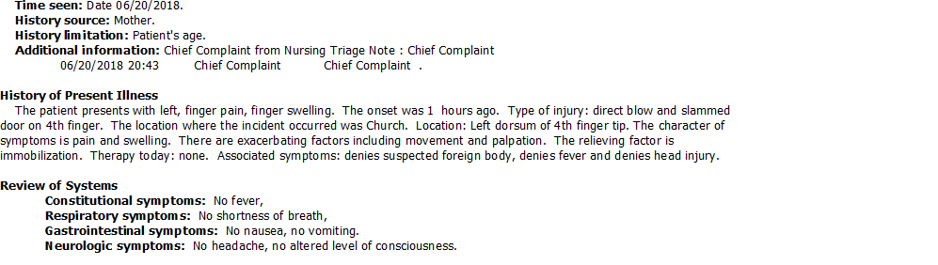
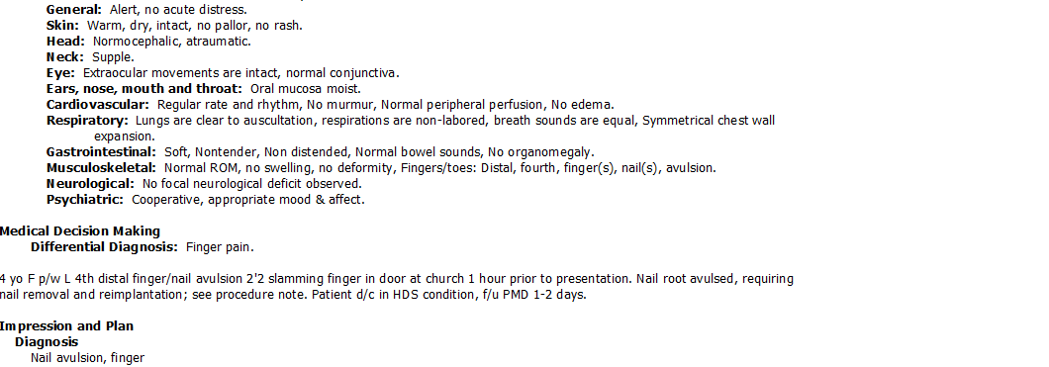
What’s good and what could be better???

Slide 15
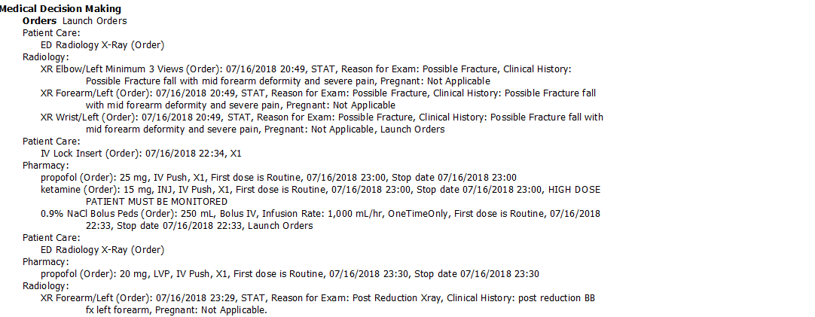
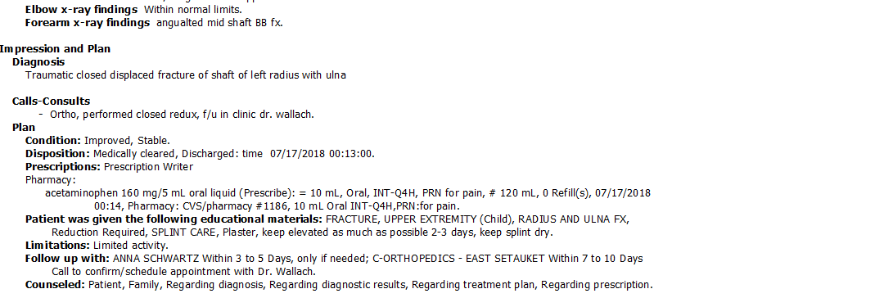

Slide 16
Addenda
This may be for your change of shift or to document care provided under a new attending when they change…
Choose “Addendum ED*” note
Who/When you received care from
Acknowledge the initial care
MDM
Disposition

Slide 17
ED Observation
Write a comprehensive note
  H/P/ROS/Past histories etc., then…
3 observation notes must be completed
  Initial (timed with ED obs order), periodic, disposition (discharge)
The observation notes will serve as serial exams, MDM, disposition (don’t write addendum)
Endorse notes to attending at the time of the note.

Slide 18
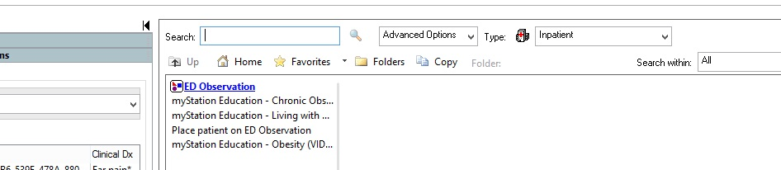
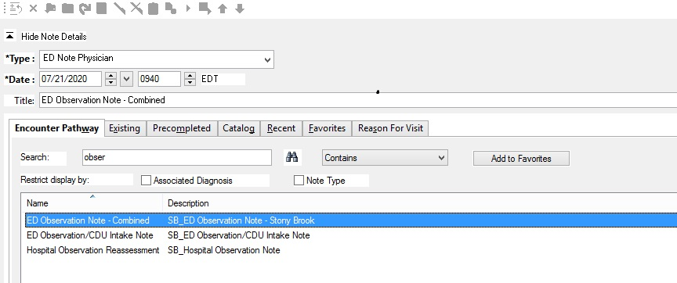
ED Observation

Slide 19
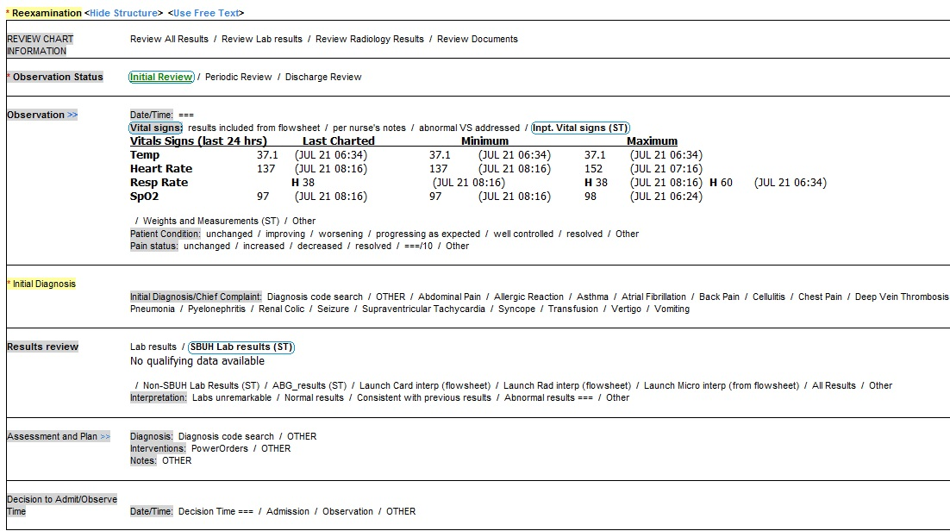
ED Observation

Slide 20
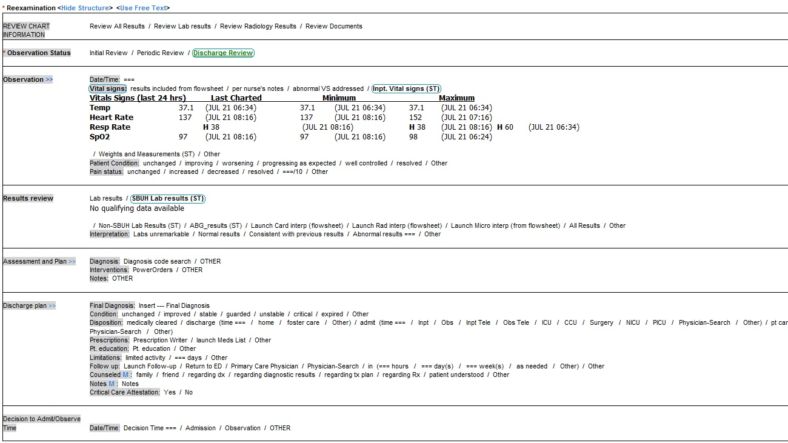
ED Observation

Slide 21
Saving time
Save Macro statements
Do no harm
  What faculty care about and evaluate
  What faculty don’t care about but lawyers do
Sometimes less is more
  Don’t obsess in the 11th hour
  Faculty must review/addend your notes
Faculty may write a discharge addendum or observation note, if so, ENJOY don’t REPEAT!

Slide 22
Necessities
Source of the info
HPI
ROS
PMHx, PSHx, Social Hx
Physical Exam
Results
Procedures
Diagnosis/Disposition

Slide 23


Slide 24
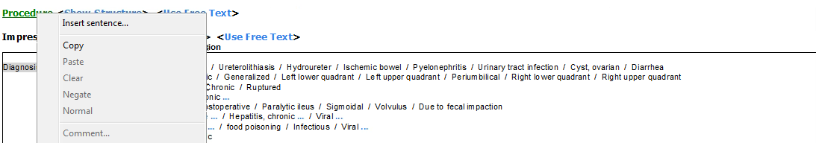
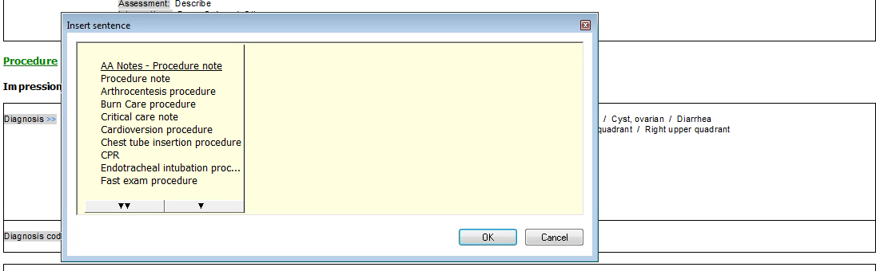
Procedure Documentation
Faculty have been instructed to fail procedures performed/assisted by residents in New Innovations if no note is written.

Slide 25
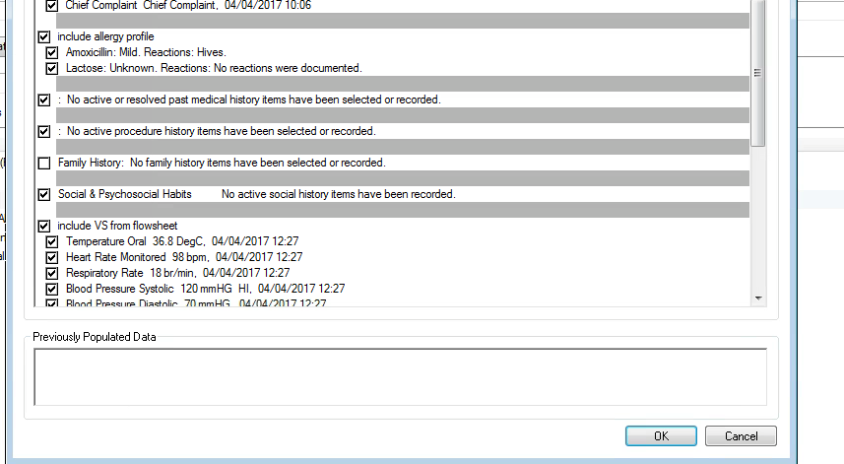
Import VS/PMHx

Slide 26
My Comprehensive 1 min HPI
12 yo M 6 days of intermittent, generalized abdominal pain, 15/10, worsening with meals, occasional NBNB nausea/vomiting and watery diarrhea. Today pain worse in RLQ, sent in for evaluation by PCP. No medications or interventions attempted.
ROS: decreased appetite, ankle sprain last week, infrequent BMs, nasal congestion, remainder negative.
PMHx: constipation, ADHD, depression
PSHx: T/A
Social: in school, lives at home, not sexually active, snorts oxycodone but only on w/e
Allergies: Tylenol, NSAIDS, Seroquel, haloperidol
Meds: Adderal, risperdone
Vax: UTD

