Slide 1
Updates to Estimating Risk for Early-Onset Sepsis (EOS) in the Newborn Nursery

Slide 2
What is EOS?
Neonatal Early Onset Sepsis (EOS)
  Culture proven invasive infection (blood or CSF) that occurs from birth to 6 days of age
  Rare, but life-threatening
  Most often caused by Group B Streptococcus (GBS) or Escherichia coli
  Diagnostic challenge
          Delayed onset of symptoms
          Low specificity of biomarkers
        Majority of infants will become symptomatic by 12-24 hours of life (HOL)
Puopolo, Lynfield, Cummings, 2019

Slide 3
What are the risk factors for EOS?
Maternal
Age
African American race
Intrapartum fever
Intramniotic infection (aka “Chorioamnionitis”)
Duration of ROM
GBS colonization
Intrapartum antibiotics
Meconium-stained amniotic fluid
Foul-smelling amniotic fluid
Obstetrical interventions (frequent vaginal exams, invasive fetal monitoring, membrane sweeping)
Neonatal
Gestational age
Birth weight
Twin gestation
Fetal tachycardia
Postnatal distress
*CBC and CRP abnormalities?
Mukhopadhyay and Puopolo (2010) Semin Perinatol.

Slide 4
EOS Decisions
  Who should be evaluated?
  Who should receive empiric antibiotics?
  How long to evaluate/observe?

Slide 5
At Stony Brook, our current practice has been based on the CDC 2010 and AAP 2012 recommendations
  Using CBC w/ diff +/- CRP to evaluate infants with risk factors (inadequate GBS treatment of mother, prolonged rupture of membranes, gestational age <37 weeks) and clinical observation
  NICU admission and empiric antibiotics for chorioamnionitis, clinically ill appearing infants, infants with abnormal screening labs

Slide 6
Review of Prior management guidelines
Management of Newborns (CDC 2010 Guidelines)
EOS evaluation and empiric treatment of:
  All infants who are not well-appearing
  All infants born to a mother with chorioamnionitis
In the event of inadequate indicated GBS prophylaxis
  Limited EOS evaluation and observation of preterm infants
  Limiter EOS evaluation and observation of term infants if ROM > 18 hours
Verami, 2010

Slide 7
Review of Prior management guidelines
AAP Committee on the Fetus and Newborn (2012)
For infants >37 weeks and asymptomatic
Polin and COFN (2012) Pediatrics

Slide 8
Based on these approaches, many more newborns are treated compared to the incidence of EOS
  Brigham and Women’s Hospital (Boston)
          8% of well appearing infants born ≧ 34 weeks treated with antibiotics
          Incidence of EOS 0.4 cases/1,000 live births
        Kaiser Permanente (Northern California)
          15% of infants ≧ 34 weeks had blood cultures
          5.4% received antibiotics
          Incidence of EOS 0.3 cases/1,000 live births
Mukhopadhyah, 2013; Kuzniewicz, 2016

Slide 9
Risks of Evaluation and Treatment
  Admission to NICU if lab testing abnormal
  Maternal-infant separation
  Decreased breastfeeding
  Early antibiotic exposure which has been associated with:
          Childhood obesity
          Gut microbiome changes
          Wheezing
          Inflammatory bowel disease
Kuzniewicz, 2016

Slide 10
Newborn early onset sepsis screening
Can we do better?
  How can we better identity asymptomatic infants with a high likelihood of EOS?
  Can we safely expose fewer infants to testing and antibiotics, while still identifying the infected ones?
Limitations of Current Methods
  Risk does not change along a continuum, i.e. ROM of 19 hours is assessed the same as 48 hours
  No accounting for interactions between predictors

Slide 11
Updated Guidelines
AAP Clinical Report August 2019
  Recommended 3 possible approaches to the risk assessment of infant ≧35 weeks gestation
          Categorical risk assessment
          Enhanced Observation based on clinical condition
          Multivariate Risk Assessment (Neonatal Early-Onset Sepsis Calculator)
Puopolo, Lynfield, Cummings, 2019

Slide 12
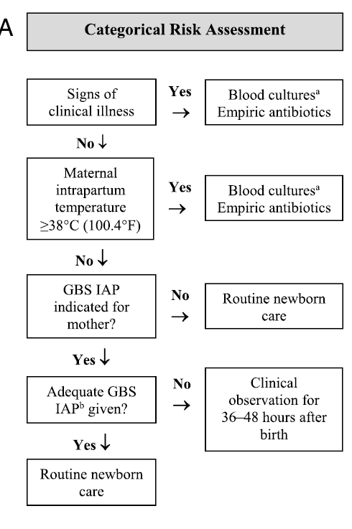
Categorical Approach
Puopolo, Lynfield, Cummings, 2019

Slide 13
Categorial approach
Limitations
  Risk is highly variable among newborn infants recommended to receive empiric treatment in this approach
  Unable to risk stratify along a continuum
  Many low risk infants will be treated empirically with this approach
Puopolo, Lynfield, Cummings, 2019

Slide 14
Enhanced Observation
Risk assessment based on newborn clinical condition
  Relies on clinical signs of illness to identify at risk infants
  Well appearing exam at birth associated with a 60-70% risk reduction for EOS
  Empiric treatment for any ill appearing infant in the first 48 hours after birth
  Requires serial, structured and documented physical assessments to identify at risk infants
Puopolo, Lynfield, Cummings, 2019

Slide 15
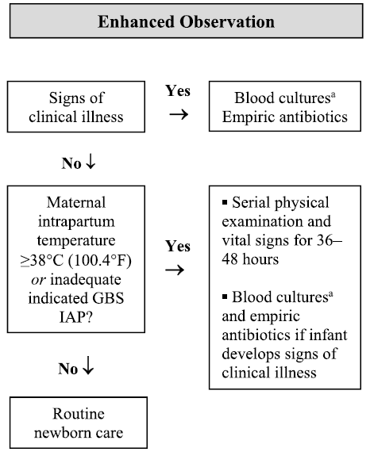
Enhanced observation
Puopolo, Lynfield, Cummings, 2019

Slide 16
Kaiser Permanente
Neonatal early-onset sepsis calculator
Multivariate model used to develop sepsis risk calculator
  Maternal factors – used to establish a prior probability for EOS
          Intrapartum maximum temperature
          Duration of ROM
          GBS status
          Intrapartum antibiotic treatment
        Neonatal factors – used to establish a posterior probability of EOS to guide evaluation and management decisions
          Gestational age
          Clinical exam findings
  https://neonatalsepsiscalculator.kaiserpermanente.org/
Escobar, 2014

Slide 17
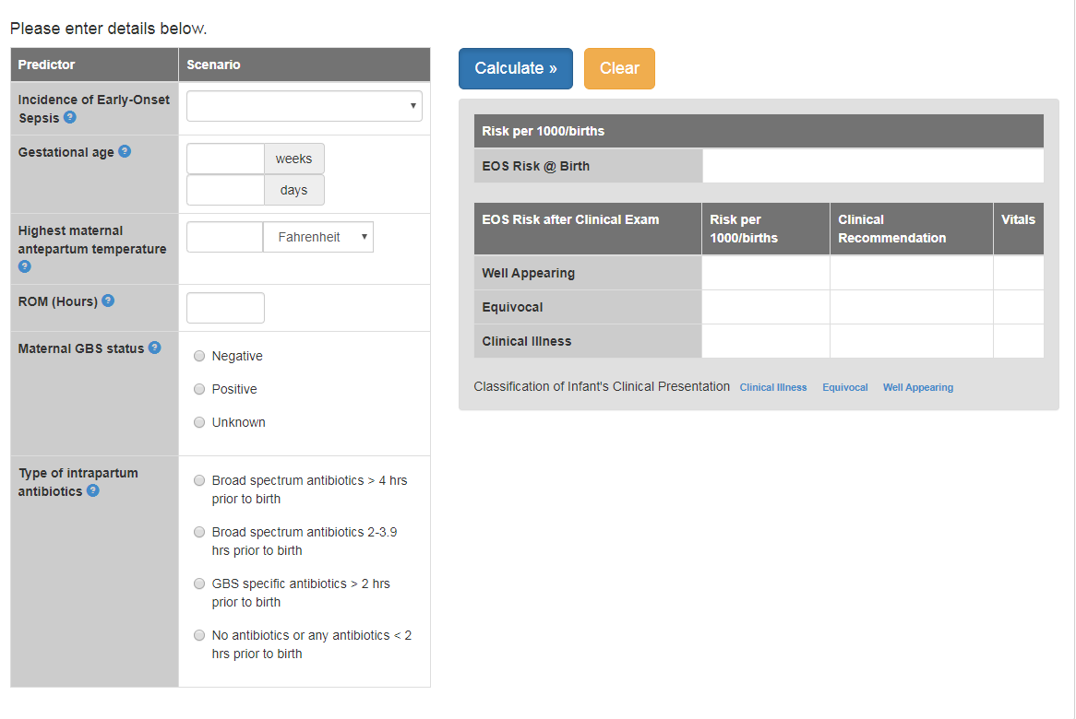
KAISER PERMANENTE
NEONATAL EARLY-ONSET SEPSIS CALCULATOR
https://neonatalsepsiscalculator.kaiserpermanente.org/

Slide 18
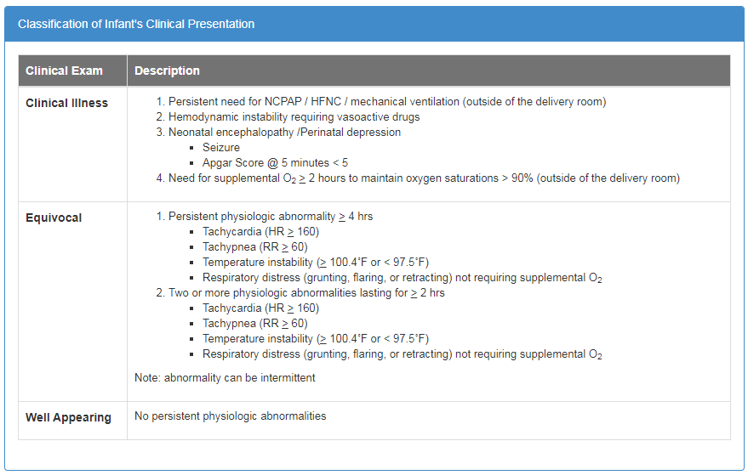
KAISER PERMANENTE
NEONATAL EARLY-ONSET SEPSIS CALCULATOR
https://neonatalsepsiscalculator.kaiserpermanente.org/

Slide 19
KAISER PERMANENTE
NEONATAL EARLY-ONSET SEPSIS CALCULATOR
Advantages
  Efficient – fewer infants evaluated, but still able to identify same proportion of cases
  Uses mostly objective data
  Clearly defines sick and well-appearing based on vital signs and time frame

Slide 20
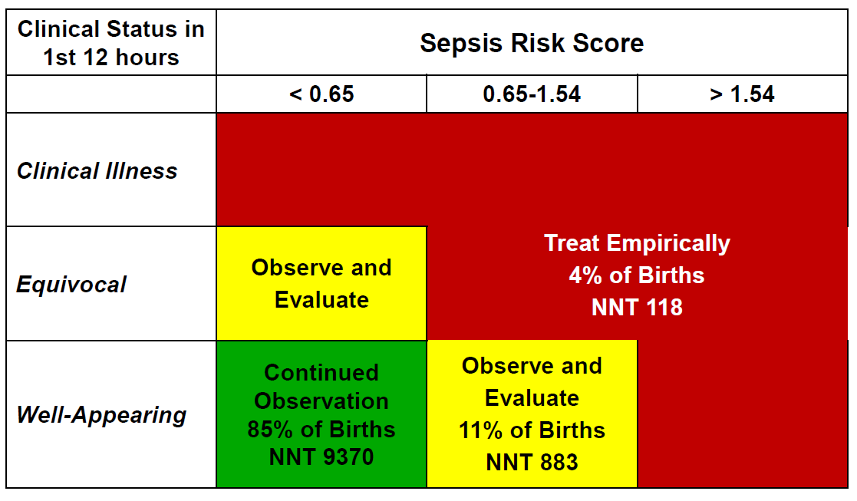
Quantitative risk stratification for EOS
Escobar, 2014

Slide 21
Important Points
  GBS specific antibiotics include PCN, ampicillin and cefazolin
  Clindamycin and Vancomycin (or other non-β-lactam antibiotics)
          when given of any duration for GBS prophylaxis, are not considered adequate in neonatal risk calculation due to insufficient evidence for their efficacy
  Calculator distinguishes between <2 hours before delivery and >2 hours before delivery
          GBS specific abx ≥ 4 hours prior to delivery is most effective
          However, if given at least 2 hours before delivery, are effective in decreasing maternal vaginal colonization and neonatal surface colonization in 97% of cases studied

Slide 22
KAISER PERMANENTE
NEONATAL EARLY-ONSET SEPSIS CALCULATOR
Case Example (using incidence of 0.6/1000 live births)
  38 weeks gestation infant
  Mother with max temp of 37.2
  ROM x 23 hours
  GBS negative
  no intrapartum antibiotics given

Slide 23
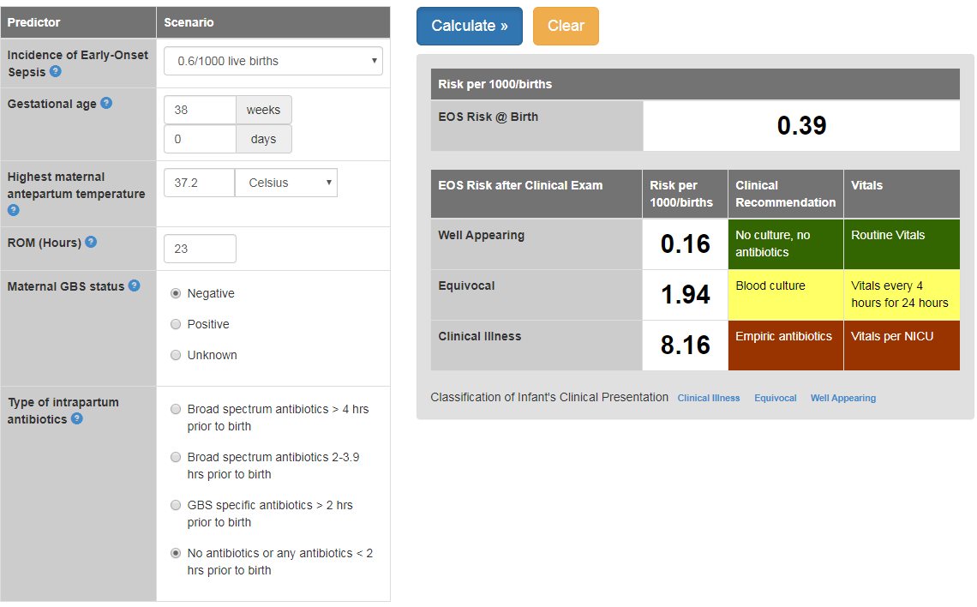
KAISER PERMANENTE
NEONATAL EARLY-ONSET SEPSIS CALCULATOR
https://neonatalsepsiscalculator.kaiserpermanente.org/

Slide 24
Implementation of EOS screening
Stony Brook children’s NewbOrn Nursery
Stony Brook Children’s will adopt the use of a multivariate risk assessment for EOS using the Kaiser Permanent Early-Onset Sepsis Calculator
L&D or Post-partum RN to notify on call pediatrics resident for Newborn Nursery/ NICU of the following infants with risk factors within the first 4 HOL
  Maternal GBS positive
  ROM ≥ 18 hours
  Maternal intrapartum temp (prior to delivery and up to 1 hour post delivery) ≥ 38C
  Gestational age <37 weeks
  Need for resuscitation/signs of clinical illness
Physician to complete Kaiser Sepsis Score and document results in EMR of infant using baseline incidence of EOS of 0.6/1000

Slide 25
Management based on KSS risk assessment
GREEN
  Routine vitals (Q4 hours) in newborn nursery
YELLOW **pay close attention to written recommendations
  No culture, no antibiotics
          Observation in Newborn Nursery with q4 vitals.
          Not eligible for discharge until after 36-48 HOL
        Blood culture, +/- antibiotics
          NICU admission and management
RED
  NICU admission and management
  Blood culture and empiric treatment per NICU attending

Slide 26
What about the CBC?
Using the 2002 Criteria for EOS screening¹
  3.2% of evaluated infants and a CBC with an abnormal WBC count or I/T ratio
  None of these infants has a blood-culture proven infection
2019 AAP Clinical Report²
  Routine measurement of CBCs or CRPs alone in newborn infants to determine risk GBS EOS is not justified given the poor test performance of these in predicting what is currently a low incidence disease
¹Mukhopadhyay S, Eichenwald EC, Puopolo KM. (2013) J Perinatol. 33:198-205.; ²Puopolo, Lynfield, Cummings, 2019

