Slide 1


Emergency Management
New Employee Orientation
Notes:
Reviewed May 2024

Slide 2
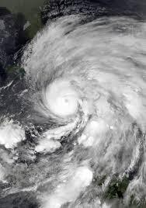
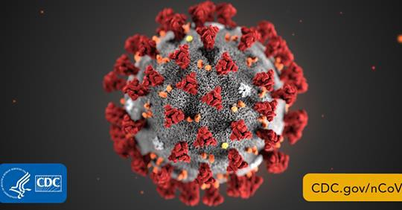



All-Hazards Approach
Hurricane
Pandemic
Closed roadways
Mass Shooting
Bombing

Slide 3


Our Mission: A Safe Environment
“A healthcare disaster exists when the patient load exceeds the capability of normal emergency care systems…and the hospital is forced to apply new systems designed for mass medical care”
Incident response guidance found in FEMA’s National
Incident Management System (NIMS)
Emergency Management regulated by The Joint Commission

Slide 4


National Incident Management System (NIMS)
Share
Integrate Tactics
Resources
Communicate
Information
Comprehensive, collaborative approach to managing incidents across the country

Slide 5
NIMS Framework
Prevent the occurrence of an emergency or minimize potential adverse effects
Support and enhance response to a disaster/ emergency
Assessments, infrastructure improvements
Response plans, Drills, training
Mitigation
Preparedness
Recovery
Response
Respond to disruptive events
Return the facility to complete business operations
Protect life and property

Slide 6





A required Joint Commission function
A multi-disciplinary group:
Medical staff
IT
Communications
Security
Facilities
Support Services
Others
Develops SBUH-specific Comprehensive
Emergency Management Plan (CEMP)
Emergency Management Committee

Slide 7

Emergency Management Policies and Procedures Manual
Comprehensive Emergency Management Plan (CEMP): “all hazards” plan addresses many potential events organization-wide

Slide 8

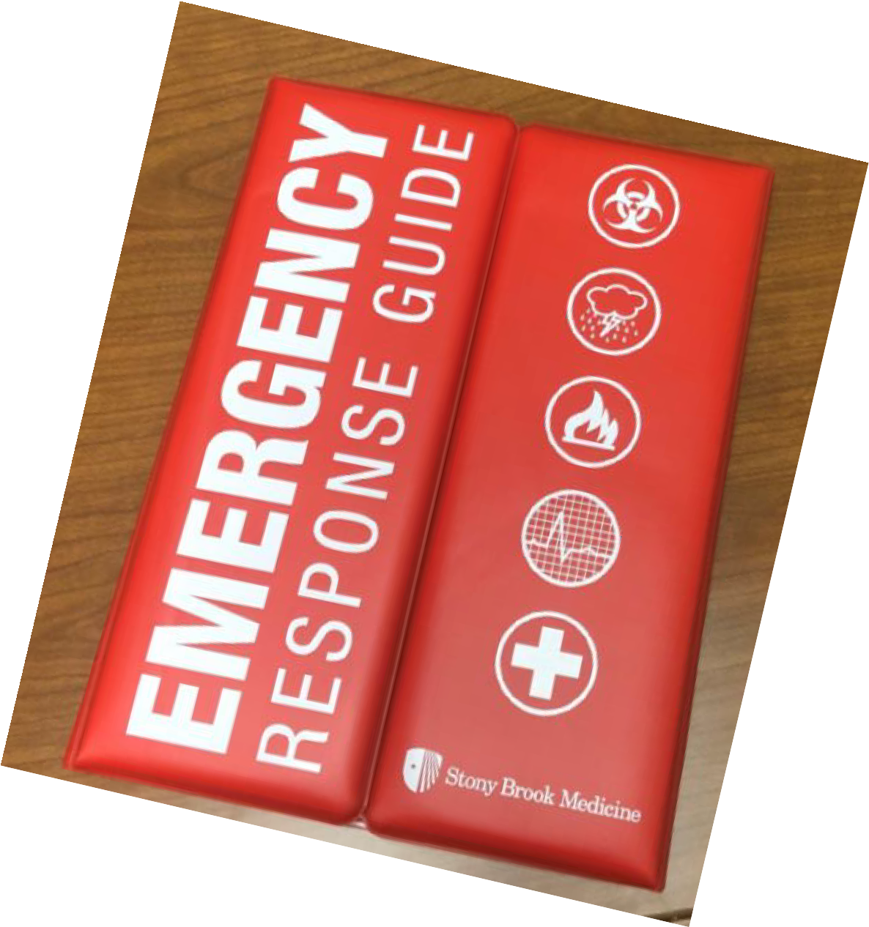
Emergency Response Guide
Comprehensive Emergency Management Plan (CEMP): “all
hazards” plan addresses many potential events organization-wide
Emergency Response Guide
Emergency Response Guide

Slide 9
*all staff must know where their unit’s Emergency Response
Emergency Response Guid
e
Guide is located*
Comprehensive Emergency Management Plan
(CEMP): “all
hazards” plan
Emergency Response Guide
addresses many potential events organization-wide
Emergency Response Guide

Slide 10

Emergency Response Guide
Comprehensive Emergency Management Plan (CEMP): “all
hazards” plan addresses many potential events organization-wide
Emergency Response Guide
Emergency Response Guide

Slide 11
Emergency Response Guide Topics
General Emergency Guidelines
Hospital Incident Command
System (HICS)
HICS Job Action Sheets
External Disaster Plan
Bomb Threat Policy
Bioterrorism Policy
Decontamination Plan
Utilities or Physical Plant Failure Plan
Pandemic Flu Plans
CHEMPACK Plans
Communications Failure Plan
Weather Emergencies Plan
Central Station Medical Monitoring
Equipment Failure Plan
Fire & Emergency Evacuation Plan
Total Facility Evacuation Plan
Disaster Mental Health Plan
Department Specific Plans
Offsite Facilities Emergency Plan
Active Shooter Response
Stop-the-Bleed

Slide 12
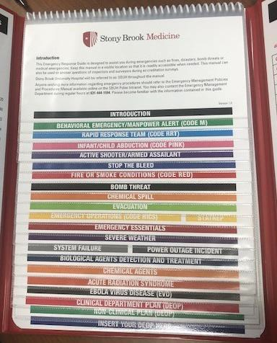
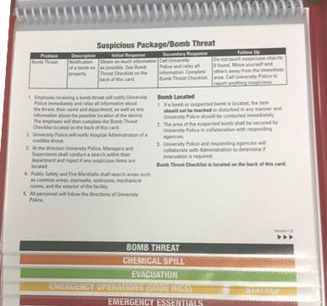
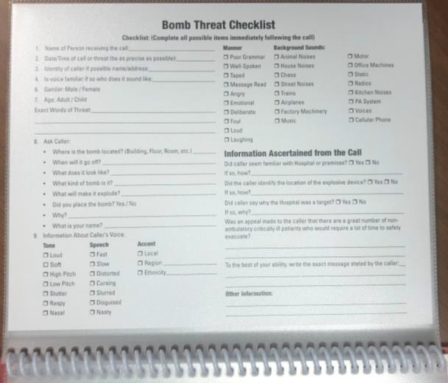
Use of Emergency Response Guide: Bomb Threat Policy
As instructed in Step 1, flip tab over & complete the Bomb Threat Checklist
1
Open the Emergency Response Guide
2
Open the tab for Bomb Threat & follow all steps
3

Slide 13


My-EOP Emergency Guide App
The Emergency Guide is also available on-the-go via your mobile device:
Click here for
Emergency contact phone numbers
Info about codes used in the hospital
Info about severe weather conditions
And more!
how to use the
My-EOP App

Slide 14
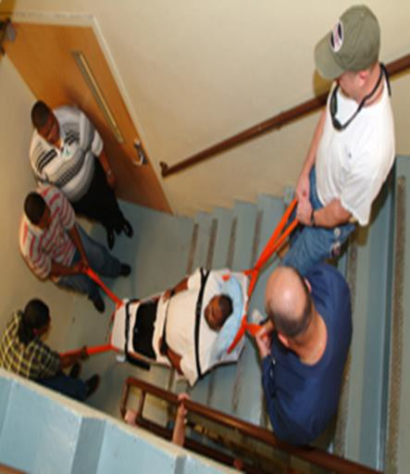
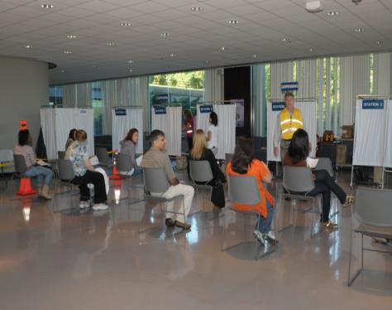
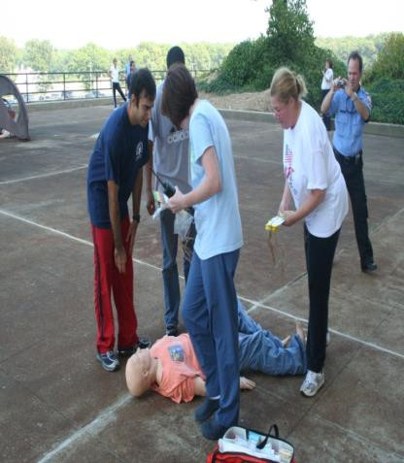
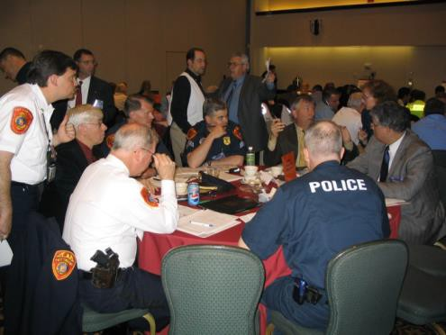
Testing Our Plans with Drills and Exercises
Exercises test our ability to surge and to respond to changing conditions
Opportunities to participate in training exercises are emailed out to all employees
– check your inbox and sign up!

Slide 15


Hospital Incident Command System (HICS)
Incident Commander
Public Information Officer
Safety Officer
Liaison Officer
Medical/Technic al Specialist
Operations Section Chief
Planning Section Chief
Logistics Section Chief
Finance/Admin Section Chief
HICS = Teamwork.
Everyone has an important role to play!

Slide 16
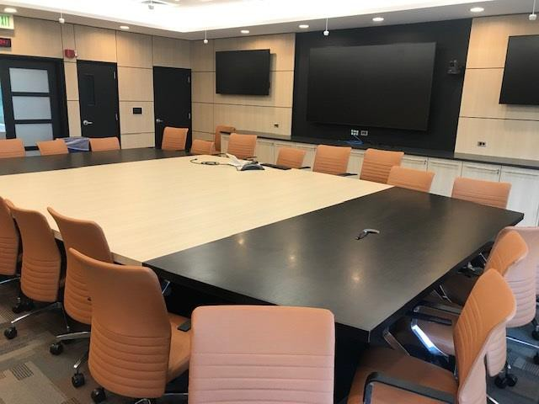
Hospital Command Center
HOSPITAL COMMAND CENTER
OVP Conference Room, HSC Level 4 Back Up: Level 5 MART
Incident Management Team gathers here to establish objectives, strategies, tactics
Computer Connections, Laptops,
Internet, & Video Teleconferencing
Phones, Fax, Fixed and Portable Satellite Phones
Nextel Radios, 800 MHZ Radios
Comprehensive Emergency Management Plan (CEMP) Manuals
And our resilience!

Slide 17
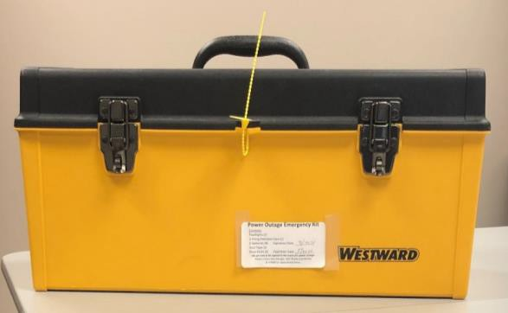
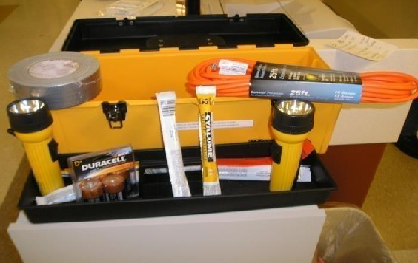

Disaster Boxes
Extension Cords
Light Sticks
Batteries
Flashlights
Disaster Boxes
Duct Tape
Emergency Back-
Up Phone System

Slide 18
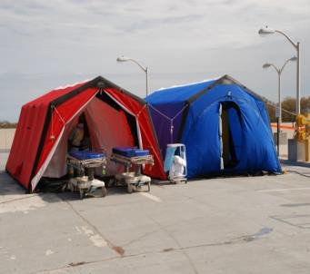
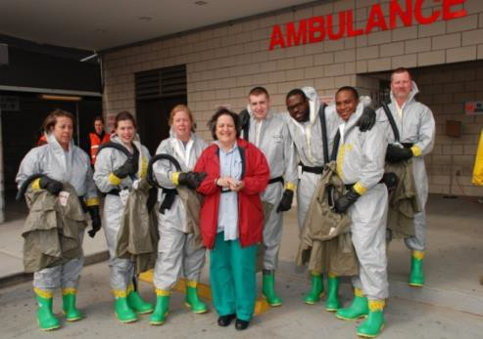
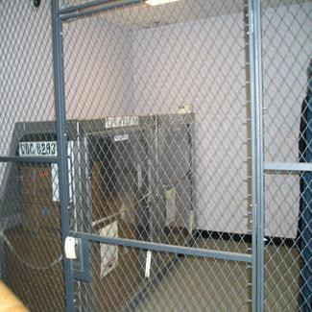
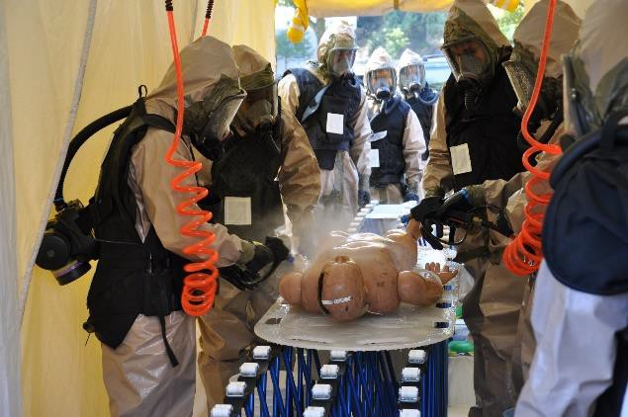

Hazardous Materials – Patient Decontamination
Well trained teams
Equipment
Pharmaceutical Stockpiles
Directly linked to CDC
Now accepting volunteers to join our Patient Decontamination Team!
Free Training!
Call us at 444-9074

Slide 19
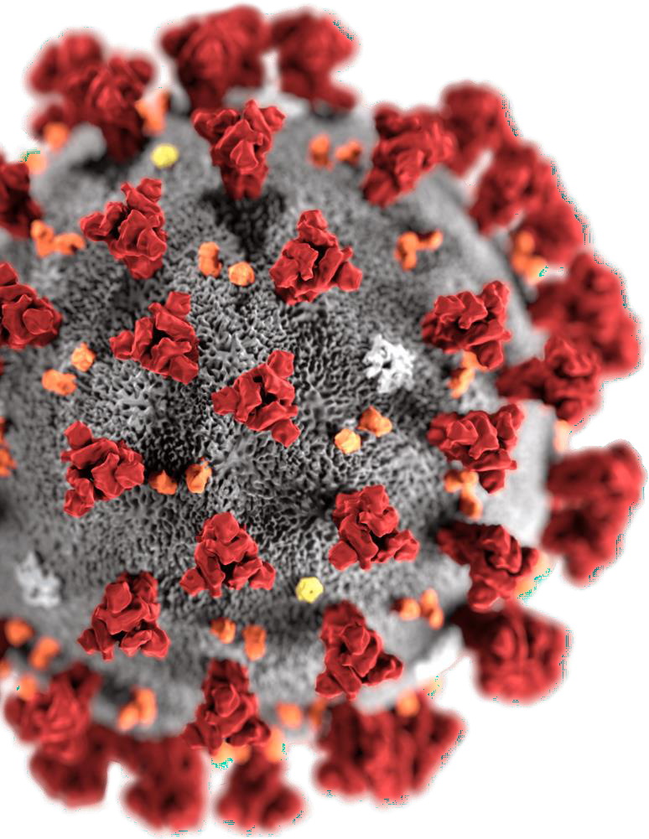

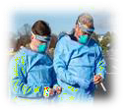


Infectious Diseases & Emerging Pathogens
PERSONAL PROTECTIVE EQUIPMENT (PPE)
PLANNING & PREPAREDNESS
SURGE CAPACITY
“Stony Brook Prepares to Take on Overflow of Coronavirus Patients”
Newsday: March 20, 2020

Slide 20

Your Role
BE AWARE
Know where your department/units Emergency
Response Guide and disaster box are kept
GET TRAINED
Complete Annual Required Education (ARE)
PARTICIPATE
Flu Shot POD, Training exercises
RESPOND
Follow department/units Emergency Response Guide

Slide 21
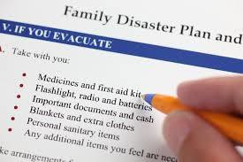

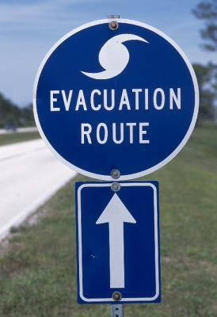
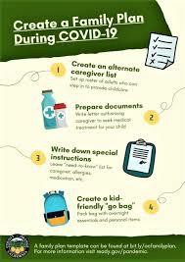



Have a Family Emergency Plan
Sheltering
Evacuation
Supplies
Communications
Pets
Ready.gov
Redcross.org
FEMA.gov

Slide 22
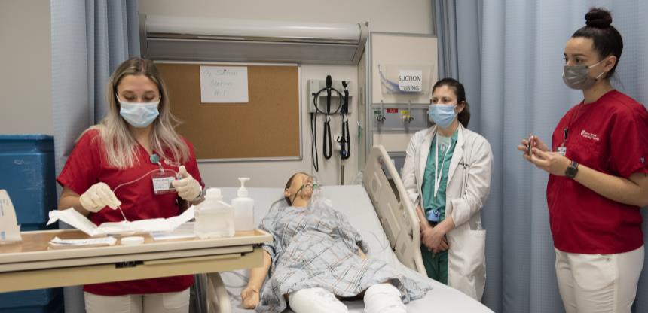
Knowledge
Check
Select NEXT to begin.

Slide 23
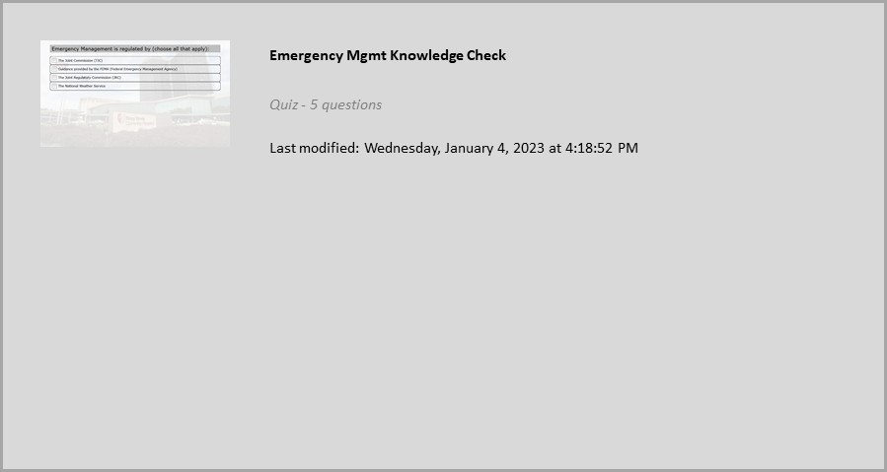


Properties
On passing, 'Finish' button: Goes to next slide On failing, 'Finish' button: Goes to next slide
Allow user to leave quiz: After user has completed quiz User may view slides after quiz: After passing quiz
Show quiz in menu as: Single Item
Edit in Quizmaker
Edit Properties

Slide 24



CONTACT
US (631)
444-9074
QUESTIONS?
IDEAS?
24

Slide 25

Thank you for completing this course. You may close this window to return to the LMS.

