Slide 1
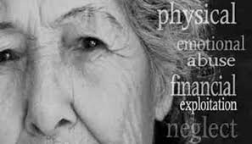
Family Violence
Family Violence Includes:
Child Abuse, Neglect and Maltreatment
Domestic Violence/Intimate Partner Violence
Elder Abuse
Family Violence
June 2024

Slide 2
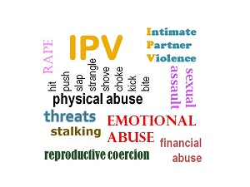
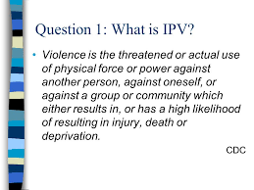
Domestic Violence
Domestic Violence

Slide 3
SBUH Policies & Procedures
Policies:
PC0162: Identification and Response to Child Abuse, Neglect and Maltreatment
PC0003: Identification and Treatment of Family Violence, Abuse, Neglect, and Maltreatment
Policy Statement:
SBUH staff members identify, assess, treat, and/or refer to community agencies all patients who are confirmed or alleged victims of abuse, neglect and or maltreatment.

Slide 4
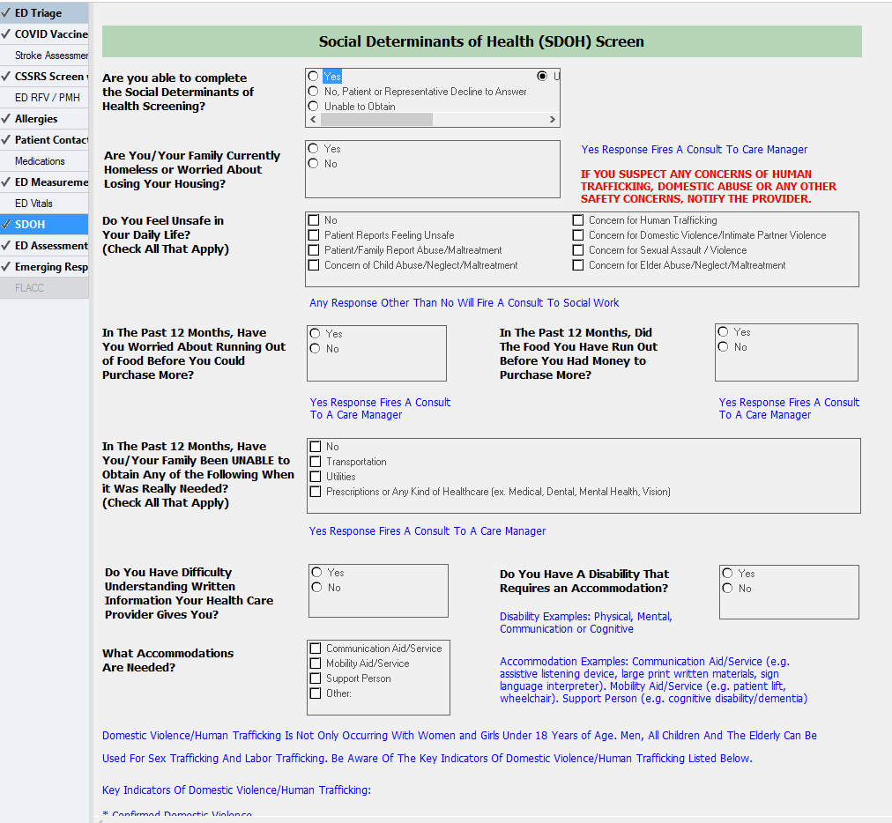
ED (Adult/Pediatrics and CPEP) /OB Triage
Screening for
Social Determinants of Health (SDOH) will be completed for all patients in ED/OB Triage
If unable to obtain is selected and the patient is admitted, it will fire the Social Determinants of Health (SDOH) screening Task to Nursing

Slide 5
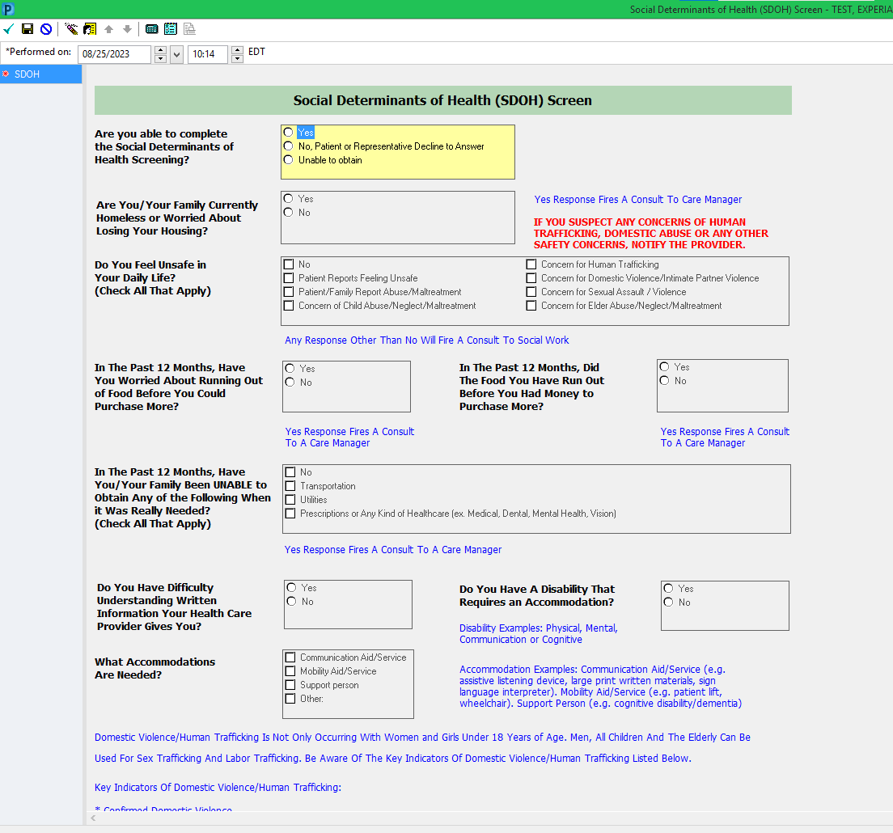
Social Determinants of Health (SDOH) Screening Power form
This form will be tasked to the Nurse on admission and is to be completed on the inpatient units if the screening was not completed in ED/OB Triage

Slide 6
Social Determinants of Health Workflow
Any “yes” response or
response other than “No”
will fire consult to social work or
care manager for follow-up
(as indicated in blue reference text)
If you suspect any concerns of Human trafficking, Domestic Abuse or any other safety Concern notify the provider

Slide 7
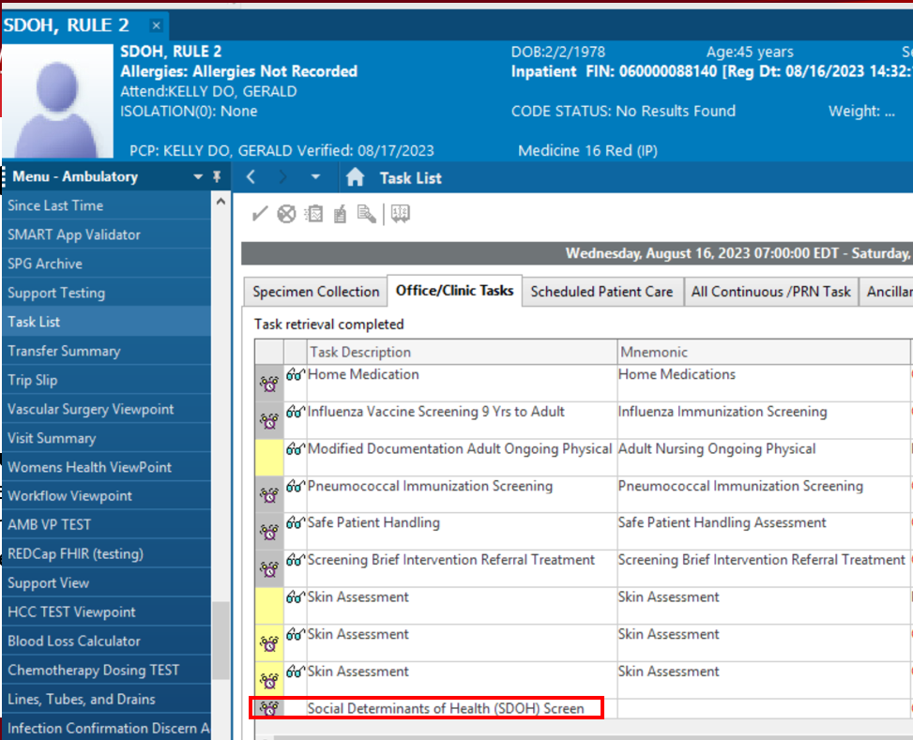
Social Determinants of Health (SDOH) Screening Task
If “Unable to Obtain” is charted the task will re-fire Q8 hours until completed.

Slide 8
Domestic Violence Overview
Domestic Violence historically was referred to as Spousal Abuse. It is no longer referred to as “Spousal Abuse” due to the fact that the violence crosses into non-married and same gender couples. Intimate Partner Violence( IPV) is the most recent phrase or acronym for this important and serious issue.
It is defined as pattern of abusive behaviors by one or both partners in an intimate relationship such as dating, family, friends, marriage or cohabitation that is used by one partner to gain or maintain power and control over another intimate partner.
Domestic violence can happen to anyone regardless of race, age, sexual orientation, religion, or gender.
Domestic violence is a serious, preventable public health problem affecting more than 32 million Americans or over 10% of the U.S. population.
One in every four women and one in every seven men will experience domestic violence in her lifetime.
Of all the woman murdered every year, 1/3 are killed by an intimate partner.
Domestic Violence Overview
Domestic Violence

Slide 9
Sexual Assault awareness month

Slide 10
Domestic Violence Statistics
An average of 24 people per minute are victims of rape, physical violence or stalking by an intimate partner in the US ( more then 12 million woman and men over the course of a single year)
1 in 4 woman and 1 in 7 men age 18 and older in the US have been the victim of severe violence by an intimate partner in their lifetime.
Almost half of all women and men in the US have experienced psychological aggression by an intimate partner in their lifetime.
Woman ages 18-24 and 25-34 generally experience the highest rates of intimate partner violence.
Nearly 1 in 10 woman in the US have been raped by an intimate partner in their lifetime.
Children witnessed violence in nearly 1 in 4 intimate partner violence cases
30%-60% of intimate partner violence perpetrators also abuse children in the household
Domestic Violence

Slide 11
Domestic Violence Overview
Alcohol and drug abuse, addiction, and mental illness can be co-morbid with domestic violence, and present additional challenges when present alongside patterns of abuse.
On a typical day there are more than 20,000 phone calls placed to domestic violence hotlines nationwide.
The presence of a gun in a domestic violence situation increases the risk of homicide by 500%.
Intimate partner violence accounts for 15% of all violent crime.
Women between the ages of 18-24 are most commonly abused by an intimate partner; only 34% of people who are injured by intimate partners receive medical care for their injuries.
19% of domestic violence involves a weapon.
Domestic victimization is correlated with a higher rate of depression and suicidal behavior.
Domestic Violence Overview
Domestic Violence

Slide 12
Domestic Violence –
Examples of Physical Abuse
Causing Physical Pain in any way
Hitting, punching, pinching, kicking with body or other object
Throwing
Pulling hair
Use of a dangerous weapon or deadly weapon including objects not normally used as a weapon;
Throwing objects
Burning
Holding or twisting arms/legs/other parts of body
Holding back doors or blocking free movement
Holding person down to trap or hurt
Domestic Violence

Slide 13
Domestic Violence –
Examples of Sexual Abuse
Any non-consensual sexual contact
Forcing a sexual activity
Forcing unwanted sexual behaviors or activities
Threatening behaviors
Derogatory Name Calling
Refusal to use contraception
Deliberately causing unwanted physical pain during sex,
Deliberately passing on sexual diseases or infections
Using objects, toys, or other items without consent
Domestic Violence

Slide 14
Domestic Violence –
Examples of Financial Abuse
Controlling how all of the money is spent
Not allowing the victim access to bank accounts
Withholding money or giving “an allowance”
Forbidding the victim from attending job training or advancement opportunities
Forcing the victim to write bad checks or file fraudulent tax returns
Running up large amounts of debt on joint accounts, taking bad credit or loans
Hiding assets
Stealing the victim’s identity, property or inheritance
Refusing to pay bills and ruining the victims’ credit score
Refusing to pay or evading child support or manipulating the divorce process by drawing it out by hiding or not disclosing assets
Domestic Violence

Slide 15
Domestic Violence – Examples of
Psychological or Emotional Abuse
Humiliating the victim in public or private
Demeaning the victim in public or private
Controlling what the individual can and cannot do
Withholding information from the individual
Deliberately doing something to make the individual feel diminished or embarrassed
Isolation the Victim from friends and/or family
Convincing the victim that they are “crazy”
Purposely causing undo stress to the victim
Blaming the victim consistently for issues or problems in the relationship
Making unreasonable demands
Criticizing for incomplete task
Demanding
Cruel
Stalking
Domestic Violence

Slide 16
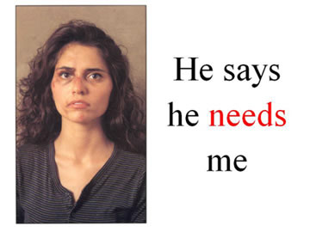
Why do people stay
in abusive relationships?
The victim:
fears the abusers violent behavior and will escalate if they try to leave
loves his/her abuser and believes (s)he will change
believes abuse is a normal part of a relationship
is financially dependent on the abuser
wants her/his children to have two parents.
religious and/or cultural beliefs preclude him/her from leaving
has low self esteem and believe he is to blame for the abuse
is embarrassed to let others know he has been abused
has nowhere to go if he leaves
fears retribution from the abusers friends or family
Domestic Violence

Slide 17
Why Won’t They Leave?
People who have never been abused often wonder why a person wouldn’t just leave an abusive relationship. They don’t understand that leaving can be more complicated than it seems.
Leaving is often the most dangerous time for a victim of abuse, because abuse is about power and control. When a victim leaves, they are taking control and threatening the abusive partner’s power, which could cause the abusive partner to retaliate in very destructive ways.
Aside from this danger, there are many reasons why people stay in abusive relationships. Here are just a few of the common ones:
Fear: A person may be afraid of what will happen if they decide to leave the relationship.
Believing Abuse is Normal: A person may not know what a healthy relationship looks like, perhaps from growing up in an environment where abuse was common, and they may not recognize that their relationship is unhealthy.
Domestic Violence

Slide 18
Safety Plan
One of the key errors in attempting to support a patient or colleague who is experiencing Domestic Violence/ Intimate Partner Violence is suggesting they “ get out immediately”.
More critical is working with them to clarify a personalized safety plan and preparing to activate that safety plan while in a the relationship, outlining steps to take while in the relationship, planning on leaving , or even after you leave.
Components of a safety plan are;
Telling a trusted source- friend, family, or neighbor
Having financial ability to leave for a few days
Making safe plan for children as needed should they witness violence
Having memorized phone numbers for crisis hot lines and shelters specific for IPV
Having a friend who is aware of your crisis and opening their home to you in an emergency
Domestic Violence

Slide 19
Role of Social Work
Social Work is called to respond to suspected or confirmed cases of Domestic Violence*:
Assist finding a safe place to go away from the violence if patient wishes to go
Counseling and Crisis intervention
Safety Planning for self and family
Assessment in regards to safety of children if applicable
Give information about resources in the community, including housing, financial help, legal services
Give pertinent information and resources in regards to legal rights such as order of protection process, etc.
Referral to other resources such as mental health, drugs and alcohol as indicated
* In the case of a sexual assault case a SANE nurse and Police will be involved BEFORE Social Work in order to get forensic evidence and clear, unbiased story and testimony. Social Work will remain available for counseling and crisis intervention after SANE and Police work is completed.
Domestic Violence

Slide 20
Intervention Questions
The American Medical Association, which suggests phrasing questions in your own words, offers the following examples:
Are you in a relationship in which you've been physically hurt or threatened by your partner? Have you ever been in such a relationship?
Are you (have you ever been) in a relationship in which you felt you were treated badly? In what ways?
Has your partner ever destroyed things you cared about?
Has your partner ever forced you to have sex when you didn't want to? Have you been forced to engage in sex that makes you feel uncomfortable?
We all fight at home. What happens when you and your partner fight or disagree?
Do you ever feel afraid of your partner?
Domestic Violence

Slide 21
Intervention Ideas
I'll say something like, “What you've just told me doesn't explain your injury. Is there a reason you're hesitant to tell me more about it? Is there something else you'd like to say?”
Sometimes that helps the patient realize that you're trustworthy and she can tell you what's happening to her.
Domestic Violence

Slide 22
Future Domestic Violence Screen
Increasingly, medical groups and hospitals are developing their own domestic violence protocols.
HITS:
Does your partner Hurt you?
Insult you or talk down to you?
Threaten you with harm?
Scream or curse at you?
The questioner scores one point if the answer is "never“, two points if the answer is "rarely“, three points for "sometimes, ,four points for "fairly often“, and five points for "frequently“.
A total score of more than 10 points indicates abuse.
Domestic Violence

Slide 23
Reportable Injuries
Injury Reporting Laws:
New York State's Penal Law requires that:
All injuries resulting from discharge of a firearm, and all potentially life-threatening injuries inflicted by a knife or other sharp object, must be reported to the local police. (§265.25)
All 2nd or 3rd degree burns to 5% or more of the body, all respiratory tract burns, and all burns which might result in death, must be reported in writing within 72 hours to the Office of Fire Prevention and Control. (§265.26)
These reports must be made by the physician or manager in charge of the case, and intentional failure to report is a class A misdemeanor.
There is no mandatory reporting of adult domestic violence in New York State.
Domestic Violence

Slide 24
Indicators of Domestic Violence - Physical Abuse
Signs and Symptoms of Physical Abuse
Old bruises
Explanation inconsistent with injury
Injuries to face, arms, neck, throat, chest, abdomen or pelvic area
Bilateral bruises
Burns in unusual shapes, sizes, or locations
Injuries in different stages of healing
Have frequent injuries, with the excuse of “accidents”
Dress in clothing designed to hide bruises or scars (e.g. wearing long sleeves in the summer or sunglasses indoors)
Domestic Violence

Slide 25
Domestic Violence - Indicators of Sexual Abuse
Indicators of Sexual Abuse;
Behavioral Signs of Domestic Violence
Recurrent urinary tract infections
Bruising, bleeding, pain, or itching in the genital area (may also be seen in anus, mouth, or throat)
Presence of sexually transmitted disease
Stained, torn, or bloody undergarments
Vaginal discharge and/or odor
Vaginal Bleeding not related to menses
Indicators of Domestic Violence - Behavioral Signs
Possible Behaviors of Victim:
Quiet, non verbal, letting partner do “all the talking”.
Talk about partners “temper” or fear of retaliation.
Unwillingness to communicate.
Depression, anxiety, or suicidal ideation.
Change in sleep, eating patterns.
Increase in alcohol/drug use.
Domestic Violence

Slide 26
General Presenting Issues
Headache or migraine
Increased depression or anxiety
Increased substance use
Recent noticeable weight gain or loss
Abdominal pain
Pelvic pain
Upset stomach or other gastrointestinal issues
Dizziness
Insomnia and other sleep disturbances
General malaise
Unexplained bruises
Multiple bruises( different stages of healing)
Evasive answers
Injuries that aren't consistent with the story being told
Multiple visits to ED
Domestic Violence

Slide 27
Signs and Symptoms of Domestic Violence
Other Signs and Symptoms of Domestic Violence
Panic or depression
Injuries in various stages of healing.
Pattern injuries—those in which a hand or finger mark, or a shoe tip, belt buckle, signet ring, cord, or other object is outlined on the body.
Defensive injuries, such as those to the midulnar region.
Injuries to the head, neck, upper body, and,
in pregnant women, the abdominal area.
Overbearing partner
Partner who won’t leave patient’s side
Partner who won’t let the patient answer for herself
Partner who seems to control what the patient is saying or corrects the patient
Stories that differ in regards to injury
Domestic Violence

Slide 28
Who Do You Contact?
Unlike Child Abuse, there is no “mandated reporter” duty for Adult Family Violence.
POLICE: In situations with severe injuries such as stabbing, gunshot, or multiple trauma the police need to be contacted. If you think the person is in imminent danger, contact the police (911 gets our Stony Brook Police who triage to the local precincts as needed).
In other situations the victim needs to consent prior to a call to police or any other response agency.
Contact Social Worker by calling the Office at 4-2552 during normal business hours and on weekend days or by paging the On Call Social Worker via the operator on off hours.
For patients of Sexual Assault with patient consent- Contact the SANE/SAFE nurse via the operator and/or ECLI-VIBS Emergency Room Companion (ERC)Program at their hot line number (631)360-3606.
The SANE nurse is involved in collection of evidence and clinical exam while the ERC provides emotional support, information and referrals.
Domestic Violence

Slide 29
External Resources - Domestic Violence
Social Work, SBUH: 631-444-2552
ECLI-VIBS: 24-Hour Hotlines, 7 days a week: (631) 360-3606, (631) 360-3607 ask for HOPE
Brighter Tomorrows 24-Hour Hotline, 7 days a week: (631) 666-8833 ask for HOPE
You can also call (631) 666-7181
Retreat 24-Hour Hotline, 7 days a week (Hotline) (631) 329-2200
Domestic Violence

Slide 30
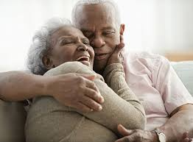
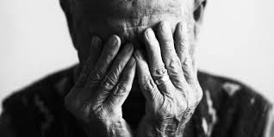
Elder Abuse
Elder Abuse

Slide 31
Elder Abuse Statistics
Data on elder abuse in domestic settings suggest that only 1 in 14 incidents, come to the attention of authorities.
There is an estimated 5 million elder abuse cases a year in the United States.
Most abusers are family members (70%), most commonly adult children (40%).
Every year approximately 5 million older Americans are victims of physical, psychological and/or other forms of abuse and neglect
Older adults who require assistance with daily life activities are at increased risk of being emotional abused or financially exploited.
Approximately 50% of older adults with dementia are mistreated or abused.
An estimated 13.5% of older adults have suffered emotional abuse since the age of 60.
Victims of elder financial abuse lost an estimated $3.2 billion in 2015.
Elder Abuse

Slide 32
Seven Types of Elder Abuse
Physical abuse. Use of physical force that may result in bodily injury, physical pain, or impairment. Can also include force feeding, and physical restraints.
Sexual Abuse. Non-consensual sexual contact of any kind with an elderly person.
Emotional Abuse. Infliction of anguish, pain, or distress through verbal or non-verbal acts. Includes insults, threats, intimidation, humiliation and harassment and non physical punishment. Silent treatment and enforced social isolation are also examples.
Financial/Material Exploitation. Illegal or improper use of an elder's funds, property, or assets including cashing their check without permission, coercing or deceiving an older person into signing any document.
Neglect. Refusal, or failure, to fulfill any part of a person’s obligations or duties to an elderly person. Neglect also includes situations where a caregiver refuses to pay for or set up necessary home care or other services.
Abandonment. The desertion of an elderly person by an individual who has assumed responsibility for providing care for an elder, or by a person with physical custody of an elder.
Self Neglect. Characterized as the behavior of an elderly person that threatens their own health or safety. Self negect generally manifest itself in an older person as a refusal or failure to provide themselves with adequate food, water, clothing, shelter, personal hygiene, medication and safety precautions.
Elder Abuse

Slide 33
Indicators of Elder Abuse - Neglect
Unusual weight loss, malnutrition, dehydration
Untreated physical problems such as bed sores
Unsanitary living conditions: dirt, bugs, soiled bedding and clothes
Being left dirty or unbathed
Unsuitable clothing or covering for the weather
Unsafe living conditions (no heat or running water; faulty electrical wiring, other fire hazards)
Over or under medicated
Lack of home care even though indicated
Lack of necessary and indicated services
Elder Abuse

Slide 34
Indicators of Elder Abuse - Financial
Significant withdrawals from the elder’s accounts
Sudden changes in the elder’s financial status, large or consistent withdrawals
Homelessness,
Inability to pay utilities, rent or other bills,
Suspicious changes in wills, power of attorney, and policies,
Financial activity the senior couldn’t have done, such as an ATM withdrawal when the account holder is bedridden
Increase in anxiety when the elder is discussing finances
Care takers refusal to plan for necessary patient care
Unapproved and suspicious changes in titles, car, real estate etc.
Elder Abuse

Slide 35
Indicators of Elder Abuse –
Sexual & Physical
Indicators of Elder Abuse - Sexual
Bruises around breasts or genitals
Bruises between legs and on buttocks or lower back
Unexplained venereal disease or genital infections
Unexplained vaginal or anal bleeding
Torn, stained, or bloody underclothing
Indicators of Elder Abuse - Physical
Bruises, pressure marks, broken bones, abrasions, and burns
Bruises at different stages of healing
Explanation not matching injury
Changing story in regards to origin of injury
Frequent presentation with injuries
Bilateral bruising or “wrap around” bruising
Broken eyeglasses or frames
Signs of being restrained, such as rope marks on wrists
Caregiver’s refusal to allow you to see the elder alone
Elder Abuse

Slide 36
Other Indicators of Elder Abuse
& Resources
Emotional Elder Abuse
Behavior such as belittling, threats, harassment and intimidation
Humiliation and ridicule by the caretaker
Ignoring of the elderly person by the caretaker
Isolating an elder from friends or activities
Terrorizing or menacing the elderly person
Strained or tense relationships, frequent arguments between the caregiver and elderly person
Elderly person’s increased anxiety or depression
Elder Abuse

Slide 37
Signs of Abandonment & Self Neglect
Abandonment:
Change in appearance, weight loss, unkempt
Sudden changes address
Unclear care giver situation
Homelessness
Inability to reach family
Family refusing to pick up patient
Family in disagreement with discharge plan of care and unavailable for discharge
Self Neglect:
Refusal to allow treatment
Not getting necessary medical care
Refusal to obtain medication
Not eating to the point of malnourishment
Poor hygiene
Living in dirty, unsanitary, or hazardous condition
Increased alcohol or drug use
Elder Abuse

Slide 38
Local Resources
Elder Abuse Resources:
Suffolk County Office for the Aging
(631) 853-8200
Adult Protective Services
(631) 854-3195
Elder Abuse

Slide 39
Internal Contacts & Questions
Social Work Domestic Violence, Elder Abuse & Child Protection
Main Social Work Office: (631) 444-2552
Susan McCarthy, Director of Social Work(631) 444-3215
Fatima Calle, Assistant Director Social Work (631) 638-2367
Shatara Jean, Social Work Supervisor (631) 444-3104
Geoffrey O’Connell, Out-Patient Social Work Supervisor (631) 444-4343
Michelle Tepper, Clinical Instructor Emergency Department/Clinical Supervisor Suffolk County SANE and Forensic Nurse Services (631) 965-9568
Dr. Gillian Hopgood, DO, FAAP Child Abuse Pediatrics (631) 216-8310, (631) 873-7898
Contacts

