Slide 1
Hemodialysis Curriculum
Sobia Khan, D.O.
Assistant Professor of Clinical Medicine
In-Center Medical Director/Co-Medical Director @ Stony Brook Kidney Center
Division of Nephrology & Hypertension
Stony Brook Medicine

Slide 2
The idea of this curriculum is to increase the knowledge of the management of ESRD patients, dialysis modalities and help prepare our nephrology fellows to be a better nephrologist. The goal of this exercise is to enhance the understanding and to condense the key concepts but not to replace the vast literature and education available in the field of nephrology.
Take some time to go over this packet during the first week of the initiation of your ambulatory rotation to have an idea where you should be investing your time during the rotation. Good Luck in all your future endeavors.

Slide 3
Break down of Hemodialysis lectures
Physiology and principles of Hemodialysis, dialysis prescription and Hemodialysis adequacy (Lecture)
Hemodialysis machine, Basics (Ambulatory rotation/Bedside teaching)
Water treatment for dialysis (Visit to water treatment area during ambulatory rotation)
Vascular access, anatomy and complications (Lecture)
Catheter related infection (Lecture)
Introduction to Quality Improvement, quarterly QI case discussions (during Renal grandrounds) and 1-2 QI project completion by the nephrology fellow during nephrology fellowship (ambulatory rotation)

Slide 4
Patients start dialysis with significant comorbidities burden. The most common comorbidity is Hypertension, present in > 85% of patients and second being Diabetes, noted to be present in 50% of the patient population. This information is collected from Centers for Medicare and Medicaid services evidence report (Form CMS-2728) which must be completed on initiation of dialysis.

Slide 5
Hemodialysis is the most common modality used for ESRD care worldwide. Hemodialysis entails substantial costs because of the need for the dialysis unit and the expensive reverse osmosis system. Peritoneal dialysis has been noted to be used successfully in several developing countries. The center for Medicare and Medicaid has introduced a mandatory payment model, called the End Stage Renal Disease Treatment choices model (ETC model) to encourage the use of home dialysis and kidney transplant for Medicare beneficiaries to reduce Medicare expenses and to enhance the quality of care provided to Medicare beneficiaries. The initial proposed rule has a goal of 80% combined home dialysis and preemptive transplant rate by 2025, but no specific target number is provided.

Slide 7
Q 1: A 58-year-old female with past medical history of CKD stage 4/5, hypertension, T2DM presented to ED with shortness of breath, inability of urinate, severe pruritis, grossly overloaded. Patient was evaluated by nephrologist in the ED and the decision was made to initiate dialysis. Patient was educated about the different modalities of dialysis, and she chose hemodialysis. Which access can be used at the time of start of dialysis?
A- Central Venous Catheter
B- Arteriovenous Fistula
C- Arteriovenous Graft
D- Peritoneal dialysis catheter

Slide 9
Types of Vascular Access for Hemodialysis
1- Central Venous Catheter (CVC)
2- Arteriovenous Fistula (AVF)
3- Arteriovenous Graft (AVG)

Slide 10
Patient with CKD stage 4/5 need close follow up and a team approach. At this stage, the patient needs to have CKD education and education related to different Renal Replacement treatment (RRT) modalities. Vascular access planning should start around the same time as timely referral to the vascular surgeons, which can result in early placement of native AVF and may reduce the chances of CVC placement.

Slide 11
Central Venous Catheter
Catheters are usually used in urgent cases that require hemodialysis or in an unprepared CKD 4/5 patients.
Right Internal Jugular vein is the preferred vein to be used due to direct route to the Right atrium, if not possible then Left Internal Jugular vein is used.
CVC can also be placed in Femoral vein.
Subclavian vein catheters should be avoided because of the risk of central vein stenosis.
When CVC is used for longer duration of time, cuffed and tunneled catheters are used.
Other Locations for CVC:
Lumbar
Axillary-axillary and femoral-popliteal

Slide 12
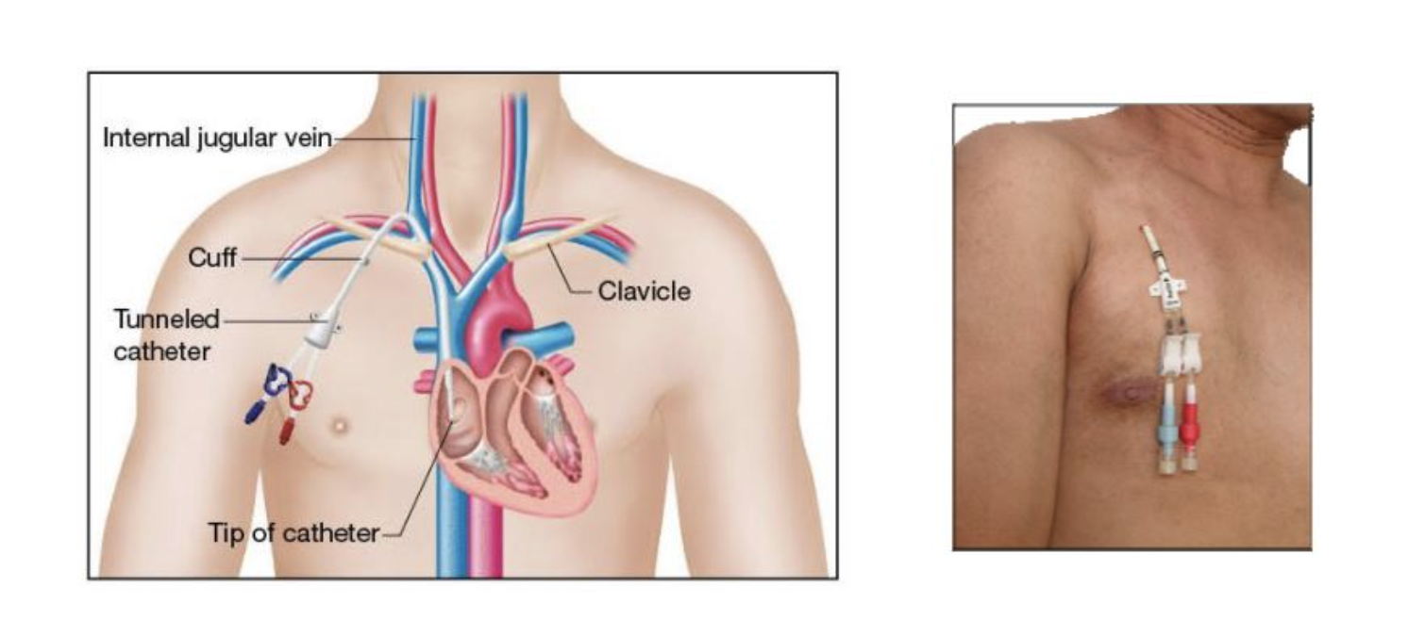
CENTRAL VENOUS CATHETER

Slide 13
Arteriovenous Fistula
Patient with CKD stage 4/5 who are followed by nephrologist and have received CKD education and had extensive discussions about the different modalities of dialysis and options of vascular access. These patients can make informed decisions about their care and are usually prepared for dialysis with a permanent access.
Rule of 6’s is used to assess the readiness of the AVF:
Diameter of the fistula should be greater than 6mm, the vessel depth should be less than 6mm from the skin surface, Blood Flow should be >600ml/min and the fistula should be mature within 6 weeks of placement.
AV fistulas tend to have lower rate of infection, but they are well known for low maturation rate.

Slide 14
Location of AVF:
Wrist: snuff box, radiocephalic fistula
Forearm: radiocephalic fistula
Radiobasilic transposition
Upper arm: Brachiocephalic or brachiobasilic

Slide 15
Arteriovenous Fistula

Slide 16
Arteriovenous Graft
AVG is used in patients when the artery and vein cannot be connected because of the distance and a synthetic/biologic material is used.
Synthetic material: expanded polytetrafluoroethylene(ePTFE), Dacron or
Biologic: human umbilical cord, saphenous vein, bovine mesenteric vein etc. can be used as an interposition between an artery and a vein

Slide 17
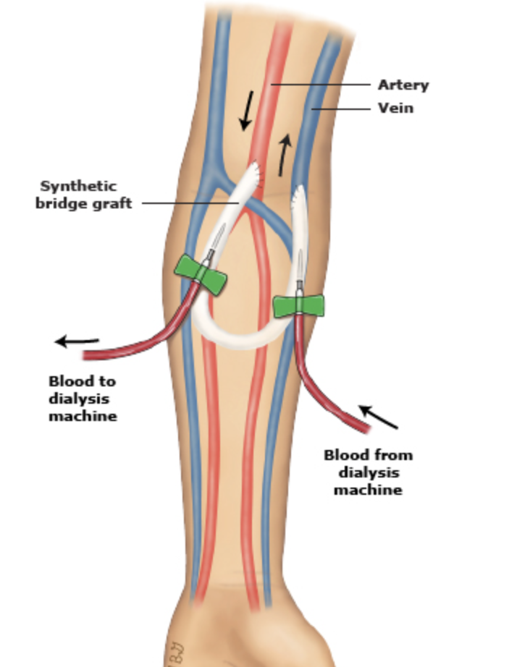
ARTERIOVENOUS GRAFT

Slide 18
Q 2- What is the most common complication of AVG?
Answer: The most common complication of AVG is recurrent stenosis and thrombosis.

Slide 19
Q 3: You are the medical director of the dialysis unit. Before the start of the shift, a dialysis nurse comes to you so you can evaluate one of the chronic hemodialysis patients, she is concerned about prolong bleeding from the access site after dialysis session has ended. What could be the reason for increased bleeding?
Answer: Stenosis of the arteriovenous fistula

Slide 20
Methods of cannulation used in AVF and AVG
There are 2 types of cannulation method:
1- Buttonhole or Constant site
2- Rope Ladder or Site rotation

Slide 21
Rope ladder is the most common method of cannulation used. Buttonhole method is used by some dialysis centers to decrease pain, infiltration, and formation of pseudoaneurysm. Studies had shown 22 episodes of AVF related bacteremia in 56 patients with buttonhole cannulation, 10 cases with Staph. aureus infection, out of which 4 had pneumonia, septic arthritis, and epidural abscess. Infection presumably occurred due to inadequate hygiene technique; scab was removed before cannulation was performed with a blunt needle (Nesrallah, CJASN 5: 1047-1053, 2010)

Slide 22
Hemodialysis
Hemodialysis is an extracorporeal therapy that is used to replace function of the kidneys when they are unable to maintain homeostasis, electrolyte balance, and water balance.
Basic Principles of Hemodialysis: Diffusion and convention are the two processes that are needed for hemodialysis:
Diffusion: it is the movement of solutes from higher concentration across a semi-permeable membrane to low concentration. The rate and amount of the solute that diffuses across the membrane in either direction depends on the difference in the concentration between the blood and the dialysate, the molecular size of the solute, membrane surface area and porosity. These membrane characteristics are called” coefficient of diffusion” or mass transfer characteristics (KoA).
Convection/Ultrafiltration: Process of fluid removal due to transmembrane pressure gradient (TMP)which leads to solute removal via solute drag is called convection. The amount of solute removed by convection depends on the difference in hydrostatic pressure between the blood and the dialysate compartment and is called “sieving coefficient.”

Slide 23
Key terms to Know
Dialysis Dose: is the total amount of blood cleared of urea during the entire hemodialysis session.
Kt/V is the reference standard and one of the goals of Quality Assessment Performance Improvement (QAPI) metrics
KDIGO recommends target minimum Kt/V >1.2 and target ~1.4 for three times per week dialysis.
Dialysate: Solution which facilitated removal of solutes from blood. A typical dialysate contains Na 135-140mM, K 2.0-3.5, HCO 28-34mM, Ca 2.5-3.5mEq/L and Mg 1mEq.
Sodium bicarbonate is used as a base/buffer. It is the most physiologic buffer.
One of the functions of dialysis is to compensate for metabolic acidosis by replenishing blood bicarbonate.

Slide 24
Ultrafiltration rate:
Typical weight gain is 2-3 kg per treatment interval.
If the ultrafiltration rate is not optimal it results in volume overload and hypertension. A chronic dialysis patient should have a “Dry weight”, the weight below which if more fluid is removed during hemodialysis, patient experiences nausea, vomiting, hypotension and muscle cramps.
Fluid removal rate of 10-13ml/kg/hour are well tolerated in volume overloaded patients.

Slide 25
Type of Dialyzers used
There are two kinds of dialyzer membrane; cellulose and synthetic polysulfones or polyacrylonitrile or polyarylethersulfone. Through this membrane, the process of diffusion, convection and ultrafiltration occur in the extracorporeal circulation.
Cellulose membranes are relatively thin (6.5-15nanometer) to achieve high diffusive solute transport and symmetric structure of the fiber. These membranes have poor bio-incompatibility and are generally unable to adsorb small bacterial products.
Synthetic membranes are more porous and can also help in the removal of middle molecule and high molecular weight toxins (beta2 microglobulin). AN69, one of the dialysis membranes available, was noted to cause anaphylactoid reaction in patient taking ACE inhibitors because of production of vasoactive substances like bradykinin.

Slide 26
Dialyzer reaction
Dialyzer Reaction: are of two types.
Type A (anaphylactoid reaction) reported in patient taking ACEI and were dialyzed using AN69. High endotoxins can also cause type A reaction if present in dialysate.
Type B dialyzer reaction is non-specific, can present as chest pain or back pain within 20-40 minutes after initialing dialysis.

Slide 27
Q 4: A 32-year-old female with history of ESRD on hemodialysis for 3 years via Right brachiocephalic fistula, ESRD due to lupus nephritis presented for her regular dialysis treatment. After initiating dialysis for 40 minutes, patient started shivering, complain of itching and noticed to have hives. Vitals stable. What should be the next step?
A- Stop dialysis and sent her to the emergency department
B- Supportive care, may give acetaminophen and Benadryl to the patient for pain and hives
C- Ask the charge nurse, if AN69 dialyzer has been used
D- Continue treatment and do nothing

Slide 28
Complications of Hemodialysis
Q 5: A 32-year-old male with ESRD due to obstructive uropathy on hemodialysis for 3 years presented to his regular dialysis session. His prescription BFR~400ml/min, 4 hour with right brachiocephalic fistula. 20 minutes in dialysis, arterial pressure noted to increase from -80 to 10mmHg and venous pressure dropped from 170→ 50mmHg, BFR was reduced to 360ml/min. Hemodialysis was continued for another 40 minutes, due to repeated alarms, patient was moved to another HD machine and completed his session for 3:45 with no issues and blood was returned at the end of session.
When leaving the dialysis unit, patient was noted to have dark red color of his skin. After reaching home, he developed severe abdominal pain, nausea and vomiting and presented to ED.

Slide 29
Physical Exam: AAOx3, BP 122/88, HR 98, T 36.7. He was noted to be jaundiced with soft abdomen. Labs were drawn, reported as hemolyzed. WBC 6.78, Hgb 7.7 (2 weeks ago Hgb 10.5), Platelets 138, Na 135, K 4.3, Cl 95, HCO 26, BUN/Cr 69/9.5, Total bilirubin 3.1, ALT/AST 5/156, amylase 525, lipase 1260, alkaline phosphatase 69 albumin 4.0, comb’s test negative, blood smear showed no schistocytes, no evidence of microangiopathic hemolysis.
RUQ US showed no evidence of cholecystitis and cholelithiasis, no ductal dilation. CT abdomen/pelvis: distended gall bladder with minimal pericholecystic fluid, no radiopaque gallstone. MRCP: dilated CBD without evidence of slid intraluminal filling defect. HIDA Scan: no evidence of acute cholecystitis, no CBD obstruction. Patient received 1 unit of PRBC during HD next day during hemodialysis. He was discharged home on the third day with no further issues.

Slide 30
What was the reason for acute pancreatitis and acute hemolysis in this patient?
A- Mechanical hemolysis during hemodialysis due to faulty tubing.
B- Autoimmune hemolytic anemia
C- Dialysate was contaminated with chlorine.
D- Dialysate has < 200 CFU/ml of bacteria.

Slide 31
Q 6: A 60-year-old male with past medical history of CKD V (SCr~15.7, GFR~ 4ml/min/1.73m2), HTN, T2DM presented to ED with complaint of shortness of breath and decreased urination. On examination: T 37.5 BP 160/90 P 97 RR 20 on 2L nasal cannula, Labs: BUN/Cr 170/15.70, Na 134 K 5.8 HCO 15bCa 9.5 P 9.8 Mg 2 H/H 9.3/29.8 platelets 186, serum iron 39, TIBC 208, transferrin sat 18%. CXR showed increased vascular congestion. Echo showed EF~47%, mild diastolic dysfunction and moderate left ventricular hypertrophy. Patient was short of breath, unable to complete sentences.
Home medications include amlodipine 10mg daily, coreg 25mg bid, furosemide 80mg bid, metolazone 10mg daily, renvela 1600 mg tid with meals, sodium bicarbonate 1300mg bid, Epogen 10,000 IU q two times a week.
Patient was initiated on hemodialysis, after completion of dialysis, the patient complaint of nausea, vomiting, headache and was noticed to have a seizure by the nurse.

Slide 32
What could have happened to the patient?
A- Severe hypotension
B- Dialysis disequilibrium syndrome
C- Exposure to increased endotoxin level in the dialysate
D- Air embolism

Slide 33
Other hemodialysis complications to keep in mind
Air Embolism: Can occur secondary to return of air through venous return line. The treatment is to stop hemodialysis, give 100% oxygen to the patient and keep the patient’s tight side up.
Intradialytic hypotension: This is a common complication. It is related to excessive amount of volume removed, can be medication related and due to decrease cardiac output.
Hemorrhage: Patient can experience hemorrhage due to needle dislodgement. The key to prevent hemorrhage from happening, is to keep the dialysis access visible during hemodialysis sessions.

Slide 34
Anticoagulant used in Dialysis
The most common anticoagulant used for hemodialysis worldwide is unfractionated heparin (UFH). Clotting occurs in extracorporeal circuits as the cellular elements during passage through the dialysis circuit are activated, resulting in activation of tissue factors which activates the intrinsic and extrinsic clotting cascade and accelerated thrombin generation, resulting in clotting in the dialysis chamber. Heparin is typically used as a bolus infusion in chronic dialysis patients.

Slide 36
https://www.ch.ic.ac.uk/local/projects/McIntosh/Howitworks.html

Slide 37
Nutrition requirement in Dialysis patients
One of the known complications of CKD/ESRD patients is Protein Energy Wasting (PEW). One of the screening tests for which is to check serum albumin levels during monthly blood work.
A typical ESRD patient requires protein intake~1.2-1.4 gram/kg body weight and calorie intake~30-35 kcal/kg. Protein Energy wasting is one of the risk factors for death in these patients. In certain patients who are unable to tolerate food intake, Intradialytic Parenteral Nutrition (IDPN) should be considered. IDPN is usually initiated at the beginning of hemodialysis and given into the venous line. It is usually completed 25-30 minutes before the end of hemodialysis session.

Slide 38
Water treatment
Dialysis patient is typically exposed to ~120-200L of water per treatment.

Slide 40
Contaminants found in water
Aluminum: the source is municipal water. Patient can present with anemia, encephalopathy, and bone disease.
Calcium/Magnesium: the source is municipal water. Patient can present with nausea and vomiting.
Copper: the source is dialysis water treatment. Patient can present with nausea/vomiting and hemolysis.
Chlorine: the source is dialysis water treatment. Patient can present with hemolysis.
Endotoxins: the source is dialysis water treatment. Patient can present with fever and inflammation.
Fluoride: the source is municipal water treatment. Patient can present with arrythmia, abdominal pain, nausea and pruritis.

Slide 41
Water Quality Requirements

Slide 42
Role of a Medical Director
Nephrologist plays two roles in outpatient HD units: Medical director and/or attending physicians. The Conditions for coverage (Cfc) effective October 2008, made the medical director the ultimate authority responsible for all aspects of quality care delivered in the unit. The tasks can be divided into three categories: administrative, medical and technical oversight.
The primary role of the medical director in quality aspect is quality assessment and performance improvement process (QAPI) to a population health management role with responsibility for the facility patient care and outcome.
The QAPI is led by the medical director with an interdisciplinary team which comprises of a physician (typically the medical director), registered nurse (clinical manager), social worker and a registered dietitian.

Slide 43
QAPI Metrics
Metrics that are discussed during QAPI meeting are as follow:
Adequacy of dialysis
Nutritional status
Mineral metabolism and renal bone disease
Anemia management
Vascular access
Medical injuries and medical errors identification
Patient satisfaction and grievances
Infection control
Transplant rate

Slide 44
References:
1- Daugirdas J, Blake P. Handbook of Dialysis. 5th ed. Kluwer
2- Gilbert S, Weiner D. National Kidney Foundation. Primer on Kidney Disease. 6th ed. Elsevier
3- Nissenson A, Fine R. Handbook of Dialysis Therapy. 5th ed. Elsevier
4- Uptodate, accessed on August 21, 2021
5- Projecting ESRD Incidence and Prevalence in the United States through 2030. DOI: 10.1681/ASN.2018050531
6- Nesrallah, CJASN 5: 1047-1053, 2010)
7- Case Report: Acute pancreatitis related to hemolysis during hemodialysis due to defective/kinked blood tubing: M.Yaziji, S.Khan, L.Arbeit, K.Kim, N.Wadhwa, Stonybrook NY.
8- The Medical Director and Quality requirements in the dialysis facility: Brigitte Schiller
9- Department of Health and Human services: CMS: http://www.cms.gov/CFCsAndCoPS/downloads/ESRD finalrule0415.pdf.
10- What Medical Directors Need to Know about Dialysis Facility Water Management. CJASN June 2015, 10 (6) 1061-1071; DOI: https://doi.org/10.2215/CJN.11851214

Slide 45
Thank You!
For questions, please email me:
sobia.khan@stonybrookmedicine.edu

