Slide 1
HIPAA
&
Other Confidentiality Laws
HIPAA Privacy Office
2020 Reviewed Apr 2021

Slide 2
HIPAA privacy Office
HIPAA Provides the Minimum Requirements for Patient Privacy and Confidentiality Protection
A state or other federal law prevails when it provides the patient greater protection
Such laws include:
NYS PHL Article 27-F Confidentiality of HIV – related information (labs, rx’s)
NYS MHL Confidentiality of mental health information applicable to OMH certified providers & locations (CPEP, 10N, 12N)
GINA (Fed & NYS) Genetic Information Non-Discrimination Act
42 CFR Part 2 (known as Part 2) Confidentiality of Substance Use Disorder Patient Records (ELIH Inpatient & Outpatient Treatment Units)
Other Confidentiality Laws

Slide 3
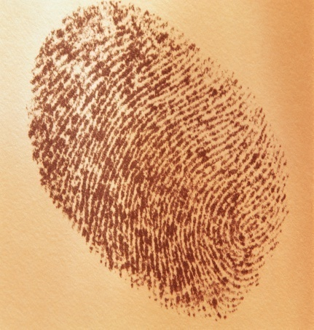
HIPAA Privacy Office
Protected Health Information (PHI)
Any form of information that can identify an individual
who has, is or will be obtaining health care services
What makes up PHI ?
Name, Address, SSN, Phone Number, Medical Record Number, Diagnosis, Test Results, Photographs, Doctors notes, Health Plan Information, etc.
What is being Protected?

Slide 4



HIPAA Privacy Office
Privacy Rule
Pertains to all manners of communicating PHI including:
Spoken
Written
Electronic
HIPAA Privacy Rule

Slide 5

HIPAA Privacy Office
Provide Care
Obtain payment
Health Care Operations
When are we permitted to share PHI?

Slide 6

HIPAA Privacy Office
Maintain our patient’s trust
(↑ patient safety & satisfaction)
Safeguard our patient’s PHI
Educate our patients as to their rights.
What are our Privacy Goals ?

Slide 7
HIPAA Privacy Office
request restricted use and disclosure of PHI
request to receive communications via alternate mechanism
inspect and copy their health information
request to amend their medical record
request an accounting of disclosures
file a complaint
PATIENT’S RIGHTS

Slide 8

HIPAA Privacy Office
Breach Notification report misdirected faxes, mail, email, lost portable devices, etc.
Electronic Copies patient health information from the EHR
Individually Directed Privacy Restrictions for insurance billing
Vendors/Business Associates subject to same penalties
Increased Enforcement and New Penalties - Individuals & Organizations are subject to the criminal provisions; State AG’s can bring civil suit in Federal Courts on behalf of state residents; harmed individuals can receive a % of CMP’s or settlement
HITECH CHANGES TO HIPAA

Slide 9
Stony Brook Organized Health Care Arrangement (SBOHCA)
NOTICE OF PRIVACY PRACTICES
`HIPAA Privacy Office
Notice of Privacy Practices

Slide 10
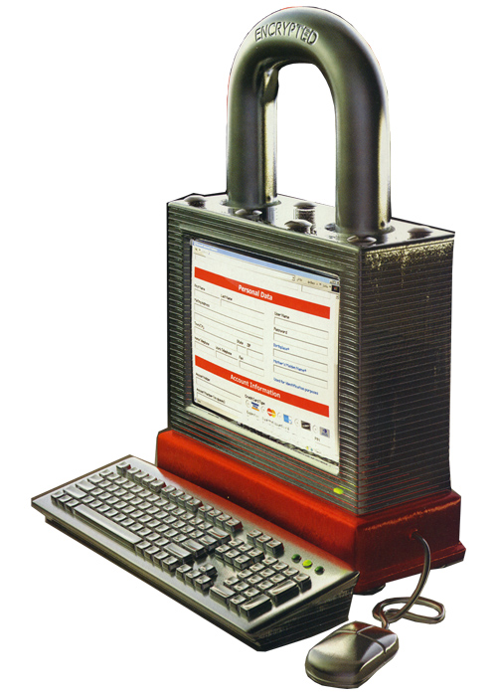

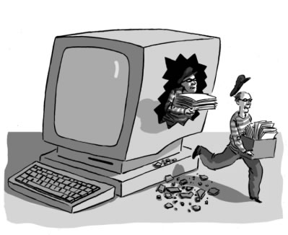
HIPAA Privacy Office
Information Security is the process of protecting data from accidental or
intentional misuse by persons inside or outside of the organization.
The HIPAA Security Rule sets the standards for ensuring that only those
who should have access to e- PHI will actually have access and that
the integrity of patient information in electronic systems is maintained.
e-PHI = Electronic Protected
Health Information
HIPAA Security Rule

Slide 11



HIPAA Privacy Office
Administrative Safeguard
(policies, training, audits, etc)
Physical Safeguards
(locks, privacy screens, etc)
Technical Controls
(firewalls, encryption, virus protection, etc)
Note: The Federal HIPAA Security Regulation requirements are in alignment with
the NYS Cyber & Information Security Law , TJC standards & the NYS DOH Regs.
HIPAA Information Security Requirements

Slide 12
HIPAA privacy Office
Privacy Best Practices:
Use, Access and Disclose the minimum necessary to perform your assigned duties & responsibilities (provide treatment; obtain payment; perform a healthcare related activity (QA/QI, audit, teaching, research, etc.)
Definition of T,P,O can be found in the Admin P&P LD: 0075
Do Not Snoop even if someone asks you to
(neighbors, friends, relatives, family members, colleagues)
Dispose of PHI properly HIPAA Bins or Cross Cut Shredders
Store PHI Securely Lock-up all paper documents containing PHI
Use only SBM approved electronic storage solutions Secure share drives (u: or w: drives), SBM OneDrive for Business, SBM Box for Research
Ensure PHI that is sent electronically is sent to the proper recipient
When in doubt ask the HIPAA Privacy Office phone 631-444-5796 or
e-mail hipaa@stonybrookmedicine.edu
What is expected of me to protect patient privacy?

Slide 13
HIPAA privacy Office
Security Best Practices:
Remember your username and password are your signature:
Do Not Share usernames/passwords
Strong password Use a combination of Alpha/Numeric and special characters
Log-Off before walking away from a workstation
Do Not place/post patient information on MOBILE DEVICES or SOCIAL NETWORK sites
(Laptops, USB Drives, cellphones, Facebook, Twitter, Instagram)
Do Not text patients without ensuring you are in compliance with the federal regulation
Do Not take pictures of patients with non-approved devices & w/o patient consent
Do Not install/download applications/software, etc. on a SBUH computer without IT approval
Remember when sending patient information via e-mail:
Use only SBM Outlook and send only to another SBM Outlook email address
Send only the minimum necessary amount of information
Ensure you have the correct recipient
When in doubt contact hipaa@stonybrookmedicine.edu
What is expected of me when using electronic information?

Slide 14
HIPAA Privacy Office
2 Seconds
One, one thousand; two, one thousand - 2 seconds is all it takes:
To check EACH tab/sheet/page of an excel file to ensure identifiable patient information is not on any of the sheets/pages.
To check the LED window on a fax to verify that you have dialed the number correctly and that you have flipped through all the pages to ensure all the documents are for the same/correct patient before hitting send/start fax.
To check the recipients on the “To/cc/bcc” lines of an email to verify you have entered all the correct recipients and that you are only sending health information to another stonybrookmedicine.edu user and not any other email account.
To double check you have made all the correct selections prior to XR Clinical Reporting for printing and faxing through our EMR.
To flip through all pages to ensure all the documents are for the same/correct patient prior to handing the documents to a patient.
To flip through all the pages to verify all the documents are for the same/correct patient and the envelope is addressed correctly prior to stuffing and mailing the documents.
To ensure you have limited the amount of health information being shared/sent/disclosed to only that which is requested – no more, no less.
To clarify the correct primary care physician (PCP) has been selected for continuity of patient care communications.
Please stop & take 2 seconds to prevent a breach of patient confidentiality.
2 Second Rule

Slide 15
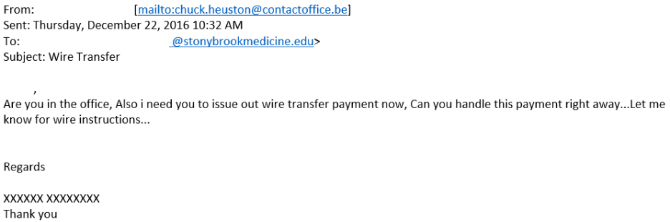
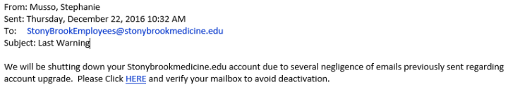
HIPAA Privacy Office
Be on the look out for and report to the HELP-Desk any unusual emails
as they could be phishing, spoofing or Ransomware attempts.
DO NOT open/click on any links or attachments in these emails.
(email Helpdesk or call 4-4357)
April Lee and Gary Bie

Slide 16
HIPAA privacy Office
Patient Privacy Monitoring
We are introducing a new proactive privacy monitoring solution called FairWarning
to help us ensure compliance with healthcare regulations and internal policies.
By proactively protecting our patients’ privacy, we are:
• Building a reputation for privacy, helping us attract and retain patients
• Giving our patients confidence in their choice of care provider
• Assuring patients that they can share sensitive information without fear
• Positioning our organization for long-term success
By working together to build a culture of privacy, we can reduce the following types of activities:
• Co-worker snooping
• Household/Family snooping
• VIP snooping
• Neighbor snooping
• Identity theft
• Medical identity theft
FairWarning - Patient Privacy Monitoring

Slide 17


HIPAA Privacy Office
Civil monetary penalty:
Civil penalty for inadvertent violation such as a misdialed fax number: Fines $100-$1000/per incident
Criminal Penalties :
Criminal penalties = large fines + jail time,
and increase with the degree of the offense.
Example:
A hospital employee steals and sells patient information for personal profit. Criminal penalties could be as much as $250,000 to 1.5 million and/or 10 years in jail.
How is HIPAA Enforced?

Slide 18
HIPAA Privacy Office
CALIFORNIA SURGEON SENTENCED TO JAIL FOLLOWING HIPAA VIOLATION - Former UCLA cardiothoracic surgeon caught snooping in celebrities medical records and the medical record of his colleagues. Sentenced reduced to 4 months in jail and $2000 fine.
LONG ISLAND HEALTH CARE PROVIDER SENTENCED TO 12 YEARS IN PRISON FOR $10 MILLION MEDICARE FRAUD AND HIPAA IDENTITY THEFT – Operated a medical equipment company in Hicksville and user her position to enter nursing homes in order to access/steal patient records. Also falsely resumed roles as doctor, NP, etc. and accompanied doctors on patient evaluation rounds. Spent stolen Medicare funds on LI multi-million dollar home, half-million dollar pension account and luxury items.
Was ordered to forfeit $1.3 million seized by government at indictment.
Anthem to pay OCR $16M in Record HIPAA Settlement following the largest U.S Health Data Breach in History
Allergy Practice pays $125,000 to settle doctor’s disclosure of patient information to a reporter – A patient of Allergy Associates of Hartford contacted a local TV station to speak about a dispute that occurred between the patient and the practice. The reported subsequently contacted the doctor for a comment and the doctor impermissibly disclosed the patient’s PHI to the reporter. OCR found that the physician’s discussion with the reporter demonstrated reckless disregard for the patient’s privacy and that the disclosure occurred after the doctor was instructed by the Practice Privacy Officer to either not respond to the media or respond with “no comment.”
Settlements for impermissible disclosures of PHI include:
Memorial Hermann Health System – $2.4 million settlement for disclosing a patient’s PHI in a press release.
New York Presbyterian Hospital – $2,200,000 penalty for filming patients without consent.
Massachusetts General Hospital– $515,000 penalty for filming patients without consent.
Luke’s-Roosevelt Hospital Center – $387,000 settlement for careless handling of PHI/Disclosure of a patient’s HIV status to their employer.
Brigham and Women’s Hospital– $384,000 penalty for filming patients without consent.
Boston Medical Center – $100,000 penalty for filming patients without consent.
Phoenix Cardiac Surgery - $100,000 penalty for practice posting patient appointments on publicly accessible web-based calendar
But are they really taking this seriously?

Slide 19
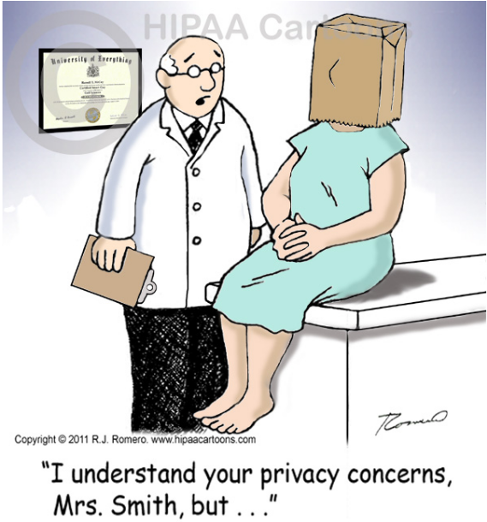
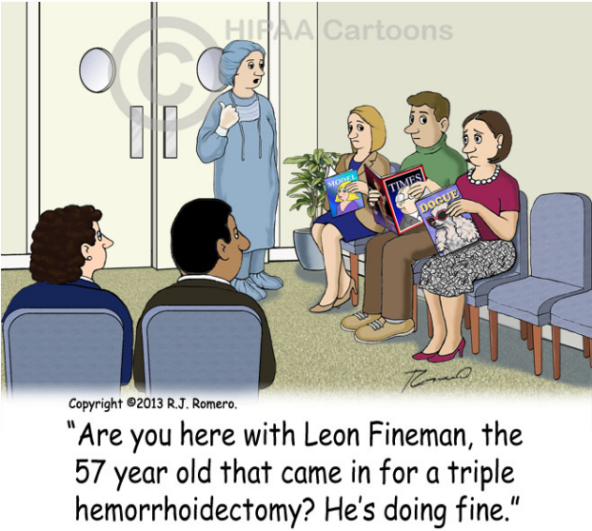
HIPAA Privacy Office

Slide 20
HIPAA Privacy Office Revised 1/11/2016
HIPAA Privacy Questions
Call 631-444-5796
or
Email:
hipaa@stonybrookmedicine.edu
Thank you !

Slide 21
HIPAA Privacy Office
Chief Information Security Officer
Matthew P. Nappi
matthew.nappi@stonybrook.edu
Call the SBMIT Helpdesk
631-444-4357
BEST WISHES ON YOUR STONYBROOK CAREER

