Slide 1
Stony Brook Medicine

Slide 2
Hand Hygiene
Annual Training
Designed by: Infection Control and The Hand Hygiene Committee Version: 06/4/2025

Slide 3
Learning Objectives
By the end of this section, participants will be able to demonstrate an understanding of the following:
How hand hygiene helps prevent infections.
When hand hygiene is performed.
How individuals clean their hands with alcohol-based hand sanitizer, or soap and water, so as to ensure they cover all surfaces of hands and fingers, including thumbs and fingernails.
When gloves should be used, in addition to hand washing (e.g., caring for C. diff. patients) and how hand hygiene should be performed when gloves are used.
The minimum time that should be spent performing hand hygiene with soap and water and alcohol-based hand sanitizer.
How hand hygiene compliance is monitored.
Notes:
Facilitator notes:

Slide 4
Hand Hygiene Saves Lives
Practicing hand hygiene is a simple yet effective way to prevent infections. Cleaning hands can prevent the spread of germs, including those that are resistant to antibiotics and are becoming difficult, if not impossible, to treat.
As stated by the CDC, “Most germs that cause serious infections in healthcare are spread by people’s actions. Hand Hygiene is a great way to prevent infections. However, studies show that on average, healthcare providers clean their hands less than half of the times they should. This contributes to the spread of healthcare-associated infections that affect 1 in 31 hospitalized patients on a given day.”
Notes:
Facilitator notes:

Slide 5
Stony Brook Medicine Commitment
We all play a critical role in protecting our patients, visitors, fellow caregivers, and even ourselves from the spread of infection. It’s a simple step that should never be missed.
Equally important is to speak up when you observe the potential for a missed opportunity.
We are committed to prevent harm to our patients here at Stony Brook, and expect to accomplish some of this with 100% hand hygiene compliance.
Notes:
Facilitator notes:

Slide 6
When Should I Perform Hand Hygiene?
Immediately before AND after leaving patient's room
Before/after removing gloves
Before/after handling an invasive device for patient care (regardless of glove use)
After contact with blood, body fluids or visibly contaminated surfaces
If moving from a contaminated body site to another body site on the same patient
Notes:
Facilitator notes:

Slide 7
When to use Hand Sanitizer:
Alcohol-based rub or gel is used:
Preferred method for MOST circumstances
Immediately before AND after leaving patient's room
Before an aseptic task or handling invasive medical devices (regardless of glove use)
Immediately before and after glove use
Notes:
Facilitator notes:

Slide 8
When to use Soap and Water:
When hands are visibly soiled or contaminated with blood / body fluids
After caring for persons with known / suspected infectious diarrhea or spore-forming pathogens (e.g. C. diff)
Before / after eating
After using restroom
Notes:
Facilitator notes:

Slide 9
How to perform hand hygiene using…
Alcohol-based sanitizer: place sanitizer on hands and rub hands together, covering all surfaces until hands feel dry (roughly ~15-20 seconds)
Soap/water: wet hands/apply soap, rub vigorously covering all surfaces of hands/fingers for at least ~15 seconds. Rinse with water, dry with disposable towels, use towel to turn off the faucet
Notes:
Facilitator notes:

Slide 10
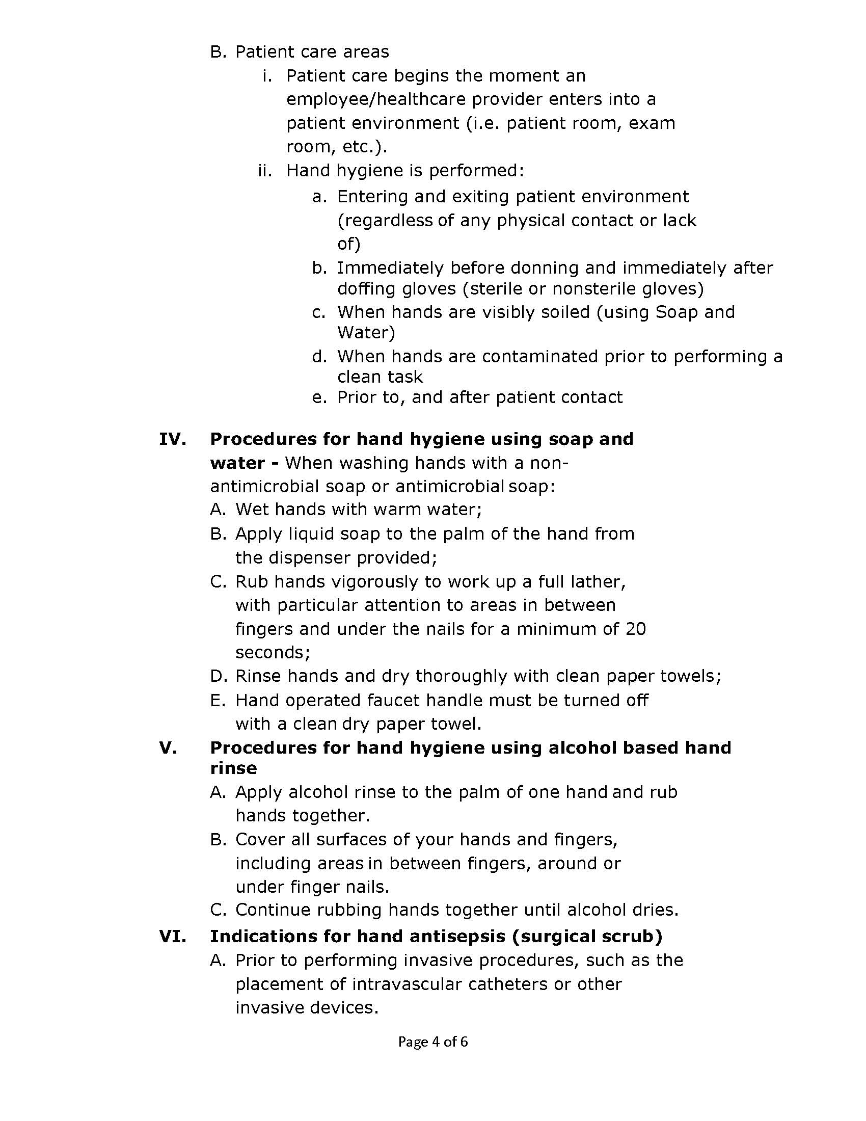
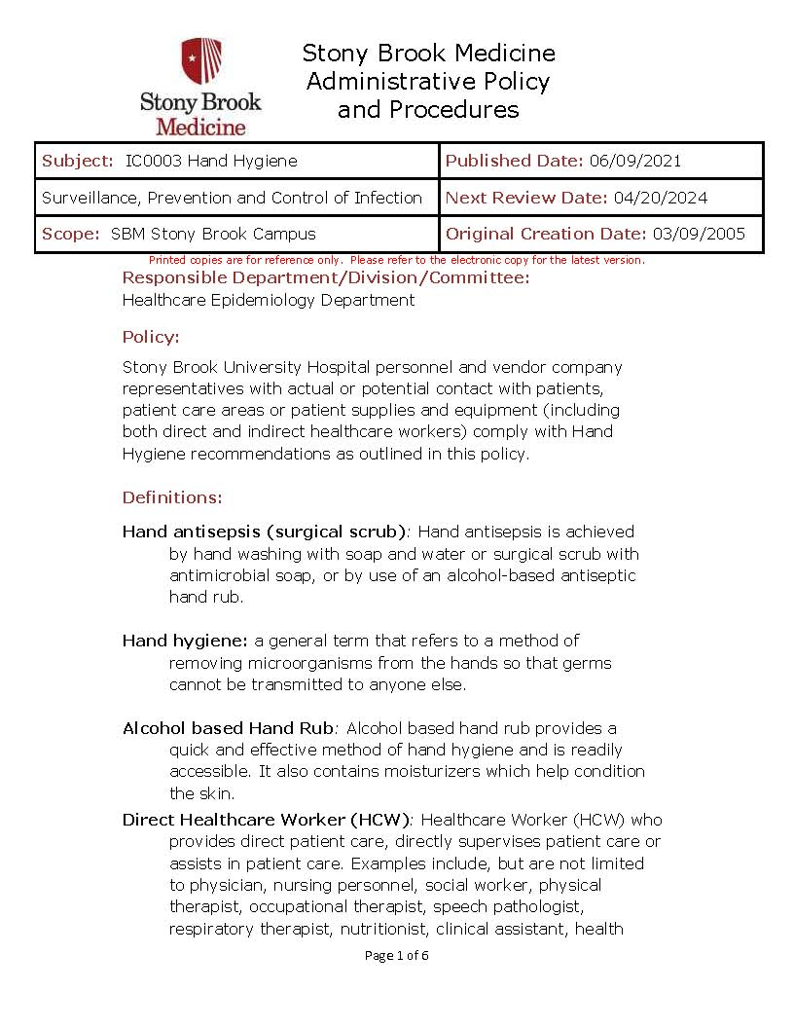
Hospital Policy: IC0003
1. Perform hand hygiene every time you enter and exit a patient’s room.
2. If patient is isolated with C.diff – wash with soap and water.
3. Wash hands before donning gloves and after removing gloves.
Notes:
Facilitator notes:

Slide 11
When gloves should be used in addition to hand washing
From Hospital Policy: IC0012 Standard Precautions
Gloves:
a. For touching blood and body fluids, mucous membranes, or nonintact skin.
b. For handling items or surfaces soiled with blood or body fluids.
c. For performing venipuncture or other vascular access procedures.
d. For all invasive procedures.
e. Changed after each patient contact
f. For procedures likely to generate splashes of blood or other body
fluids.
g. All invasive procedures including assisting in vaginal or cesarean
deliveries.
Gloves are also required when providing any care for all patients requiring contact precautions.
Notes:
Facilitator notes:

Slide 12
Annual Physicals
As faculty and staff complete annual physicals, they will sign an attestation in Employee Health & Wellness, which will reside in Human Resources. For recertification, employees will attest electronically. PeopleSoft will automatically track this activity. All new employees will sign a similar attestation during orientation.
Notes:
Facilitator notes:

Slide 13
Hand Hygiene Monitoring
Monitoring is done by Direct Observation.
Observations:
Identify opportunities for hand hygiene.
Determine compliance with these opportunities and that proper technique was used.
Conducted on all units and patient care areas.
Monthly across all shifts and on all days of the week.
Number of observations based on census or number of procedures (typically 200 per month).
Different roles of individuals (e.g., Nurses, Physicians, Techs, Dietary)
Validation of observers conducted by Infection Control
Notes:
Facilitator notes:

Slide 14
Thank You
For questions or comments please contact:
Quality Improvement
(631) 444-4595

