Slide 1
Title: Stony Brook Medicine

Slide 2
Stony Brook Medicine , Advanced Heart Failure Program, Heart Failure Orientation for Medical Staff
Stony Brook Medicine
Advanced Heart Failure Program
Heart Failure Orientation for Medical Staff
Updated 9/2025
MG/NU

Slide 3







Advance Heart Failure and Cardiomyopathy Program at the Stony Brook Heart Institute of Stony Brook Medicine
Advanced Heart Failure and Cardiomyopathy Program at the Stony Brook Heart Institute of Stony Brook Medicine
2023-2025

Slide 4
Objectives:
Objectives:
Be familiar and able to define HEART Failure
Differentiate between Systolic and Diastolic HEART Failure
Differentiate between left and right sided HEART Failure
Describe current medications for HEART Failure treatment
Understand Joint Commission Metrics and AHA Get with the Guidelines
Describe inpatient care, patient education goals, discharge instructions & transition of care into outpatient setting
Have basic awareness of Advanced HEART Failure therapies

Slide 5
Heart Failure Statistics
Heart Failure Statistics
Approximately 6.7 million adults 20 years or older are living with Heart Failure in the United States
Heart Failure directly accounts for about 8.5% of all heart disease deaths in the United States
Heart Failure is the cause of over 379,800 deaths per year
Approximately half of those diagnosed with Heart Failure die within the first 5 yrs
Heart Failure will cost the nation $70 billion by 2030

Slide 6
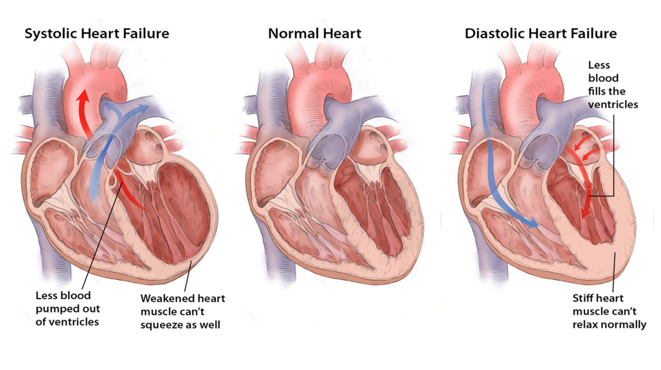
Phenotypes of Heart Failure
Phenotypes of Heart Failure
SYSTOLIC HEART FAILURE
HFrEF: Reduced ejection fraction– also referred to as systolic heart failure. The heart muscle does not contract effectively and less oxygen-rich blood is pumped out to the body due to decreased cardiac output. Blood backs up into the lungs and systemic circulation, creating pressure and the symptoms of congestion
LV Ejection Fraction ≤ 40%
Thin, weakened Myocardium
Enlarged ventricle
DIASTOLIC HEART FAILURE
HFpEF: Preserved ejection fraction– also referred to as diastolic heart failure. The heart muscle contracts normally but the ventricles do not relax as they should during ventricular filling (or when the ventricles relax).
LV Ejection Fraction > 50%
Thick, stiff myocardium
Impaired relaxation and filling

Slide 7
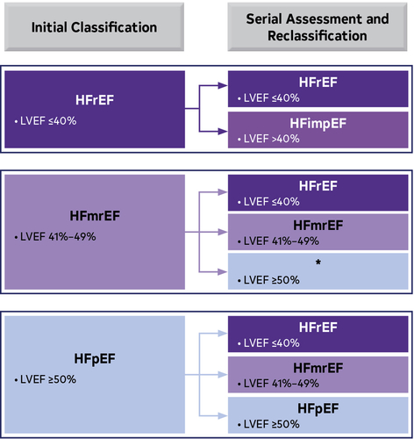
Classification of Heart Failure by LVEF
Classification of Heart Failure by LVEF
Paul A. Heidenreich et al. J Am Coll Cardiol 2022; 79:e263-e421.

Slide 8
Causes of Left & Rights Sided Heart Failure
Causes of Left Sided Heart Failure:
Hypertension
Coronary Artery Disease
Valvular Disease
Atrial or Ventricular Arrhythmias
Infection/Viral
Peripartum
Alcohol or illicit drug use
Chemotherapy (ie: Anthracycline)
Radiation Therapy
Causes of Right Sided Heart Failure:
Tricuspid Regurgitation
Severe COPD
Acute Pulmonary Embolus
Pulmonary HTN
Long standing Left Sided Heart Failure

Slide 9
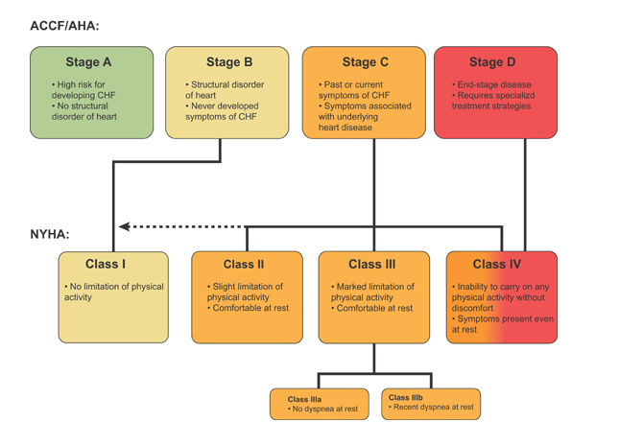
Stages and Classes of Heart Failure
Stages and Classes of Heart Failure

Slide 10
Treatment of Heart Failure
Treatment of Heart Failure
Goals of Therapy
#1 Improve Quality of Life
Risk factor modification
Increase cardiac output
Limit sodium intake
Improve prognosis by delaying progression of heart failure
Treatment of Heart Failure
Aims to relieve symptoms
Maintain a euvolemic state
Cardiac Rehabilitation Referral for HFrEF
Clinical Practice Guidelines
2022 AHA/ACC/HFSA Guideline for the Management of Heart Failure: A Report of the American College of Cardiology/American Heart Association Joint Committee on Clinical Practice Guidelines | Circulation
2024 Update:
https://www.sciencedirect.com/science/article/pii/S0735109724074497

Slide 11
The Joint Commission
The Joint Commission
What does the Joint Commission want to see
Defect Free Quadruple Therapy Medication for Patients with HFrEF
SGLT2i for All Heart Failure Patients
Follow-up appointments: Scheduled within 7 days post-discharge for an office or home health visit for management of HF and documented including location, date and time.
Care transition record: Transmitted to a next level of care provider within seven days of discharge. Must contain all: reason for hospitalization, treatment(s)/service(s) provided during the hospitalization, discharge medications, including dosages and indications for use, follow-up treatment(s) and service(s).
Advance Directives/Advance Care Planning: Medical record documentation of a one-time discussion with a healthcare provider.
Advance Directive: Medical record documentation that the advance directive was executed.

Slide 12
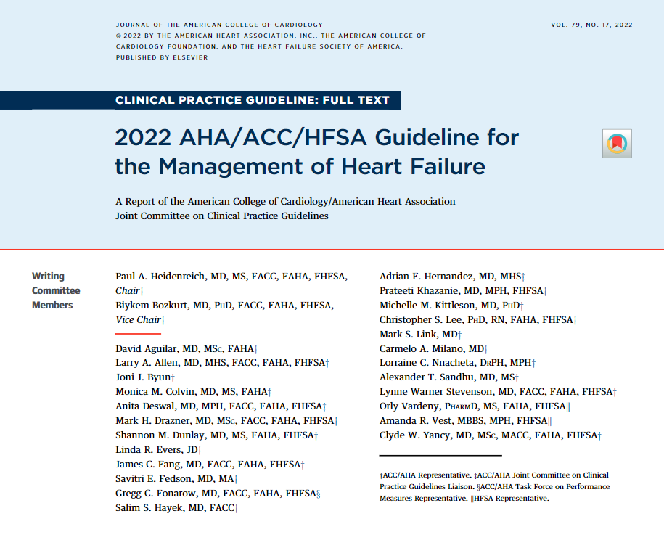
American Heart Association Get With the Guidelines Heart Failure
American Heart Association
Get With the Guidelines Heart Failure
Clinical practice guidelines (CPGs) written for HF in 2022, with updates in 2024-- adopted by SBUH.
AHA changed metrics to ensure compliance with CPGs – in effect January 2025.
All CPG resources available on SBUH Intranet (Manuals -> Heart Failure)
Achievement Measures (THE MUST-DO LIST)
AHAHF2: Evidence-Based Beta Blocker at Discharge (carvedilol, bisoprolol, metoprolol succinate)
AHAHF3: LVEF Assessed (either resulted this admit or documented from previous)
AHAHF4: Post Discharge Appointment Scheduled with PCP or cardiologist
(date, time and location MUST BE documented on patient’s discharge papers)
AHAHF6: ARNi prescribed at discharge: sacubitril/vastartan (Entresto)
AHAHF93: SGLT2i prescribed at discharge: empagliflozin (Jardiance), dapagliflozin (Farxiga), sotagliflozin (Inpefa).
AHAHF110: Mineralocorticoid Receptor Agonist (MRA) at Discharge
**If you do NOT document or order any of the above then you MUST write a contraindication (writing GDMT is not acceptable)**

Slide 13

AHA: Quality Measures of January
Quality Measures as of January 2025
AHAHF1: ACEi/ARB or ARNi (LVEF<40%)
AHAHF7: Anticoagulation for Afib
AHAHF9: DVT Prophylaxis by end of Day 2
AHAHF106: 100% Defect-Free Care for Quadruple Therapy Medication for Patients with HFrEF
AHAHF94: SGLT2I at discharge for Patients with HFpEF and HFmrEF
**If you do NOT document or order any of the above then you MUST write a contraindication (Writing GDMT is not acceptable)**

Slide 14
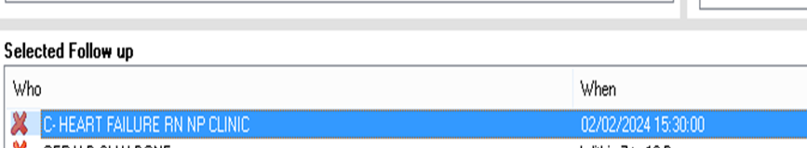

Key Takeaways
Key Takeaways
All heart failure admissions must have an LVEF% documented.
If LVEF ≤ 40% patient must have beta blocker (carvedilol, metoprolol succinate, or bisoprolol), ARNi (or ACE/ARB if ARNi contra’d), SGLT2i and MRA ordered or contraindicated.
“GDMT” is NOT acceptable documentation – each medication must be ordered or contraindicated individually.
Do NOT remove this appointment – “C-Heart Failure RN NP Clinic”

Slide 15
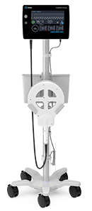
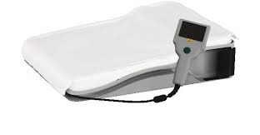

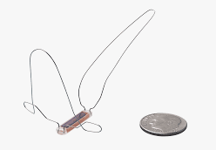

Pulmonary Artery Sensors (PA)
Pulmonary Artery Sensors (PA)
PA Sensors are implanted devices used to remotely monitor a patient’s volume status via Pulmonary Artery pressures. This device is inserted during a right heart catheterization to manage fluid status in the outpatient setting, leading to a > 75% reduction in hospitalizations. There are 2 devices available at SBUH.
1) Cardiomems* (Abbott) patients are asked to lay on a “special pillow” daily and pulmonary artery pressures are wirelessly transmitted to clinician's secure website
2) Cordella* (Edwards) patients have a kit that includes a sensor, transmitter, tablet, blood pressure cuff, oxygen sensor and scale. The information is uploaded and transmitted remotely for clinicians to assess. Cordella does not have a hospital monitor at this time.

Slide 16
Milrinone Infusions
Milrinone Infusions
Milrinone (Primacor) is a Phosphodiesterase inhibitor; positive inotrope with little chronotropic effect; direct vasodilator (decreases both preload and afterload). It is used here for patients with end - stage heart failure, NYHA Class IV Stage D.
Monitor electrolytes, renal function, blood pressure
Starting dose of 0.2cg/kg/minute
Check with Heart failure attending for continued dosing requirements
Patient must follow with the Heart Failure and Cardiomyopathy Center at SB. A Home Care Infusion company will support milrinone continuous infusions with education, home set-up and supplies. Labs drawn weekly and sent to the Stony Brook Heart Failure and Cardiomyopathy Center.

Slide 17





More information
You can find more information here, on the Hospital Intranet
Clinical Practice Guideline Links:
2022 AHA/ACC/HFSA Guideline for the Management of Heart Failure: A Report of the American College of Cardiology/American Heart Association Joint Committee on Clinical Practice Guidelines | Circulation
2024 Update:
https://www.sciencedirect.com/science/article/pii/S0735109724074497

Slide 18
Any Questions….?
Any Questions….?
Contact Us:
INPATIENT:
Cardiology Consult through SPOK
631-444-4CHF (4-4243)
631-444-1396 (4-1396)
Or Page CHF RN through SPOK
NURSE TRANSITION CLINIC:
631-444-1396
OUTPATIENT:
631-444-9746

