Slide 2
Stony Brook Medicine
Advanced Heart Failure Program
Heart Failure Orientation for Medical Staff

Slide 3
Advanced Heart Failure and Cardiomyopathy Program at the Stony Brook Heart Institute of Stony Brook Medicine

Slide 4
Objectives:
Be familiar and able to define HEART Failure
Differentiate between Systolic and Diastolic HEART Failure
Differentiate between left and right sided HEART Failure
Describe current medications for HEART Failure treatment
Understand Joint Commission Metrics and AHA Get with the Guidelines
Describe Inpatient care, patient education goals, discharge instructions & transition of care into outpatient setting
Have basic awareness of Advanced Heart Failure therapies

Slide 5
Heart Failure Statistics
Approximately 6.7 million adults 20 years or older are living with Heart Failure in the United States
Heart Failure directly accounts for about 8.5% of all heart disease deaths in the United States
Heart Failure is the cause of over 379,800 deaths per year
Approximately half of those diagnosed with Heart Failure die within the first 5 yrs
Heart Failure will cost the nation $70 billion by 2030

Slide 6
Phenotypes of Heart Failure
SYSTOLIC HEART FAILURE
HFrEF: Reduced ejection fraction– also referred to as systolic heart failure. The heart muscle does not contract effectively and less oxygen-rich blood is pumped out to the body due to decreased cardiac output. Blood backs up into the lungs and systemic circulation, creating pressure and the symptoms of congestion
LV Ejection Fraction < 40%
Thin, weakened Myocardium
Enlarged ventricle
DIASTOLIC HEART FAILURE
HFpEF: Preserved ejection fraction– also referred to as diastolic heart failure. The heart muscle contracts normally but the ventricles do not relax as they should during ventricular filling (or when the ventricles relax).
LV Ejection Fraction > 50%
Thick, stiff myocardium
Impaired relaxation and filling

Slide 7
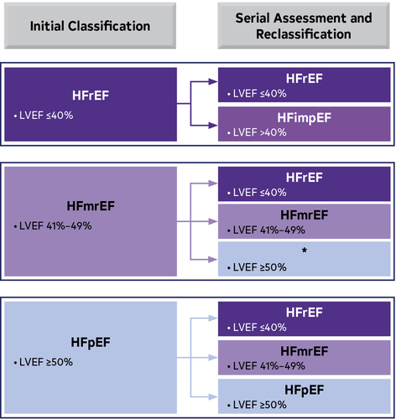
Classification of Heart Failure by LVEF
Heart Failure is a complex clinical syndrome that can result from any structural or functional cardiac disorder that impairs the ventricle’s ability to fill with or eject blood.
In each classification, the cardiac output is diminished. Blood backs up into the lungs and systemic circulation, creating pressure and the symptoms of congestion.
Paul A. Heidenreich et al. J Am Coll Cardiol 2022; 79:e263-e421.

Slide 8
Causes of Left Sided Heart Failure:
Hypertension
Coronary Artery Disease
Valvular Disease
Atrial or Ventricular Arrhythmias
Infection/Viral
Peripartum
Alcohol or illicit drug use
Chemotherapy (ie: Anthracycline)
Radiation Therapy
Causes of Right Sided Heart Failure:
Tricuspid Regurgitation
Severe COPD
Acute Pulmonary Embolus
Pulmonary HTN
Long standing Left Sided Heart Failure

Slide 9
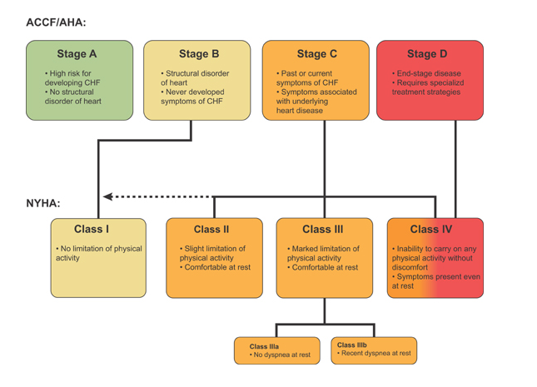
Stages and Classes of Heart Failure

Slide 10
Treatment of Heart Failure
Goals of Therapy
#1 Improve Quality of Life
Risk factor modification
Increase cardiac output
Block endogenous neuro hormonal stress hormone activation
Decrease sodium intake and minimize symptoms
Treatment of Heart Failure
Aims to relieve symptoms
Maintain a euvolemic state (having appropriate hydration)
Improve prognosis by delaying the progression of heart failure
Medication Management
ARNi (vasodilator): Lowers blood pressure, prevents ventricular remodeling with diuretic effect [(Sacubitril/Valsartan (Entresto)]
ACEi/ARB (vasodilators): Afterload reduction, allows blood to flow easier (lisinopril, quinapril, enalapril, losartan, valsartan)
Beta Blockers: Slows the HR to allow extra time for the heart to fill; minimizes arrhythmias (metoprolol xl, carvedilol, bisoprolol)
SGLT-2 Inhibitors: gentle diuresis while decreasing blood sugar [empagliflozin (Jardiance) or dapagliflozin (Farxiga)]
Aldosterone Antagonists: blocks aldosterone and increases diuresis [spironolactone (Aldactone), Eplerenone (Inspra)]
Diuretics: induces diuresis [furosemide, torsemide, bumex, ethacrynic acid]
Digitalis: increases contractility (digoxin)
Nitrates/Hydralazine: Reduce systemic vascular resistance (Imdur and hydralazine)

Slide 11
Bedside Nurse Responsibilities
Daily AM weights – upon waking and before breakfast
Give diuretics ~ 6-7 am to allow for a reportable diuresis
Follow-up serum potassium & creatinine prior to 2nd diuretic dose
Ensure accurate and precise documentation of I&Os in EMR
Report to LIP if 24 hr input > 24 hr output
Alert medical team if parameters are prohibiting the administration of Heart Failure medications
Follow activity as ordered by the LIP
Communicate recommendations of physical therapists to patients
Advocate with patient for optimal activity level

Slide 12
The Joint Commission
What does the Joint Commission want to see– LIP driven
Beta-blocker therapy: Prescribed for Heart Failure patients with HFrEF/LVSD at discharge (Carvedilol, Metoprolol XL, Bisoprolol)
Follow-up appointments: Scheduled within 7 days post-discharge for an office or home health visit for management of HF and documented including location, date and time.
Care transition record: Transmitted to a next level of care provider within seven days of discharge. Must contain all: reason for hospitalization, treatment(s)/service(s) provided during the hospitalization, discharge medications, including dosages and indications for use, follow-up treatment(s) and service(s).
Advance Directives/Advance Care Planning: Medical record documentation of a one-time discussion with a healthcare provider.
Advance Directive: Medical record documentation that the advance directive was executed.
Post Discharge Phone Call: A documented phone call or home visit within 72 hours of discharge. [Three attempts must be made and documented within 72 hours].

Slide 13
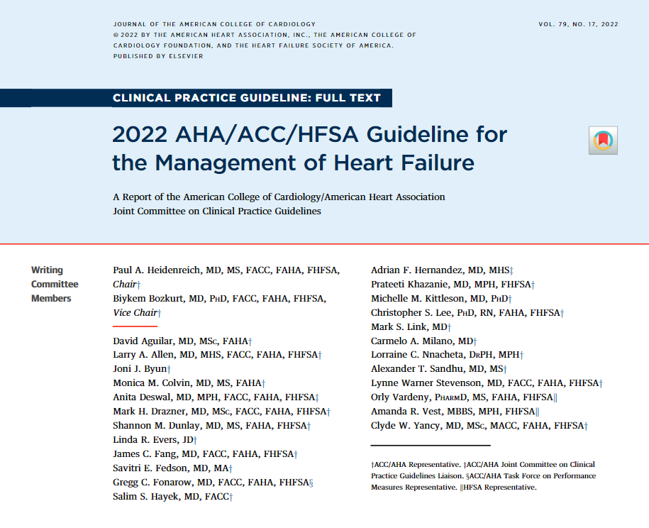
American Heart Association
Get With the Guidelines Heart Failure
New clinical practice guidelines (CPGs) written for HF in 2022 – adopted by SBUH.
AHA changed metrics to ensure compliance with CPGs – in effect January 2024.
Available on SBUH Intranet (Manuals -> Heart Failure)
Achievement Measures (THE MUST-DO LIST)
AHAHF2: Evidence-Based Beta Blocker at Discharge (carvedilol, metoprolol, bisoprolol)
AHAHF3: LVEF Assessed (either resulted this admit or documented from previous)
AHAHF4: Post Discharge Appointment Scheduled
(date, time and location MUST BE documented on patient’s discharge papers)
AHAHF6: ARNi prescribed at discharge
AHAHF93: SGLT2i prescribed at discharge
AHAHF110: Mineralocorticoid Receptor Agonist (MRNa) at Discharge
**If you do NOT document or order any of the above then you MUST write a contraindication**

Slide 14
**ATTENTION LIP’s: A CONTRAINDICATION TO ANY OF THE ABOVE MEDS MUST BE WRITTEN IF THE MEDICATION IS NOT ORDERED (EITHER DURING THE ADMISSION OR ON DISCHARGE)

Slide 15
Quality Measures
AHAHF1: ACEi/ARB or ARNi (LVEF<40%)
AHAHF7: Anticoagulation for Afib
AHAHF9: DVT Prophylaxis by end of Day 2
AHAHF13: Flu Vaccine in Season
**If you do NOT document or order any of the above then you MUST write a contraindication**

Slide 16
Key Takeaways
All heart failure admissions must have an LVEF% documented. If LVEF<41%, patient must have beta blocker (carvedilol, metoprolol, or bisoprolol only), ARNi (or ACE/ARB if ARNi contra’d), SGLT2i, and MRA ordered or contraindicated.
“GDMT” is NOT acceptable documentation – each medication must be ordered or contraindicated individually.
Do NOT remove this appointment – “C-Heart Failure RN NP Clinic”

Slide 17
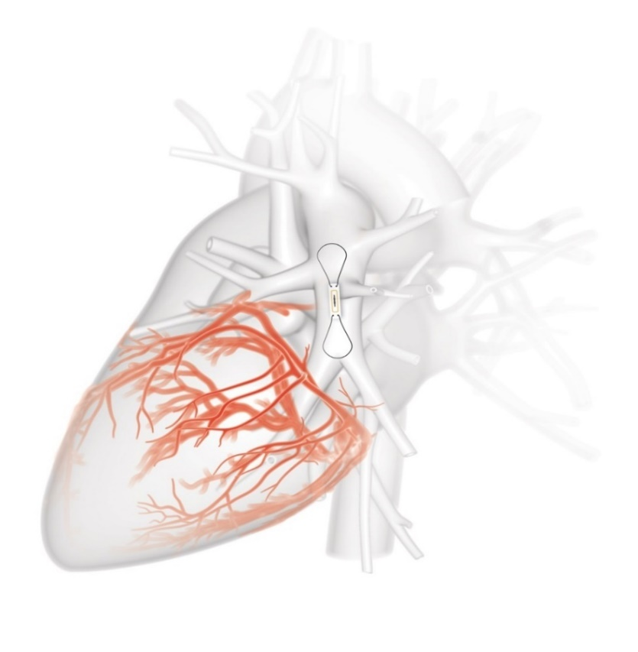
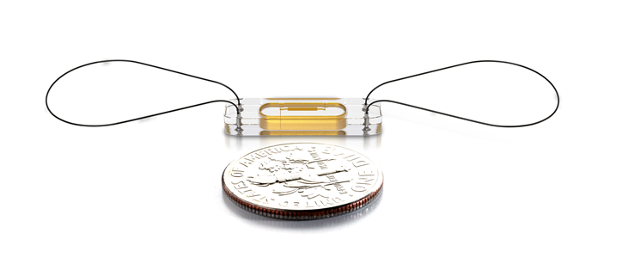
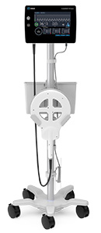
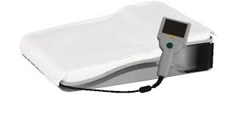
CARDIOMEMS HF SYSTEM:
An implanted device used to remotely monitor a patient’s volume status via Pulmonary Artery pressures. The device is inserted during a right heart catheterization and used to avoid preventable admissions. Patients are asked to lay on a “special pillow” daily and pulmonary artery pressures are wirelessly transmitted to clinician's secure website

Slide 18
You can find more information here, on the Hospital Intranet:

Slide 19
Any Questions….?
Contact Us:
INPATIENT:
631-444-4CHF (4-4243)
631-444-1396 (4-1396)
Or Page CHF RN through Operator
NURSE TRANSITION CLINIC:
631-444-1396
OUTPATIENT:
631-444-9746
November 2024

