Slide 1
Immediate Use Compounding of Medications
May 2026

Slide 2
Objectives
By the end of this presentation the learner will be able to
Define compounding of medications
Identify situations where immediate use compounding outside of the pharmacy is appropriate
Identify the criteria that must be followed with preparing an immediate use CSP
Identify the appropriate environment & importance of maintaining aseptic technique
Identify the “not to touch” critical areas on the medication vials, needle, and syringe
Identify proper labeling of the CSP after preparation is complete
Defines beyond-use date for CSPs

Slide 3
Compounding of Medications
Sterile compounding is defined as combining, admixing, diluting, pooling, reconstituting, repackaging, or otherwise altering a drug product or bulk drug substance to create a sterile preparation.
CSP = Compounded Sterile Preparation

Slide 4
Immediate Use CSP
!
Whenever possible, compounding of medications should be performed in the pharmacy by
or under the direct supervision of a pharmacist.
In urgent or emergent situations in which waiting to obtain the compounded medication(s) from pharmacy could cause a delay in patient care and increased risk for patient harm, a trained RN or provider may compound medications aseptically, outside of the pharmacy.
Examples:
Adding a medication from a vial to an IV piggyback bag
Adding a vasoactive medication from a vial to an IV bag of fluid for continuous infusion
Preparing syringes in advance in anticipation of use during a procedure.
*This does NOT apply to hazardous drugs. Hazardous drugs are to only be compounded in the Pharmacy (ie. Chemotherapy drugs)

Slide 5
Immediate Use CSP
What is NOT considered Immediate Use Compounding?
Immediate Use Compounding does not include mixing, reconstituting, or other such acts that are performed in accordance with directions contained in approved labeling or supplemental materials provided by the product’s manufacturer – as long as the product is prepared as a single dose for an individual patient and administered to that patient immediately after preparation.
Examples:
Reconstitution of powder in a vial and drawing it up for administration in a syringe
Drawing up liquid from a vial for administration
Preparation of t-PA

Slide 6
Immediate Use CSP
When preparing a CSP the following criteria must be met:
Aseptic technique is followed
NO hazardous drugs are used
The preparation involves not more than 3 different sterile products
Any unused starting component from a single-dose container must be discarded after preparation is complete.
Administration begins within 4 hours following the start of preparation. If administration has not begun within 4 hours of compounding, the CSP must be promptly, appropriately, and safely discarded.
The CSP must be labeled with the following:
  Names and amounts (doses) of all active ingredients
  Name or initials of the person who prepared the preparation
  The 4-hour time period within which administration must begin (beyond-use date)

Slide 7
Immediate Use CSP
Environment for Preparation
Designated area is clean & uncluttered
Preparation activities take place on a hard, non-porous surface that can be disinfected
At least 3 feet away from a sink
  if within 3 feet of a sink, a splash guard is installed to provide a physical barrier between the prep area and sink.
Free from sources of contamination, including:
  Food and drink
  Biohazardous materials (e.g., lab specimens)
  Visible contaminants, both non-microbial (e.g., rust, dust, flaking paint) and microbial (e.g., mold/mildew)
  Airflow from HVAC vents, windows, etc.
  Foot traffic (e.g., near entrance/exit, in busy hallway)

Slide 8
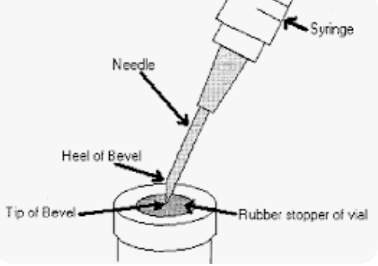
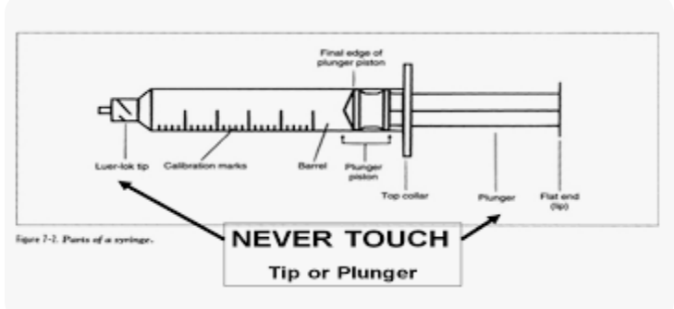
Immediate Use CSP
Aseptic Technique Principles
Aseptic technique refers to the manner of handling, preparing, and storing medications and injection equipment/supplies (e.g., syringes, needles) to prevent microbial contamination and infection
To preserve sterility of materials used in sterile preparation of medications, knowledge of what not to touch is important. These “not to touch” points are known as critical sites and include:
  Stopper of vial
  Needle
    Hub, Bevel, Tip, Lumen
  Syringes
    Tip
    Plunger
    Inner Shaft

Slide 9
Immediate Use CSP
Preparation
Confirm/review ordered dose of medication and volume & type of IV fluid
Designate clear and clean working environment to prepare CSP; disinfect work area per hospital policy
Gather all necessary supplies for compounding (medications, IV fluids, syringes, needles, etc.)
Handwashing (soap & water) is performed prior to preparation of medication.
Disinfect any ports that will be punctured via needle during the compounding process with sterile 70% isopropyl alcohol and allow sufficient time to dry. (vial stopper, IV fluid bag access ports, etc.)
Draw up the ordered dose of medication and inject it into the ordered amount of IV fluid bag via the cleaned access port, while maintaining aseptic technique
  Prevent vial stopper coring or glass ampule contamination
  Visually inspect final CSP to ensure it is free from particulates
Label compounded medication with the following:
  Name/dose of ingredients; diluent of IV admixture
  Initials of the person who prepared the medication.
  The Beyond Use Date (4 hours from time of preparation)
Begin administration of medication within 4 hours of the time of preparation

Slide 10
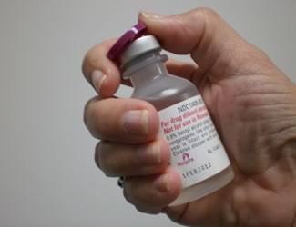
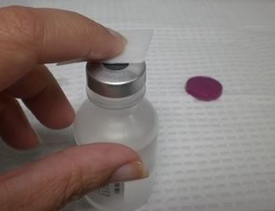
Immediate Use CSP
Considerations
Plastic caps on vials are “dust shields” and not intended to maintain sterility of the rubber stopper. Once removed, the rubber stopper needs to be cleaned.

Slide 11
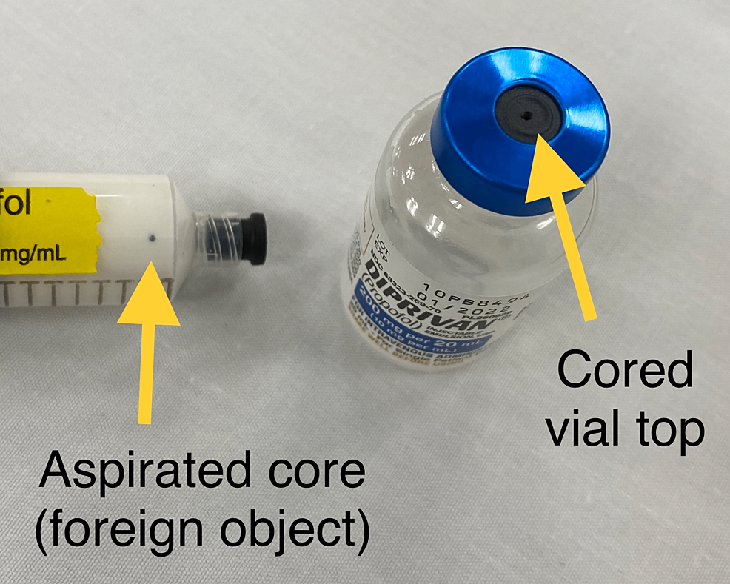
Immediate Use CSP
Considerations
Prevent coring of vial stopper by
inserting needle at 45*-60* angle with bevel facing up and away from stopper
use sharp needle (not blunt)
inspect syringe/vial for evidence of coring, small flecks or pieces of stopper.
Prevent contamination from glass ampules.
Use a 5-micron filter straw or filter needle.
Filter straw/needle should be removed and discarded after use and replaced with the needle one would use to inject into the final solution while maintain aseptic technique
Hruska J L, Saasouh W, Alhamda M S (September 29, 2022)
Notes:
Picture: Hruska J L, Saasouh W, Alhamda M S (September 29, 2022) Coring Revisited: A Case Report and Literature Review. Cureus 14(9): e29750. doi:10.7759/cureus.29750

Slide 12
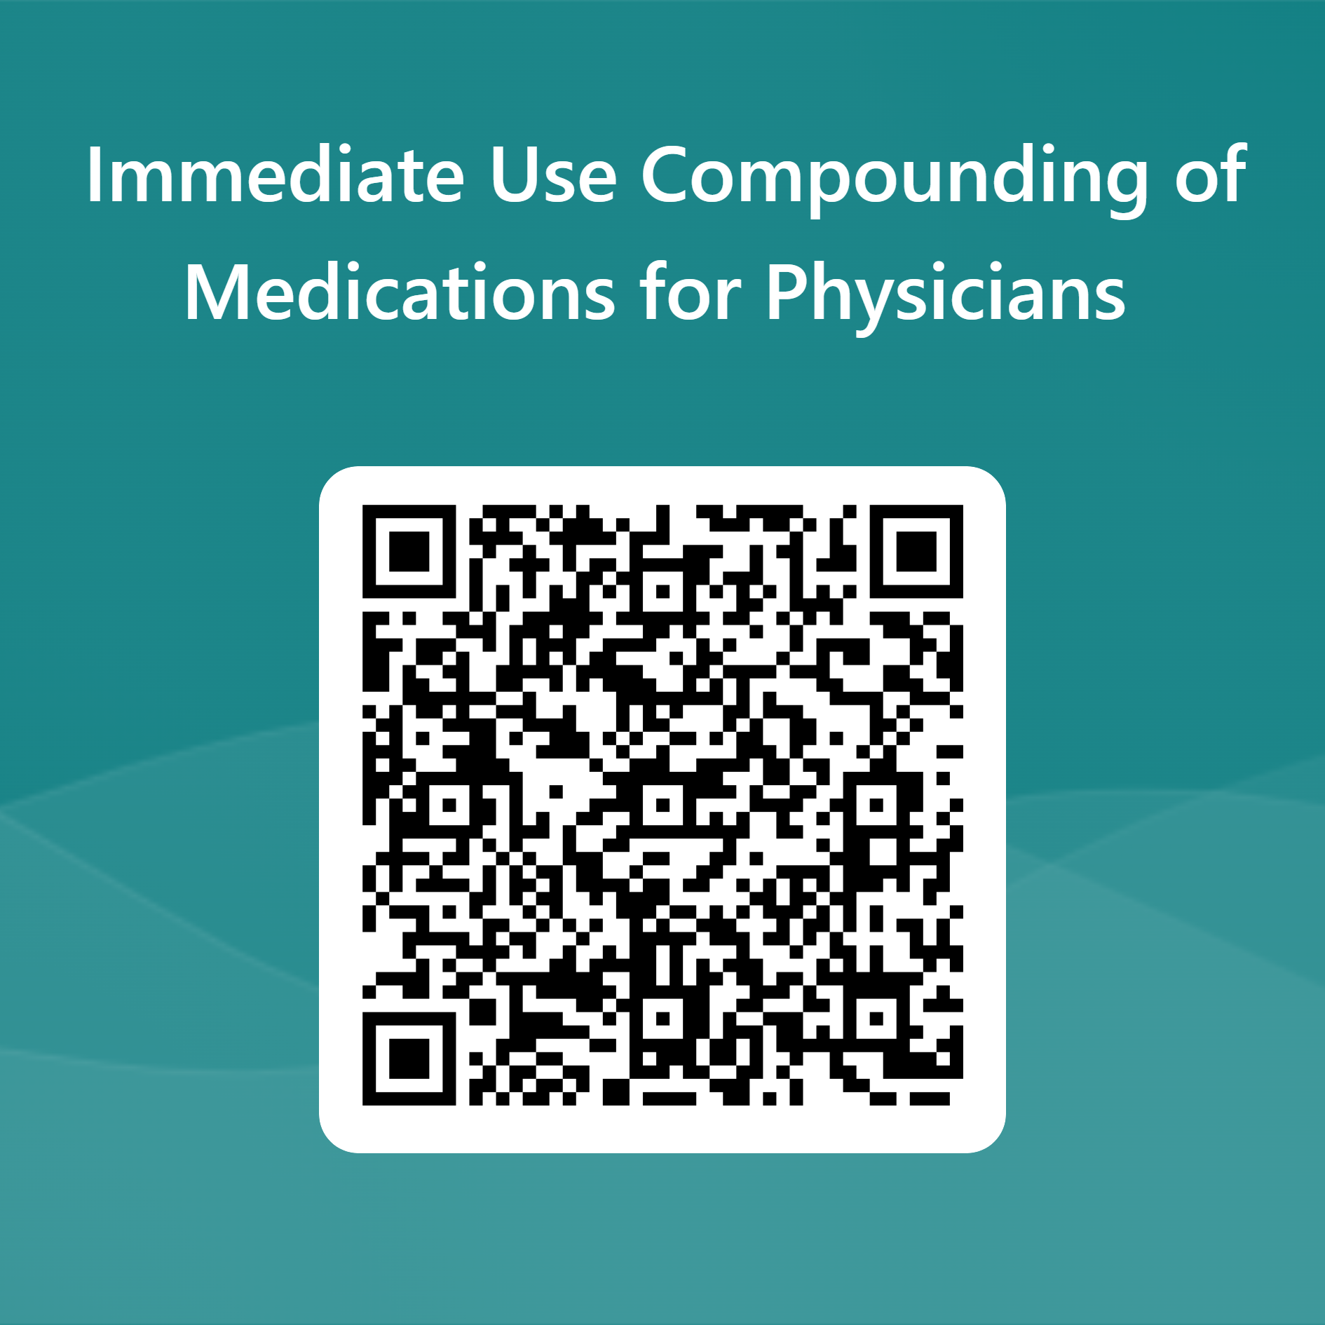
Immediate Use CSP Exam
Documentation of Competency is required
Please scan QR code to take short exam or use the link in the email from Dr. Buscaglia

Slide 13
References
<797> Pharmaceutical Compounding—Sterile Preparations. USP-NF 2022. November 1, 2022.
National Infusion Center Association (NICA) (2021) National Infusion Center Association (NICA). Medication-Preparation-Area-Checklist. Retrieved from: https://infusioncenter.org/wp-content/uploads/2021/01/Medication-Preparation-Area-Checklist_0121.pdf
Centers for Disease Control and Prevention. Medication Preparation FAQs regarding Safe Practices for Medical Injections. https://www.cdc.gov/injectionsafety/providers/provider_faqs_med-prep.html. Accessed December 14, 2022

