Slide 1
Healthcare Epidemiology Department
Infection Control Update
Updated 6/24/24

Slide 2
Healthcare Epidemiology Department
Susan Donelan, MD, FSHEA, Medical Director ​
Tamasin Adams, MPH, CIC, FAPIC, Director​
​
Raquel Tavarez, Staff Assistant​
​
Infection Preventionists:​
Pamela Calvanese, MPH, MSN, RN, CIC, Lead IP​
Benson Joseph, CIC, Lead IP​
Barbara Kranz, LPN, CIC​
Allison Ward, BS, RN, CMSRN, CIC​
Noemi Valerio-Mansibang, BSN, RN, CIC, CDIP ​
Melinda Hochberg-Arroyo, BA​
Alana Gomez, BS​
Matthew Groveman, MBA, MPH

Slide 3
Healthcare Epidemiology Department
Located on Hospital L1, Room 716 (near the green elevators)
Hours 7:30am to 4:00pm
Main Office # 444 – 7430, Fax # 444 – 8875
Email: SBUH Healthcare Epidemiology Practitioners
After hours Emergency Coverage – use SPOK or
ask the operator for the HED person on-call

Slide 4
Infection Prevention is in your hands

Slide 5
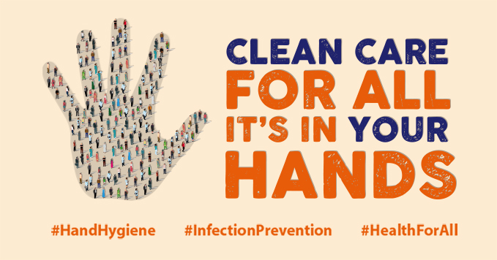
Hand Hygiene

Slide 6
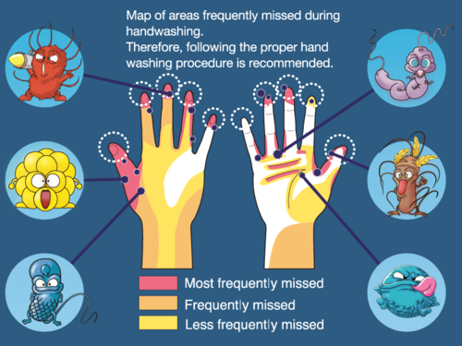
Healthcare Epidemiology Department
Hand Hygiene
One of the most important measures to prevent the spread of infections
Infection Control is in your Hands.

Slide 7
Healthcare Epidemiology Department
Hand Hygiene
Soap and Water vs Alcohol Sanitizer
When hands are visibly soiled
After contact with a patient with an enteric pathogen (diarrhea)
Before Eating
Hands are visibly clean
Routine hand hygiene before and after patient care
Before entering patient environment
After leaving patient environment (unless patient has isolation for an enteric pathogen)
Infection Control is in your Hands.

Slide 8
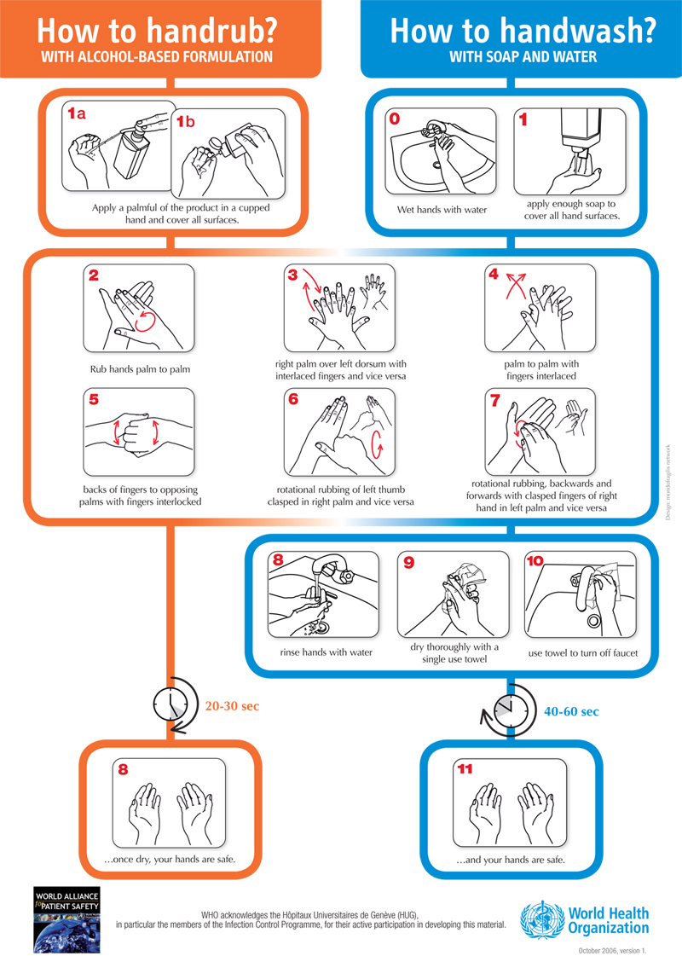

Slide 9
Hand Hygiene Guidelines
Healthcare Epidemiology Department
Fingernails
The guidelines also forbid artificial materials on fingernails (such as silk, acrylic, glue-ons, etc.) of direct and indirect healthcare workers.
Clean, non-chipped nail polish on trimmed nails (no > than ¼ inch beyond the tip of the fingers) is allowed.
Wash Hands Prevent Transmission

Slide 11
Blood-borne Pathogens – HIV, HBV, HCV
Healthcare Epidemiology Department
Bloodborne Pathogens –
How are Bloodborne Pathogens (BBP) Transmitted:
Blood-borne pathogens are transmitted primarily through blood and semen, although all body fluids and tissues should be regarded as potentially infectious.
Most common BBP in Healthcare are:
HIV – Human Immunodeficiency Virus
HBV – Hepatitis B Virus
HCV – Hepatitis C Virus
The most common modes of transmission are
sexual contact,
needle sharing, and
to a much lesser degree, infusion of contaminated blood products.
An infected woman can pass pathogens to her fetus.

Slide 12
Blood-borne Pathogens
Healthcare Epidemiology Department
Modes of transmission
Puncture wounds or cuts
Contaminated sharps
Cut or puncture with contaminated equipment
Contact (touch, splash, or spray) with blood or other potentially infectious material (OPIM)
Blood or OPIM comes in contact with
Mucous Membranes (Eyes, nose, mouth)
Non-intact Skin
Cuts, abrasions, burns
Acnes, rashes
Paper cuts, etc.

Slide 13
How Can I Prevent Transmission?
Healthcare Epidemiology Department
How Can I Prevent Transmission?
Follow hospital Infection Control and Safety policies.
The use of Universal Precautions and safety devices will decrease the incidence of occupational exposures.
Universal Precautions consist of
appropriate workplace practices
engineering (safety) controls, and
using Personal Protective Equipment (PPE)

Slide 14
Workplace Practices
Healthcare Epidemiology Department
Workplace Practices
Wash hands thoroughly after removing gloves, and immediately after contact with blood or body fluids.
Use disposable needles, syringes and other sharps whenever possible.
Wear appropriate Personal Protective Equipment (PPE) when blood or OPIM could splash or spray
Use gloves when cleaning surfaces contaminated with blood or OPIM
DO NOT recap, bend, or cut used needles.
DO NOT pass sharps – set down and allow other person to pick up

Slide 15
Workplace Practices
Healthcare Epidemiology Department
Workplace Practices - Continued
Any disposable items heavily contaminated (i.e., dripping) with blood or body fluids should be discarded in an infectious waste container indicated by a red bag.
Do not eat, drink, apply cosmetics or lip balm, or handle contact lenses where there is a potential exposure to blood and body fluids.
Lab specimens should be placed in leak proof containers and transported in specimen bags. All lab specimens at SBUH will be processed using Universal Precautions.
Get your Hepatitis B vaccination

Slide 16
What if I'm Exposed to Blood or Body Fluids?
Healthcare Epidemiology Department
What if I’m Exposed to Blood or Body Fluids
Clean affected area immediately.
Notify supervisor immediately.
Complete an Incident/Accident form (to be signed by supervisor).
Immediately report to Employee Health & Wellness, Mon. - Fri., 8 a.m.- 4 p.m.
All other times report to the Emergency Department

Slide 17
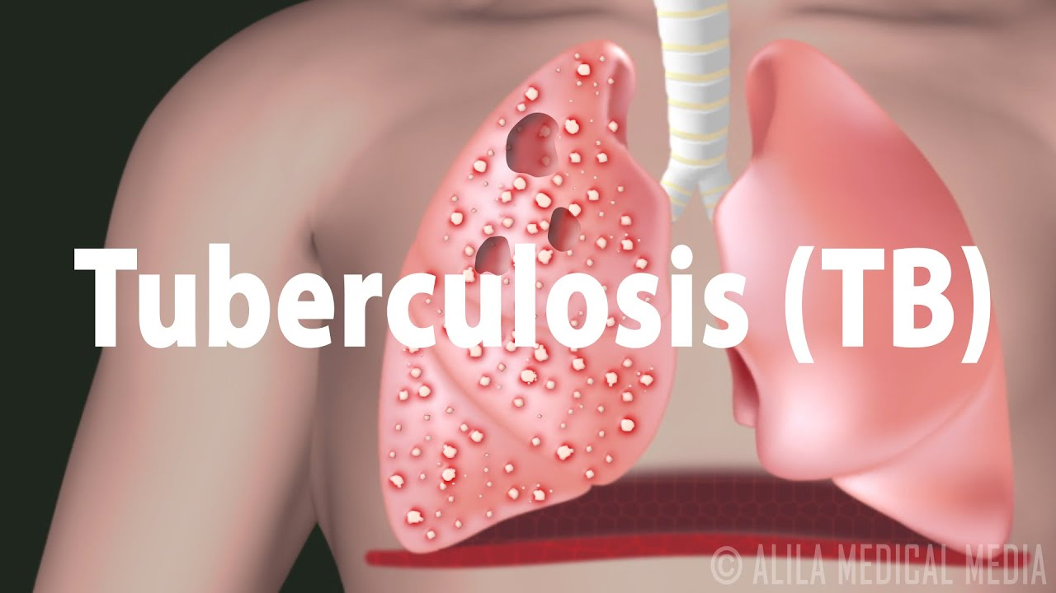
Tuberculosis

Slide 18
Tuberculosis
Caused by a specific bacterium Mycobacterium tuberculosis
Germs from active TB patient’s cough can float in air for a long time and cause infection when you inhale them
Pulmonary (Lungs)
Extra-Pulmonary TB
(outside of lungs)
Contagious in Specific Situations (aerosolizing of tissue/fluid infected with MTB)
Active TB
Contagious
Symptoms
Latent TB
Not Contagious
No Symptoms

Slide 19
Infection Control is in your Hands.

Slide 20
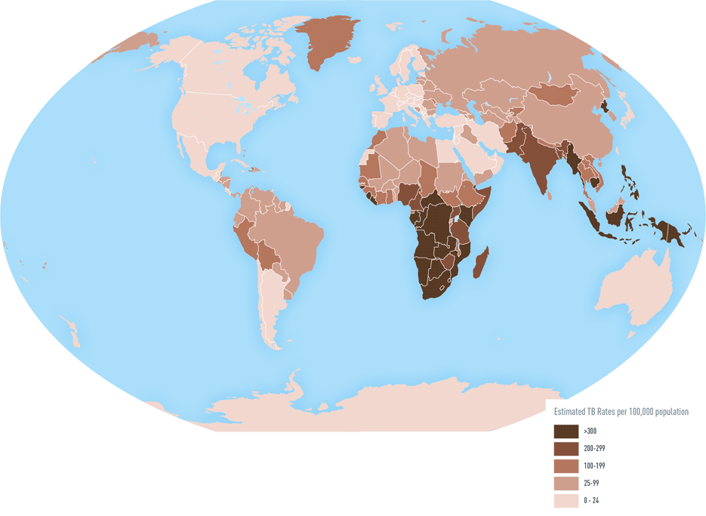
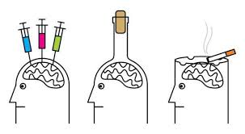
Healthcare Epidemiology Department
Persons at High Risk for Tuberculosis
Persons with HIV infection
Close contacts of infectious tuberculosis cases
Foreign-born persons from high prevalence countries
Low-income populations, including high-risk minorities
Alcoholics and intravenous drug users
Residents of long-term care facilities (including prisons)
Healthcare workers

Slide 21
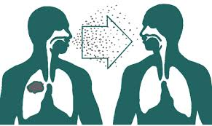
Healthcare Epidemiology Department
Transmission
Small infectious droplet nuclei
Produced when persons with tuberculosis of the lung or larynx sneeze, cough, speak, or sing
Susceptible person breathes air contaminated
Prolong exposure in a confined space

Slide 22
Pulmonary TB
Occurs in the lungs
Requires Isolation
Special Airborne Precautions – TB
N95
Negative Pressure Room
Isolation discontinuation requires approval from HED
To rule out TB requires AFB sputum x3
Cerner will automatically order isolation when the rule out TB powerplan (AFB x3) order is placed.
Extrapulmonary TB
Occurs outside of the lungs
Does not require isolation unless:
Location of infection has a procedure on the site of the infection. E.g. surgical debridement of a wound with MTB.
Pulmonary source should be ruled out

Slide 23
Healthcare Epidemiology Department
Treatment of TB Disease
Initiate 4 drug therapy with “RIPE”
Rifampin
Isoniazid
Pyrazinamide
Ethambutol
Cerner will automatically place Airborne Precautions if all 4 drugs are ordered for a patient
Isolation discontinuation required approval from Healthcare Epidemiology

Slide 24
Patient Care Considerations
Patient wears surgical mask outside of room
Nurse prepares patient in the room for transport
Transportation staff do not enter patient room.
Screen all patients for TB asking about:
Cough with hemoptysis
Unexplained weight loss
Night sweats
Travel to (or visits with persons from) endemic areas.

Slide 25
Healthcare Epidemiology Department
What Happens if I am Exposed to TB?
Healthcare Epidemiology Department (HED) and Employee Health & Wellness Services (EH&W) determine which employees are considered as exposures.
EH&W then contacts the exposed individuals to arrange appropriate follow-up.
This evaluation includes a PPD approximately 8-10 weeks after exposure, if they had a previous negative skin test within the last three months.
If the prior PPD date is greater than three months, a PPD at identification of the exposure and again several weeks after exposure are indicated.

Slide 26
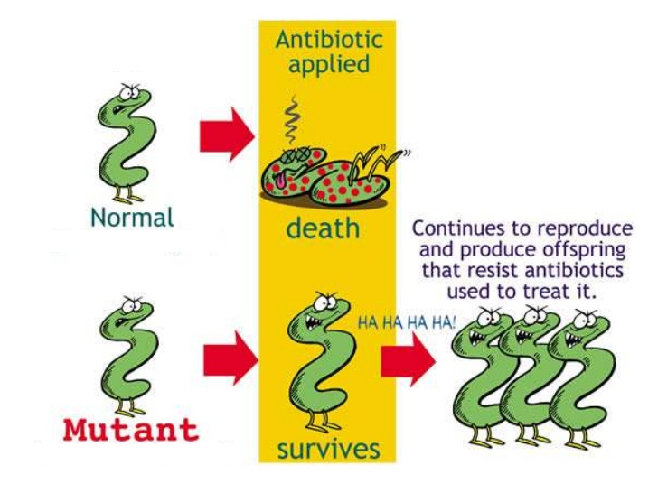
MDRO
Multi-Drug Resistant Organisms

Slide 27
Healthcare Epidemiology Department
Multi-Drug Resistant Organisms (MDRO)
Gram-positive
Oxacillin – (Methicillin) resistant Staphylococcus aureus, (MRSA)
Vancomycin-resistant Staphylococcus aureus (VISA/VRSA) (intermediate and high-level).
Penicillin-resistant Pneumococcus, (PRP) (intermediate and high-level)
Vancomycin-resistant Enterococci, (VRE) (faceium or faecalis)

Slide 28
Healthcare Epidemiology Department
Multiply-Resistant Organisms (MRO)
Gram-negative
Carbapenem-Resistant Enterobacteriaceae (CRE) (doripenem, ertapenem, imipenem, meropenem) Klebsiella pneumoniae and Escherichia coli
Other organisms that may be added by the Healthcare Epidemiology Department

Slide 29
Survival Time
Healthcare Epidemiology Department
Survival Time
For some bacteria and viruses on environmental surfaces
MRSA 30 days or more
VRE 30 days or more
RSV 6 hours
Influenza 18 hours
C. difficile spores years

Slide 30
Prevent MDRO
Stop the Spread of MDRO’s
Good hand hygiene practices
Compliance with Standard and Transmission Based Precautions
Antimicrobial Stewardship

Slide 31
Healthcare Epidemiology Department
Infection Control is in your Hands.

Slide 32
Interventions to Break the chain
Reservoir
Surface cleaning
Water management programs
Portal of Exit
Cover your cough
Wound dressings
Mode of transmission
Personal Protective Equipment (PPE)
Hand hygiene
Scrub the hub of IV’s and central lines
Portal of entry
Hand hygiene between clean and dirty tasks
Oral care
Susceptible host
Health promotion activities
Nutrition
Infectious agent
Isolation precautions

Slide 33
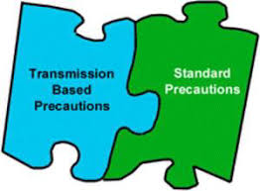
Isolation Precautions

Slide 34
Standard Precautions If it is Warm and Moist and not yours… Put a barrier between you and it.
Applies to all patients
Protects the Healthcare worker and patients
Includes use of :
Gowns if clothing could become soiled
Mask / Eye protection if task could create a splash or spray
Gloves if hands could become soiled

Slide 35
Transmission Based Precautions
Airborne – Measles, TB, Disseminated Zoster
Contact – MRSA, Scabies, MDROs
Droplet – Flu, Meningitis, Pertussis
Special Contact – C. difficile, Norovirus
Special SARS CoV2 – COVID19

Slide 36
https://inside.stonybrookmedicine.edu/sites/default/files/Isolation_Precautions_Guide.pdf

Slide 37
Transmission Based Isolation Precautions
Main Hospital – ISOLATION SIGN

Slide 38
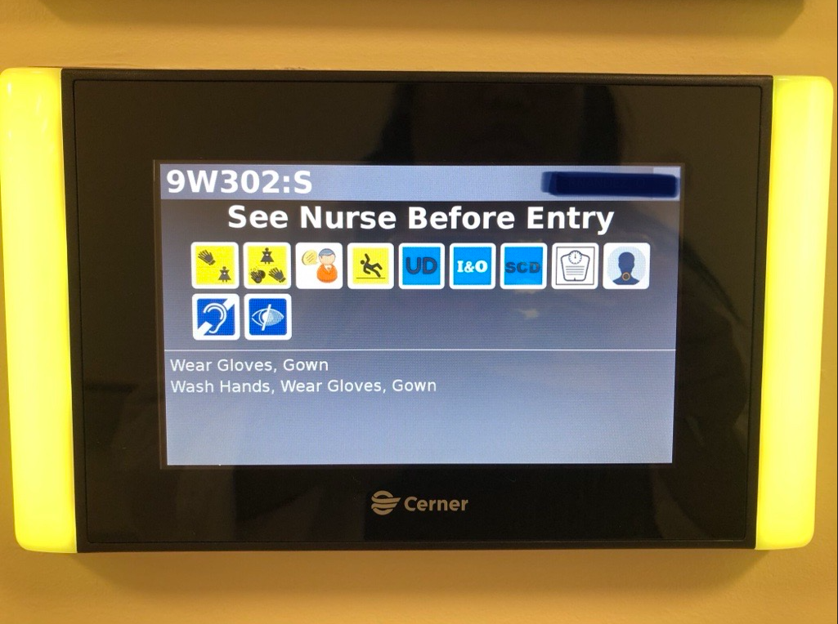
Transmission Based Isolation Precautions
Pavilion - Electronic ISOLATION SIGN

Slide 39
Healthcare Epidemiology Department
Isolation Patient Identification
Banner Bar in Cerner

Slide 40
Healthcare Epidemiology Department
Ordering Isolation
Many are Cerner generated orders that will automatically order isolation when needed.
Isolation generated automatically when labs are ordered
C. diff, Influenza, etc.
Isolation generated automatically when labs results
MRSA, VRE, COVID etc.
Isolation generated automatically for historical reasons
Cystic Fibrosis, History of a multi-drug resistant organism, etc.
Some circumstances will still need orders to be entered manually such as:
Patient has a rash that is suspect for a communicable disease
Laboratory culture is in pending/preliminary state
Results came from an outside facility

Slide 42
Discontinuing Isolation
See grid for items that need HED Approval prior to discontinuation
Discontinuation of Isolation:
Isolation was ordered for testing and tests resulted negative
E.g. Contact Precautions ordered for C. diff testing – Discontinue isolation if test is negative.

Slide 43
Isolation and PPE
Airborne - N95 & Negative Pressure Room
Special SARS-CoV-2 – N95, Face shield/Eye protection, Gown & Gloves
Droplet - Surgical Mask
Contact - Gown & Gloves
Special Contact - Gown & Gloves, Wash hands with soap and water

Slide 44
Mask / Eye Protection
Surgical mask / N95 or PAPR
PAPR do require an additional surgical mask
Cloth masks are not considered PPE
If you use your own mask you have to put a hospital provided one on top of it
Eye protection
Eyeglasses are not considered eye protection
Clip on eye shields that attach to prescription eyewear are not considered PPE

Slide 45
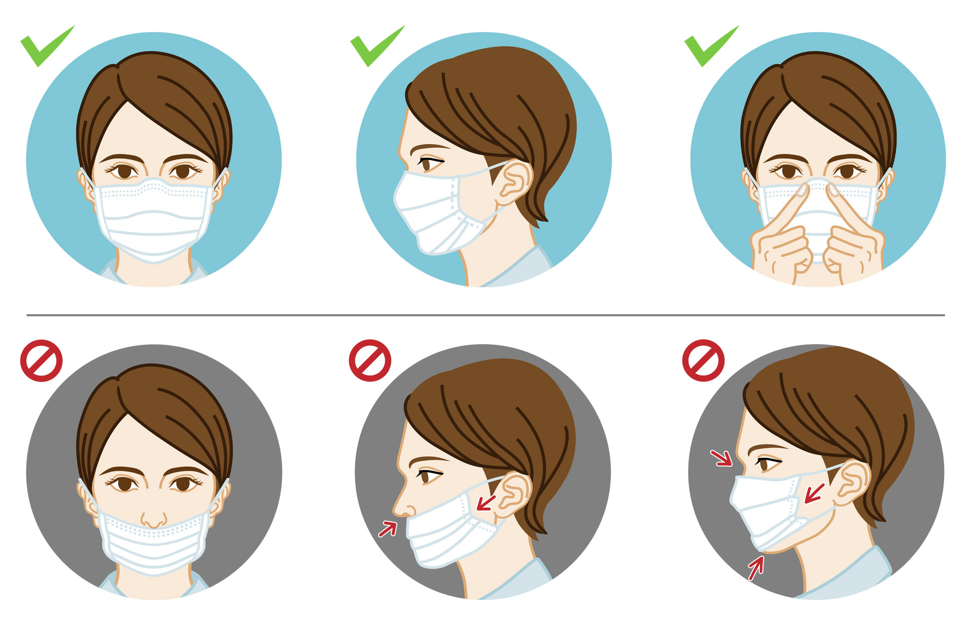
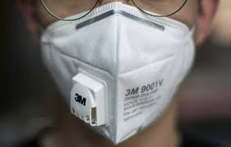
Mask Do’s and Don’ts

Slide 46
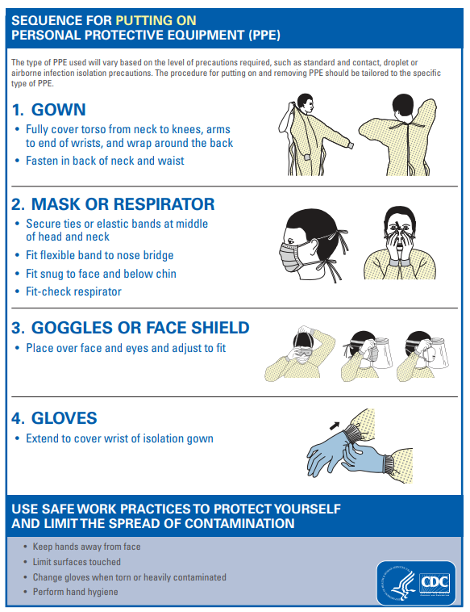
Donning -Always start with Hand Hygiene

Slide 47
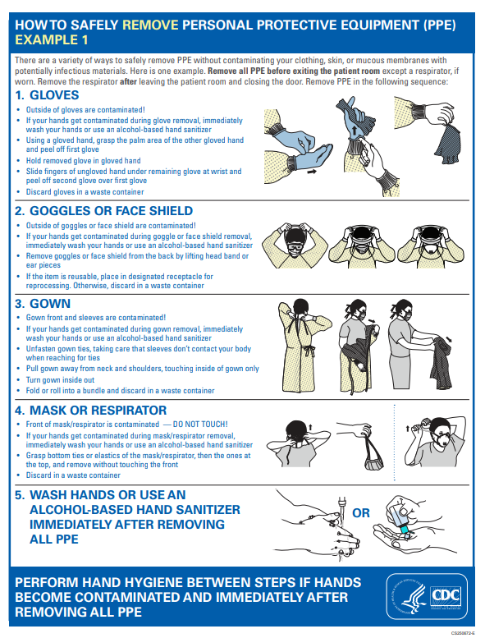
Doffing Method 1

Slide 48
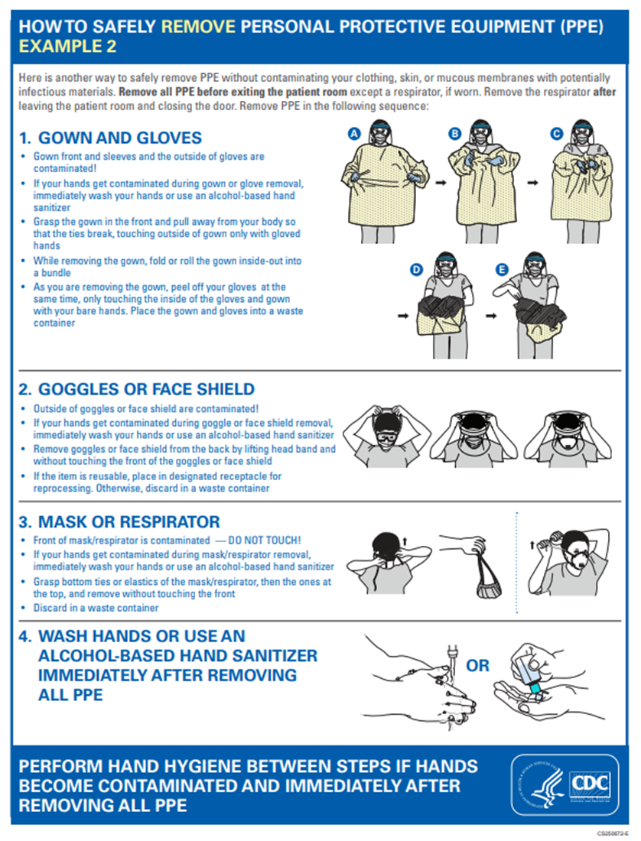
Doffing Method 2

Slide 49
Disposal of PPE
Inside the Room
Gloves
Gown
Surgical mask
Disposable eye protection
Outside the Room
Eye Protection if reusable clean
N95 / PAPR
Don’t forget Hand Hygiene!

Slide 50
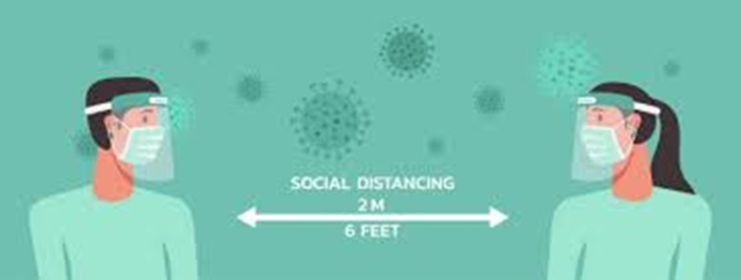
Staying Safe
Stay 6 feet part whenever possible
Including when eating
Hand Hygiene
Wear your PPE
Mask and eye protection for all patient interactions
Clean surfaces
Daily symptom checks

Slide 51
Main Office # 444 – 7430
Email: SBUH Healthcare Epidemiology Practitioners
After hours Emergency Coverage: use SPOK
or ask the operator for the HED person on-call

