Slide 1
Infection Prevention
SBM Orientation & Annual Training
Infection Control is in your Hands
Updated 6/4//2025

Slide 2
Infection Prevention and Control Department
Interim Medical Director ​Coming Soon
Christy Beneri, DO, Assistant Medical Director
Tamasin Adams, MPH, CIC, FAPIC, Director​
Noemi Valerio-Mansibang, MA, RN, CPHQ, CDIP, CIC, Assistant Director
​
Raquel Tavarez, Staff Assistant​
​
Infection Preventionists:​
Pamela Calvanese, MPH, MSN, PMHNP-BC, RN, CIC, Lead IP​
Benson Joseph, BS, CIC, Lead IP​
Allison Ward, BS, RN, CMSRN, CIC​
Melinda Hochberg-Arroyo, BA​
Alana Gomez, BS​
Matthew Groveman, MBA, MPH
Samantha Rennekamp, MPH
Amanda Healy, BS, MLS (ASCP)

Slide 3
Infection Prevention and Control Department
Located on Hospital L1, Room 716 (near the green elevators)
Hours 7:30am to 4:00pm
Main Office # 444 – 7430, Fax # 444 – 8875
Email: SBUH_IPC or SBUH Healthcare Epidemiology Practitioners
After hours Emergency Coverage – use SPOK or
ask the operator for the IPC person on-call

Slide 4
Infection Prevention and Control
Isolation Information Guide:
https://inside.stonybrookmedicine.edu/sites/default/files/Isolation_Precautions_Guide.pdf
Our Policies be found on the Hospital intranet under Policies and Procedures → Policy Manager → Administration Policy and Procedures → Infection Control.
Policies of note:
Standard Precautions, IC0012
Isolation Precautions/Transmission-Based Precautions, IC0006
Prevention of Transmission of Mycobacterium Tuberculosis, IC0011

Slide 5
Topics
Bloodborne Pathogens
Tuberculosis
Multi-drug Resistant Organisms
Breaking the Chain of Infection
Hand Hygiene
Standard & Transmission-Based Precautions
Personal Protective Equipment (PPE)

Slide 6


Slide 7
Blood-borne Pathogens – HIV, HBV, HCV
Blood-borne Pathogens
How are Bloodborne Pathogens (BBP) Transmitted:
Primarily through blood and semen, although all body fluids and tissues should be regarded as potentially infectious.
Most common BBP in Healthcare are:
HIV – Human Immunodeficiency Virus
HBV – Hepatitis B Virus
HCV – Hepatitis C Virus
The most common modes of transmission are
sexual contact,
needle sharing, and
to a much lesser degree, infusion of contaminated blood products.
An infected woman can pass pathogens to her fetus.

Slide 8
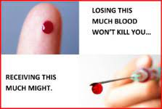
Blood-borne Pathogens
Puncture wounds or cuts
- Contaminated sharps
- Cut or puncture with contaminated equipment
Blood or other potentially infectious material (OPIM) comes in contact via splash, spray or touch with
- Mucous Membranes (Eyes, nose, mouth)
- Non-intact Skin
Cuts, abrasions, burns
Acnes, rashes
Paper cuts, etc.

Slide 9
How Can I Prevent Transmission?
How Can I Prevent Transmission?
Follow hospital Infection Control and Safety policies.
The use of Universal Precautions and safety devices will decrease the incidence of occupational exposures.
Universal Precautions consist of
appropriate workplace practices
engineering (safety) controls, and
using Personal Protective Equipment (PPE)

Slide 10
Workplace Practices
Workplace Practices
Wash hands thoroughly after removing gloves, and immediately after contact with blood or body fluids.
Use disposable needles, syringes and other sharps whenever possible.
Wear appropriate Personal Protective Equipment (PPE) when blood or OPIM could splash or spray.
Use gloves when cleaning surfaces contaminated with blood or OPIM.
DO NOT recap, bend, or cut used needles.
DO NOT pass sharps – set down and allow other person to pick up.

Slide 11
Workplace Practices
Workplace Practices - Continued
Any disposable items heavily contaminated (i.e., dripping) with blood or body fluids should be discarded in an infectious waste container indicated by a red bag.
Do not eat, drink, apply cosmetics or lip balm, or handle contact lenses where there is a potential exposure to blood and body fluids.
Lab specimens should be placed in leak proof containers and transported in specimen bags. All lab specimens at SBUH will be processed using Universal Precautions.
Get your Hepatitis B vaccination.

Slide 12
What if I'm Exposed to Blood or Body Fluids?
What if I’m Exposed to Blood or Body Fluids
Clean affected area immediately.
Notify supervisor immediately.
Complete an Incident/Accident form (to be signed by supervisor).
Immediately report to Employee Health & Wellness, Mon. - Fri., 8 a.m.- 4 p.m.
All other times report to the Emergency Department

Slide 13
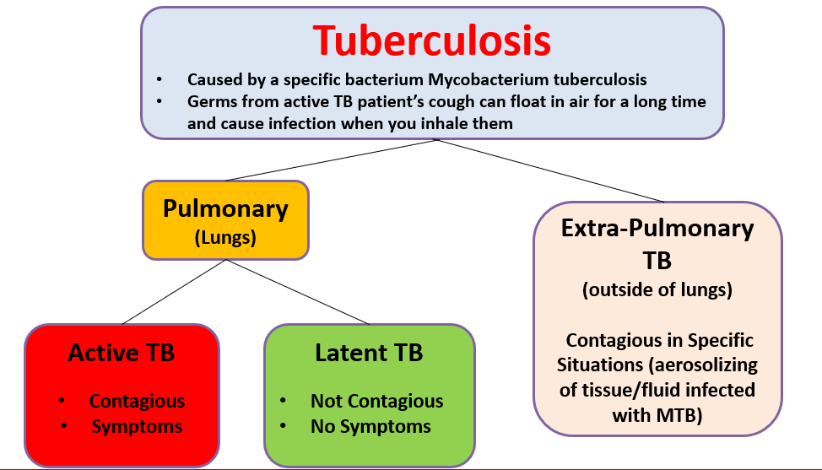

Slide 14
Infection Control is in your Hands.

Slide 15

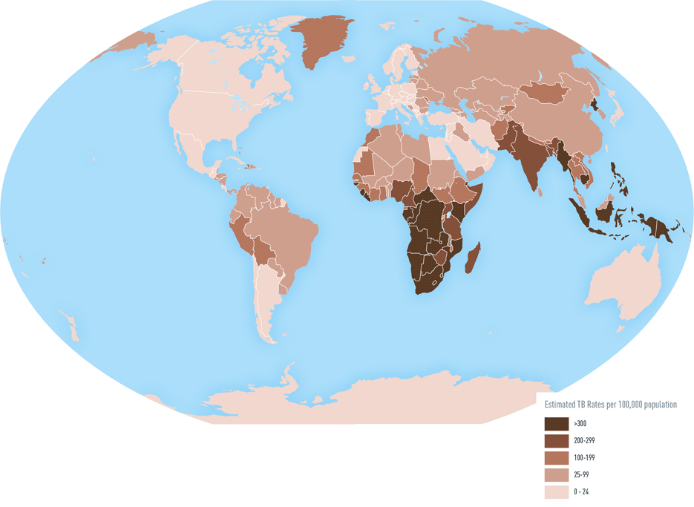
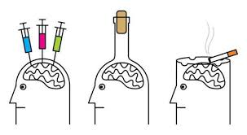

Persons at High Risk for Tuberculosis
Persons with HIV infection
Close contacts of infectious tuberculosis cases
Foreign-born persons from high prevalence countries
Low-income populations, including high-risk minorities
Alcoholics and intravenous drug users
Residents of long-term care facilities (including prisons)
Healthcare workers

Slide 16
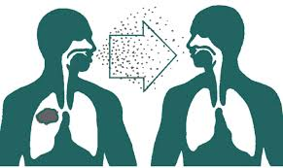
Transmission
Small infectious droplet nuclei
Produced when persons with tuberculosis of the lung or larynx sneeze, cough, speak, or sing
Susceptible person breathes air contaminated
Prolong exposure in a confined space

Slide 17
Pulmonary TB
Occurs in the lungs
Requires Isolation
Special Airborne Precautions – TB
N95
Negative Pressure Room
Isolation discontinuation requires consultation with IPC
To rule out TB: Requires AFB sputum x3
Cerner will automatically order isolation when the rule out TB powerplan (AFB x3) order is placed or when 4 drug TB therapy is ordered.
Extrapulmonary TB
- Occurs outside of the lungs
- Does not require isolation unless:
A procedure is done on the site of the infection. e.g. surgical debridement of a wound with MTB.
- Pulmonary source should be ruled out

Slide 18
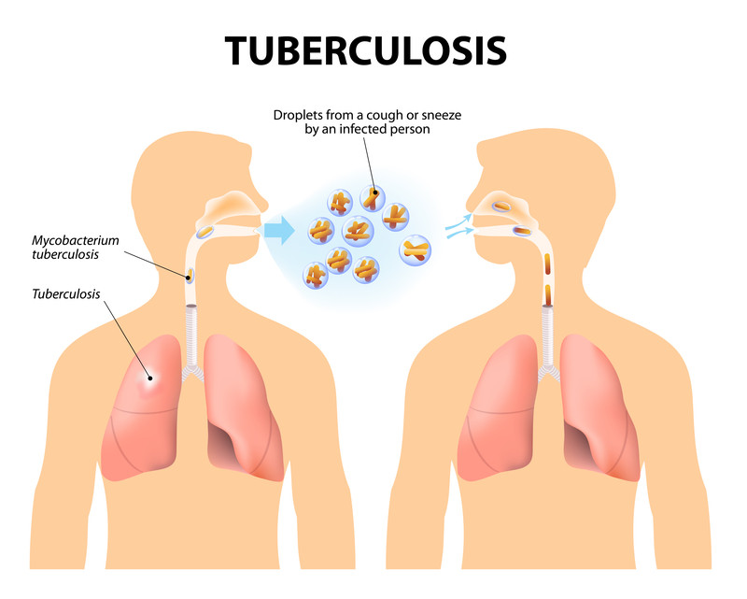
Ruling out Tuberculosis
Airborne Precautions should be ordered whenever multiple TB meds are started or AFB sputum are ordered to R/O TB
Sputum of good quality must be collected a minimum of 8 hours apart (at least one sample needs to be collected first thing in the morning) “Scant” specimens are not acceptable to r/o TB.
Need 3 negative AFB sputum smears and/or attending physician documentation of TB being ruled out from the differential diagnosis with an alternative etiology for symptoms
*note*: A QuantiFERON test is not a diagnostic test that can be used to rule out active pulmonary tuberculosis

Slide 19
Treatment of TB Disease
Initiate 4 drug therapy with “RIPE”
Rifampin
Isoniazid
Pyrazinamide
Ethambutol
Cerner will automatically place Airborne Precautions if all 4 drugs are ordered for a patient
Isolation discontinuation required approval from Infection Prevention Department

Slide 20
Patient Care Considerations
Screen all patients for TB asking about:
Cough with hemoptysis
Unexplained weight loss
Night sweats
Travel to (or visits with persons from) endemic areas.
Patient wears surgical mask outside of room.
Nurse prepares patient in the room for transport
Transportation staff do not enter patient room.

Slide 21
What Happens if I am Exposed to TB?
Infection Prevention & Control (IPC) and Employee Health & Wellness Services (EH&W) determine which employees are considered exposed.
EH&W then contacts the exposed individuals to arrange appropriate follow-up.
This evaluation includes a PPD approximately 8-10 weeks after exposure, if they had a previous negative skin test within the last three months.
If the prior PPD date is greater than three months, a PPD at identification of the exposure and again several weeks after exposure are indicated.

Slide 22
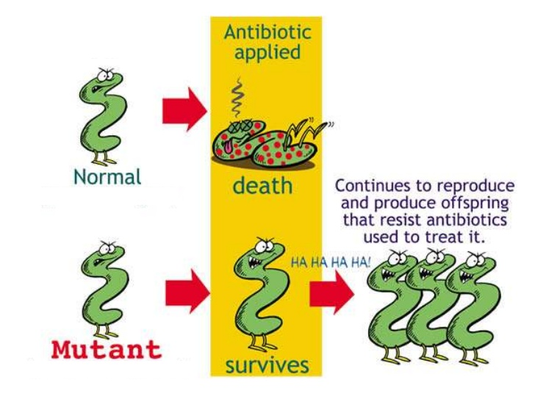
Multi-Drug Resistant Organisms

Slide 23
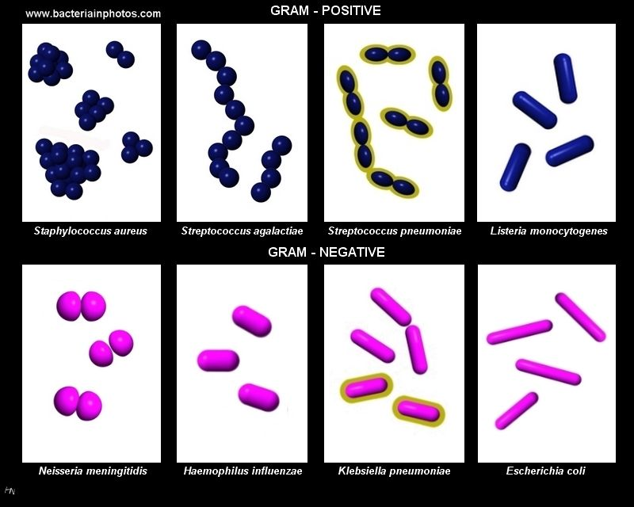
Multi-Drug Resistant Organisms (MDRO)
Gram-positive
Vancomycin-resistant Staphylococcus aureus (VISA/VRSA) (intermediate and high-level).
Penicillin-resistant Pneumococcus, (PRP) (intermediate and high-level)

Slide 24
Multi-Drug Resistant Organisms (MDRO)
Gram-negative
Carbapenem-Resistant Enterobacteriaceae (CRE) (doripenem, ertapenem, imipenem, meropenem) Klebsiella pneumoniae and Escherichia coli
Other organisms may be added by the Infection Prevention and Control Department

Slide 25
Survival Time
Survival Time
For some bacteria and viruses on environmental surfaces
MRSA 30 days or more
VRE 30 days or more
RSV 6 hours
Influenza 18 hours
C. difficile spores years

Slide 26
Stop the Spread of MDRO’s
Good hand hygiene practices
Compliance with Standard and Transmission-Based Precautions
Cleaning equipment and environment
Antimicrobial Stewardship

Slide 27
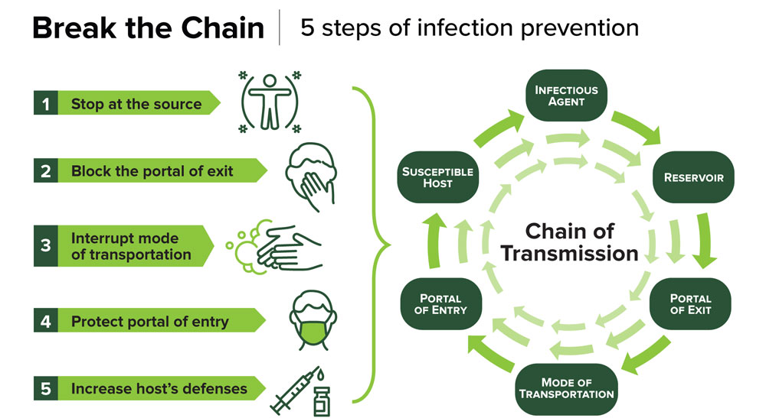

Slide 28
Interventions to Break the chain
Reservoir
Surface cleaning
Water management programs
Portal of Exit
Cover your cough
Wound dressings
Mode of transmission
Personal Protective Equipment (PPE)
Hand hygiene
Scrub the hub of IV’s and central lines
Portal of entry
Hand hygiene between clean and dirty tasks
Oral care
Susceptible host
Health promotion activities
Nutrition
Infectious agent
Isolation precautions

Slide 29

Infection Prevention is in your hands

Slide 30
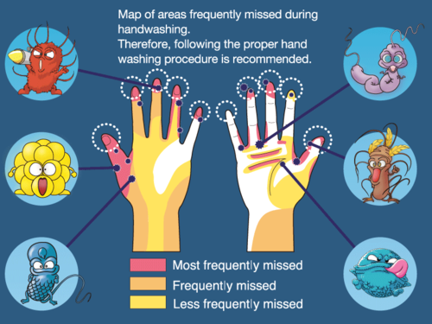
Infection Prevention and Control Department
Hand Hygiene
One of the most important measures to prevent the spread of infections
Infection Control is in your Hands.

Slide 31
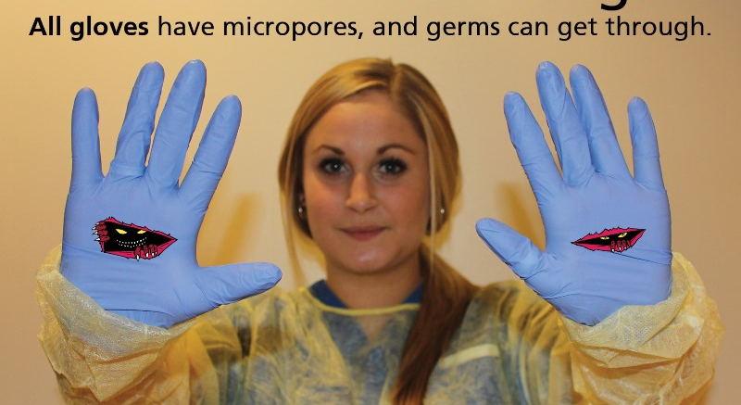
Notes:
Important to wear the right size glove
Do not wash or sanitize or reuse your gloves
Gloves are NOT a substitute for hand washing

Slide 32
Hand Hygiene
Soap and Water
Alcohol Sanitizer
Hands are visibly soiled
Hands contaminated with blood or bodily fluids
After contact with a patient with an enteric pathogen (i.e., Norovirus or C. difficile)
Before Eating
After using the restroom
Hands are visibly clean
Routine hand hygiene before and after patient care
Immediately before/after glove use
If moving from a soiled body site to a clean one on the same patient
Before entering patient environment
After leaving patient environment (unless patient has isolation for an enteric pathogen)

Slide 33
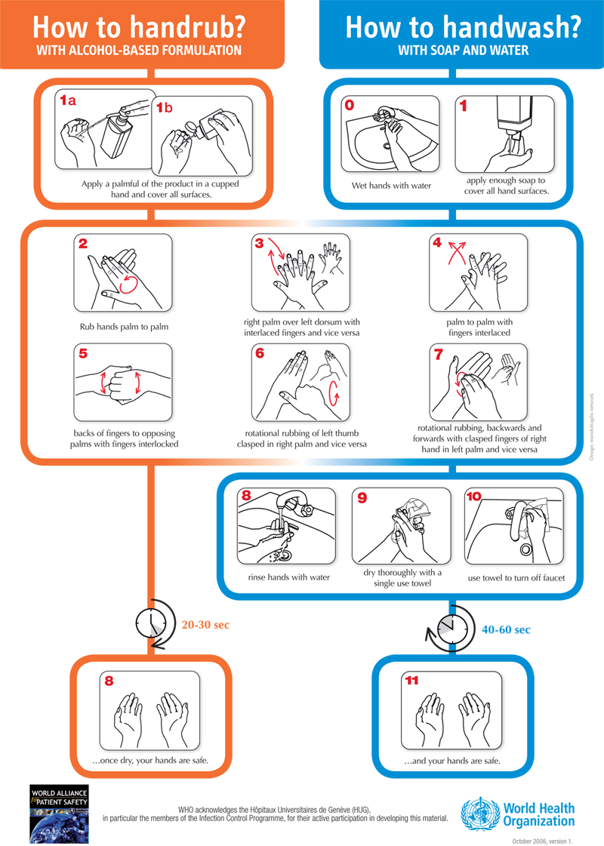

Slide 34

Nail Hygiene

Slide 35
Nail Hygiene
Keep nails short, most microbes on the hands come from beneath the fingernails.
Nails longer than ¼ inch and nails with chipped polish have been found to be problematic.
Do not wear rings with stones or ridges since they interfere with thorough hand washing and make it more difficult to don gloves.
Do not wear artificial nails; this includes anything applied to the natural nail other than polish; such as artificial tips, wraps, appliqués, and acrylics.
Artificial nails are more likely to be colonized with bacteria and yeast than natural nails.

Slide 36
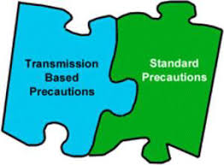
Isolation Precautions

Slide 37

Standard Precautions If it is Warm and Moist and not yours… Put a barrier between you and it.
Applies to all patients
Protects the Healthcare worker and patients
Includes use of :
Gowns if clothing could become soiled
Mask / Eye protection if task could create a splash or spray
Gloves if hands could become soiled

Slide 38
Transmission-Based Precautions
Airborne – TB, Disseminated Zoster
Contact – Scabies, MDROs
Droplet – Flu, Meningitis, Pertussis
Special Contact – C. difficile, Norovirus
Special Precautions – COVID19, Mpox
Quarantine – Exposed to COVID19 person

Slide 39
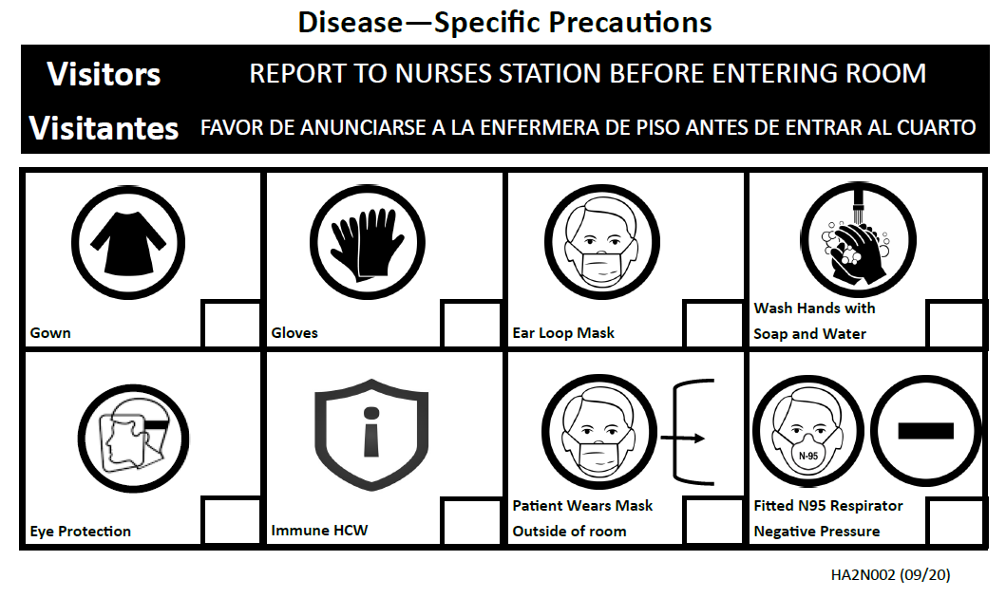
Main Hospital – ISOLATION SIGN
Transmission-Based Precautions

Slide 40

Main Hospital
New ISOLATION SIGNS
are

Slide 41

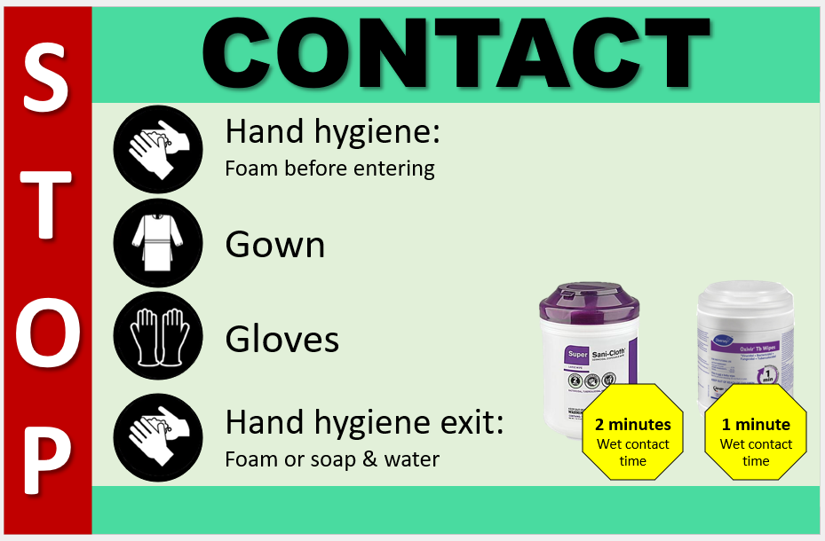
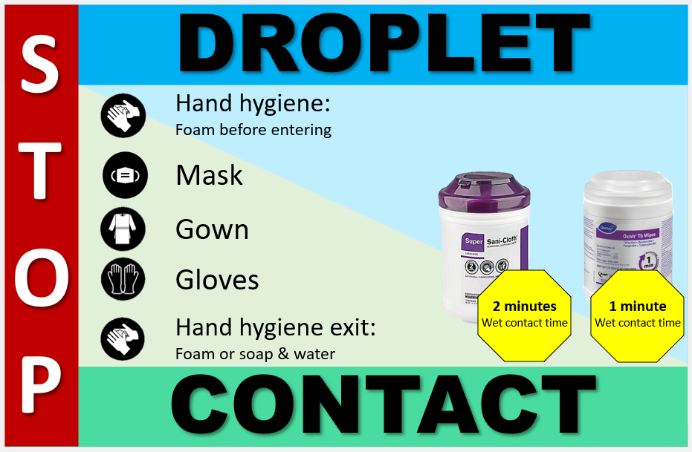
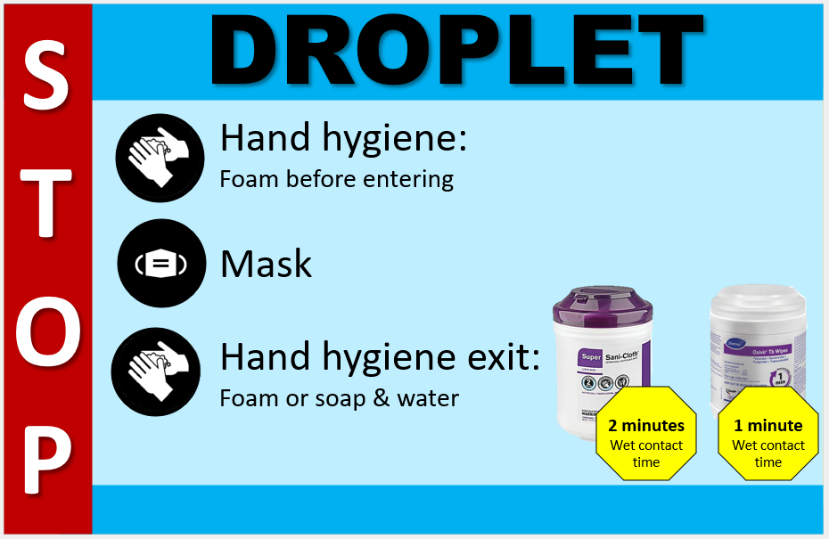
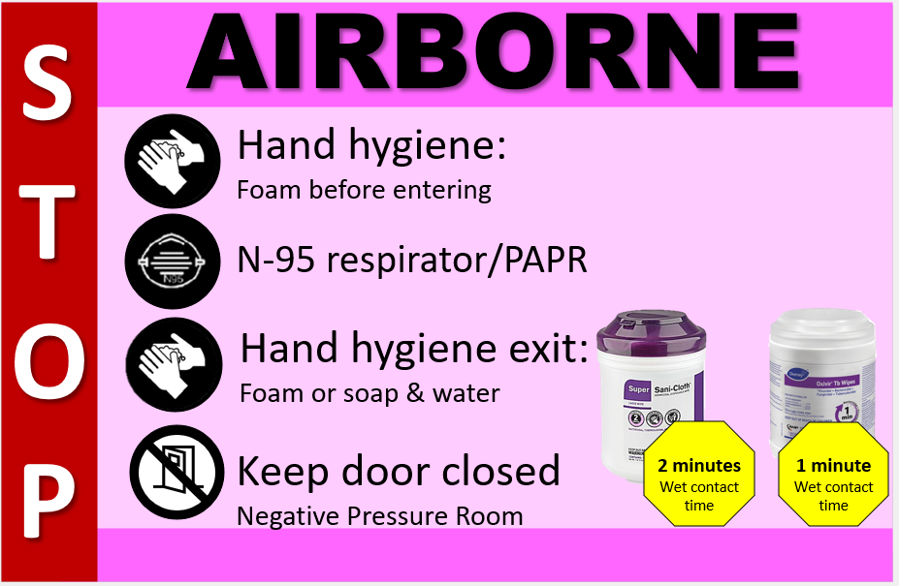
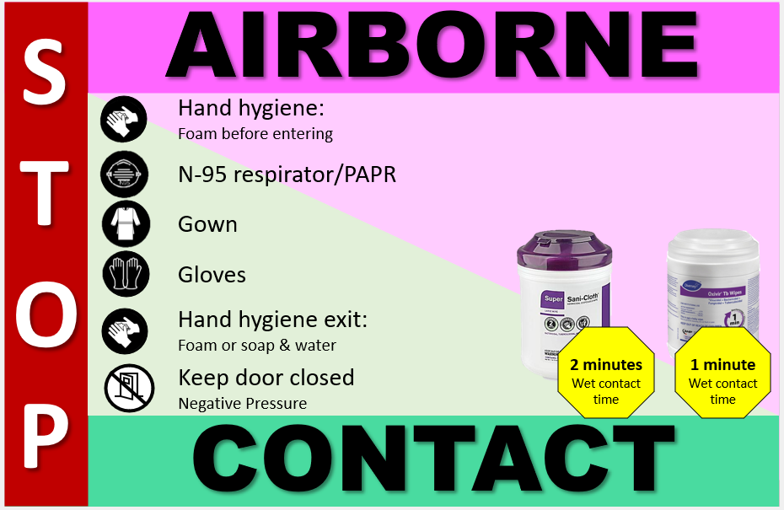
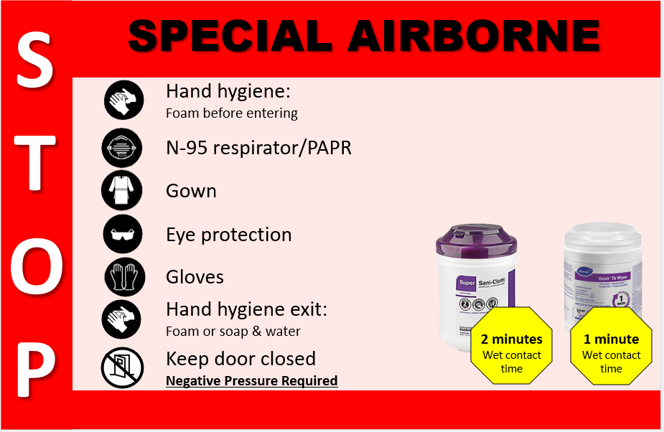
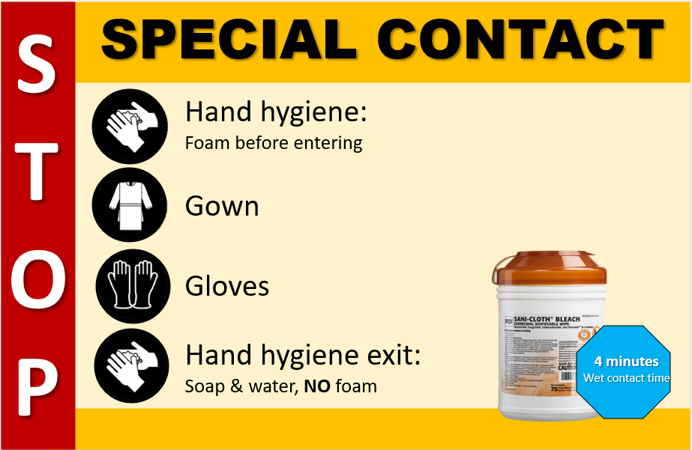
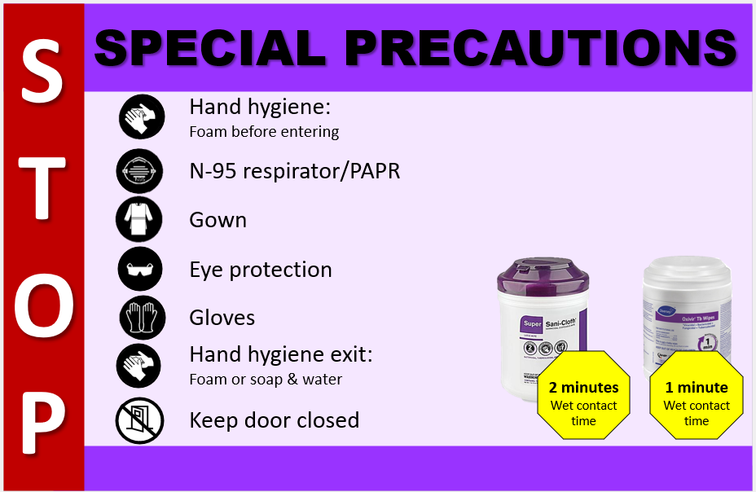
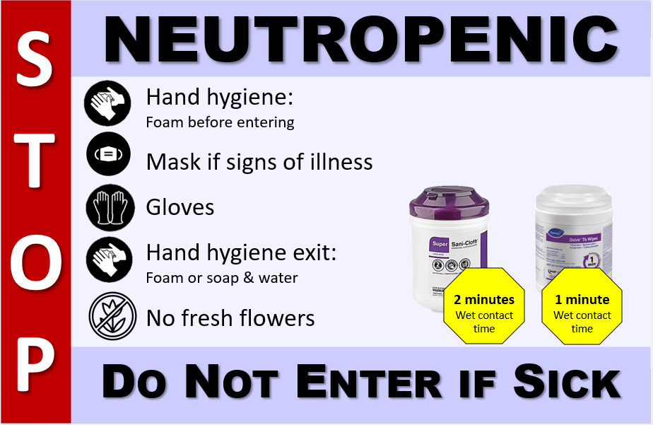
ISOLATION SIGNS
Transmission-Based Precautions

Slide 42
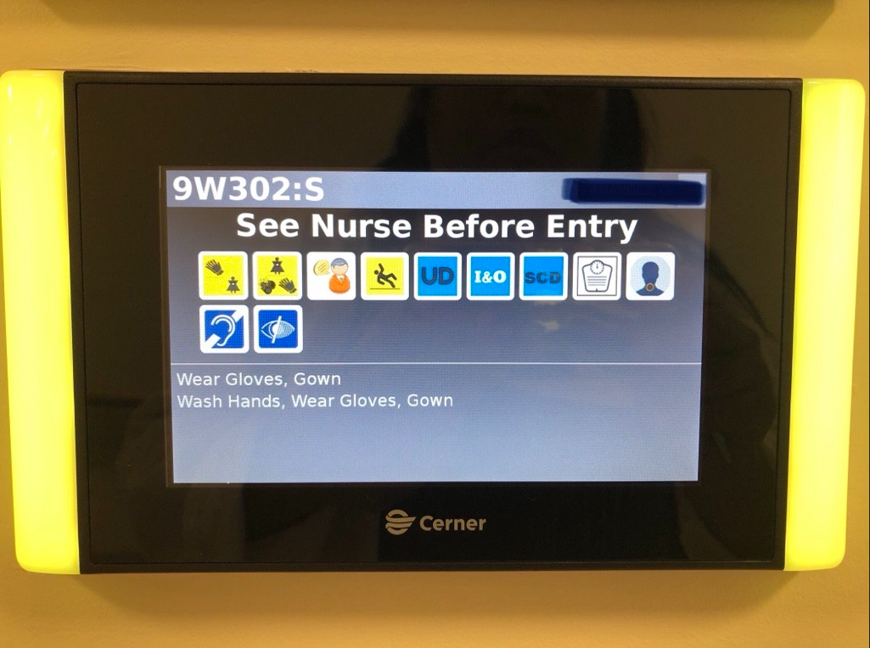
Pavilion - Electronic ISOLATION SIGN
Transmission Based Precautions

Slide 43






Pavillion Electronic Icons
Gloves
Gloves & Gown
Surgical Mask
Gloves, Gown, Washing hands with soap & water
N95
Negative Pressure
Transmission Based Precautions

Slide 44
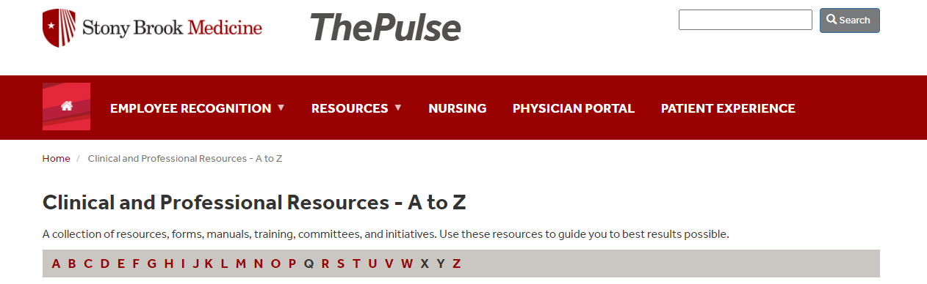


Slide 45
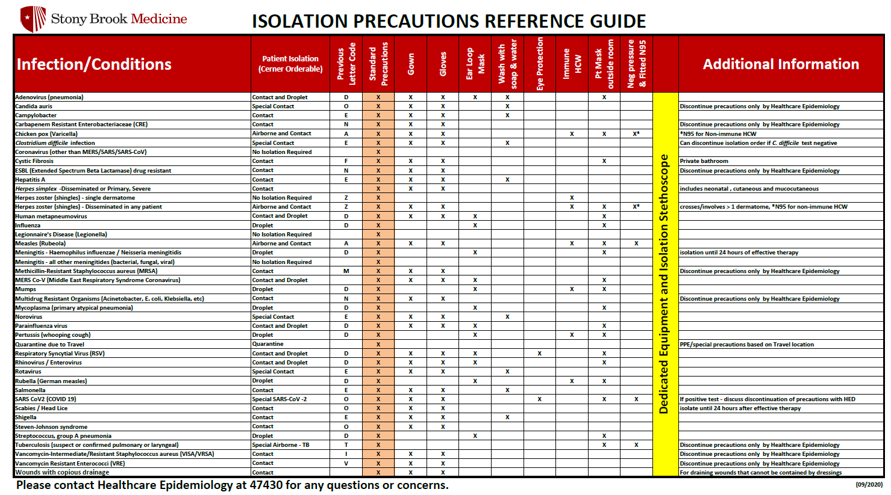
https://inside.stonybrookmedicine.edu/sites/default/files/Isolation_Precautions_Guide.pdf

Slide 46
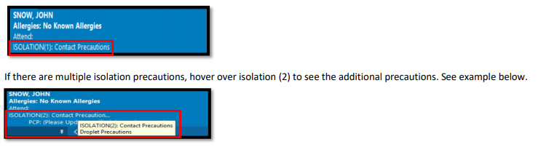
Isolation Patient Identification
Banner Bar in Cerner

Slide 47
Ordering Isolation
Many are Cerner generated orders that will automatically order isolation when needed.
Isolation generated automatically when labs are ordered
C. diff, Influenza, etc.
Isolation generated automatically when labs results are positive
Carbapenem Resistant Enterobacteriaceae (CRE) bacteria
Isolation generated automatically for historical reasons
Cystic Fibrosis, History of a multi-drug resistant organism, etc.
Some circumstances will still need orders to be entered manually such as:
Patient has a rash that is suspect for a communicable disease
Laboratory culture is in pending/preliminary state
Results came from an outside facility

Slide 48
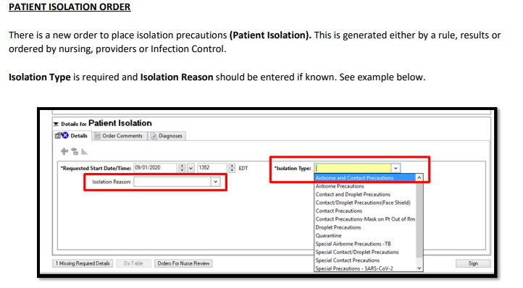

Slide 49
Isolation and PPE
Airborne - N95 & Negative Pressure Room
Special Precautions - N95, Face shield/Eye protection, Gown & Gloves, Keep door closed
Droplet - Surgical Mask
Contact - Gown & Gloves
Special Contact - Gown & Gloves, Wash hands with soap and water

Slide 50
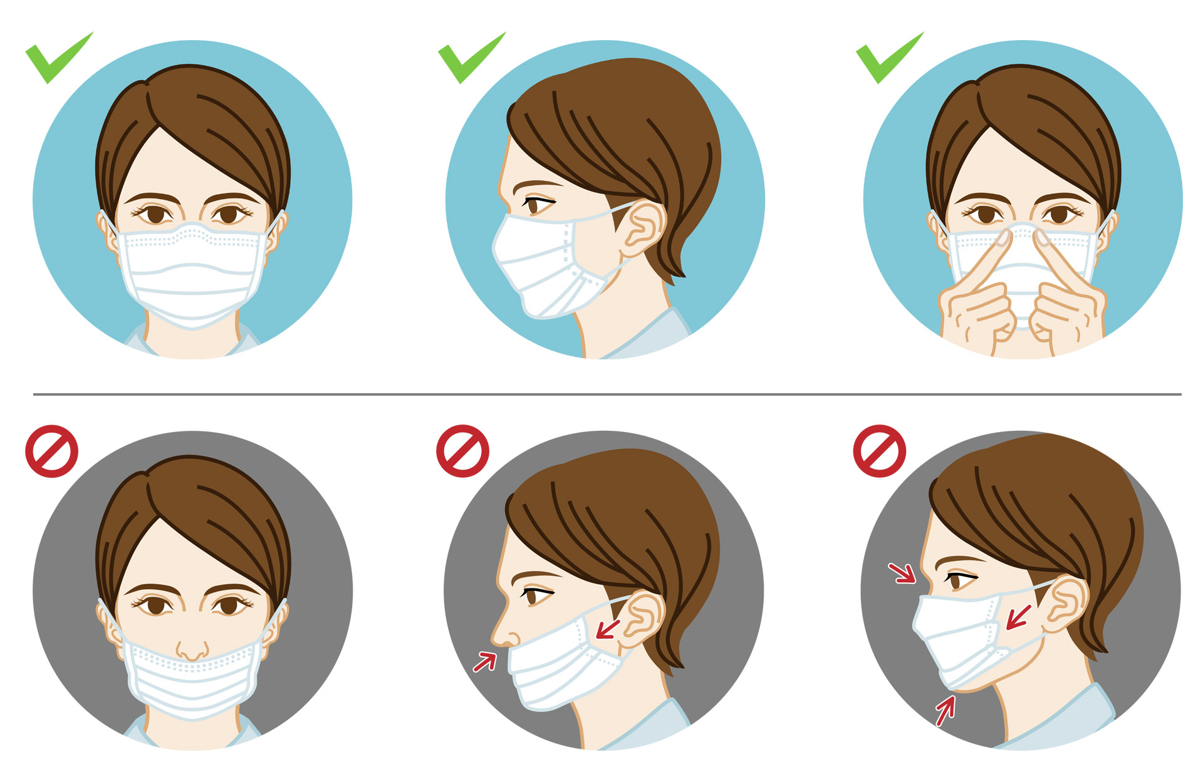
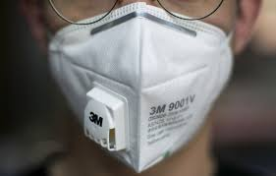
Mask Do’s and Don’ts

Slide 51
Eye Protection
Eyeglasses are not considered eye protection
Clip on eye shields that attach to prescription eyewear are not considered PPE

Slide 52
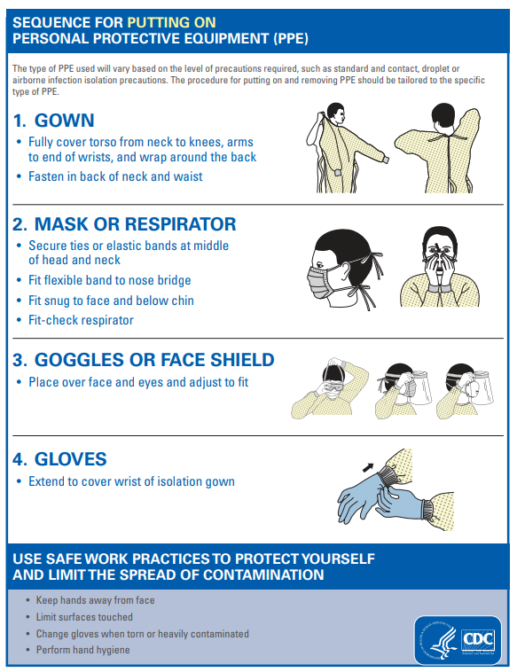
Donning -Always start with Hand Hygiene

Slide 53
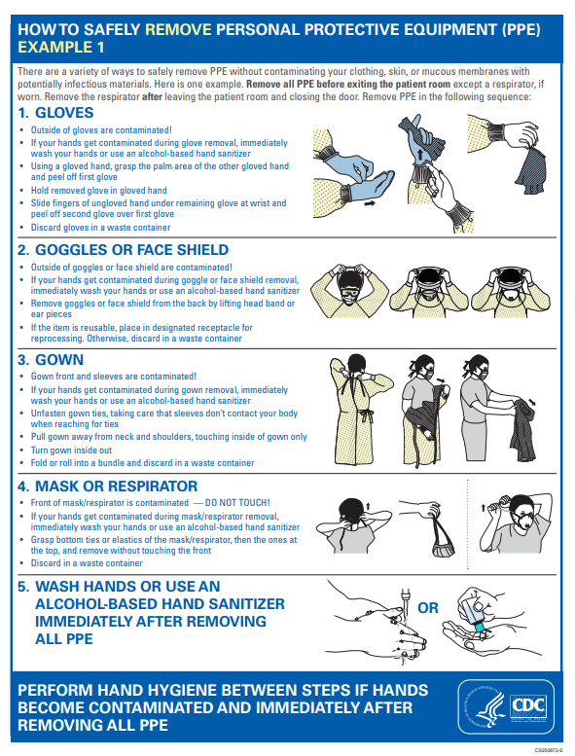
Doffing Method 1

Slide 54
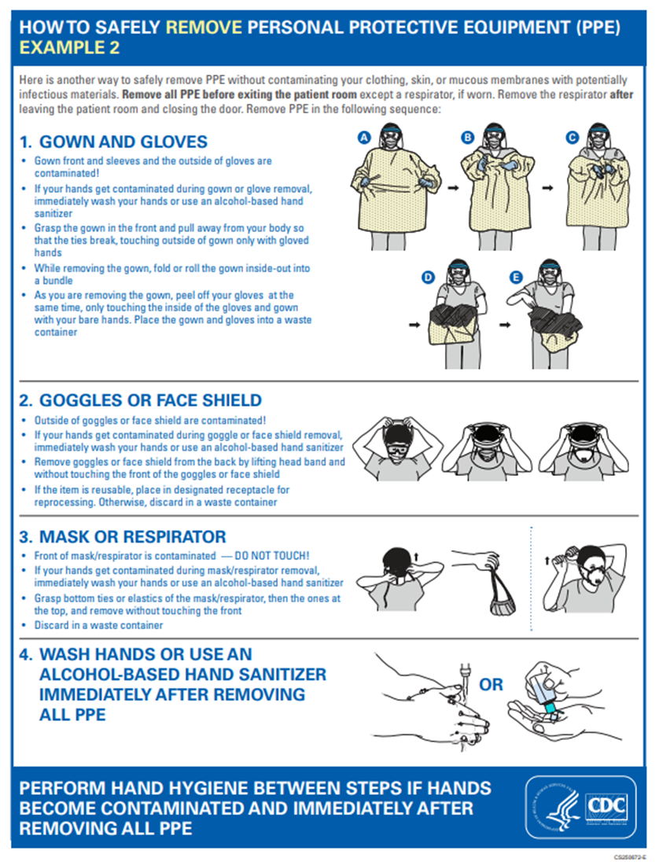
Doffing Method 2

Slide 55

Disposal of PPE
Inside the Room
Gloves
Gown
Surgical mask
Disposable eye protection
Outside the Room
Eye Protection if reusable clean
N95 / PAPR
Don’t forget Hand Hygiene!

Slide 56
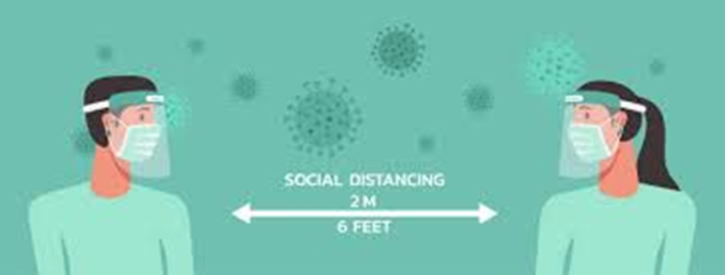
Staying Safe
Stay 6 feet part whenever possible
Including when eating
Hand Hygiene
Wear your PPE
Clean surfaces
Screen yourself for illness
Stay home when ill

Slide 57

Main Office # 444 – 7430
Email: SBUH_IPC or
SBUH Healthcare Epidemiology Practitioners
After hours Emergency Coverage: use SPOK
or ask the operator for the ICP person on-call

