Slide 1
Scholarship
Introduction to Scholarship
Notes:
Why are we here? What is expected of you?
Scholarly activity requirements and expectations (deadlines), who to contact for help, IRB expectations, first year expectations, timeline difference for Child Neurology, let them know they will have 4 weeks of research rotation(s) in 2nd year, etc.

Slide 2
What is expected of you? What is the requirement?
Residents must participate in scholarship.
“The ACGME recognizes the diversity of residencies and anticipates that programs prepare physicians for a variety of roles, including clinicians, scientists, and educators. It is expected that the program’s scholarship will reflect its mission(s) and aims, and the needs of the community it serves. For example, some programs may concentrate their scholarly activity on quality improvement, population health, and/or teaching, while other programs might choose to utilize more classic forms of biomedical research as the focus for scholarship.”
Notes:
Pose a research question/hypothesis formation
Navigate literature review
Participate in a collaborative process
Design a study (understand the methodology of your study)
Statistical analysis
Abstract and/or manuscript drafting
Scholarly dissemination

Slide 3
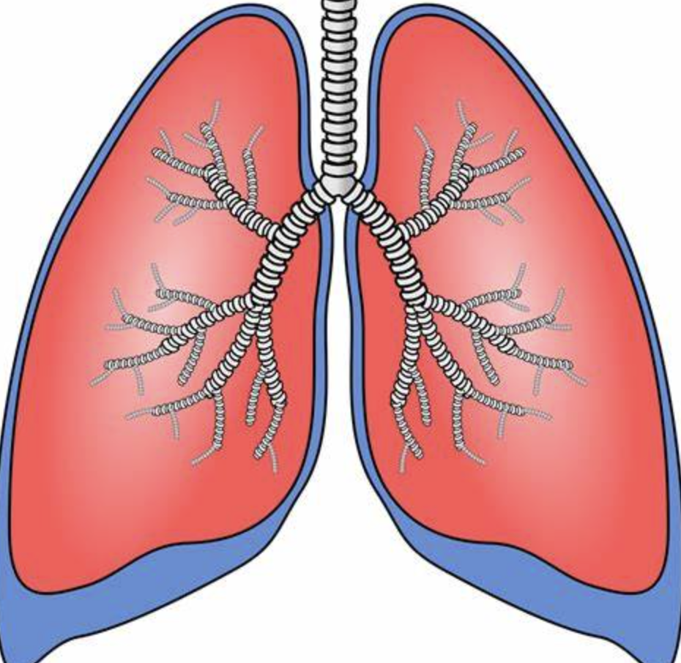
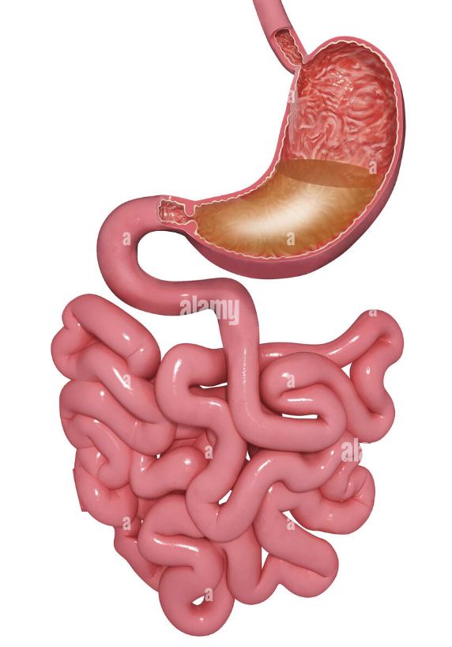
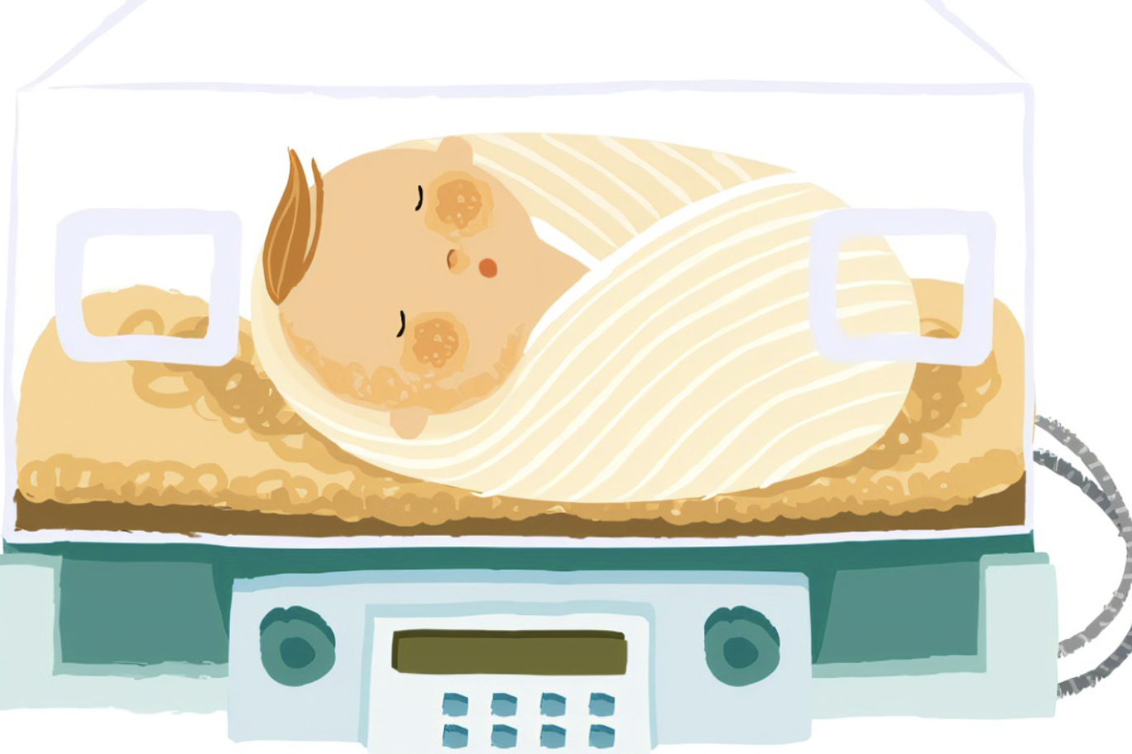
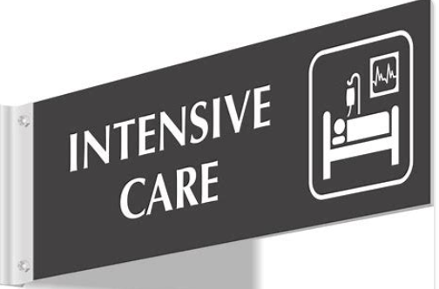
How do I choose a good project for me?
Notes:
Subspecialty – adolescent, GI, endo, pulm, PICU, cardio, heme/onc, NICU
ED, Peds hosp med, D&B….etc

Slide 4
How do I choose a good project for me?
Clinical or bench research
Chart review – quantitative stats
Educational research
Qualitative
Quality improvement
Process and outcome improvement over time- PDSA cycles
Notes:
Chart reviews – use descriptive stats, correlations – may need to learn how to use SAS or SPSS
Timelines for these are different – so should be considered with your mentor
Might also ask yourself –

Slide 5
How do I choose a good project for me?
Interesting
Achievable
Rigor (finding the right balance)
Process vs Product
What are my skills?
What can I learn?

Slide 6
Goals/Objectives for the scholarly project experience
Pose a research question/hypothesis formation
Navigate literature review
Participate in a collaborative process
Design/understand methodology
Statistical analysis
Abstract and/or manuscript drafting
Presentation/Scholarly dissemination

Slide 7
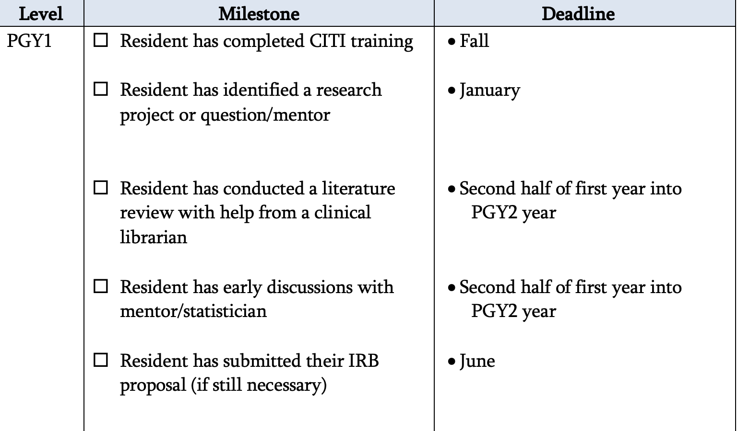
timeline
Notes:
Everyone should have already completed CITI Training
If you identify a research project/mentor before January don’t wait to get started!
Words on stats – who is available/how to get help

Slide 8
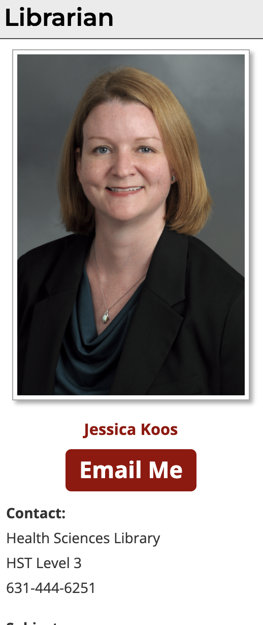
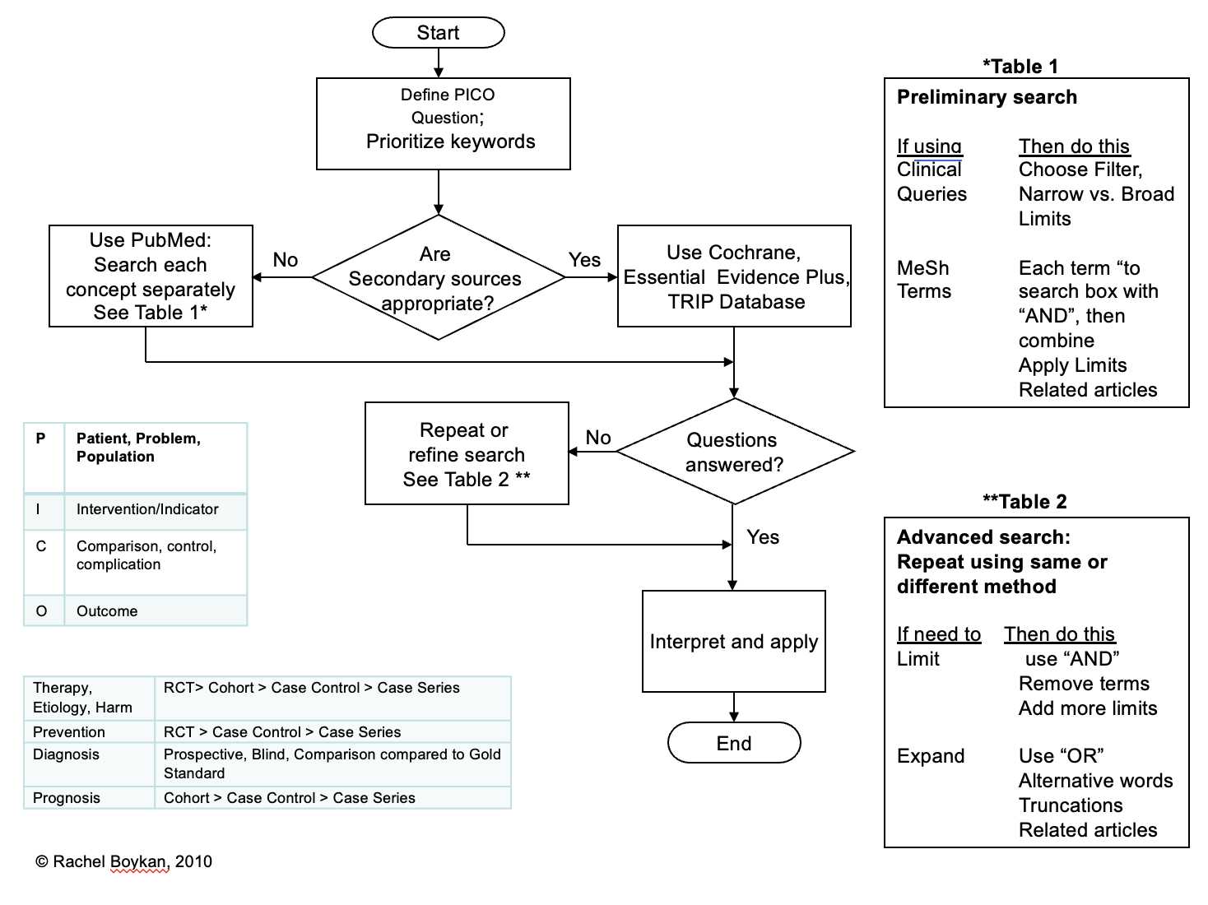
Literature searching
Notes:
Lecture on searching to be rescheduled (was last month but missed due to illness)

Slide 9
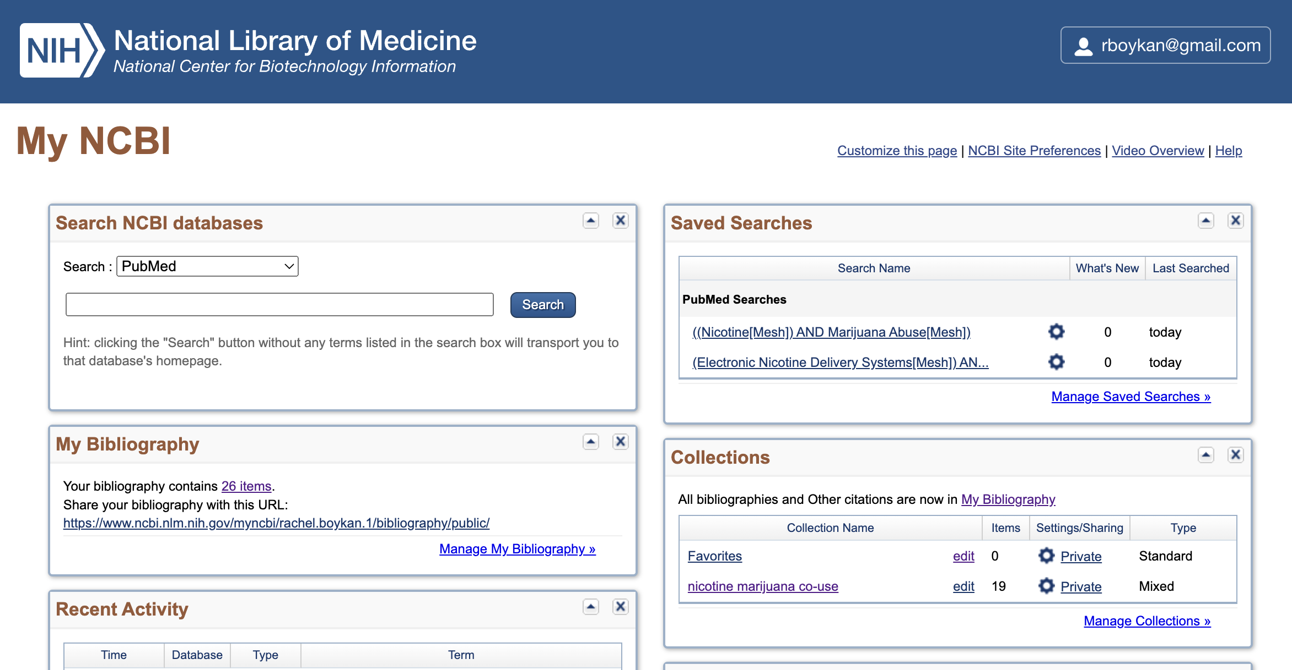
Using pubmed

Slide 10
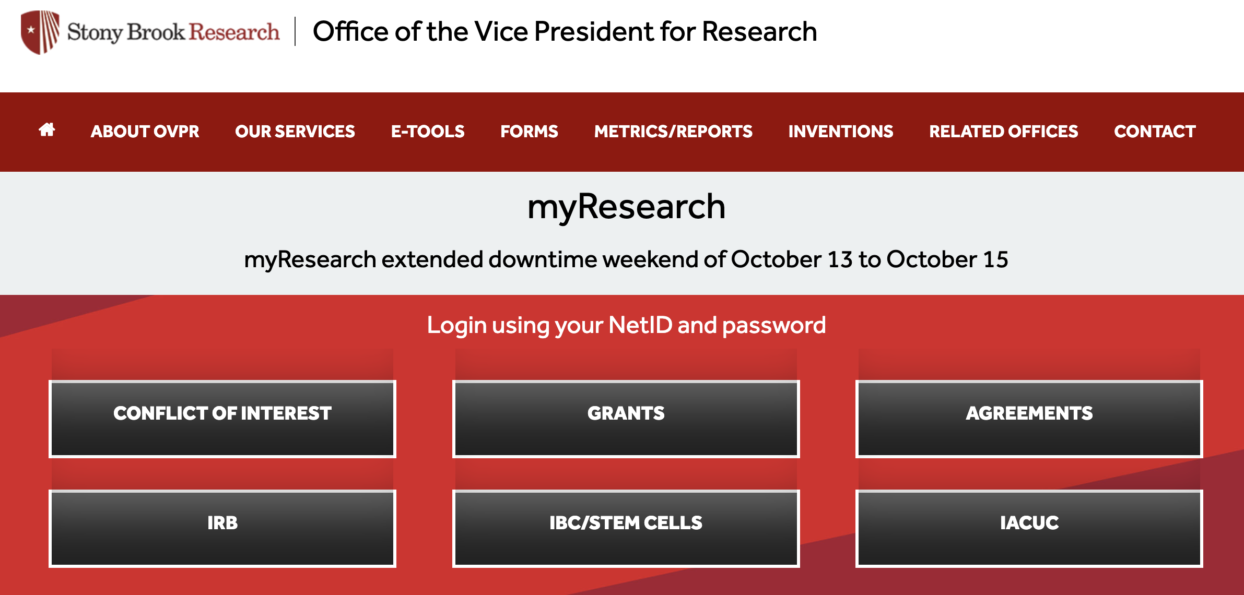
IRB doesn’t need to be daunting
https://research.stonybrook.edu/myResearch.php/
Notes:
Aimee Minton will be giving the IRB lecture in December

Slide 11
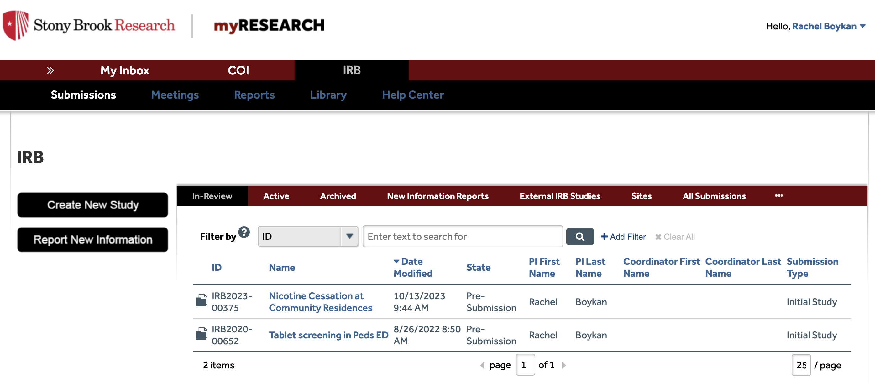

Slide 12
You must have IRB approval to start your project

Slide 13
It takes time!
Notes:
IRB always takes longer than anticipated.
IRB always takes longer than anticipated—give yourself plenty of time and anticipate extra time to obtain signatures (chair, IT, etc), submit revisions, etc
Aimee Minton will be doing IRB lecture on Dec 13th

Slide 14
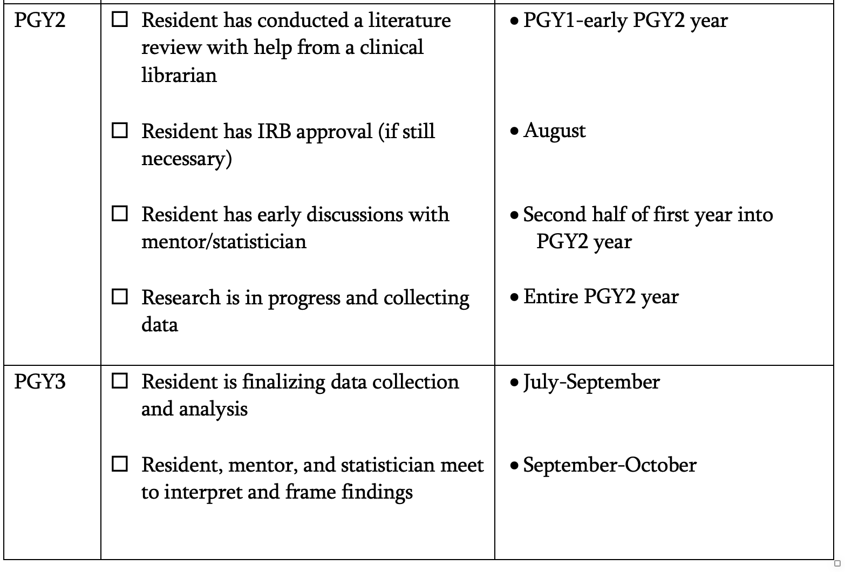
PGY 2 – 3 timeline

Slide 15
Resident Scholarship Oversight Committee Committee(RSOC)
Comprised of 15 Faculty members, Dr. Blair & Dr. Milana
Approve project/mentor selections
Provide feedback, oversight, accountability
Provide support when necessary for successful completion of project

Slide 16
Mentor/resident relationship Opportunity
Selection is as important as the project
Communication
Worksheet available to frame meetings and in-between time
Notes:
Graduation requirement
Deadlines
Project selection
IRB submission
Progress report updates (beginning of Nov and beginning of May – mentor will complete report on your progess)
Abstract submission/revisions
Presentation or Poster submission
Response to Communication
Research rotation meetings

Slide 17
Pitfalls: What if……
Faculty mentor on vacation?
Faculty mentor too busy?
IRB takes too long
You are scheduled for research rotation before you have data to analyze
You don’t understand what is asked of you?
Etc.………………..
Notes:
Add pitfalls –
Faculty member on vacation?
If you get stuck?
Timeline
Impress upon residents their ownership over the timeline
I know the PGY-1 year is very heavy, encourage them to plan ahead so they can utilize the time they have wisely –
They know schedule they have all year. PLAN.
CC https://www.flickr.com/photos/jeepersmedia/16209750221/

Slide 18
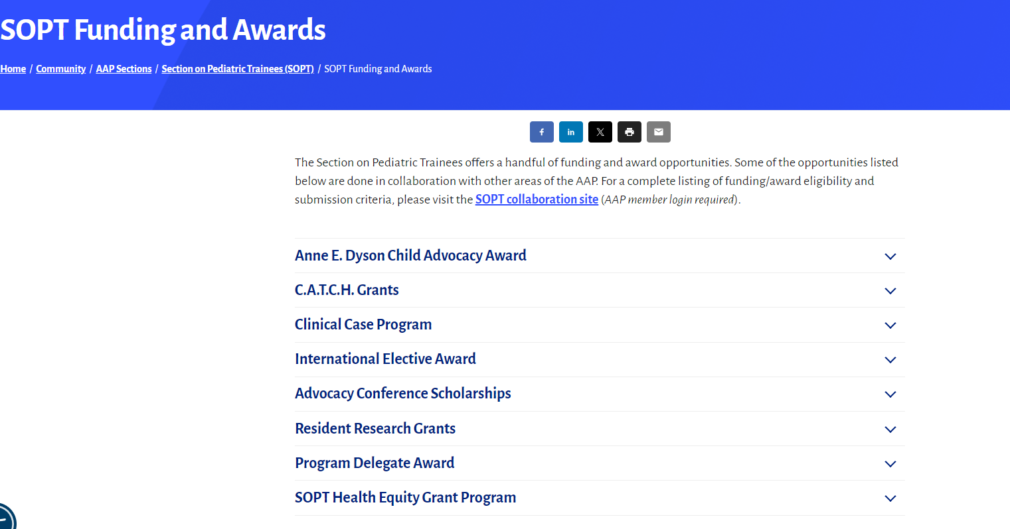
Other resources
https://www.aap.org/en/community/aap-sections/pediatric-trainees/sopt-funding-and-awards/

Slide 19
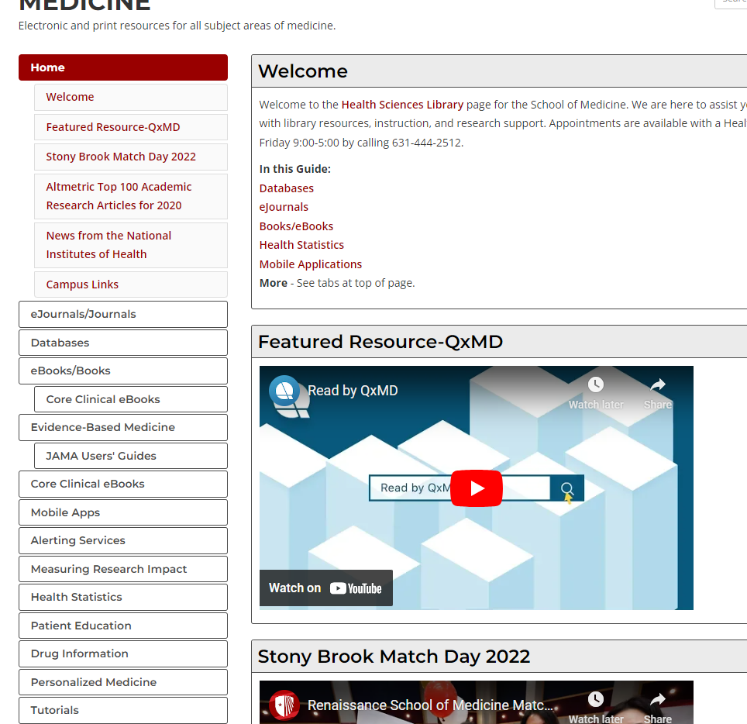
Other resources: ENDNOTE
https://guides.library.stonybrook.edu/medicine

Slide 20
Scholarly dissemination
Notes:
AAMC – NEGEA
IDSA – local conference ID Society of New York

Slide 21
Questions?

