Slide 2
Stony Brook Medicine
LVAD Program
Orientation for Medical Staff

Slide 3

Objectives:
Understand what an LVAD is.
Learn how to contact a VAD coordinator.
Understand why we use LVADs for patients.
Learn how to obtain a blood pressure for a VAD patient.
Understand our modified VAD ACLS protocol

Slide 4
What is an LVAD?
LVAD stands for Left Ventricular Assist Device. It is a mechanical pump that ASSISTS the left side of the heart by pumping blood throughout the body when the heart is too weak to pump blood on its own.
It is used for end-stage heart failure patients when medications have stopped working.
It is NOT an artificial heart.
It can be used as a “Bridge to Transplant” –supports patients and improves their quality of life while they wait for a donor heart to become available.
It can also be used as “Destination Therapy” –used as a permanent option for patients who are not eligible for a heart transplant due to age or other comorbidities.

Slide 5
Who do I call FIRST if I need assistance with an LVAD patient?
Call the LVAD Coordinator at 631-444-LVAD (5823). This information is available in the on-call switchboard, including the name of the coordinator on-call.
Coordinators are on-call 24/7. Please only contact coordinators using the VAD phone number above ONLY.
Please do NOT call a coordinators work phone or page through SPOK

Slide 6
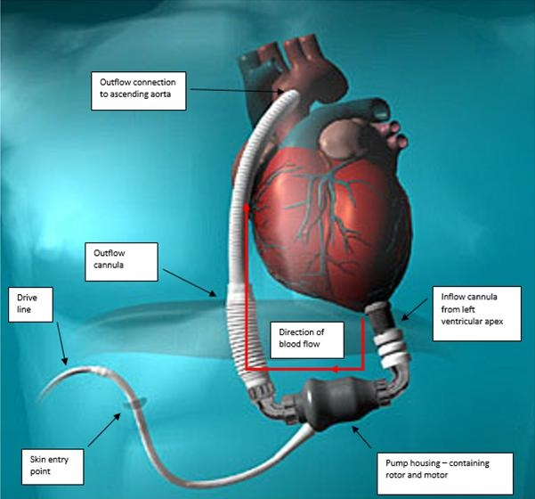
How does the pump work?
Heartmate 2
Designed to assist the left ventricle in pumping the blood throughout the body.
Heartmate 2 is an axial flow pump. Inflow cannula surgically implanted in the apex of the left ventricle; outflow graft attached to the ascending aorta.
Driveline that connects to the system controller exits the upper abdomen, either left or right side.
Powered externally by a power source. Two 14-v Li-ion batteries during the day or continuous A/C power at night.
Designed to restore blood flow throughout the body, enabling the patient to breath more easily and feel less fatigued. Likely improving organ function.

Slide 7
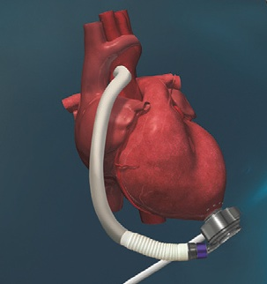
Heartmate 3
Only FDA approved pump on the market.
Works the same as Heartmate (HM) 2 as in it assists the left ventricle in pumping blood to the rest of the body.
Heartmate 3 is a centrifugal flow pump. The inflow cannula is surgically implanted in the apex of the left ventricle and sits flush against the heart. Outflow graft attached to the ascending aorta.
Driveline that connects to the system controller, exits the body in the upper abdomen either left or right side.
Driveline has a modular cable that makes it 2 pieces. It should always be locked, and the yellow line should never be visible.
Powered the same as the HM 2.

Slide 8
Does the patient have a pulse with an LVAD?
The patient typically will NOT have a pulse. It is a continuous flow pump. Remember it is an ASSIST device so the left side of the heart is still beating. How much blood is ejecting out of the aortic valve vs. going through the pump, will determine how palpable their pulse is. No palpable pulse no problem.
Obtain signals via doppler.
The right side of the heart is still supplying blood to the left side of the heart on its own.
The LVAD does NOT affect the EKG. These patients can be in V-tach or V-fib and be awake and alert and communicating. EP should still be consulted if their own ICD isn’t converting them to NSR.

Slide 9
How do I get a Blood Pressure?
Try a non-invasive blood pressure cuff first. Because they are continuous flow pumps their pulse pressure can be very narrow, only go by the MAP. Goal 60-80 mmHg.
Use a doppler if you are unable to obtain a BP with a cuff.
When using a doppler you must obtain a manual cuff, find the signal (either radial or brachial) using the doppler then inflate the cuff until you no longer hear the signal. As you deflate the cuff you are listening for the signal again and the first sound you hear is the MAP. It should be between 60-80 mmHg.

Slide 10
What happens if the patient is in cardiac arrest?
Do not perform CPR unless instructed by the LVAD coordinator 631-444-LVAD (5823).
Defibrillate as needed. Do NOT turn off the VAD before doing so.
All medications as per ACLS guidelines.
Cardioversion as per ACLS guidelines.
Externally pace as per ACLS guidelines.
Any questions or concerns please contact the LVAD coordinator at 631-444-LVAD (5823)

Slide 11
Modified ACLS for VAD
Unresponsive patient with a VAD
Initiate Emergency Response and notify VAD team @ 631-444-5823
Check controller for green arrows, when lit, VAD is on.
Check the driveline is fully inserted and door is in locked position.
Check VAD for power, make sure driveline is connected to the controller and listen for the VAD hum
Doppler carotid or femoral artery signal
No Doppler signal obtained/No Doppler available
Positive Doppler signal
No CPR
Obtain Mean Arterial Pressure (MAP)
CPR
ACLS
Continue to attempt to obtain signals/MAP every 2 min
Continue Medical Management
Consider calling a Code BAT
Check the blood sugar
Consider an overdose
Always call 631-444-LVAD Prior to Starting Compressions!

Slide 12
Additional Information:
No exposure to MRI.
CT scan and X-ray are OK.
May be transported via ground ambulance, helicopter or fixed wing.
May be transported throughout the hospital as per LVAD team guidelines which can be accessed on the hospital intranet under manuals.
If unsure of what type of device they have or patients implanting center please ask the patient if possible. If the patient is unable to answer check their wrist for a band or check the equipment that is on them.

Slide 13
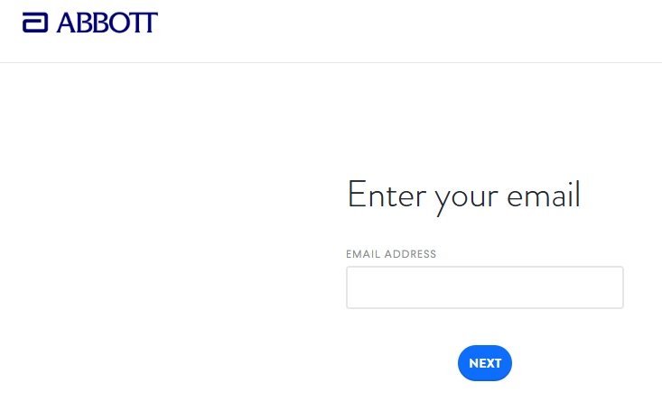
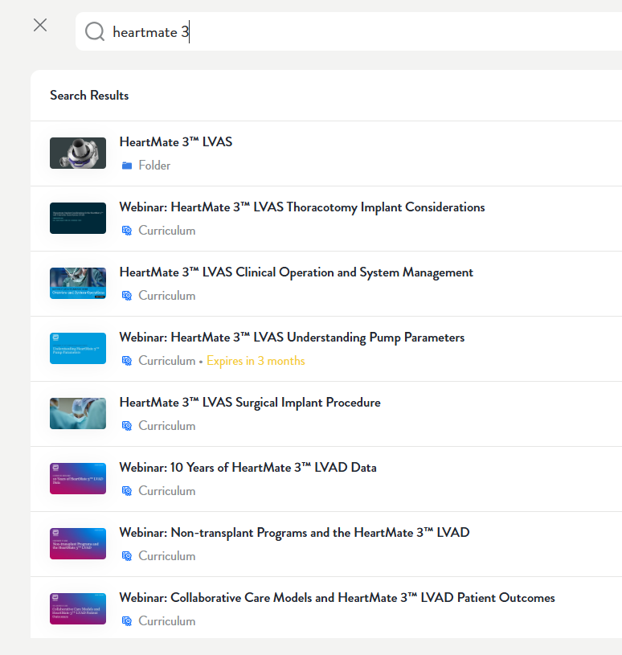
Abbott Educational Network
For further education through Abbott please refer to the Abbott Educational Network located at: https://education.cardiovascular.abbott/login
You will need to create an account using your SB email address if you don’t already have one. Once signed in, type ‘heartmate 3’ in the search bar.
A full list of LVAD education video and webinars will populate to enroll in.

Slide 14

When in Doubt, call 631-444-LVAD (5823)

