Slide 1
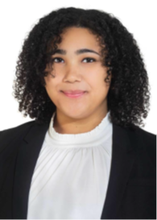
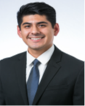
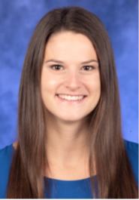
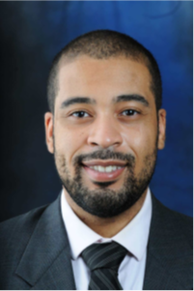
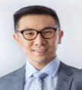
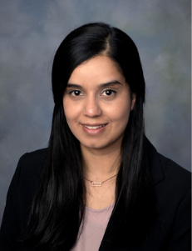
MED-PEDS RESIDENTS 2021-22
PGY1 PGY2 PGY3 PGY4
Ana Maria Lopez, MD
Fredy Huertero, MD
Annamarie Fernandes, MD
Suguna Chaganti, MD
Kaitlyn Ruffing, MD
Yang Liu, MD
Hans Chiang, MD
Jeremy Grossman, MD
Nathan Smith, MD
Dawei Wu, DO
Belliny Phaeton, MD
Ammarah Spall, MD

