Slide 1
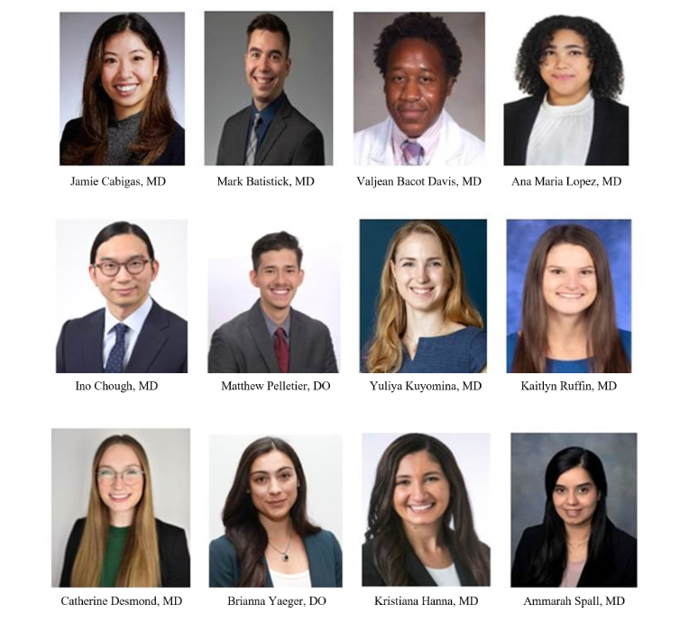
Medicine Pediatric Residents
2024-2025
PGY-1
PGY-2
PGY-3
PGY-4
Brianna Yaeger, DO
Brianna Yaeger, DO
Brianna Yaeger, DO
Medicine Pediatric Residents
2024-2025

