Slide 1
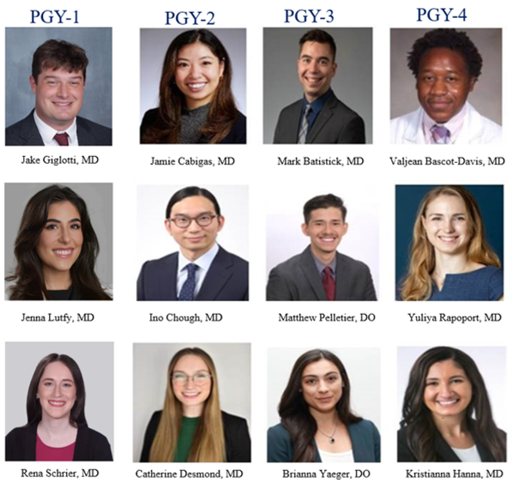
Medicine Pediatric Residents
2025-2026
Brianna Yaeger, DO
Brianna Yaeger, DO
Brianna Yaeger, DO
Medicine Pediatric Residents
2024-2025

