Slide 1
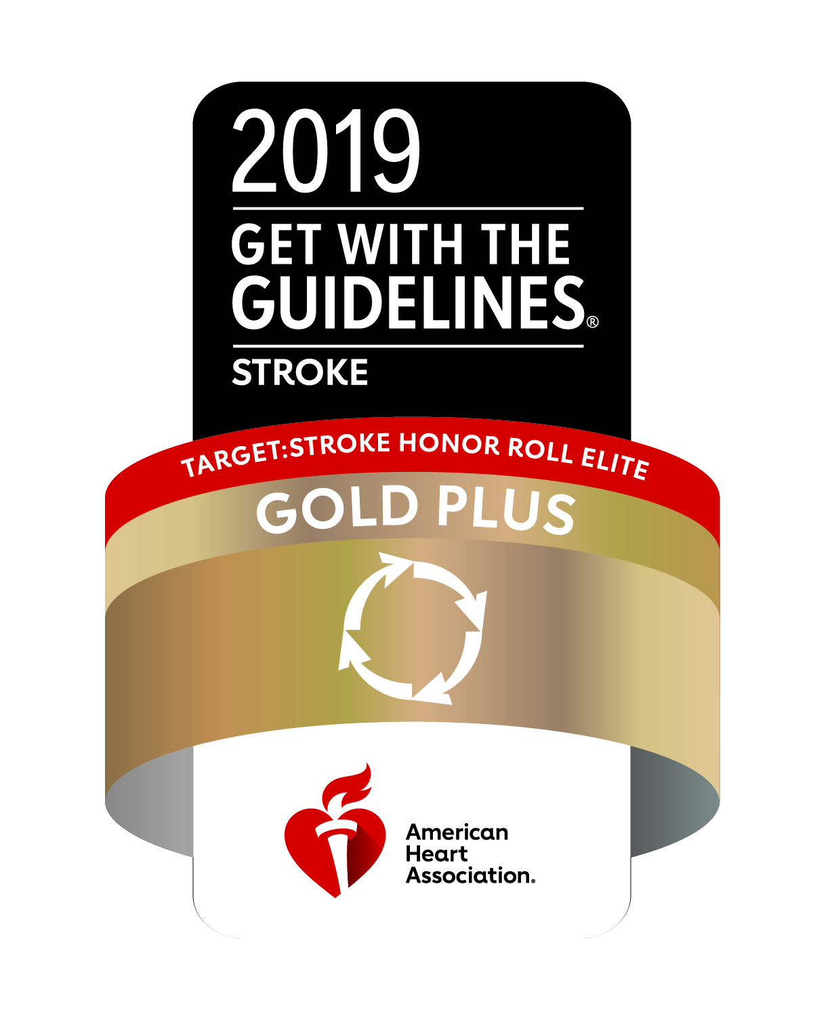

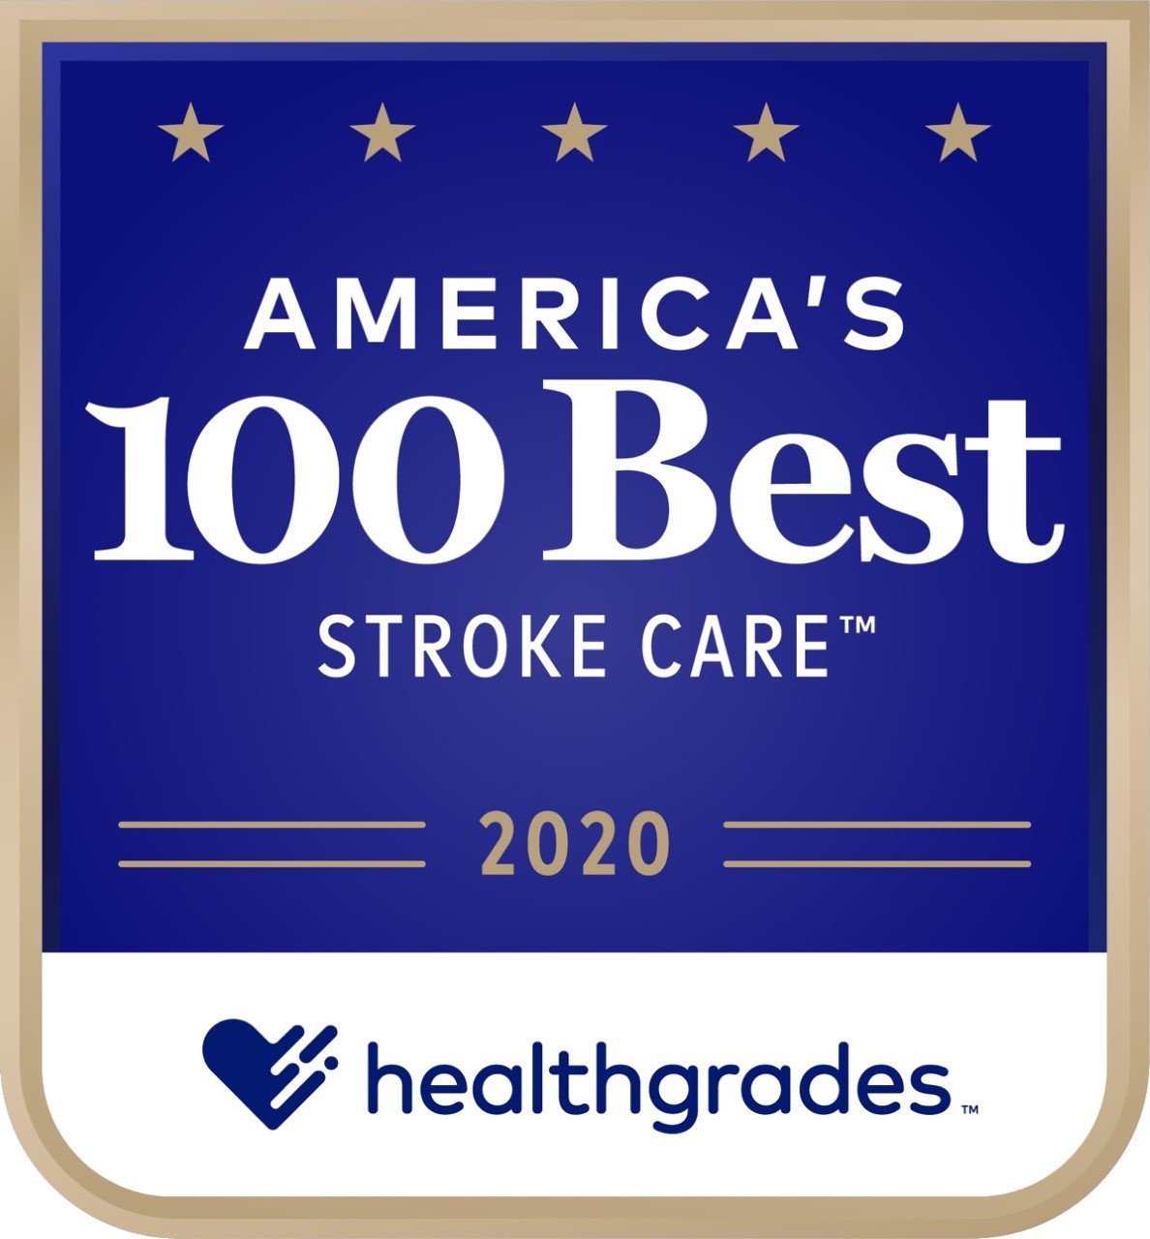
Acute Stroke Update 2019-2020
Stony Brook Medicine
Stroke Program
Comprehensive
Stroke Center

Slide 2
Acute Stroke Care Update 2019-2020
Module Learning Objectives:
Familiarize with the Stony Brook Stroke Program
Recognize acute stroke as a medical emergency
Familiarize with the change in the CODE BAT (Brain Attack Team) criteria for the Emergency Department and Inpatient units
Familiarize with the new CODE CSI (Complex Stroke Intervention) for the Emergency Department
Understand responsibilities of the primary team for an inpatient CODE BAT
Verbalize location of Stroke Program’s guidelines, protocols and references
Familiarize with stroke core measures and quality measures per Joint Commission and New York State Department of Health

Slide 3
Acute Stroke Care Update 2019-2020
Stroke Facts
87% are ischemic caused by blood clot/plaque or narrowing in a vessel
13% are hemorrhagic caused by hypertension and ruptured aneurysm or arteriovenous malformation
Worldwide 1 in every 4 people will have a stroke
In the US someone will have a stroke every 40 seconds
In the US 142,000 lives lost a year to stroke and stroke complications
The number of hospitalizations for stroke in adults 25-44 years of age has increased 43% in recent years
#1 cause of disability in the US
#5 cause of death in the US
American Stroke Association www.stroke.org/en/about-stroke

Slide 4

Acute Stroke Care Update 2019-2020
Treatments for Ischemic Stroke
IV tPA within 3 hours of last known well time, in some cases up to 4.5 hours
Endovascular thrombectomy within 24 hours of last known well time
1.9 million brain cells die with each minute of a stroke, any decrease time to treatment results in substantial decrease in disability and death
Time is Brain!
Guidelines for the Early Management of Acute Ischemic Stroke (AHA/ASA 2019)

Slide 5
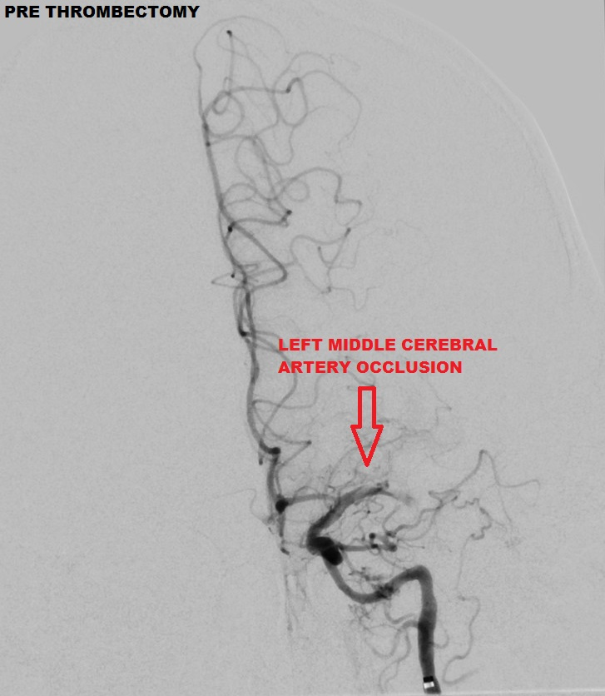
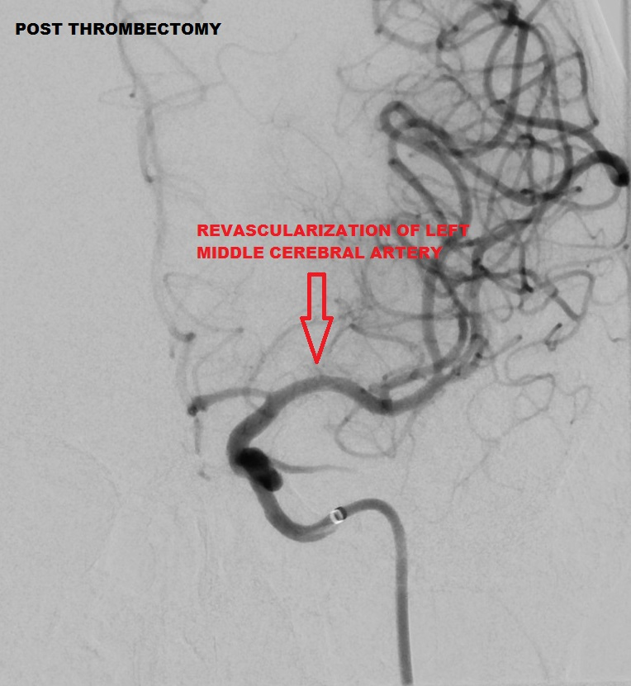
Acute Stroke Care Update 2019-2020
Thrombectomy is quick and effective

Slide 6
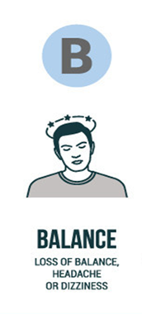





Acute Stroke Care Update 2019-2020
ACUTE STROKE IS A TRUE EMERGENCY
If you think it, CALL IT, do not wait!
CT Initiation Time <25 minutes
tPA administration <45 minutes
Thrombectomy < 60 minutes*
*There are different time targets for ED patients and inter-facility transfer patients

Slide 7
Acute Stroke Care Update 2019-2020
Acute Stroke Response Changes
Addition of the Mobile Stroke Unit (MSU) program (April 2019)
- Ambulances designated for acute stroke in the community
Addition of a new stroke activation CODE CSI for the ED
(December 2019)
Patient criteria changes for CODE BAT for the ED and Inpatient Units (December 2019)

Slide 8
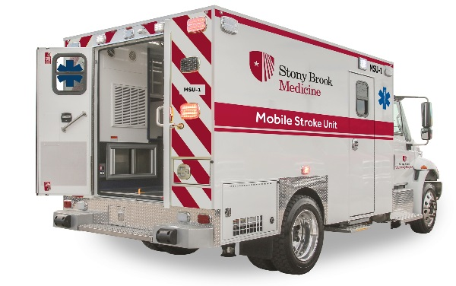
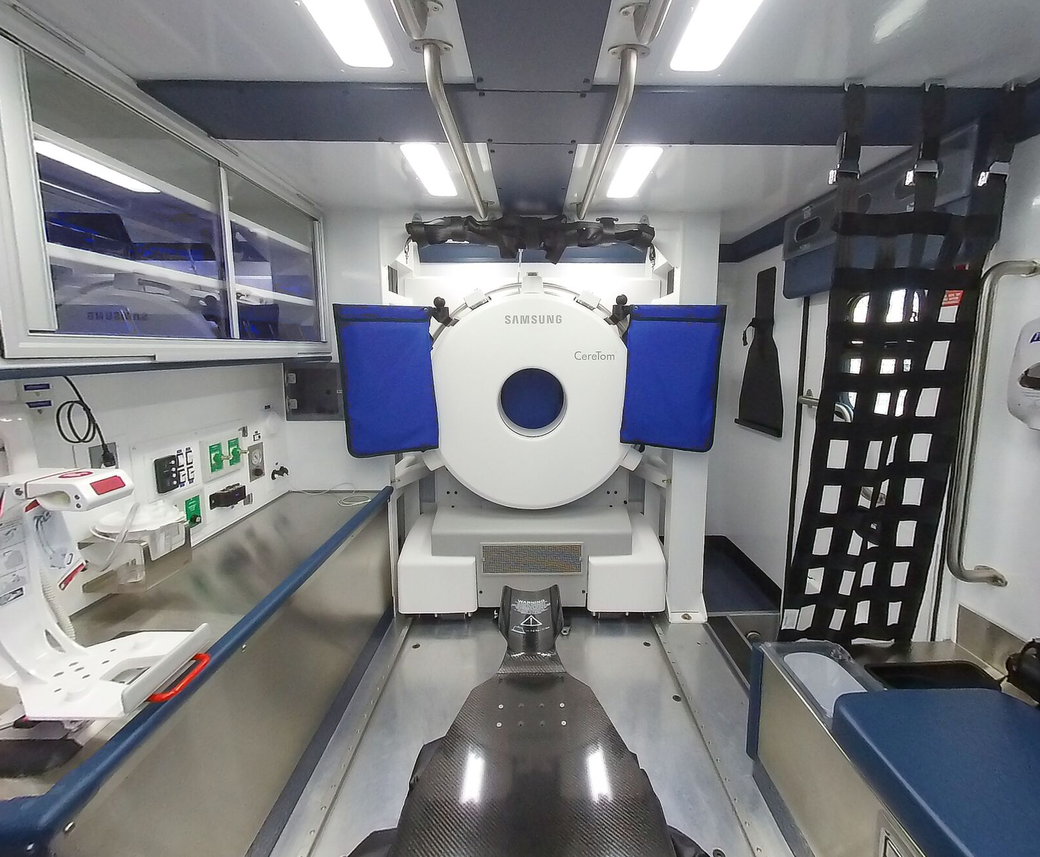
Acute Stroke Care Update 2019-2020
Dispatched by Suffolk County EMS/911
Assessment on scene
CC ED RN, Paramedic, Neurologist-telemedicine
Imaging on scene immediately sent to PACS
CT Head to see bleeding/stroke
CTA Head to see vessel occlusion
Treatment provided enroute
tPA “clot buster” for vessel occlusion
Kcentra for bleeding due to anticoagulant
Critical Care medicines and equipment for blood pressure and airway emergencies
Disposition to the appropriate hospital coordinated by Stony Brook EMS
* Stony Brook for complex stroke such as:
Bleeding stroke
Large Vessel Occlusion requiring Thrombectomy
Nearest Primary Stroke Center for non-interventional stroke care
Mobile Stroke Unit (MSU)
“Emergency Department on Wheels”
* Some complex stroke patients are brought to another comprehensive center if it is closer and appropriate

Slide 9
Acute Stroke Care Update 2019-2020
5/20/2019
MSU #3
2020?
MSU #2
4/8/2019
MSU #1
MSU 1 LIE Exit 57 MSU 2 LIE Exit 68 Future MSU 3 Riverhead

Slide 10
Acute Stroke Care Update 2019-2020
STROKE CODE UPDATE
CODE BAT remains the single mechanism by which an inpatient is assessed rapidly for acute stroke within 24 hours of last known well time
CODE BAT remains the single mechanism by which a pediatric patient is rapidly assessed for acute stroke within 24 hours of last known well time
CODE CSI is introduced which primarily affects Emergency, Neurology and Neurosurgery Departments (NOT INPATIENTS)

Slide 11
Acute Stroke Care Update 2019-2020
CODE CSI= Complex Stroke Intervention
How is a CODE CSI different than a CODE BAT?
It can only be called by an authorized person in Emergency Medical Services or in the Emergency Department. It is NOT for inpatients.
Once an ED or transfer patient is identified as a patient having severe stroke symptoms using the LAMS+Speech criteria, a CODE CSI will activate Neurosurgery and the Cerebrovascular Center Staff in addition to Neurology as these patients will benefit from the most aggressive treatments available, both medical and procedural.
* Refer to Los Angeles Motor Score (LAMS) + Speech Score

Slide 12
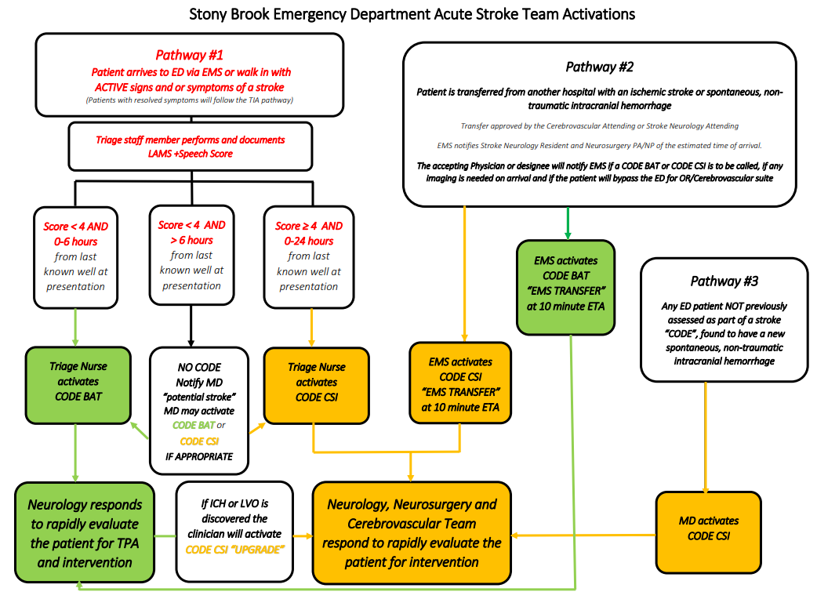

Slide 13
Acute Stroke Care Update 2019-2020
Inpatient Stroke Pathway
CODE BAT is called for a patient suspected of having a stroke within 24 hours of last known well time regardless of severity
Stroke Team arrives at bedside to assess patient
Staff are expected to act quickly, communicate clearly and coordinate care together to expedite emergent stroke treatment for the best outcome possible

Slide 14
Acute Stroke Care Update 2019-2020
Responsibilities of Primary Team Provider and RN
Stay at bedside to give SBAR to the Stroke Team including:
Pertinent history/hospital course (smoker, HTN, HLD, CAD, DM, vascular disease, arrhythmia, valve disease, infection, immune disease, prior stroke or TIA)
last known well time the time the patient was last “normal” or at “baseline”
patient’s symptoms speech/vision disturbance, motor weakness, etc
time of symptoms discovery the time the symptoms were discovered (unless it is a witnessed event, this will be different than the last known well time)
if patient is on anticoagulation
pertinent lab results-coagulation studies, CBC, pregnancy status

Slide 15
Acute Stroke Care Update 2019-2020
Responsibilities of Primary Team Provider and RN
Obtain a finger stick blood sugar level
Obtain IV access, 2 IVs preferable but DO NOT DELAY IMAGING FOR IV ACCESS. There are IV supplies in CT.
Place orders (make a favorites folder for stroke with these orders)
“CODE BAT CT Head w/o Contrast” STAT
“CODE BAT CT Angio Head/ Neck with IV CON with Perfusion”
Notify CT that you are on the way with the CODE BAT patient (Main CT 4-3715, ED CT 4-9002)
Transport the patient to CT with a monitor and oxygen

Slide 16
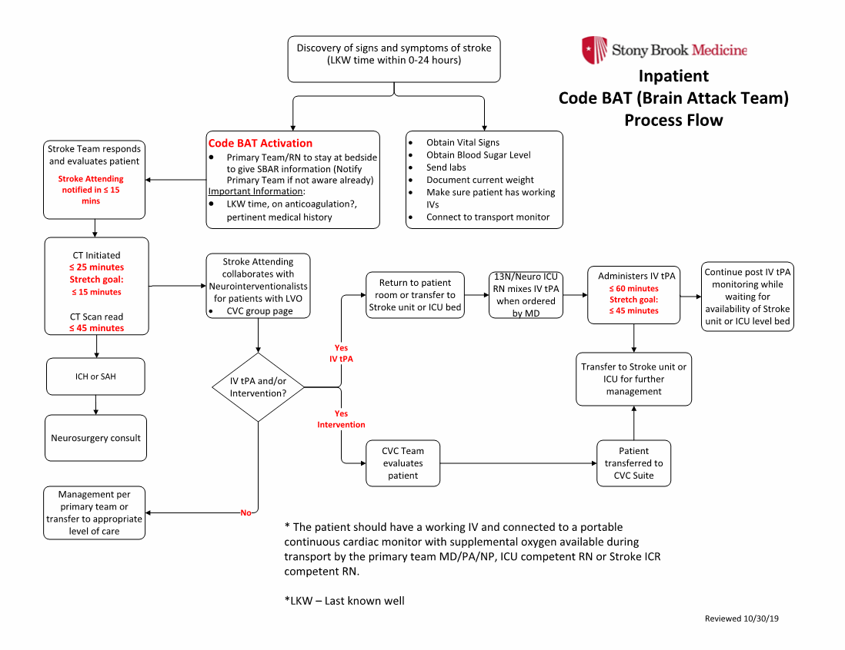

Slide 17
Joint Commission/New York state:
PRIMARY STROKE CoRE MEASURES
STK-1 VTE prophylaxis on the day of or the day after hospital admission.
STK-2 Antithrombotic therapy at hospital discharge.
STK-3 Anticoagulation for Atrial fibrillation/flutter at hospital discharge.
STK-4 IV t-PA initiated at this hospital within 3 hours of time last known well.
STK-5 Antithrombotic therapy by the end of hospital day 2.
STK-6 Statin medication at hospital discharge.
STK-8 Patient and/or caregiver stroke education: activation of emergency
medical system, need for follow-up after discharge, medications
prescribed at discharge, personal risk factors for stroke, and warning
signs and symptoms of stroke.
STK-10 Rehabilitation services assessment
LIPs must be mindful of the specific time period of the core measures for compliance.
Reason(s) must be documented in the medical record why elements of the core measures were not implemented for the patient.

Slide 18
Joint commission/New York state:
Comprehensive Stroke Core measures
CSTK 01 – NIH Stroke Scale score performed for Ischemic Stroke patients
CSTK 02 - Modified Rankin Score at 90 Days
CSTK 03a - Severity Measurement Performed : Hunt and Hess Scale performed for
SAH
CSTK 03b – Severity Measurement Performed: ICH Score performed for ICH patients
CSTK 04 - Procoagulant Reversal Agent Initiation for ICH patients
CSTK 05a - Hemorrhagic Transformation for IV t-PA patients
CSTK 05b - Hemorrhagic Transformation for IA t-PA and/or Mechanical Endovascular Reperfusion Therapy patients
CSTK 06 - Nimodipine Treatment Administered
CSTK 07 - Median Time to Revascularization
CSTK 08 - Thrombolysis in Cerebral Infarction (TICI) post-treatment reperfusion grade
CSTK 09 - Arrival Time to Skin Puncture
CSTK 10 - Modified Rankin Score at 90 Days: Favorable Outcome
CSTK 11 - Timeliness of Reperfusion: Arrival Time to TICI 2B or Higher
CSTK 12 - Timeliness of Reperfusion: Skin Puncture to TICI 2B or Higher

Slide 19
Quality Measures
AHA/ASA Quality Measures
- Dysphagia Screen before being given any food, fluids, or medication by mouth
RN or LIP completes bedside swallow evaluation using the Yale Swallow Protocol
If indicated, formal swallow evaluation by Speech Therapist
For patients who failed swallow evaluation: Order Aspirin per rectum or place NGT for patients who need Plavix, Brilinta or oral anticoagulant.
- Documented Lipid profile
- Intensive Statin Therapy Use especially for patients with evidence of atherosclerosis
(Lipitor ≥ 40mg, Crestor ≥ 20mg)
Additional New York State requirements
- Documentation of NIH Stroke Scale on discharge
- Annual 8 hours of cerebrovascular-related continuing education for Physicians, NP, PAs and RNs taking care of stroke patients

Slide 20
STROKE PROGRAM
Compliance to the Core Measure and Quality Measures are reported to the Joint Commission and New York State
Transient Ischemic Attack (including ED Observation status)
Ischemic Stroke
non-traumatic Intracerebral Hemorrhage
non-traumatic Subarachnoid Hemorrhage
Compliance to the recommended Target Response Times are reported for patients who arrive to the ED with last known well time within 6 hours

Slide 21
Stroke Program
Stroke Quality/Oversight Meetings:
Cerebrovascular Conference – every 1st and 2nd Wednesday of the month, case-based discussion. Offers 1.0 CME credit.
Stroke QA/Peer Review – every 3rd Wednesday of the month, stroke case reviews and discussion. Offers 1.0 CME credit.
Code BAT meeting – every second Tuesday of the month at 3PM. Attended by EMS, ED, Stroke/Neurology, CVC/Neurosurgery, Radiology, Pharmacy, Neuroscience Administration.

Slide 22
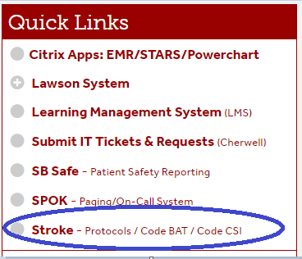
Stroke Program
Fore more information on protocols and clinical practice guidelines check out the Stroke website located on the right hand side of the intranet homepage
ThePulse
Under
Quick Links

Slide 23
THANK YOU !
For questions, contact:
Anne Froehlich, Stroke Program Coordinator: anne.froehlich@stonybrookmedicine.edu
Marret Anderson, Stroke Program Navigator: marret.anderson@stonybrookmedicine.edu
Colleen Calandra, Neurosurgery PA: colleen.calandra@stonybrookmedicine.edu
Antonieta Rosenberg, Stroke Service NP: antonieta.rosenberg@stonybrookmedicine.edu

