Slide 1

Nutrition and Immune Function: Focus on SARS-CoV2
Josephine Connolly-Schoonen, PhD, RD

Slide 2
Immune System influenced by environment
Environment
  Diet/nutrient status
  Products of microbiome metabolism
Appropriate immune response and recovery
  Initial response against pathogen
    Inflammation part of this
  Resolution; clear damaged tissue; prevent damage to the host
  Surveillance
  Benefits from Vitamins A, D, B1 and C, as well as zinc and melatonin in reducing infection
Dysregulated immune function (autoimmune and inflammatory disorders)

Slide 3
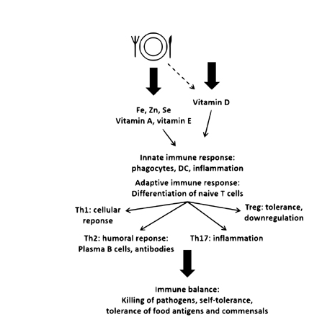
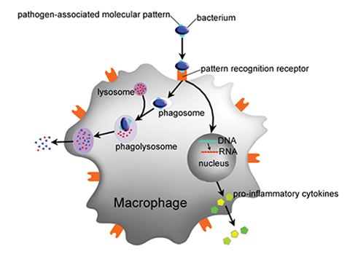
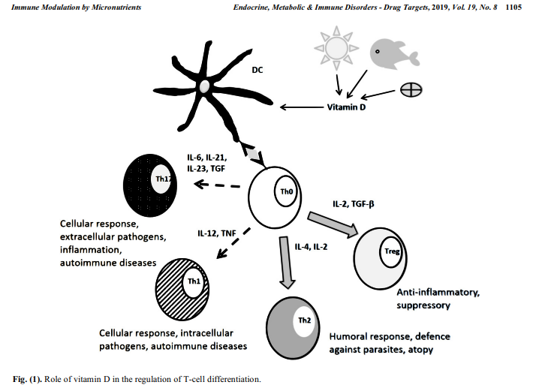

http://www.eurekaselect.com/node/172318/article/the-role-of-the-status-of-selected-micronutrients-in-shaping-the-immune-function

Slide 4
Vitamin A
There are different forms of retinol in food; absorbed and stored in liver
Hydrolyzed by ubiquitous alcohol dehydrogenases
2nd step is via cell-specific retinaldehyde dehydrogenases leading to retinoic acid which is biologically active
Innate immunity
  Facilitates differentiation of dendritic cells and therefore cytokines they produce
  Enhances the migratory properties of dendritic cells which is important for antigen presenting function during infections
Plays a role in driving adaptive immunity

Slide 5
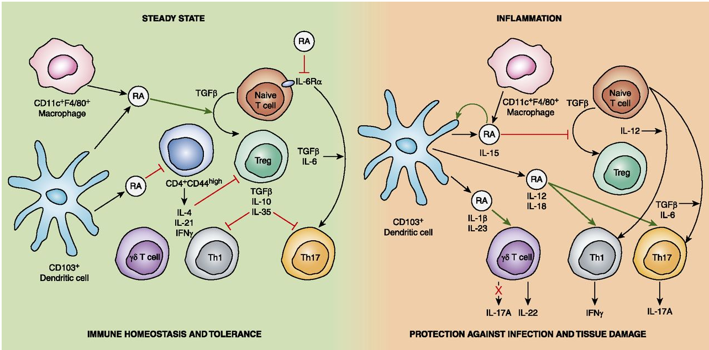

RA can influence immune cell; immune cells can make RA
The influence of RA on the function of DC depends on cytokine context
FIGURE 1. Immunomodulatory effects of RA. In the steady-state, RA produced by CD103+ DCs and alveolar macrophages helps to maintain immune homeostasis and mucosal tolerance by working with TGF-b to promote expansion of Tregs from naive T cells, while inhibiting Th1 and Th17 cells. In addition, RA constrains the inhibitory effect of CD4+ CD44high T cells on Tregs.
However, in conditions of inflammation (e.g., during autoimmunity or infection), when the inflammatory cytokines IL-1b, IL-12, IL-18, and IL-23 are produced, RA promotes IFN-g production by Th1 cells, IL-17 production by Th17 cells, and IL-22 production by gd T cells. During inflammation, RA also works with IL-15 to decrease conversion of naive T cells into Tregs.
The Journal of Immunology, 2014, 192: 2953–2958.

Slide 6
Vitamin D
Vitamin D originating in skin or from food is hydroxylated to 25(OH)D3 mainly in liver; then further hydroxylated to 1,25(OH)2D3 in kidney
Vitamin D Receptor (VDR) widely dispersed in tissues/cells, i.e. immune cells express VDR and 1-alpha-hydroxylase (second hydroxylation)
  Can induce production of several antimicrobial peptides (cathelicidin and defensins) by macrophages, neutrophils and epithelial cells
  Enhances elimination of invading bacterial, viruses and fungi by innate immune system
Adaptive immune responses
  VDR found in both T and B cells…. but
  Inhibits T cell proliferation and effector function of CD4+ and CD8+ T cells
  Still controversial but appears that vitamin D restricts CD4+ T cell polarization toward the pro-inflammatory Th1 and Th17 cells while favoring Th2 and Treg cells (see diagram)
  Antigen presenting cells – vitamin D thought to program dendritic for tolerance, alleviating inflammatory (autoimmune) conditions
Applications
  Studies are mixed but some positive evidence regarding vitamin D supplementation in treatment of TB, upper respiratory infections hepatitis C virus and HIV; perhaps while also mitigating against excessive inflammatory response

Slide 7
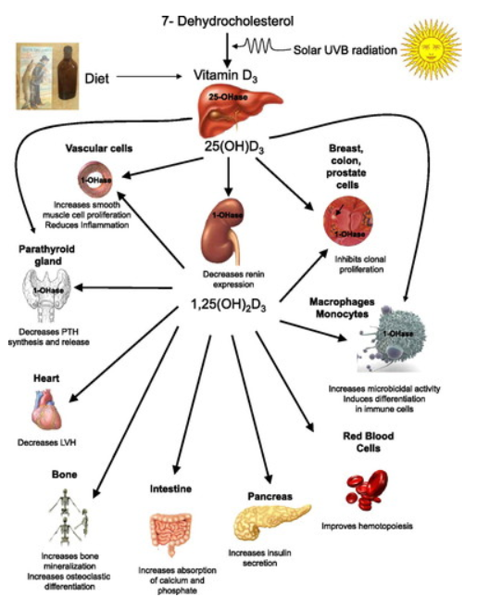
https://journals.physiology.org/doi/full/10.1152/ajprenal.00130.2009

Slide 8
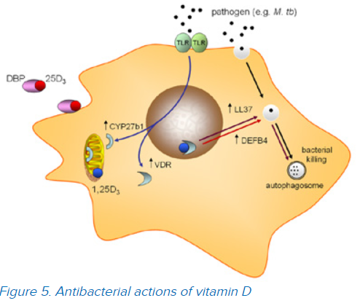
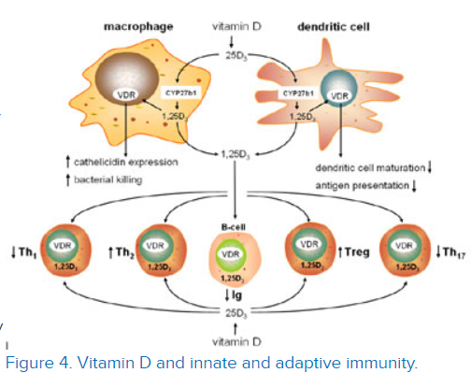
1.25(OH)2D3 promotes chemotactic and phagocytic capacity of macrophages
Unlike the skeletal effects of vitamin D, the induction of cathelicidin by vitamin D has been shown to be due to induction of local, monocyte, expression of 1α -hydroxylase (CYP27B1), the vitamin D-activating enzyme. We have also shown that the bioavailability of precursor 25-hydroxyvitamin D (25OHD – the main circulating form of vitamin D) to this enzyme is dependent on the serum carrier of 25OHD, the vitamin D binding protein (DBP). In particular we have shown that genetic variations in DBP differentially affect the antibacterial actions of vitamin D, suggesting that vitamin D supplementation strategies may need to be tailored according to DBP genotype
Figure 4. Vitamin D and innate and adaptive immunity.
Using cultures of human monocytes we have shown that vitamin D supplementation of insufficient patients enhances production of the antibacterial protein cathelicidin following immune activation of the monocytes
https://www.uclahealth.org/ortho/non-classical

Slide 9
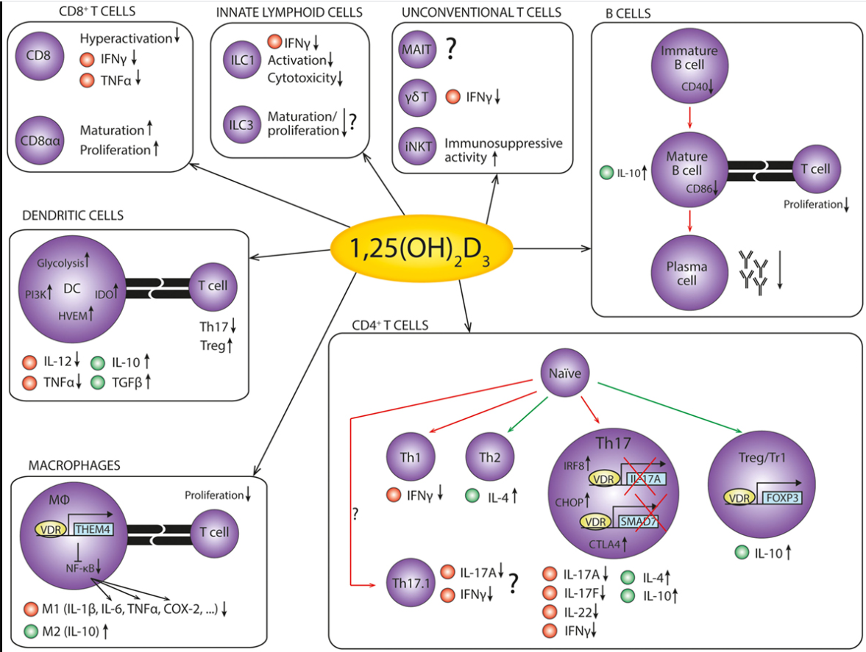
Figure 2. The anti-inflammatory effects of 1,25(OH)₂D₃ on cells of the immune system. An overview of the anti-inflammatory effects of 1,25(OH)₂D₃ on the cells of the immune system in autoimmunity. Red dots represent pro-inflammatory cytokines, while green dots represent anti-inflammatory cytokines. Red arrows indicate decreased differentiation, and green arrows indicate increased differentiation. References: CD8⁺ T cells (79–81); innate lymphoid cells (82–86); unconventional T cells (87–89); B cells (75, 90–96); dendritic cells (97–103); macrophages (104–108); CD4⁺ T cells (109–125).
https://www.frontiersin.org/articles/10.3389/fimmu.2016.00697/full
https://www.frontiersin.org/files/Articles/236441/fimmu-07-00697-HTML/image_m/fimmu-07-00697-g002.jpg

Slide 10
Vitamin C
A water soluble antioxidant; readily donates electrons; protects biomolecules (proteins, lipids, nucleic acids) from oxidants produced by metabolism or through environmental exposure
Cofactor for enzymes (mono-oxygenases and dioxygenases, as well as lysyl and prolyl hydroxylases (required to stabilize tertiary structure of collagen) and hydroxylases for biosynthesis of carnitine (required for transport of fatty acids into mitochondria), catecholamines (norepinephrine), amidated peptide hormones (vasopressin necessary for cardiovascular response to severe infection) and for the downregulation of the transcription factor hypoxia-inducible factor-1alpha (HIF-1a)
Leukocytes, esp. neutrophils accumulate high levels of vitamin C via SVCT2 transporters and following oxidative burst take in much more via oxidized form, dehydroascorbate via GLUT transporters and then rapidly reduced to ascorbate (levels of 10mM within cell)
  Serves as antioxidant
  Regenerates glutathione and vitamin E
  Upon phagocytosis can be depleted; antioxidants low relative to oxidants; alterations in signaling pathways; i.e. activate NFkB triggering a cascade with continued production of ROS and inflammatory mediators
B and T lymphocytes also accumulate vitamin C in high levels; antioxidant protection; enhance proliferation

Slide 11
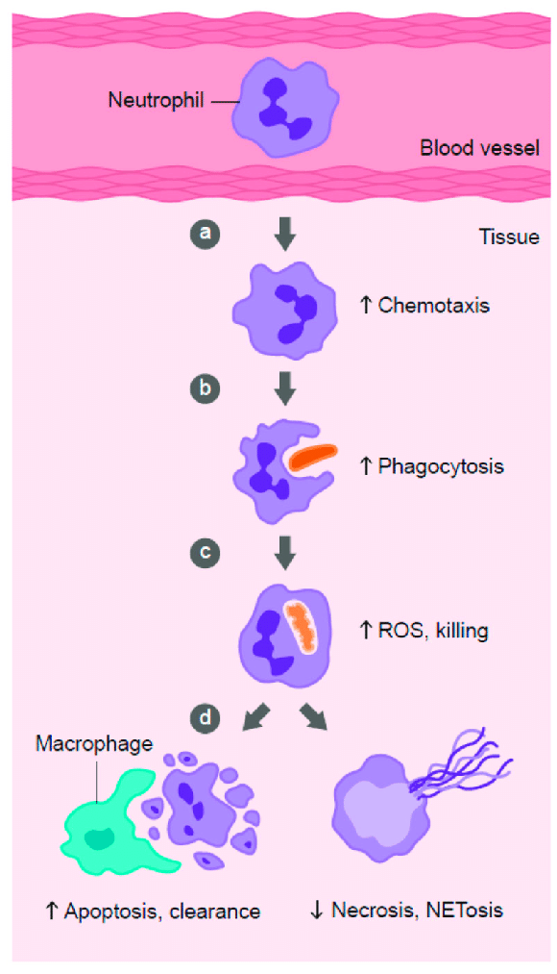
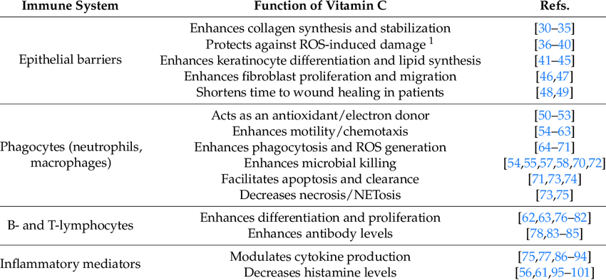
Neutrophils have 30+ chemoattractant receptors; swarm
Pathogen or host signal=IL-8, leukotriene B4, complement protein C5a
Pts with sepsis w/ decrease phagocytosis and ability to make ROS; high dose vit C may improve
Role of vitamin C in phagocyte function. Vitamin C has been shown to: (a) enhance neutrophil migration in response to chemoattractants (chemotaxis), (b) enhance engulfment (phagocytosis) of microbes, and (c) stimulate reactive oxygen species (ROS) generation and killing of microbes. (d) Vitamin C supports caspase-dependent apoptosis, enhancing uptake and clearance by macrophages, and inhibits necrosis, including NETosis, thus supporting resolution of the inflammatory response and attenuating tissue damage.
Necrotic cell death; release toxic persistent inflammatory loci
Nutrients 2017; 9:1211.

Slide 12
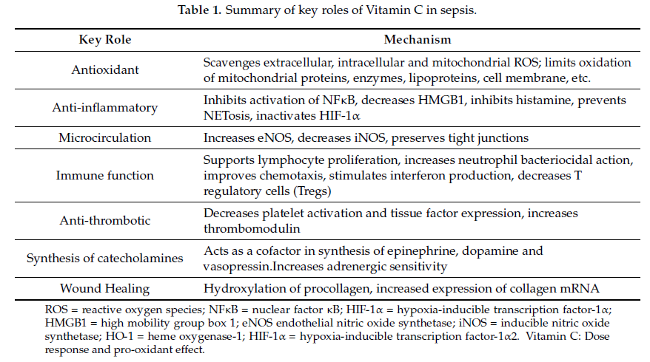
Histamine stimulates vasodilation and capillary permeability
Some studies show vitamin C supplementation in patients with acute respiratory infections: decreases severity of symptoms; clearance of neutrophils from infected lungs (apoptosis); low level vitamin C likely a cause and a consequence of the disease.
Nutrients 2018; 10:1762.

Slide 13
Ascorbic Acid, thiamine & hydrocortisone for treatment of Sepsis
Organ failure and death in the context of sepsis – usually results from host response to the infection
  Leukocyte exposure to bacterial endotoxin (LPS)
    impacts transcription of 3700+genes (pro/anti-inflammatory cytokines, chemokines, adhesion molecules, transcription factors, enzymes, clotting factors, stress proteins and anti-apoptotic molecules
    Leads to vasoplegic shock, myocardial dysfunction, altered microvascular flow and diffuse endothelial injury
    Results in excess production of ROS (hydrogen perioxide H2O2, superoxide O2-, hydroxyl radicals HO*, peroxynitrite ONOO- and hypochlorous acid HOCl) due to uncoupling of mitochondrial oxidative phosphorylation and products of xanthine oxidase, lipoxygenase and cyclooxygenases)
    Markers of oxidative stress correlate with SOFA and APACHE II scores among patients with sepsis (impaired mitochondrial functions & metabolic failure); proinflammatory cytokines and inadequate thiamin contribute to inhibition of pyruvate dehydrogenase complex preventing pyruvate from entering Krebs cyle
  Proposed combination addresses ROS and targets multiple components of pathogenesis of sepsis
  Thiamine
    Precursor of thiamine pyrophosphate, coenzyme of several decarboxylases necessary for Krebs cycle and pentose phosphate pathway, as well as synthesis of ATP and NADPH (keeps glutathione in reduced state; facilitates neutrophil migration)
    Anti-inflammatory effects via suppression of oxidative-stress induced activation of NF-kB
    Deficiency leads to decrease ATP production and contributes to oxidative mitochondrial injury and bioenergetics failure
    Study with septic shock patients with thiamin deficiency, those given 200 mg thiamine BID for 7 days had significantly lower lactate levels and lower mortality; also had lower need for renal replacement therapy and lower creatinine*
Donnino et al Crit Care Med. 2016;44:360. Moskowitz et al. Ann Am Thorac Soc. 2017; 14:737.

Slide 14
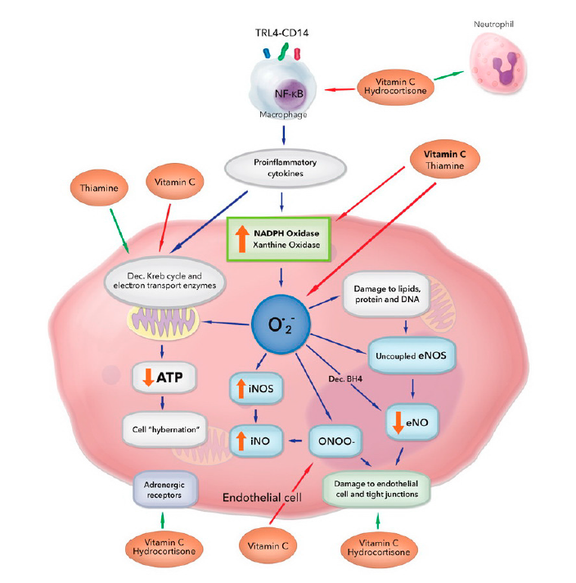
Sepsis Pathogenesis
Figure 1. Multiple and overlapping effects of hydrocortisone, vitamin C, and thiamine in the setting
of bacterial sepsis.
Vitamin C and thiamine scavenge free radicals from superoxide (O2−) and inhibit activation of xanthine oxidase and NADPH oxidase.
Vitamin C protects the mitochondria from oxidative stress caused by increased leakage of electrons from the dysfunctional electron transport chain and recovers tetrahydrobiopterin (BH4) from dihydrobiopterin (BH2), restoring endothelial nitric oxide synthase (eNOS) activity and increasing eNO bioavailability.
Vitamin C inhibits inducible NOS (iNOS) activation, preventing profuse iNO production and peroxynitrite (ONOO−) generation.
Vitamin C scavenges ONOO-, preventing loosening of the tight junctions of the endothelium.
Vitamin C and hydrocortisone decrease the activation of nuclear factor B (NF-B), thereby decreasing the release of proinflammatory mediators. They restore endothelial tight junctions and increase adrenergic receptor function.
Thiamine increases the activity of pyruvate dehydrogenase and alpha ketoglutarate dehydrogenase. These actions act in concert to restore cellular adenosine tri-phosphate (ATP) levels.
Figure adapted from Spoelstra-de Man et al. [19].
Nutrients 2018, 10, 1762; doi:10.3390/nu10111762

Slide 15
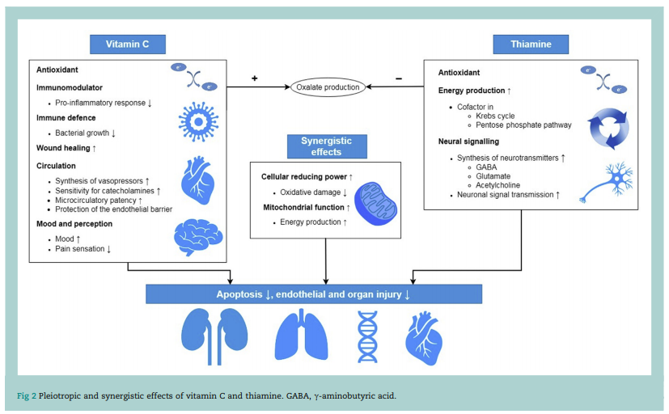

Slide 16
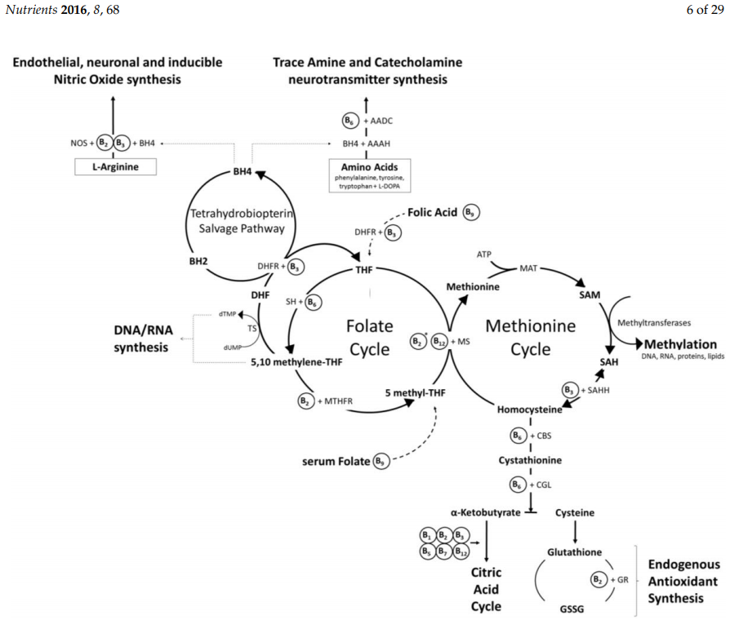
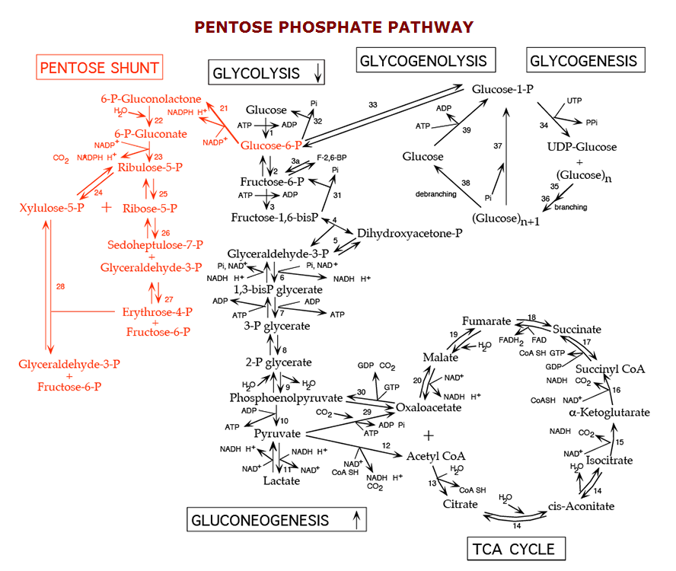

Slide 17
Doses for Vitamin C and thiamine
Thiamine Dosing
DRI for thiamine during: 1.1- 1.2 mg/day for adults
Standard enteral nutrition formulations: 2-3 mg/day
Standard parenteral nutrition contains: 3-4mg/day
Recommendation for refeeding syndrome: 200-300 mg/day i.v.
Recommendation for Wernicke’s encephalopathy: 200-500 mg TID i.v.
Such doses can restore thiamine concentrations in critically ill patients within hours.
In clinical studies including critically ill patients, thiamine doses similar to recommendations for refeeding and Wernicke’s encephalopathy were used.
IV high doses for Short term - days
“frequently used dosing protocol of 1.5 g 6-hourly”

Slide 18
Zinc
May prevent virus replication (see video)
Induces development of Treg cells and dampen pro-inflammatory Th17 cell differentiation; favors Treg
Supplement level studied include 20-45 mg/day
With sepsis inflammation becomes systemic/over-reaction and can be fatal; pathogens also use zinc
Important to test for zinc deficiency before supplementation and monitor; low and excess zinc can impair immune function

Slide 19
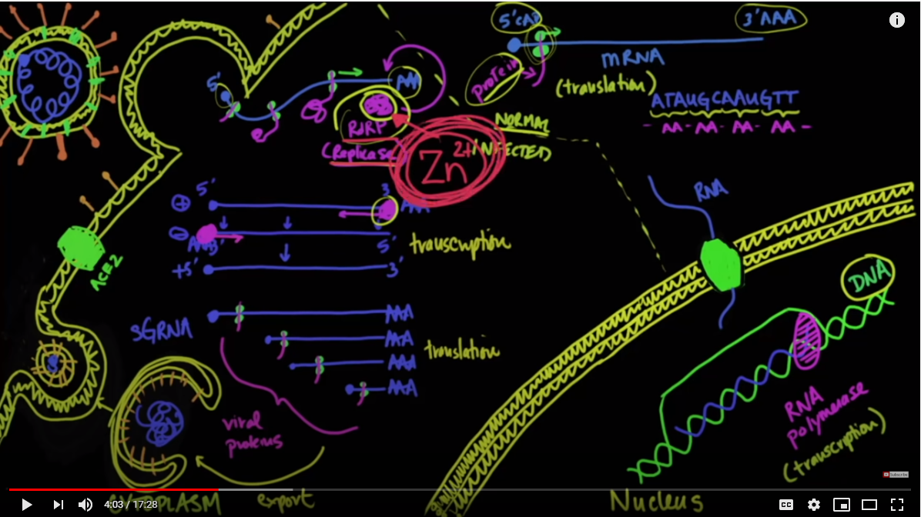
https://www.youtube.com/watch?v=U7F1cnWup9M&feature=youtu.be
MedCram and Dr. John Campbell; accessed 4/14/2020

Slide 20
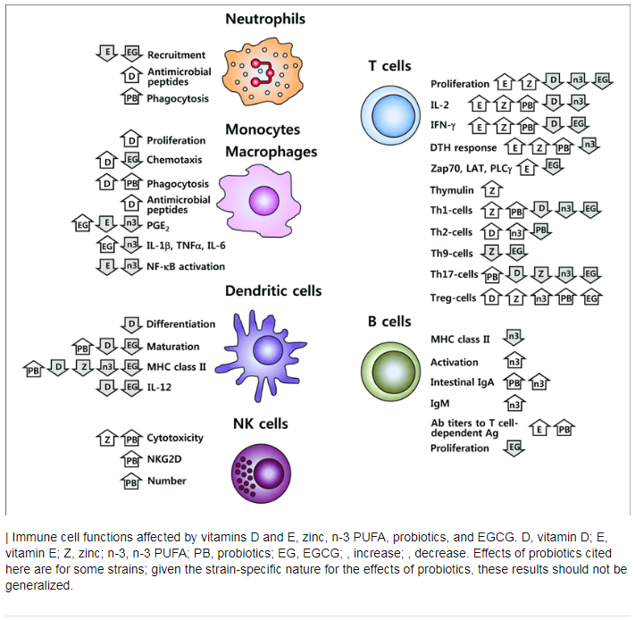
Frontiers in Immunology. January 2019 Article 3160 DOI: 10.3389/fimmu.2018.03160

Slide 21
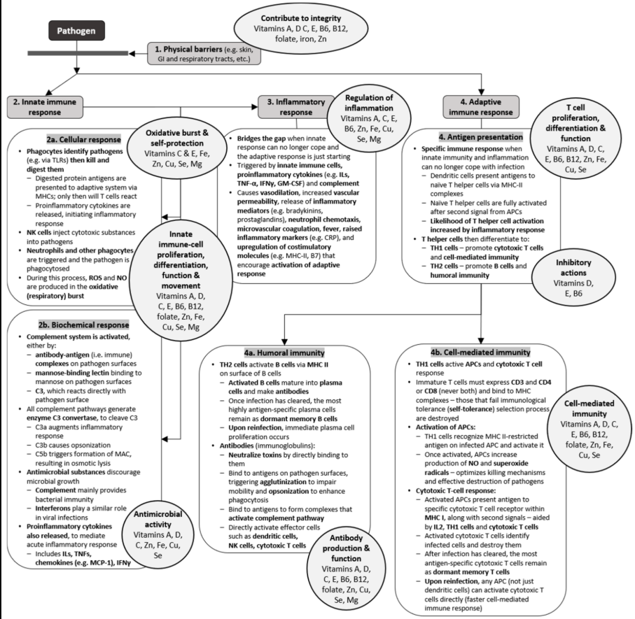
Nutrients 2020, 12, 236; doi:10.3390/nu12010236

Slide 22
SARS-CoV2 Virus Specific comments
Single strand RNA codes for ~16 proteins
Protein ORF3a, ORF9 and ORF10 (viroporins) create cell-free hemoglobin (CHF)
  Very toxic – increases ALT and AST
  SARS COV2 causes release of iron from heme ; ORF8 takes its place; also causes oxidation of Fe+2 to Fe+3; increases free iron and ferritin; high ferritin associated with acute kidney injury and increased creatinine
  CFH activates macrophages
  CFH also decrease nitric oxide in endothelial and immune cells, leading to impaired endothelial function and defense mechanism (NO contributes to oxidative burst by neutrophils); leading to less destruction of pathogens and decreased negative feedback look to decrease macrophage maturation (contributes to sustaining inflammation)

Slide 23
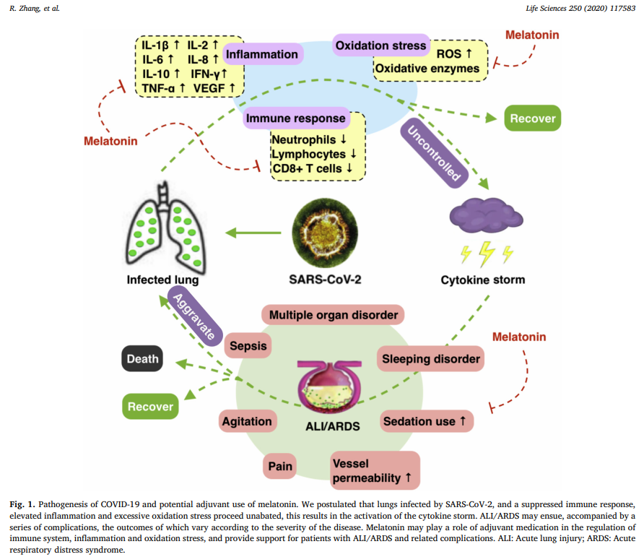

Slide 24
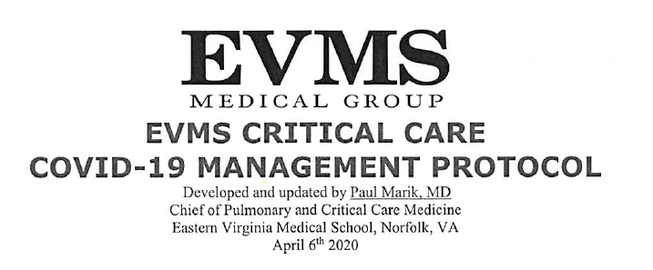
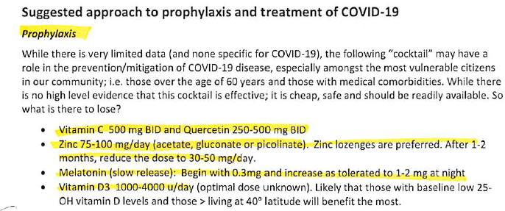
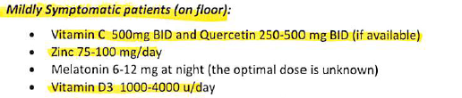
If high dose vitamin C need lab glucose as Accu-chek POC glucose monitor will be spuriously high

