Slide 1
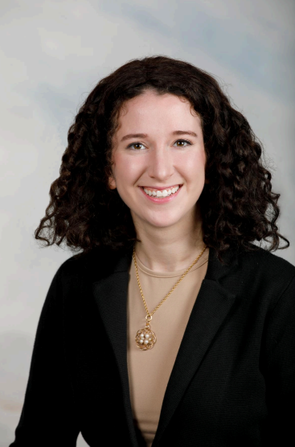
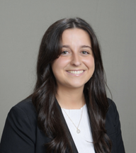
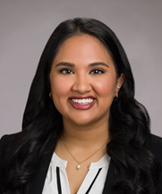
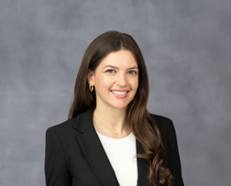
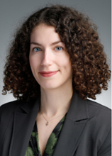
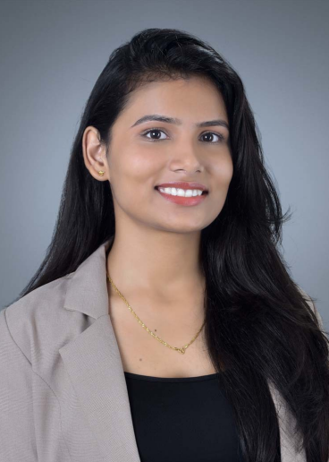
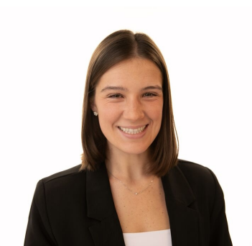
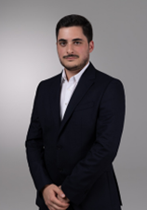
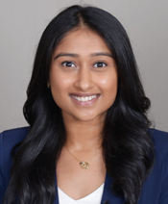
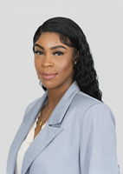
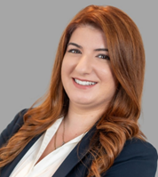
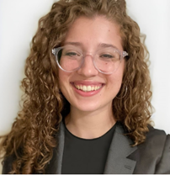
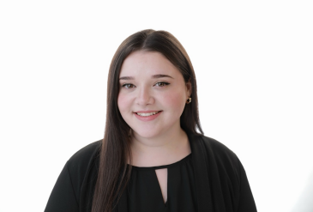
Peds PGY-1 Residents 2025-2026
Sophia Anfang, MD
Christina Carey, MD
Divya Dadi, MD
Kenza Fertitta, MD
Angeliki Gkaifyllia, MD
Ashwini Gupta, MBBS
Kaitlin Johnsen, DO
Otar Koniashvili, MD (CN)
Divya Kumar, DO
Olatunbosun Olakunri, DO
Sophia Prentzas, MD
Elizabeth Rose, DO
Suzanne Tawch, DO
PGY-1

Slide 2
Peds PGY-2 Residents 2025-2026
Marianna Catege, DO
Kimberly Drago, DO
Kathryn Fox, MD
Cannon Greco Hiranaka, MD
Michael Grzybek, MD
Ashley Jimenez Valentin,
MD (CN)
Christina Mazza, MD
Prachi Mohapatra, DO
Troy Moody, DO
Tanha Patel, MD
Sarah Rose, MD
Riya Shah, MD
Leah Shimunov, MD
PGY-2

Slide 3
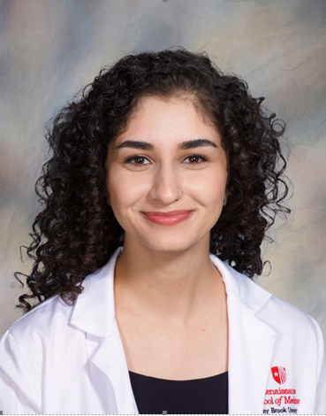
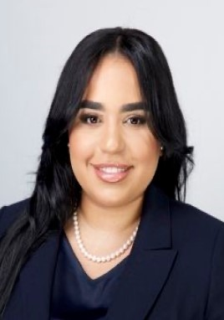
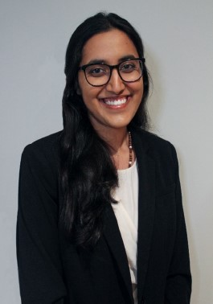
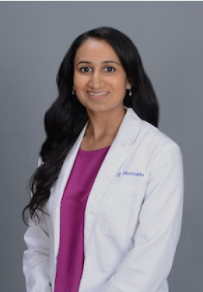
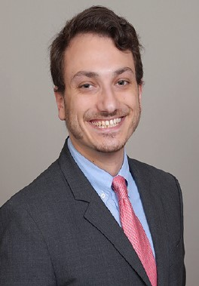
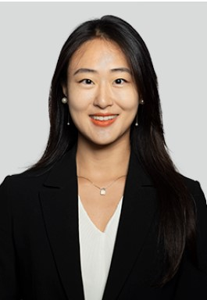
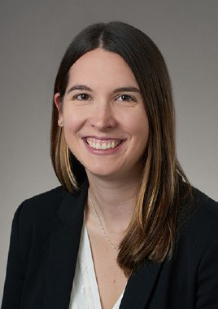
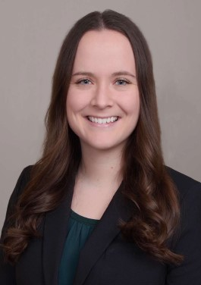
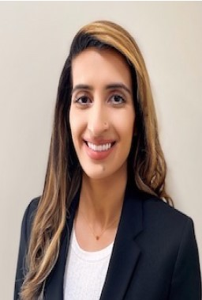
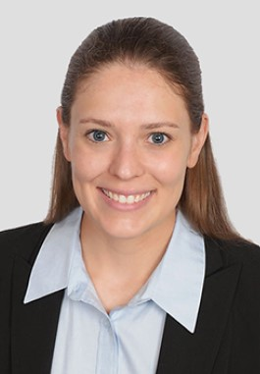
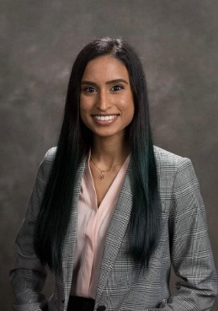
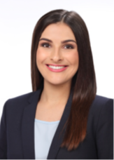


Pediatric PGY-3 Residents 2025-2026
Yasaman Badakhshi, MD
Jenelys Fernandez-Torres, MD
Vahnee Garimella, MD
Zeenat Hussain, DO
Harrison Kronfeld, DO
Rosen Jeong Ling, MD
Lauren Loy-Stranieri, MD
Kelcy Mclntyre, MD
2025-2026 Chief Residents
Rubab Mian, DO
Hayley Myles, DO
Leah Ramkelawan, DO
PGY-3

