Slide 1
Safety
Hazard Communication/Right-to-Know
for Medical Staff Office (MSO), Residents, Medical Students and Nursing Students
Environmental Health & Safety, 4-6783
https://ehs.stonybrook.edu/programs/healthcare-safety
November 2024

Slide 2
The Joint Commission
Environment of Care
(EOC)

Slide 3
Training Outline
  Environment of Care
  Occupational Injury & Illness Prevention
    Injury Reporting
    Latex Allergy
    Slips & Trips Prevention
    Ergonomics & Safe Patient Handling
    Respiratory Protection
    Contaminated Sharps Injury Prevention
    Radiation Safety and Laser Safety
  Hazard Communication/Right to Know
    Safety Data Sheets and Chemical Inventories
    Eyewashes/Safety Showers
    Chemical Spill Response
    Hazardous Drugs Safety
    High Level Disinfectants
    Formaldehyde (Formalin) Safety
    Waste Anesthetic Gases Safety
  Environmental Awareness & Hazardous Waste
  Transporting Infectious and Biological Specimens

Slide 4
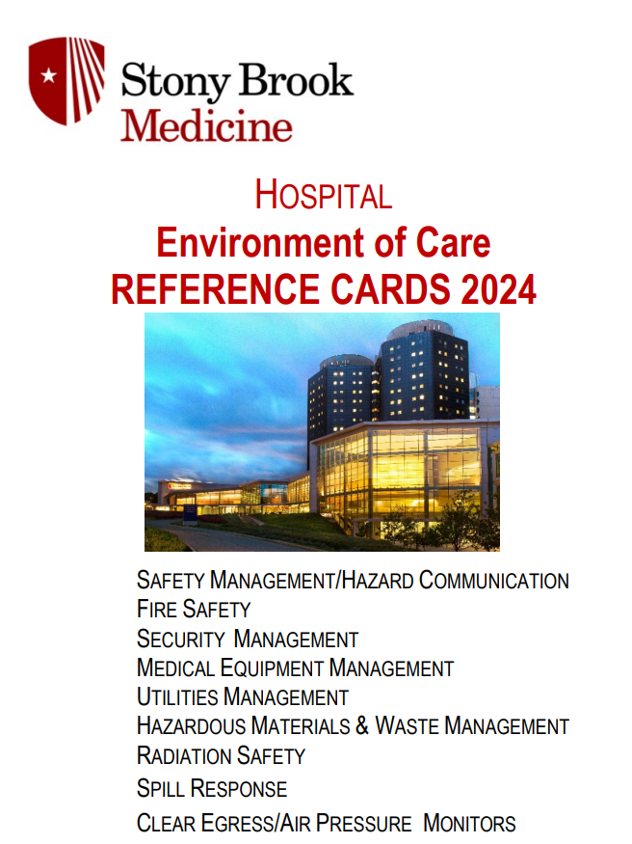
Environment of Care (EOC)
Reference Cards
Program highlights can be found on the Hospital Intranet:
  Resources A to Z →
  Manuals →
  EOC Reference Cards (Hospital)

Slide 5
Top Eight EOC Compliance Facts
Director of Healthcare Safety is: Barbara Boyle, Environmental Health & Safety HSC 01-059 (phone: 4-6783).
Chemical Inventories and Safety Data Sheets (SDS) are on the Hospital intranet (SDS Pro).
Emergencies and Major Chemical Spill Response: call University Police at 911 (or 631-632-3333 from cell phone). Off-sites call 911.
Know the locations of your department’s: Emergency Response Guide and Plan and Disaster Kit for power outages (flashlights, batteries, extension cord, duct tape, glow sticks).

Slide 6
5. Know fire response:
        procedures (RACE) Remove, Alarm, Confine, Evacuate/Extinguish
      how to use fire extinguisher (PASS) Pull, Aim, Squeeze, Sweep
      locations of nearest fire alarm pull stations and extinguishers
Know the process to shut off an oxygen supply valve.
Keep corridors clear of clutter and don’t block emergency equipment (e.g., eyewash, fire extinguisher, fire alarm pull station, oxygen supply valve, and electrical cabinets).
Report building issues:
Hospital: 4-2400 Off-site (Article 28): 4-4066 Tech Park: 4-4380

Slide 7
Occupational Injury and Illness Prevention Program
Program Elements
Communication Modes
Safety compliance component in all staff performance programs with annual review.
Recognize employees who promote a safe and healthy work environment -You Got Caught Being Safe program.
Compliance with safe work practices and procedures are enforced.
New employee orientation and annual training
Daily briefing huddles
Safety huddles
Posted and distributed safety information
Safety Committees

Slide 8



Report All Injuries
Injury/
Illness
Notify Supervisor and get medical attention
Complete Injury and Illness Report
Contact
NYS Accident Reporting System (ARS) 888-800-0029
Medical Attention:
Employee Health & Wellness (days) or Emergency Department
Keep
Time Keeping up to date on your status for lost time incidents.
Supervisors complete and submit the
Incident investigation report.
Workplace Violence – submit SB Safe report
Sharps – complete sharps log

Slide 9
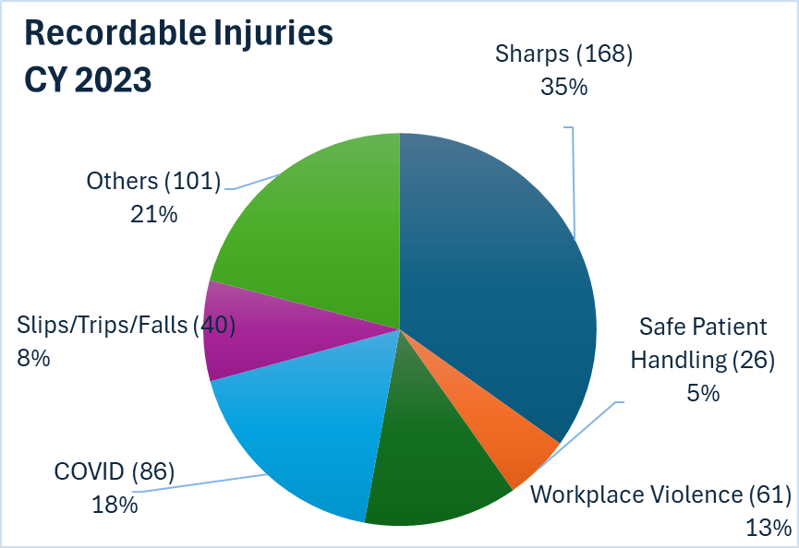
2023 Distribution of Reportable Injuries and Illnesses at SBM
Sharps 35%
Patient Handling 5%
Workplace Violence 13%
COVID* 18%
Slips/Trips 8%
Other 14%
*COVID Workplace Exposures
PESH/OSHA Reportable Injuries

Slide 10

Latex Allergy
If you know or suspect that you have
a latex allergy:
  notify your supervisor, and
  go to Employee Health & Wellness for evaluation.
Lawson requisitioned Store Room items are labeled as LATEX or NON-LATEX.

Slide 11
Prevent Slips & Trips-
Take Action and Report Unsafe Conditions
If you see a wet or slippery floor, immediately clean it up safely or report it to appropriate staff for clean up.
Wear appropriate footwear!

Slide 12
Ergonomics
How we move (or don’t move) and use our bodies can determine how healthy and comfortable we feel.
Move or change positions about every 30 minutes
Stand up when talking on the phone or when reading documents when possible
To avoid eye strain, practice the 20/20/20 rule: every 20 minutes, focus on something 20 feet away for 20 seconds.

Slide 13

To request ergonomics assistance, including a workstation evaluation, contact EH&S at 4-6783
Report potential injuries.

Slide 14

Office Stretches

Slide 15


Slide 16

Safe Patient Handling
What is Safe Patient Handling?
A practice that creates a safe work environment for patients and healthcare workers by eliminating hazardous manual lifting tasks through the implementation of new technologies, such as mechanical lifts and repositioning devices.
NYS Regulation on
Safe Patient Handling
Active SPH Committee
For more information, go to Resources A to Z on the hospital intranet and select Safe Patient Handling
  –Educational Materials
  –Algorithms
  –Equipment Inventory
  –Standards & Policies

Slide 17
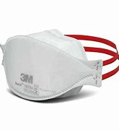
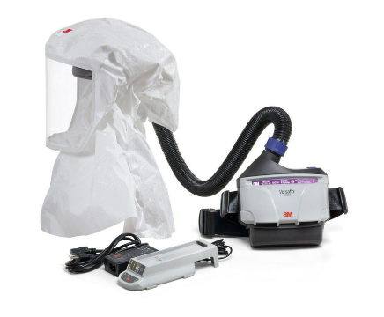
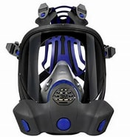
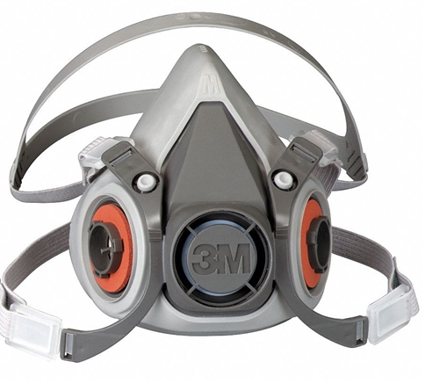
Respirators
You need to correctly use
the correctly chosen and correctly fitted
respirator to protect yourself.
Respirators are only used when other controls can not keep you safe.

Slide 18
Respirator Basics
Prior to being issued a respirator, you must be
medically cleared by Employee Health & Wellness,
trained, and
fit tested to identify the brand and size that fits your face.
Only wear the brand, model, and size for which you were successfully fit tested.
Anyone with interfering facial hair cannot use a close-fitting respirator (e.g., a filtering facepiece N95) because the hair prevents a good seal.
Keep fit test card with respirator info in your ID badge.
Get refitted if you gain or lose 20 lbs or change your facial contours.

Slide 19
N95 Basics
Prior to each use: inspect your N95 respirator and review fitting instructions. Mold metal nosepiece to nose, if present. Ensure straps are not twisted or crisscrossed. Conduct User Seal Check.
Before entering room/area that requires a respirator, put on your respirator in the corridor or anteroom (not in the patient room).
Discard N95 respirator when wet (not from perspiration), soiled or damaged. Review Covid-19 reuse and extended use policies.

Slide 20
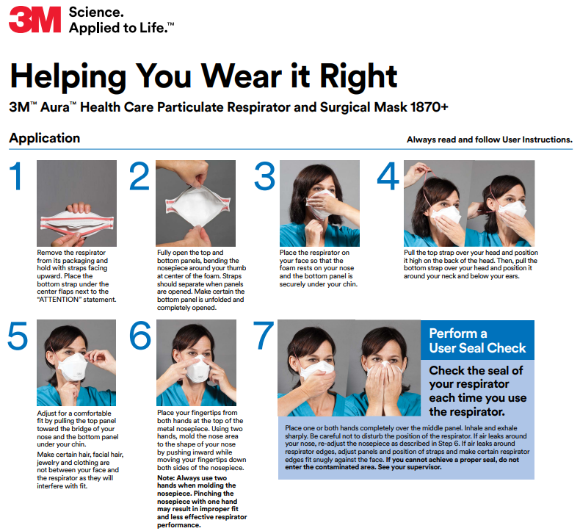
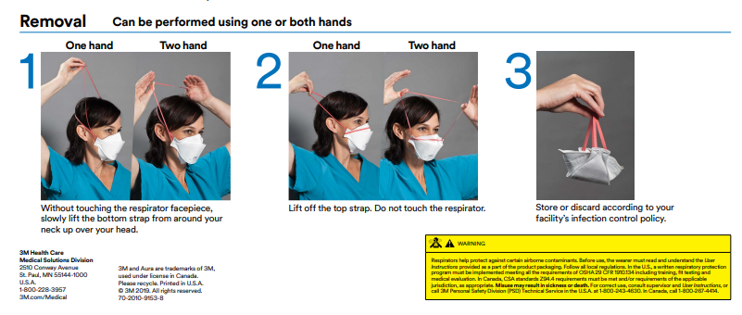
Respirator On and Respirator Off
3m-wear-it-right-aura-particulate-resp-english-poster.pdf

Slide 21
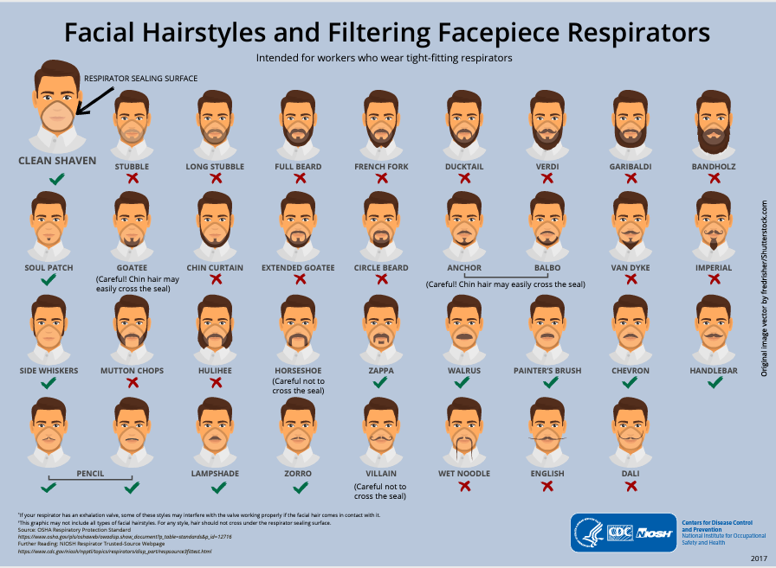

Slide 22
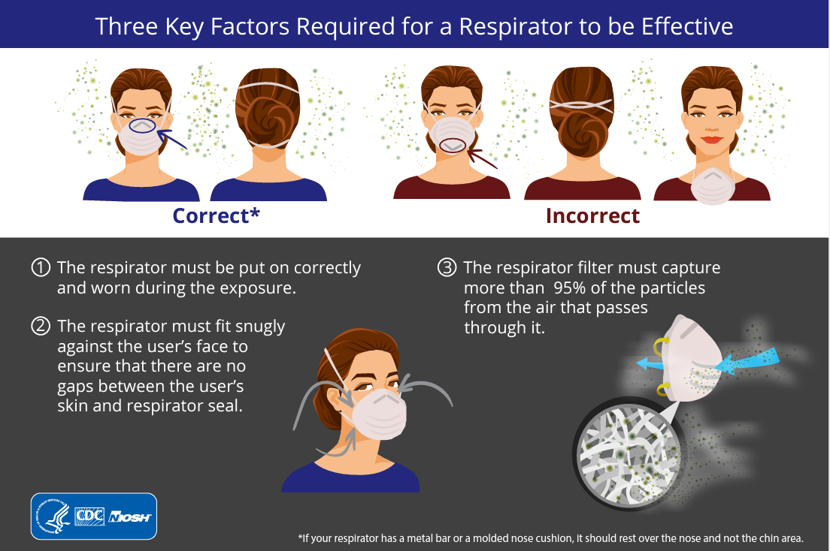

Slide 23
Power Air Purifying Respirator (PAPR)
Anyone with interfering facial hair cannot wear a filtering facepiece N95 respirator because the hair prevents an acceptable face seal. Note: Hooded PAPRs do not require fit testing since they are used in positive pressure mode.
Powered Air Purifying Respirators (PAPR) are available from EH&S for:
        Staff with beard for religious or medical reasons (with approval), staff unable to fit with any N95, or to minimize N95 usage during aerosol generating procedures.

Slide 24
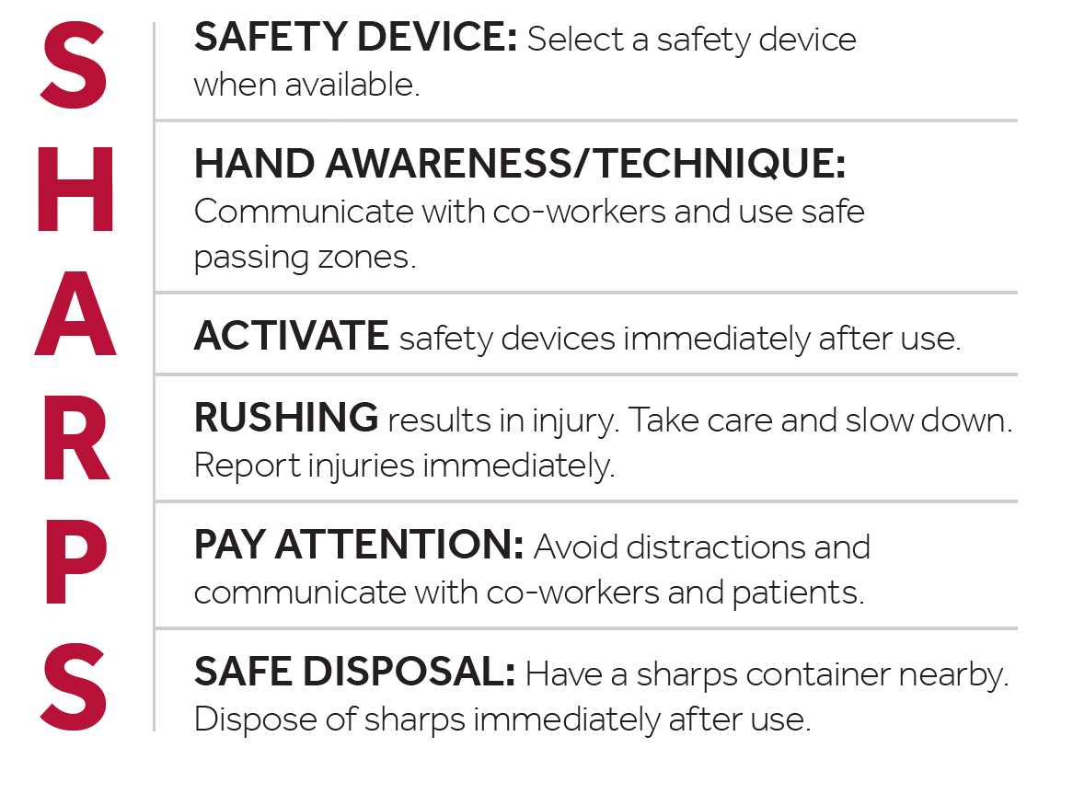
Reducing Sharps Injuries
Safe Handling Alleviates Risk and Prevents Sharps Injury

Slide 25
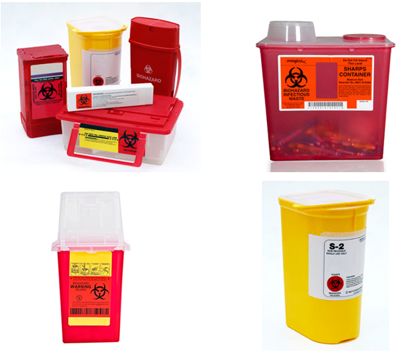
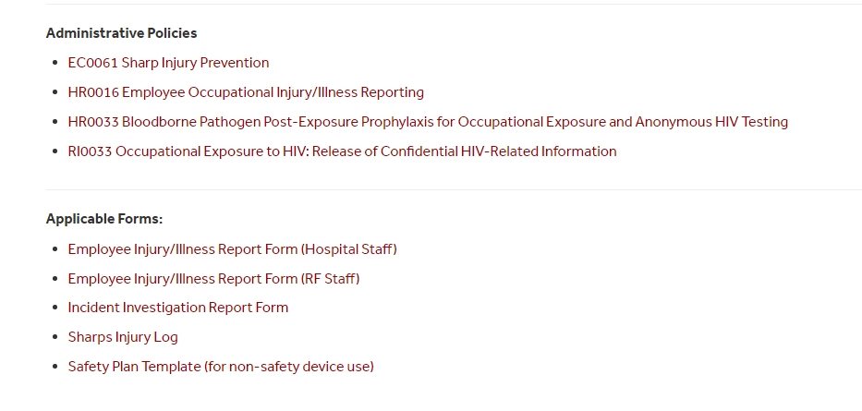

Immediately discard used sharp in sharps disposal container to avoid injuring coworkers.
When a sharps containers is ¾ full,
contact Housekeeping at 4-1455.
Off-sites: contact Off-site EOC Coordinator, 4-4066

Slide 26
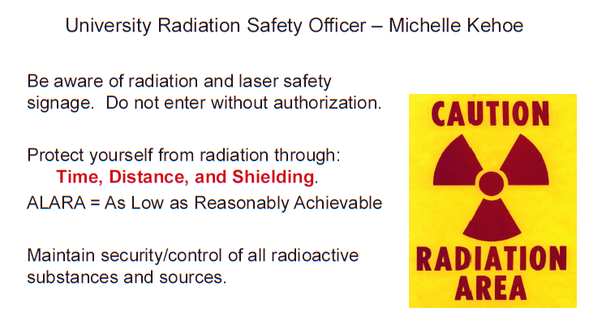

Radiation Safety
University Hospital Radiation Safety Officer – Michelle Kehoe

Slide 27
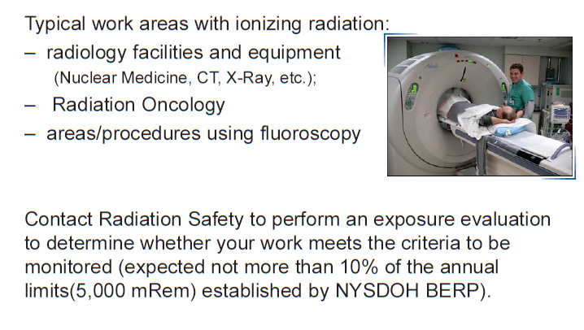
Radiation Safety
Hospital Radiation Safety 631-638-2356

Slide 28
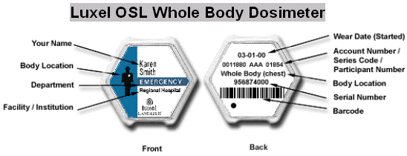
Radiation Safety
Dosimeter Reminders:
Wear your issued dosimeter whenever working in the vicinity of radiation.
Wear your badge according to the type issued.
Ensure timely exchange of badges at each new cycle with department dosimeter coordinator.
  Monthly dosimeters on the 1st of each month.
  Quarterly dosimeters at the 1st each calendar quarter (January, April, July and October)
Chest Dosimeter:
When worn without protective lead garment: wear between shoulders and waist.
When worn with protective lead garment: wear OUTSIDE the lead garment between shoulders and waist.
Collar Dosimeter: wear on outside of lead thyroid shield.
Extremity or Ring Dosimeter: Worn with your name facing the source of radiation.

Slide 29

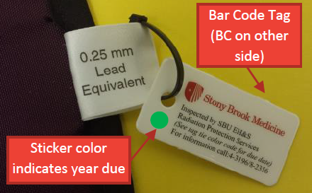
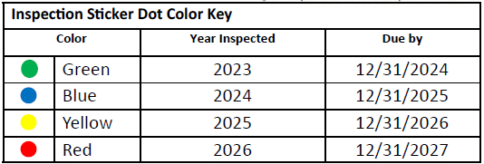
Radiation Safety
Before each use, inspect lead aprons/shields for damage and ensure the PPE is tagged indicating a current annual inspection by radiation safety.
  If PPE damaged, do not use and contact radiation safety.
If a radioactive spill occurs, follow emergency procedures posted in your area.
Questions?
Contact Radiation Safety:
    Hospital Radiation Safety: 631-638-2356
    Anthony.Boccia@stonybrookmedicine.edu

Slide 30
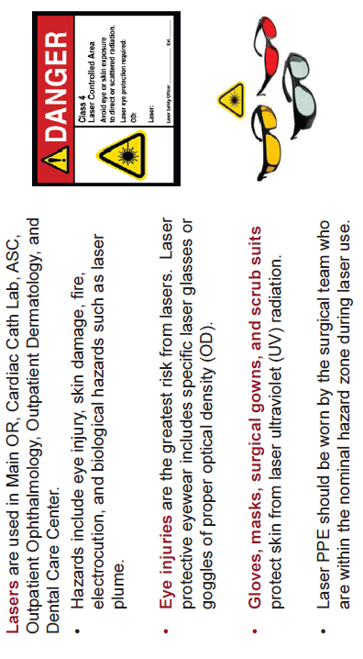
Laser Safety
Hospital Laser Safety Officer 631-444-3196

Slide 31
OSHA Hazard Communication Standard
NYS Right-to-Know Law (PESH)
Occupational Safety & Health Administration (OSHA) → private sector employees
Public Employees Safety & Health Bureau (PESH) → public (state & local) employees

Slide 32
Right-to-Know Law guarantees employees the right to information, training and education regarding toxic substances in the workplace.
Employees have access to:
  ▪Safety Data Sheets of hazardous chemicals used
  ▪Guidelines for proper container labeling
  ▪Information on what protective measures are available to prevent exposure or injuries

Slide 33
Labor Law Information Relating to Public Employees

Slide 34
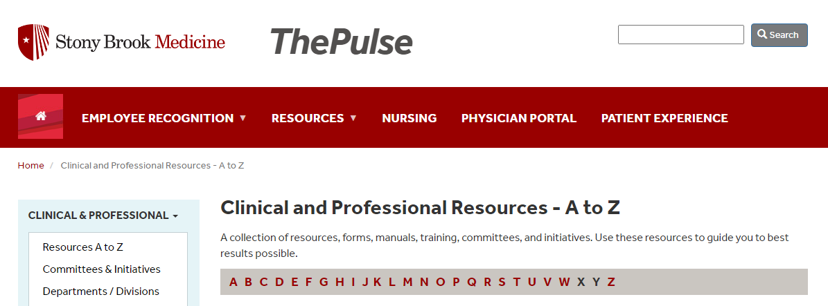
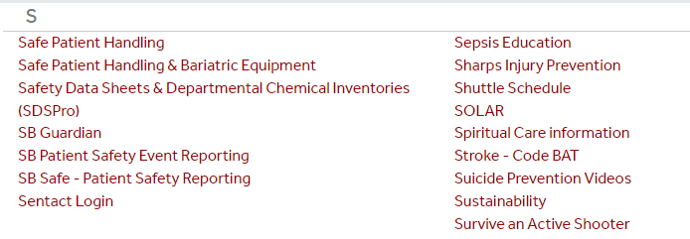

Slide 35

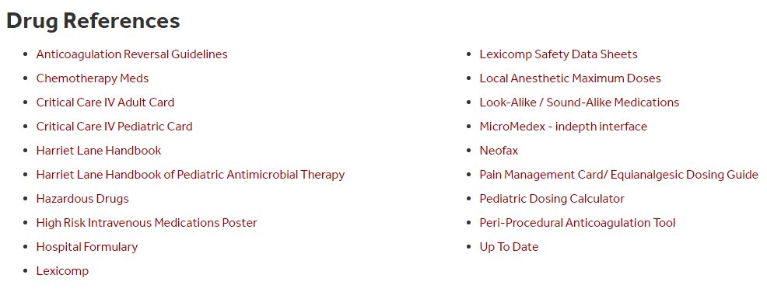
Accessing Pharmaceutical SDS
On the Hospital Intranet page, scroll down to Resources.
Select drop down for Drug References
and select MicroMedex
Type in the name of the drug in the search field and click “Search”
Select "Toxicology,”
under Related Results
Select MSDS.
OR select Lexicomp

Slide 36
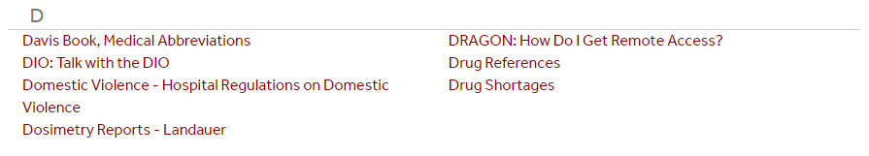
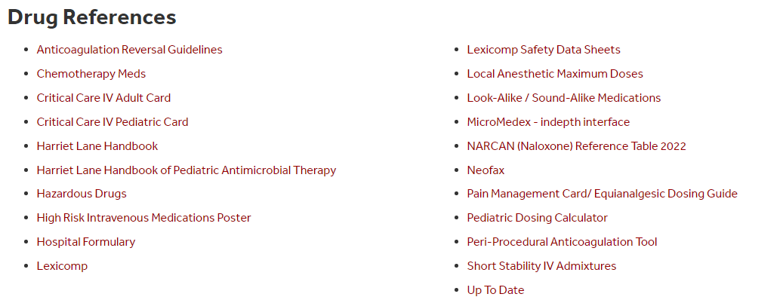

Slide 37
Chemical Safety
Before you handle a new chemical, READ THE LABEL
Follow product instructions.
Look for additional info on a Safety Data Sheet.
YOU HAVE THE RIGHT TO KNOW ABOUT
HAZARDOUS CHEMICALS AT WORK

Slide 38
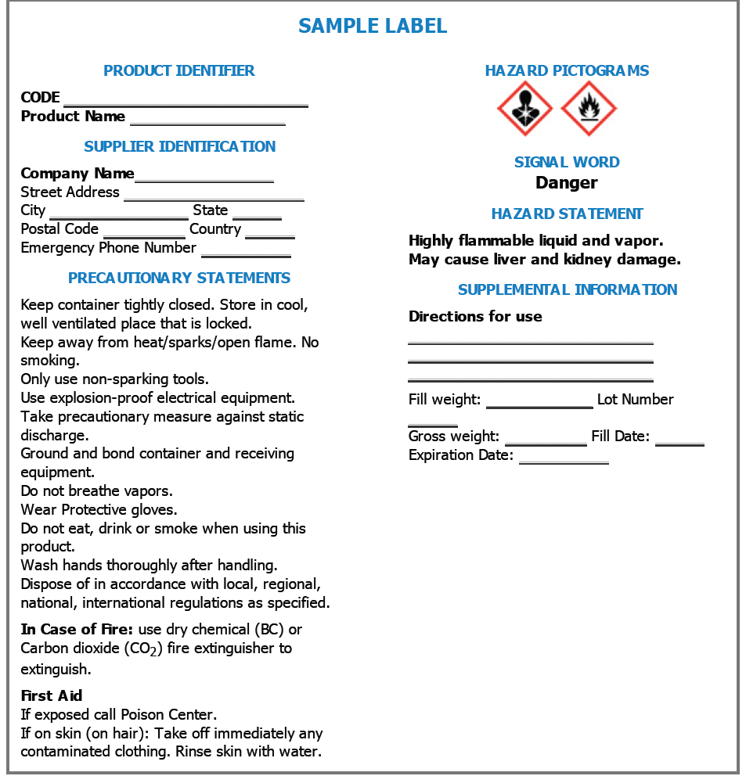
Label format
Info on
Hazard
Storage
PPE
handling
first aid

Slide 39
Importance of a SDS
IMPORTANT INFO on SDS
Hazards
How to protect yourself from injury or illness
  Exposure controls
  Safe work practices
  PPE to wear
3. What to do if a spill occurs
What to do if you or a co-worker are exposed
  First aid
  Emergency response
Environmental & disposal information

Slide 40
Standardized SDS Format
  Identification
  Hazards Identification
  Composition/Ingredients
  First Aid Measures
  Fire Fighting Measures
  Accidental Release Measures
  Handling & Storage
  Exposure Controls & Personal Protection
  9. Physical & Chemical Properties
  10. Stability & Reactivity
  11. Toxicological Info
  12. Ecological Info
  13. Disposal Info
  14. Transport Info
  15. Regulatory Info
  16. Other Info

Slide 41
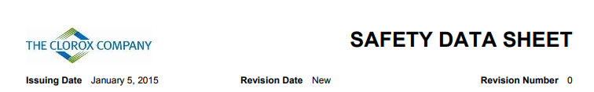
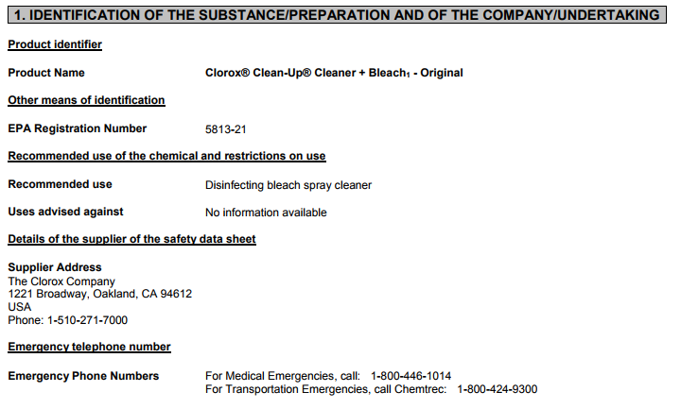
Safety Data Sheet:
Household Cleaner: Clorox Clean-Up
Go to SDS database
Product
identifier
In case of an emergency

Slide 42
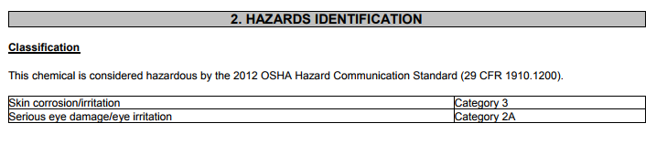
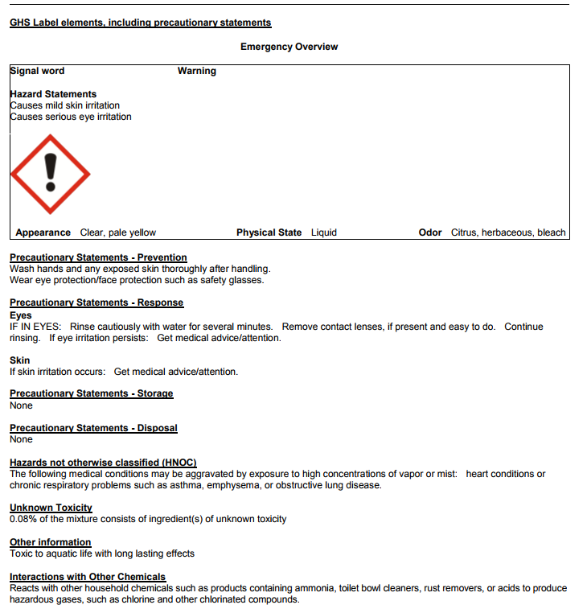
Safety Data Sheet:
Clorox Clean-Up
Signal Word
  SIGNAL WORD:
  Indicates severity of hazard and alerts reader to a hazard
      Danger – more severe
      Warning – less severe

Slide 43
Safety Data Sheet:
Let’s Review: Household Cleaner: Clorox Clean-Up
IRRITANT
Hazard Pictogram
  HAZARD STATEMENTS
  Nature and degree of hazard
    Example: “Causes mild skin irritation. Causes serious eye irritation”
  All hazard statements must be on label & SDS.

Slide 44
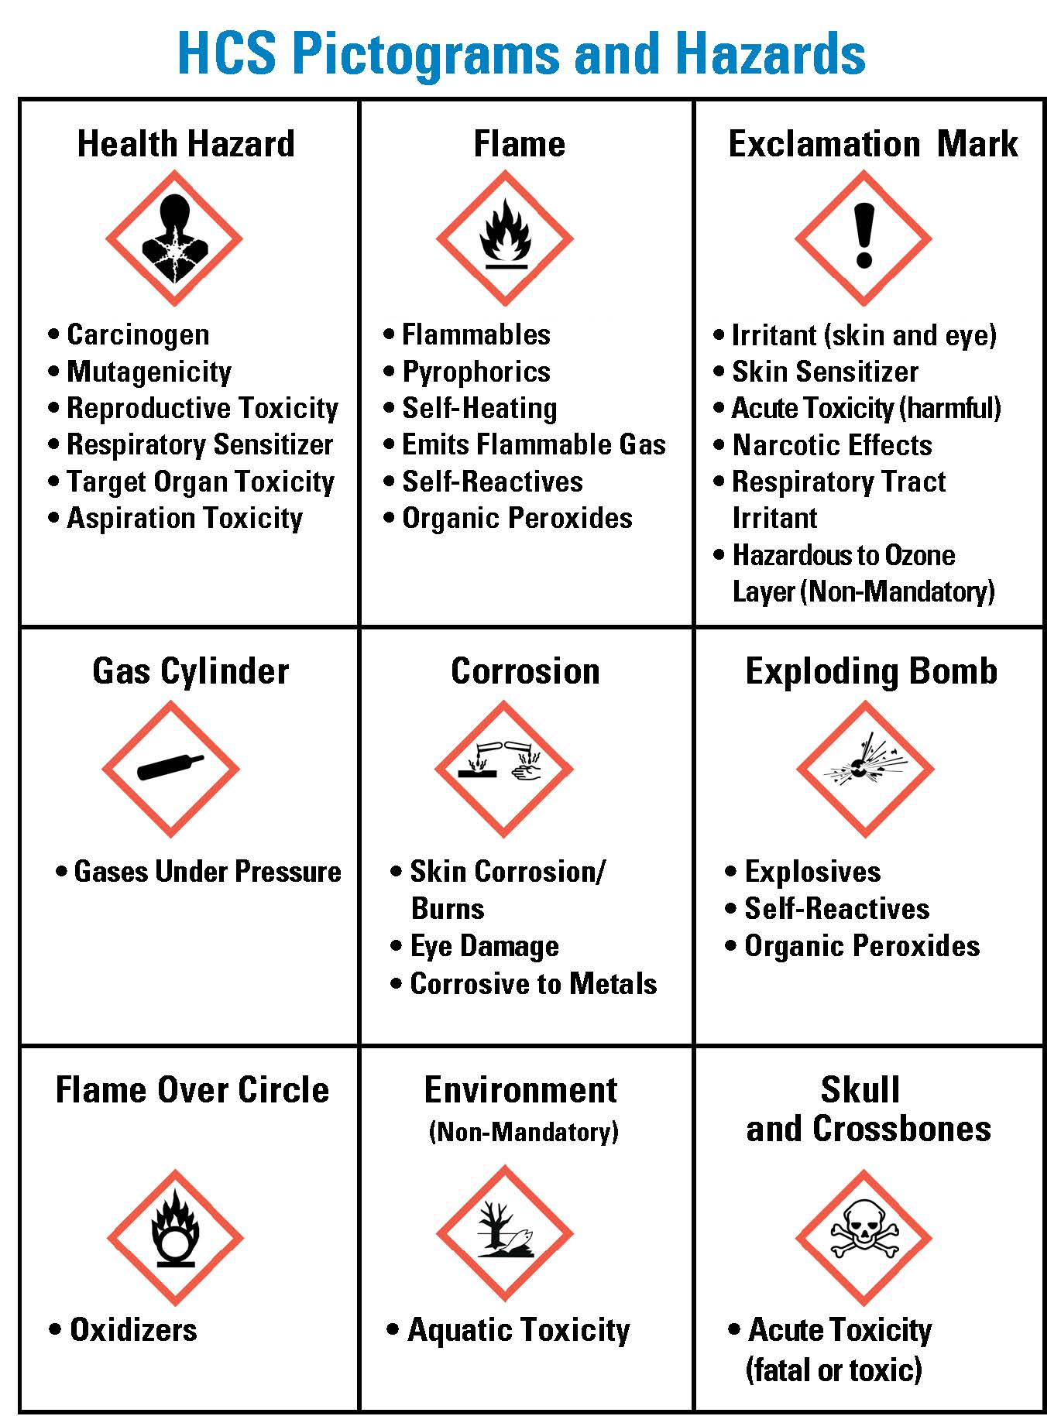
Pictograms and Hazard Classes on Labels and Safety Data Sheets
Oxidizer: make other chemicals less stable
Toxic Substances: poisonous
Carcinogenic: cause cancer
Mutagens: change genetic info
Teratogens: cause birth defects
Self Reactives: Chemically unstable
Corrosives: destroy living tissue
Irritants: inflame tissue on contact
Sensitizers: cause allergic reactions
Notes:
Flaming ball, Flames, Explosion, Skull/Cross Bones, Spill on Hand, Gas cylinder, Human, Tree/fish, Exclamation Point

Slide 45
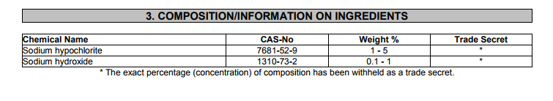
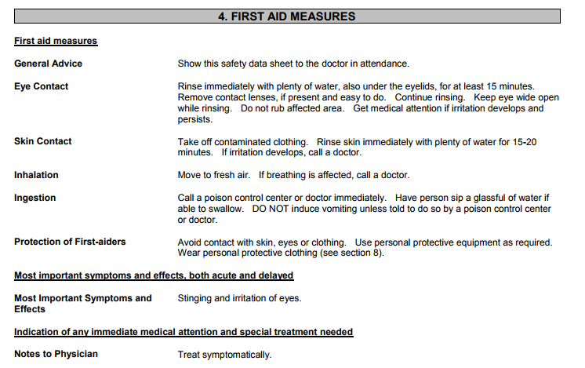
Safety Data Sheet:
Clorox Clean-Up
3. Components
4. First Aid

Slide 46
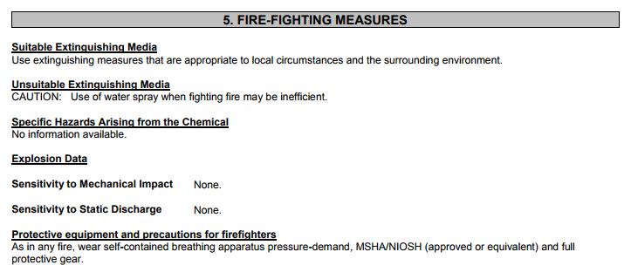
Safety Data Sheet:
Clorox Clean-Up
5. Fire Fighting Measures

Slide 47
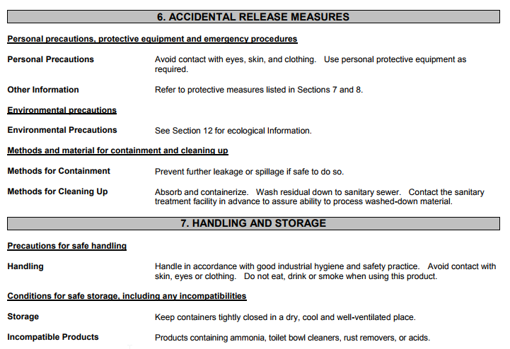
Safety Data Sheet:
Clorox Clean-Up
6. Accidental Release Measures
7. Handling & Storage

Slide 48
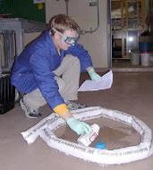

Chemical Spill Response
Minor spills
less than or equal to 1 gallon (or <50 ml hazardous drugs)
Cleaned up by trained staff using a spill kit.
Major spills = over 1 gallon (>50 ml hazardous drugs)
Call University Police at 911 (cell: 631-632-3333).
If at any time during clean up of a minor spill, you need assistance, call 911 (631-632-3333).

Slide 49
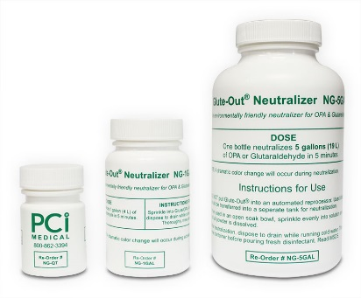
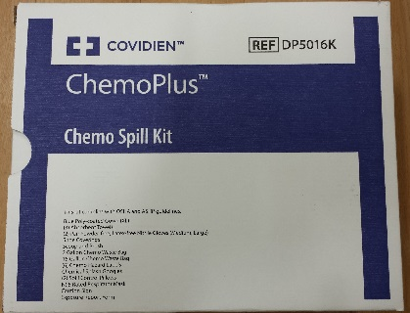
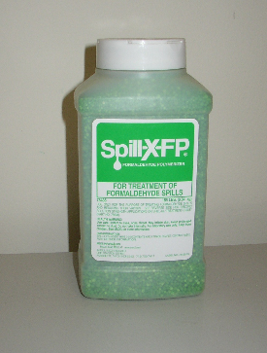
Spill Kits for Minor
Chemical Spills
Glutaraldehyde/OPA Spill Kits
GUS stations and areas where glutaraldehyde/Cidex OPA used
Chemotherapy Spill Kits
areas where chemotherapy prepared and/or administered
Formalin Spill Kits
labs and areas using formalin
Acid Spill Kits
powered industrial truck charging areas and other non-alkaline battery areas.
Only trained staff can use a minor spill kit. Unit Educators train clinical staff annually on applicable spill kits. Lab staff are trained annually during Lab Recertification.
Off-site staff are trained by the off-site EOC Coordinator.
Notes:
Glutaraldehyde User Stations (GUS)

Slide 50
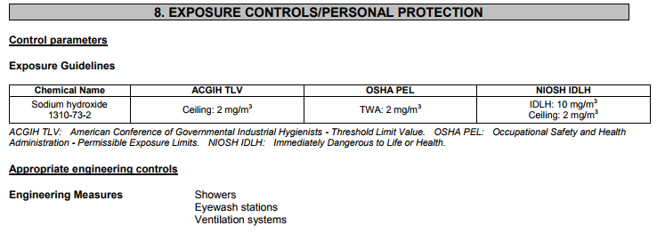
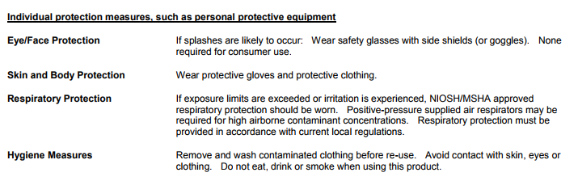
Safety Data Sheet:
Clorox Clean-Up
8. Exposure Control & Personal Protective Equipment

Slide 51
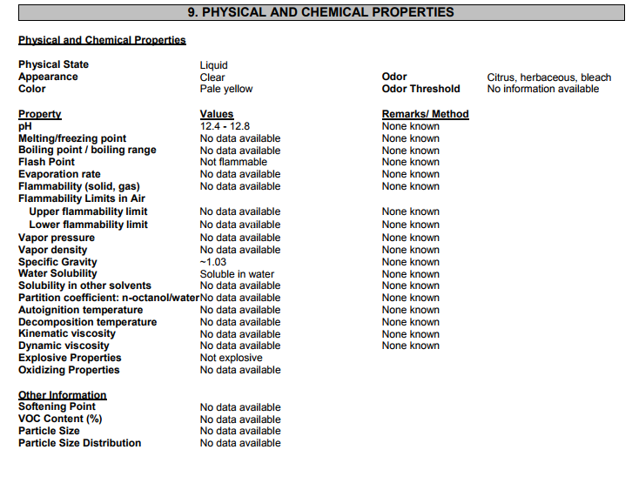
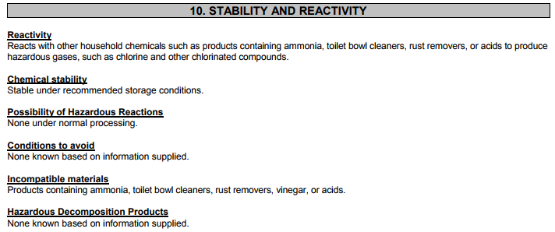
Safety Data Sheet:
Clorox Clean-Up
Physical/Chemical Properties
Stability & Reactivity

Slide 52
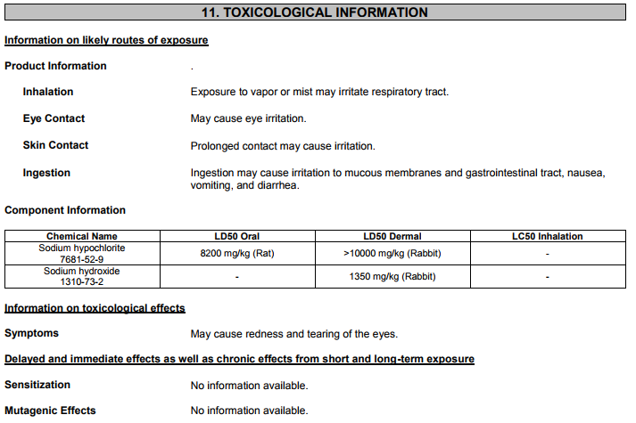
Safety Data Sheet:
Clorox Clean-Up
11. Toxicological Info

Slide 53
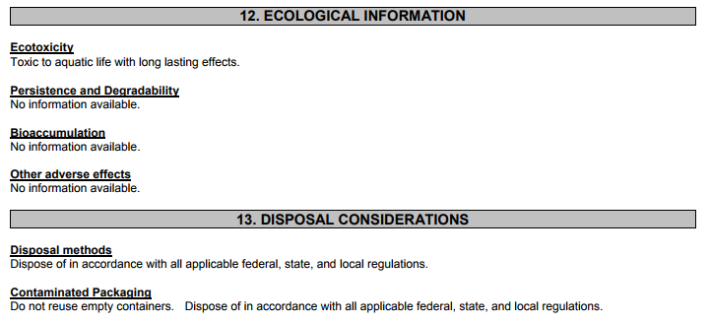

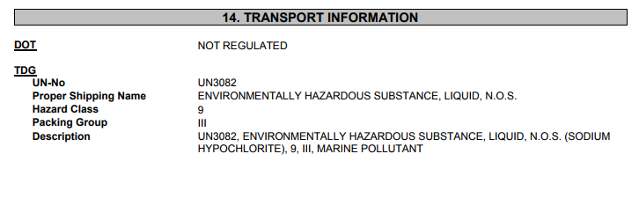
Safety Data Sheet:
Clorox Clean-Up
12. Ecological Info
13. Disposal Considerations
14. Transport Info

Slide 54
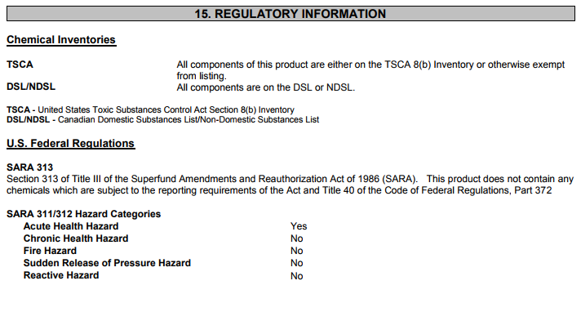
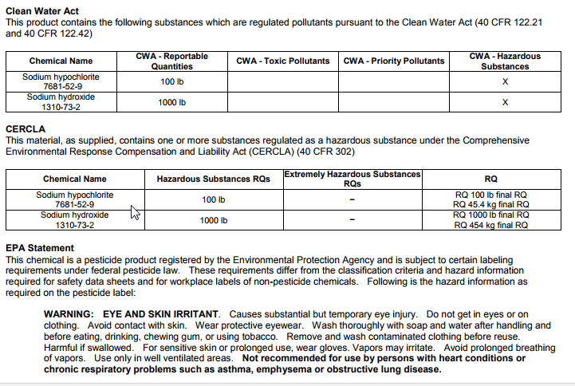
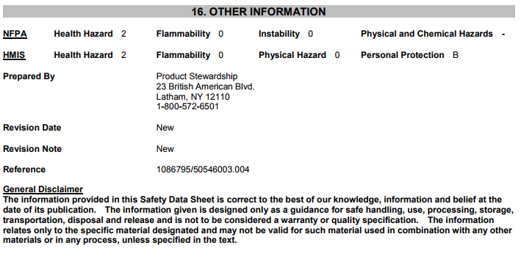
Safety Data Sheet:
Clorox Clean-Up
15. Regulatory Info
16. Other Info

Slide 55

Routes of Entry
Chemicals can only hurt you if they come onto contact with your body, through a route of entry:
Inhalation
Ingestion
Injection
Skin and eye contact/absorption
Work Practices and Personal Protective Equipment (PPE) try to block those routes to keep you safe.

Slide 56
SDS Terms
Danger is more serious than Warning.
Groups of chemicals can interact to cause greater harm (synergistic), added harm (additive), or less harm (antagonistic).
Chemicals which are health hazards are those which are potential cancer producers, toxic or highly toxic agent, reproductive toxins, irritants, corrosives, sensitizers, chemicals which damage the liver, kidneys, nervous system, blood, lungs, skin, and eyes or mucous membranes.
Chemicals which are physical hazards are combustible liquids, compressed gases, explosives, flammables, organic peroxides, oxidizers, pyrophoric materials, and unstable or water reactive materials.

Slide 57
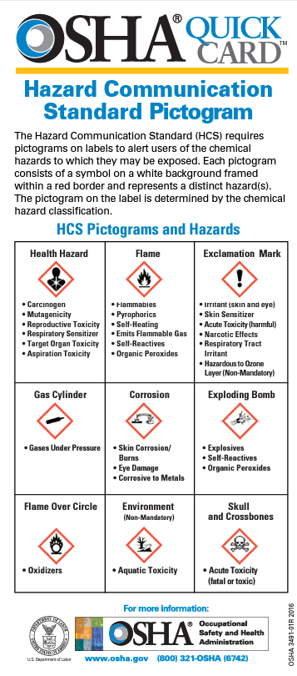
OSHA uses standard pictures to let you know about hazards.
Oxidizer: make other chemicals less stable
Toxic Substances: poisonous
Self Reactives: chemically unstable
Sensitizers: cause allergic reactions
Carcinogenic: cause cancer
Mutagens: change genetic info Teratogens: cause birth defects
Corrosives: destroy living tissue Irritants: inflame tissue on contact

Slide 58
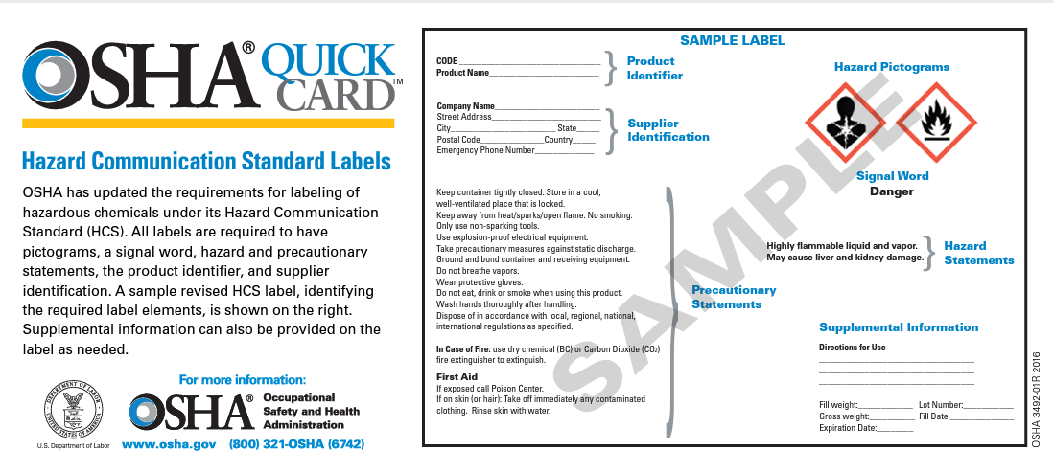
Labels provide important safety info.

Slide 59


Safety Data Sheets provide more detailed information.
SDSs are available from:
SDS Pro
Your supervisor
EH&S

Slide 60




Emergency Equipment – Eyewashes & Safety Showers
Know locations of eyewashes and emergency showers in your area.
Never block eyewashes or showers!
Know how to use equipment.
  Eyewash activation depends on style:
    push paddle or pin
    lift cover
    swing down
    swing over sink
  Keep dust caps on eyewash when not in use. (Note: you don’t need to remove caps before activation.)
  Flush eyes for at least 15 minutes.
  For shower, pull chain
Practice activating eyewash.
User area must test eyewashes weekly (run water for 1 minute) and complete eyewash log.
For operational issues (i.e., flow or temperature), contact Plant Operations at 4-2400. (Note: Off sites call 4-4066)
Refer to Admin policy, EC0039, Emergency Safety Showers & Eyewashes.

Slide 61

Chemical Spill Response
Minor spills = less than or equal to 1 gallon (or <50 ml hazardous drugs) → Cleaned up by trained staff using a spill kit.
Major spills = over 1 gallon (>50 ml haz drugs) → Call University Police at 911 (or 631-632-3333).
Clean up minor spills only if you have been trained and are using the correct spill kit. Areas must keep their spill kits well stocked and clearly labeled. Follow the instructions to respond safely and manage wastes!!

Slide 62
Hazardous Drugs/Chemo
Patient Treatment and Therapy
Locations: Pharmacy, BMT and Oncology, OR, Radiation Oncology, Peds, MART Cancer Center
Routes of entry: Inhalation, dermal, ingestion, injection
Health Hazards: Reproductive hazards (genotoxicity, teratogen, fertility), carcinogen, organ toxicity
Controls: policies/SOPs, closed system drug transfer devices (CSTD), PPE (i.e., double gloved nitrile gloves, chemotherapy gown), local ventilation, spill kits
Note: Safety Data Sheets (SDS) for medications are available on Hospital Intranet under Resources>Drug References>MicroMedex or Lexicomp

Slide 63
Hazardous Drugs
Look for “HD Precautions” sign on in-patient room doors
Wear appropriate PPE
Anticipation of hand exposure –wear double nitrile gloves, change out after 30 minutes.
For chemo and for anticipation of body splash –wear chemo gown
        Avoid crushing or cutting HD tablets
Hazardous Drug -as defined by NIOSH (National Institute of Occupational Health & Safety), any drug identified by at least 1 of the following 6 criteria: carcinogenicity, teratogenicity or other developmental toxicity, reproductive toxicity in humans, organ toxicity at low doses in humans or animals, genotoxicity, or new drugs that mimic existing HDs in structure or toxicity. Include drugs for cancer chemotherapy, antiviral drugs, hormones, some bioengineered drugs and other miscellaneous drugs and are identified on NIOSH’s List of Antineoplastic and Other Hazardous Drugs in Healthcare Settings.

Slide 64
Spill Kits for Minor Chemical Spills
Glutaraldehyde/OPA Spill Kits
GUS stations and areas where glutaraldehyde/Cidex OPA used
Chemotherapy Spill Kits
areas where chemotherapy prepared and/or administered
Formalin Spill Kits
labs and areas using formalin
Acid Spill Kits
powered industrial truck charging areas and other non-alkaline battery areas.
Only trained staff can use a minor spill kit. Unit Educators train clinical staff annually on applicable spill kits. Lab staff are trained annually during Lab Recertification.
Off-site staff are trained by the off-site EOC Coordinator.
Notes:
Glutaraldehyde User Stations (GUS)

Slide 65


High-level Disinfectants & Sterilants
These units are used for high level disinfecting or sterilizing of medical equipment. All units are automated, closed systems which greatly reduce risk of exposure when you follow SOPs!
Medivators Endoscope Reprocessors (22% hydrogen peroxide HP & 5% peracetic acid) Endoscopy & CSS | Trophon EPR (35% HP) L&D, Ultrasound, ACP Imaging, MART Oncology, Urology/ObGyn/Hampton Bays clinics | Sterrad 100S/NX/100NX (50-70% HP) CSS

Slide 66

High–level Disinfectants
Gluteraldehyde and OPA
Locations: ACP Endoscopy (GUS-OPA), Operating Room and Non-Invasive Cardiology (TEE Probe Disinfector-glutaraldehyde)
Route of Entry: Inhalation or skin
Health Hazard: respiratory, eye, and skin irritant
Controls: Local ventilation, keep containers closed, PPE

Slide 67

Formaldehyde/Formalin
Specimen preservative
Locations: Labs, Radiology, Endoscopy, OR offsites,
Cancer Center, Breast Center, Ambulatory Surgery
Routes of entry: inhalation, skin
Health Hazards: carcinogen, ENT irritant, skin irritant
Controls:
•Use in chemical fume hood where feasible
•Minimize time containers are open
•Avoid spills, trained staff clean up spills immediately
•Wear PPE (e.g., nitrile gloves and gown/lab coat)
Label original and secondary containers!

Slide 68
Waste Anesthetic Gases
Examples: nitrous oxide and halogenated anesthetics (e.g., sevoflurane, isoflurane, desflurane).
Locations: Operating Rooms, Radiology, PACU & Procedural Areas
Route of entry: Inhalation
Health Hazards: nausea, dizziness, headaches, fatigue, and irritability, as well as sterility, miscarriages, birth defects, cancer, and liver and kidney disease
Controls:
Proper equipment maintenance
Tight gas-line connections
Use anesthesia delivery unit’s gas scavenging per manufacturer’s instructions
Use pliable face masks in various sizes that can provide effective seal to prevent leakage
Position mask on patient’s face properly.

Slide 69
Sustainability
Commitment to minimize climate impacts
Sustainability Committee
Member of Practice Greenhealth (PGH)
Organizational Environmental Pledges
Recent Recognition: PGH Environmental Excellence, PGH Top 25 Environmental Excellence, PGH Emerald Award, PGH Greening the OR Award
Initiatives –Engaged Leadership, Less Waste, Safer Chemicals, Greening the OR, Healthy Food, Environmentally Preferable Purchasing, Energy/Water Conservation, and Green Buildings
Go to hospital intranet Resources A-Z and select Sustainability

Slide 70



Environmental Awareness
Hazardous and Universal Waste
What happens to waste that is poured down the drain?
It goes to the Sewage Treatment Plant at the University and then into the Long Island Sound.
Sewage Treatment Plant at the University
Long Island Sound
Port Jefferson, NY
Do not put any hazardous waste down the drain.
Follow Hazardous Waste disposal procedures.

Slide 71



Hazardous and Universal Waste
How do I know if I have to manage a chemical as a hazardous or universal waste?
Most hazardous wastes & universal wastes have already been identified and are being collected.
  e.g., medications, paints, solvents and other lab chemicals
Review the Waste Determination
  Located in Safety Data Sheet database (SDSPro) on Hospital Intranet.
  For waste effluent from lab equipment or processes that contain multiple chemicals/products, EH&S maintains waste determinations.
  Any questions, contact EH&S at 4-6783.

Slide 72

What is a Hazardous Waste?
Hazardous and Universal Waste
A waste that exhibits one of the following characteristics:
  Harmful or fatal when ingested or absorbed (Toxicity)
  Unstable under normal conditions (Reactivity)
  Flashpoint <60ºC (140ºF) (Ignitability)
  pH <2 or >12.5 (Corrosivity)
Or is listed in the applicable NYS regulations (6 NYCRR Part 371)

Slide 73

Use the right waste container
Pharmacy Return Box –Unused drugs | Locked Container w/ fiberboard drum (Critical Care Areas) –epinephrine, propofol/diprivan, eptifibatide/integrilin, and nitroglycerin
Black 2-gallon container –Drugs with a HW label | Chemo container (Oncology Areas) –Chemotherapy waste
Unused chemo waste
Trace chemo waste

Slide 74
How should Hazardous Waste be stored in the lab?
Hazardous waste is stored in a Satellite Accumulation Area (SAA) or a <90 Day Storage Area (not more than 55 gallons).
•Label waste with orange hazardous waste label.
•List name of hazardous waste on the label, along with hazard(s). No abbreviations permitted.
•Write date on <90 Day Storage Area label, but not on SAA label.
•Keep waste containers closed.
•Hazardous Waste contractor collects hazardous waste as per schedule.
Any hazardous waste questions, contact EH&S at 4-6783.

Slide 75
Universal Wastes –
A special type of waste that can not be disposed as regular trash
Lamps (bulbs) Contact Plant Operations at 4-2400 | Mercury-containing equipment Thermometers, Thermostats, Sphygmomanometers (blood pressure monitors) Contact EH&S at 4-6783 | Batteries Contact Hospital Recycling at 4-1462

Slide 76

Recycling
Reuse
Remove
Follow the rules for the items that we recycle or reuse.
The EOC card on Hazardous Materials and Waste Management lets you know how to dispose of many items – from refrigerators, to batteries, to regulated medical waste, to toner and paper.
Recycling/Reuse

Slide 77
Transporting Infectious and Biological Specimens

Slide 78


Infectious Substances/
Biological Specimen Shipping
Biannual training is required for:
–Anyone who handles,
–Offers for transport, or
–Transports infectious substances and/or biological specimens.
Training is available from EH&S 4-6783.
If you are exporting technology that may have both military and civilian end use (or information) to restricted countries, you may need to consult with the Research Security Office.

Slide 79

Questions or Concerns?
EMERGENCIES 911
EH&S:
  4-6783
  ehsafety@stonybrook.edu
For additional information:
  Review Admin and EH&S P&Ps on hospital intranet
  Review EH&S Fact Sheet
  OSHA Hazard Communication Standard and Resources
  PESH Resources

Slide 80
Safety Training Available on LMS
Receiving and Handling of Hazardous Materials (HTZ002)
Universal Waste Management (HTZ003)
Hearing Conservation (HTZ018)
Spill Prevention, Control and Countermeasure Plan (HTZ052)
Sharps Safety Bundle (HQM010)
Safe Handling of Hazardous Drugs (HNZ187 & HNZ211)
Fire Evacuation (HTZ045)
Laser Safety (HNZ213)
Radiation Safety in Fluoroscopy (HTRAD1)
MRI Safety
General Safety
Hazard Communication
Latex Allergy
Fire Safety
Personal Protective Equipment
Slips, Trips and Falls
Safe Patient Handling
Workplace Violence

Slide 81
Quiz – Question #1
Why are SDS important?
Provide nutritional information
Provide economics information
Provide safety information about the material including what to do in the event of an exposure or spill
Provide biomedical engineering information

Slide 82
Quiz – Question #1
Why are SDS important?
Provide nutritional information
Provide economics information
Provide safety information about the material including what to do in the event of an exposure or spill
Provide biomedical engineering information

Slide 83
Quiz – Question #2
What phone number would you call for a major chemical spill response?
321
From a hospital phone call 911 or 631-632-3333 from a cell phone which will connect you with University Police (Off-sites call 911.)
444
311

Slide 84
Quiz – Question #2
What phone number would you call for a major chemical spill response?
321
From a hospital phone call 911 or 631-632-3333 from a cell phone which will connect you with University Police (Off-sites call 911.)
444
311

Slide 85
Thank you for reviewing these slides and making Stony Brook Medicine safer for patients, staff, and visitors.
Please contact EH&S (4-6783) if you have safety questions or concerns.

