Slide 1
Use of Restraints
Required Education for Providers
Updated 05/2026

Slide 2
Course Goals
After completing this course, you should be able to:
Define restraint and seclusion
List the risks of restraint and seclusion
Recognize best practices and regulatory standards for the use of restraint and seclusion in Non-Behavioral Units
SBUH restraint policy is Administrative manual:
PC0008 Restraint and Seclusion
Behavioral Health Units have the following policy:
MHPC0014 Restraint and Seclusion in Behavioral Health Units

Slide 3
Providers must be trained and competent in the following:
1. How to identify behaviors, events, and situations
that may trigger circumstances that require the
use of restraint or seclusion
How to use non-physical intervention skills
3. How to use an assessment of the patient’s status
or condition to choose the least restrictive intervention

Slide 4
Restraint is any method for limiting:
Patient movement
Patient activity
A patient’s normal ability to reach parts of his or her own body
Seclusion is the involuntary confinement of a patient alone in a room, under continuous observation or area from which the patient is physically prevented from leaving.
The decision to use restraint or seclusion is based on the patient’s
behavior. Each patient must be assessed to determine if restraint or
seclusion is needed.
No patient may ever be restrained in any way, in a prone position, as the risk of asphyxiation is high.

Slide 5
Restraint Types
Violent/Self-Destructive Patient Restraint Use:
The restriction of patient movement in response to severely aggressive, violent, destructive, self-destructive, or suicidal behaviors that place the patient or others in imminent danger.
The duration of time for adults 18 years and above may not exceed 2 hours, for children 10-17 years may not exceed 1 hour and for children 9 years and younger 30 minutes at which time a new restraint order is entered or discontinued.
Non-Violent Patient Restraint Use:
Restraint used to restrict a patient’s movement as to assist with the provision of medical or surgical care. (i.e. preventing removal of lines and/or tubes).
Patient immobilization that is a normal component of a procedure (e.g. MRI, surgery, etc.) is not considered restraint. Restraint orders must be either reordered or discontinued daily.

Slide 6
Restraint Types
Use of Medication as Restraint (Chemical Restraint):
Medication can be used to manage agitation or aggression and to protect the patient and/or others from harm.
However, if the medication or dosage is not a standard treatment for the patient’s condition and it restricts the patient’s freedom of movement or sedates the patient to the point of incapacitation, this is termed “chemical restraint.”
Medications that are sometimes used in this way include, but are not limited to ketamine, midazolam, lorazepam, haloperidol, and droperidol.
Chemical restraint is a form of violent restraint and, as such, requires a face-to-face evaluation of the patient.

Slide 7
Seclusion:
The involuntary confinement of a patient alone in a room, under continuous observation or area from which the patient is physically prevented from leaving.
Seclusion may be used only for the management of violent or self-destructive behavior that jeopardized the immediate safety of the patient, a staff member or others.
Confinement on a locked unit, where the patient is with others, does not constitute seclusion.

Slide 8
Hospital approved restraints
What is considered a restraint?
Type of restraint | Categorized as restraint | Not categorized as restraint
Physical hold | Holding patient in a manner that restricts movement against the patient’s will. | Other holding of patient (e.g., for procedures)
Vest | Always a restraint | ---
Wrist or wrist and ankle | Always a restraint; using with soft chest band is limited to psychiatric units | ---
Hand mitt or mitten | If tied down | If not tied down
Bed rails | If 4 sides are up to restrict the patient to bed | If fewer than 4 sides are up
Enclosure bed | If all sides are zipped | If sides are open

Slide 9
Restraint use has risks.
All healthcare facilities should work toward reducing or eliminating use of restraint:
Intervene early to avoid later need for restraint
Find alternatives to restraint
Restraint should be used only when:
Less restrictive interventions are ineffective
Clinically justified to promote healing
Warranted by violent patient behavior that threatens the physical safety of the patient, staff, or others. These behaviors are categorized as either Combative, Self-Injurious, or Destructive.
Restraint and seclusion should NEVER be used to:
Discipline a patient
Make patient care tasks more convenient for staff
Make a patient do something against his/her will
Retaliate against a patient
The patient’s rights and safety must be protected during restraint or seclusion.

Slide 10
Non-Violent Restraints
Restraint or seclusion for non-violent patients must be ordered by a Physician or LIP :
Orders must be issued on a case-by-case basis.
Orders are time-limited.
PRN (as needed) orders are NEVER acceptable.
Every day, the physician or LIP who is primarily responsible for the patient must see and re-evaluate the patient before writing a new order. The need for the restraint is documented in the note.

Slide 11
Non-Violent Restraints
Patients who have been placed in restraints emergently by an RN for non-violent reasons must have an order entered immediately (i.e., within 5 minutes) and must be evaluated (face to face) within one hour. The patient must be on One-to-One Observation until the face-to-face evaluation is completed. If the patient remains in non-violent restraints, they must be re-evaluated in person on a daily basis by the provider primarily responsible for their care.
The evaluation (face to face) AND documentation must include:
The patient’s immediate situation
The patient’s reaction to the intervention
The patient’s medical and behavioral condition
The need to continue or terminate the restraint or seclusion
Patients must also be monitored during restraint or seclusion by qualified and trained unit staff according to hospital policy.

Slide 12
Violent/Self-destructive Restraints
Restraint or seclusion for Violent/Self-destructive patients may ONLY be ordered by a Physician on a behavioral health unit but can be ordered by a Physician or LIP on other hospital services outside of behavioral health:
Orders must be issued on a case-by-case basis.
Patient is on 1:1 observation as long as they are in a violent restraint
Orders are time limited and restricted to a specific duration based on patient age:
2 hours for ages 18 and up
1-hour ages 10-17
30 minutes age 9 and younger
PRN (as needed) orders are NEVER acceptable.
Every 24 hours or less, the physician who is primarily responsible for the patient must see the patient (face to face) before renewing any more orders and document their evaluation. i.e. after initial order and face to face evaluation, renewals may be done but only for 24 hours before re-evaluation of the patient.
Orders cannot be renewed on behavioral health units but can renewed, if needed, on other services i.e. medicine, surgery.
See slides 20 & 21 for additional requirements for patients in a Psychiatric Unit in Violent/Self-Destructive Restraints and/or Seclusion

Slide 13
Documentation
Restraint and seclusion must be documented fully in the patient’s medical record.
Documentation in a progress note should include:
Actions/behaviors or conditions that indicated the need for initial and/or continued use of restraint.
Consideration or failure of nonphysical interventions/alternatives
Restraint orders/time of initiation.
Patient monitoring/assessment/reassessment.
Significant changes in the patient’s condition.

Slide 14
Potential issues related to use of Restraints
Positional asphyxiation - When holding a patient, it is important to have another person monitor the patient for signs of breathing difficulties. Release the patient, if there is evidence of respiratory distress.
Hanging in a restraint - if a patient is witnessed hanging by their neck in a restraint, it is to be immediately removed (cut off if necessary). Lower patient to the floor, get help and begin CPR as needed.
Circulatory compromise - if a restrained limb is blue, or cold, or painful to the patient, then immediately release the restraint and call for help.
Universal Precautions apply to all patient contacts

Slide 15
Potential issues related to use of Restraints
Bleeding - if a patient is found to be bleeding, release restraint, apply pressure to the site and call for help.
Choking - If a patient is found to be choking on food, fluids, medications, or any foreign body, release restraints, place the head of the bed up and administer Heimlich maneuver if necessary. Call for assistance.
If a patient is found unconscious, release restraints, call for help, open airway, and begin CPR if necessary.
Universal Precautions apply to all patient contacts

Slide 16
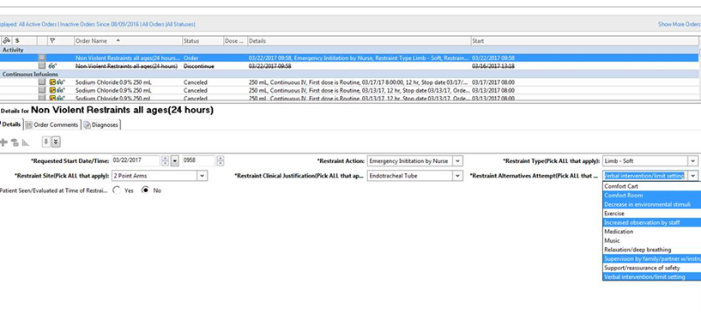
Powerchart order entry
This button does not constitute a note.
Non-Violent Restraint order - all fields are required.
If you have already seen the patient, choose yes. A screen will pop up, click continue and the Face-to-Face Note will appear. Complete this and your face-to-face note is done.
If you click no, the popup instructs you to cancel the order and then re-enter it when you’ve seen the patient.
Restraint orders are final once signed and can no longer be modified. Renewals need all required fields.

Slide 17
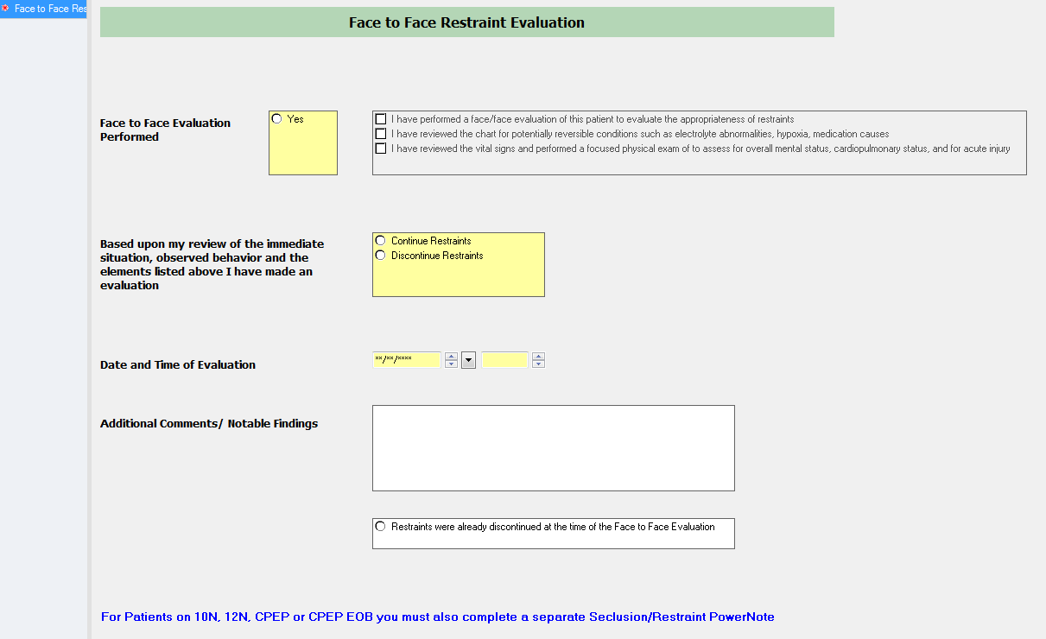
Documentation
This is the required face to face form that pops up when you click “yes and choose continue” from the order for both Non-Violent and Violent Self-Destructive Restraint orders.

Slide 18
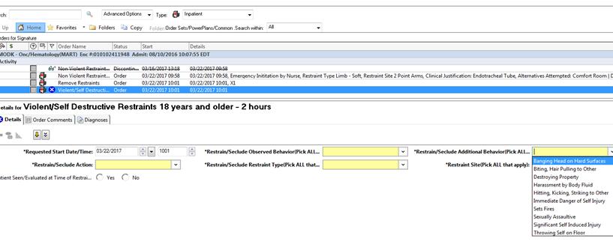
Powerchart order entry
This button does not constitute a note.
Violent-Self Destructive Restraint order - all fields are required.
Please make sure if you have already seen the patient, choose yes. A screen will pop up, click continue and the Face-to-Face Note will appear. Complete this and your face-to-face note is done.
This pop up will NOT fire for behavioral health units (CPEP, 10N, 12N)
If you click no, you need to add THIS specific note when you do see the patient.
Behavioral Health units must always have a new (initiation order for all episodes).
Restraint orders are final once signed and can no longer be modified. Renewals need all required fields.
This is the end of the presentation for MD/LIP’s that do not work in behavioral health units

Slide 19
Additional Requirements behavioral health units
Physician face to face must occur within 30 minutes.
Under the very rare circumstance when this is impossible (e.g., physician is addressing life threatening situation with another patient), the RN is to place a note in the chart explaining the circumstance and the physician must also document the reason for the delay at the time the evaluation is conducted.
The physician must complete the PowerNote titled “Psychiatry Restraint Seclusion Note V_SD”
Renewals are not used on behavioral health units.
Once an order is about to expire the patient should be afforded the opportunity for release, if imminent danger is still present, a new initial order is required as is all documentation and another face-to-face evaluation by the ordering physician.
Remember: Restraint orders must be entered by a physician on behavioral health units.

Slide 20
Additional Requirements behavioral health units
Debriefing on a behavioral health unit:
The patient is informed of the behavioral criteria for discontinuation of the restraint at the time of restraint initiation.
Debriefings occur as follows:
Patient Debriefing – Occurs as soon as possible after the restraint removal, with the patient, for the purpose of assessing the patient’s needs and the patient’s response to the event. What might have been prevented and how to prevent future episodes.
Post-acute Event Analysis Staff Debriefing – Occurs as soon as possible after the restraint initiation with involved staff for the purpose of assessing the patient and staff members’ immediate needs. What might have been prevented and how to prevent future episodes.
Formal debriefing with leadership – Occurs as soon as possible after the restraint episode (within 24 hours of episode or the next business day) to delineate details of the episode, elicit participants’ feelings regarding the events, and identify any operational and/or training issues that may require attention.

