Slide 1
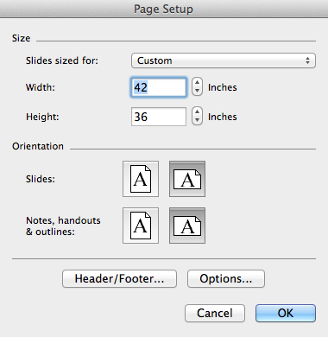
Important Information about
Poster Resizing
This template was designed to be 42” wide x 36” high.
      Although not recommended, if you must increase the poster size,
      follow these steps:
      Go to File, Page Setup, Width and Height.
      Check with your printer for paper size
      availability and cost increase.
      Change both the Width and Height to
      increase the paper by 5%, 10% or 15%
      using the specific dimensions here:
      5% - 44.1” w x 37.8” h
      10% - 46.2” w x 39.6” h
      15% - 48.3” w x 41.4” h
      Note: DO NOT simply change the paper size of the template, as all linked logo(s) and images will be distorted, resulting in poor branding practices.

