Slide 1
Infection Prevention
SBM Orientation & Annual Training
Revised 6/3/2026

Slide 2
Infection Prevention & Control Department
Natalie Mackow, MD Interim Medical Director ​
Christy Beneri, DO, Assistant Medical Director
Tamasin Adams, MPH, CIC, FAPIC, Director​
​
Raquel Tavarez, Staff Assistant​
​
Infection Preventionists:​
Pamela Calvanese, MPH, MSN, PMHNP-BC, RN, CIC, Lead IP​
Benson Joseph, MHA, CIC, Lead IP​
Alana Gomez, MPH, CIC​
Matthew Groveman, MBA, MPH
Amanda Healy, BS, MLS (ASCP)
Melinda Hochberg-Arroyo, BA​
Samantha Rennekamp, MPH
Noemi Valerio-Mansibang, MA, RN, CPHQ, CDIP, CIC, LTC-CIP
Allison Ward, BS, RN, CMSRN, CIC​

Slide 3
Infection Prevention & Control Department
Located on Hospital L1, Room 716 (near the green elevators)
Hours 7:30am to 4:00pm
Main Office # 444 – 7430, Fax # 444 – 8875
Email: SBUH_IPC or SBUH Healthcare Epidemiology Practitioners
After hours Emergency Coverage – use SPOK or ask the operator for the IPC person on-call

Slide 4
Objectives
Review Bloodborne Pathogens & Workplace Practices
Discuss Hand Hygiene Best Practices
Identify & Implement Standard & Transmission-Based Precautions
Utilize Personal Protective Equipment appropriately
Incorporate Infection Prevention Strategies into Clinical Practice

Slide 5


Slide 6
How are Bloodborne Pathogens (BBP) Transmitted:
Primarily through blood and semen, although all body fluids and tissues should be regarded as potentially infectious.
Most common BBP in Healthcare are:
  HIV – Human Immunodeficiency Virus
  HBV – Hepatitis B Virus
  HCV – Hepatitis C Virus
The most common modes of transmission are
  Sexual contact,
  Needle sharing, and
  Infusion of contaminated blood products, to a lesser degree
An infected woman can pass pathogens to her fetus.

Slide 7
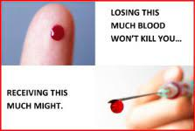
How are Bloodborne Pathogens (BBP) Transmitted:
(continued)
  Puncture wounds or cuts
    - Contaminated sharps
    - Cut or puncture with contaminated equipment
    Blood or other potentially infectious material (OPIM) comes in contact via splash, spray or touch with
      - Mucous Membranes (Eyes, nose, mouth)
      - Non-intact Skin
        Cuts, abrasions, burns
        Acnes, rashes
        Paper cuts, etc.

Slide 8
How Can I Prevent Transmission?
Follow Hospital Infection Control and Safety policies.
The use of Universal Precautions and safety devices will decrease the incidence of occupational exposures.
Universal Precautions consist of
  Appropriate Workplace Practices
  Engineering (Safety) Controls
  Using Personal Protective Equipment (PPE)

Slide 9
Workplace Practices
Wear appropriate Personal Protective Equipment (PPE) when blood or OPIM could splash or spray.
Use gloves when cleaning surfaces contaminated with blood or OPIM.
Wash hands thoroughly after removing gloves, and immediately after contact with blood or body fluids.
DO NOT recap, bend, or cut used needles.
DO NOT pass sharps – set down and allow other person to pick up.

Slide 10
Workplace Practices - Continued
Use disposable needles, syringes and other sharps whenever possible.
Any disposable items heavily contaminated (i.e., dripping) with blood or body fluids should be discarded in an infectious waste container indicated by a red bag.
Do not eat, drink, apply cosmetics or lip balm, or handle contact lenses where there is a potential exposure to blood and body fluids.
Lab specimens should be placed in leak proof containers and transported in specimen bags. All lab specimens at SBUH will be processed using Universal Precautions.
Get your Hepatitis B vaccination.

Slide 11
What if I’m Exposed to Blood or Body Fluids
Clean affected area immediately.
Notify supervisor immediately.
Complete an Incident/Accident form (to be signed by supervisor).
Immediately report to Employee Health & Wellness, Mon. - Fri., 8 a.m.- 4 p.m.
All other times report to the Emergency Department

Slide 12
Preventing Infections
Hand Hygiene
Standard Precautions
Transmission-Based Precautions
Cleaning of Equipment & Environment

Slide 13
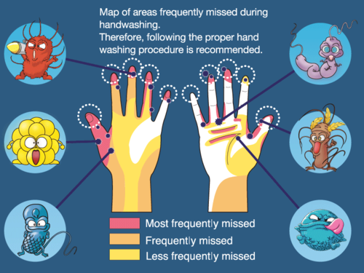
Hand Hygiene
  One of the most important measures to prevent the spread of infections.
Infection Prevention is in your Hands.

Slide 14
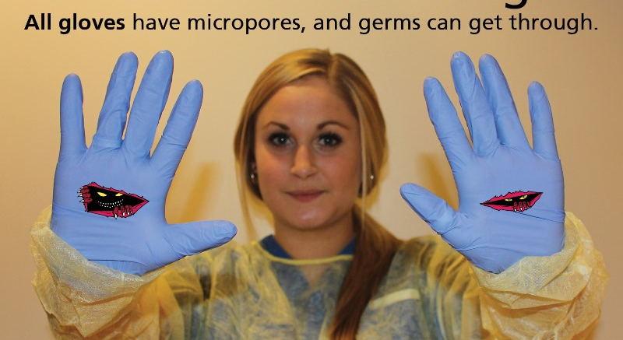
Always remember to wash your hands before and after using gloves.

Slide 15
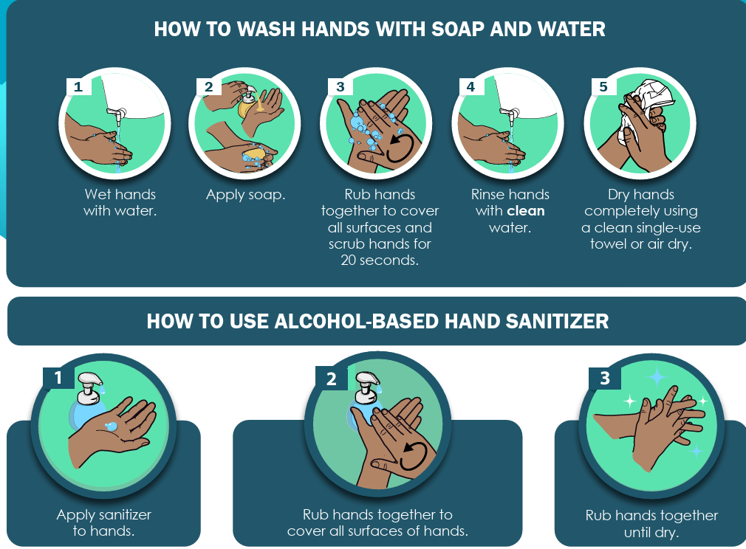


Slide 16
Hand Hygiene
Soap and Water
Alcohol Sanitizer
Hands are visibly soiled
Hands contaminated with blood or bodily fluids
Before Eating
After using the restroom
After assisting a patient with toileting
Hands are visibly clean
Routine hand hygiene before and after patient care
Immediately before/after glove use
If moving from a soiled body site to a clean one on the same patient
Before entering patient environment
After leaving patient environment

Slide 17
Nail Hygiene
Hand Hygiene Policy: Nails should not extend past the fingertip.
Keeping nails short is important - most microbes on hands come from beneath the fingernails.
Do not wear rings with stones or ridges since they interfere with thorough hand washing and make it more difficult to don gloves.
Do not wear artificial nails; this includes anything applied to the natural nail other than polish; such as artificial tips, wraps, appliqués, and acrylics.
Artificial nails are more likely to be colonized with bacteria and yeast than natural nails.
https://www.cdc.gov/clean-hands/hcp/clinical-safety/index.html

Slide 18
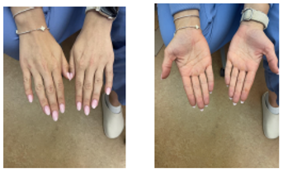

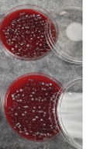
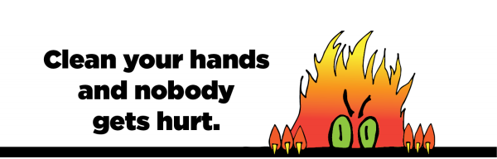
Infection Prevention is in your hands
Before HH
After HH
Longer nails are harder to clean.
Artificial nails are more likely to be colonized with bacteria and yeast than natural nails.
Long and artificial nails have been linked to infections and death in both pediatric and adult populations.

Slide 19
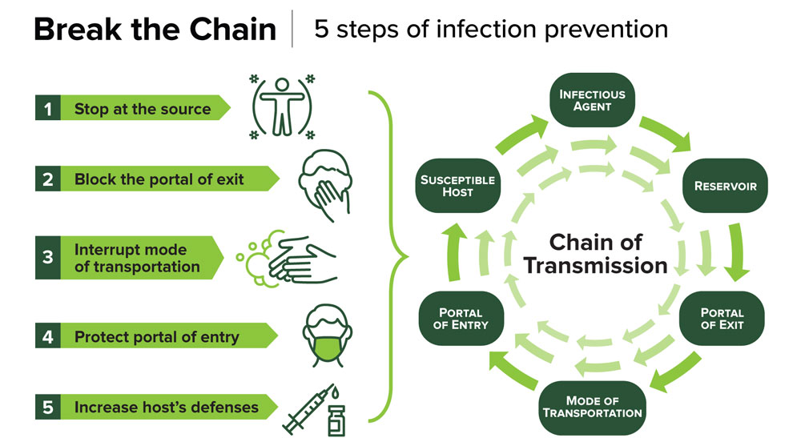
UAB: The University of Alabama at Birmingham

Slide 20
Interventions to Break the Chain
Infectious agent
  Early detection & treatment
  Isolation precautions
    Standard
    Transmission-based
Reservoir
  Water management programs
  Clean equipment & surfaces
    Glucometers
    BP machines, Stethoscopes
    Computer stations
Portal of Exit
  Cover your cough
  Wound dressings
Mode of transmission
  Personal Protective Equipment (PPE)
  Hand hygiene
  Scrub the hub of IVs & central lines
Portal of entry
  Hand hygiene between clean & dirty tasks
  Oral care
Susceptible host
  Health promotion activities
  Vaccinations
  Nutrition

Slide 21
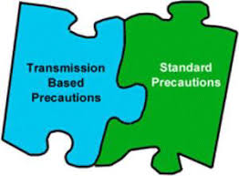
Infection Prevention Precautions
Transmission-Based Precautions: used when we know a patient has a specific disease.
Patient has Influenza - you wear mask and the patient wears a mask.
Standard Precautions:
used for all patients.
We may not know what the patient has but if they are coughing – you wear a mask and the patient wears a mask.

Slide 22
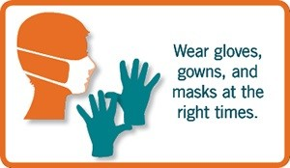
Standard Precautions
If it is Warm and Moist and not yours…
Put a barrier between you and it.
Applies to all patients
Protects YOU and your patients
Includes use of:
  Gowns if clothing could become soiled
  Mask / Eye protection if task could create a splash or spray
  Gloves if hands could become soiled

Slide 23
Transmission-Based Precautions
Airborne - TB
Airborne & Contact - Disseminated Zoster
Special Airborne - Measles
Special Precautions - COVID19, Mpox
Droplet - Flu, Meningitis, Pertussis
Contact - Scabies, MDROs
Special Contact - C. difficile, Norovirus

Slide 24

Infection Prevention and Control
Our Policies can be found on the Hospital intranet
Policy Manager → Administration Policy and Procedures → Infection Control
Policies of note:
  Standard Precautions, IC0012
  Transmission-Based Precautions/Isolation Precautions, IC0040
  Prevention of Transmission of Mycobacterium Tuberculosis, IC0011

Slide 25
This Infection Prevention Grid lists common infections and the correlating specific precautions which should be used.
It also lists important additional information for example, if an Immune Health Care Worker is recommended.

Slide 26
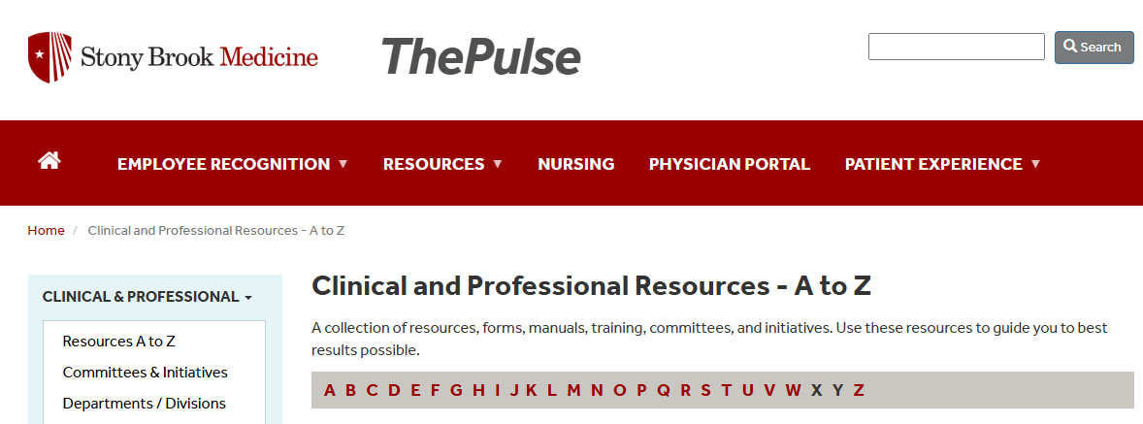
Isolation Precautions Reference Guide

Slide 27
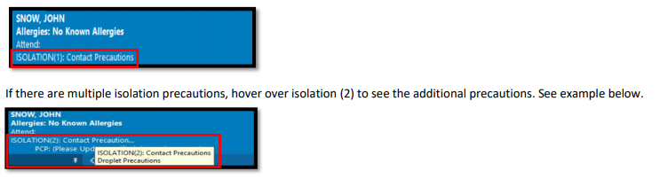
Isolation Patient Identification
Banner Bar

Slide 28
Ordering Transmission-Based Precautions/Isolation
Isolation is generated automatically when:
    Labs are ordered
      C. difficile, Respiratory Pathogen Panel, etc.
    Lab results are positive & finalized
      Culture positive for a Carbapenem Resistant Enterobacteriaceae (CRE) bacteria
    Historical reasons
      Cystic Fibrosis, History of a multi-drug resistant organism, etc.
Orders need to be entered manually when:
    Patient has a rash that is suspect for a communicable disease (e.g, Shingles/Measles/Mpox)*
    r/o Meningitis*
    Laboratory culture has multi-drug resistant organism but is a preliminary positive.
      Be cautious and isolate early you don’t have to wait for the result to be finalized.
    Results came from an outside facility
  *If r/o shingles (Herpes zoster), meningitis, scabies, measles, Mpox or any other infectious disease, place the patient on appropriate isolation.
Please call Infection Prevention
SBUH at 631-444-7430
SBELIH 631-477-5197
SBSH 631-726-8616

Slide 29
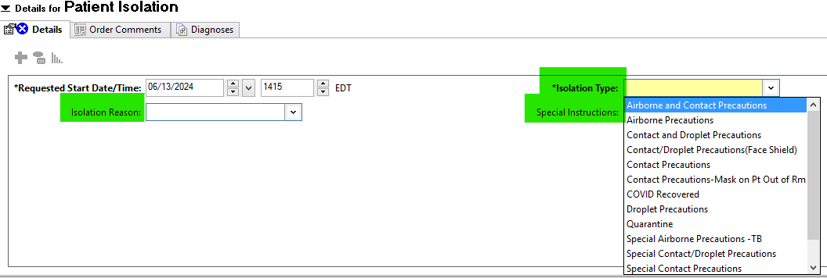
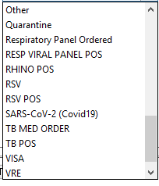
Patient Isolation Order
Patient Isolation can be ordered manually by providers, nursing, or Infection Prevention.
Isolation Type and Isolation Reason can be selected from a drop-down menu.
Comments can be placed in the Special Instructions section (e.g., r/o meningitis).
Isolation Type
Select the precautions you are ordering “Contact, Airborne, or Droplet” etc.
Isolation Reason
“Other” is an option if you don’t see the reason you are looking for.
Special Instructions
Can be manually entered for example:
R/o meningitis
Wash hands only with soap and water
Remember to order isolation whenever needed and do it early.
Isolation can always be discontinued but you can’t take back an exposure.

Slide 30
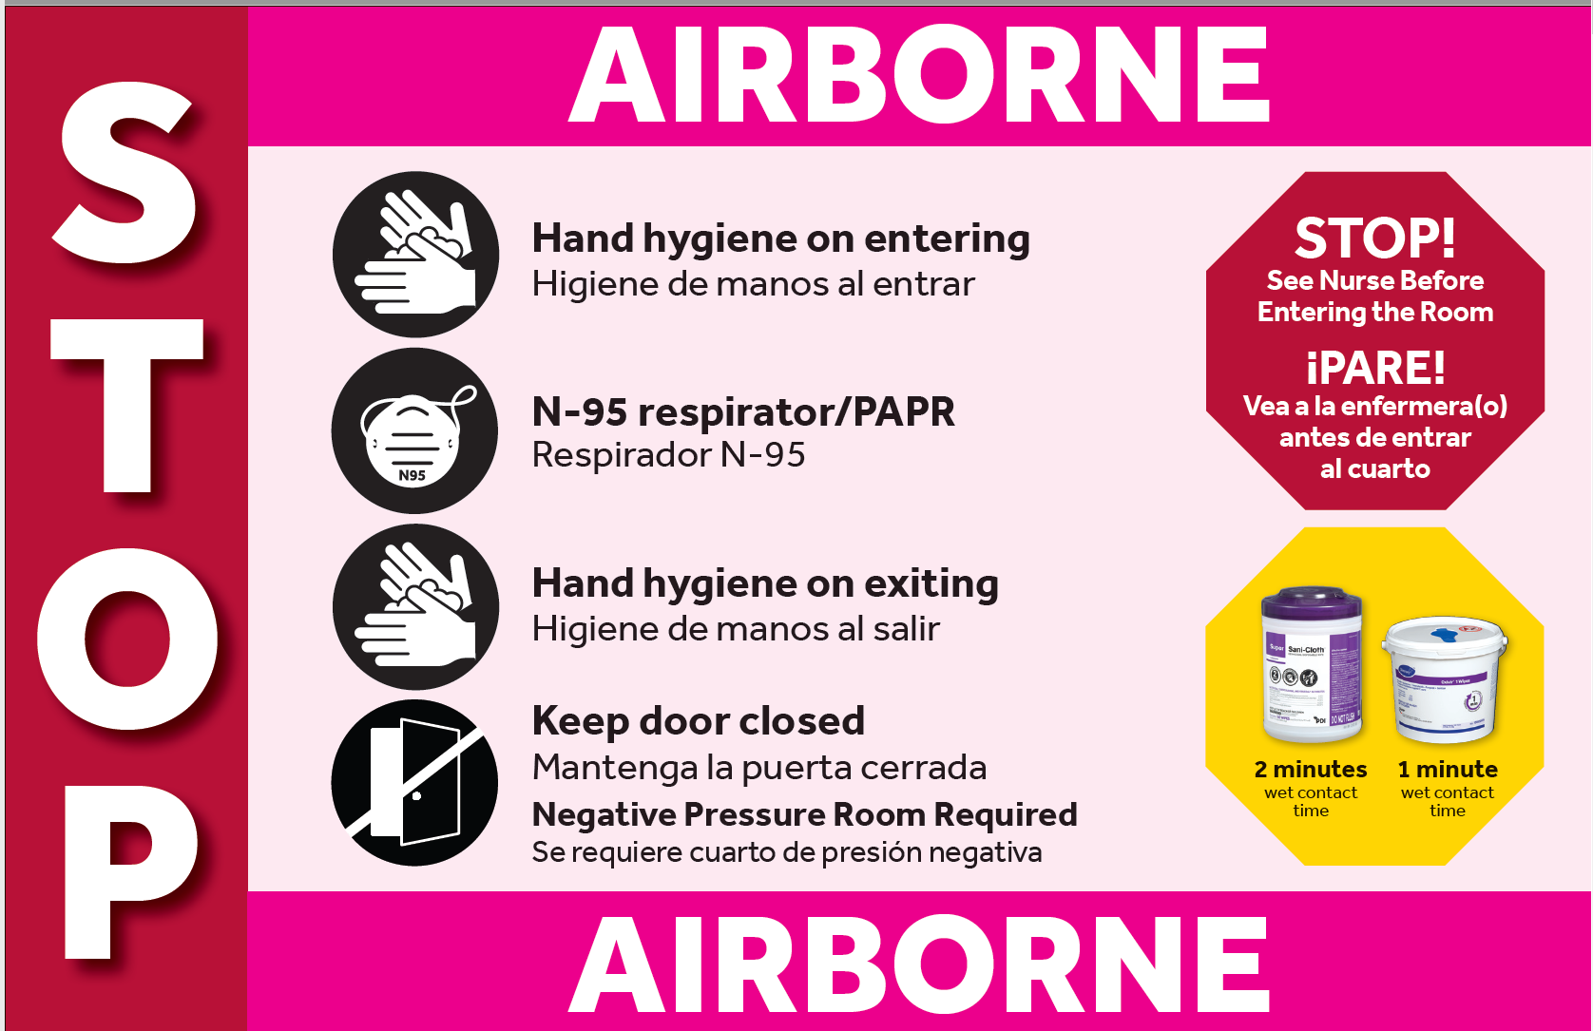
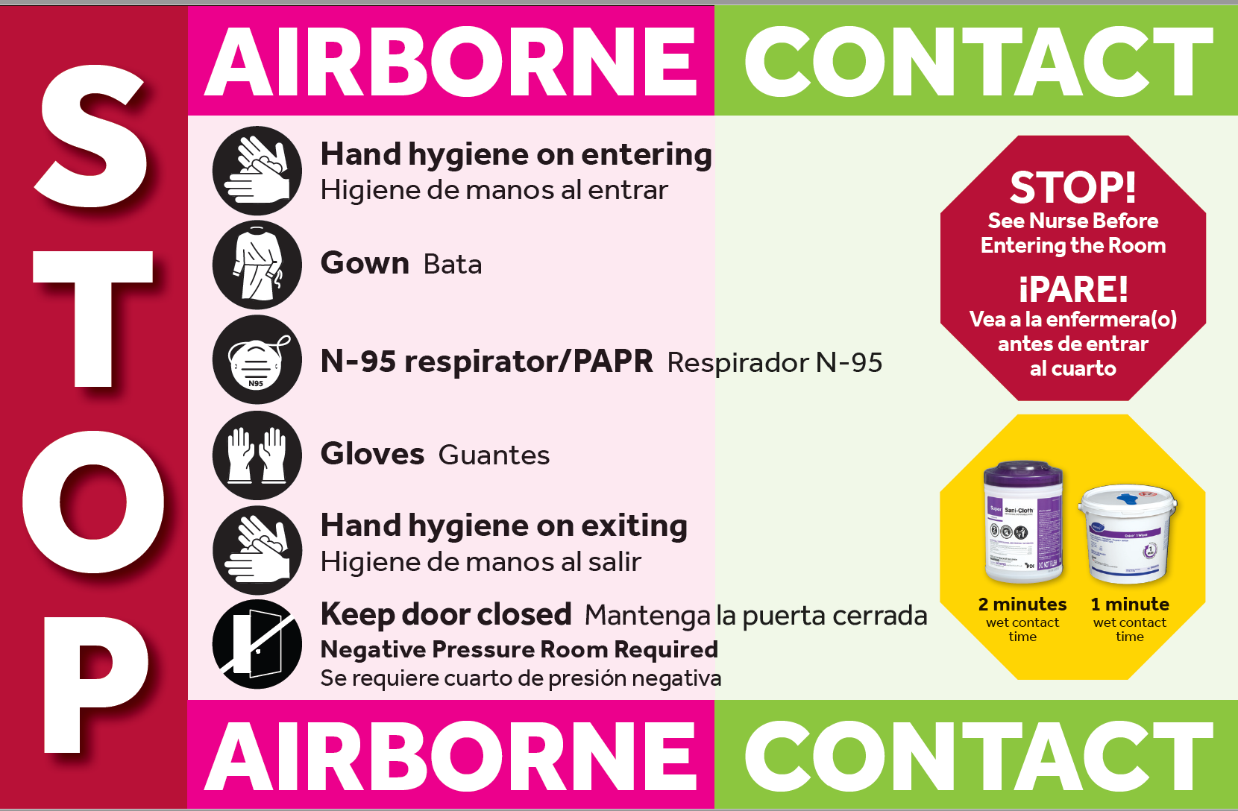
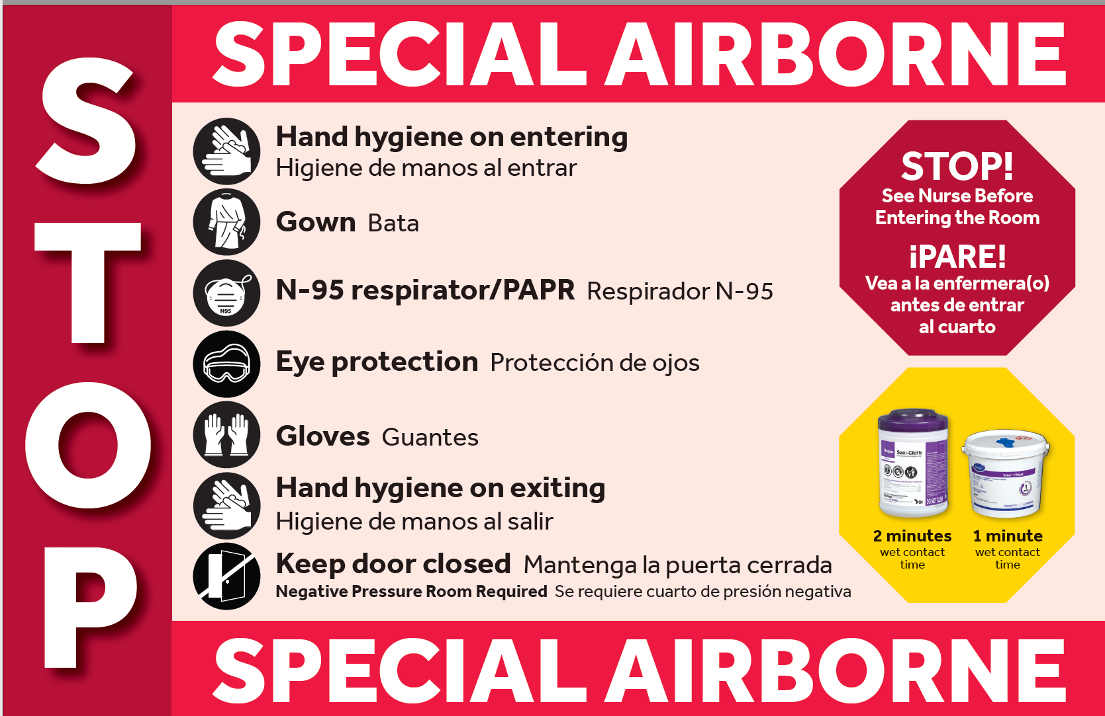
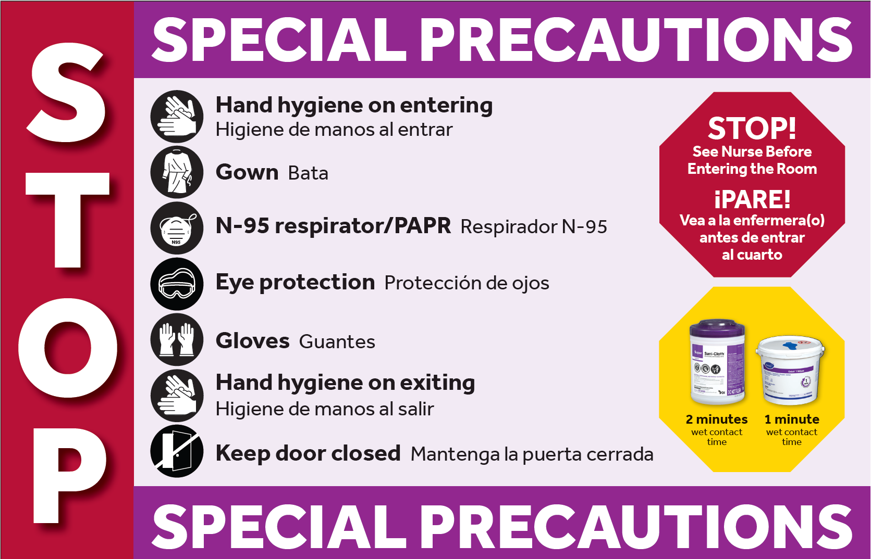
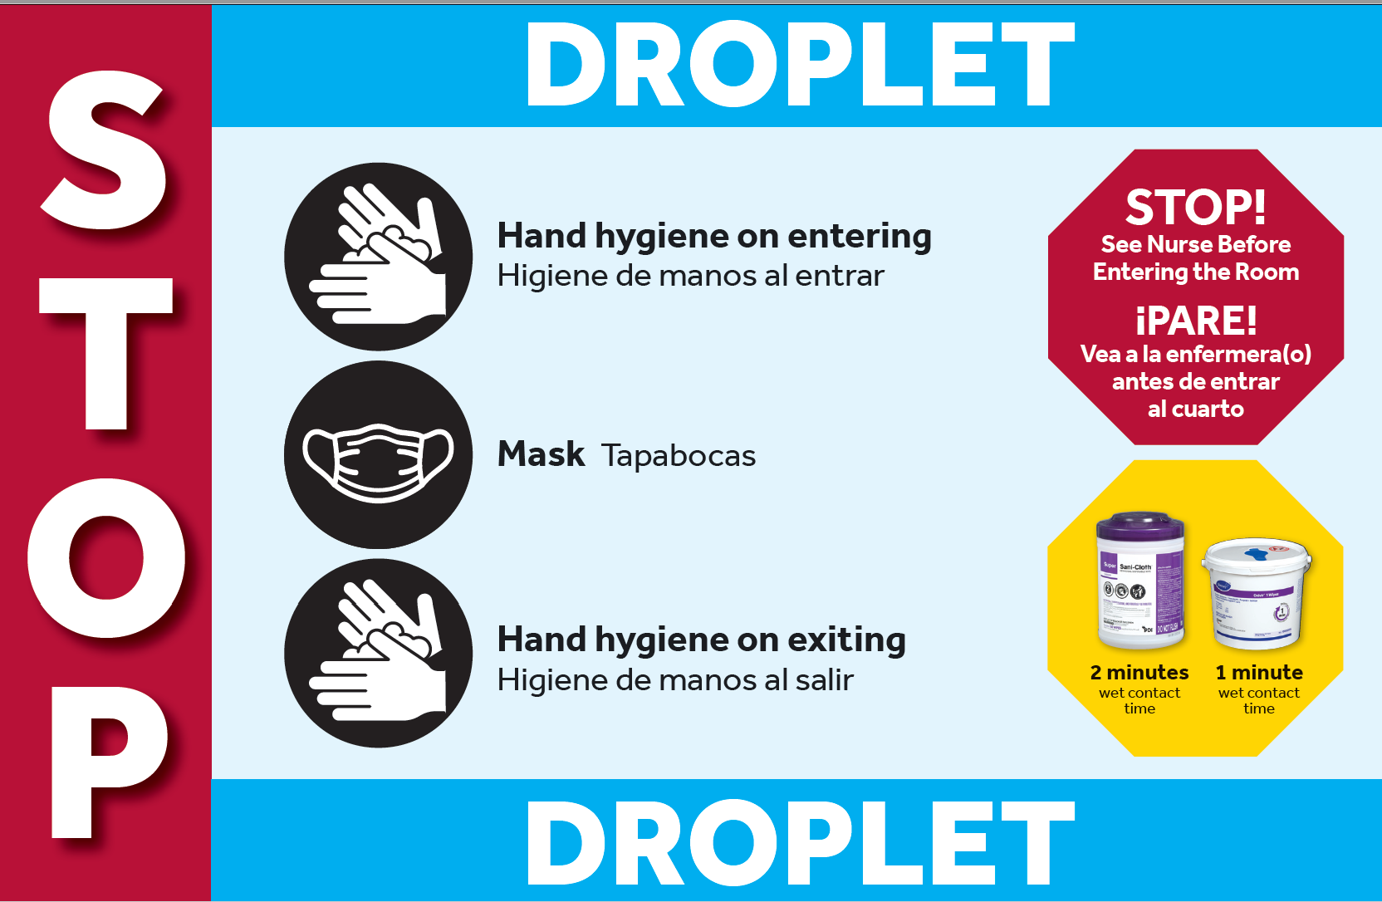
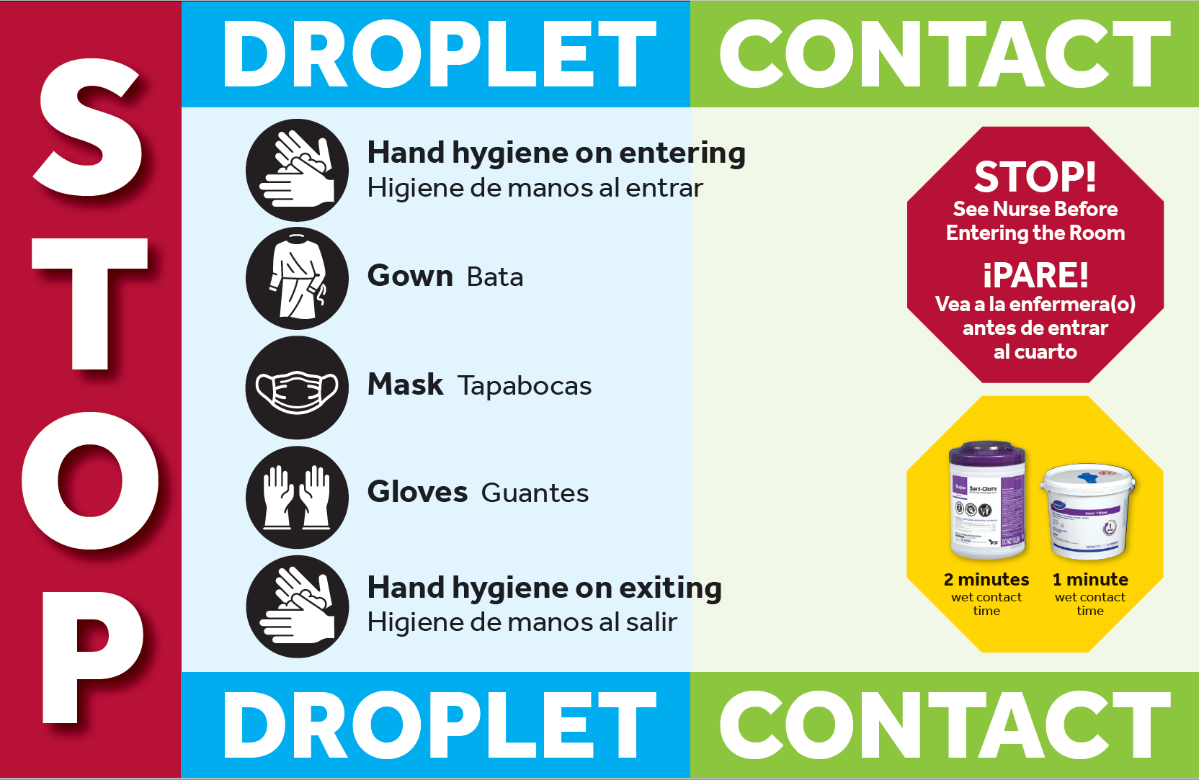
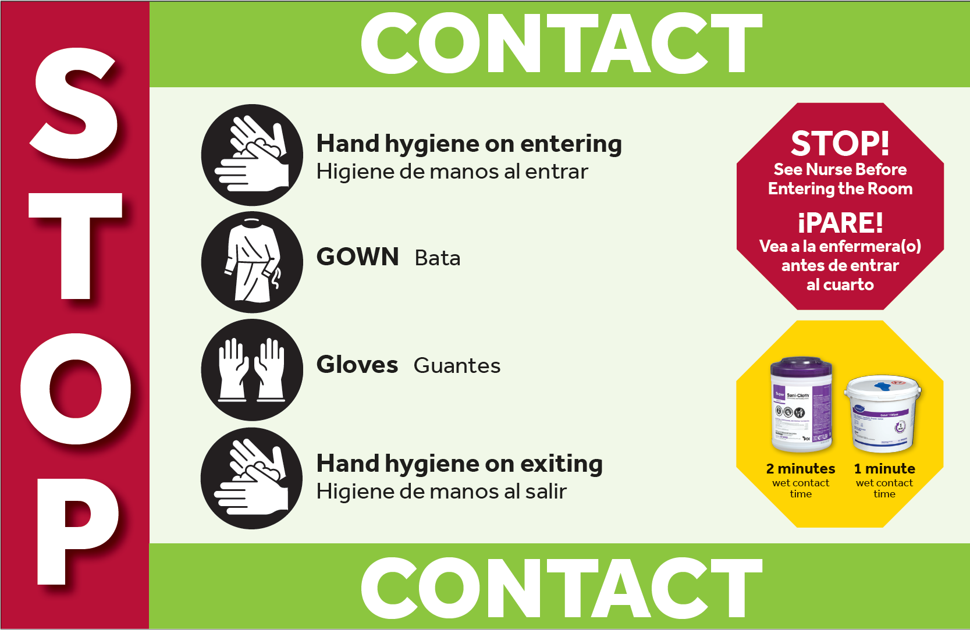
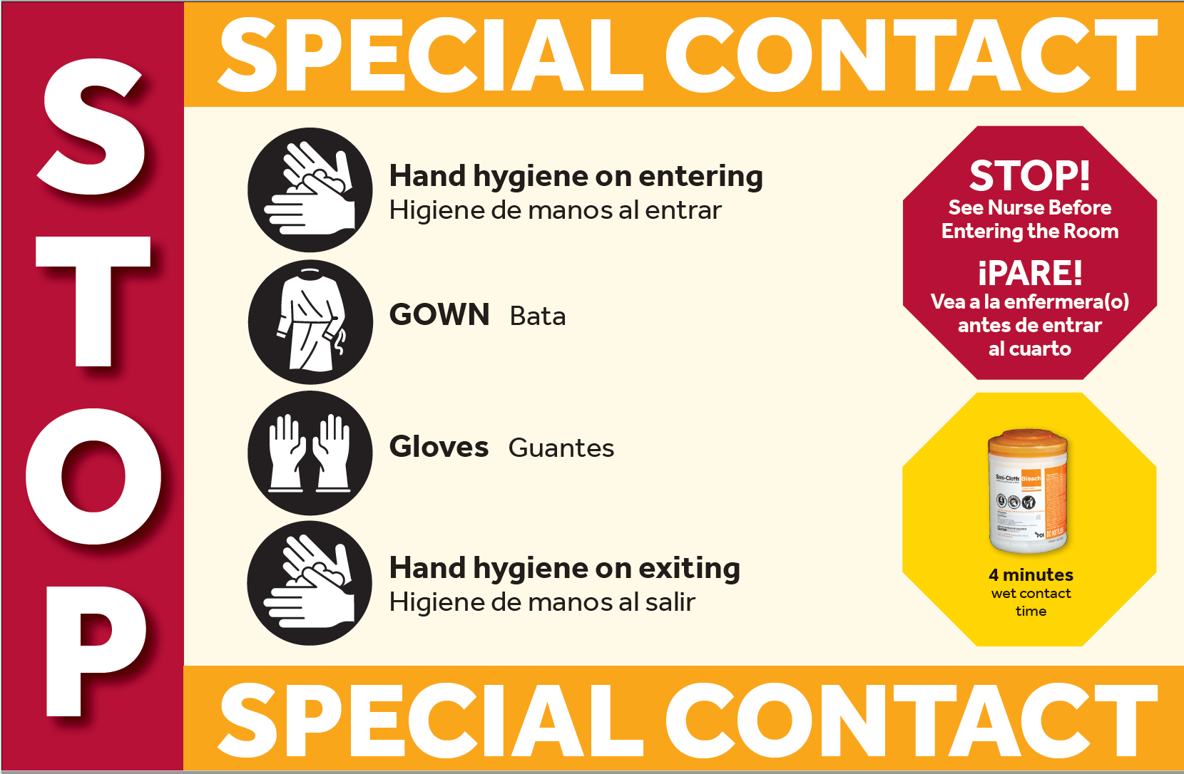
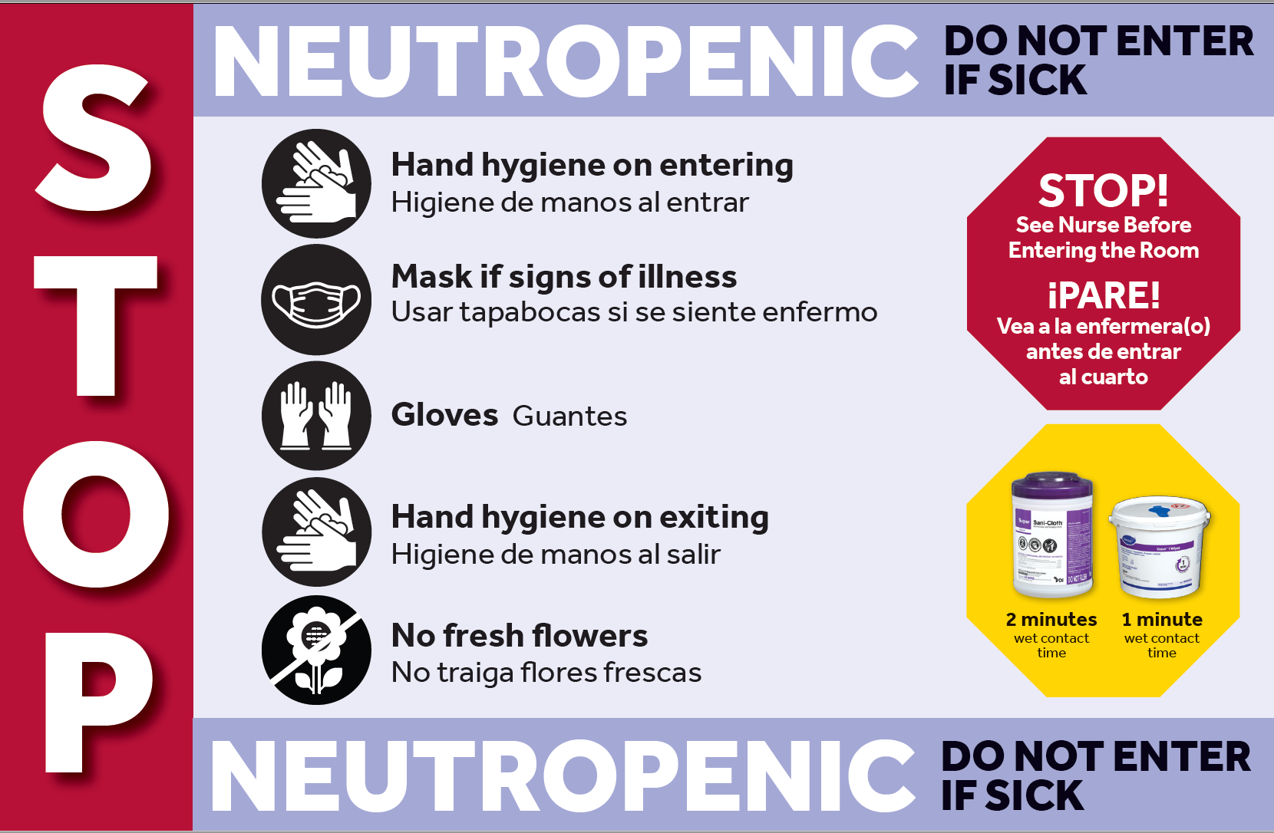
Transmission Based Precautions Signs - Hospital Towers

Slide 31
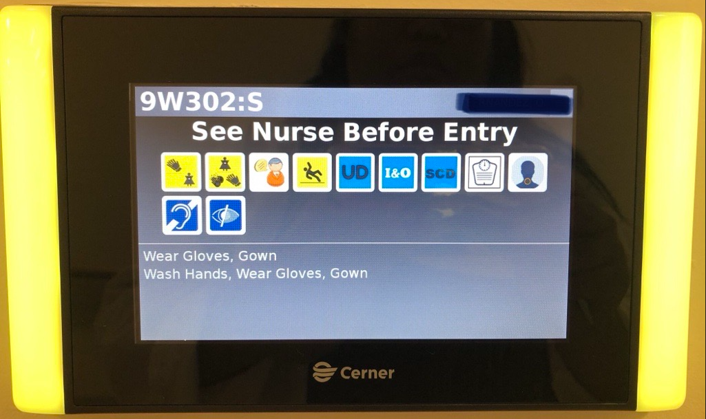
Transmission-Based Precautions – Pavilion
In the pavilion when a patient is on Transmission-Based Precautions, the monitor at the entrance to their room will display yellow lights and icons indicating the appropriate PPE to be utilized.

Slide 32






Pavilion Building - Electronic Icons
Gloves
Gloves & Gown
Surgical Mask
Gloves, Gown, Washing hands with soap & water
N95
Negative Pressure

Slide 33
Transmission-Based Precautions & PPE
Airborne - N95 & Negative Pressure Room
Special Precautions - N95, Face shield/Eye protection, Gown & Gloves, Keep door closed
Droplet - Surgical Mask
Contact - Gown & Gloves
Special Contact - Gown & Gloves, Clean with bleach

Slide 35
Tuberculosis
Caused by a specific bacterium Mycobacterium tuberculosis
Germs from active TB patient’s cough can float in air for a long time and cause infection when you inhale them
Pulmonary (Lungs)
Extra-Pulmonary TB
(outside of lungs)
Contagious in Specific Situations
Active TB
Contagious
Symptoms
Latent TB
Not Contagious
No Symptoms

Slide 36
Infection Control is in your Hands.

Slide 37


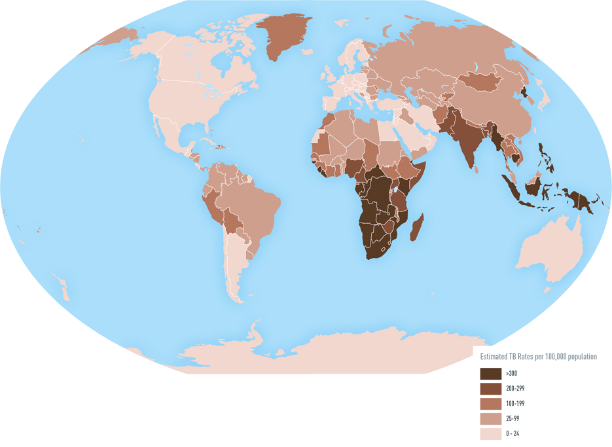
Persons at High Risk for Tuberculosis
Persons with HIV infection
Close contacts of infectious tuberculosis cases
Foreign-born persons from high prevalence countries
Low-income populations, including high-risk minorities
Alcoholics and intravenous drug users
Residents of long-term care facilities (including prisons)
Healthcare workers
Infection Prevention is in your Hands.

Slide 38
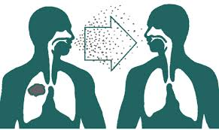
Transmission
Small infectious droplet nuclei
Produced when persons with tuberculosis of the lung or larynx sneeze, cough, speak, or sing
Susceptible person breathes in contaminated air
Prolonged exposure in a confined space

Slide 39
Pulmonary TB
Occurs in the lungs
Requires Isolation
Airborne Precautions
      N95
      Negative Pressure Room
    Isolation discontinuation requires approval from Infection Prevention & Control
Ruling out TB requires utilizing the TB PowerPlan (this orders the AFB sputum x3 with MTB PCR+)
Cerner will automatically order isolation when the AFB x3 order is placed or when 4 drug TB therapy is ordered.
Extrapulmonary TB
Occurs outside of the lungs
Does not require isolation unless: A procedure is done on the site of the infection e.g., surgical debridement of a wound with MTB
Pulmonary source should be ruled out

Slide 40
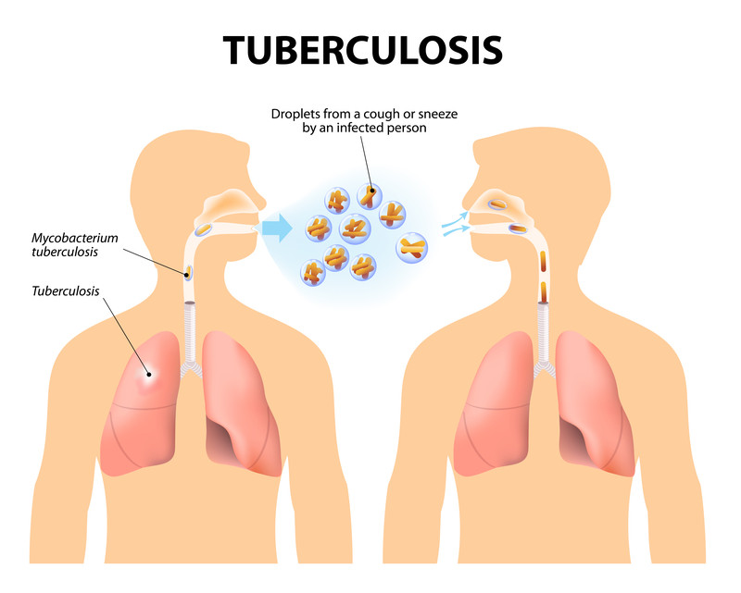
Ruling Out Tuberculosis
Airborne Precautions should be ordered whenever all 4 TB meds are started or AFB sputums are ordered to R/O TB
Sputums of good quality must be collected a minimum of 8 hours apart (best time to collect is first thing in the morning)
Need 3 negative AFB sputum smears and attending physician documentation of TB being ruled out from the differential diagnosis with an alternative etiology for symptoms.
*note*: A QuantiFERON test is not a diagnostic test that can be used to rule out active pulmonary tuberculosis

Slide 41
Treatment of TB Disease
Initiate 4 drug therapy with “RIPE”
  Rifampin
  Isoniazid
  Pyrazinamide
  Ethambutol
Cerner will automatically place Airborne Precautions if all 4 drugs are ordered for a patient
Isolation discontinuation requires approval from Infection Prevention & Control Department

Slide 42
Patient Care Considerations
Screen all patients for TB asking about:
  Cough with hemoptysis
  Unexplained weight loss
  Night sweats
  Travel to (or visits with persons from) endemic areas.
Patient wears surgical mask outside of room.
Nurse prepares patient in the room for transport
  Transportation staff do not enter patient room.

Slide 43
What Happens if I am Exposed to TB?
Infection Prevention & Control (IPC) and Employee Health & Wellness Services (EH&W) determine which employees are considered exposed.
EH&W then contacts the exposed individuals to arrange appropriate follow-up.
  This evaluation includes a PPD approximately 8-10 weeks after exposure, if they had a previous negative skin test within the last three months.
  If the prior PPD date is greater than three months, a PPD at identification of the exposure and again several weeks after exposure are indicated.

Slide 44
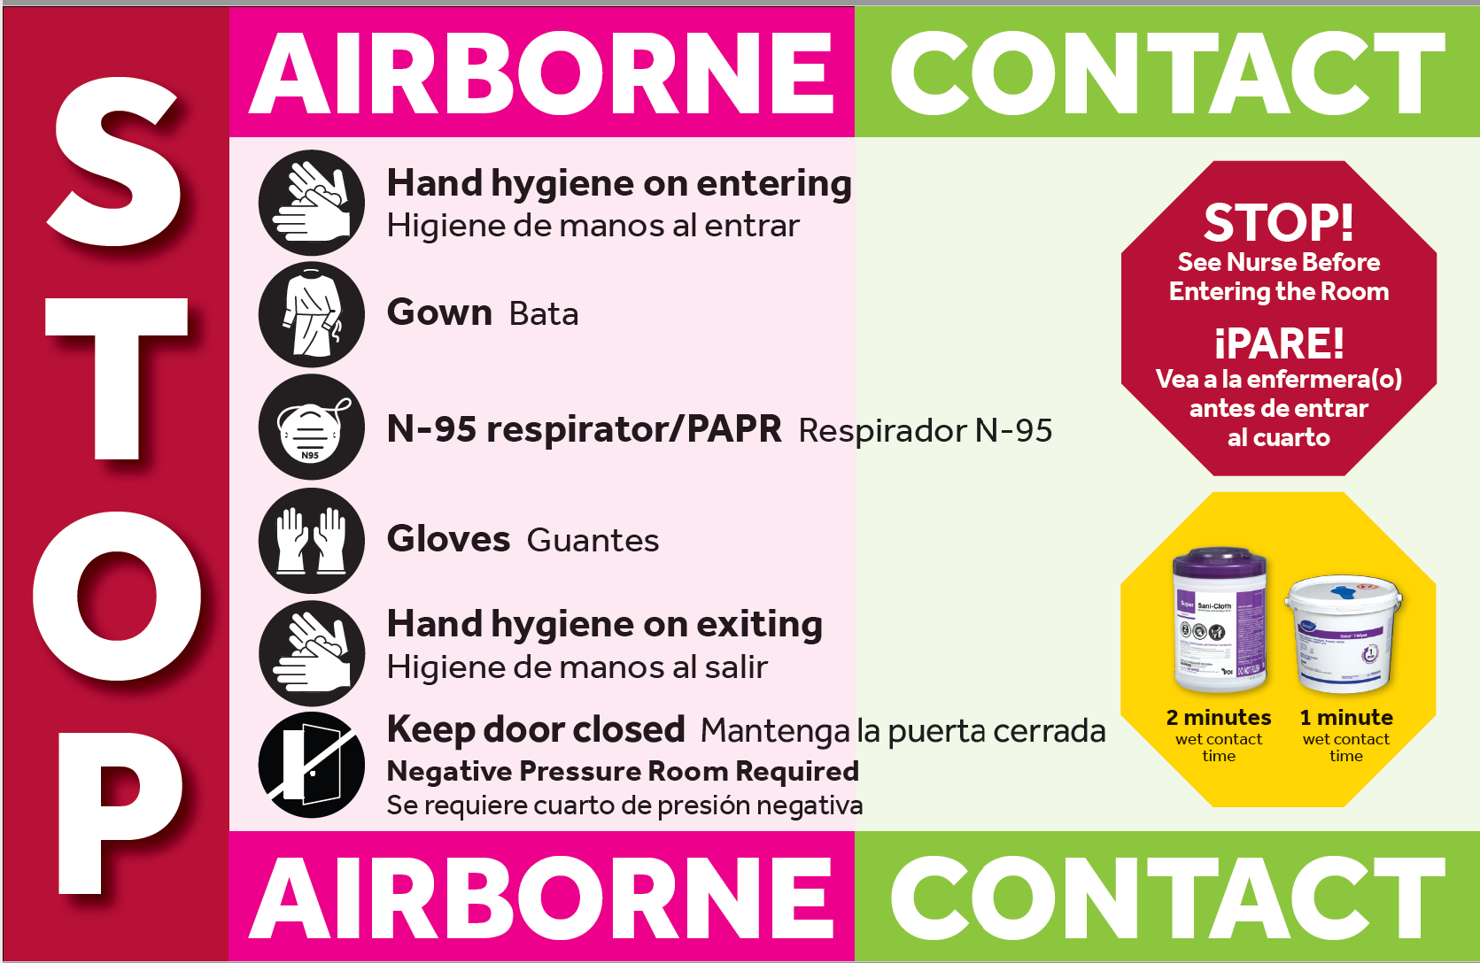
Examples:
Disseminated Zoster/Shingles
Immunocompromised Patient that has Shingles
Patient with Shingles on the Face

Slide 45
Key Points
Undiagnosed RASH should be placed on Airborne and Contact. Cover affected area.
Recommend Immune Health Care Workers provide care to patients with Chickenpox/Varicella, Measles, Shingles/Zoster, Mumps, Rubella. Wear appropriate PPE to protect yourself.
Patients need to wear a mask when outside the room
  Any respiratory precautions such as Airborne, Droplet, Special Precautions.
Door must remain CLOSED for patients on negative pressure, even when patient is NOT present

Slide 46
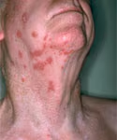
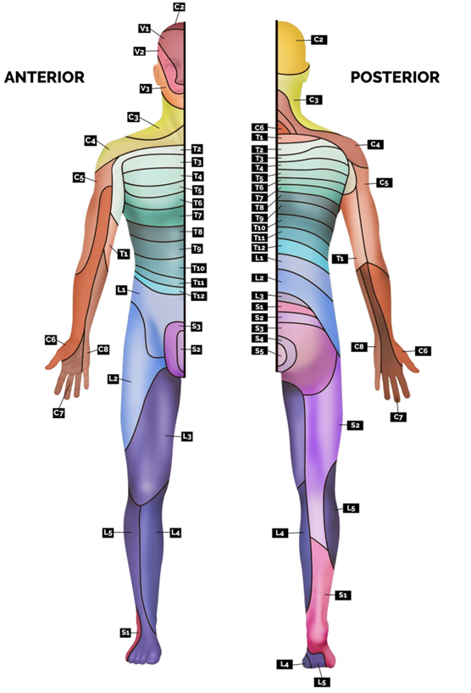
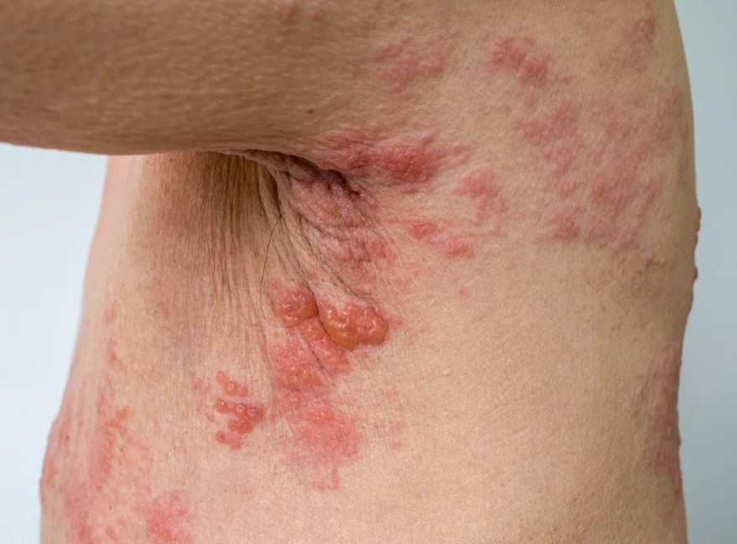
Varicella (Herpes Zoster) Isolation Precautions
Is it disseminated? Does it spread across more than 2 dermatomes or the face?
Immediately Order
Airborne & Contact
Isolation Precautions in PowerChart
Patient requires a negative pressure room; doors must be kept closed at all times.
Only healthcare workers immune to varicella/chickenpox should be entering the room and providing care.
If leaving the room, patient must wear a mask, the infected area should be covered (if possible) and door must be kept closed even if the patient is not in the room.
Place a sign on door: SEE NURSE BEFORE ENTERING.
When in doubt
Place patient on isolation
Call Infection Prevention
SBUH at 631-444-7430
SBELIH 631-477-5197
SBSH 631-726-8616
Infection Prevention & Control 11.2025

Slide 47
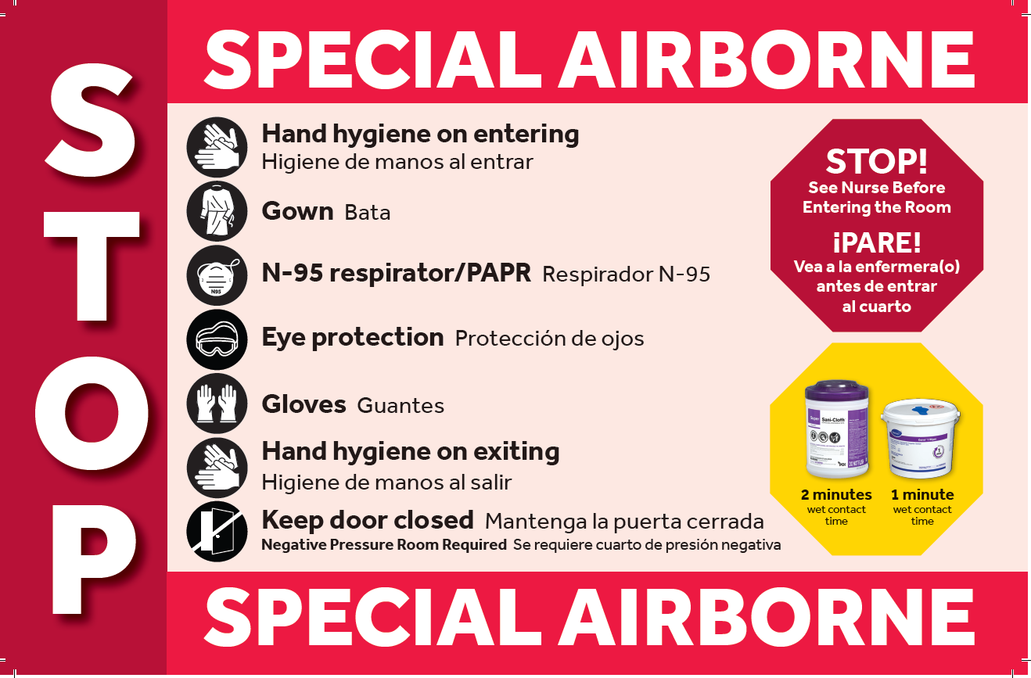
Examples: Measles, MERS-CoV, or Emerging Respiratory Pathogens
Illnesses that require negative pressure and multiple types of PPE. Please Call Infection Prevention.
Need to manually order both “Airborne” and “Special Precautions – SARS-CoV-2” isolation.
Identify
Isolate
Inform

Slide 48
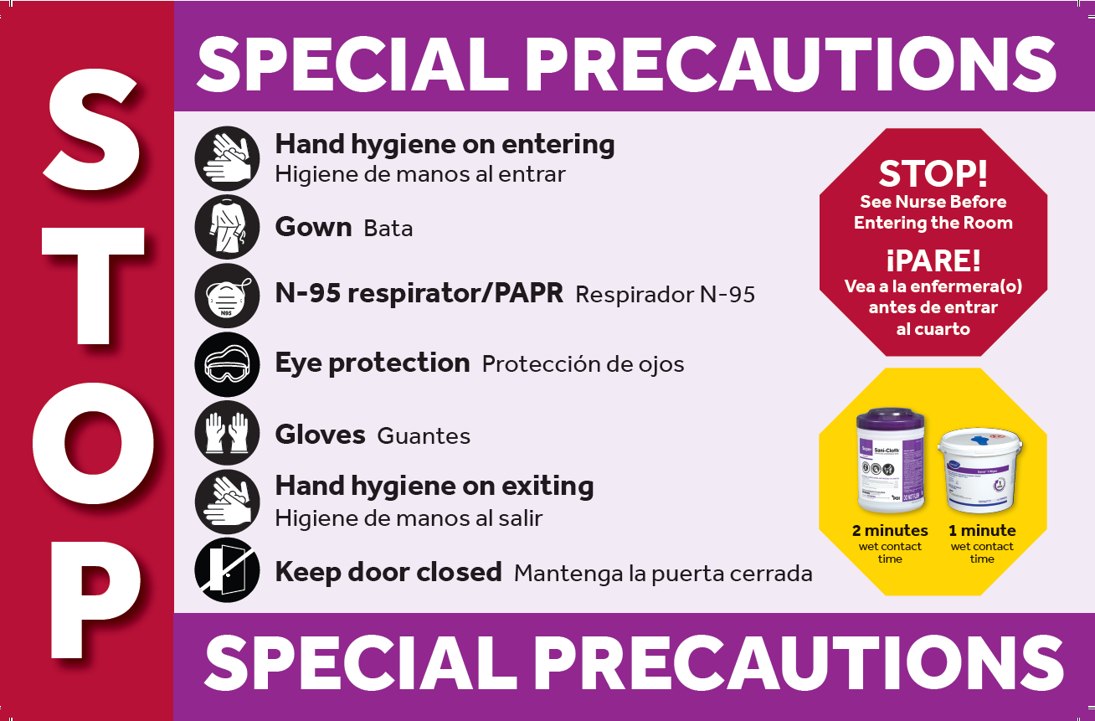
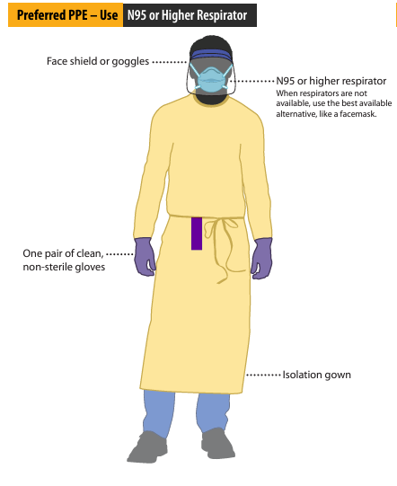
Patients with COVID or Mpox
Cerner order: “Special Precautions SARS-CoV-2” is also used for Mpox OR any disease that requires the same PPE but does not need a negative pressure room.

Slide 49
Eye Protection
    Eyeglasses are not considered eye protection
    Clip on eye shields that attach to prescription eyewear are not considered PPE

Slide 51
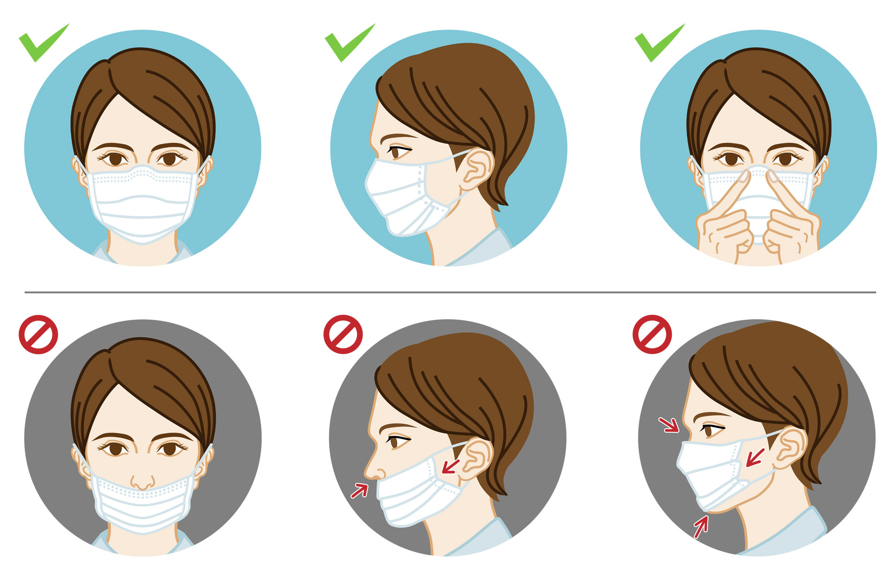
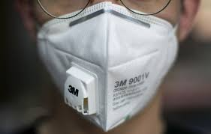
Mask Do’s and Don’ts

Slide 52
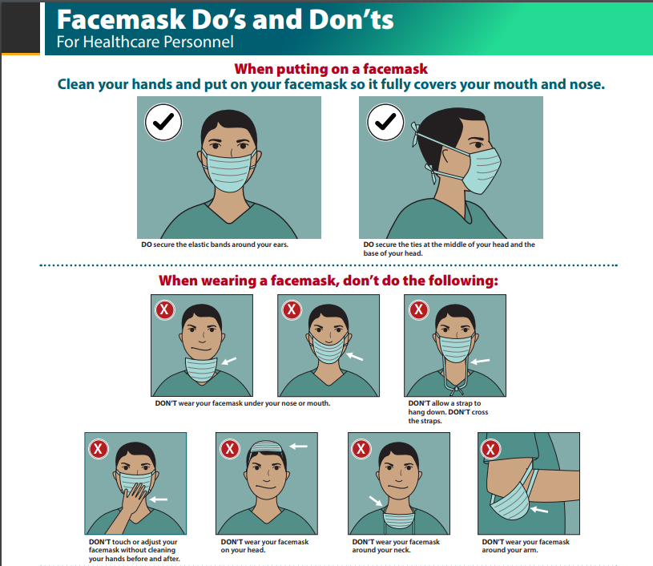

Slide 55
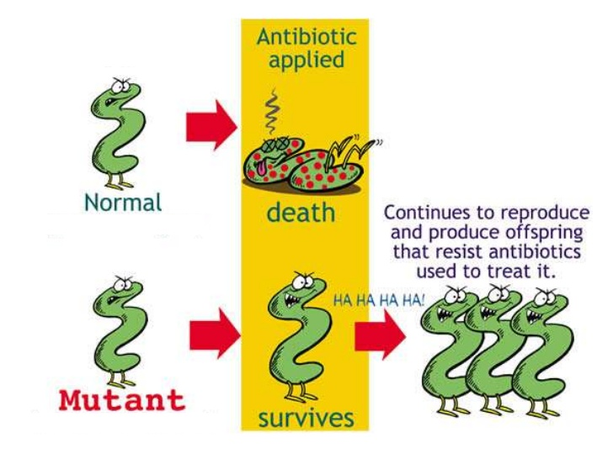
Multidrug Resistant Organisms (MDRO)

Slide 56
Stop the Spread of MDRO’s
Good hand hygiene practices
Compliance with Standard and Transmission-Based Precautions
Cleaning equipment and environment
Antimicrobial Stewardship

Slide 57


Slide 58
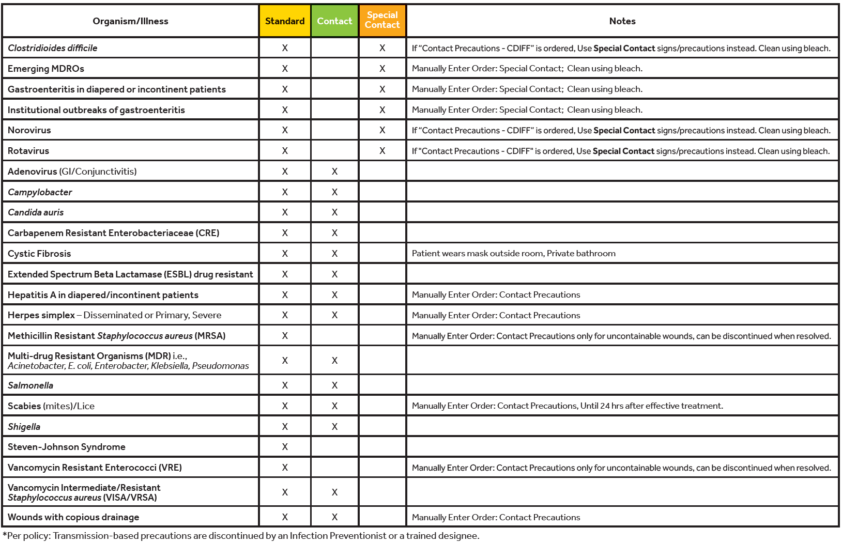
The back of the sign will have common illness that require the type of precautions with additional information in the notes section.
For C. diff, Norovirus, Rotavirus + results - Cerner will automatically fire “Contact Precautions” instead use “Special Contact” sign and precautions.

Slide 59
Best Practice
Always wear gloves when managing patients on Special Precautions.
Remove gloves carefully to avoid self-contamination during doffing.
Clean and disinfect all equipment used on Special Contact patients with a sporicidal disinfectant (e.g., bleach) prior to use on other patients.

Slide 60
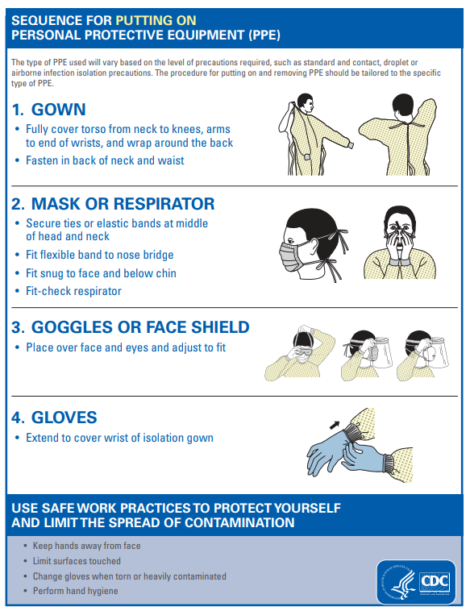
Donning PPE
*Always start with Hand Hygiene

Slide 61
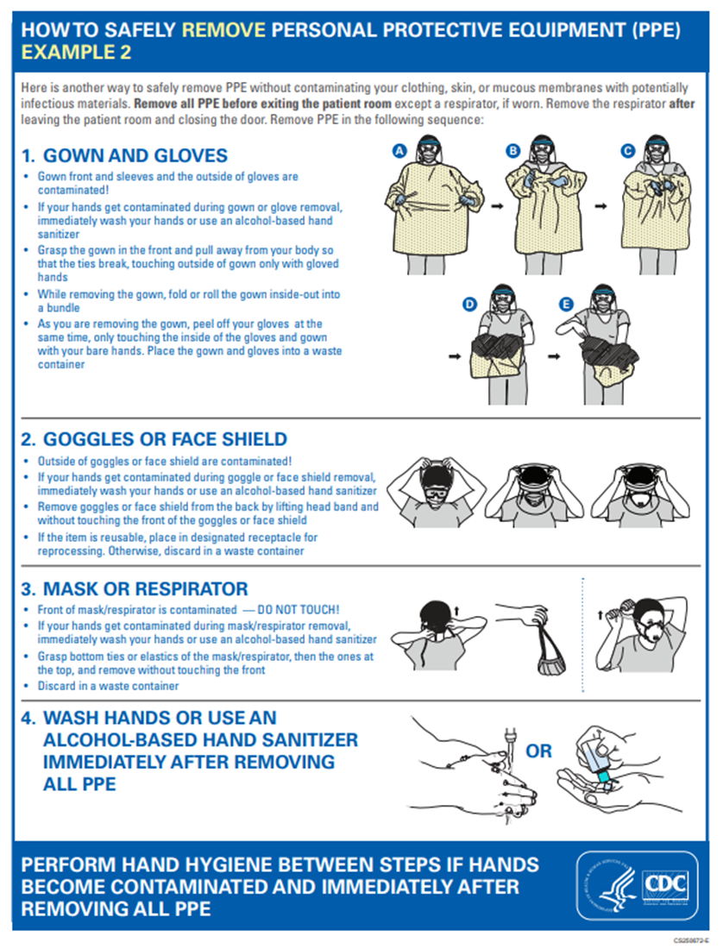
Doffing PPE

Slide 62

Disposal of PPE
Inside the Room
    Gloves
    Gown
    Surgical mask
    Disposable eye protection
Outside the Room
    Eye Protection if reusable clean
    N95 / PAPR
Don’t forget Hand Hygiene!

Slide 63
Staying Safe
Hand Hygiene is important for your patients, yourself and your family.
Screen patients for signs & symptoms of communicable diseases.
Wear the appropriate PPE for Standard Precautions or Transmission-Based Precautions.
Clean and disinfect equipment/devices using Manufacturer’s Instructions for Use (MIFU). Don’t forget to clean your stethoscope!
Monitor yourself for signs & symptoms of illness. Stay home if sick or feeling unwell.

Slide 64

Ask now…or contact us later
ICP office: x 4-7430
Email: SBUH_IPC or SBUH Healthcare Epidemiology Practitioners
After hours Emergency Coverage Available
Use SPOK or ask the operator for the IPC person on call

