Slide 1
Safe Handling of Hazardous Drugs
Stony Brook University Hospital
Notes:
Updated 8/15/2025

Slide 2

COURSE OBJECTIVES
Describe procedures for safe handling of hazardous drugs (HD) at Stony Brook University Hospital
Define a HD
Describe the three categories of HD, as defined by the National Institute for Occupational Safety and Health (NIOSH)
Identify the potential adverse health effects associated with exposure to HD
Describe appropriate engineering controls and personal protective equipment required for handling HD
Outline the importance of administrative and safe work practice controls in the workplace

Slide 3
RISK OF HANDLING HAZARDOUS DRUGS (HD)
Each year, more than 8 million U.S. health care personnel are potentially exposed to HD.
The risk can lead to serious health issues for you and/or your staff.
Exposure can cause both acute and chronic health effects such as:
  Skin rashes
  Adverse reproductive outcomes
  Leukemia and other cancers

Slide 4
WHAT MAKES A DRUG HAZARDOUS?
Carcinogenic
According to the National Institute for Occupational Safety and Health (NIOSH), a drug is considered hazardous if it exhibits one or more of these characteristics:
Teratogenicity
Reproductive Toxicity
Organ Toxicity
Genotoxic
Structure and toxicity profiles of new drugs that are the same as drugs considered hazardous by the above criteria
American Society of Health-System Pharmacists. ASHP guidelines on handling hazardous drugs. Am J Health-Syst Pharm. 2006; 63:1172–93.

Slide 5
NIOSH & USP - HAZARDOUS DRUGS
National Institute for Occupational Safety and Health (NIOSH) developed a Hazardous Drugs list that recommends special precautions to minimize exposure and prevent work-related illness.
Requirements for handling HD are set by the U.S. Pharmacopeia (USP): Chapter 800.
USP Chapter 800 is designed to complement USP Chapter 797 on sterile compounding and Chapter 795 on non-sterile compounding.
Antineoplastic
Non-Antineoplastic
Reproductive Risk Only
  NIOSH [2016]. NIOSH list of antineoplastic and other hazardous drugs in healthcare settings, 2016. By Connor TH, MacKenzie BA, DeBord DG, Trout DB, O’Callaghan JP. Cincinnati, OH: U.S. Department of Health and Human Services, Centers for Disease Control and Prevention, National Institute for Occupational Safety and Health, DHHS (NIOSH) Publication Number 2016-161 (Supersedes 2014-138).
Notes:
The NIOSH list is updated periodically, most recently in 2016.

Slide 6
HAZARDOUS DRUGS EXAMPLES
Hazard | Hazard Definition | Examples
Carcinogenicity | causes cancer or increases its incidence | Anastrozole (Arimidex) Leuprolide (Lupron)
Teratogenicity/Developmental Toxicity | causes malformations of embryo or fetus | Valproic Acid (Depakote) Fluconazole (Diflucan)
Reproductive Toxicity | Adversely affects sexual function and fertility in adult males and females | Colchicine (Colcrys) Dutasteride (Avodart) Paroxetine (Paxil)
Organ Toxicity | harms specific organs | Carbamazepine (Tegretol)
Genotoxicity | damages genetic information (DNA, RNA) within a cell causing mutations, which may lead to cancer. | Abacavir (Ziagen) Mycophenolic Acid (Myfortic)
Notes:
Abacavir: genotoxic
Mycophenolic acid: embryofetal toxicity, increased risk of miscarriage

Slide 7
HAZARDOUS DRUG EXPOSURE
Manufacture Transport
Order Receive Store
Handle Prepare Dispense
Administer Handle Waste Clean up Spills
Equipment Certification Maintenance Repair
American Society of Health-System Pharmacists. ASHP guidelines on handling hazardous drugs. Am J Health-Syst Pharm. 2006; 63:1172–93.
Notes:
All employees involved in these activities have the potential for contact with trace contamination. Breakage during the manufacturing process, or during transport of the drugs can lead to contamination on the outside surfaces of the packaging. Receiving and storage, can receive these vials and packages without knowing that the contamination had taken place. Breakage during transport can potentially expose someone opening shipping totes to dermal contact with hazardous agents. During preparation and dispensing there are opportunities for contamination to the external surfaces of finished products as well as compounding areas and surrounding surfaces. During administration contamination from spills and leaks. Primary engineering controls such as the BSC must also be certified to protect the users from aerosolized HDs

Slide 8
HAZARDOUS DRUG EXPOSURE
Inhalation
Dermal/Mucosal Absorption
Ingestion
Injection
Common Tasks where exposure can occur:
Reconstituting powdered drugs and further diluting the reconstituted powder or concentrated liquid forms
Priming a hazardous IV infusion
Removing personal protective equipment (PPE)
Packaging uncoated tablets in a unit-dose machine
Opening a capsule or crushing a tablet to place down a patient’s feeding tube or to compound into a liquid
Touching the residue on the exterior of a hazardous medication container without wearing PPE
During a spill or cleaning up spills.
National Institute for Occupational Safety and Health. NIOSH alert: pre- venting occupational exposure to anti- neoplastic and other hazardous drugs in health care settings. www.cdc.gov/niosh/ docs/2004-165/
Notes:
While some hazardous drugs are dermally absorbed, a 1992 report showed no detectable skin absorption of doxorubicin, daunorubicin, vincristine, vinblastine, or melphalan. An alternative to dermal absorption is that surface contamination transferred to hands may be ingested via the hand-to-mouth route.

Slide 9

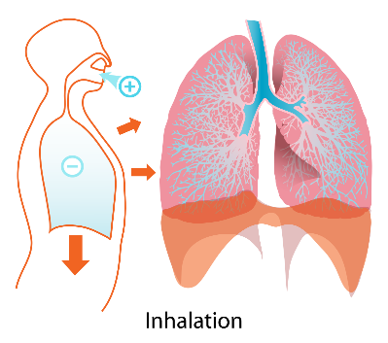
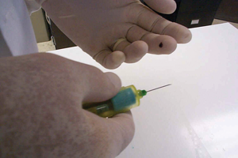

COMMON ROUTES OF EXPOSURE
Inhalation
Aerosolized HD
Spills & spill clean up
Improper use of PPE
Ingestion
Touching contaminated surfaces
Improper use of PPE
Not washing your hands
Eating/drinking in work area
Dermal/mucosal absorption
Touching cartons
Unpacking drugs
Removing PPE
Spills & spill clean up
Needle stick injury (injection)
Recapping needles
Improper use of safety needles
Not using Closed System Transfer Devices (CSTDs)

Slide 10
HEALTH EFFECTS
Exposure to hazardous drugs in the workplace has been associated with acute and short-term reactions, as well as long term effects
Integumentary/Mucosal
Neurologic
Gastrointestinal
Respiratory
Reproductive/
Developmental
Carcinogenic
American Society of Health-System Pharmacists. ASHP guidelines on handling hazardous drugs. Am J Health-Syst Pharm. 2006; 63:1172–93.
Notes:
The health risk these drugs pose depends on the toxicity of the drugs as well as how much exposure a worker has to these drugs.

Slide 11
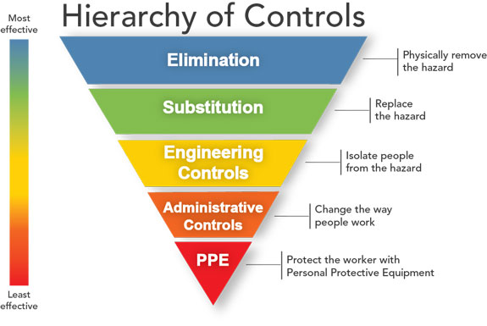
NIOSH’s HIERARCHY OF HAZARD CONTROLS
Includes Work Practices

Slide 12
HOW TO PROTECT YOURSELF FROM EXPOSURE
Administrative controls
Engineering controls
Work practices
Personal protective equipment (PPE)
National Institute for Occupational Safety and Health. NIOSH alert: pre- venting occupational exposure to anti- neoplastic and other hazardous drugs in health care settings. www.cdc.gov/niosh/ docs/2004-165/

Slide 13
ADMINISTRATIVE CONTROLS
Implement a program for the safe handling of HD
Effective polices (i.e., MM0081 Hazardous Drugs Management), procedures, SOP addressing:
  Labeling and storage
  Procedures for preparation, administration, and disposal
  Spill control procedures
  Handling damaged containers or cartons
Provide training for handling HD safely, using equipment and PPE properly, and cleaning up spills
  Annual competency exam for pharmacy staff
  Annual competency for Nursing
National Institute for Occupational Safety and Health. NIOSH alert: pre- venting occupational exposure to anti-neoplastic and other hazardous drugs in health care settings. www.cdc.gov/niosh/ docs/2004-165/

Slide 14
HOW WE IDENTIFY HD
External Labeling
EMAR – Warning “CAUTION - Handling Precautions”
EMAR Link to the NIOSH list
Risk Assessments on Hospital Intranet
  Hazardous Drugs Assessment of Risk Worksheet
  Antineoplastic Medication Assessment of Risk Worksheet
Pyxis Pop Up upon removal

Slide 15




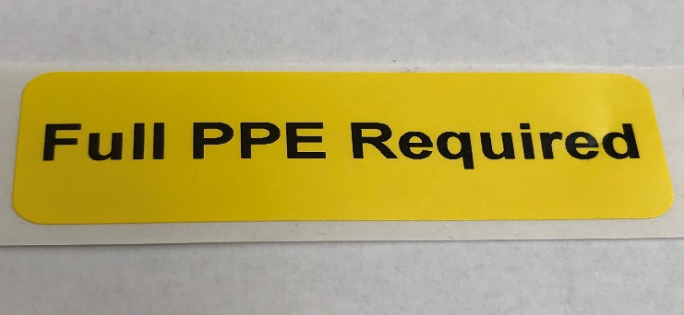
HAZARD LABELING
Drug packages and HD storage areas have distinctive labels identifying those drugs as requiring special handling precautions
HD will contain appropriate labels to alert Nursing and to guide proper PPE for safe handling
National Institute for Occupational Safety and Health. NIOSH alert: preventing occupational exposure to anti- neoplastic and other hazardous drugs in health care settings. www.cdc.gov/niosh/ docs/2004-165/

Slide 16
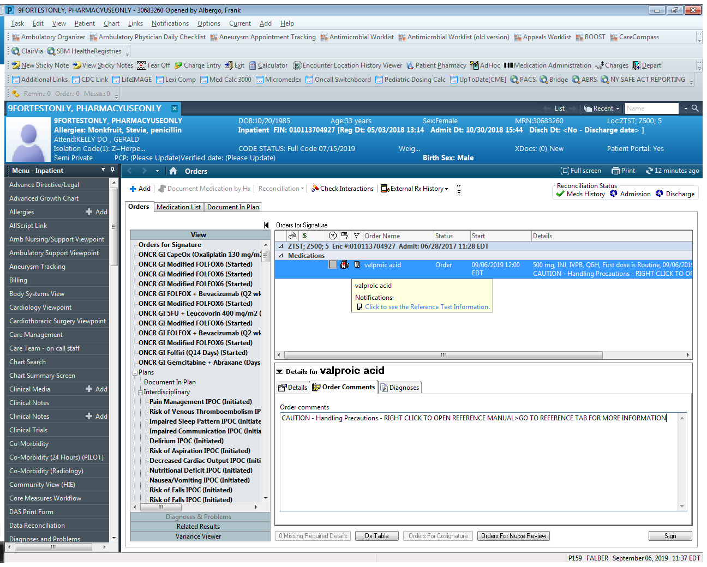
EMAR LINK
Caution –Handling Precaution links to NIOSH handling recommendations
EMAR LINK

Slide 17
ADMINISTRATIVE CONTROLS
Pharmacy has a process for reviewing the hazardous potential of new medications and addressing concerns prior to introducing them to the pharmacy
NIOSH recommendation
  Assessment of Risk for SBUH hazardous drug formulary
  Safety Data Sheet (SDS) from manufacturer
  Hospital intranet – source of HD handling
  Product labeling
    Reproductive and developmental toxicity (commonly USP 800 section 8, Use in Specific Populations)
    Risk of carcinogenicity, genotoxicity, or teratogenicity (commonly section 13, Nonclinical Toxicology)
    Precautions while handling (commonly section 16, How Supplied/Storage and Handling)
    Hospital labeling of all products
US Pharmacopeial Convention. (2016). <800> Hazardous Drugs—Handling in Healthcare Settings.

Slide 18
ADMINISTRATIVE CONTROLS
Hazardous Drug Precautions:
HD precautions are implemented from the time of initiation of the HD until 48 hours after completion of administration.
An “HD Precautions” sign is posted by the patient room door or displayed on electronic room sign to notify staff.
HD PRECAUTIONS
US Pharmacopeial Convention. (2016). <800> Hazardous Drugs—Handling in Healthcare Settings.

Slide 19
ASSESSMENT OF RISK
Chemotherapeutic HD
Mitigation of Risk is Universal for all injectable Chemotherapy hazardous drugs
Detailed document found on Hospital Intranet
Non-Chemotherapeutic HD
Mitigation of Risk is dependent on type of hazard agent presents to staff
Detailed document found on Hospital Intranet

Slide 20

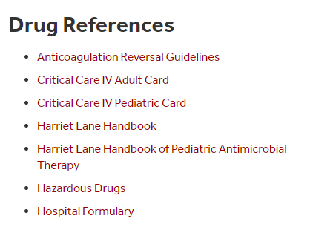
ASSESSMENT OF RISK WORKSHEET
Details risk present in all handling steps (receiving/storage, compounding, dispensing, transporting, storage, administration, manipulation, disposal)
Lists required PPE to mitigate risk
https://inside.stonybrookmedicine.edu/clinical-professional-resources/drug-references

Slide 21

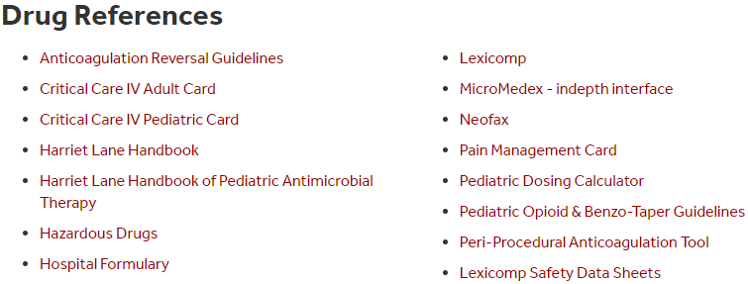
HD SAFETY DATA SHEETS (SDS)
Micromedex and Lexicomp sites include pharmaceutical SDS
Micromedex instructions:
Select MicroMedex – indepth interface.
Select Micromedex in application box on top right.
Enter name of the drug in the search field and press enter.
Click on Toxicology in the Related Results section (on right side).
Click on MSDS From USP. To print, click on printer icon.

Slide 22
WORK PRACTICES
Delivery to Nursing Units
Manufacturer original packages can be sent via pneumatic tube system
  Unit dose oral solid hazardous drugs (e.g. tablets) may be delivered via pneumatic tube system
Injectable hazardous drugs must be hand-delivered or picked up
IVPB and oral syringes must be delivered by Pharmacy Technician in a container with cover
All solid dosage forms of medication and oral syringes must be dispensed in HD precaution zip-lock bag

Slide 23
WORK PRACTICES
Administration of Hazardous Drugs
IV hazardous medications, will have a primed IV set attached
- All Antineoplastic Drugs will be primed
- All Carcinogenic and Mutagenic HD will be primed.
CSTDs will be used for all Antineoplastic drugs, and all carcinogenic or mutagenic HD
Avoid spiking an IV set with HD at the patient bedside
Learn how to handle spills safely
US Pharmacopeial Convention. (2016). <800> Hazardous Drugs—Handling in Healthcare Settings.

Slide 24
WORK PRACTICES
Transport of Hazardous Drugs
Prior to Transport, Pharmacy staff applies caution labels to HD dispensing containers and sealable transport bags
HDs are not transported through the pneumatic tube system (“P tube”), except when its in oral solid form
US Pharmacopeial Convention. (2016). <800> Hazardous Drugs—Handling in Healthcare Settings.

Slide 25
ENGINEERING CONTROLS
Use of Closed System Transfer Devices (CSTD) supplied with hazardous IVs
Utilization of mechanical equipment such as biological safety cabinets during preparation in Pharmacy
  Certification
  Testing
  Calibration
Notes:
Class II/III: ventilated BSC that protect personnel, product and work environment
A Class II Type B2 (TOTAL EXHAUST) is preferred: can be used for volatile toxic chemicals

Slide 26
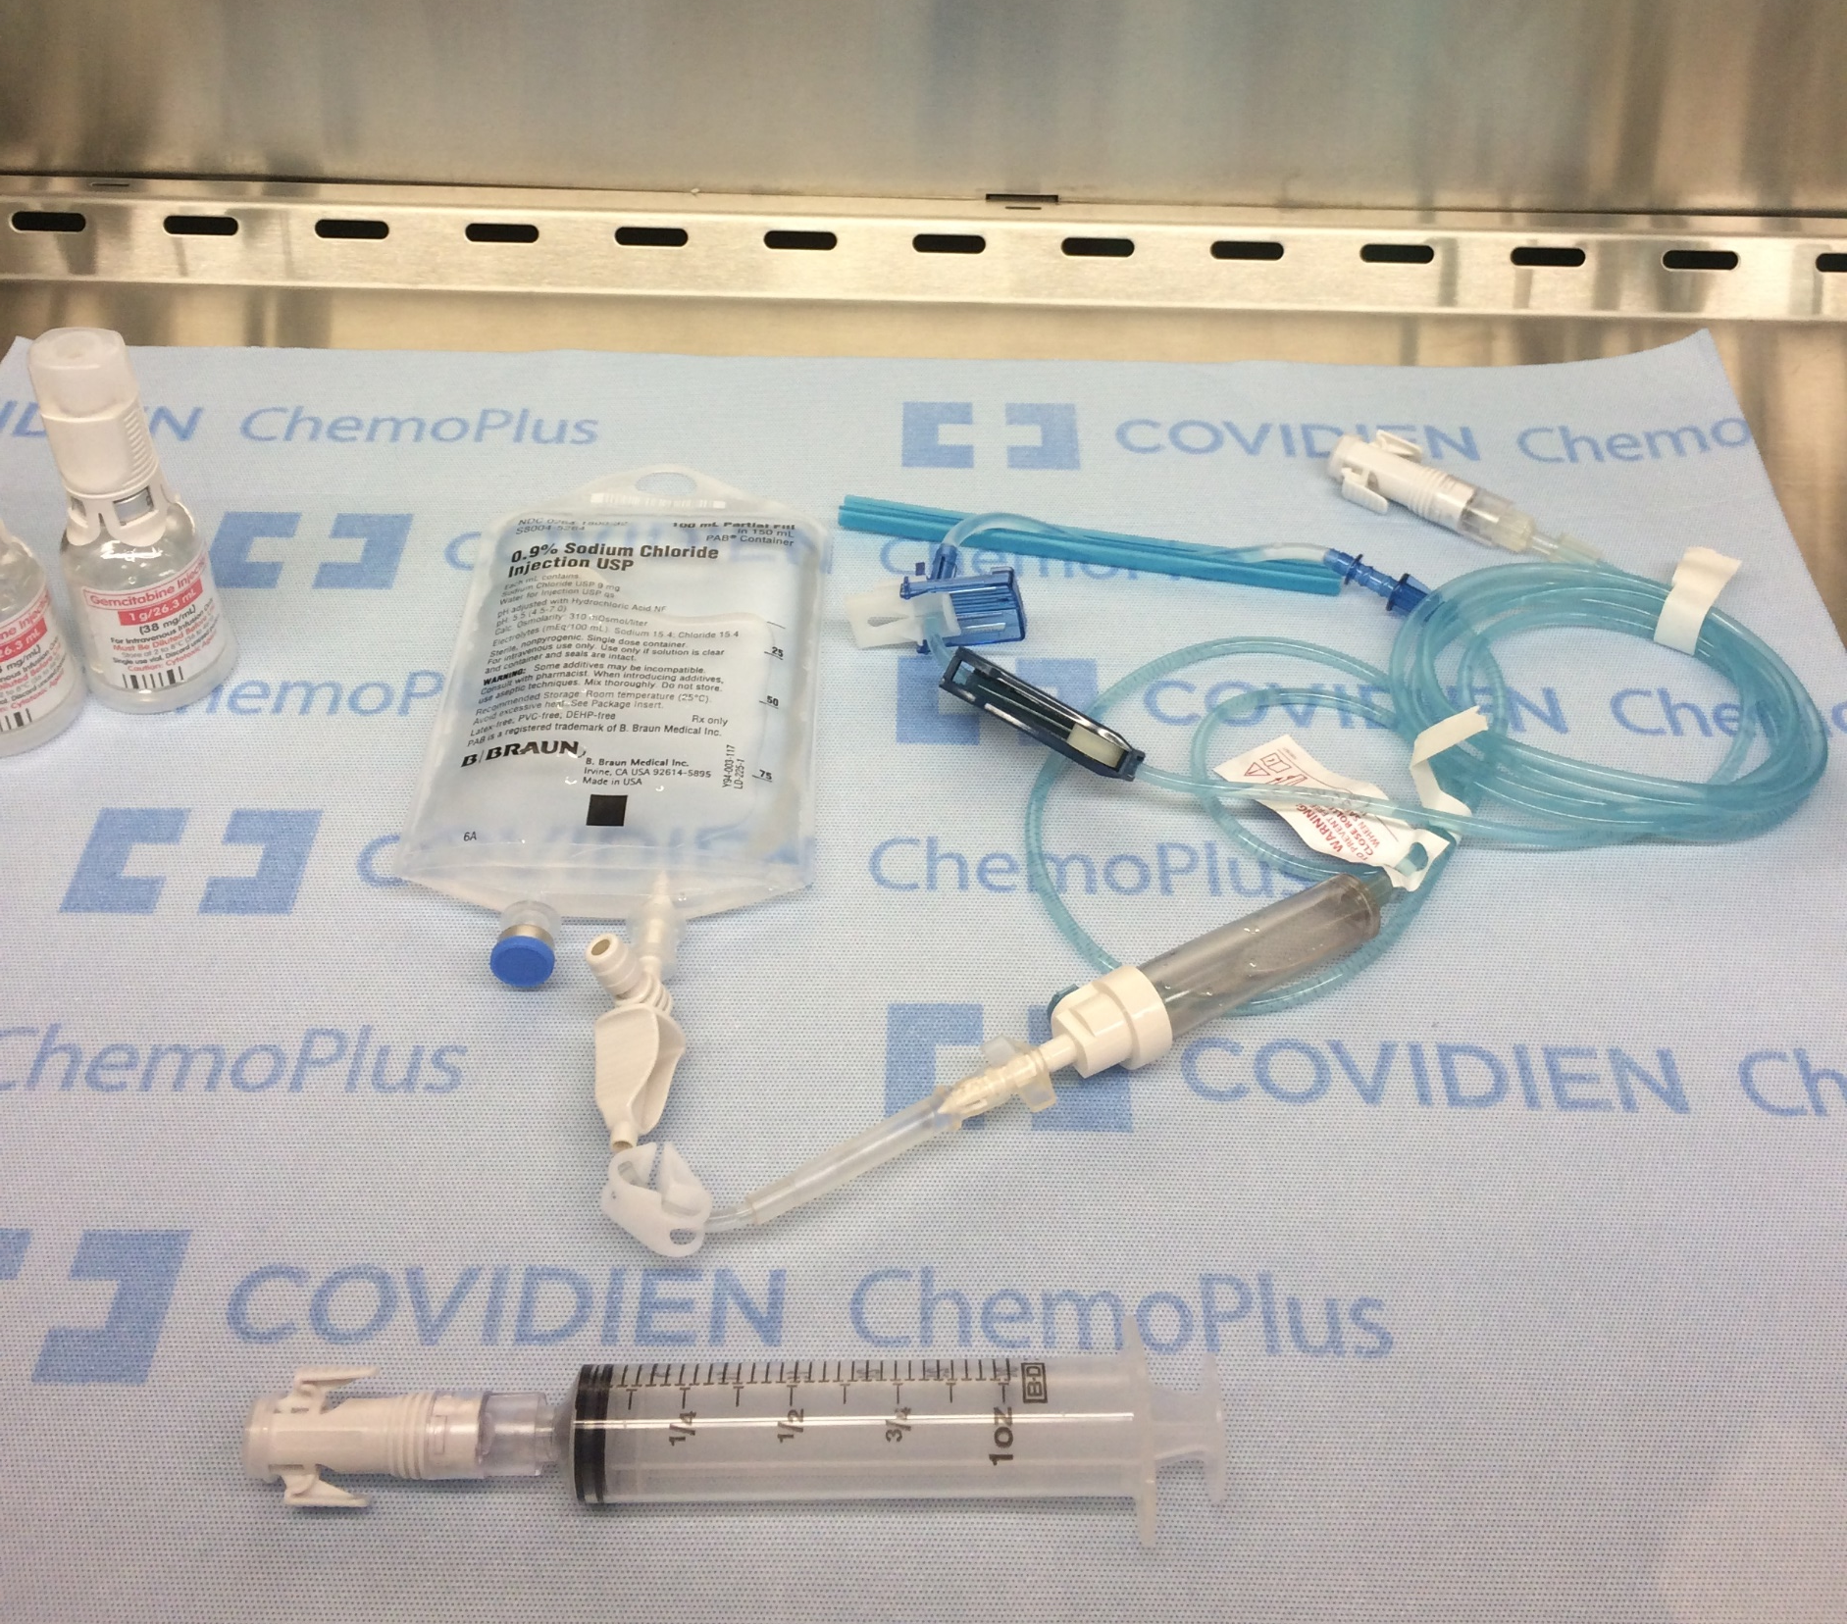
COMPONENTS OF CSTD
Syringe Adaptor
Vial Adaptor
Diluent
Drug
IV Line
Spike Port Adaptor
Syringe Adaptor
Syringe

Slide 27

CSTD PHARMACY
Closed-system drug transfer (CSTD) device
  Prohibits transfer of environmental contaminants into system
  Prevents escape of HD or vapor concentrations to external environment
CSTD video, with permission from BBraun
American Society of Health-System Pharmacists. ASHP guidelines on handling hazardous drugs. Am J Health-Syst Pharm. 2006; 63:1172–93.
Notes:
Class II/III: ventilated BSC that protect personnel, product and work environment
A Class II Type B2 (TOTAL EXHAUST) is preferred: can be used for volatile toxic chemicals

Slide 28

CSTD NURSING
Closed-system drug transfer (CSTD) device
  Prohibits transfer of environmental contaminants into system
  Prevents escape of HD or vapor concentrations to external environment
CSTD video, with permission from BBraun

Slide 29
PERSONAL PROTECTIVE EQUIPMENT
Handling HD or items contaminated with HD – wear double (two pairs) HD compliant gloves* and chemotherapy gown (disposable gown made of lint-free, low-permeability fabric with a solid front, back closure, long sleeves and enclosed elastic or knit closed cuffs.), with minor exception:
  Exception: When receiving, unpacking, storing HD or administering an intact tablet or capsule maintained in original manufactured form (i.e., not crushed or split), a single pair of HD compliant gloves can be worn and a chemotherapy gown is not required.
Where there is the anticipation of splash, splatter or aerosolization, additional PPE such as a face shield, chemical splash goggles and/or fitted N95 respirator is required.
For minor spill response, trained personnel wear double HD compliant gloves, chemotherapy gown, chemical splash goggles, shoe covers and fitted N95 respirator.
*HD compliant gloves meet ASTM standard D6978-05 for permeability of hazardous drugs
MM0081, Hazardous Drug Management

Slide 30
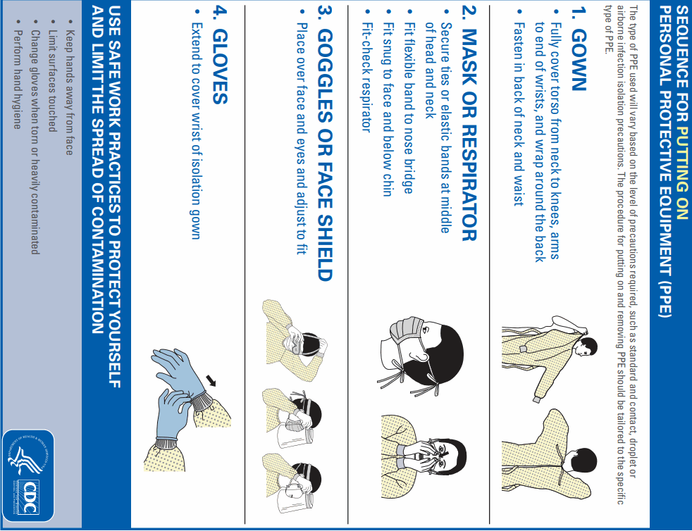
PROPER DOUBLE GLOVING
One HD compliant glove is placed under the chemotherapy gown cuff and the other HD complaint glove over the cuff.
American Society of Health-System Pharmacists. ASHP guidelines on
handling hazardous drugs. Am J Health-Syst. Pharm. 2006; 63:1172–93.

Slide 31
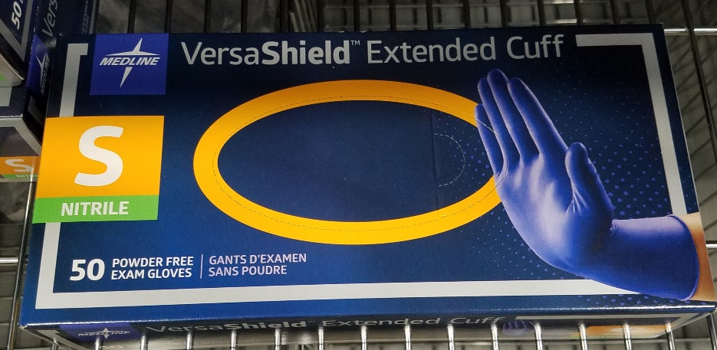
HAZARDOUS DRUGS COMPLIANT GLOVES
Must meet American Society for Testing and Materials (ASTM) standard D6978
Must be disposable and powder-free
Inspect gloves for physical defects before, during and after use
Change gloves every 30 minutes or immediately if damaged or contaminated
Remove gloves carefully, turning then inside out to protect bare hands from coming in contact with the outside of the gloves
Always wash hands with soap and water after removing gloves!
American Society of Health-System Pharmacists. ASHP guidelines on handling hazardous drugs. Am J Health-Syst Pharm. 2006; 63:1172–93.

Slide 32
CHEMOTHERAPY GOWNS
Gowns are fluid impervious, disposable, single use and cannot be reapplied after removal.
  Lint-free, low-permeability fabric with a solid front, back closure, long sleeves and enclosed elastic or knit closed cuffs.
One HD compliant glove is placed under the chemotherapy gown cuff and the other HD compliant glove over the cuff.
Chemotherapy gowns are changed when contaminated with HD or bodily fluids.
American Society of Health-System Pharmacists. ASHP guidelines on handling hazardous drugs. Am J Health-Syst Pharm. 2006; 63:1172–93.

Slide 33
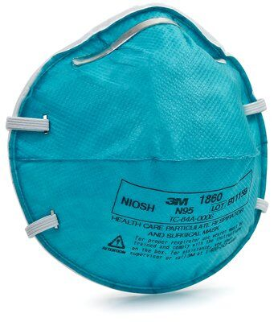
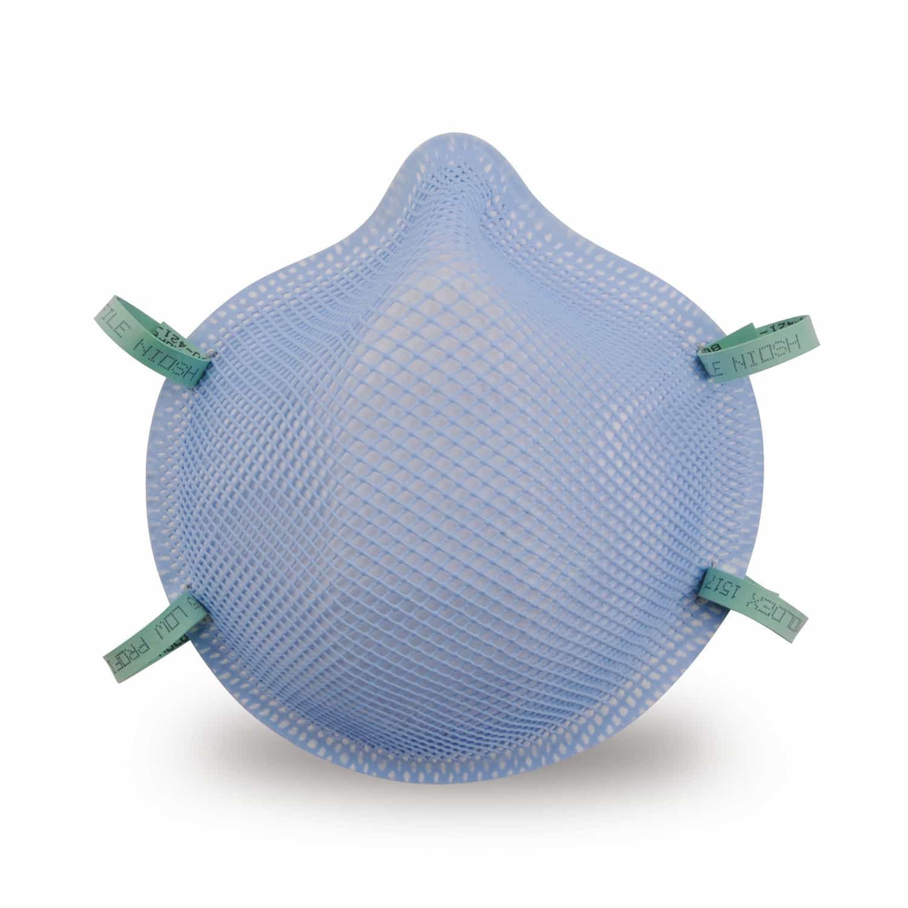
RESPIRATORY PROTECTION
Respiratory protection
  Possible risk of exposure to aerosols or vapors through inhalation
  Fit-tested N95 may be required for particulate protection during certain circumstances such as spill response
    Annual Fit Testing required; no interfering facial hair
  Surgical mask may be used during sterile
  compounding in biological safety cabinet
  (BSC) with negative pressure
American Society of Health-System Pharmacists. ASHP guidelines on handling hazardous drugs. Am J Health-Syst Pharm. 2006; 63:1172–93.
Notes:
Proper respirators can filter hazardous agents from workplace air.
A surgical mask does not offer respiratory protection.

Slide 34
ADDITIONAL PPE
Head, hair, and double shoe covers (typically Pharmacy staff)
  Provide protection from contact with HD residue
  Shoe covers worn in hazardous medication areas must be removed prior to walking into other areas to prevent contamination
Eye protection
  Wear eye protection if splash risk present
HD spills
  Chemotherapy gown, shoe covers, chemical splash goggles, your own fitted N95, double HD compliant gloves
American Society of Health-System Pharmacists. ASHP guidelines on handling hazardous drugs. Am J Health-Syst Pharm. 2006; 63:1172–93.

Slide 35
HANDLING HD - PPE
HD PPE and supplies are available in Materials Management
  HD compliant gloves
  Chemotherapy gowns
  Eye protection
  N95 respirators
  Chemo spill kit with HD Clean wipes
PROTECT YOURSELF
Know where PPE is located.
Know how to use each item correctly.
Use PPE provided every time you handle HD.

Slide 36
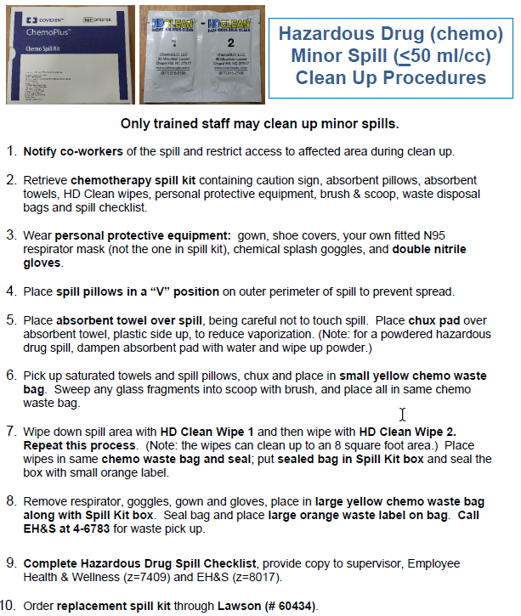
HD SPILL RESPONSE
For Minor Spills, trained staff use spill kit
For a major spill or if you need assistance with a minor spill:
In hospital: Call University Police, 911 (cell phone 631-632-3333)
Hospital Off-sites: Call local police at 911

Slide 37
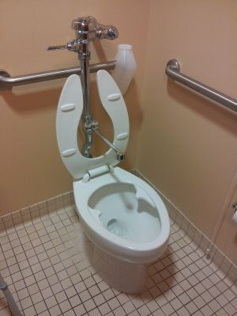
HANDLING BODY EXCRETA
Staff handling excreta (i.e., blood, urine, stool or vomit) or soiled linen from a patient who received HD in the last 48 hours must wear double HD compliant gloves and a chemotherapy gown.
  If splashing likely, wear eye protection.
When disposing excreta in toilet or hopper, close lid or cover with chux or other covering (not linen).
If excreta in diapers, dispose in yellow bags.
Once done handling excreta, remove gloves and then wash hands with soap and water.

Slide 38
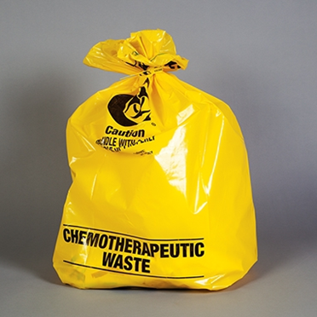
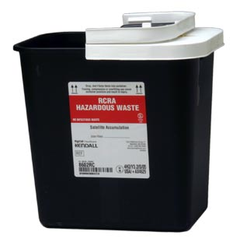
WASTE DISPOSAL
Trace Chemo
Yellow Chemo Bag
RCRA Hazardous Drugs
Black Plastic Container (2 or 8 gallons)
Empty Vials, Ampules, IV Bags, Tubing
Empty Syringes (NO SHARPS)
Gowns, Gloves, other PPE
Any potentially contaminated debris (i.e., diapers)
Only visible/retrievable pharmaceutical agents of the following:
RCRA hazardous waste pharmaceuticals (e.g., Warfarin, Mitomycin, Cyclophosphamide, Phenol, Silver Nitrate, Arsenic Trioxide)
NIOSH Hazardous Drugs
Black containers are typically located in Medication Rooms.
IMPORTANT:
Expired or unused medications are returned to Pharmacy.
Waste questions: Call Environmental Health & Safety (EH&S) at 4-6783

Slide 39
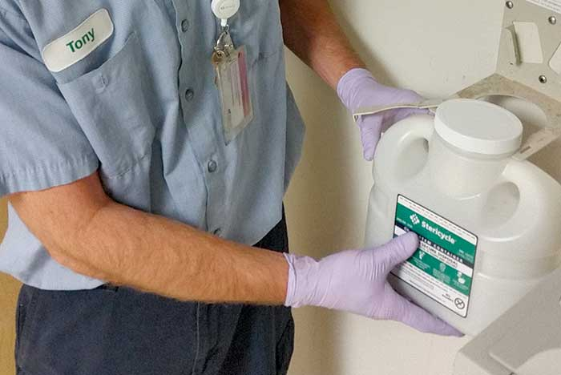
WASTE DISPOSAL
Controlled Substances
Dispose all forms of controlled substances waste (liquid, pills, patches, tablets and IV solutions) into the Stericycle CSRx containers.
Containers are typically located in medication rooms.
Contains a pre-loaded deactivating agent-deterrent.

Slide 40
SUMMARY
As defined by NIOSH, a HD is any drug identified by at least one of these criteria: carcinogenicity, teratogenicity or other developmental toxicity, reproductive toxicity in humans, organ toxicity at low doses in humans or animals, genotoxicity, or new drugs that mimic existing HD in structure or toxicity.
Healthcare workers may be exposed to HD at many points during its life cycle.
Workers can be protected from exposure through engineering and administrative controls, work practices and PPE.
For more information, refer to applicable policies listed on next slide or contact a Pharmacy Manager.

Slide 41
APPLICABLE POLICIES
MM0081 Hazardous Drugs Management
MM0067 Chemotherapy Medications
MM0068 Intravenous Monoclonal Antibody Administration
MM0074 Aerosolized Ribavirin Administration for Adult Patients
EC0051 Management of Contaminated Personal Clothing
MM0084 Pharmaceutical Waste Management
P105 Equal Opportunity/Affirmative Action (University Policy)

Slide 42
RESOURCES
Hospital/University Departments:
Employee Health & Wellness, 4-7767
  https://inside.stonybrookmedicine.edu/hr/emphealth/aboutus
Pharmacy, 4-2680
  Hazardous Drugs Assessment of Risk Worksheet
  Antineoplastic Medication Assessment of Risk Worksheet
Environmental Health & Safety, 4-6783
Office of Institutional Diversity and Equity: Accessibility, Disability and Accommodation, 2-6280
  https://www.stonybrook.edu/commcms/oide-accessibility/
Agencies/Associations:
NIOSH
https://www.cdc.gov/niosh/topics/hazdrug/
Oncology Nursing Society (ONS)
https://www.ons.org/
OSHA
https://www.osha.gov/SLTC/hazardousdrugs/index.html
United States Pharmacopeia (USP)
https://www.usp.org/compounding/general-chapter-hazardous-drugs-handling-healthcare

Slide 43
ATTESTATION – Hazardous Drug Education
I have completed the Hazardous Drug Educational Program and understand its contents, including, but not limited to, the risks associated with working with hazardous drugs and the proper use of personal protective equipment to minimize exposure.
I understand that I may ask questions related to Hazardous Drugs to my supervisor and/or departmental leadership.
I am aware of and understand Stony Brook Medicine's policies and procedures on the proper storage, handling, transport and disposal of Hazardous Drugs and that said policies may be revised as needed in light of new information.
I understand and have reviewed the related policy and procedures:
•MM0081 Hazardous Drugs Management
•MM0067 Chemotherapy Medications
•MM0068 Intravenous Monoclonal Antibody Administration
•MM0074 Aerosolized Ribavirin Administration for Adult Patients
•MM0074 Aerosolized Ribavirin Administration for Adult Patients
•EC00Sl Management of Contaminated Personal Clothing
•MM0084 Pharmaceutical Waste Management
Printed Name: ______________________________________
Signature : __________________________________________ Date: _______________________
Print this completed Attestation form and Email or Fax to: Laura.Coppola@stonybrookmedicine.edu FAX: 631-706-3340
Do Not Forget to PRINT Your Name

