Slide 2
Early Detection and Treatment of
Bacterial related Severe Sepsis and Septic Shock
Stony Brook University Medical Center
Provider Education
July 2025
Approved by
Sepsis Workgroup
5/2025

Slide 3
Surviving Severe Sepsis and Septic Shock: Objectives
Discuss the types of Sepsis
Describe the clinical presentation of patients experiencing SIRS
Identify the diagnostic findings of Sepsis
Describe the different criteria between Severe Sepsis and Septic Shock
Identify the required interventions to be completed within the first 1-3 hours for either the Adult or Pediatric patient (as applicable)
Discuss the Adult Severe Sepsis or Pediatric Bundles
Explain the importance of repeating the Lactate Level if >2
Discuss the importance of fluid resuscitation & documentation for the hypotensive patient
Outline the nursing response to the electronic Sepsis Alert
Review the role of the Nurse Specialist & the LIP in responding to the Septic Shock screening alerts, including related documentation

Slide 4
Surviving Severe Sepsis and Septic Shock
More than 1.5 million people get sepsis each year
One in three patients who die in a hospital have sepsis
Severe sepsis is the leading cause of death in the non-coronary ICU

Slide 5
Background
Sepsis is a clinical syndrome characterized by abnormal, severe host response to infection.
Sepsis is systemic inflammatory response syndrome (SIRS) with an identifiable cause or suspected infectious source.
Bacteria are the predominant pathogen detected
Both gram positive bacteria (i.e., Staphylococcus aureus) and gram-negative bacteria (i.e., Enterobacterales spp.) frequently identified
Viral and fungal infections can also cause sepsis
Mortality rate: >10%

Slide 6
Background
SIRS (Systemic inflammatory response syndrome) - results from a deregulated inflammatory response.
Sepsis - SIRS that is secondary to infection.
Severe Sepsis - Sepsis plus at least one of the signs of hypoperfusion or organ dysfunction.
Septic Shock (adult) - Severe sepsis associated with
refractory hypotension (systolic blood pressure (SBP) less than 90 mmHg or mean arterial pressure less than 65 mmHg) despite adequate fluid resuscitation
blood lactate level greater than or equal to 4.0mmol/L.
Poor prognostic factors: immunosuppression, leukopenia, advanced age

Slide 7
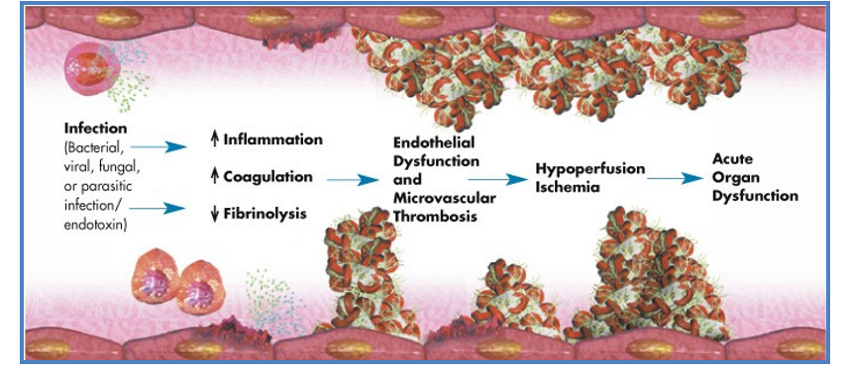
Sepsis Pathophysiology

Slide 8
Adult Severe Sepsis Criteria All three of the following must be met within 6 hours of each other.
Documentation of a suspected source of clinical infection
B. Two or more manifestations of systemic infection according to the SIRS criteria, which are:
Temperature > 38.3 C/101 F or < 36.0 C/96.8 F
Heart rate > 90 bpm
Respiration > 20 per min
WBC > 12,000 or < 4,000 (k/uL) or > 10% bands
C. Organ dysfunction, evidenced by any one of the following:
SBP < 90 mmHg, or MAP < 65 mmHg, or a SBP decrease of more than 40 pts (if documented by LIP as due to infection)
Cr > 2.0 mg/dL, or urine output < 0.5 mL/kg/hour for 2 hours
Bilirubin > 2 mg/dL
Platelet count < 100,000
INR > 1.5 or a PTT > 60 sec
Lactate > 2 mmol/dL
Acute respiratory failure requiring a new need for invasive or non-invasive mechanical ventilation
OR Physician/NP/PA documentation of severe sepsis

Slide 9
Pregnant 20 weeks through Day 3 Postpartum-delivery Severe Sepsis Criteria All three of the following must be met within 6 hours of each other.
Documentation of a suspected source of clinical infection
B. Two or more manifestations of systemic infection according to the SIRS criteria, which are:
Temperature > 38.0 C/100.4 F or < 36.0 C/96.8 F
Heart rate > 110 bpm
Respiration > 24 per min
WBC > 15,000 or < 4,000 (k/uL) or > 10% bands
C. Organ dysfunction, evidenced by any one of the following:
SBP < 85 mmHg, or MAP < 65 mmHg, or SBP decrease of more than 40 mmHg
Creatinine > 1.2 mg/dL, or urine output < 0.5 mL/kg/hour for 2 hours
Bilirubin > 2 mg/dL
Platelet count < 100,000
INR > 1.5 or a PTT > 60 sec
Lactate > 2.0 mmol/dL NOTE: Do no use lactate obtained during active delivery defined as documentation of uterine contractions resulting in cervical change (dilation or effacement) through delivery.
Acute respiratory failure requiring invasive or non-invasive mechanical ventilation
OR Physician/NP/PA documentation of severe sepsis

Slide 10
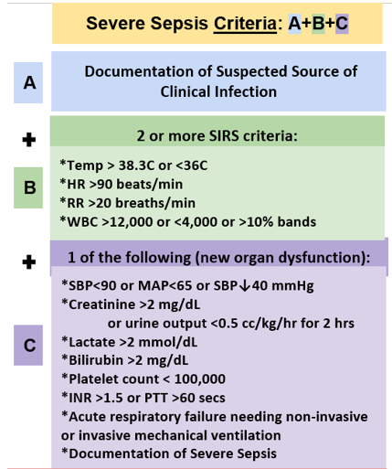
The ABCs of Severe Sepsis Diagnosis

Slide 11
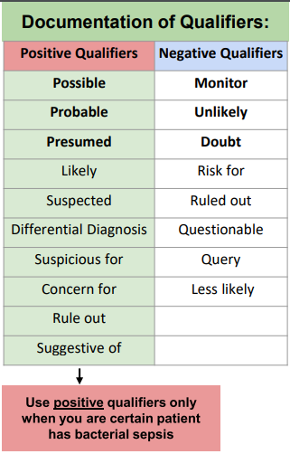
LIP Documentation of Severe Sepsis
LIP documentation of “severe sepsis” in a note with or without clinical criteria requires implementation of the sepsis bundle. The cases may be reported to CMS SEP-1 for sepsis bundle compliance.
If the diagnosis of severe sepsis/septic shock is being considered:
If unsure whether severe sepsis is present or not, use the negative qualifiers for expressing that doubt in documentation.
Positive Qualifiers indicate that severe sepsis is likely or being considered as part of the differential and requires implementation of the sepsis bundle

Slide 12
Laboratory Evaluation within 3 Hours
of Severe Sepsis/Septic Shock Recognition
CBC → Patient with Sepsis may present with an Elevated WBC
Lactate → Patient with Sepsis may present with an Elevated Lactate
Blood Culture → Patients diagnosis with Severe Sepsis/Septic Shock, the source of infection and appropriate treatment plan require the collection of blood for culturing.

Slide 13
Clinical Pearls of Bacterial Sepsis
Lab values (routine labs, lactate, ABG, blood cultures) should be obtained within 45 minutes of sepsis recognition.
However, lab analysis should not delay fluid resuscitation or antibiotics.
Potential causes include gram positive and gram negative bacteria.

Slide 15
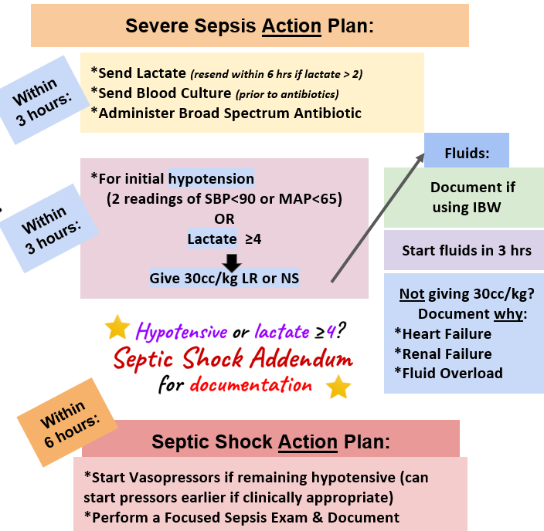

Slide 16
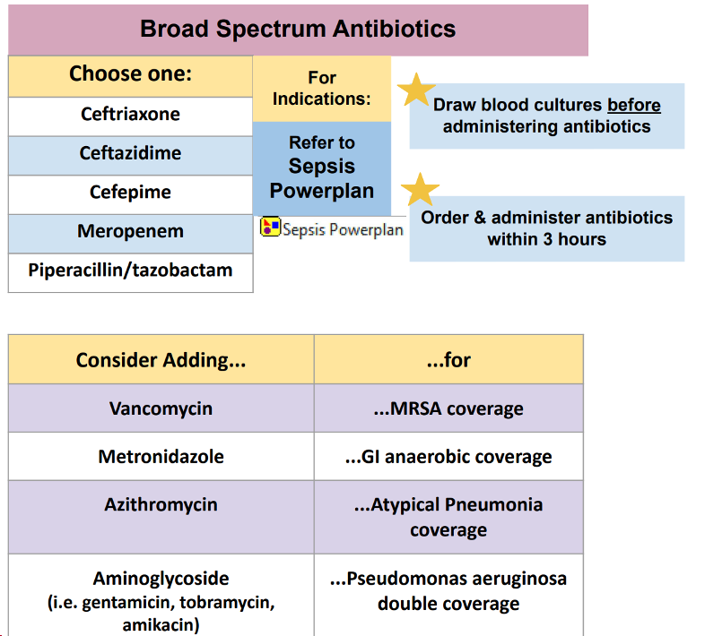
Antibiotic Timeliness is Critical!
Most of these antibiotics are available in Pyxis in the event that dispensing is delayed.

Slide 17
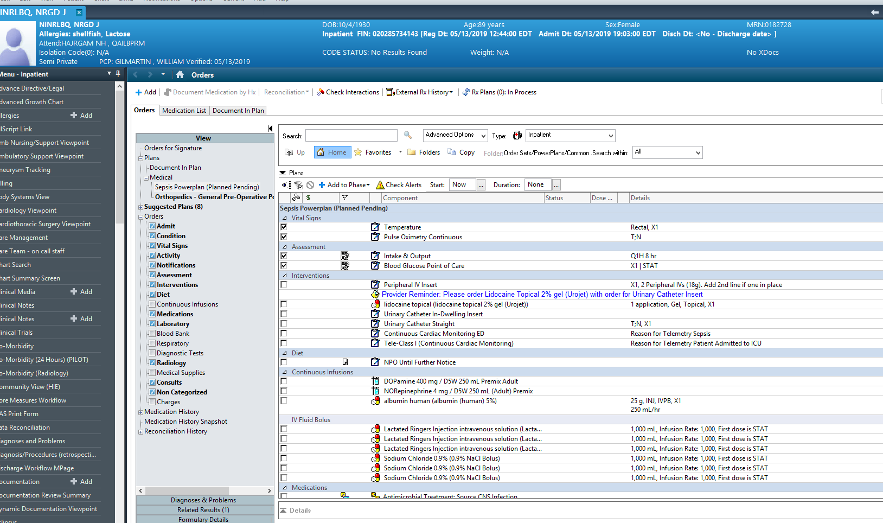
Recognition to Immediate Treatment
the Sepsis Powerplan

Slide 18
Adult Management:
Required Interventions within 3 Hours
of Severe Sepsis/Septic Shock Recognition
Initial Lactate Collection
Blood culture collection prior to antibiotic administration
Early, appropriate broad-spectrum antibiotic administration
Fluid resuscitation
*Adult = Age 18 and Older

Slide 19
Management
Fluid boluses are preferred initial method of resuscitation:
Normal saline or LR (crystalloid solutions).
Antimicrobial therapy with IV antibiotics within 1 hour of presentation.
Broad spectrum antibiotics: gram-positive and gram-negative organisms.
MRSA: vancomycin or daptomycin
Pseudomonas: cefepime or meropenem

Slide 20
Adult Management:
Fluid Resuscitation for Adults
For
Severe Sepsis + Lactic Acid ≥4 OR
Any episode of hypotension (SBP <90 or MAP<65 mmHg)
Crystalloid fluid resuscitation (30 mL/kg) must be initiated within 3 hours with a rate of fluid infusion greater than 125 mL/hr.
Less than 30 mL/kg of crystalloid fluids is acceptable IF a reason is provided such as
Concern for fluid overload, heart failure, renal failure, blood pressure responded to less volume
Provider must document reason and amount of fluid that will be ordered

Slide 21
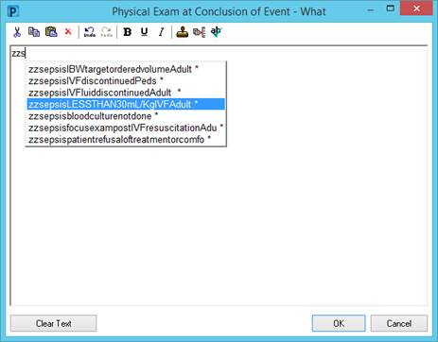
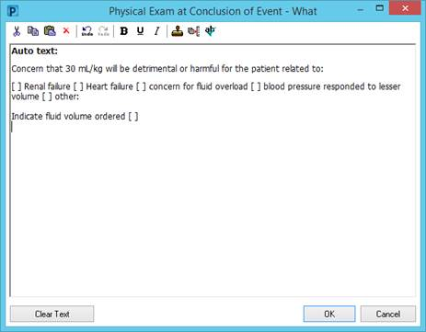
Adult Management:
Fluid Resuscitation for Adults

Slide 23
Adult Management:
Within 6 Hours of Recognition
Re-measure lactate if the initial value was elevated (greater than 2 mmol/L).
When severe sepsis criteria are met and the initial lactic acid result is > 2, a repeat Lactic Acid order is required and will be generated automatically by the system. Send the Lactate! Don’t wait.
THESE ORDERS SHOULD NOT BE CANCELLED!
*Emergency Department: Second lactate may NOT be automatically reordered if the first was not ordered through the Sepsis Order Set. The Lactate order MUST then be manually reordered by the admitting LIP.
Initiate vasopressor therapy IF hypotension persists after appropriate fluid resuscitation
Reassess and document volume status and tissue perfusion

Slide 24
If you do not care for patients < 18 years of age, skip to the summary

Slide 25
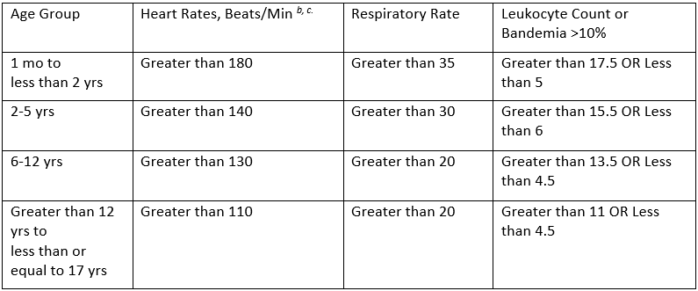
Pediatrics: Patients Less than 18 Years Old
Pediatric age-specific SIRS criteria

Slide 26
Pediatrics: Patients Less than 18 Years Old
Pediatric Severe Sepsis Criteria
Patient must first meet Pediatric age-specific SIRS criteria
Sepsis plus one of the following:
Respiratory Dysfunction
OR
Two or more other organ dysfunctions:
Renal Hepatic
Neurologic Hematologic
Pediatric Septic Shock Criteria
Sepsis and cardiovascular organ dysfunction

Slide 27
Pediatrics: Patients Less than 18 Years Old
Interventions within 1 Hour of Recognition
Blood culture collection prior to broad spectrum antibiotics
Early and appropriate broad-spectrum antibiotic administration
Less than 18 years of age: Fluid resuscitation = (20 mL/kg)*
Single lactate level
Interventions within 6 hours of Recognition
If persistent hypotension (septic shock) vasopressors must be initiated

Slide 28
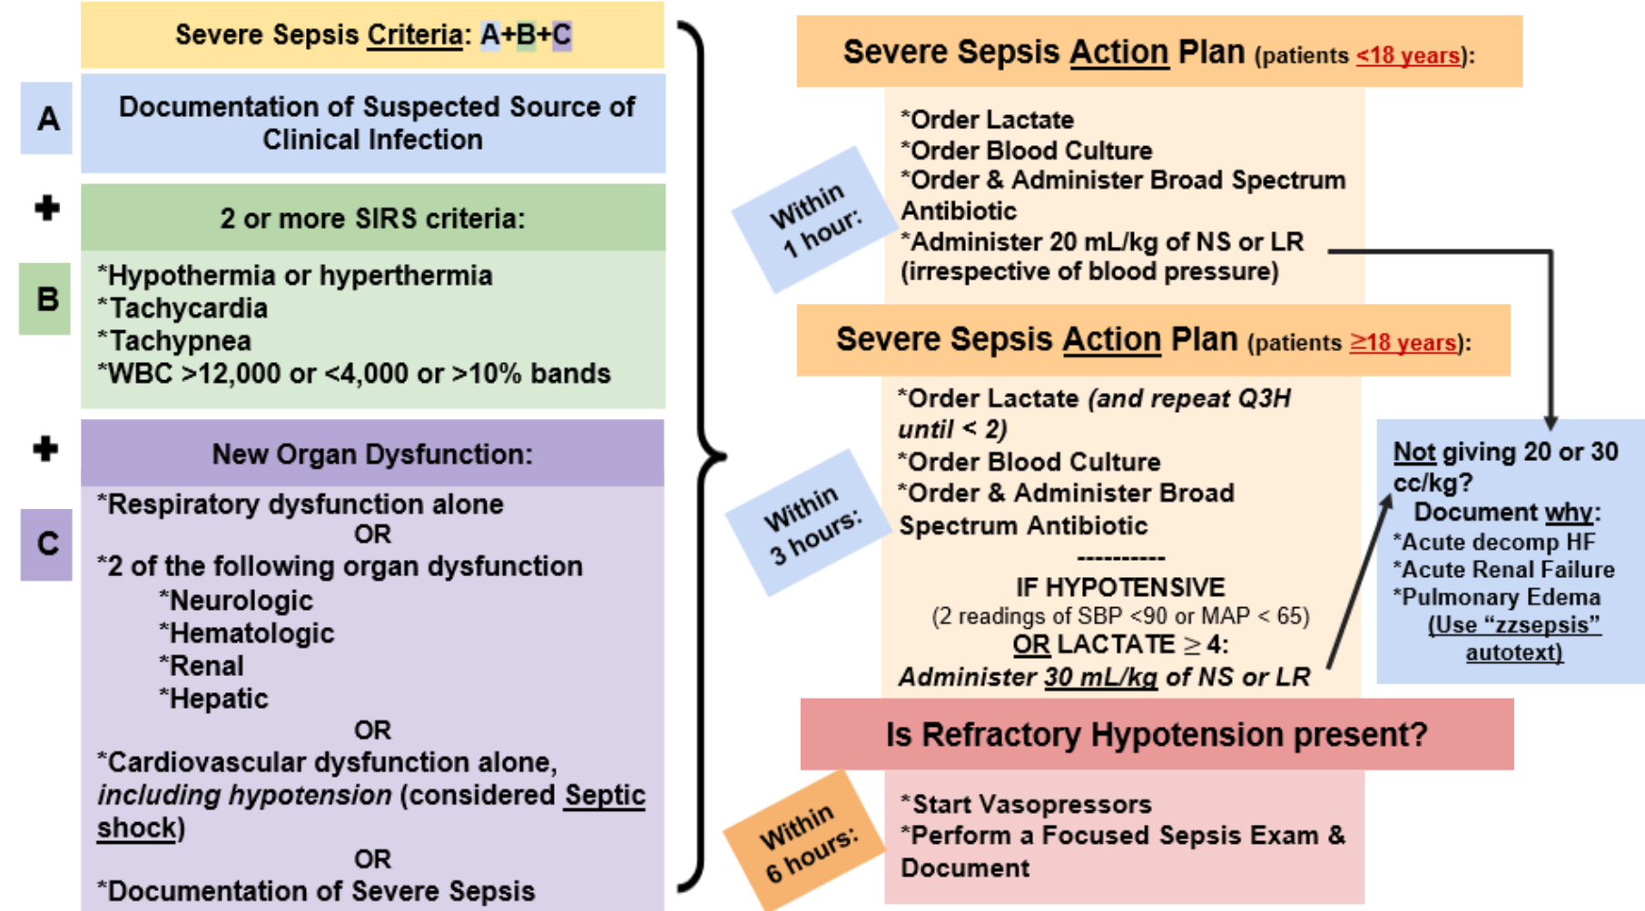

Slide 29
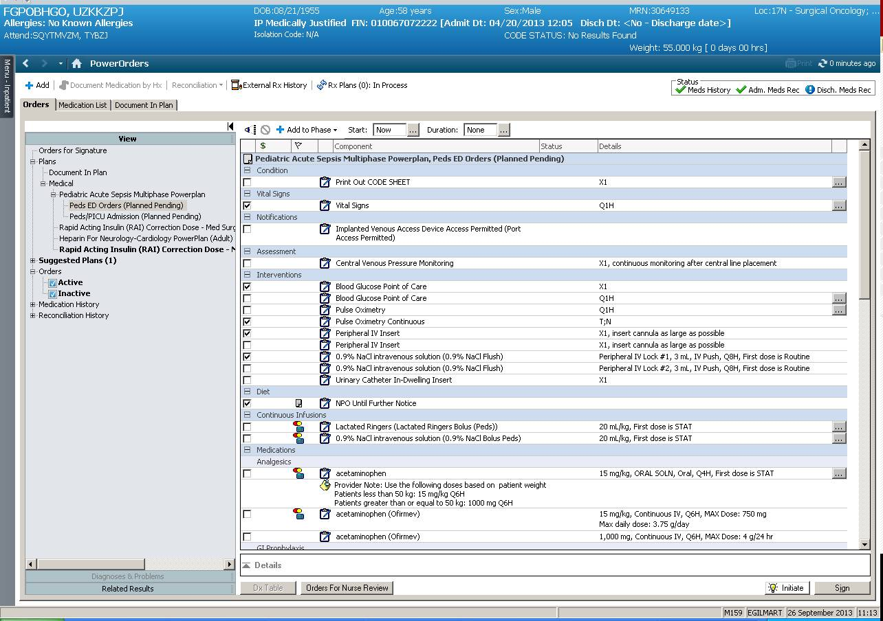
Pediatrics: Patients Less than 18 Years Old
Recognition to Immediate Treatment
The Pediatric Acute Sepsis Multiphase Power plan
Early Detection and Treatment of Severe Sepsis

Slide 30
In Summary…
Lactic Acid and Blood Culture specimens are critical to the diagnosis and appropriate treatment of Sepsis.
Blood cultures must be collected prior to antibiotic administration time. Check that the collection time is correct on all blood culture orders before sending to the lab
Early Antibiotic therapy is critical, and verification of orders and dispensing of medication is a priority.
Nurses may override the Pyxis for the first dose of certain broad spectrum antibiotics in the treatment of severe sepsis/septic shock, become familiar with those available in your area!
Early fluid resuscitation and administration is also critical!

Slide 31
Electronic Sepsis Screening Alerts

Slide 32
Nurse: Cerner Sepsis Screening Alert
2 SIRS criteria within a 5 hr period will trigger a task to fire in Cerner for the bedside nurse to evaluate their patient for suspicion of infection, and to send a serum Lactate.
If an infection is suspected, the RN contacts the physician for a sepsis workup. The RN documents name of physician and date/time notified. The Adult and Pediatric Sepsis Power plans are offered under suggested power plans.
If the screen is found to be negative, complete the task as “No.” Comments addressing the criteria that fired the alert must be entered as to WHY the answer is No. For example: “Patient with brief tachycardia was walking to the bathroom”
Once addressed, the alert will not fire again for an 8 hour period.

Slide 33
Identifying SIRS – Notify MD – Suspicion of Sepsis
Task Reminders:
Answer all alerts
Alerts that are removed from the task list without answering “Yes” OR “No” is non-compliant.
Answer the alert for the current patient presentation.
Send Lactate

Slide 34
Identifying SIRS – Notify MD – Suspicion of Sepsis
The ORDER details is located in the Notifications. Click or hover over the order for details related to vital signs and WBC Count

Slide 35
Provider: Cerner Severe Sepsis Screening Alert
This alert will appear whenever a LIP opens the patient’s chart and the following criteria have been met:
2 SIRS criteria + 1 Organ Dysfunction (within 6 hours of each other)
Answering alerts is time sensitive; clock is ticking on bundle compliance!
Primary team providers must answer “agree” or “disagree” that severe sepsis is present (i.e. there is a new suspected or documented infection)

Slide 36
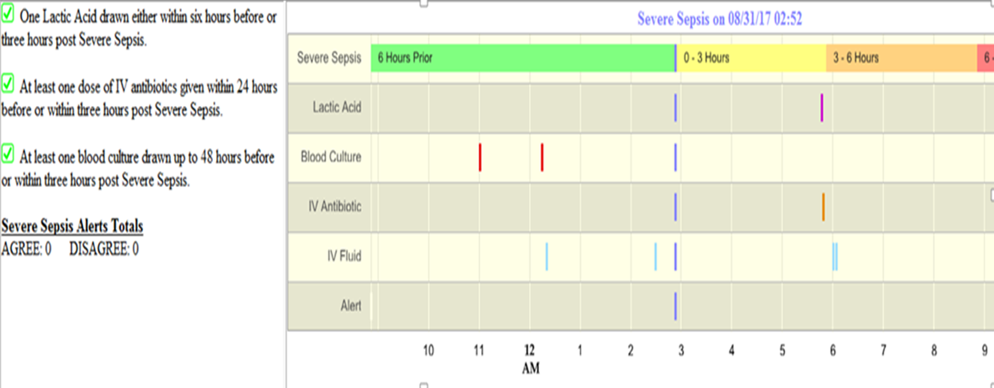
Sepsis Dashboard
Provides visual estimation of when criteria was met or “time zero”
Hovering over lines identifies criteria used to determine severe sepsis presence or intervention details.
Provides timeline for interventions required and visual cues for which interventions are still outstanding

Slide 37
Adult Severe Sepsis:
Recognition Pager Workflow
Patient meets severe sepsis criteria
Pager fires to location Nurse Specialist (NS) or designee
Page identifies the patient and location of the sepsis alert
NS or designee reviews the sepsis dashboard
NS or designee speaks to the provider responsible for the patient and asks them to assess the patient and respond to the severe sepsis alert.
The sepsis dashboard is reviewed by the provider and NS or designee and outstanding bundle elements implemented if appropriate.

Slide 38
Pediatric Inpatient Severe Sepsis: Recognition Pager Workflow
Patient meets severe sepsis criteria
Pager fire's location to PICU attending
Page identifies the patient and location of the sepsis alerts
PICU attending speaks with the provider responsible for the patient and asks them to assess the patient
Findings are to be reviewed by the primary medical team, and outstanding bundle elements implements if appropriate.
The responsible provider answers the severe sepsis screening alert AND documents findings in SBAR format using the Pediatric Severe Sepsis note template.
This document is to be forwarded to the primary attending that the case was discussed with.

Slide 39
References
Dellinger, R. Phillip et al, Surviving Sepsis Campaign: International Guidelines for Management of Severe Sepsis and Septic Shock: 2012. Critical Care Medicine, Feb. 2013. Vol. 41, No.2.
Goldstein, Brahm, et al, International Pediatrics Sepsis Consensus Conference: Definitions for sepsis and organ dysfunction in Pediatrics. Pediatric Critical Care Medicine, 2005, Vol.6 No. 1.
Surviving Sepsis Campaign: An international collaborative recommending resuscitation and management care bundles for the recognition and treatment of sepsis/septic shock. Recommendations were first published as in Critical Care Medicine, Mar 2004.
https://www.ncbi.nlm.nih.gov/pmc/articles/PMC3916377/
https://www.ncbi.nlm.nih.gov/pmc/articles/PMC10120799/
SBUH PC0169 Severe Sepsis/Septic Shock Recognition and Treatment Protocols – Adult and Pediatric
https://policymanager.uhmc.sunysb.edu/dotNet/documents/?docid=21977

