Slide 2
Teddy Bear Clinic
Train-The-Trainer
Kristi L. Ladowski, MPH
Injury Prevention & Outreach Coordinator
Stony Brook Trauma Center

Slide 3
Teddy Bear Clinics
Designed for kindergarteners
Safety Topics: Car Safety, Use of Helmets
Repetitive Questions
Get safety messages home to parents

Slide 4
Injury Trends in Kids

Slide 5
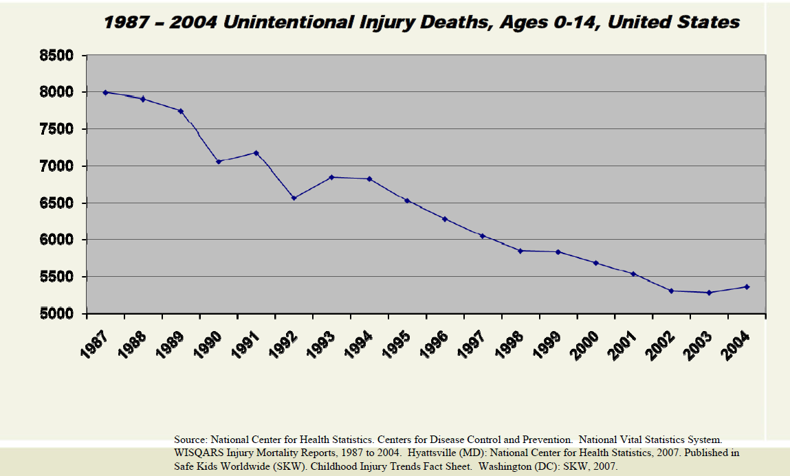
The good news…

Slide 6
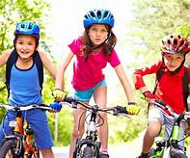
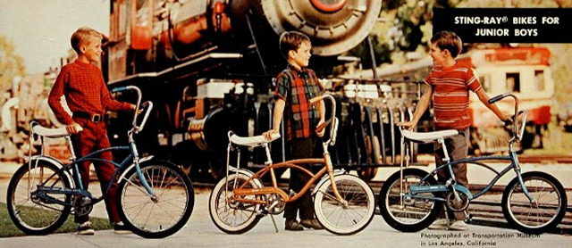
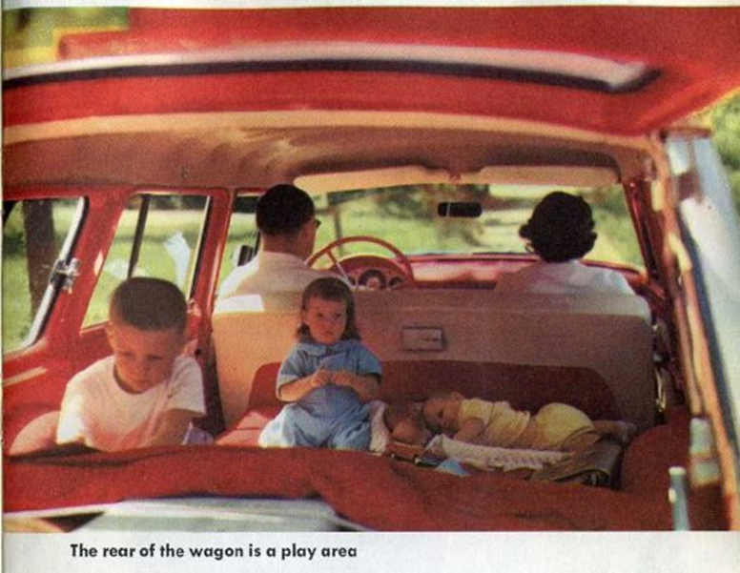
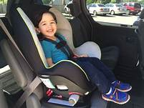
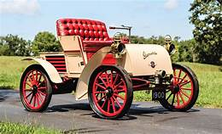

Safety Improvements
Cars:
      Seatbelts
      Child Passenger Safety Seats
      Airbags
      Crash Protection
      Computer Safety Features
Bikes
      Helmets
      Bike Lanes

Slide 7
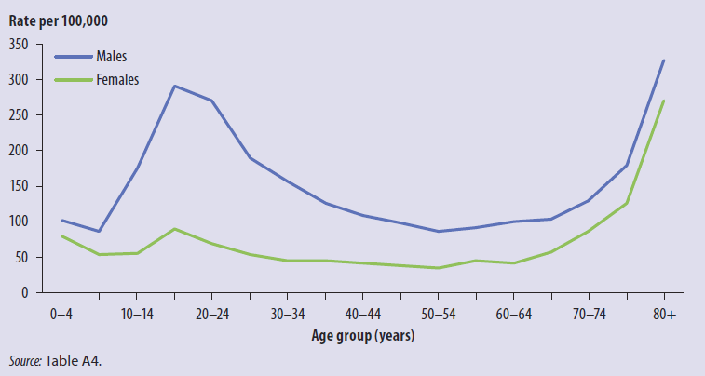
The not so good news…
Road Injuries

Slide 8


Slide 9
Safety Tips

Slide 10
 | Best Practices | Current NY Laws
Car Seat | Keep in seat until outgrows max ht/wt, each transition offers less protection (4-7 yrs) | Car seat until 4 years, or 40 lbs
Booster Seat | Until properly fits in seatbelt (8-12 yrs) for most is 4’9” | Booster seat until 8th birthday, unless 4’9” or 100lbs and properly fits in seatbelt
Back Seat | At least until 13 yrs | No Law
Seatbelts | Everyone | Everyone
Helmets | Everyone | NYS 14 yrs, Suffolk 18 yrs

Slide 11
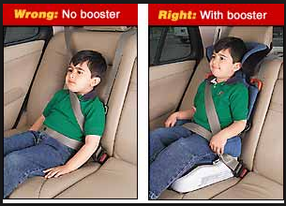

Slide 12
Program Design

Slide 13
Why Lower Elementary?
Start early to build foundation for safety behaviors
They can understand consequences to actions
Influenced by peers
Children can have positive influence on family behaviors
Successful programs include group sessions that incorporate:
Group activities: interactive rather than lecture
Rehearsal opportunities: develop problem solving skills rather than content specific knowledge alone (i.e. What if Q’s)

Slide 14
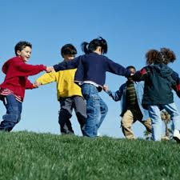
Talking to Kindergarteners
5-6 year olds:
Love to participate and aim to please
VERY excited to have you in their classroom
They will talk about this for days/ weeks/ months!!
Expect the unexpected
Kids say the darndest things!
Don’t know the difference between a story and a question…

Slide 15
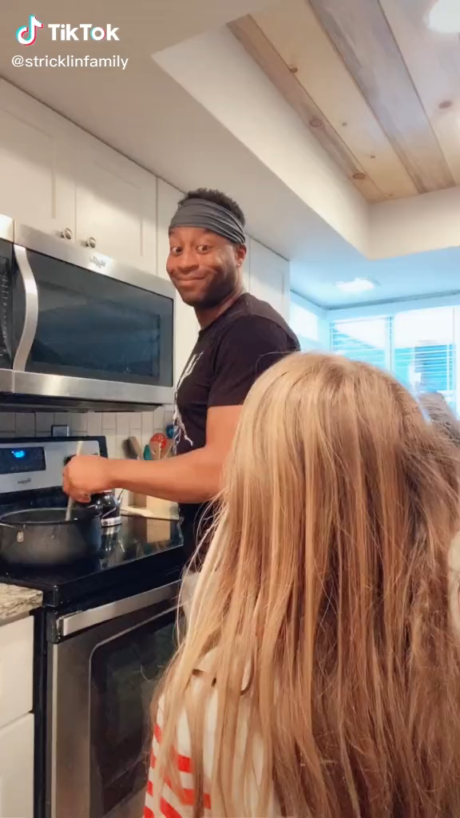

Slide 16
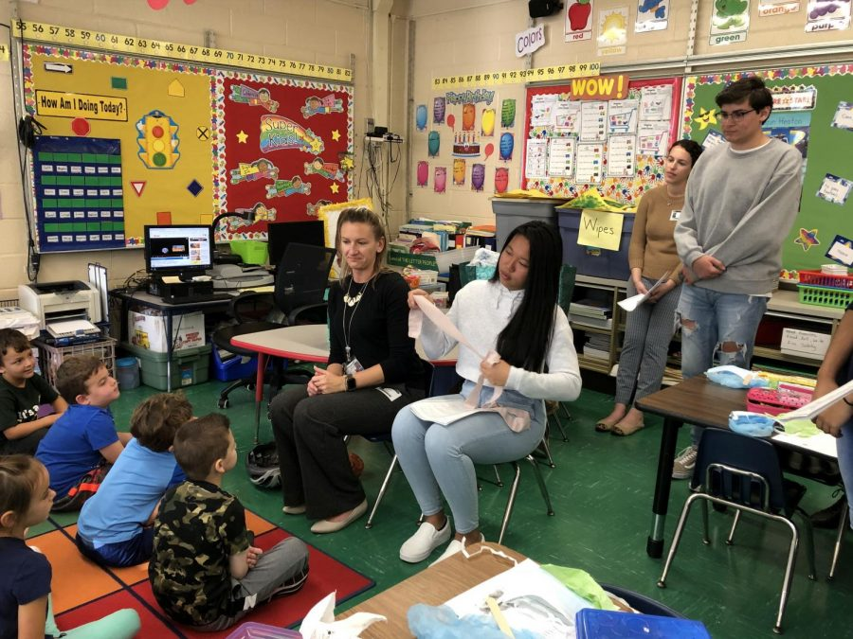
Classroom Presentation
Interactive Discussion ~25 minutes
Introductions
Talk about why people might need to go to a hospital
Talk about who helps us stay safe
Emphasize we can keep ourselves safe with good decisions
Car Safety
Wearing a seatbelt
Car seats and booster seats help kids stay safe in cars
Back seat is safest for kids
“What if” questions to problem solve
Helmet Safety
Why is our brain important?
How do we protect our brains?
What kind of activities or games we do play that we need to wear a helmet?
EGG DROP DEMO
“What if” questions to problem solve

Slide 17
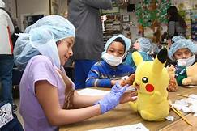
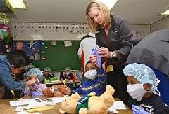
Classroom Presentation
Teddy Bear Clinic ~20 minutes
Explain students will dress up like doctors and nurses:
  Why do doctors and nurses wear gloves and hats?
  What do you do every day to prevent germs?
Teddy Bear Clinic
  Worksheets
  Dress Up as hospital staff
  Take care of stuffed animals

Slide 18
Program Implementation

Slide 19
Preparation Checklist
Schedule Class days and times
  About 45 mins/class
Send Teachers the Prep Handout
  Asks students to bring stuffed animal
  Have a pencil available for the handouts
Identify all facilitators for each class
  3-5 people/class
Request supplies from Stony Brook Trauma (Kristi)
  Each bag/box contains 25 sets

Slide 20
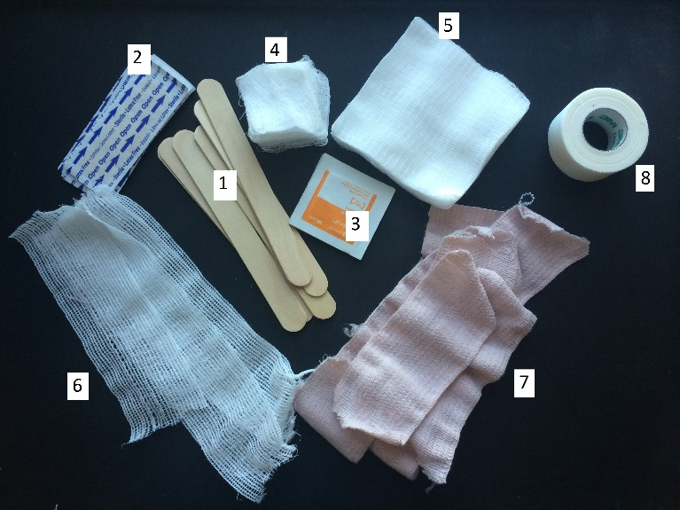
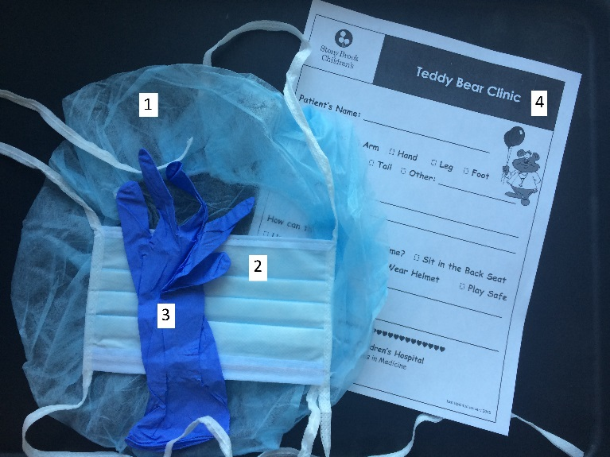
Supplies
Supplies:
At Students Desks (preferably after the video to reduce distraction):
Handout
Pencil
Medical Dress Up supplies: hat, glove (students have their own masks)
Bandages: gauze pieces, gauze pads, tongue depressor
For Teacher/Facilitator:
Medical tape to give small pieces to students as needed
*If student group is preparing supplies, refer to “Packing Instructions” handout

Slide 21
Classroom Setup
-Social Distancing
Social Distancing: Individual desks spread out
Children watch classroom video from individual desks
  If possible, avoid having stuffed animals and other supplies at desks for this portion to reduce distractions
Distribute supplies after video
  Have students get their stuffed animals if they don’t already have them
  Begin with having student’s complete the handout
  Then allow students to “Dress Up” with supplies (hat/glove)
  Finish distributing bandage supplies for clinic play
    Students can use as many/few bandages as they’d like
    Teachers/Facilitators give out small pieces of medical tape as needed

Slide 22
Classroom Setup
-NO Social Distancing
No Social Distancing: Tables grouped together
Ask children to take a seat on learning carpet during video presentation
  Leave stuffed animals at desk/chair (reduce distractions)
Ask classroom helpers to place supplies on tables during video
  At each child’s seat, place: worksheet, hat, glove
  Center of table place some bandages
Children return to desks for clinic play
  Have student dress up (hat/glove)
  Complete handout
  Bandage stuffed animals
    Students can use as many/few bandages as they’d like
    Teachers/Facilitators give out small pieces of medical tape as needed

Slide 23
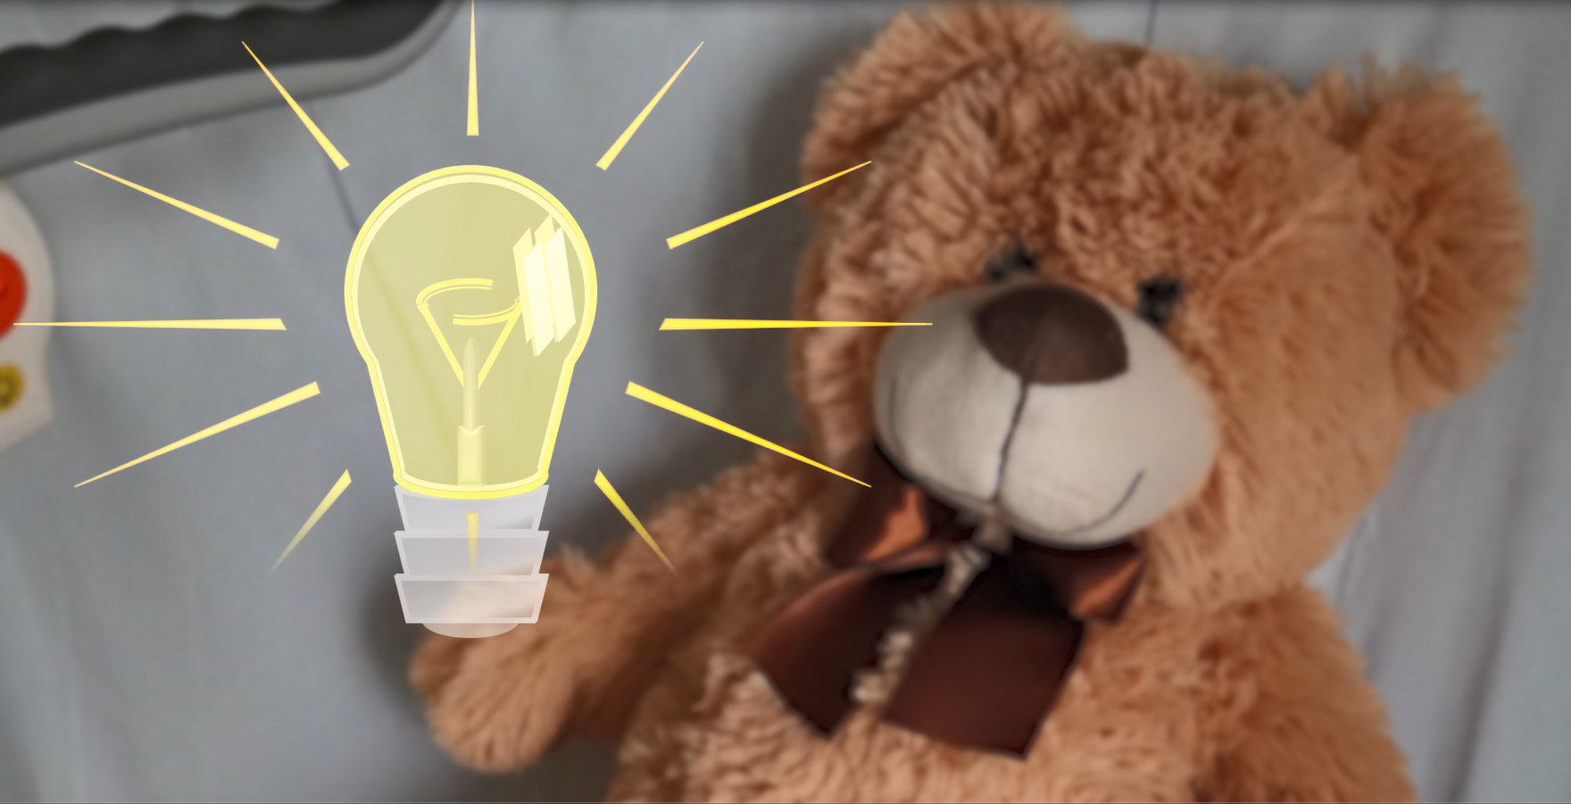
Using the Classroom Video
Pause to take Answers
Encourage the class to shout out the answers with the video:
  Who is in charge of keeping you safe? (SHOUT Ourselves!)
  What is the first thing we do when we get in the car? (SHOUT Buckle Up!)
  Where is the safest place to sit? (SHOUT In the Back!)
  How do we protect our brains? (SHOUT Wear a Helmet!)
Egg drop (if doing in person)
  Use 2 baggies for Humpty Dumpty to avoid any leaks
  If dropping on a hard floor: keep eggs at kids’ hip height
  If dropping on carpet/rug: ask kids to hold eggs as high as possible (need more momentum to break Humpty Dumpty on carpet)
  Slowly take Shelly out of helmet to check for any small cracks just in case. If Shelly has cracks: discuss how Shelly only has a small crack that the doctors can fix but Humpty Dumpty is really broken and can’t be fixed
  Use the previous Shelly as the next Humpty Dumpty since it already experienced a fall

Slide 24
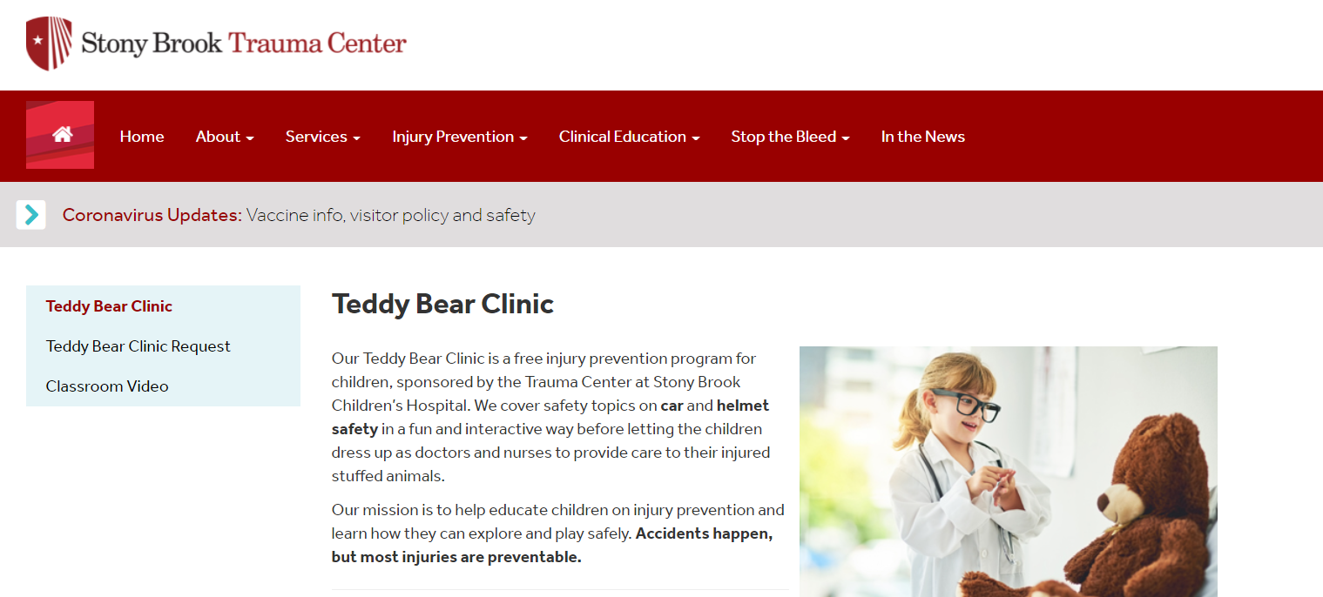
Accessing the Classroom Video
Log In: https://trauma.stonybrookmedicine.edu/teddybear
Click on the “Classroom Video” tab to the left
You will be asked to enter your username and password
Once you finish the video, click “Continue” to log out
Trouble Shooting:
If you return the website and cannot see the video, you may still be logged in. Access the video with the direct link: https://trauma.stonybrookmedicine.edu/tbcvideo

Slide 25
Teddy Bear Clinic
Teddy Bear Clinic Announcement
  Explain out loud to students and classroom helpers:
    When your teachers says it okay, you’ll get your stuffed animal and take your seat
    Helpers will help put on hats first-explain how
    Then put on gloves-try to have the glove on non-dominant hand so it will be easier to hold the pencil and use bandages in ungloved hand
    Helpers will help fill out form to tell us what happened to your stuffed animal and how you will make them feel better
    Then we will start to bandage the animals
Begin Teddy Bear Clinic by letting students return to tables, one at a time
  Let the teacher call them back to their tables
  Dress up, fill out worksheet, bandage animals, take class photos
  When done, show how hat can be a ‘bag’ for them to put everything in and take home

Slide 26
Key Points
Keep an eye on everything that’s going on
  Walk around the room during clinic portion
  Help guide classroom helpers on what to do
  Make sure all students who want to be involved are getting some help during the “play” portion
Watch the time
  About 25 mins for education, 15-20 mins for clinic (longer if teacher allows more play time)
  Control the conversation and don’t allow students to tell stories (take answers, not stories)
  If classroom is interested, allow time for pictures at the end
If you are short on time
  Skip the handouts, teachers can do them another time or send home
  Shorten some of the education by taking less answers during pauses

Slide 27
Key Points
Check in with the teacher
  Introduce yourself and explain how you will run the program
  Ask if the teacher wants to take classroom photos
  Confirm when you need to finish to make sure they can move on to their next lesson
  Ask if the teacher wants to let them keep playing after you leave or have them put everything away to move on to next lesson
  Thank the teacher before you leave
Have fun!

Slide 28
Other “Stuff”

Slide 29
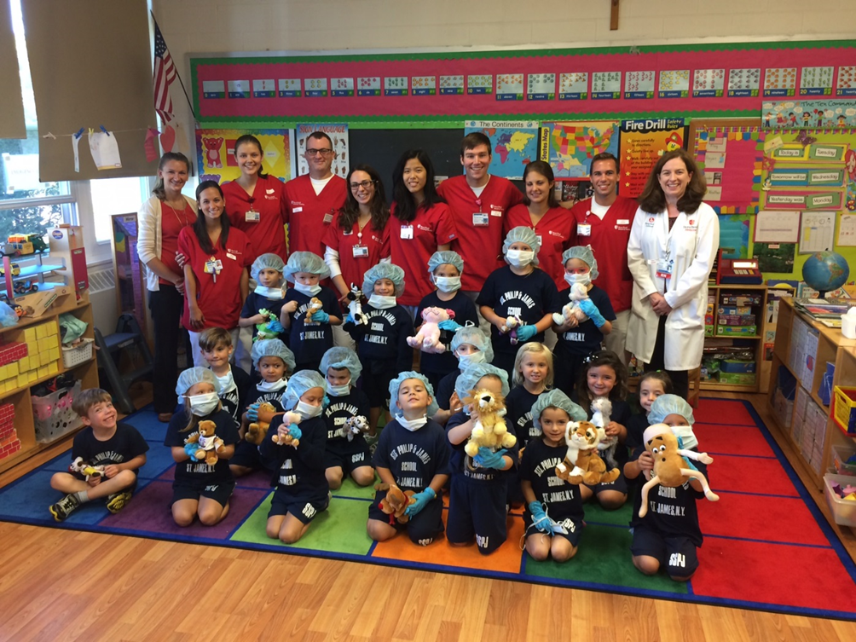

Being a Role Model in your Community

Slide 30
Important Things to Remember
Carry school and formal ID (license) and dress to represent your organization
Remember: what you do and say will be observed by the community
Leave bags, coffee, food, etc in car
Schools take safety very seriously, do not make jokes
Review the Facilitator Guide in advance
HAVE FUN!

Slide 31

Other Important Stuff
Do not laugh at students answers
K.I.S.S.-Keep It Simple and Short
Speak clearly and confidently
Follow classroom rules and teacher’s lead
Remember school rules:
  No talking in hallway
  Do not wander off on your own
  No smoking on school property
  Ask before using the bathroom

Slide 32
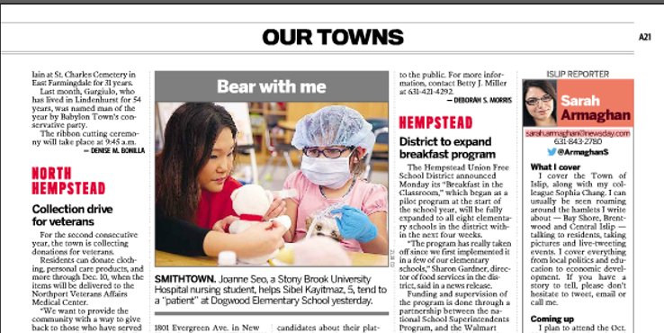
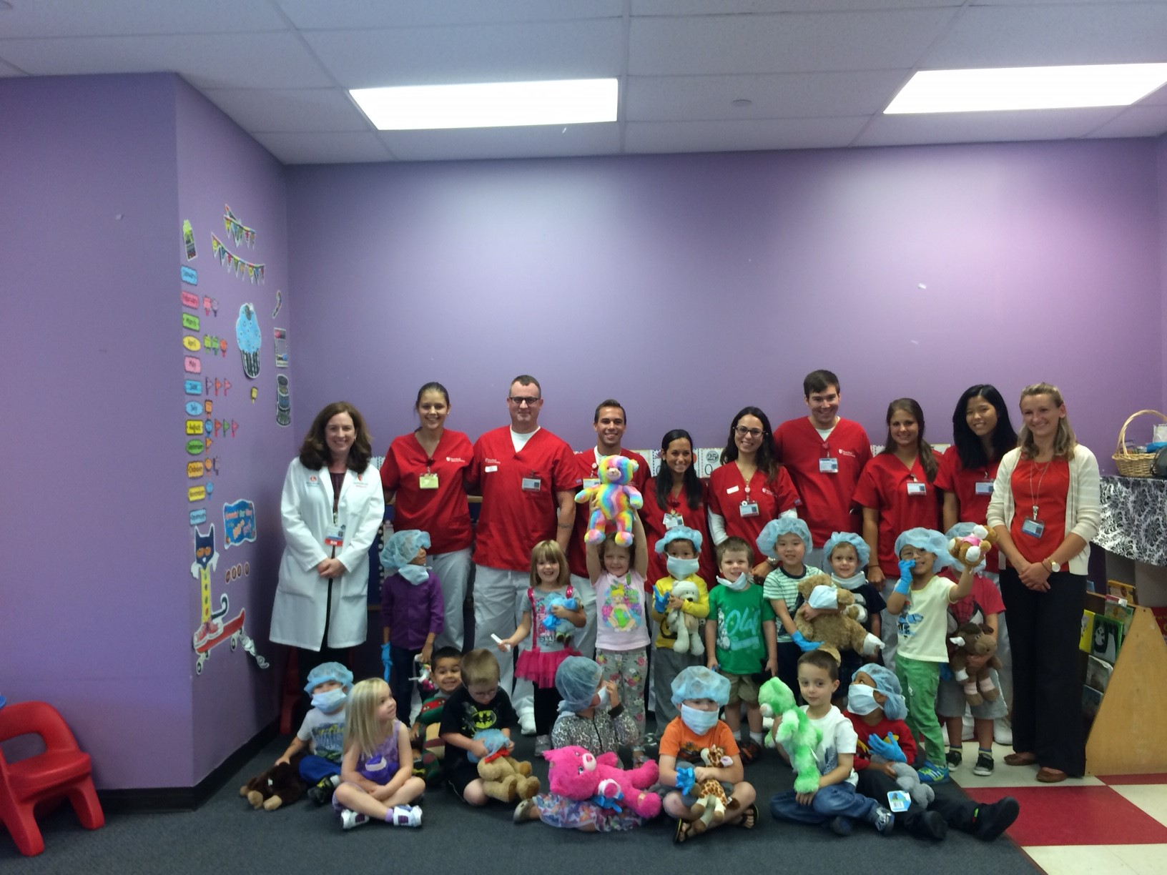
Notes:
Talk about the 4 page outline that will be emailed to them the week before- so you have an idea of whats happening in the class.
We typically do several classes back-to-back. Depends on the school. One school had 7 classes.

Slide 33
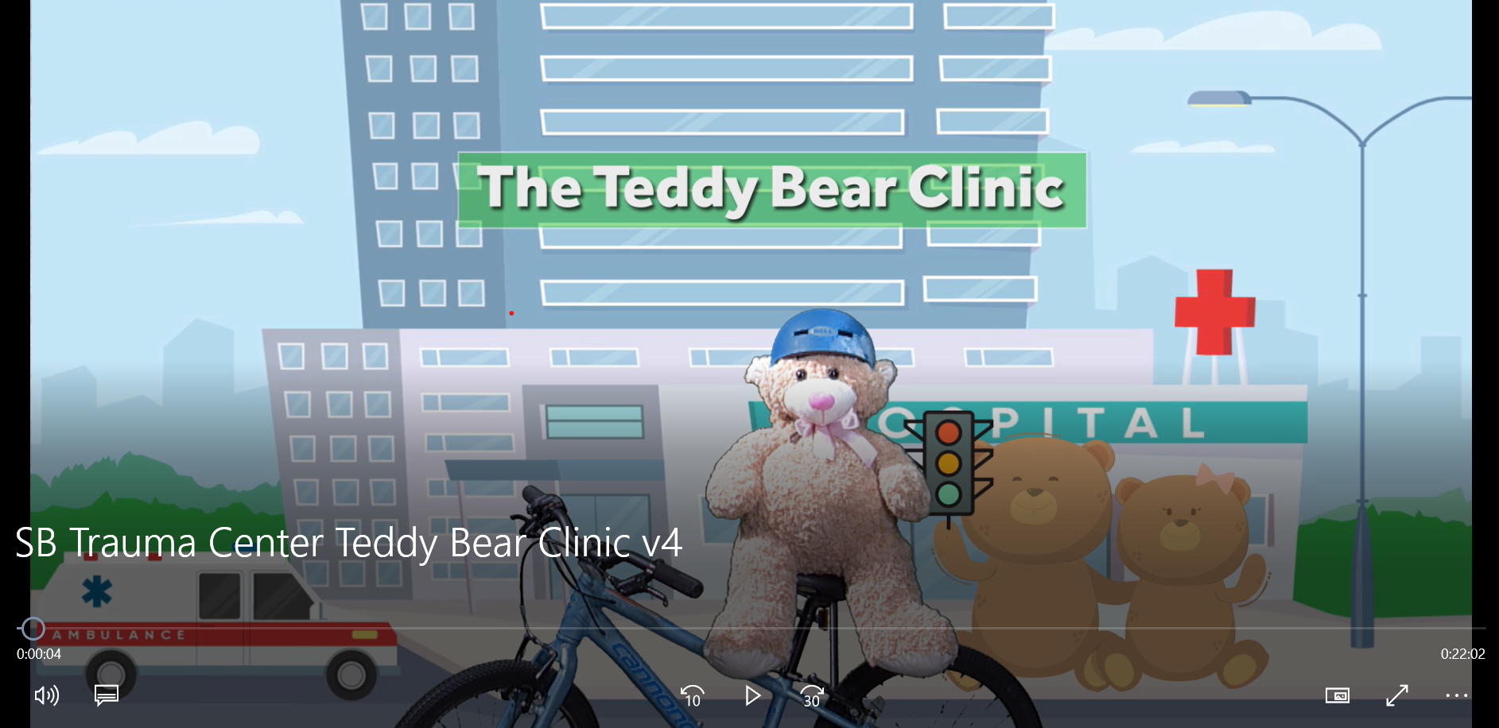
Thank You! Questions?

